Slide 1
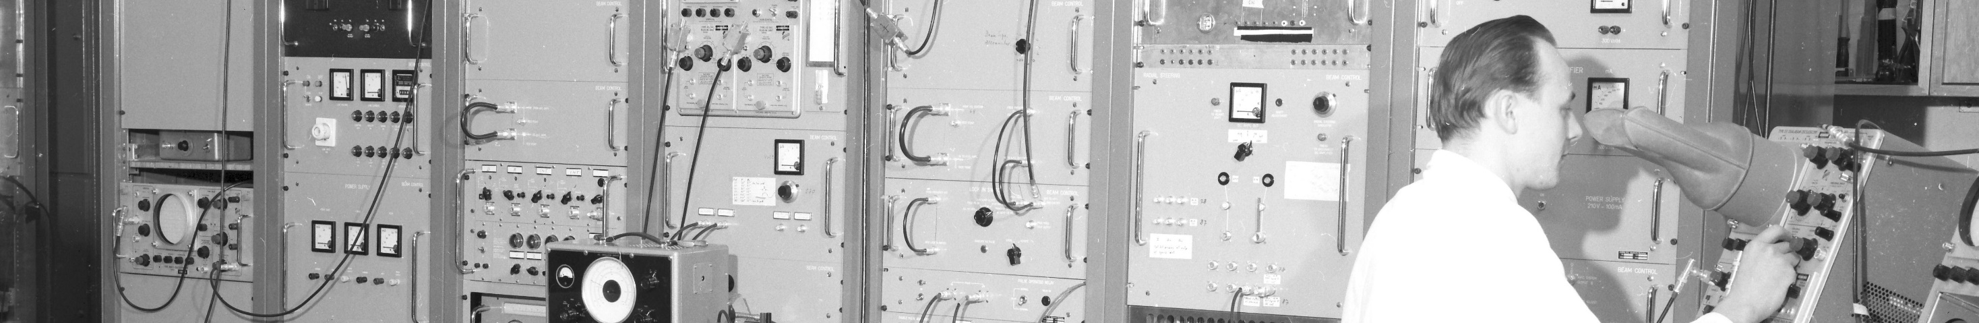
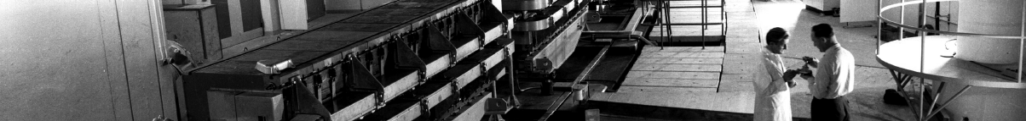
PS Report week 38
Many thanks
to the PS OP and coordination teams as well as all equipment experts and support teams!

Slide 2
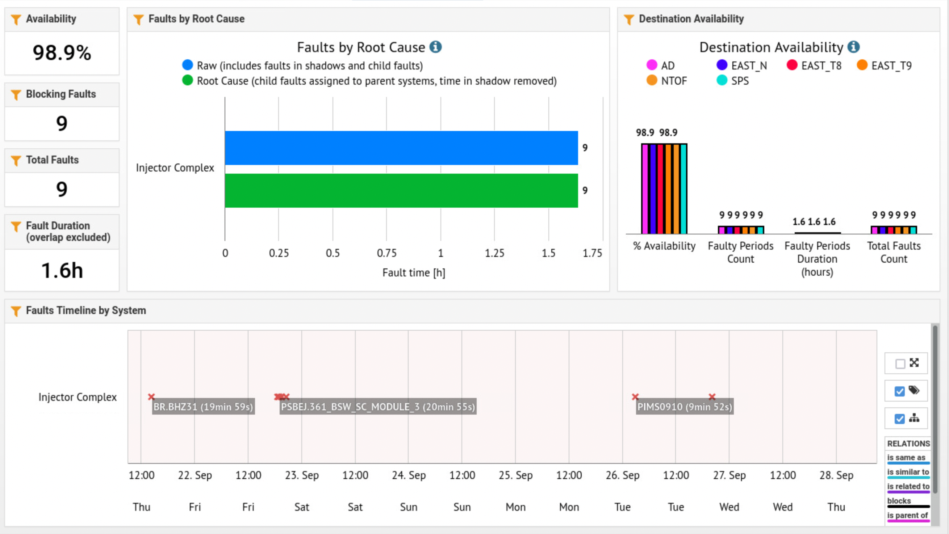
Recent beam availability

Slide 3
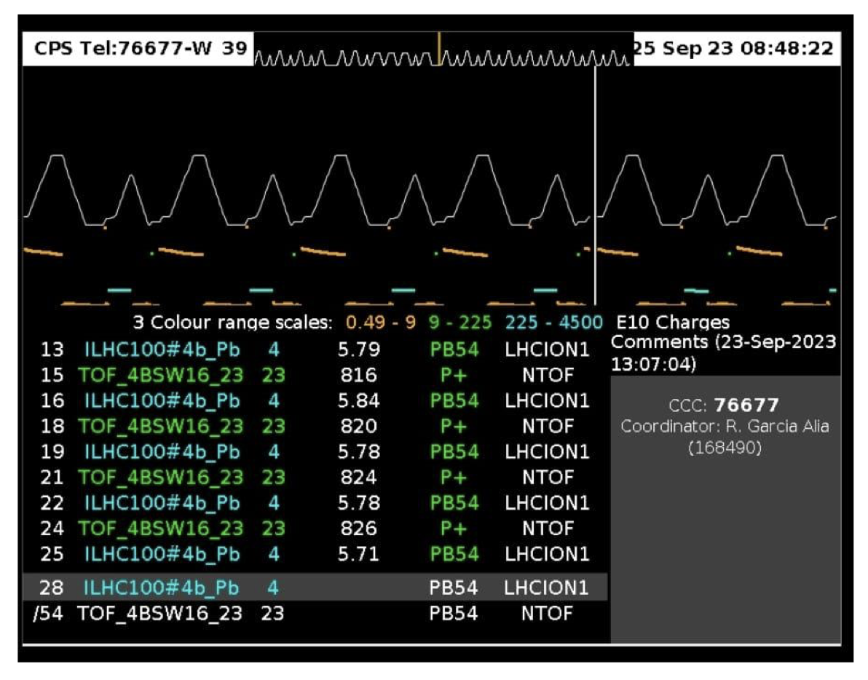
Main Issues and Activities
- M-TOF beam with 2 bunches sent to nTOF target on Tuesday evening between 23h40 and 00h10. Different intensity 2x400, 2x500, 2x600e10, SEM grid and BCTs worked fine.
- Only one cycle between ion cycles when SPS is filled with ion trains (for LHC) – hence, room in between for nTOF cycle, but not for East Area cycles. Request from Barbara to, when possible, compensate this during normal operation

Slide 4
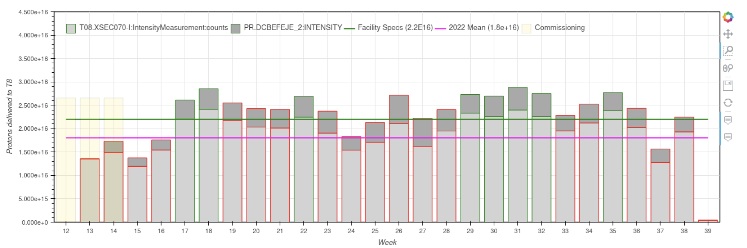
Delivered Intensity: T8

Slide 5
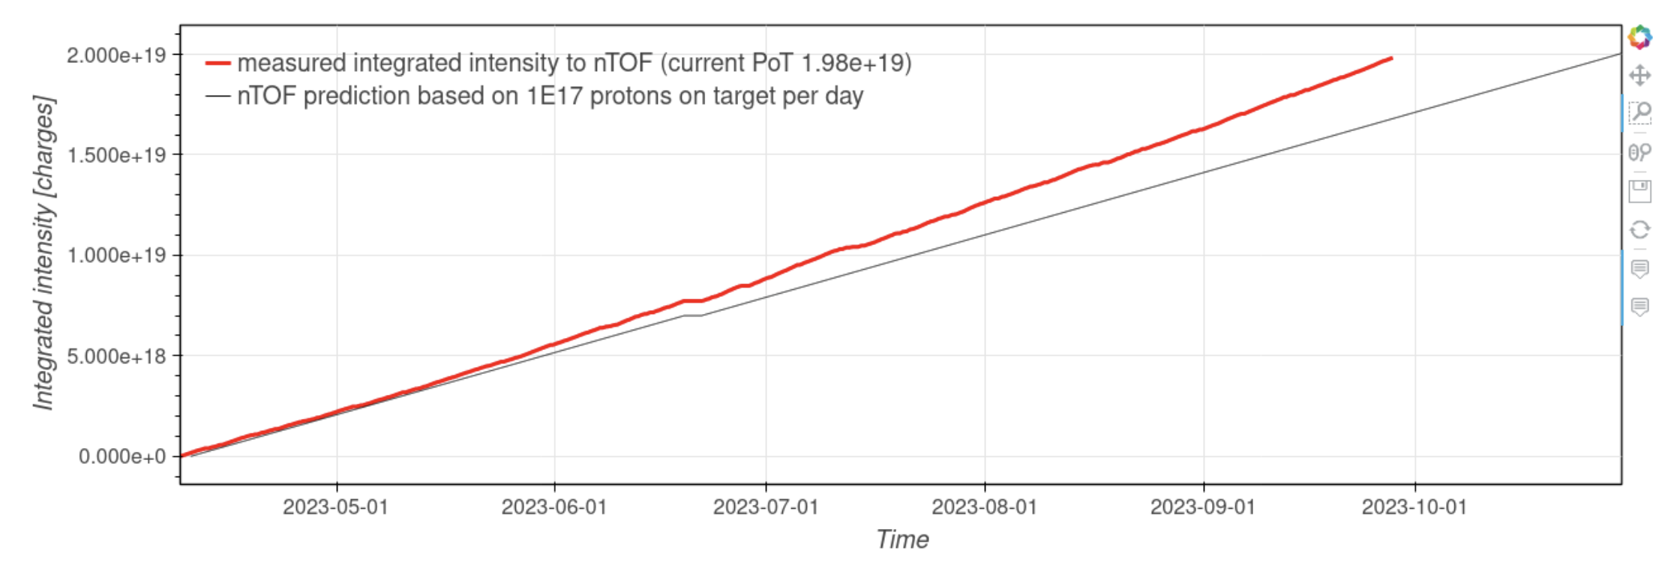
Delivered Intensity: n_TOF

