Slide 1

SPS status
M. Schenk
for the SPS team
PS / SPS User Meeting 28. September 2023

Slide 2
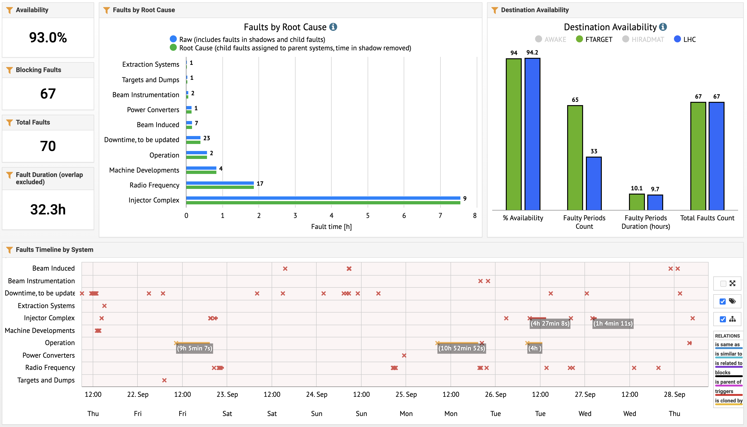
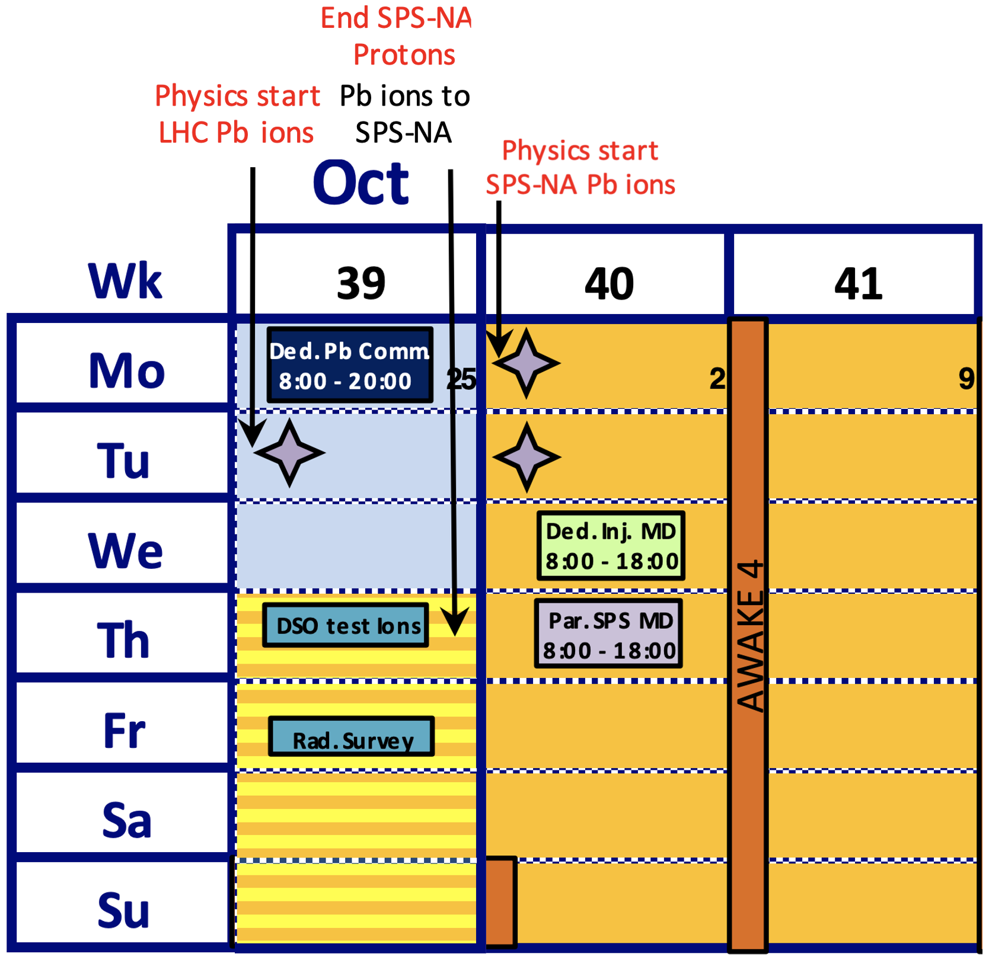
This week
Machine availability: good, however, with important perturbations for NA physics given LHC ion setting up & frequent, long fills. Thanks for your understanding.
Tuesday - Thursday: suddenly strong 50 Hz spill noise, difficult to keep under control. To be investigated.
Today
  08:00: end of proton run
  DSO tests ongoing
  Setting up operational SFTION: transverse tuning, rf gymnastics, extraction, steering to targets …
Friday
  Beam stop at 13:30, followed by radiation survey (14:00 - ~16:00).
Next
Wk 40: start Pb ion run, short & long parallel MDs, dedicated MD moved to Wk 43
AWAKE Run 4
Wk 43
Next coordinator: Giulia Papotti
Coordination meeting: Monday, 11:30

