Slide 1
Status and requirements of HEPS alignment
Tong Wang
on behalf of alignment team
Lan Dong，team leader
Xiaolong Wang
Lingling Men
Shang Lu
Luping Yan
Yuanying Han
Luyan Zhang
Xiaoyang Liu
Haoyue Yan
Tong Wang
Bo Li
Jing Liang
Zhiyong Ke
Zhengqiang He
Na Ma

Slide 2
Outlines
1、 Overview of HEPS
2、 Lattice layout and tolerance requirement
3、 Pre-alignment
4、Alignment in tunnel
5、Summary

Slide 3
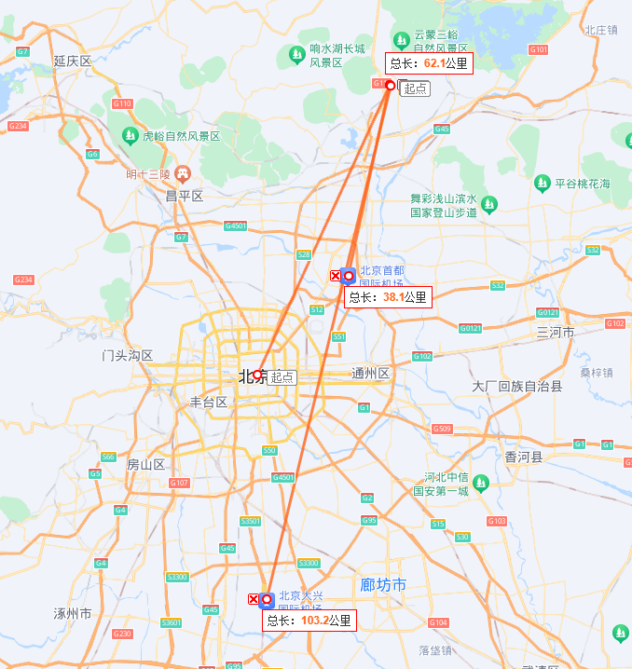
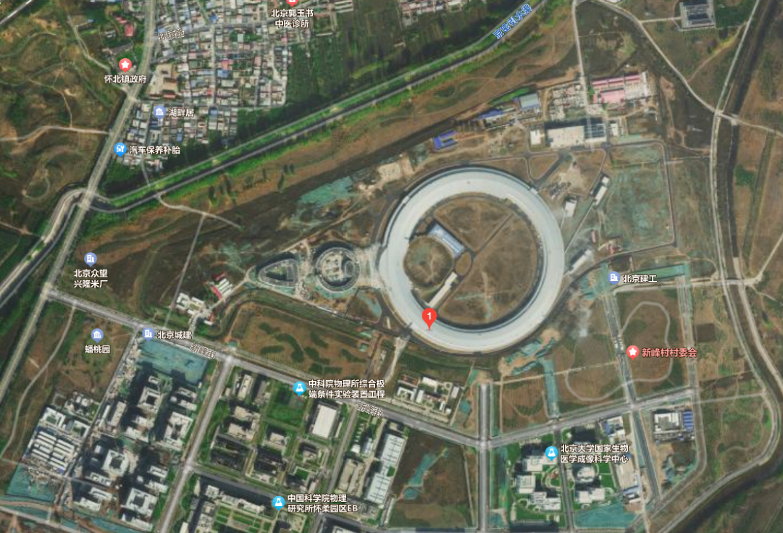
Overview of HEPS
HEPS is located in Huairou district , Northeast of Beijing.
It is about 62km to the center of Beijing , 38km to the Beijing Capital International Airport , 103km to the Beijing Daxing International Airport.
aerial view
The appearance looks like a magnifying glass, symbolizes the exploring the microscopic world of matter.

Slide 4
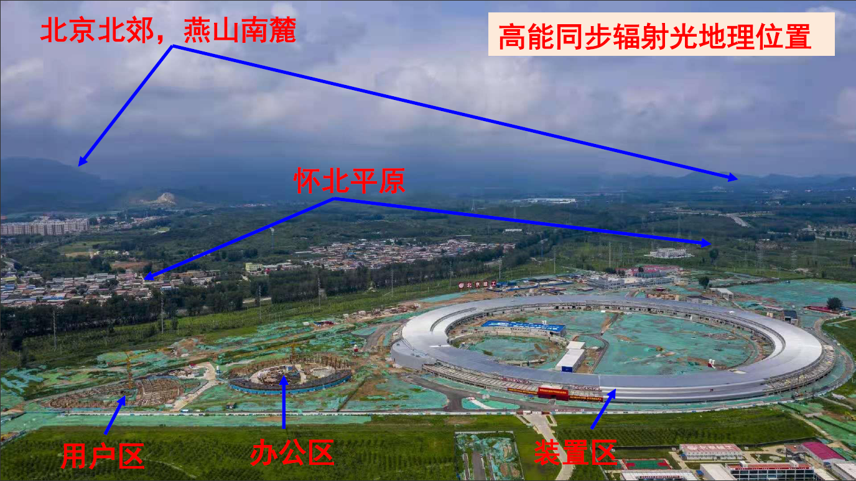
Overview of HEPS
Yanshan Mountain
Northern Plain

Slide 5
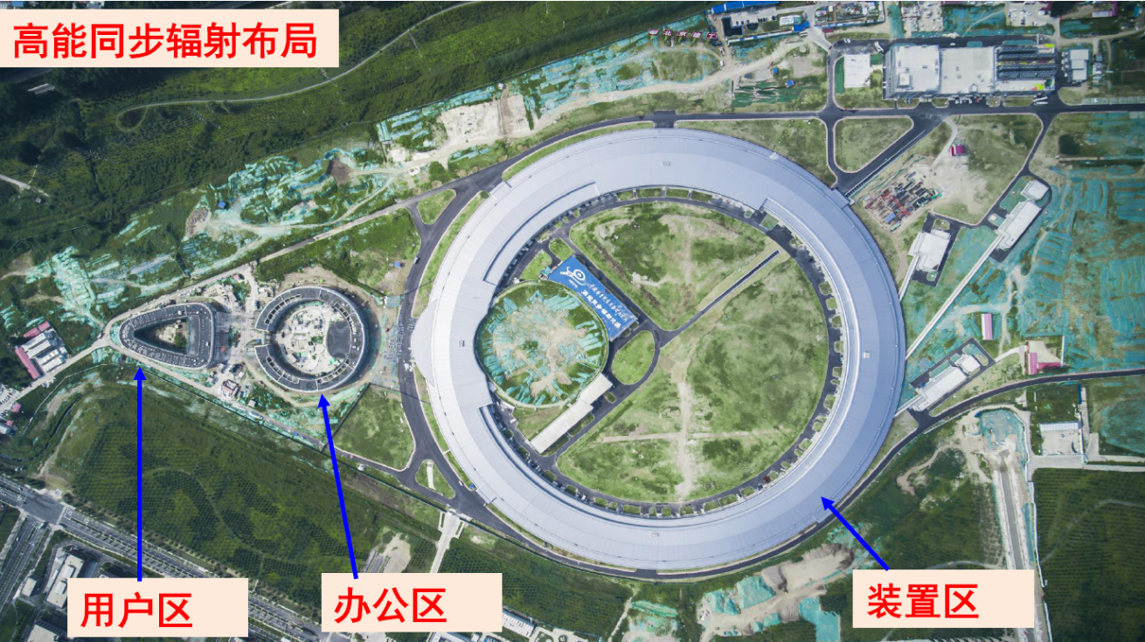
Overview of HEPS
Project overview of HEPS
Project period | 2019.06~2025.12
Energy | 6Gev
Emittance | 60pm·rad
Circumference | 1360.4m
Lattice | 48-7BA
Beamlines | 14 built in phase-I capacity of 96
User building
Office building
Facility building

Slide 6
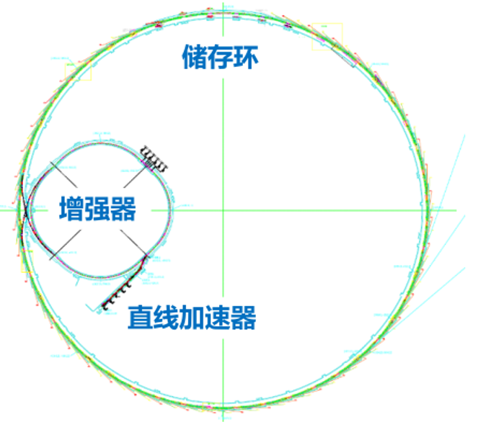
Overview of HEPS
Milestones
2019.06 — project launched.
2021.06 — start the installation of Linac.
2023.02 — start installation of SR.
2023.03 — successful operation of Linac.
2023.07 — start beam commissioning of Booster.
Planning
2024.03 — systems integration and debugging together of SR.
2024.06 — beam commissioning of SR.
2024.12 — generating the first beam of synchrotron radiation.
2025.09 — test running of SR.
2025.12 — project completed.
Storage ring
Booster
Linac

Slide 7
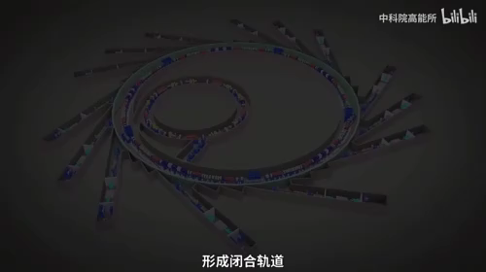
Overview of HEPS

Slide 8
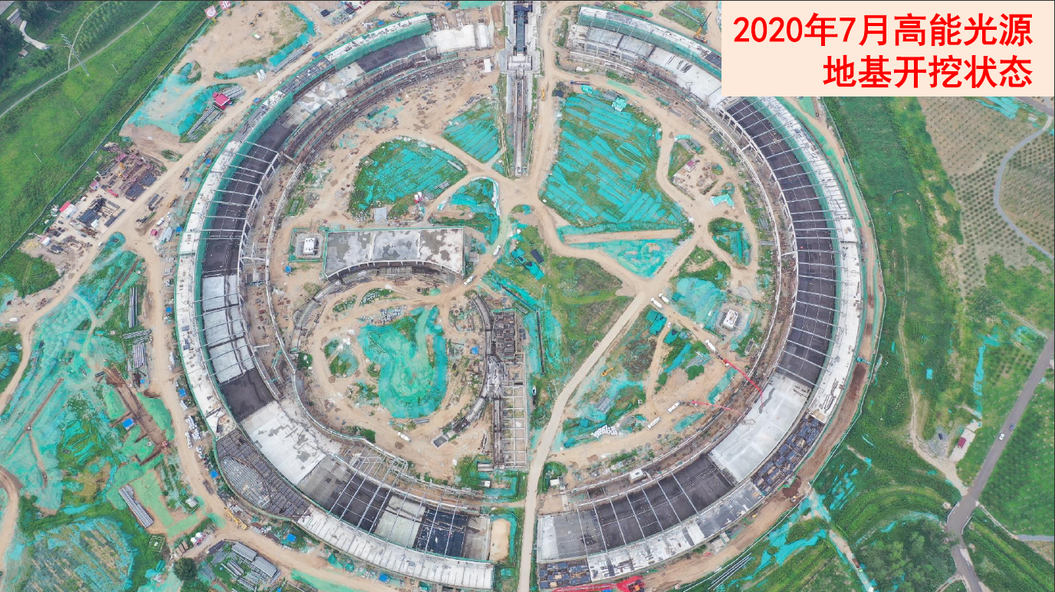
Overview of HEPS
2020.07 Civil construction_
Foundation excavating

Slide 9
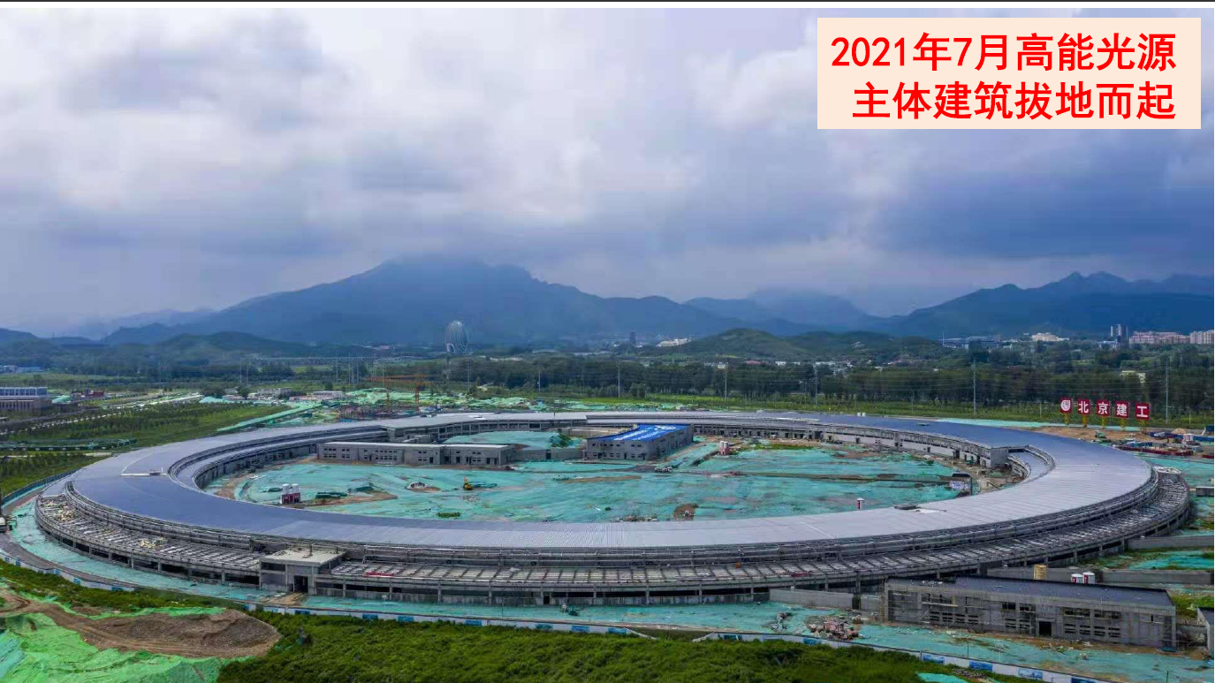
Overview of HEPS
2021.07 Civil construction_
preliminary finishing of the building structure.

Slide 10
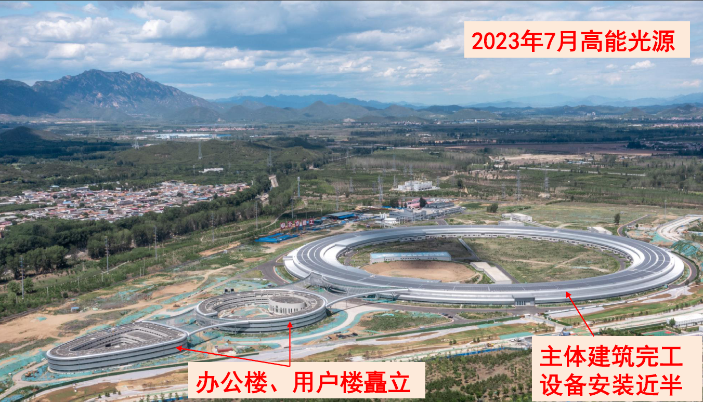
Overview of HEPS
2023.07 Civil construction_
nearly completion of major buildings

Slide 11
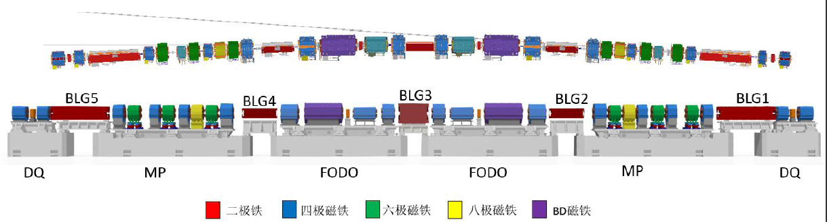
Lattice layout and tolerance requirement
The SR consist of 48 hybrid-7BA cells.
Each cell contains 6 girders of three types: DQ、MP、FODO，and distribute in symmetry.
According to the mechanical design philosophy, there are 5 BLG magnets supported individually on the two adjacent plinths for lower accuracy requirement.

Slide 12
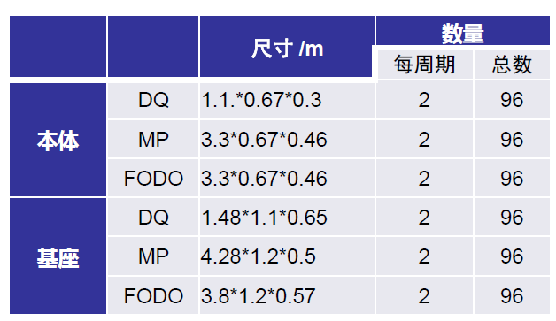
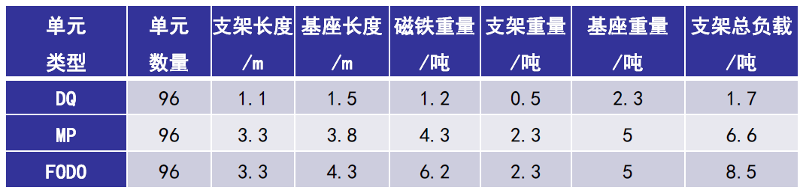
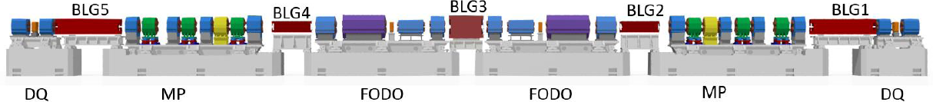
Lattice layout and tolerance requirement
The number of girders is 48*6=288.
There are 8 magnets on MP, 5 magnets on FODO, 3 magnets on DQ. The total number of magnets is 1776 including the BLG magnets.
The dimensions of the MP and FODO are designed to the same for standardization, and the girder length is 3.3m, the maximum weight is 8.5ton.
[1] HEPS储存环磁铁支撑系统总体设计与准直安装-李春华-第八届粒子加速器准直会议(银川)-2023-07-19

Slide 13
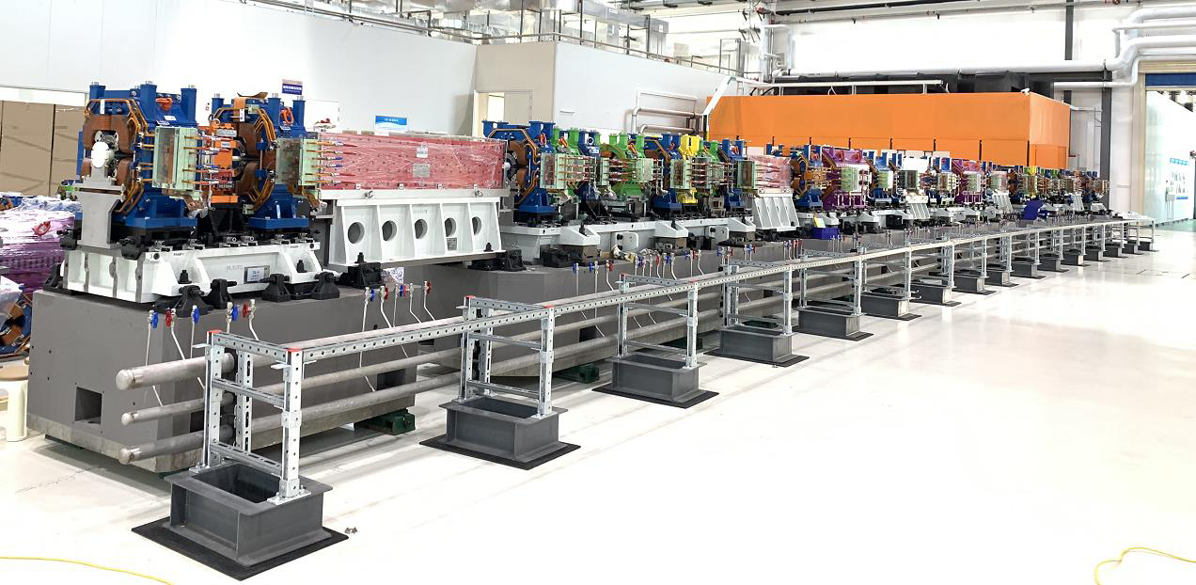
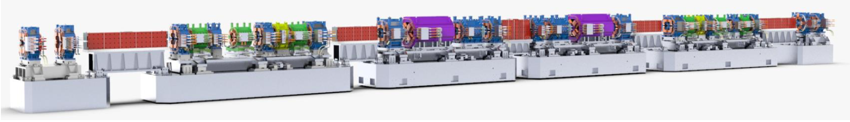
Lattice layout and tolerance requirement
magnet
girder
plinth
Prototype of one cell in experiment hall

Slide 14
Lattice layout and tolerance requirement
The 4th Photon source demanded high accuracy to the alignment.
Alignment Tolerance: magnet to magnet within a girder, girder to girder in Ring.
Photon Source | Tolerance of magnet to magnet within a girder/μm | Tolerance of girder to girder in Ring/μm
MAX-IV | 20~30★ | 100
BNL-NSLSII | 30 | 100
ANL-APSU | 30 | 100
ESRF-EBS | 50 | 50★
SPring-8-II | 30 | 90
LNLS- Sirius | 40 | 80
IHEP-HEPS | 30★ | 50★
The alignment accuracy of HEPS was at the forefront in the similar facility around the world. ★★

Slide 15
Lattice layout and tolerance requirement
[References]
MAX IV
[1] Alignment and Stability Strategies at MAX IV_20230726-keyu zhou.
[2] 2016_MAX-IV_MAX IV 3 GeV ring magnets_Martin Johansson.
[3] 2015_MAX-IV_Relative alignment within the MAX IV 3 GeV storage ring magnet blocks_Jonas Björklund Svensson.
NSLS-II
[1] NSLS-II Survey and Alignment Activities_Nov_2015.
[2] Precision Alignment of Multipoles on a Girder for NSLS-II.pdf
[3] Magnetic and Mechanical Center Deviations of NSLS-II Magnets-Yu Chenghao.pdf
[4] Slides_28-0-NSLS-II_GIRDER_PROFILING_ACTIVITES.pdf
[5] Yu_chenghao_-_Smoothing__Based_on_Best-fit_Transformation.ppt
APSU
[1] Multi-Bend Achromat Lattice White Paper.https://www.aps.anl.gov/APS-Upgrade/Documents.
[2] Penicka_IWAA2016_slides_Alignment Strategy for APS Upgrade Project.pptx.
[3] Jaromir M. Penicka.Alignment Strategy for APS Upgrade Project. International Workshop on Accelerator Alignment,Grenoble, October 3-7, 2016
[4] Chapter 4 - Accelerator.pdf. APS Upgrade Project Preliminary Design Review Report - 2017.
EBS
[1] Alignment for the ESRF Extremely Brilliant Source-IWAA2022.pptx
[2] Status of the ESRF EBS Storage Ring Engineering and Construction.pdf
[3] Sergei Gurov . Lessons learned from the ESRF magnets and vacuum chamber assembling . Beam Tests and Commissioning of Low Emittance Storage Rings, Karlsruhe, 2019.
[4] ESRF alignment techniques and results-2021-05-11-12 FCC-ee OpticsTuningAlignment_DMartin.pdf
[5] Measurement and fiducialization of the ESRF-EBS magnets_Gael_IMMW21.pdf
[6] Sergei Gurov . Lessons learned from the ESRF magnets and vacuum chamber assembling . Beam Tests and Commissioning of Low Emittance Storage Rings, Karlsruhe, 2019.
[7] ESRF alignment techniques and results-2021-05-11-12 FCC-ee OpticsTuningAlignment_DMartin.pdf.
SPring-8-II
[1] Yuichi okayasu, hiroaki kimura, Sakuo matsui . A Numerical alignment error estimation for the SPring-8-II. International Workshops on Accelerator Alignment 2018, Batavia, 8-12 October 2018.
[2] Kimura. Construction and alignment of test half-cell of SPring-8-II kimura, IWAA2018, Batavia, 8-12 October 2018.
Sirus
[1] Leo R J , Baldo C R , Reis M L C D C , et al. Engineering survey planning for the alignment of a particle accelerator: part II. Design of a reference network and measurement strategy[J]. Measurement Science and Technology, 2018, 29(3):034007 (10pp).
[2] Lin L2017 Sirius storage ring alignment and excitation errors.
https://wiki-sirius.lnls.br/mediawiki/index.php/Table:Storage_ring_alignment_and_excitation_errors.

Slide 16
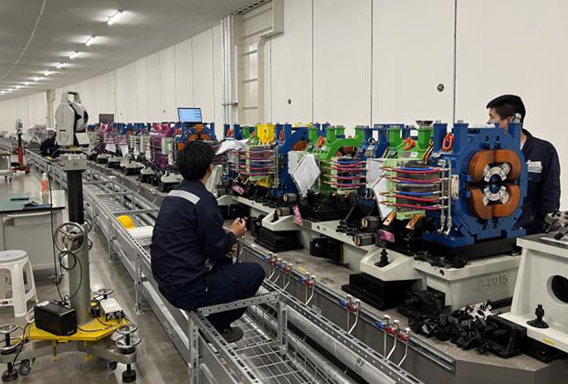
Lattice layout and tolerance requirement
Strategy of Alignment：3 basic processes
Pre-alignment in temperature controlled room：Magnets alignment accurately on one common girder, then the girder transports and installs in storage ring as an assembly unit.
Preliminary alignment in tunnel：put the girder to the theoretical position of the storage ring relative to the control network.
Final alignment in tunnel：put the girder to the smoothing position relative to the adjacent girders.
Alignment processes are broke down, so that every steps could be controlled well to realize the final result. The benefit is that steps become clear and feasible to implement.

Slide 17
Lattice layout and tolerance requirement
Pre-alignment ：includes 4 steps，each has specified strict requirements.
Process I | Tolerance requirement /μm | Steps | Specifications | Tolerance breakdown /μm
Pre-alignment in temperature controlled room | 30 | Fiducialisation | Fiducialisation of individual magnet by rotating coil and CMM system | 10
 |  | Spatial measurement | Coordinate measurement in real time relative to the girder coordinate system during the adjustment | 10
 |  | Positioning | Magnet position adjustment offset | 10
 |  |  | Magnet displacement after locking | 10
 |  | Displacement and deformation | Open and close of magnet | 10
 |  |  | Displacement after transportation | 15
 |  |  | Deformation due to girder uneven supported on plinth in tunnel | 10

Slide 18
Lattice layout and tolerance requirement
Preliminary alignment in tunnel：
Process II | Tolerance requirement /μm | Steps | Specifications | Tolerance breakdown /μm
Preliminary alignment in tunnel | 1000 (absolute error) 100 (relative error) | Control network | Control network measurement by laser tracker in station by station mode with large amount of observations. | 800(absolute error) 30 (relative error)
 |  | Spatial measurement | Coordinate measurement by one laser tracker in real-time relative to the nearby control network points during the adjustment | 50
 |  | Positioning | Girder position adjustment offsets (meanwhile, measure all the magnets within girder to check the deformation of girder) | 15
 |  |  | Girder displacement after locking | 15

Slide 19
Lattice layout and tolerance requirement
Final alignment in tunnel：
Process III | Tolerance requirement /μm | Steps | Specifications | Tolerance breakdown /μm
Final alignment in tunnel | 40 | Full survey | Full survey after the girder preliminary alignment finished, include all the magnets and control points. | 30(relative error)
 |  | Displacement measurement | implement the smoothing strategy, displacement measurement in real-time relative to smoothing position | 10
 |  | Positioning | Girder position adjustment offsets | 15
 |  |  | Girder displacement after locking | 15

Slide 20
Lattice layout and tolerance requirement
Recall that the requirement of tolerance of magnet to magnet within a girder is 30μm, tolerance of girder to girder in SR is 50μm.
It should combine the error in pre-aglignment and final alignment, and then meet the requirement of 50μm.
Tolerance requirement in overall /μm |  | Tolerance requirement in each process /μm
Alignment in SR | 50 | Pre-alignment in temperature controlled room | 30
 |  | Final alignment in tunnel | 40

Slide 21
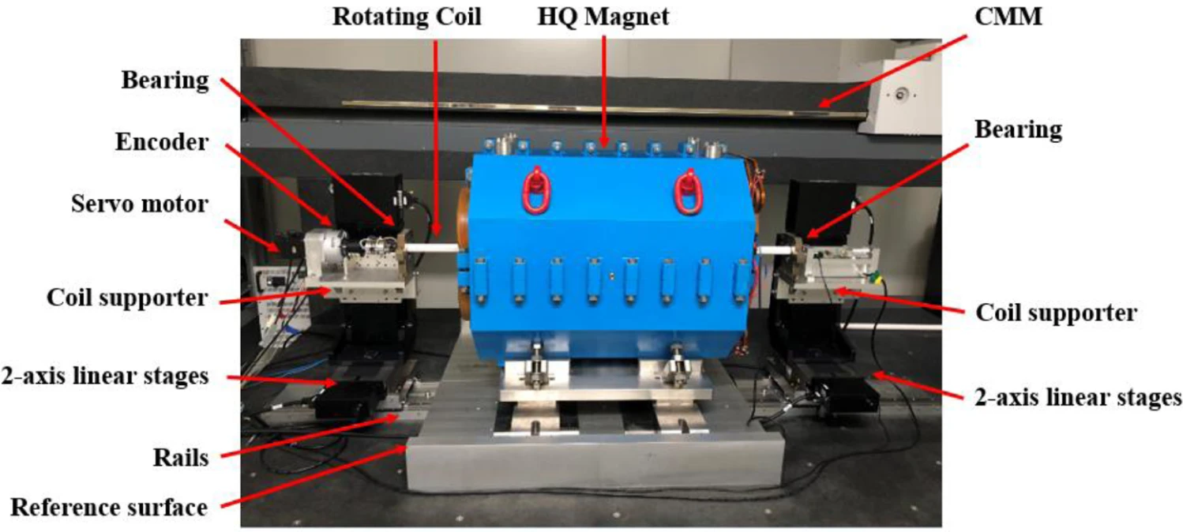
Pre-alignment—fiducialisation
For quadrupoles and octupoles, the fiducialisation based on magnetic center was implemented by rotating coil measurement system.
A precisely machined ceramic skeleton with bucking coil was used for the magnets of small aperture 25 mm and length up to 0.7m. The repeatability of the magnetic center in horizontal direction is under 1.5 μm, while that in vertical direction is less than 2.5 μm in different days.
CMM (3.5 μm+ 3.5ppm)was used to measure the rotating coil representing the magnetic center and the 4 fiducials on the top of the magnet.
The fiducialisaitoin error was less than 10μm.
[1] Yang M , Chen F , Yin B ,et al.A rotating coil measurement system based on CMM for high-gradient small-aperture quadrupole in HEPS-TF[J]. Radiation Detection Technology and Methods,2021(001):005.
[2] Luyan Zhang et al . A single-turn rotating coil magnetic center calibration system designed for high energy photon source.2023 Meas. Sci. Technol. 34 085017

Slide 22
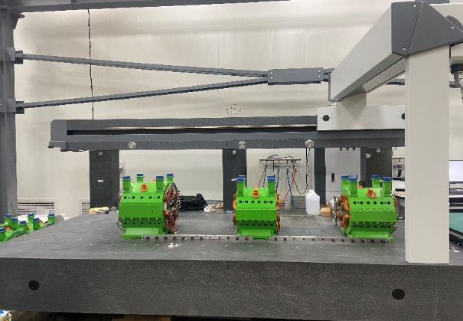
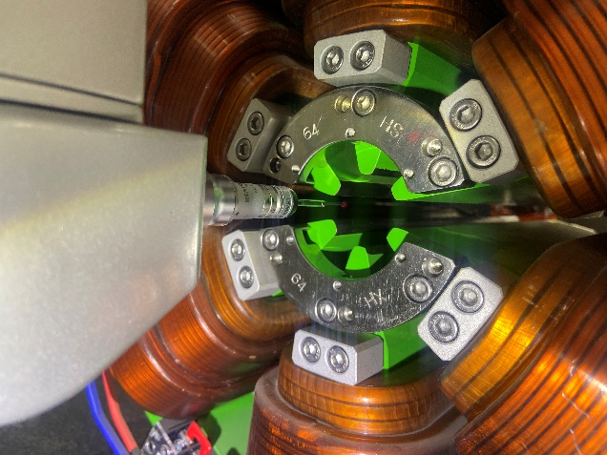
Pre-alignment—fiducialisation
For sextupoles, the fiducialisation based on mechnical center was implemented by CMM.
By importing CAD models, CMM can automatically perform measurements by routines, this greatly improves efficiency, and the time was reduced to 0.5h compared with 1.5h by laser tracker.
The repeatability was better than 10μm, and the deviation of dimension inspection was under 15μm.

Slide 23
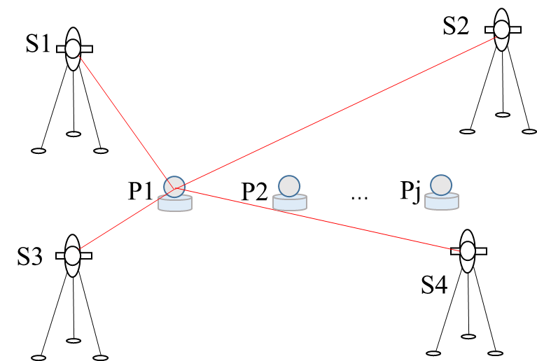
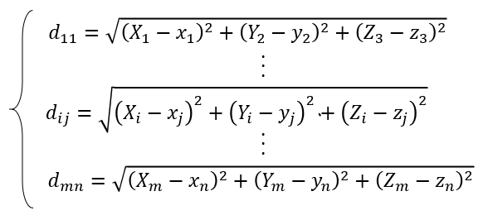
Pre-alignment—spatial measurement
In order to realize the 10μm accuracy of the spatial coordinates, a multilateral measurement method based on 4 laser trackers network was adopted.
The high precision distances from the laser trackers to the common points are obtained to solve the coordinates.
To ensure that the equation has a solution, we need to satisfy the condition mn > 3(m + n), where the number of unknowns is 3(m+n) and the number of equations is mn. Therefore, the minimum number of laser trackers required is 4, and the corresponding minimum number of common points is 12.
[1] Shang Lu, Jing Liang*, Lingling Men*, e tal. A laser tracker -based multilateration method for pre-alignment of High Energy Photon Source storage ring, Nuclear Inst. and Methods in Physics Research, A, 2023, Vol.1045.

Slide 24
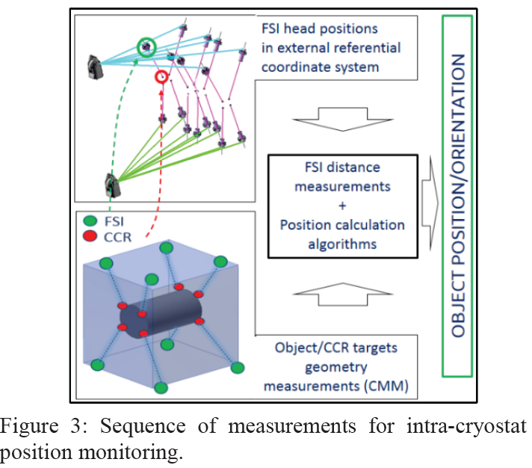
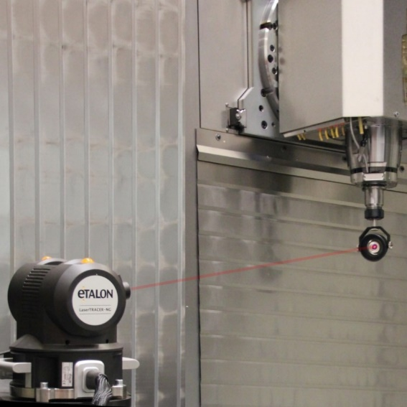
Pre-alignment—spatial measurement
CERN has proposed a automatic measurement and adjustment scheme to improve the efficiency. And put forward a new FSI distance method to measure the cavities in cryostat.
There is also a commercial product Laser tracer from Etalon. The principles are similar, and these systems take advantage of high accuracy laser distance to achieve μm level.
[1] Hélène Mainaud Durand. Survey and alignment from LEP and LHC, expectation from FCC. FCC-ee optics tuning and alignment mini-workshop _ FCCIS WP2 hybrid event.12 May 2022.
[2] M. Sosin, H. Mainaud Durand. Robust Optical Instrumentation for Accelerator Alignment Using Frequency Scanning Interferometry. IPAC2021, Campinas, SP, Brazil.

Slide 25
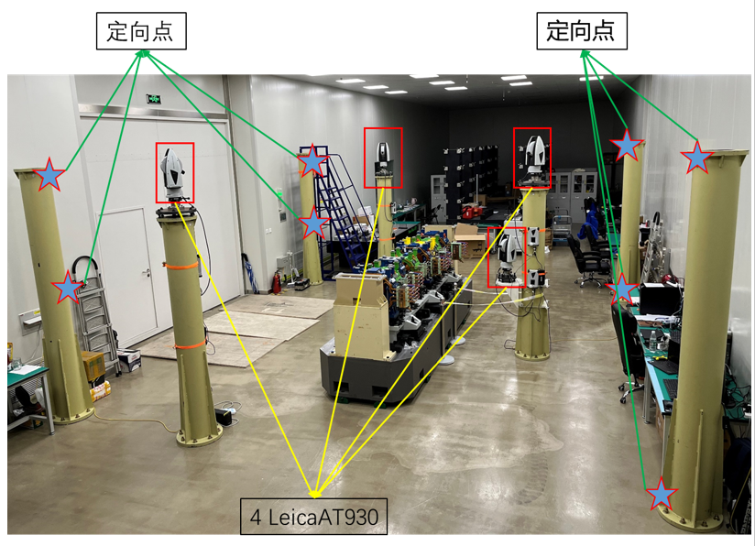
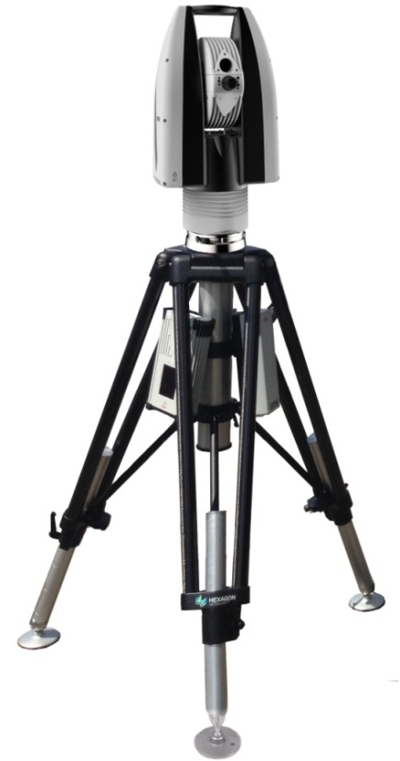
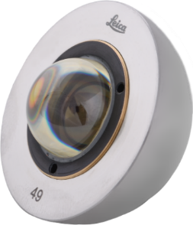
Pre-alignment—spatial measurement
Benefit from the AT930 absolute distance of high accuracy and high dynamic, and the cate-eye reflector of wide angle, we could realize the spatial measurement accuracy of 10μm, as well as dynamic position feedback which is especially important for magnet adjustment in real-time.

Slide 26
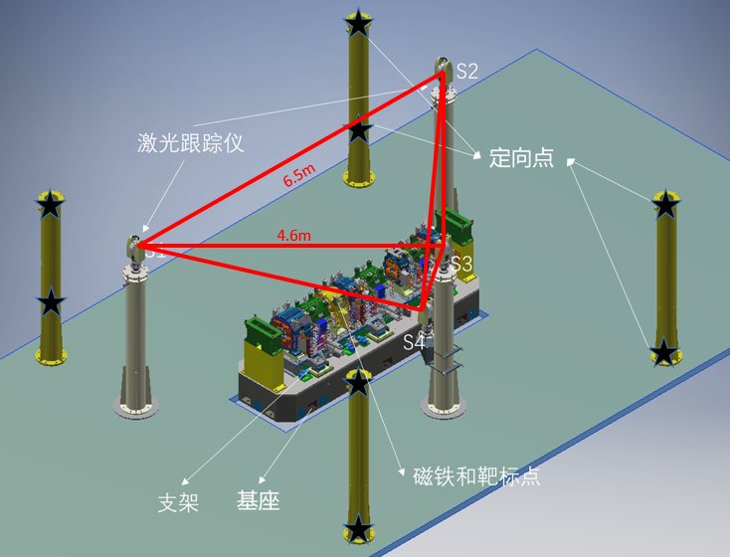
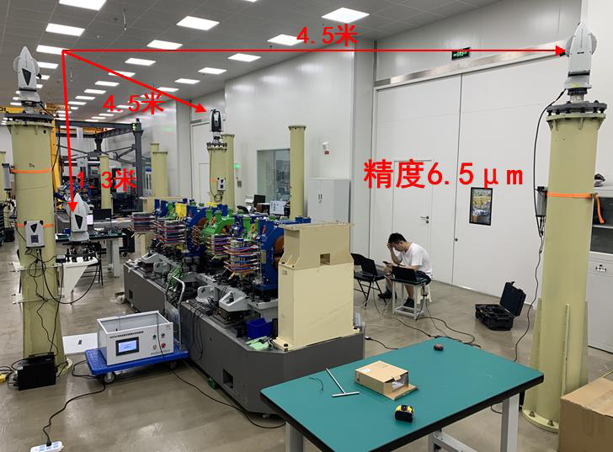
Pre-alignment—spatial measurement
The layout of the instruments has a great impact on the accuracy of the system, and simulation was carried out to reach the optimal layout. Finally, right triangular pyramid was choosen, and the accuracy was 6.5μm.
Three instruments are set up at the top to form a right triangle with the side length 4.5m. One instrument are set up at the lower with the same height of the fiducials. Due to the limitation of the room, the height difference of the top and the lower instruments is 1.3m, which is regarded as the greater the better.

Slide 27
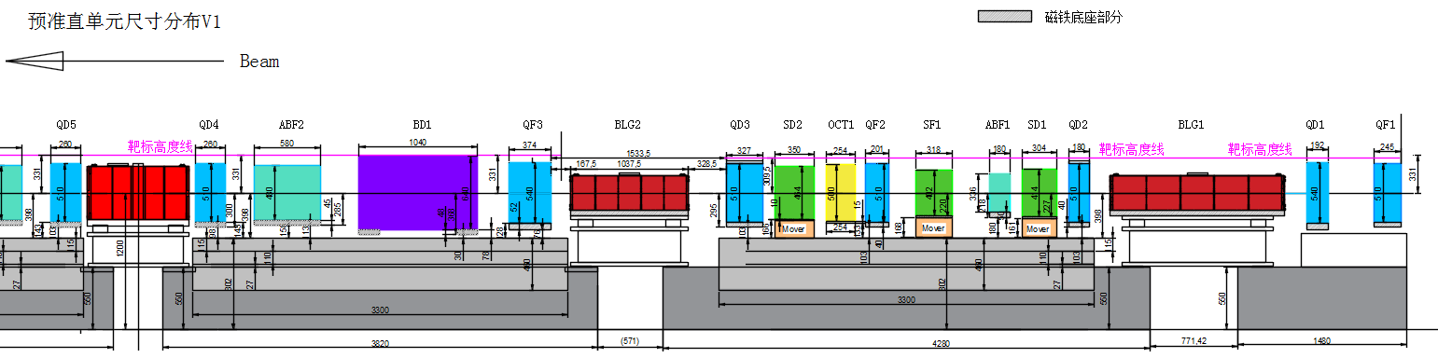
Pre-alignment—spatial measurement
It is desired to make the fiducials at the same height, so that the laser tracker could sight all the fiducials in one station, which is important for the pre-alignment as well as full survey in the tunnel.
For small-sized magnets, the support post for fiducial nests was intentionally short to ensure rigidity. A ball adapter was designed to raise the height of the fiducials.

Slide 28
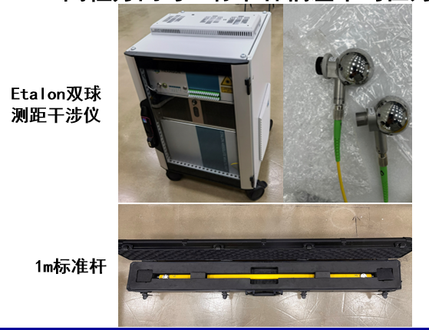
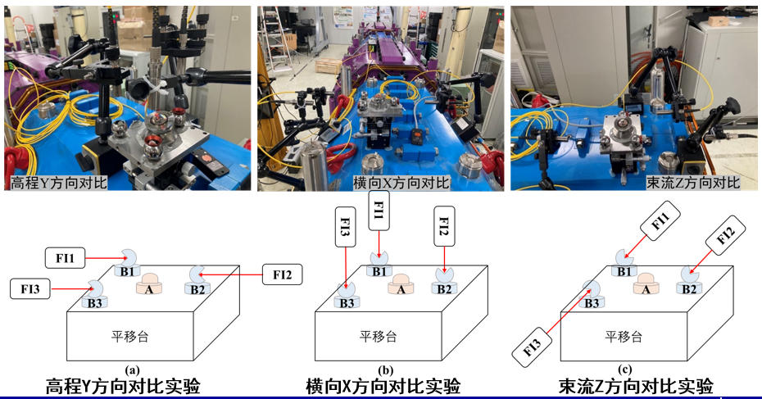
Pre-alignment—spatial measurement
Three kinds of test were made to validate the accuracy of the system.
Repetability: rms of deviation was less than 3μm, comparing the two measurement.
Absolute distance: rms of deviation was less than 6μm, comparing with the Etalon absolute interferometer.
Displacement:rms of deviation was less than 1.8μm, comparing with the Attocube relative interferometer.

Slide 29
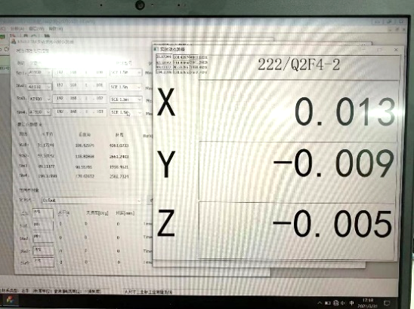
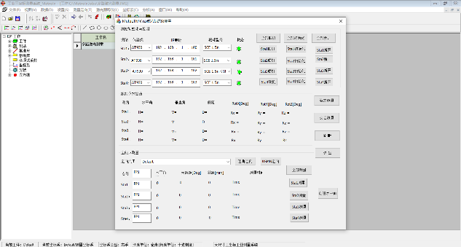
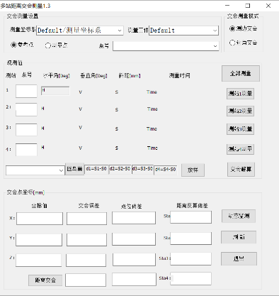
Pre-alignment—spatial measurement
A software was developed, and was capable to connect multi-laser trackers simultaneously, display the dynamic coordinates derived from the multilateral intersection method.

Slide 30
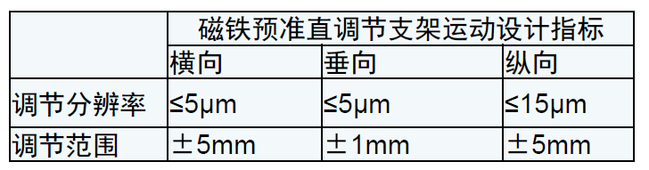
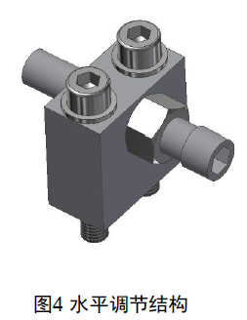
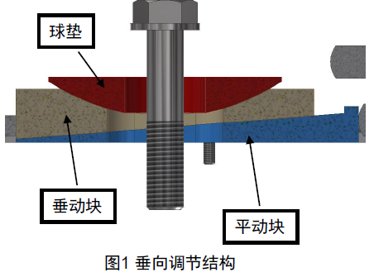
Pre-alignment—Positioning
The elevation position adjustment is implemented by wedge mechanism. The resolution was 2μm, and the stroke was ±1mm.
The transverse position adjustment is implemented by fine thread screw mechanism. The resolution was 2μm, and the stroke was ±5mm.
The wedge structure has the advantage of no backlash and provides sufficient stiffness. It is used to minimize displacement when locking the magnets to the girder.
[1] HEPS预准直磁铁精密高稳自锁调整机构研制及实验--第七届全国粒子加速器准直安装及机械设计学术研讨会大会报告（威海）-门玲鸰-20210721.pdf

Slide 31
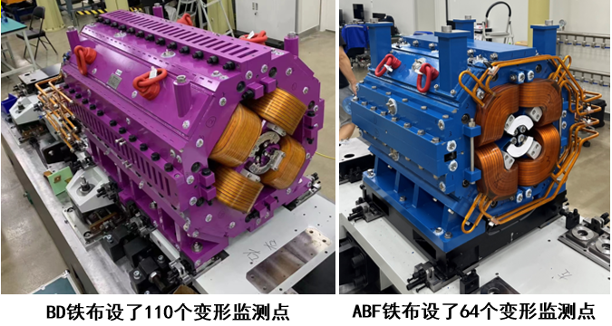
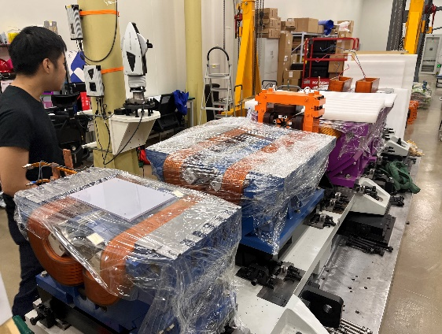
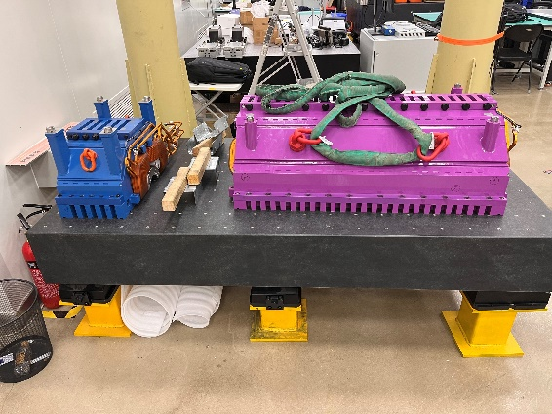
Pre-alignment—opening and closing the magnet
Two kinds of opening and closing test have been done.
For the one single magnet, measurement was done before and after opening and closing the magnet. One method was to monitor the points fixed on the magnets, and 110 and 64 points were measured for BD and ABF by 4 laser trackers multilateral system. Another method was to take the fiducialisation again by rotation coil system.
For all magnets on one girder, the fiducials were measured by 4 laser trackers multilateral system. The purpose of the test is for the installation of the vacuum chamber.
The results showed that the change was less than 10μm. Note that the torque should be kept the same. It is also recommended to open and close the magnets sufficiently to release stress before fiducialisation.
磁铁开合实验
上半铁芯放置

Slide 32
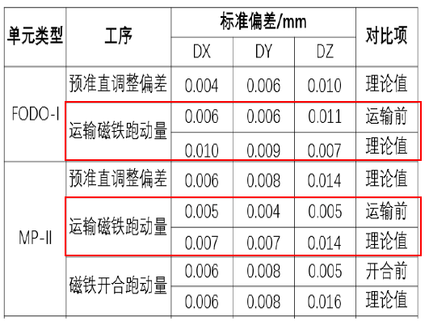
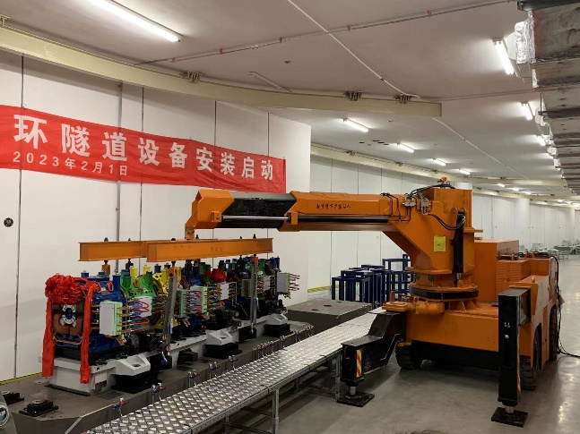
Pre-alignment—transportation
The girder transported by self-leveling truck, and speed was limited to 10~20 km/h. The displacement of magnets was less than 15μm.
实验室装车

Slide 33

Pre-alignment—deformation
The girder was supported by 6 pivot points on plinth in tunnel, the deflection would occurred if girder was uneven supported. When the deformation exceeded 10μm, then the intervention was adopted to mitigate it by loosing the screw to make the girder supported even.
偏差 | dX/mm | dY/mm | dZ/mm
最大值 | 0.014 | 0.042 | 0.056
最小值 | -0.018 | -0.034 | -0.071
标准值 | 0.008 | 0.019 | 0.039
R31MP1 supported uneven
偏差 | dX/mm | dY/mm | dZ/mm
最大值 | 0.010 | 0.011 | 0.017
最小值 | -0.012 | -0.016 | -0.032
标准值 | 0.005 | 0.007 | 0.011
R31MP1 after re-supported
For the girder R31MP1, the deformation was 0.019mm in the vertical, and the deformation decreased to 0.007mm after re-supported.

Slide 34
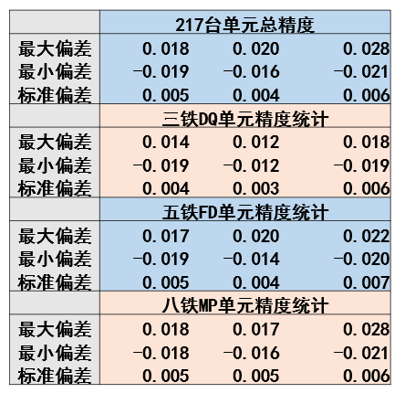
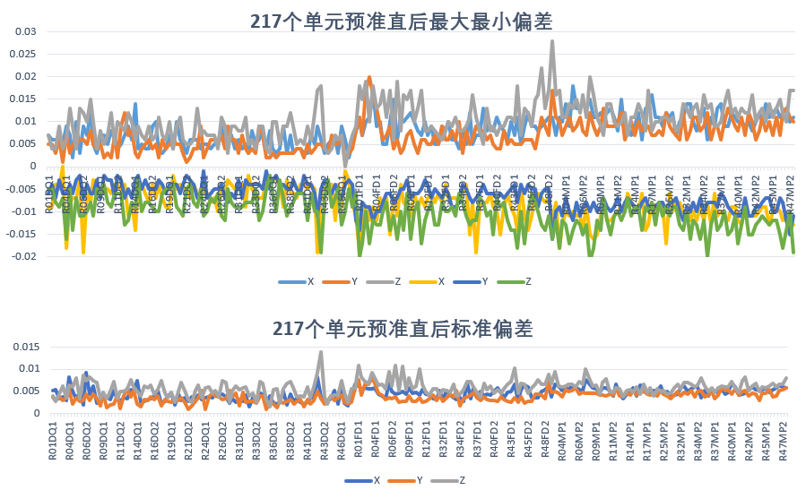
Pre-alignment—summary
Progress:The pre-alignment of 217 girders out of 288 have finished, and expect to accomplished all in November this year.
Speed: It take 5 days to finish the pre-alignment of one cell including 6 girders.
Accuracy: Take the measurement of all the magnets within girder, the rms of positioning offset was 5μm.
Sum up the fiducial error 10μm, spatial measurement error 6μm, positioning offset 5μm, opening and closing error 10μm，transportation error 15μm, deflection deformation 10μm，the pre-alignment accuracy could reach 25μm.
Statistics of the girder positioning deviation
Statistics of the maximum and minimum of girder positioning deviation
Statistics of the rms of girder positioning deviaiton

Slide 35
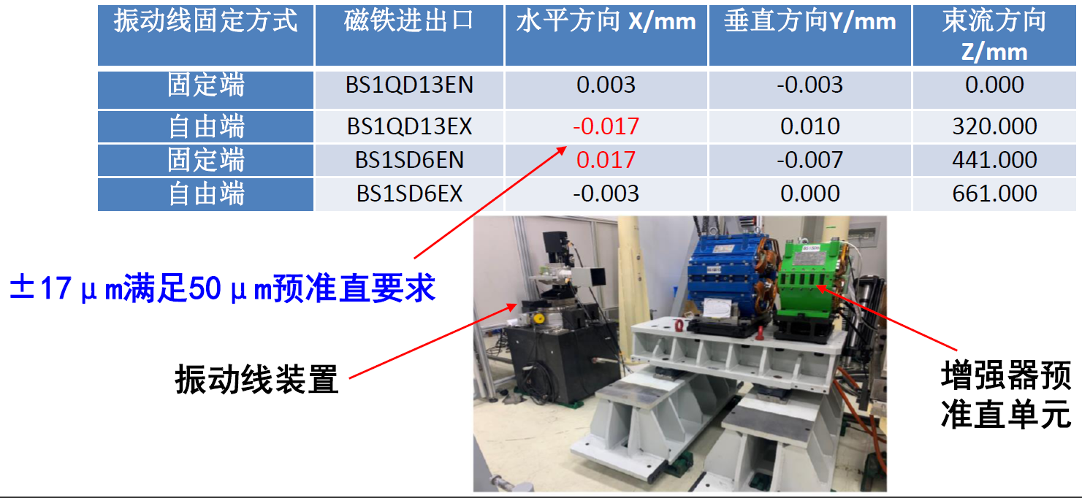
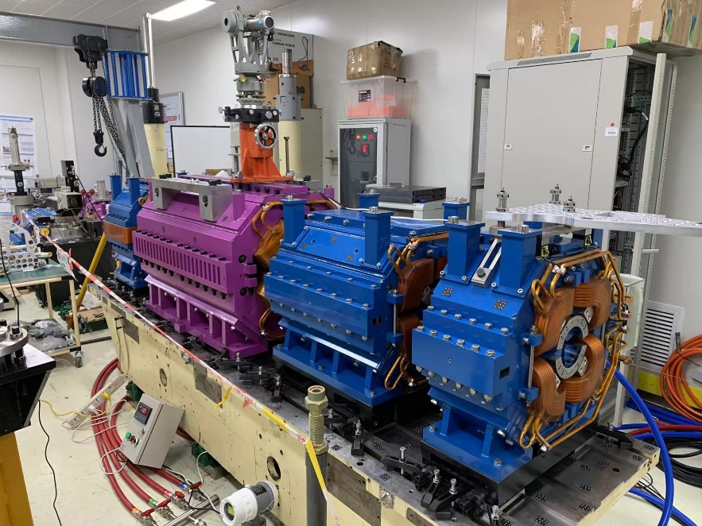
Pre-alignment—summary
Vibriation wire system(VWS) was established to validate the accuracy of pre-alignment. It is only suitable for the straight layout of magnets within girder.
A module of Booster was used for testing, first the mangets were pre-aligned into a straight line by the previous method, then VWS was used to measure the offset of the magnetic center. The result showed that both methods match well of 17μm.
The pre-alignment method adopted in HEPS has the advantage of versatility, and is capable to apply for the pre-alignment regardless of whether magnets are arranged in straight or curved layout within girder.

Slide 36
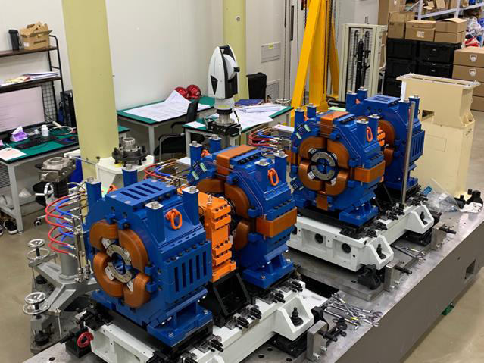
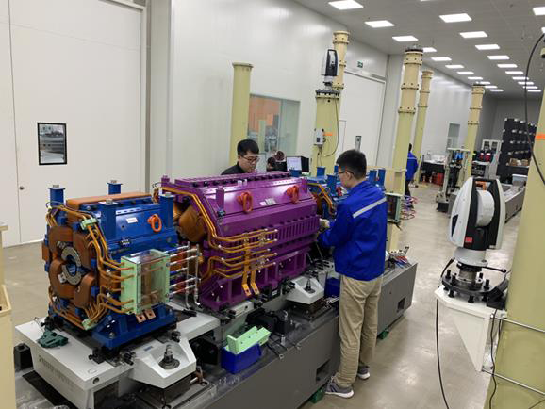
DQ
FODO
MP

Slide 37
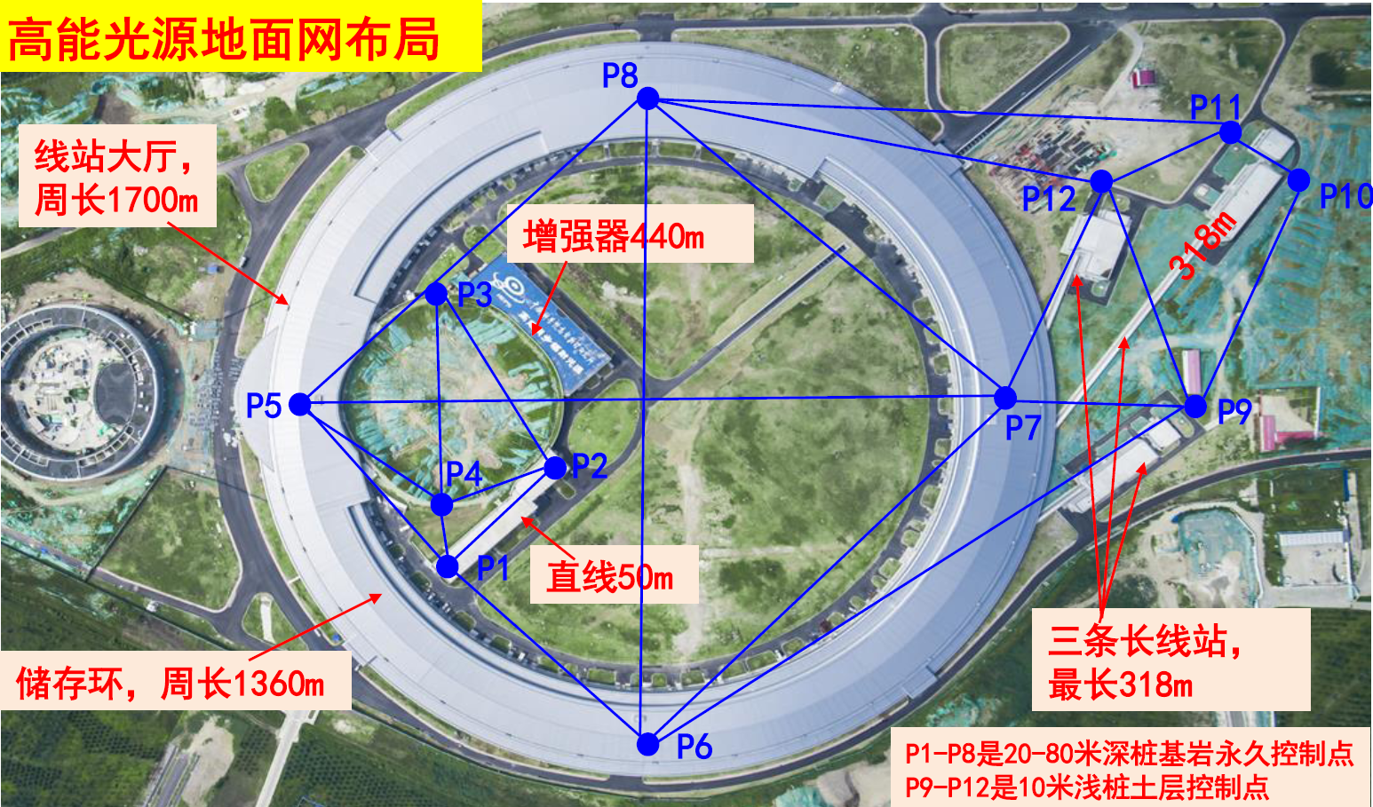
Alignment in tunnel —control network
The primary control network consists of 12 points, and P1~P8 are permanent points, they are built on the bedrock.

Slide 38
Alignment in tunnel —control network
GPS and leveling are used for the horizontal and elevation measurement.

Slide 39
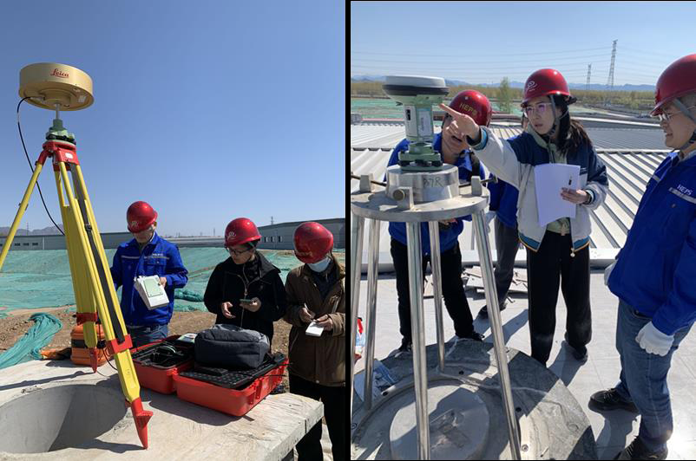
Alignment in tunnel —control network
Total station are used to check the baseline length of GPS.
The accuracy of primary control network is estimated to be better than 2mm.

Slide 40

Alignment in tunnel —control network
The secondary network layout along the tunnel with 5 points in each section, and 2 points on the ground, 2points on the wall, and 1 point on the ceiling. The interval of sections is 5m in SR.
Booster

Slide 41

Alignment in tunnel —control network
There are 288 sections in SR ,corresponding to the girder positions, have 1440 points.

Slide 42

Alignment in tunnel —control network
Laser tracker was used, each station was set up in the middle of the consecutive sections and measures the 4 sections forward and 4 sections backward in free station mode, then move to the next station. The distance between the stations is 5m, so the network is very dense, resulting in a large number of redundant observations.

Slide 43


Alignment in tunnel —control network
The self-developed program VECTOR is used for adjustment calculation. The absolute error of SR was 0.12mm in transverse and 0.06mm in vertical. We think that the absolute accuracy given by program was too optimized, that needs more investigation, such as the repeatability of two consecutive measurements.
The relative error of SR was 0.06mm in transverse and 0.04mm in vertical, that could be improved after the environment becomes stable.
Absolute error of SR
Relative error of SR

Slide 44


Alignment in tunnel —spatial measurement
The girder alignment in tunnel was measured by single laser tracker. The laser tracker was located by the surrounding control points, and measure the fiducials of magnets to guide the adjustment in real-time.
设备坐标系

Slide 45



Alignment in tunnel —positioning
The elevation position adjustment is implemented by wedge mechanism. The actual resolution was 2μm, and the stroke was ±9mm.
The transverse position adjustment is implemented by vertical placement wedge mechanism. The actual resolution was 2μm, and the stroke was ±5mm.
The girder position adjustment offsets and girder displacement after locking are both required to 15μm.
[1] HEPS储存环多极铁支架与基座的设计及关键技术研究-第七届全国粒子加速器准直安装及机械设计学术研讨会（威海）-20210721-王梓豪

Slide 46
Summary
1、 Pre-alignment of 75% girders(217 out of 288) have been finished. It’s expected to accomplish all in next month.
2、More than half of the girders (164 out of 288 ) have been preliminary aligned in tunnel. It’s expected to finish all the girder at the end of this year.
3、The accuracy of pre-alignment can reach 25μm by multilateral measurement system with 4 laser trackers.
4、 The accuracy of control network still need to be improved with more redundant observations and better ambient environment.
5、 After the preliminary alignment, we will turn to the final alignment, a smoothing strategy will be applied, and the method how to keep the light source of beamlines not moving is under studied.
6、The hydrostatic leveling system(HLS) is preparing for installation to monitor the deformation of the foundation.
Still a lot of work to do…

Slide 47
Thanks for your attention!

