Slide 2
AXEL – 2023
Introduction to Particle Accelerators
Basic Mathematics
Rende Steerenberg – CERN BE/OP

Slide 3
Contents
Vectors & Matrices
Differential Equations
Some Units we use

Slide 4
Vectors & Matrices
Differential Equations
Some Units we use

Slide 5
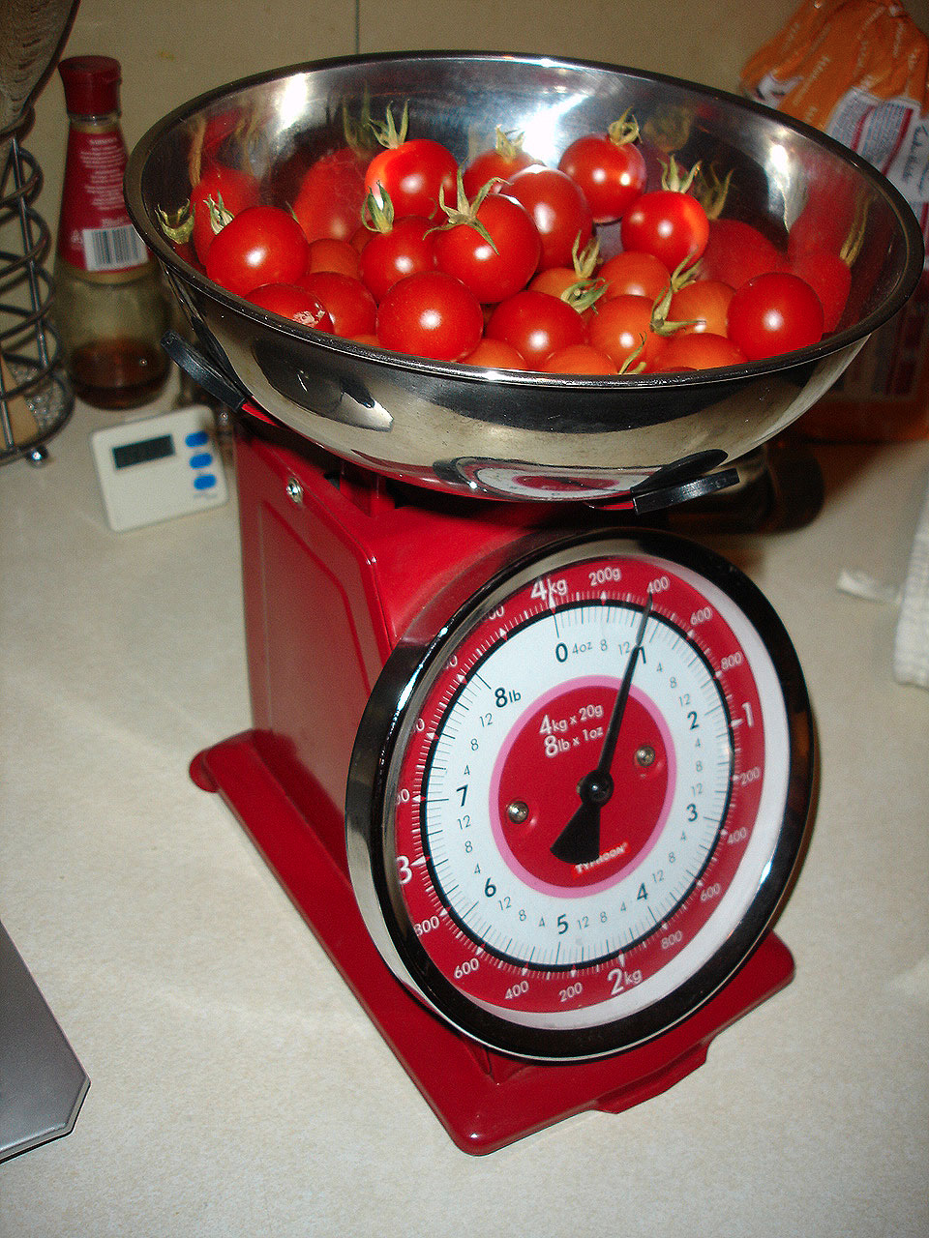

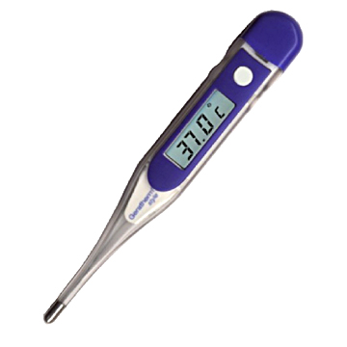


Scalars & Vectors
Scalar, a single quantity or value
Vector, (origin,) length, direction

Slide 6
Coordinate systems
A vector has 2 or more quantities associated with it
(x,y) Cartesian coordinates
(r, θ) Polar coordinates
r
y
r
θ
x
r is the length of the vector
θ gives the direction of the vector

Slide 7
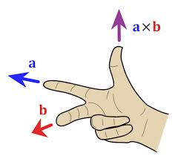
Vector Cross Product
a and b are two vectors in the in a plane separated by angle θ
a × b
a
θ
b
The cross product a × b is defined by:
Direction: a × b is perpendicular (normal) on the plane through a and b
The length of a × b is the surface of the parallelogram formed by a and b

Slide 8
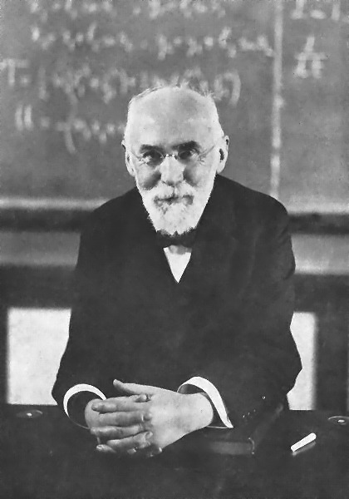
Cross Product & Magnetic Field
The Lorentz force in a pure magnetic field expression
Force
B field
Direction of current
The reason why our particles move around our “circular” machines under the influence of the magnetic fields
Today
“Electro-Magnetic Elements” by Piotr Skowronski
“Transverse Beam Dynamics” by Bernhard Holzer
Tue. & Wed.

Slide 9
Lorentz Force in Action
Velocity ‘v’
Magnetic Field
charge = -e
Particle with
mass ‘m’
charge = e
charge = 2e
The larger the energy of the beam the larger the radius of curvature

Slide 10
A Rotating Coordinate System
It travels on the central orbit
Vertical
Horizontal
Longitudinal
y
θ
s or z
x

Slide 11
Magnetic Rigidity
As a formula this is:
=
=
mv
2
Radius of curvature
F
evB
Like for a stone attached to a rotating rope
ρ
Which can be written as:
ρ
=
mv
=
p
B
Momentum
p=mv
e
e
Bρ is called the magnetic rigidity, and if we put in all the correct units we get:
Bρ = 33.356·p [kG·m] = 3.3356·p [T·m] (if p is in [GeV/c])

Slide 12
Moving a Point in a Coordinate System
To move from one point (A) to any other point (B) one needs control of both Length and Direction.
Rather clumsy !
Is there a more efficient way of doing this ?
y
A
B
x
2 equations needed !!!

Slide 13
Matrices & Vectors
So, we have:
Let’s write this as one equation:
Rows
A and B are Vectors or Matrices
A and B have 2 rows and 1 column
M is a Matrix and has 2 rows and 2 columns
Columns

Slide 14
Matrix Multiplications
This implies:
Equals
Is this really simpler ?
This defines the rules for matrix multiplication
This matrix multiplication results in:

Slide 15
Moving a Point & Matrices
Lets apply what we just learned and move a point around:
y
1
y1
2
y2
x3
x2
x1
x
y3
3
M1 transforms 1 to 2
M2 transforms 2 to 3
This defines M3=M2M1

Slide 16
Matrices & Accelerators
We use matrices to describe the various magnetic elements in our accelerator.
  The x and y co-ordinates are the position and angle of each individual particle.
  If we know the position and angle of any particle at one point, then to calculate its position and angle at another point we multiply all the matrices describing the magnetic elements between the two points to give a single matrix
Now we are able to calculate the final co-ordinates for any initial pair of particle co-ordinates, provided all the element matrices are known.

Slide 17
The Unit Matrix
There is a special matrix that when multiplied with an initial point will result in the same final point.
X_{new} = X_{old}
Y_{new} = Y_{old}
The result is :
The Unit matrix has no effect on x and y

Slide 18
Going Backwards
What about going back from a final point to the corresponding initial point ?
or
For the reverse we need another matrix M⁻¹
such that
The combination of M and M⁻¹ does have no effect
M⁻¹ is the “inverse” or “reciprocal” matrix of M.

Slide 19
Calculating the Inverse Matrix
If we have a 2 x 2 matrix:
Then the inverse matrix is calculated by:
The term (ad – bc) is called the determinate, which is just a number (scalar).

Slide 20
Example: Drift Space Matrix
A drift space contains no magnetic field.
A drift space has length L.
x₂ = x₁ + L.x₁’
x₁’
x₁
L
x₁’ small
}

Slide 21
A Practical Example
Changing the current in two sets of quadrupole magnets (F & D) changes the horizontal and vertical tunes (Q_{h} & Q_{v}).
This can be expressed by the following matrix relationship:
or
Change I_{F} then I_{D} and measure the changes in Q_{h} and Q_{v}
Calculate the matrix M
Calculate the inverse matrix M⁻¹
Use now M⁻¹ to calculate the current changes (ΔI_{F} and ΔI_{D}) needed for any required change in tune (ΔQ_{h} and ΔQ_{v}).

Slide 22
Vectors & Matrices
Differential Equations
Some Units we use

Slide 23
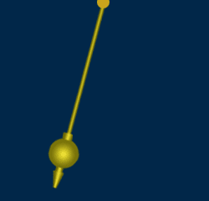
The Pendulum
Lets use a pendulum as example
The length of the pendulum is L
It has a mass m attached to it
It moves back and forth under the influence of gravity
L
M
Lets try to find an equation that describes the motion of the mass m makes.
This will result in a Differential Equation

Slide 24
Differential Equation
The distance from the centre = Lθ (since θ is small)
θ
The velocity of mass M is:
L
The acceleration of mass M is:
M
Newton: Force = mass x acceleration
Mg
Restoring force due to gravity is
-M g sinθ
θ is small
L is constant
(force opposes motion)

Slide 25
Solving a Differential Equation
Differential equation describing the motion of a pendulum at small amplitudes.
Find a solution……Try a good “guess”……
Differentiate our guess (twice)
and
Put this and our “guess” back in the original Differential equation.

Slide 26
Solving a Differential Equation
Now we have to find the solution for the following equation:
Solving this equation gives:
The final solution of our differential equation, describing the motion of a pendulum is as we expected :
Oscillation amplitude
Oscillation frequency

Slide 27
Position & Velocity
The differential equation that describes the transverse motion of the particles as they move around our accelerator.
The solution of this second order describes oscillatory motion
For any system, where the restoring force is proportional to the displacement, the solution for the displacement will be of the form:

Slide 28
Phase Space Plot
Plot the velocity as a function of displacement:
ωx₀
x
x₀
It is an ellipse.
As ωt advances by 2 π it repeats itself.
This continues for (ω t + k 2π), with k=0,±1, ±2,..,..etc

Slide 29
Oscillations in Accelerators
Under the influence of the magnetic fields the particle oscillate
x’
x
x
ds
s
dx
x = displacement
x’ = angle = dx/ds

Slide 30
Transverse Phase Space Plot
This changes slightly the Phase Space plot
X’
Position
φ
x
Angle
φ = ωt is called the phase angle
X-axis is the horizontal or vertical position (or time).
Y-axis is the horizontal or vertical phase angle (or energy).

Slide 31
Transverse Phase Space Plot
We distinguish motion in the Horizontal & Vertical Plane
x’
y’
φ
x
φ
y
Horizontal Phase Space
Vertical Phase Space

Slide 32
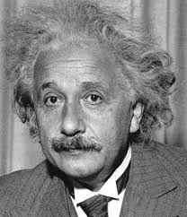
“Pure mathematics is, in its way, the poetry of logical ideas.”
Albert Einstein

