Slide 1
AXEL-2023
Introduction to Particle Accelerators
Transverse optics 2:
  Hill’s equation
  Phase Space
  Emittance & Acceptance
  Matrix formalism
Rende Steerenberg (BE/OP)
27 November 2023

Slide 2
Hill’s equation
The betatron oscillations exist in both horizontal and vertical planes.
The number of betatron oscillations per turn is called the betatron tune and is defined as Qx and Qy.
Hill’s equation describes this motion mathematically
If the restoring force, K is constant in ‘s’ then this is just a Simple Harmonic Motion.
‘s’ is the longitudinal displacement around the accelerator.

Slide 3
Hill’s equation (2)
In a real accelerator K varies strongly with ‘s’.
Therefore, we need to solve Hill’s equation for K varying as a function of ‘s’
Remember what we concluded on the mechanical equivalent concerning the shape of the gutter……
  The phase advance and the amplitude modulation of the oscillation are determined by the shape of the gutter.
  The overall oscillation amplitude will depend on the initial conditions, i.e. how the motion of the ball started.

Slide 4
Solution of Hill’s equation (1)
Remember, this is a 2nd order differential equation.
In order to solve it lets try to guess a solution:
ε and 𝛷₀ are constants, which depend on the initial conditions.
𝛽(s) = the amplitude modulation due to the changing focusing strength.
𝛷(s) = the phase advance, which also depends on focusing strength.

Slide 5
Solution of Hill’s equation (2)
Define some parameters
…and let
Remember 𝛷 is still a function of s
In order to solve Hill’s equation we differentiate our guess, which results in:
……and differentiating a second time gives:
Now we need to substitute these results in the original equation.

Slide 6
Solution of Hill’s equation (3)
So we need to substitute
and its second derivative
into our initial differential equation
This gives:
Sine and Cosine are orthogonal and will never be 0 at the same time
The sum of the coefficients must vanish separately to make our guess valid for all phases

Slide 7
Solution of Hill’s equation (4)
Using the ‘Sin’ terms
We defined
, which after differentiating gives
Combining
and
gives:
As condition for our guessed solution to be
valid we get:
hence
So our guess seems to be correct

Slide 8
Solution of Hill’s equation (5)
Since our solution was correct, we have the following for x:
d
ω
β
'
α
=
=
−
ds
2
ω
β
For x’ we have now:
Thus, the expression for x’ finally becomes:

Slide 9
Phase Space Ellipse
So now we have an expression for x and x’
and
If we plot x’ versus x as 𝛷 goes from 0 to 2𝜋we get an ellipse, which is called the phase space ellipse.
𝛷= 3𝜋/2
x’
𝛷= 0 = 2𝜋
x

Slide 10
Phase Space Ellipse (2)
As we move around the machine the shape of the ellipse will change as 𝛽 changes under the influence of the quadrupoles
However, the area of the ellipse (𝜋𝜀 does not change
x’
x’
Area = 𝜋·r₁·r₂
x
x
𝜀 is called the transverse emittance and is determined by the initial beam conditions.
The units are meter·radians, but in practice we use more often mm·mrad.

Slide 11
Phase Space Ellipse (3)
QF
QD
QF
x’
x’
x’
x’
x’
x
x
For each point along the machine the ellipse has a particular orientation, but the area remains the same

Slide 12
Phase Space Ellipse (4)
x’
x’
x
x
The projection of the ellipse on the x-axis gives the Physical transverse beam size.
Therefore the variation of 𝛽(s) around the machine will tell us how the transverse beam size will vary.

Slide 13
Emittance & Acceptance
To be rigorous we should define the emittance slightly differently.
  Observe all the particles at a single position on one turn and measure both their position and angle.
  This will give a large number of points in our phase space plot, each point representing a particle with its co-ordinates x, x’.
x’
emittance
beam
x
acceptance
The emittance is the area of the ellipse, which contains all, or a defined percentage, of the particles.
The acceptance is the maximum area of the ellipse, which the emittance can attain without losing particles.

Slide 14
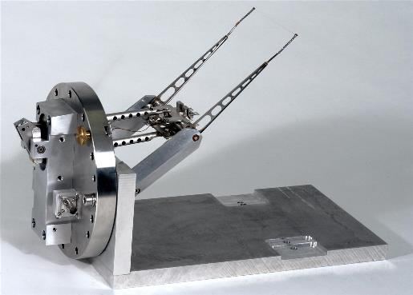
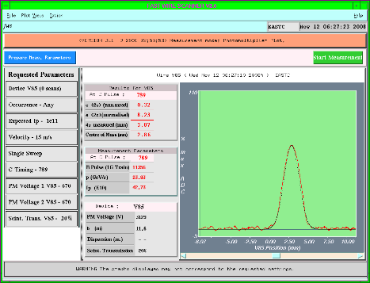
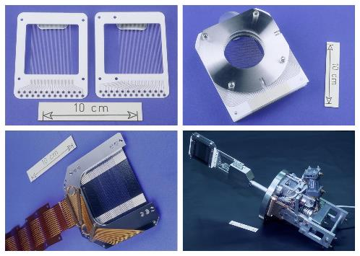
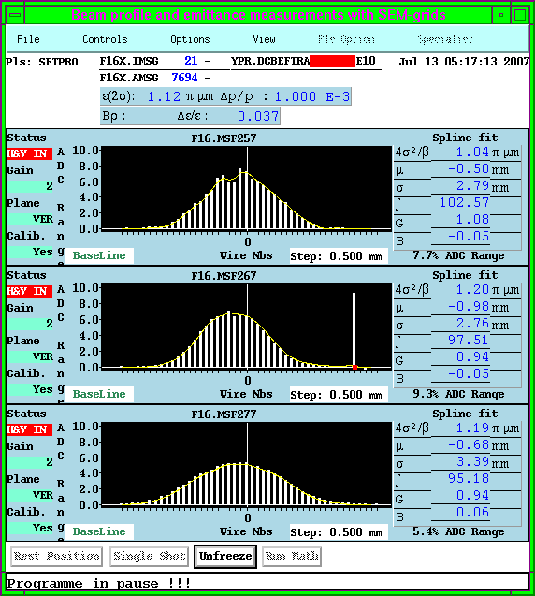
Emittance measurement

Slide 15
Matrix Formalism
Lets represent the particles transverse position and angle by a column matrix.
As the particle moves around the machine the values for x and x’ will vary under influence of the dipoles, quadrupoles and drift spaces.
These modifications due to the different types of magnets can be expressed by a Transport Matrix M
If we know x₁ and x₁’ at some point s₁ then we can calculate its position and angle after the next magnet at position s₂ using:

Slide 16
How to apply the formalism
If we want to know how a particle behaves in our machine as it moves around using the matrix formalism, we need to:
  Split our machine into separate elements as dipoles, focusing and defocusing quadrupoles, and drift spaces.
  Find the matrices for all of these components
  Multiply them all together
  Calculate what happens to an individual particle as it makes one or more turns around the machine

Slide 17
Matrix for a drift space
A drift space contains no magnetic field.
A drift space has length L.
x₂ = x₁ + L.x₁’
x₁’
x₁
x₁’ small
L
}

Slide 18
Matrix for a quadrupole
deflection
A quadrupole of length L.
x₁
x₂
x₁’
x₂’
Remember B_{y} ∝ x and the deflection due to the magnetic field is:
}
Provided L is small

Slide 19
Matrix for a quadrupole (2)
We found :
Define the focal length of the quadrupole as f=

Slide 20
How now further ?
For our purpose we will treat dipoles as simple drift spaces as they bend all the particles by the same amount.
We have Transport Matrices corresponding to drift spaces and quadrupoles.
These matrices describe the real discrete focusing of our quadrupoles.
Now we must combine these matrices with our solution to Hill’s equation, since they describe the same motion……

Slide 21
Questions….,Remarks…?
Emittance & Acceptance
Hill’s equation
Phase space
Matrix formalism

