Slide 1
AXEL-2023
Introduction to Particle Accelerators
Resonances:
  Normalised Phase Space
  Dipoles, Quadrupoles, Sextupoles
  A more rigorous approach
  Coupling
  Tune diagram
Rende Steerenberg (BE/OP)
28 November 2023

Slide 2
Normalised Phase Space
βy’
Circle of radius
y
By multiplying the y-axis by β the transverse phase space is normalised and the ellipse turns into a circle.

Slide 3
Phase Space & Betatron Tune
If we unfold a trajectory of a particle that makes one turn in our machine with a tune of Q = 3.333, we get:
y
βy’
0
2π
This is the same as going 3.333 time around on the circle in phase space
The net result is 0.333 times around the circular trajectory in the normalised phase space
q is the fractional part of Q
So here Q= 3.333 and q = 0.333
y
2πq

Slide 4
What is a resonance?
After a certain number of turns around the machine the phase advance of the betatron oscillation is such that the oscillation repeats itself.
For example:
  If the phase advance per turn is 120º then the betatron oscillation will repeat itself after 3 turns.
  This could correspond to Q = 3.333 or 3Q = 10
  But also Q = 2.333 or 3Q = 7
The order of a resonance is defined as ‘n’
n x Q = integer

Slide 5
Q = 3.333 in more detail
1st turn
2nd turn
3rd turn
Third order resonant betatron oscillation
3Q = 10, Q = 3.333, q = 0.333

Slide 6
Q = 3.333 in Phase Space
Third order resonance on a normalised phase space plot
2nd turn
3rd turn
1st turn
2πq = 2π/3

Slide 7
Machine imperfections
It is not possible to construct a perfect machine.
  Magnets can have imperfections
  The alignment in the de machine has non zero tolerance.
  Etc…
So, we have to ask ourselves:
  What will happen to the betatron oscillations due to the different field errors.
  Therefore we need to consider errors in dipoles, quadrupoles, sextupoles, etc…
We will have a look at the beam behaviour as a function of ‘Q’
How is it influenced by these resonant conditions?

Slide 8
Dipole (deflection independent of position)
y’β
y’β
Q = 2.00
1st turn
Q = 2.50
2nd turn
y
y
3rd turn
For Q = 2.00: Oscillation induced by the dipole kick grows on each turn and the particle is lost (1st order resonance Q = 2).
For Q = 2.50: Oscillation is cancelled out every second turn, and therefore the particle motion is stable.

Slide 9
Quadrupole (deflection ∝ position)
Q = 2.50
1st turn
Q = 2.33
2nd turn
3rd turn
4th turn
For Q = 2.50: Oscillation induced by the quadrupole kick grows on each turn and the particle is lost
(2nd order resonance 2Q = 5)
For Q = 2.33: Oscillation is cancelled out every third turn, and therefore the particle motion is stable.

Slide 10
Sextupole (deflection ∝ position²)
Q = 2.33
1st turn
Q = 2.25
2nd turn
3rd turn
4th turn
5th turn
For Q = 2.33: Oscillation induced by the sextupole kick grows on each turn and the particle is lost
(3rd order resonance 3Q = 7)
For Q = 2.25: Oscillation is cancelled out every fourth turn, and therefore the particle motion is stable.

Slide 11
More rigorous approach (1)
Let us try to find a mathematical expression for the amplitude growth in the case of a quadrupole error:
y’β
2πQ = phase angle over 1 turn = θ
Δβy’ = kick
a = old amplitude
Δa = change in amplitude
2πΔQ = change in phase
θ
a
y
y does not change at the kick
y = a cos(𝜃)
θ
Δβy’
In a quadrupole Δy’ = lky
2πΔQ
Δa
Only if 2πΔQ is small
So we have:
Δa = βΔy’ sin(𝜃) = lβ sin(𝜃) a k cos(𝜃)

Slide 12
More rigorous approach (2)
So we have:
∆a = l·𝛽·sin(𝜃) a·k·cos(𝜃)
Each turn θ advances by 2πQ
On the n^{th} turn θ = θ + 2nπQ
Sin(θ)Cos(θ) = 1/2 Sin (2θ)
Over many turns:
This term will be ‘zero’ as it decomposes in Sin and Cos terms and will give a series of + and – that cancel out in all cases where the fractional tune q ≠ 0.5
So, for q = 0.5 the phase term, 2(θ + 2nπQ) is constant:
and thus:

Slide 13
More rigorous approach (3)
In this case the amplitude will grow continuously until the particles are lost.
Therefore we conclude as before that:
quadrupoles excite 2nd order resonances for q=0.5
Thus for Q = 0.5, 1.5, 2.5, 3.5,…etc……

Slide 14
More rigorous approach (4)
Let us now look at the phase θ for the same quadrupole error:
y’β
2πQ = phase angle over 1 turn = θ
Δβy’ = kick
a = old amplitude
Δa = change in amplitude
2πΔQ = change in phase
θ
a
y
y does not change at the kick
y = a cos(θ)
θ
s
Δβy’
In a quadrupole Δy’ = lky
2πΔQ
Δa
2πΔQ << Therefore Sin(2πΔQ) ≈ 2πΔQ

Slide 15
More rigorous approach (5)
So we have:
Since:
we can rewrite this as:
, which is correct for the 1st turn
Each turn θ advances by 2πQ
On the n^{th} turn θ = θ + 2nπQ
Over many turns:
‘zero’
Averaging over many turns:

Slide 16
Stopband
, which is the expression for the change in Q due to a quadrupole… (fortunately !!!)
But note that Q changes slightly on each turn
Related to Q
Max variation 0 to 2
Q has a range of values varying by:
This width is called the stopband of the resonance
So even if q is not exactly 0.5, it must not be too close, or at some point it will find itself at exactly 0.5 and ‘lock on’ to the resonant condition.

Slide 17
Sextupole kick
We can apply the same arguments for a sextupole:
For a sextupole
and thus
We get :
Summing over many turns gives:
3rd order resonance term
1st order resonance term
Sextupole excite 1st and 3rd order resonance
q = 0
q = 0.33

Slide 18
Octupole kick
We can apply the same arguments for an octupole:
For an octupole
and thus
We get :
4th order resonance term
2nd order resonance term
Summing over many turns gives:
∝ a²(cos 4(𝜃+2πnQ) + cos 2(𝜃+2πnQ))
Amplitude squared
q = 0.5
q = 0.25
Octupolar errors excite 2nd and 4th order resonance and are very important for larger amplitude particles.
Can restrict dynamic aperture

Slide 19
Resonance summary
Quadrupoles excite 2nd order resonances
Sextupoles excite 1st and 3rd order resonances
Octupoles excite 2nd and 4th order resonances
This is true for small amplitude particles and low strength excitations
However, for stronger excitations sextupoles will excite higher order resonance’s (non-linear)

Slide 20
Coupling
Coupling is a phenomena, which converts betatron motion from one plane (horizontal or vertical) into motion in the other plane.
Fields that will excite coupling are:
  Skew quadrupoles, which are normal quadrupoles, but tilted by 45º about it’s longitudinal axis.
  Solenoidal (longitudinal magnetic field)

Slide 21
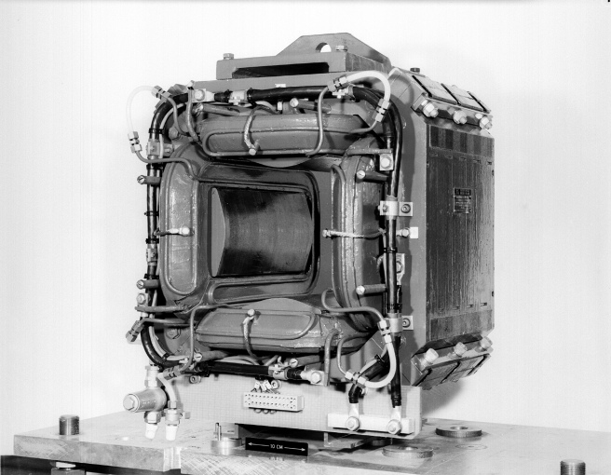
Skew Quadrupole
Magnetic field
S
N
N
Like a normal quadrupole, but then tilted by 45º
S

Slide 22
Solenoid; longitudinal field
Particle trajectory
Magnetic field
Beam axis
Transverse velocity component

Slide 23
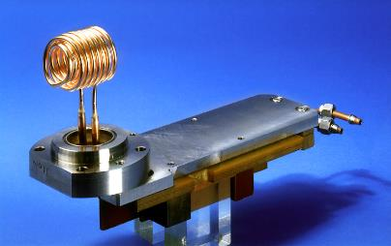
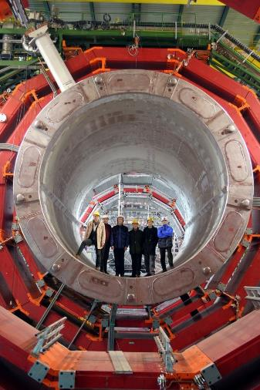
Solenoid; longitudinal field (2)
Above:
The LPI solenoid that was used for the initial focusing of the positrons.
It was pulsed with a current of 6 kA for some 7 υs, it produced a longitudinal magnetic field of 1.5 T.
At the right:
The somewhat bigger CMS solenoid

Slide 24
Coupling and Resonance
This coupling means that one can transfer oscillation energy from one transverse plane to the other.
Exactly as for linear resonances there are resonant conditions.
If we meet one of these conditions the transverse oscillation amplitude will again grow in an uncontrolled way.
nQ_{h} ± mQ_{v} = integer

Slide 25
A mechanical equivalent
We can transfer oscillation energy from one pendulum to the other depending on the strength ‘k’ of the spring

Slide 26
General tune diagram
2Q_{v} =5
Q_{v}
Q_{h} - Q_{v}= 0
2.75
2.5
4Q_{h} =11
2.25
2
2 2.25 2.5 2.75
Q_{h}
2.33
2.66

Slide 27
Realistic tune diagram
injection
During acceleration we change the horizontal and vertical tune
to a place where the beam is the least influenced by resonances.
ejection

Slide 28
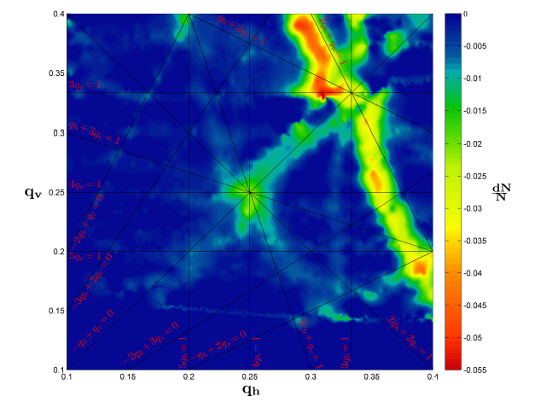
Measured tune diagram
Move a large emittance beam around in this tune diagram and measure the beam losses.
Not all resonance lines are harmful.

Slide 29
Conclusion
There are many things in our machine, which will excite resonances:
  The magnets themselves
  Unwanted higher order field components in our magnets
  Tilted magnets
  Experimental solenoids (LHC experiments)
The trick is to reduce and compensate these effects as much as possible and then find some point in the tune diagram where the beam is stable.

Slide 30
Questions….,Remarks…?
Resonance
Phase space
Coupling
Tune diagram

