Slide 1
Cross Section Measurements (Detectors)
Deborah Harris
York/Fermilab
June 7, 2024
NuSTEC 2024 Summer School

Slide 2
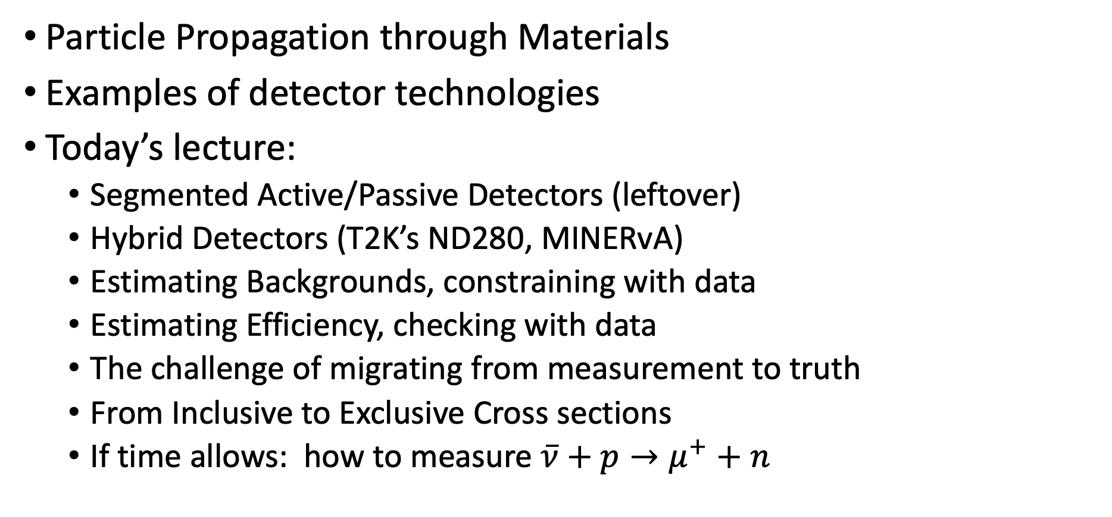
Summary from Yesterday, Plan for today
Particle Propagation through Materials
Examples of detector technologies
Today’s lecture:
  Segmented Active/Passive Detectors (leftover)
  Hybrid Detectors (T2K’s ND280, MINERvA)
  Estimating Backgrounds, constraining with data
  Estimating Efficiency, checking with data
  The challenge of migrating from measurement to truth
  From Inclusive to Exclusive Cross sections
  If time allows: how to measure $\overline{ν}+p→μ^{+}+n$

Slide 3
Homework question #1:
How far does a proton with 100MeV Kinetic Energy go in
  Plastic Scintillator (could consider C alone)
  Iron
  Argon
How far does a muon with 2000 MeV Kinetic Energy go in
  Plastic Scintillator
  Iron
  Argon

Slide 4
Homework question #1:
How far does a proton with 100MeV Kinetic Energy go in
  Plastic Scintillator (could consider C alone)
  Iron
  Argon
How far does a muon with 2000 MeV Kinetic Energy go in
  Plastic Scintillator
  Iron
  Argon
Target | Range (g/cm^2) | Density (g/cm^3) | Range (cm)
C | 8.67 | 0.92 | 9.4
H | 3.63 | 0.08 | 47.2
Fe | 11.3 | 7.90 | 1.4
Ar | 10.9 | 1.40 | 7.8
Target | dE/dx (min) (MeV/g/cm^3) | Density (g/cm^3) | dE/dx (MeV/cm) | Range (m)
Polystyrene | 1.9 | 1.1 | 2.1 | 10
Fe | 1.5 | 7.9 | 11.5 | 2
Ar | 1.5 | 1.4 | 2.1 | 10

Slide 5
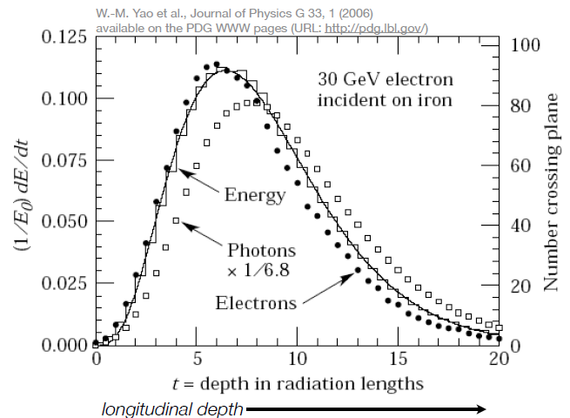
Homework question #2:
What is the shower max (in cm) for a 1GeV electron:
  Plastic Scintillator
  Iron
  Argon
  Lead
What is the shower max (in cm) for a 2GeV electron:
  Plastic Scintillator
  Iron
  Argon
  Lead

Slide 6
Homework question #2:
What is the shower max (in cm) for a 1GeV electron:
  Plastic Scintillator
  Iron
  Argon
  Lead
What is the shower max (in cm) for a 2GeV electron:
  Plastic Scintillator
  Iron
  Argon
  Lead
 | Z | Ec (MeV) | X0 | ln(1000/Ec)-0.5 | t_max (cm)
Plastic Scintillator | 6 | 111 | 42 | 1.7 | 71.3
Iron | 26 | 29 | 1.76 | 3.0 | 5.3
Argon | 18 | 42 | 14 | 2.7 | 37.5
Lead | 82 | 10 | 0.56 | 4.1 | 2.3
 | Z | Ec (MeV) | X0 | ln(2000/Ec)-0.5 | t_max (cm)
Plastic Scintillator | 6 | 111 | 42 | 2.4 | 100.4
Iron | 26 | 29 | 1.76 | 3.7 | 6.5
Argon | 18 | 42 | 14 | 3.4 | 47.2
Lead | 82 | 10 | 0.56 | 4.8 | 2.7

Slide 7
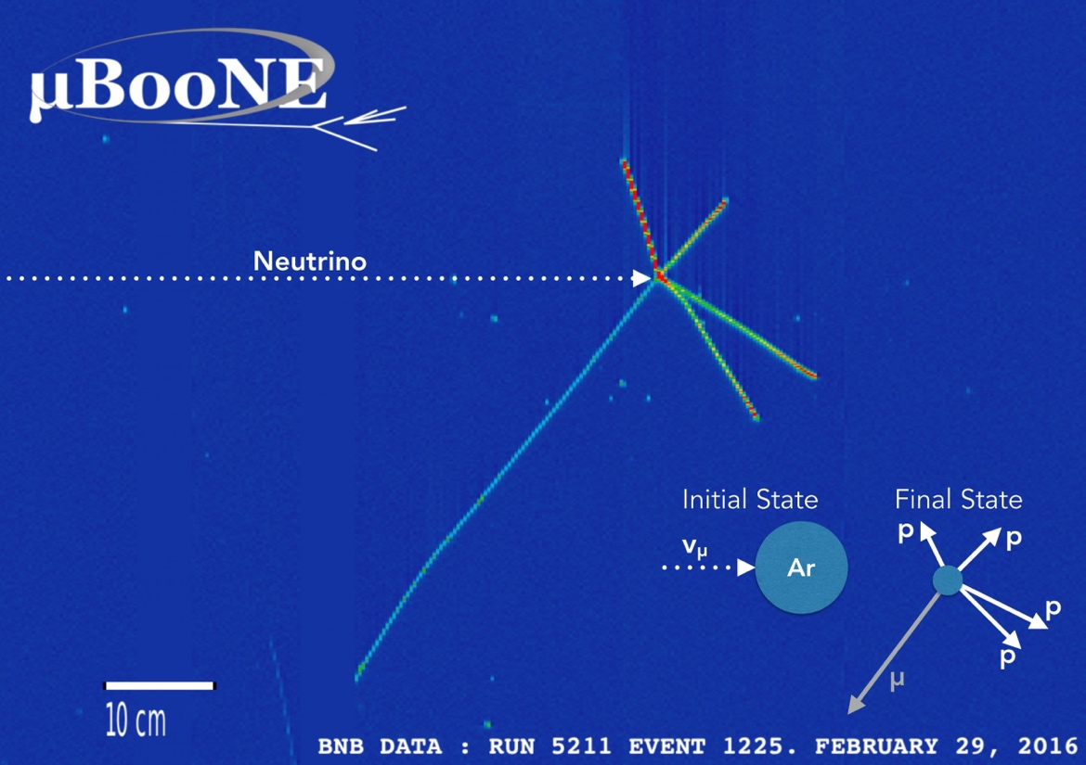
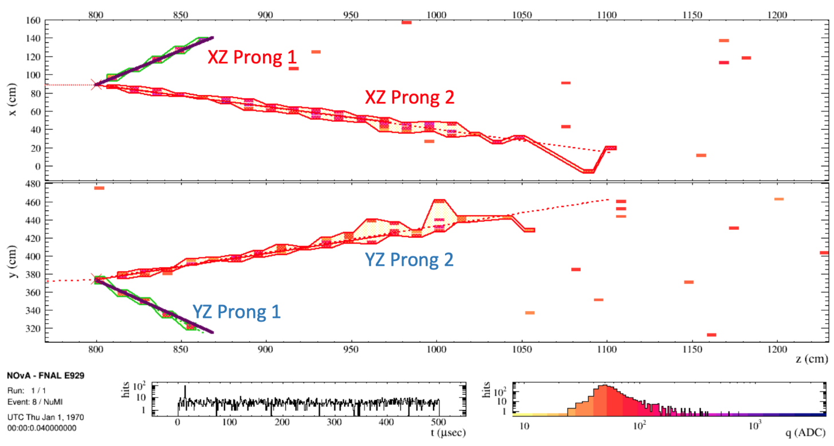
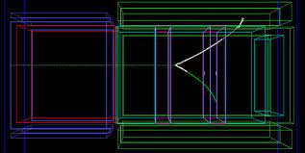


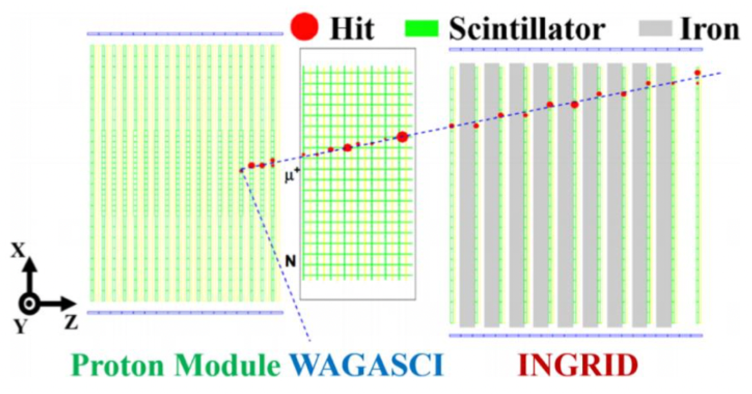
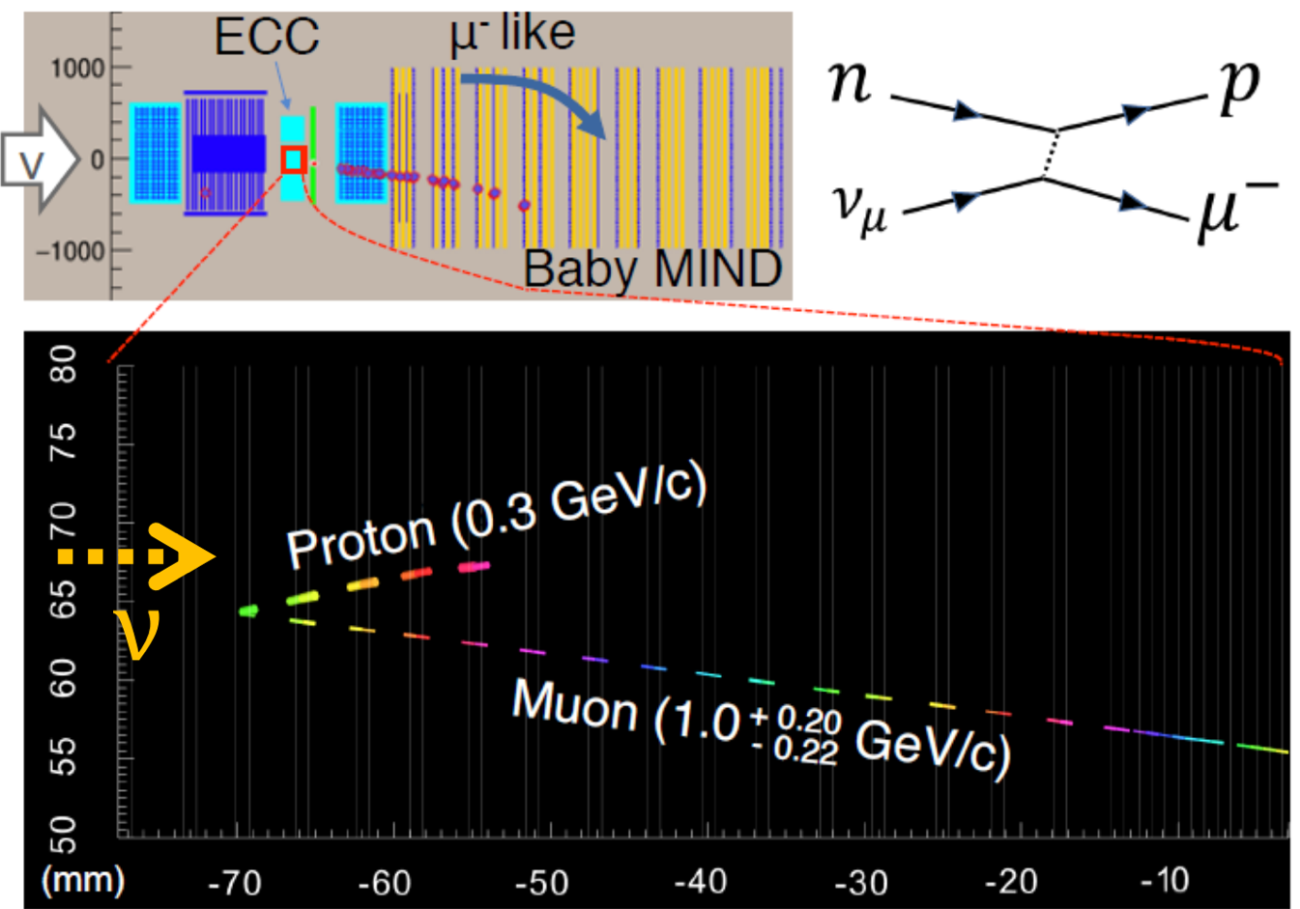
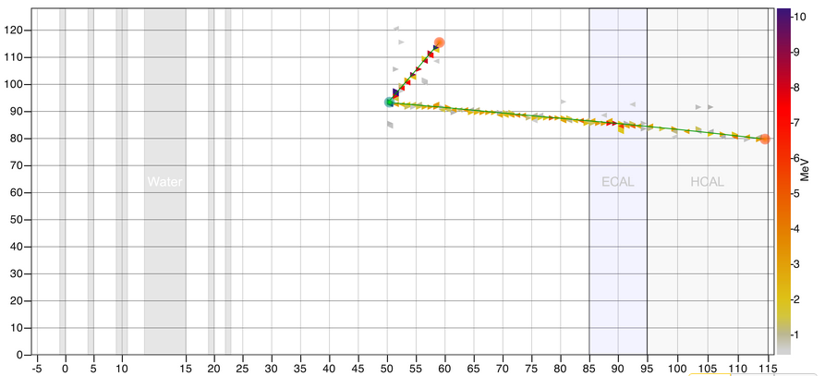
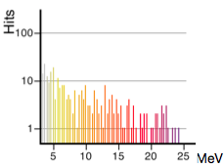

Neutrino Events at Some Experiments
p candidate
μ candidate
Module number

Slide 8
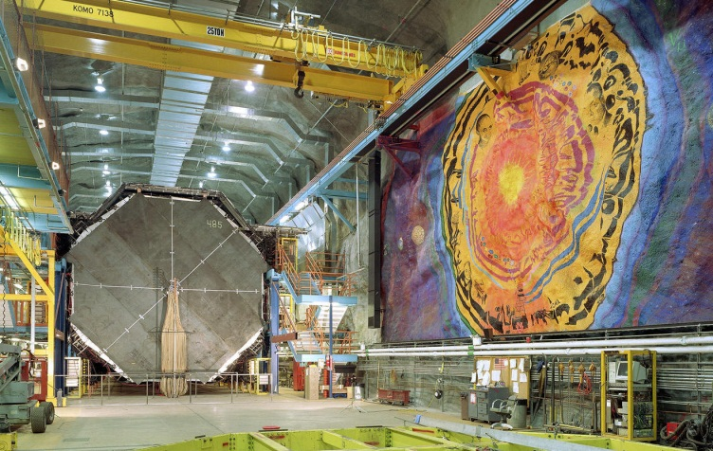
Active/Passive Detectors

Slide 9
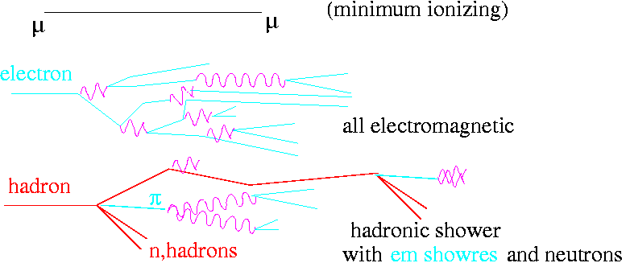
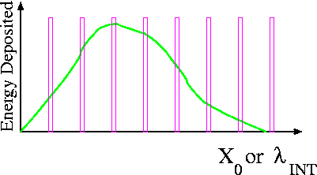
From Fully Active to Sampling Detectors
Advantages to Sampling:
  Cheaper readout costs
  Fewer readout channels
  Denser material can be used
    More N, more interactions
    Could combine emulsion with readout
  Can use magnetized material!
Disadvantages to Sampling
  Loss of information
  Particle ID is harder (except emulsion for taus in final state)

Slide 10
Sampling calorimeters
High Z materials:
  mean smaller showers,
  more compact detector
  Finer transverse segmentation needed
Low Z materials:
  more mass/X₀ (more mass per instrumented plane)
  Coarser transverse segmentation
  “big” events (harsh fiducial cuts for containment)
Material | X_{o} (cm) | λ_{INT} (cm) | Sampling (X_{o}) | X_{o} (g/cm²)
L.Argon | 14 | 83.5 | 0.02 (ICARUS) | 20
Steel | 1.76 | 17 | 1.4 (MINOS) | 14
Scintillator | 42 | ~80 | 0.13 (NOνA) | 40
Lead | 0.56 | 17 | .2 (OPERA) | 6

Slide 11
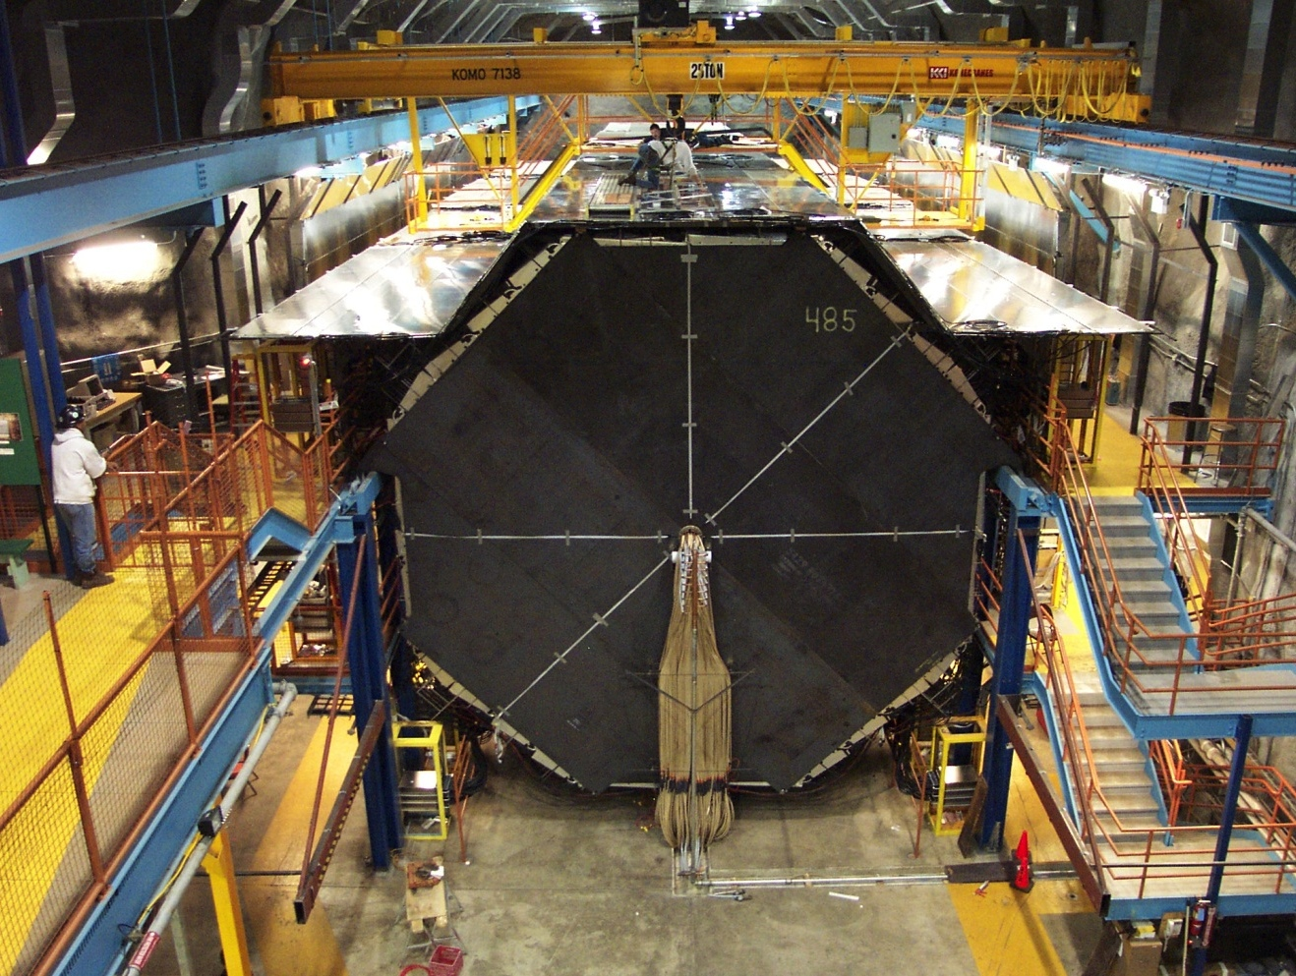
Steel/Scintillator Detector (MINOS)
8m octagon steel & scintillator calorimeter
  Sampling every 2.54 cm
  4cm wide strips of scintillator
  5.4 kton total mass
486 planes of scintillator
  95,000 strips

Slide 12
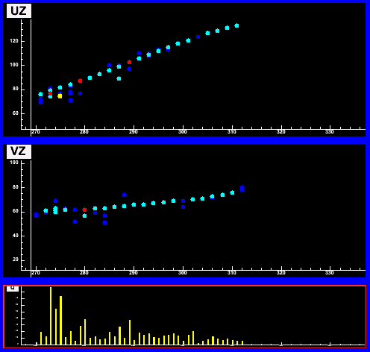
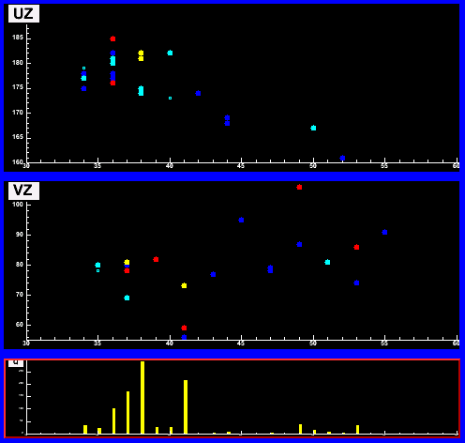
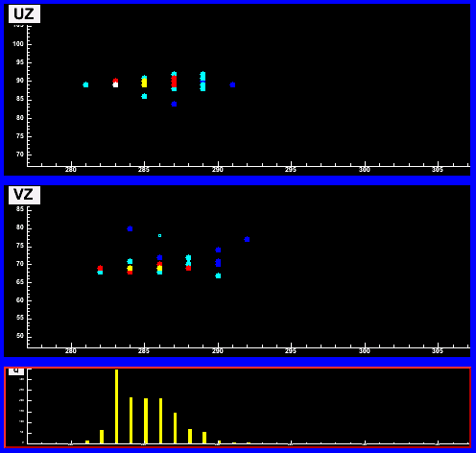
MINOS Event Topologies
ν_{μ}
CC Event
NC Event
ν_{e}
CC Event
UZ
VZ
1.8m
2.3m
Courtesy Chris Smith, FNAL Seminar
3.5m
Long muon track + hadronic activity at vertex
Short showering event, often diffuse
Short event with typical EM shower profile
E_{ν} = E_{shower} + P_{μ}
Shower energy resolution: 55%/√E
Muon momentum resolution: 6% range; 13% curvature

Slide 13
(Oscillation) Detector Summary
Detector Technology | Largest Mass to Date (kton) | Event by Event Identification |  |  | +/-? | Ideal n Energy Range
 |  | ν_{e} | ν_{m} | ν_{t}
LAR TPC | 0.8 |  |  |  | Not yet | huge
Water Cerenkov | 50 |  |  |  |  | <2GeV
Emulsion/Pb/Fe | 0.27 |  |  |  |  | >.5GeV
Scintillator++ | 14 |  |  |  |  | huge
Steel/Scint. | 5.4 |  |  |  |  | >.5GeV

Slide 14
Cross Section Detectors
Given the lengths of the muon tracks we saw earlier
Given the intense beams close to where neutrinos are produced
Will need to combine detector strategies to fit into allowed real estate for Near Detector Halls

Slide 15
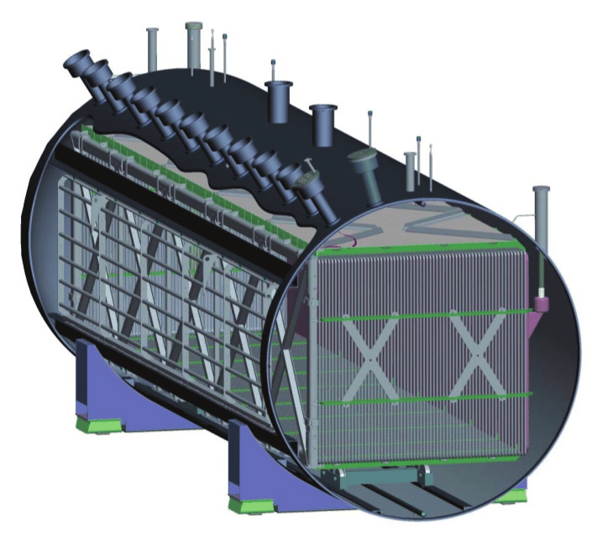
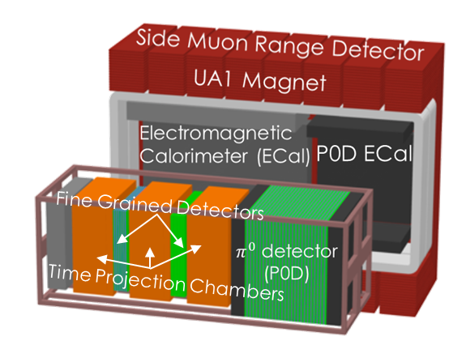
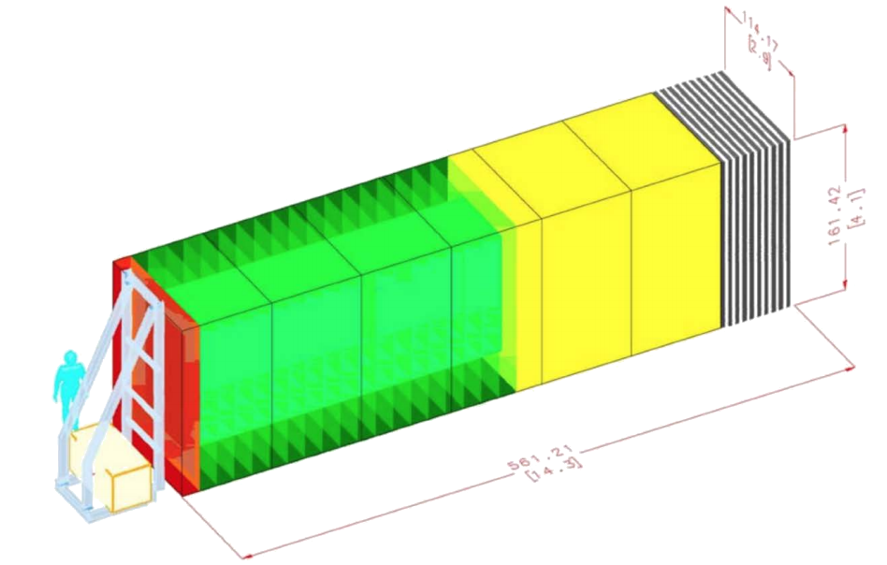
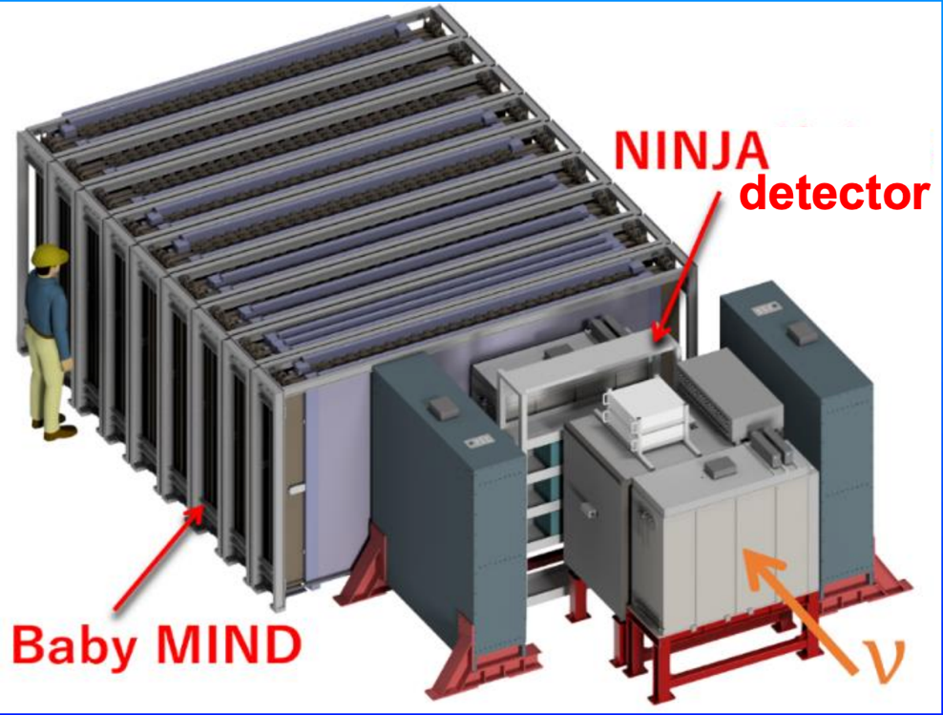
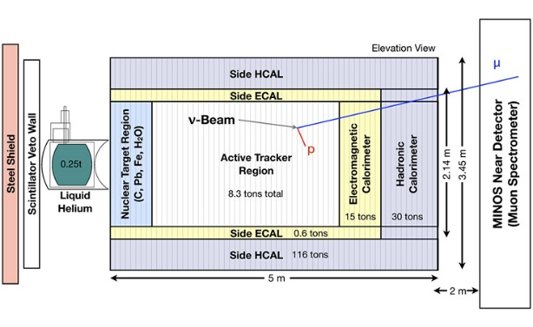
Experiments current releasing results
(in 0.5-20GeV region)
T2K Near Detector:
CH, H₂O
MicroBooNE:
Liquid Argon TPC
Booster and NuMI
(off axis) beamline!
NINJA:
CH, H₂O, Fe
MINERvA:
He, CH, C, H₂O, Fe, Pb
NOvA Near Detector: CH

Slide 16
Modern Cross Section Experiments
Experiment | Beam Energy | Target Nucleus | B field? | Granularity | Status
COHERENT | 25MeV, broad | CsI, Ar, …. | No | various | Data-taking
MINERvA | 3.5GeV and 6GeV, broad band | He, CH, C, H₂O, Fe, Pb | For muons only | 1.6cm x3.3 cm triangles (scint) | Last data: 2019 Still analyzing
T2K (Wagasci) | 600MeV | CH, H₂O | Yes! | ~few cm triangles + Gas TPC | Data-taking in 2023
NOvA | 2GeV | CH | No | 4cmx6cm (scint) | Data-taking in 2023
NINJA | 700MeV | Pb, H₂O | For muons only | Emulsion!
MicroBooNE | 600MeV (BNB) and 2GeV (NuMI) | Ar | No | 3mm wire pitch | Data-taking ended in 2022 Still analyzing
ICARUS |  |  | No | 3mm wire pitch | Data-taking in 2023
SBND | 600MeV (BNB) |  | No | 3mm wire pitch | Data-taking soon!

Slide 17
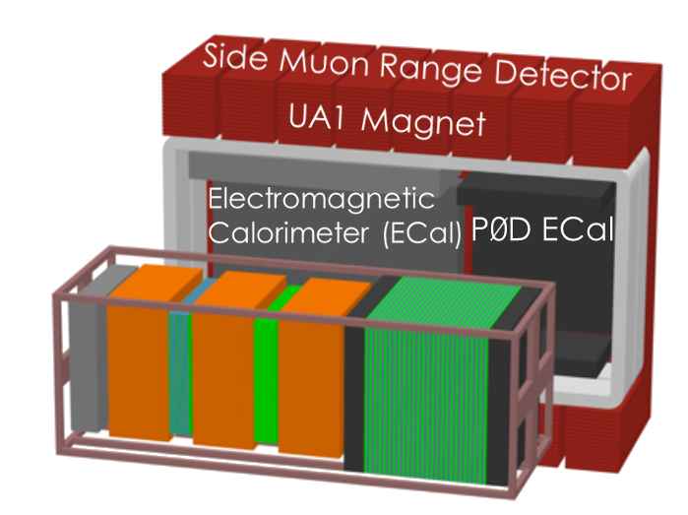
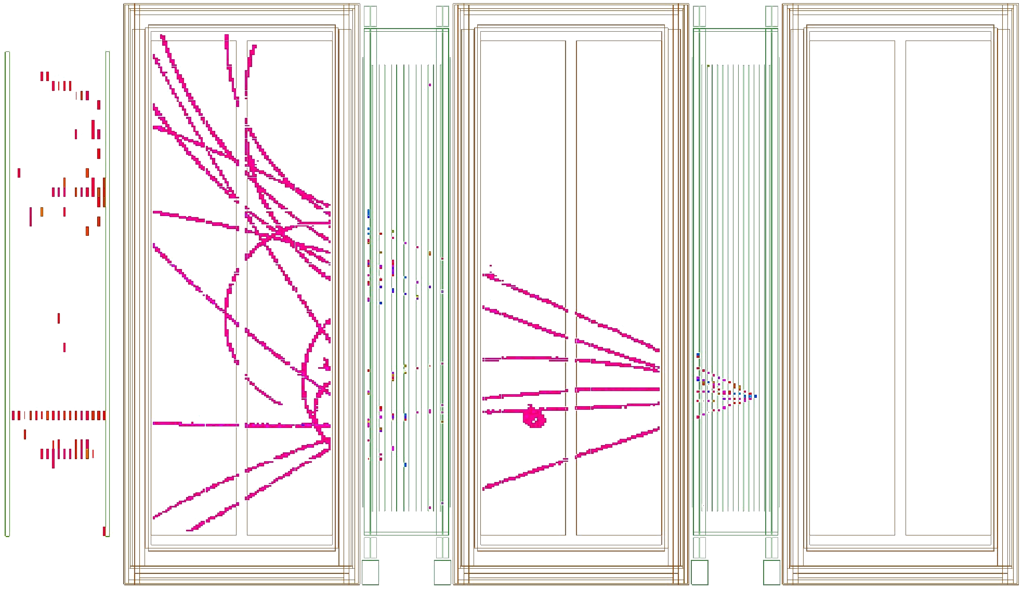
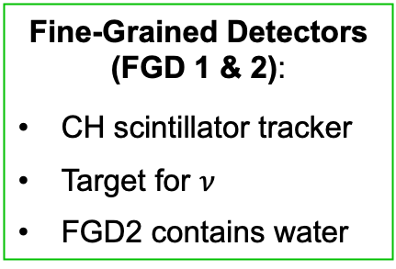
T2K Near Detector
Time Projection Chambers (TPC):
Excellent tracking
High-resolution charged-particle momenta
Accurate particle ID
Fine-Grained Detectors (FGD 1 & 2):
CH scintillator tracker
Target for $ν$
FGD2 contains water

Slide 18
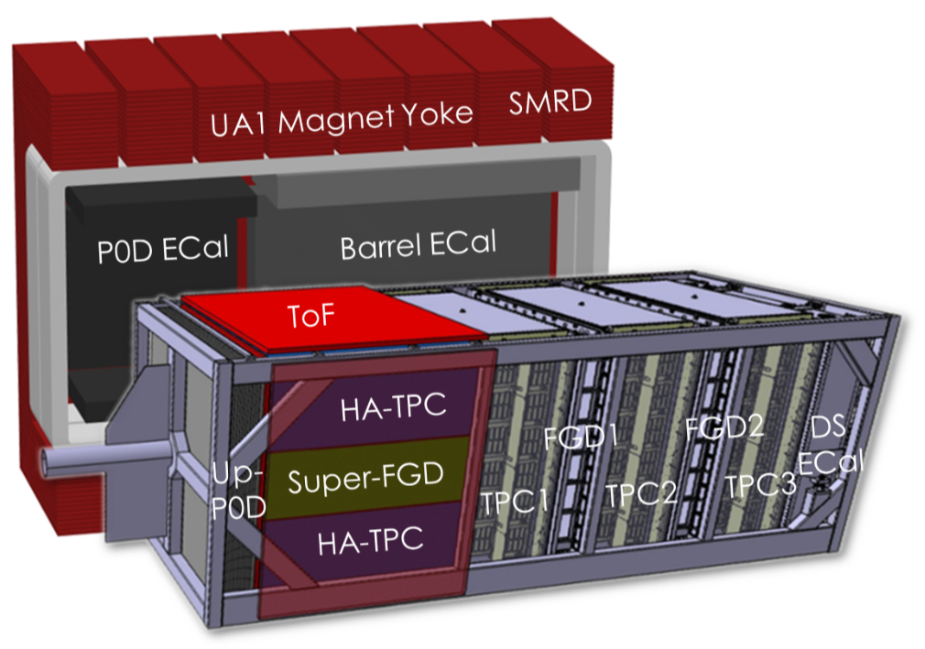
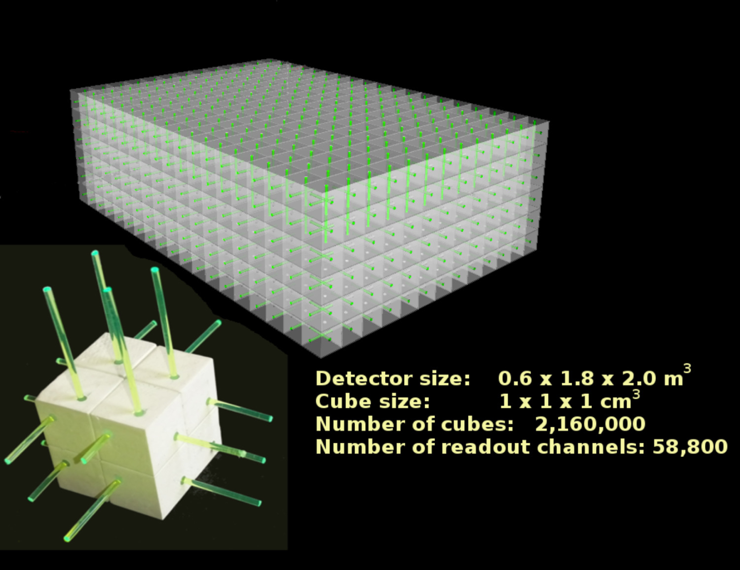


Upgrade to original T2K Near Detector

Slide 19
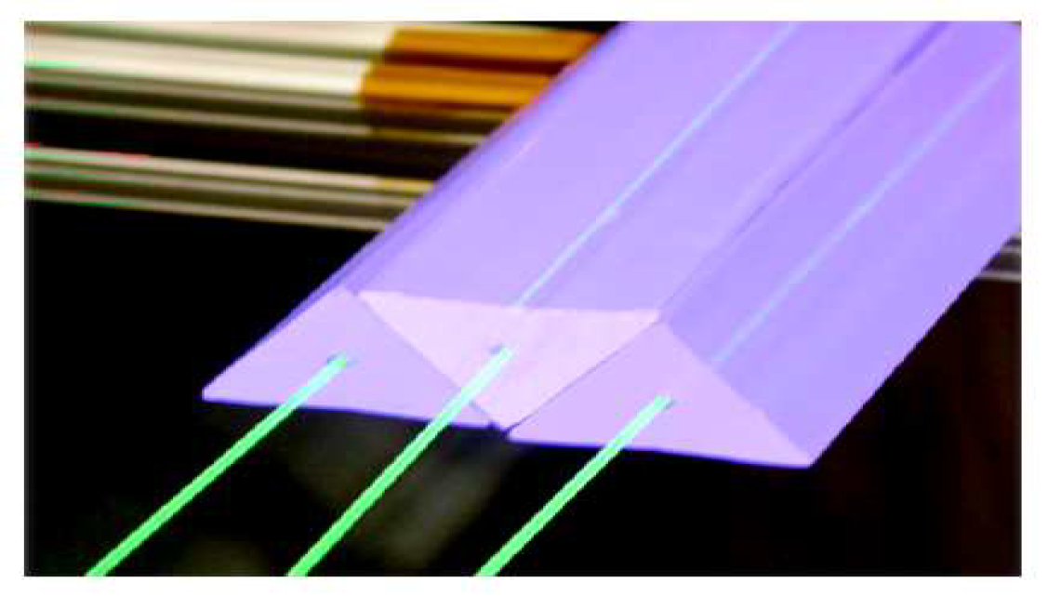
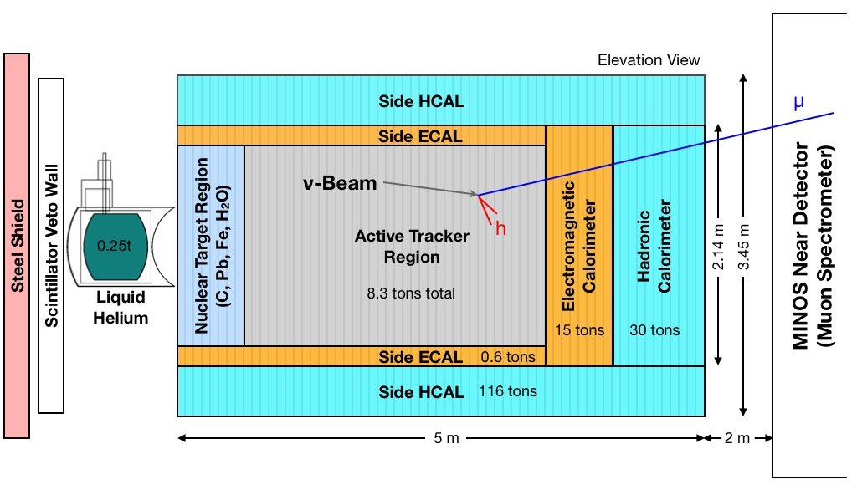
MINERvA Detector
Nucl.Instrum.Meth.A 743 (2014) 130 and beam test Nucl.Instrum.Meth.A 789 (2015) 28
Core of detector was an active scintillator strip target, surrounded by calorimetry.
Passive targets interspersed with scintillator upstream.
Detector is mostly in trash cans now, but some has been recycled for DUNE tests.

Slide 20
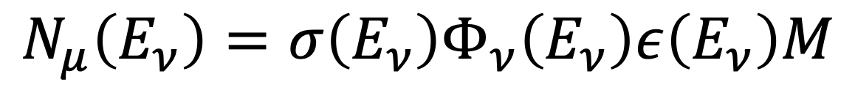
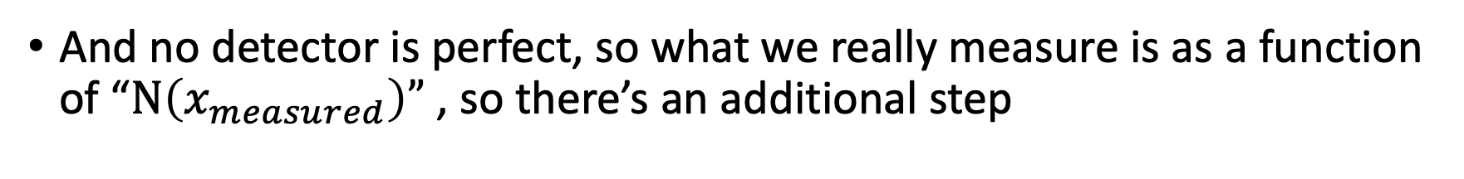
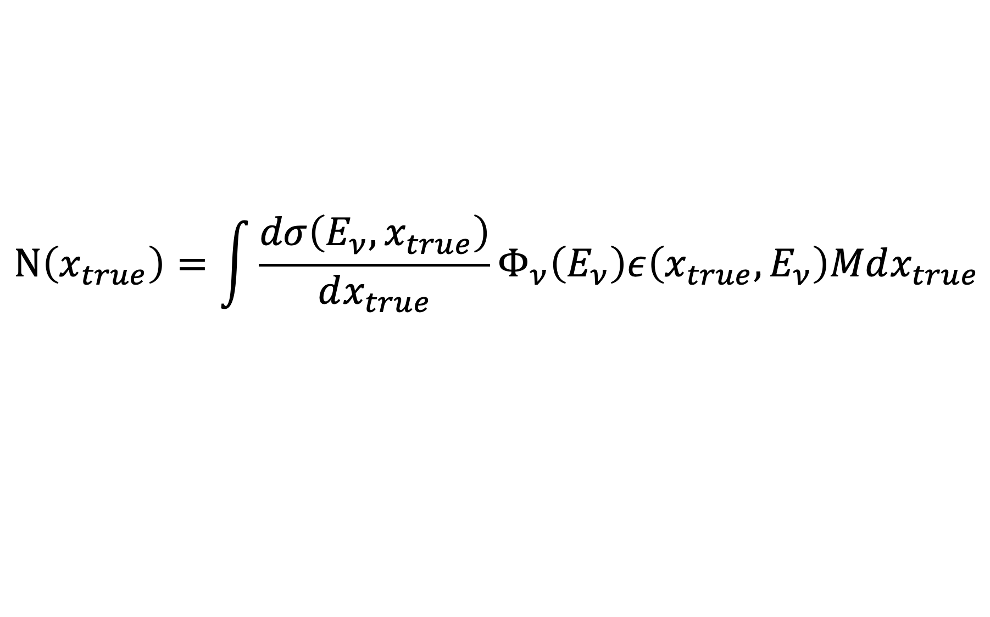
How to measure a Cross Section
Golden Rule in Cross Section Measurements:
$$N_{μ}\left(E_{ν}\right)=σ\left(E_{ν}\right)Φ_{ν}\left(E_{ν}\right)ε\left(E_{ν}\right)M$$
More generally, consider an observable x that describes the interaction
$$N\left(x_{true}\right)=\int{\frac{dσ\left({E_{ν},x}_{true}\right)}{dx_{true}}}Φ_{ν}\left(E_{ν}\right)ε\left({x_{true},E}_{ν}\right)Mdx_{true}$$
And no detector is perfect, so what we really measure is as a function of “$N\left(x_{measured}\right)”$ , so there’s an additional step

Slide 21
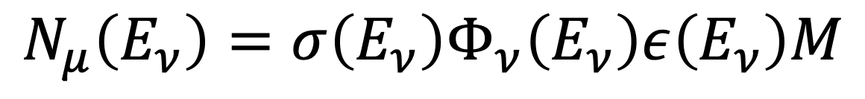
Quick word about units
$$N_{μ}\left(E_{ν}\right)=σ\left(E_{ν}\right)Φ_{ν}\left(E_{ν}\right)ε\left(E_{ν}\right)M$$
What are the units of the different components?
  N: number of events, unitless
  σ: cross section, area per target (for neutrinos, usually x10⁻³⁸ cm²)
  Φ: flux, Neutrinos per unit area (for near detector location, cm⁻²)
    example: NOvA reports*: 87ν_{μ}/cm²/10¹⁰ POT or for 10²⁰ POT, 10¹² ν/cm²
  ε: efficiency, unitless
  M: ”mass” must be “number of targets” : recall this is 6.023x10²³ if your detector weighed 1 gram
*Phys.Rev.D 107 (2023) 11, 112008

Slide 22
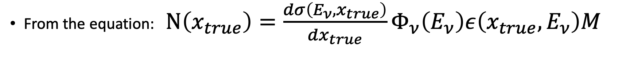
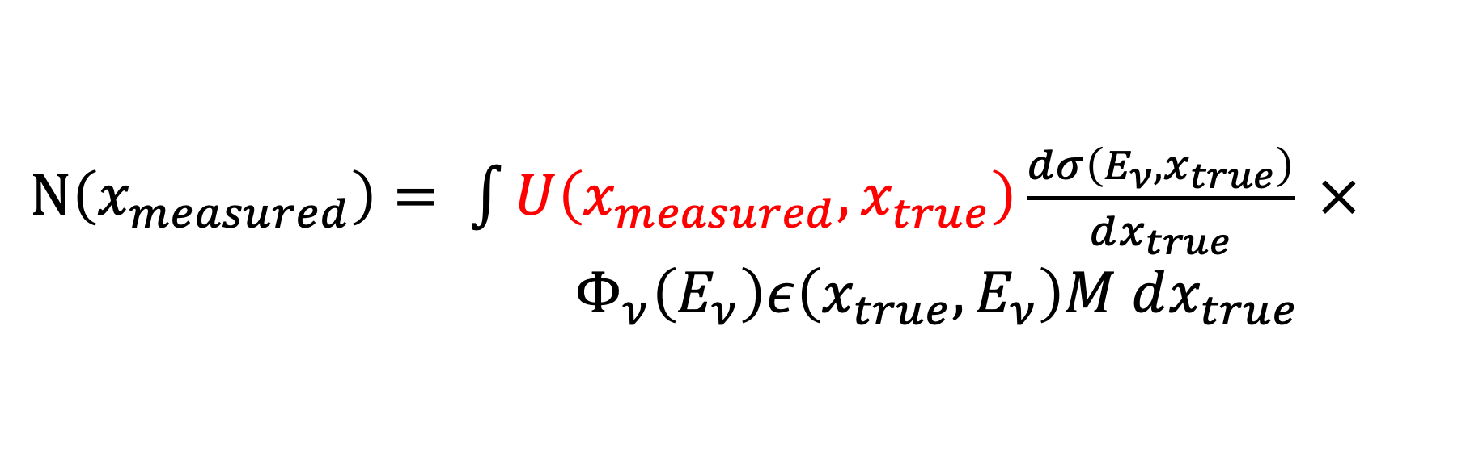
How to measure a cross section
From the equation: $N\left(x_{true}\right)=\frac{dσ\left({E_{ν},x}_{true}\right)}{dx_{true}}Φ_{ν}\left(E_{ν}\right)ε\left({x_{true},E}_{ν}\right)M$
$N\left(x_{measured}\right)= \int{U\left(x_{measured},x_{true}\right)\frac{dσ\left({E_{ν},x}_{true}\right)}{dx_{true}}} ×{ Φ}_{ν}\left(E_{ν}\right)ε\left({x_{true},E}_{ν}\right)M$ $dx_{true}$
U written this way is a “smearing” step that translates
from the true quantity to a reconstructed quantity

Slide 23
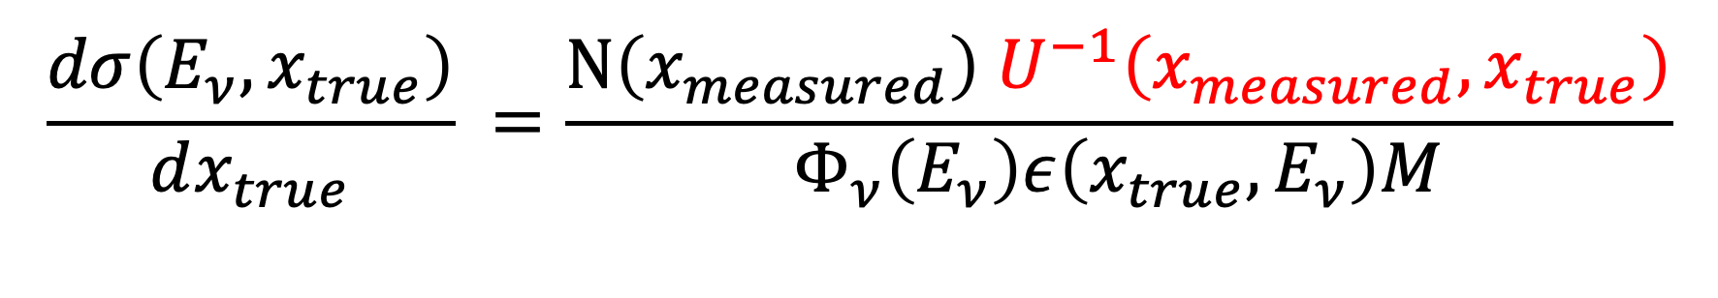
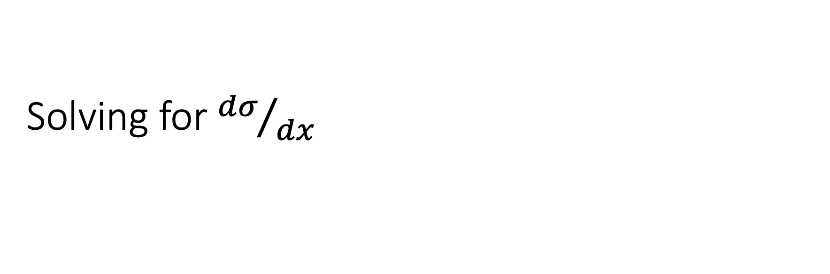
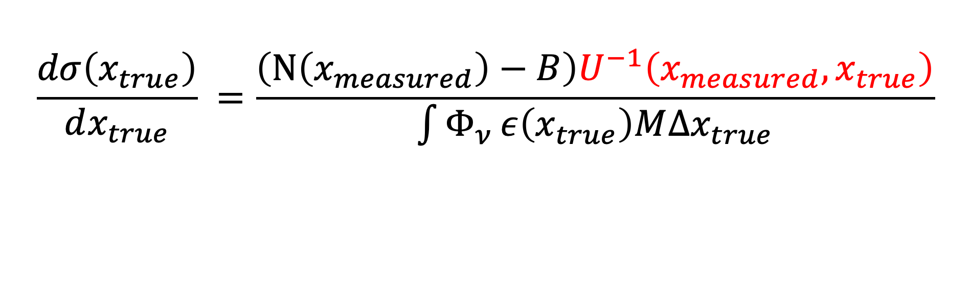
Solving for ${dσ}/{dx}$
$$\frac{dσ\left({E_{ν},x}_{true}\right)}{dx_{true}} =\frac{N\left(x_{measured}\right) U^{−1}\left(x_{measured},x_{true}\right)}{Φ_{ν}\left(E_{ν}\right)ε\left({x_{true},E}_{ν}\right)M}$$
And in real life, there are backgrounds: not every event you select is going to be the signal process you are looking for!
Integrate over the entire flux to find:
$$\frac{dσ\left(x_{true}\right)}{dx_{true}} =\frac{\left(N\left(x_{measured}\right)−B\right)U^{−1}\left(x_{measured},x_{true}\right)}{\int{Φ_{ν}}ε\left(x_{true}\right)M∆x_{true}}$$

Slide 24

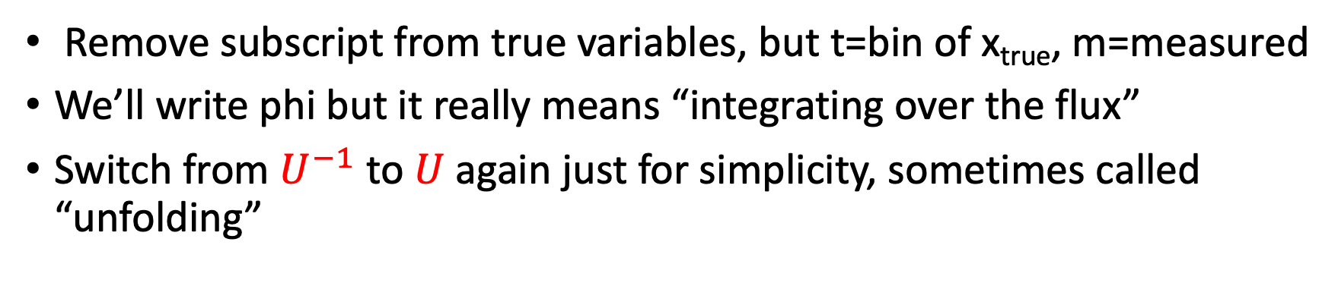
Measuring Cross Sections: Simplify notation
Remove subscript from true variables, but t=bin of x_{true}, m=measured
We’ll write phi but it really means “integrating over the flux”
Switch from $U^{−1}$ to $U$ again just for simplicity, sometimes called “unfolding”
$$\frac{dσ\left(x_{t}\right)}{dx_{t}} =\frac{\left(N\left(x_{m}\right)−B(x_{m})\right) U_{mt}}{Φ_{ν}ε\left(x\right)M∆x}$$
Deconstruct this piece by piece, from the easiest to the most complicated:

Slide 25
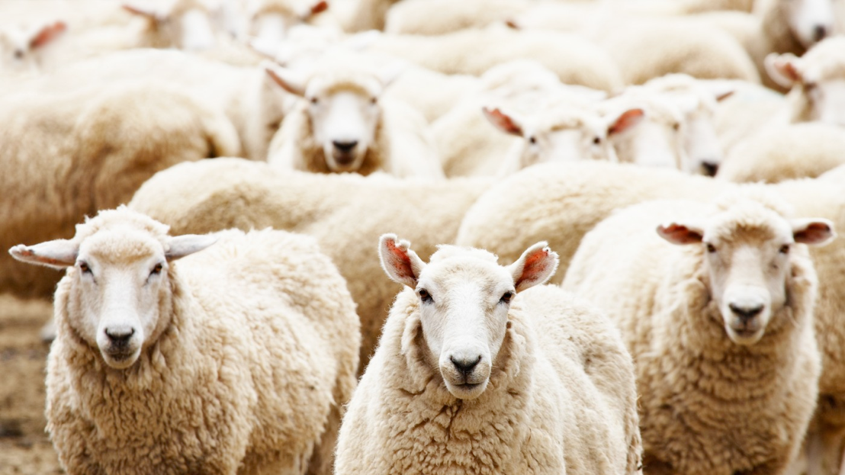

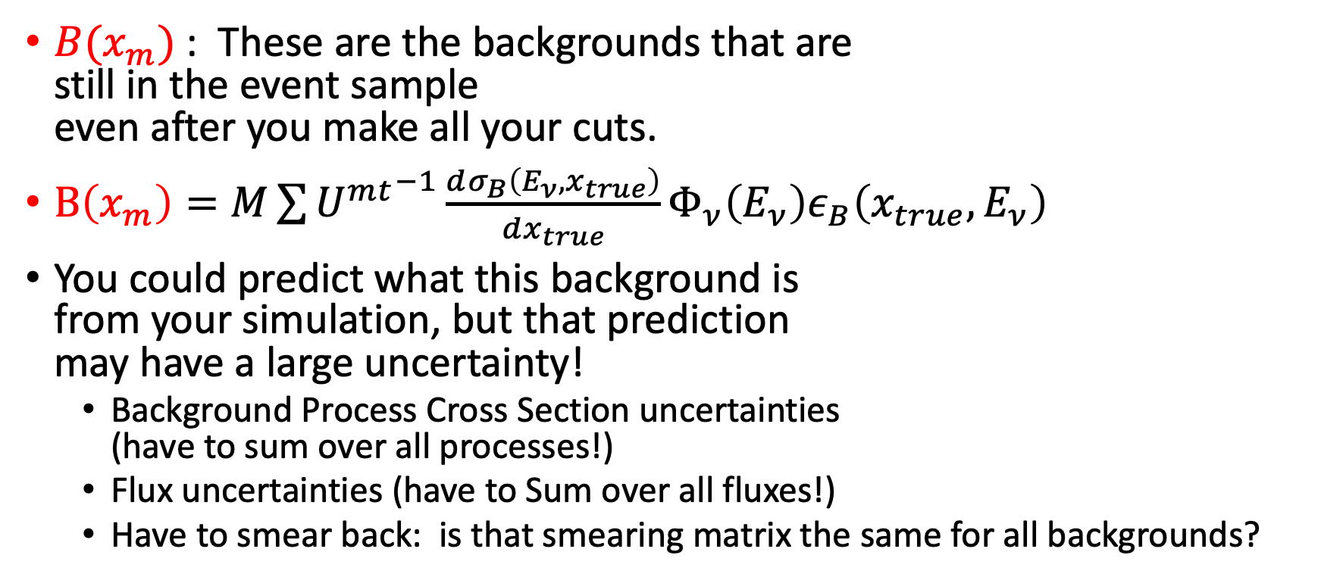

$$\frac{dσ\left(x_{t}\right)}{dx_{t}} =\frac{\left(N\left(x_{m}\right)−B(x_{m})\right) U_{mt}}{Φ_{ν}ε\left(x_{t}\right)M∆x}$$
$B(x_{m})$: These are the backgrounds that are
still in the event sample
even after you make all your cuts.
$B\left(x_{m}\right)=M\sum{{U^{mt}}^{−1}\frac{dσ_{B}\left({E_{ν},x}_{true}\right)}{dx_{true}}Φ_{ν}\left(E_{ν}\right)ε_{B}\left({x_{true},E}_{ν}\right)}$
You could predict what this background is
from your simulation, but that prediction
may have a large uncertainty!
  Background Process Cross Section uncertainties
  (have to sum over all processes!)
  Flux uncertainties (have to Sum over all fluxes!)
  Have to smear back: is that smearing matrix the same for all backgrounds?
Signal
Background

Slide 26
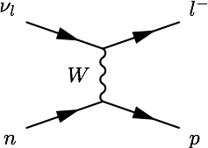
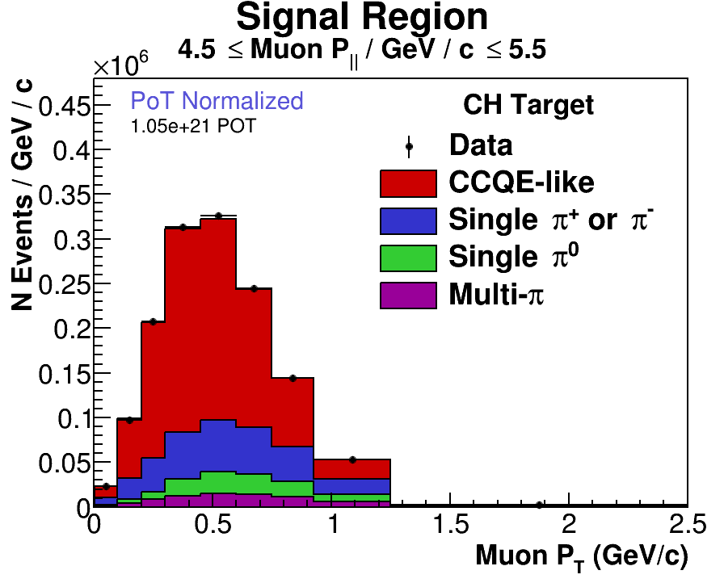
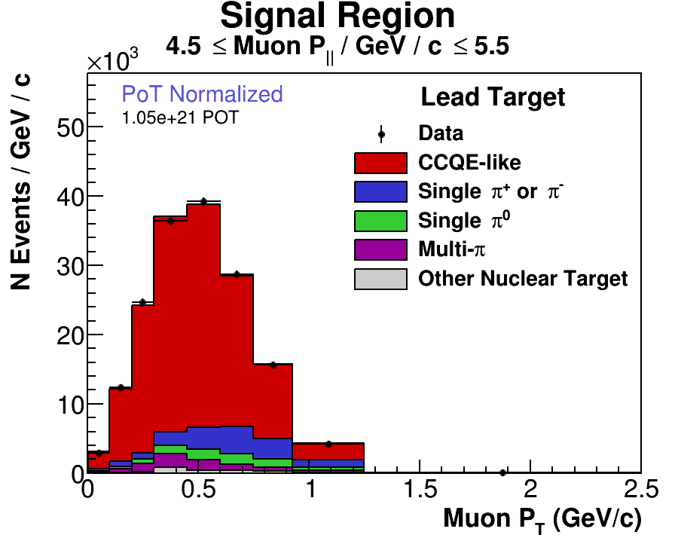
Using data to predict B(x_{m})
Quasi-elastic neutrino scattering should
have an easily-identifiable signature:
one muon and one proton
Example from MINERvA:
if you only require a
muon (p>1.5GeV/c)
and NO other
energy deposits far
from the nucleus,
no Michel electron,
here are the backgrounds:
Phys.Rev.Lett. 130 (2023) 16, 161801

Slide 27
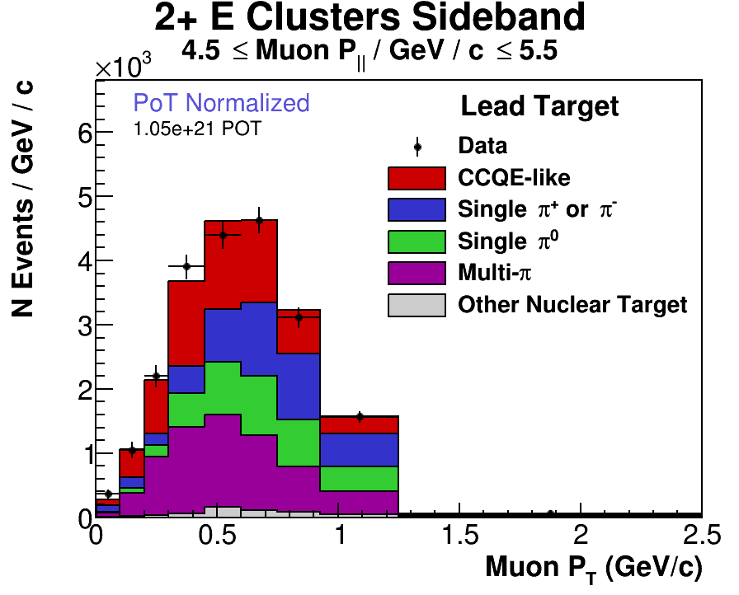
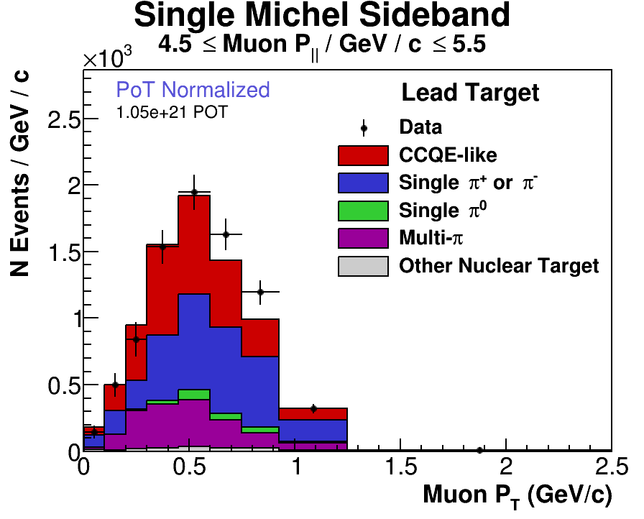
Using Data to predict B(x_{m})
Remember: the CCQE process is probably the best known neutrino-nucleus process, how could you trust your simulation to tell you the background levels?
Solution: Use the data itself, but try to isolate each background by looking at the events you REMOVED from the signal process
How to find events with π⁺?
How to find events with π⁰?
Remember, red is signal: can’t always find event samples that have all one background, or no signal events in them…
Phys.Rev.Lett. 130 (2023) 16, 161801

Slide 28
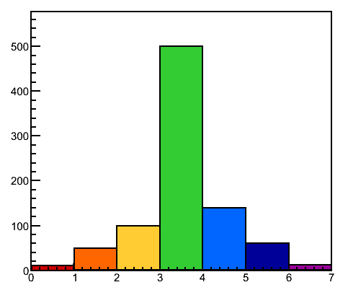
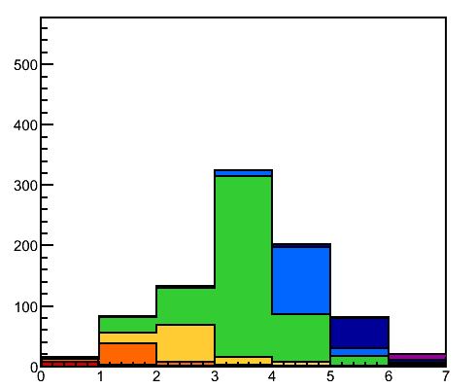
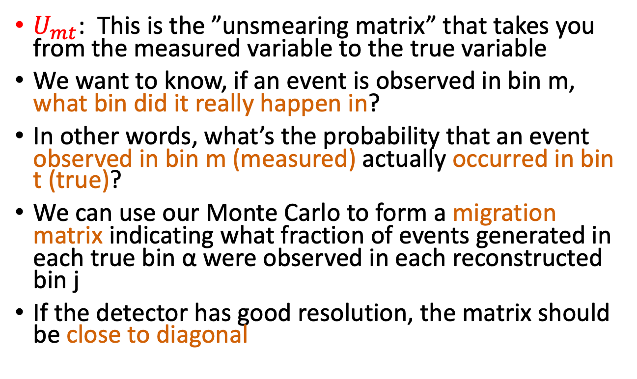

$$\frac{dσ\left(x_{t}\right)}{dx_{t}} =\frac{\left(N\left(x_{m}\right)−B(x_{m})\right) U_{mt}}{Φ_{ν}ε\left(x_{t}\right)M∆x}$$
True distribution
$U_{mt}$: This is the ”unsmearing matrix” that takes you from the measured variable to the true variable
We want to know, if an event is observed in bin m, what bin did it really happen in?
In other words, what’s the probability that an event observed in bin m (measured) actually occurred in bin t (true)?
We can use our Monte Carlo to form a migration matrix indicating what fraction of events generated in each true bin α were observed in each reconstructed bin j
If the detector has good resolution, the matrix should be close to diagonal
Reconstructed (smeared)
distribution
Graphics courtesy C. Patrick

Slide 29
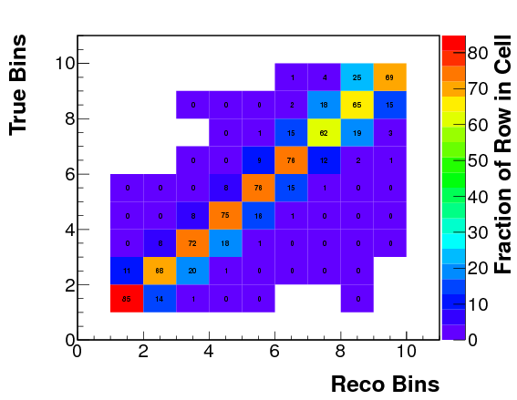
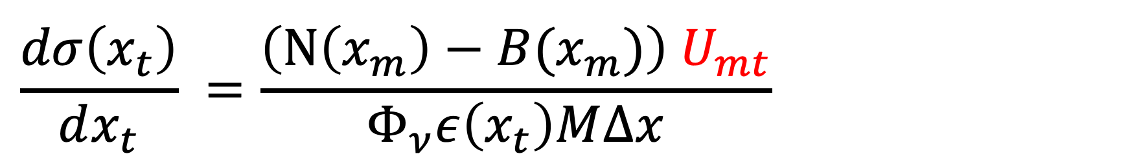
$$\frac{dσ\left(x_{t}\right)}{dx_{t}} =\frac{\left(N\left(x_{m}\right)−B(x_{m})\right) U_{mt}}{Φ_{ν}ε\left(x_{t}\right)M∆x}$$
Diagonal corresponds to events reconstructed in the right bin
Each row adds up to 100%
“Migration Matrix”
To get the unsmearing
matrix U_{tm}, you have to invert the migration matrix
…in theory. In practice, it often gives poor results and we often need to use a more sophisticated method
Graphics courtesy C. Patrick

Slide 30





T2K: Letting $U_{mt}$ vary
T2K: Showing 3 out of 5 samples
“CC0π” Analysis for ν_{μ}
Try to get as many μ as possible!
Phys.Rev.D 101 (2020) 11, 112001

Slide 31





T2K: Letting $U_{mt}$ vary
In order to incorporate systematic uncertainties on cross section model, T2K parameterizes the uncertainties and then lets them float in a fit that incorporates not only the signal region but also two control samples
Jesus-Valls, NuINT 2022, and Phys.Rev.D 101 (2020) 11, 112001

Slide 32
T2K: Letting $U_{mt}$ vary
In order to incorporate systematic uncertainties on cross section model, T2K parameterizes the uncertainties and then lets them float in a fit that incorporates not only the signal region but also two control samples
Jesus-Valls, NuINT 2022, and Phys.Rev.D 101 (2020) 11, 112001

Slide 33



$$\frac{dσ\left(x_{t}\right)}{dx_{t}} =\frac{\left(N\left(x_{m}\right)−B(x_{m})\right) U_{mt}}{Φ_{ν}ε\left(x\right)M∆x}$$
$Φ_{ν}$: Flux [neutrinos/cm²]
Usually the cross section is reported assuming you’ve integrated over all neutrino energies: so $Φ$ really means
$Φ_{ν}=\frac{{\int{dE_{ν}}Φ}_{ν}\left(E_{ν}\right)}{\int{dE_{ν}}}$
For the rare cases where neutrino energy is measurable
Total Cross Section:
$σ\left(E_{ν}\right)$= $\frac{\left(N\left(E_{ν}\right)−B(E_{ν})\right) U_{mt}}{Φ_{ν}(E_{ν})ε\left(E_{ν}\right)M}$

Slide 34



$$\frac{dσ\left(x_{t}\right)}{dx_{t}} =\frac{\left(N\left(x_{m}\right)−B(x_{m})\right) U_{mt}}{Φ_{ν}ε\left(x_{t}\right)M∆x}$$
$ε\left(x_{t}\right)$: Efficiency [unitless]
The fraction of signal events that you
retain after making all the analysis cuts
to remove your backgrounds
In truth, this efficiency may depend not only on x_{t}
but also on neutrino energy, and
remember you’re integrating over the flux
$ε\left(x_{t}\right)=\frac{\int{{ε\left(x_{t},E_{ν}\right)Φ}_{ν}dE_{ν}}}{\int{Φ_{ν}dE_{ν}}}$
One way to check: Compare efficiencies from
different generators
(Ref: T2K, Phys.Rev.D 98 (2018) 3, 032003)

Slide 35




NOvA: Using Data to test $ε\left(E_{hadronic}\right)$
NOvA has produced first double differential cross section for electron neutrino charged current inclusive scattering
Use Boosted Decision Tree to identify electrons
How do they know that they model the efficiency of the BDT correctly given uncertainties in hadron energy? Use the Data! Can you guess how?
“Muon Removal” Technique:
remove muon from ν_{μ}CC data
events, add electron at same
angle and energy, then measure
efficiency, and compare to
the efficiency for original simulation.
Phys.Rev.Lett. 130 (2023) 5, 051802

Slide 36




$$\frac{dσ\left(x_{t}\right)}{dx_{t}} =\frac{\left(N\left(x_{m}\right)−B(x_{m})\right) U_{mt}}{Φ_{ν}ε\left(x\right)M∆x}$$
100 bins
$∆x$: Bin width [units of whatever x is]
How wide should this bin width be?
The more bins you have, easier to distinguish features of the distribution
The more bins you have, the worse the statistics are in each bin
BUT…Depends on your resolution: if you can’t measure something to better than δ , you shouldn’t pick bins that are δ/10!
10 bins
Graphics courtesy C. Patrick

Slide 37

Break, now that we’ve discussed every term in
$\frac{dσ\left(x_{t}\right)}{dx_{t}} =\frac{\left(N\left(x_{m}\right)−B(x_{m})\right) U_{mt}}{Φ_{ν}ε\left(x\right)M∆x}$

Slide 38

Easiest Cross Section to measure:
“Inclusive Charged Current Interactions”
Say you want to measure total Charged Current neutrino cross section
What cuts would you use to isolate your signal?
  Require a muon-like energy or an electron-like energy
  If you have a magnetic field, might be able to cut on charge of final state lepton
What are your backgrounds?
  Antineutrino interactions (low if you have a B field)
  Neutral Current Interactions
    For muon neutrinos: $π^{+}→μ^{+}(+ν_{μ})$
    For electron neutrinos: $π^{0}→γγ$ and recall that $γ$ might look like electrons in your detector
Easiest Observables to measure: Muon Kinetic Energy (T) and angle (θ) w/rt Neutrino beam

Slide 39
One example of Inclusive Cross Section Result
NOvA ν_{μ}CC Cross Section Result, vs. muon kinematics
Phys.Rev.D 107 (2023) 5, 052011
Even for a narrow range of neutrino energy (like NOvA) any one kinematic region still has a range of interactions that contribute.

Slide 40
The Catch with Inclusive Cross Sections
NOvA ν_{μ}CC Cross Section Result, vs. muon kinematics
Phys.Rev.D 107 (2023) 5, 052011
Even for a narrow range of neutrino energy (like NOvA) any one kinematic region still has a range of interactions that contribute.

Slide 41
Using both Lepton and Hadron Information
Let’s say you have measured the following quantities:
  Final lepton charge and momentum 3-vector: can determine p_{lep}, E_{lep} ,θ_{lep}
  Total hadronic energy
  (pretend you can see all of it, even the neutron energy) E_{had}
Can define a few quantities:
  Estimated Neutrino Energy E_{ν} = E_{lep} + E_{had}
  Estimated Momentum Transfer (squared) to the nucleus:
  (remember, W is virtual) -q²=Q² = 2 E_{ν}(E_{μ} – p_{μ}cos θ_{μ}) – M_{μ}²
  Estimated Energy transferred to the nucleus = ω = E_{had}
  3-momentum transferred to the nucleus: Q²+ω²=q₃²

Slide 42




Neutrino Observables w/hadrons & leptons
Remember this picture from e⁻ scattering: e⁻
beam (energy E) comes in, scatters, you measure
the outgoing electron energy distribution (E’) at
some angle, and ω=E-E’
d²σ/dΩ/dω (nb/GeV/sr)
d²σ/dΩ/dω (nb/GeV/sr)
d²σ/dΩ/dω (nb/GeV/sr)
ω (GeV)
ω (GeV)
ω (GeV)
Phys. Rev. D 94, 013012 (2016)
Notes:
You saw the middle plot in S. Dolan’s lecture. I’m showing it at three angles

Slide 43

Neutrino Observables w/hadrons & leptons
Translating this picture to Neutrino Scattering
Graphics courtesy R. Gran
Initial and Final Electron energy and angle define a 3-momentum transfer
For neutrinos:
True Energy transfer: ω
True 3-momentum transfer: Q²+ω²=q₃²
d²σ/dΩ/dω (nb/GeV/sr)
ω (GeV)
Phys. Rev. D 94, 013012 (2016)

Slide 44

Proxy for True Energy transfer to Hadronic system: “Available Energy” (answer to HW#4)
Visible in scintillator (and argon)
π⁺⁻ deposit their kinetic energy, but not their mass
π⁰ deposit their total energy
Protons: deposit total kinetic energy
Neutrons: deposit very little.
“Available energy”: sum of visible energy
Kinetic energy
Kinetic energy
p
_{π}+
n
_{π}0
~0
Total energy
Example from MINERvA at right,
3.3cm plastic granularity
Similar in spirit to ~3cm wire pitch Liquid Argon (but different density, Z)
Figure courtesy P. Rodrigues
Phys. Rev. D 94, 013012 (2016)
Notes:
You saw the middle plot in S. Dolan’s lecture. I’m showing it at three angles

Slide 45





What does the Data Look like in this space?
$q0$ vs. $\left|\vec{q3}\right|$
Look at inclusive sample of events as function of energy AND momentum transferred
Showing event distributions, but cross sections were extracted
Cross sections were also extracted from these distributions
Available Energy: “visible” energy in scintillator
Unfolding this was tricky!
M. Ascencio et al, Phys.Rev.D 106 (2022) 3, 032001

Slide 46
From Inclusive to Exclusive
From these event displays, you know we can do better to isolate processes and look at only one (set of) final states
How would you isolate events that are quasielastic?
  Require one lepton (of the correct charge if possible)
  Do you require a proton track? Or do you only require NO pion tracks?
  What about Michel Electrons: what if you didn’t see a pion track but you saw a tiny em-like shower right near the vertex?

Slide 47


New vocabulary: Quasielastic-like
After subtracting backgrounds, MINERvA has enough statistics to bin QE-like events along 3 axes: muon kinematics AND hadron energy
Many processes contribute to ”CC0$π$ ”
  CCQE
  2p2h
  Resonance+π absorption
  DIS
Lots of discrepancies with the model
D. Ruterbories et al, Phys.Rev.Lett. 129 (2022) 2, 021803

Slide 48


Different Detectors will have different cuts
MicroBooNE example: ν_{μ} CC0π Cross section
Event with muon and proton candidate
Leading Muon candidate has p>100MeV/c
Leading Proton candidate has p<1.2GeV/c
  Proton candidate has to be shorter than
  muon candidate
Phys.Rev.D 102 (2020) 11, 112013

Slide 49


CCQE versus “CCQE-like” versus “CC0π”
Since so many other processes can look like a CCQE event even if you have a perfect detector, we have defined a new term
How would you make a CCQE-like event that is not CCQE?
Example from MicroBooNE: breakdown of signal events after background subtraction:
Phys.Rev.D 102 (2020) 11, 112013

Slide 50
Have to map on to Cross Section Models
Quasielastic Scattering
2p2h (correlated nucleon pairs) Scattering
Resonant Pion Production (Δ’s, etc.)
Continuum Pion Production
Coherent Pion Production
Shallow Inelastic Scattering (?)
Deep Inelastic Scattering
Plus models for initial and final state effects
S. Dolan, INSS 23

Slide 51


QE-like processes and Unfolding Neutrino Energy
Solution to Homework #3: QE assumption, solve for Neutrino Energy

Slide 52

What if you were to unfold to Neutrino Energy?
The energy resolution you get using this formula (or ANY FORMULA) depends on what you assume about the events that pass all your cuts
Plot at right is for T2K, one of their earliest oscillation papers
Phys.Rev.Lett. 112 (2014) 18
Moral of this story: Big model dependence in unfolding to Neutrino Energy

Slide 53



New Neutrino Observables:
Transverse Kinematic Imbalance (TKI)
If you know you’re starting with a neutrino, and you see a muon and a proton in the final state, you can calculate kinematics in the plane transverse to the neutrino direction if you measure 3-vector of both final state particles, and you are SURE they are a muon and a proton
Phys. Rev. C 94, (2016) 015503

Slide 54



New Neutrino Observables:
Transverse Kinematic Imbalance (TKI)
Hopefully all these different variables will give you a consistent story about what all the different quasielastic-like processes might be there in your data
(T2K, Phys.Rev.D 98 (2018) 3, 032003)

Slide 55

MicroBooNE: Looking at TKI in 2 dimensions
MicroBooNE split these distributions up into
“QE-rich” samples and “everything else” samples
Plus: Another tool of the trade: “Fake Data Studies”
  Put in different
  interaction models
  see if your procedure
  extracts predictions
  from
  the new model
  or the one in your
  unfolding matrix
Phys.Rev.D 108 (2023) 5, 053002

Slide 56


”Initial Nucleon Momentum” as observable?
Another “transverse kinematic imbalance variable”: if you assume conservation of momentum for events with a final state proton and muon, can calculate the initial nucleon momentum
MINERvA Phys. Rev. Lett. 121, 022504 (2018)

Slide 57
Challenges
Goal: make measurements that can constrain models
Why is this difficult?
  Given the flux, you never know precisely what neutrino energy you have for any one event
  Given the analysis cuts to isolate the signal you are trying to find, the detector limitations mean you may have backgrounds in your sample
  Given detector limitations you never know precisely what energy you missed from neutrons
  If that’s not bad enough, there’s also the fact that nuclear effects can make one process look like another even if your detector was perfect

Slide 58
If only we could measure a cross section on H first…

Slide 59




Using what you’ve learned to see H by itself
Consider antineutrino QE-like scattering:
  ${\overline{ν}}_{μ}+p→μ^{+}+n$
  If you have a
  plastic target,
  you have C and H
  If you are trying
  to measure CCQE
  on H, then
  CCQE on C is a
  background
  Use nuclear effects
  to isolate H!
Nature, 614, 48–53 (2023)

Slide 60


When life gives you lemons… make lemon meringue pie

Slide 61




Different Reactions populate different regions
Background: QELike CCQE (on C)
SIGNAL: Elastic on H
Regions of the 2D angular distribution used to fit the backgrounds proportion in the signal region.
Background: QELike 2p2h
Background: QELike Resonant
NuFact23

Slide 62

Validating the Background Prediction
CCQE is the dominant background. Small 2p2h, inelastic (absorbed), and Non-QELike contributions. The fitted model are well constrained by data.
NuFact23

Slide 63


Another test: Neutrino Beam
  $$ν_{μ}+n→μ^{−}+p$$
Recipe: select events with trackable protons in a neutrino sample. Different final states and available kinematics. Apply same fitting mechanism. Data and MC mostly agree within uncertainty. Data and MC mostly agree. Disagreement can be explained by 2p2h uncertainty.
NuFact23

Slide 64



Cross-section Extraction
[Nature 614, 48–53]
[Nature 614, 48–53]
Ingredients:
Unfolding matrix and efficiency from Data and Simulation studies
Flux from models and data measurements ($νe→νe$)
Number of Hydrogen targets from the detector assay.
Measured signal from data – predicted background
NuFact23

Slide 65


Uncertainties in the Axial Form Factor Cross-Sections
Dominated by statistical uncertainty after the background subtraction.
Systematic uncertainties from residuals of background subtraction
Particle responses in the “other” category, dominated by neutron systematics.
Always
ask
to see
uncertainties!
NuFact23

Slide 66




Free Nucleon Axial Form Factor
MINERvA found ~5800 such events on a background of ~12500.
Shape is not a great fit to a dipole at high Q².
LQCD prediction at high Q² is close to this
result, but maybe not at moderate Q².
$$dσ/dQ^{2}$$
$$dσ/dQ^{2}$$
$$F_{A}(dQ^{2})$$

Slide 67

How to summarize this field?
Want to cover “current cross sections” but…
Consider the various combinations: 6x4x5x6
Observable (x_{m})
Lepton Kinematics
Q²
q_{0 vs} q₃
Proton Kinematics
Pion Kinematics
Transverse Kinematic Imbalance variables (many)
“Neutrino Energy”
Interaction
Inclusive Scattering
CC 0 π Production
CC 1π⁺ Production
CC 1π⁰ Production
CC Shallow or Deep Inelastic Scattering
Rare Chanels (ν-e, coherent scattering)
Target Nucleus
CH
H₂O
H, He, C, Pb
Ar
Pb
Flavour, Helicity
$$ν_{μ}$$
$${\overline{ν}}_{μ}$$
$$ν_{e}$$
$${\overline{ν}}_{e}$$
Number of Dimensions
1
2
3

Slide 68

Summary of This Lecture
$$\frac{dσ\left(x_{t}\right)}{dx_{t}} =\frac{\left(N\left(x_{m}\right)−B(x_{m})\right) U_{mt}}{Φ_{ν}ε\left(x_{t}\right)M∆x}$$
So many interactions, so little time!
Measuring Cross Sections all use the same formula
Challenges with making a robust measurement
  Flux
  Detector
  Cross section
Clever ideas of new observables and ways to reduce backgrounds
are yours to discover!
All the tricks we’ve figured out to isolate different effects in Quasielastic interactins, we have to figure out for pion production!
Notes:
If you look at the Technical design report, you will NOT see the techniques MINERvA used to make its most impactful results!

Slide 69
Backup Slides

Slide 70


$$\frac{dσ\left(x_{t}\right)}{dx_{t}} =\frac{\left(N\left(x_{m}\right)−B(x_{m})\right) U_{mt}}{Φ_{ν}ε\left(x\right)M∆x}$$
M: ”Mass” [nucleons] Sounds easy, right?
Cross sections are usually reported “per nucleon” so…
BUT, it depends on what cross section you are trying to measure: are you trying to measure something “per nucleon”?
What if you are measuring something that (in principle) only happens on neutrons? (i.e. $ν_{μ}+n→μ^{−}+p$ )
What if you are measuring something that (in principle) only happens on protons? (i.e. ${\overline{ν}}_{μ}+p→μ^{+}+n$ )

Slide 71




Full Disclosure on calculating “M”
For Liquid Argon detector, it’s very pure
so you can be sure the nucleus that is
struck is Ar
For Water, at least at Super-K or Hyper-K
those detectors are very pure H₂O
But scintillator-based
detectors may not
always
be all CH or CH₂:
for example NOvA:
N
Phys.Rev.D 107 (2023) 11, 112008
NOvA Image: https://doi.org/10.1016/j.nuclphysb.2016.04.027

Slide 72

Observables in Quasielastic Interactions
If you have a quasielastic interaction, and the initial nucleon is at rest, you can estimate the neutrino energy and momentum transfer from the lepton kinematics ALONE
This is how T2K makes its (most precise) oscillation measurements!
  Require ONLY one lepton in the final state
  Require conservation of energy and momentum
You may hear from Stephen and Luke why this is a problem, but it’s still an observable
Just don’t call it
true energy if
you are
scattering off a
big nucleus!

