Slide 1
CS Group 1985 - 1999:
Personal Memories
Denise Heagerty
CS Group 40th Anniversary Event, 1st Nov 2023

Slide 2
Outline
Email Services (1985 - 1988)
  Addresses
  Gateways
DECnet (1988 - 1998)
  Network connectivity
  Transition to DECnet Phase V
Internet Service (1994 – 1999)
  IPng (IPv6)

Slide 3
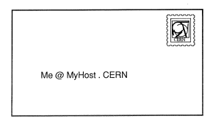
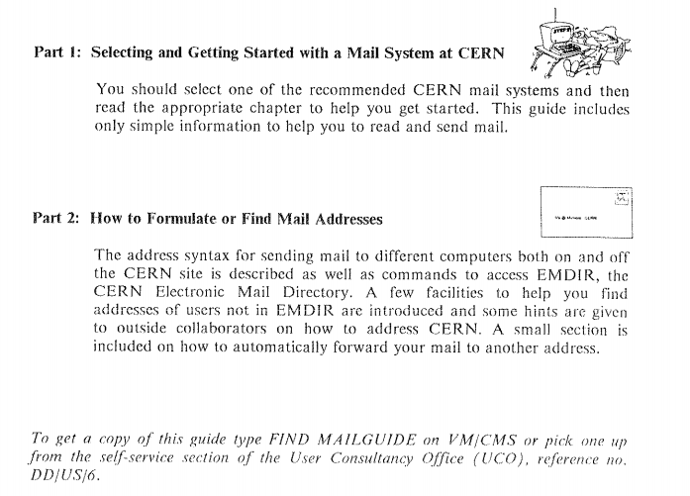
1988: Email User Guide
http://cds.cern.ch/record/1564613/files/64682.pdf

Slide 4
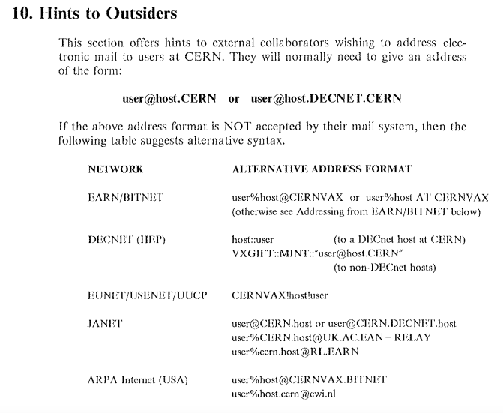
1988: Addressing E-Mail to CERN
http://cds.cern.ch/record/1564613/files/64682.pdf

Slide 5
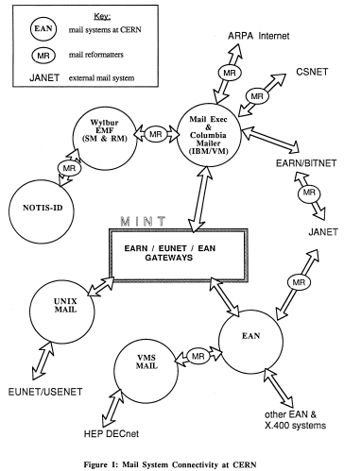
1987:
Mail Gateways at CERN
http://cds.cern.ch/record/182779/files/CM-P00059880.pdf

Slide 6
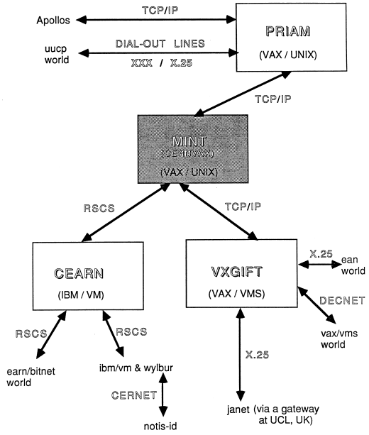
1987: CERN Network Connectivity
http://cds.cern.ch/record/182779/files/CM-P00059880.pdf

Slide 7

1986: A spy in the network

Slide 8
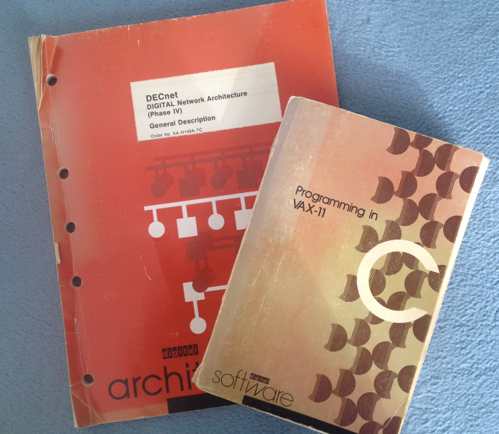
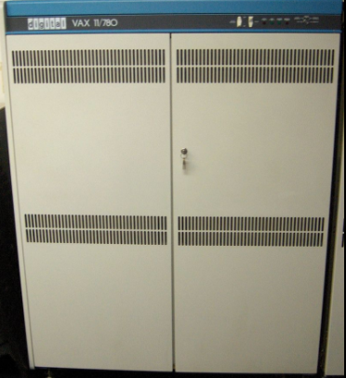
1988-2001: DECnet Service Management

Slide 9
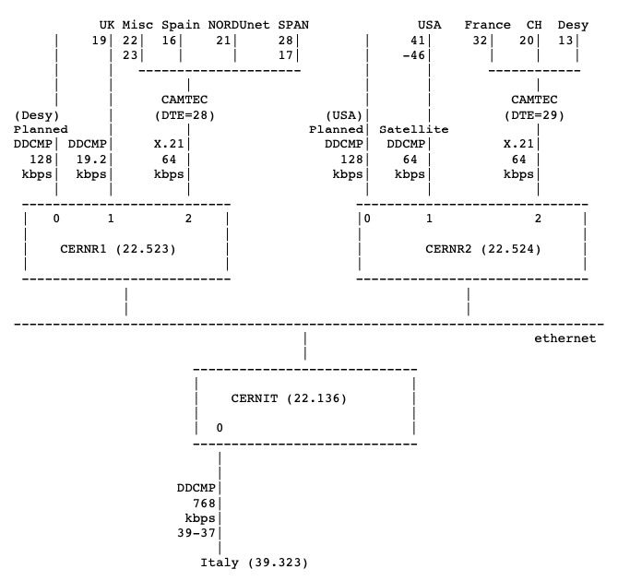
1990-1991: CERN DECnet configuration
https://www.w3.org/History/1992/nfs_dxcern_mirror/denise/Routers.txt

Slide 10
1991: DECnet documention in HTML
Extract from Recipes.txt file dated 30 May 1991 at:
https://www.w3.org/History/1992/nfs_dxcern_mirror/denise/
This document contains some information concerning the configuration of DECnet routers at CERN and some operational recipes for those without the time to read the detailed DECnet documentation. This information is for CERN internal use only. The following topics are covered:
How to reboot
Getting DECnet Node Numbers
Updating node name tables
Current Configuration for CERN DECnet Routers
Table of DDCMP circuits
DECnet circuits down

Slide 11
1990: Plans for DECnet Phase V
Why is DECnet Phase V needed?
  Rapid growth in the HEP/SPAN DECnet (20,000 nodes!)
  DECnet Phase IV has insufficient address space
  Lack of ‘Areas’ and ‘Node Numbers’
  ‘Hidden Areas’ are a common workaround
  Potential increased connectivity from running OSI standard protocols
DECnet Phase V introduces:
  A distributed naming service
  ISO network addresses
  ISO based routing protocols
  New network command language
http://cds.cern.ch/record/209639/files/CM-P00065576.pdf

Slide 12
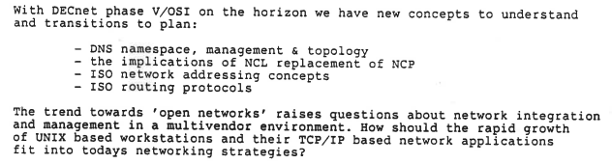
1990: DECnet Phase V & TCP/IP
Extract from DECUS (Switzerland) Newsletter, May 1990:

Slide 13
1993: European DECnet runs Phase V
Early 1993: DECdns distributed Name Service in operation
  Replacing static node name tables
Oct 1993: European circuits run Phase V protocols
  Between Italy, UK, DESY, PSI/CH and CERN
  USA continued to run Phase IV
1994: CERN internal DECnet routers run Phase V
VMS end nodes upgraded to later software versions
  VMS 6.1 (?)
  DECnet applications can use Phase V addresses (but never needed)
  DECnet applications can run over TCP/IP and use IPdns name service
https://cds.cern.ch/record/1292526/files/n-214.pdf

Slide 14
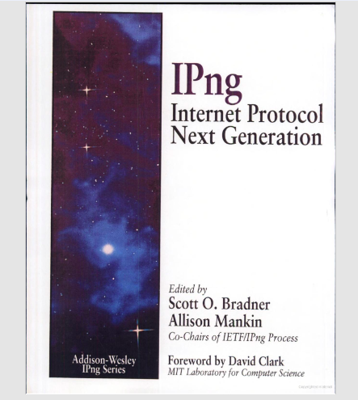
1994: The future network - IPng (IPv6)

