Slide 2


Wi-Fi @ CERN
CS 40th Anniversary
Adam SOSNOWSKI
adam.sosnowski@cern.ch

Slide 3


Agenda
Beginnings
External Wi-Fi cards
The Day which changed everything
Evolution
Revolution
Wi-Fi service at CERN
Future
Different challenges over the years
VDSL & Wi-Fi in LCH tunnel
Environment changes…
Not everyone likes Wi-Fi…

Slide 4
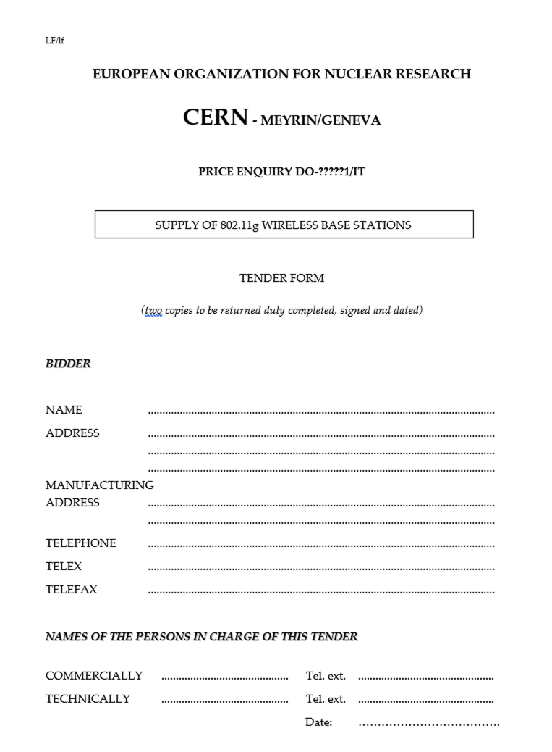

Beginnings
Adoption of 802.11 standard (up to 2 Mbit/s) -> 1997
Adoption of 802.11b standard (up to 11 Mbit/s) -> 1999
Adoption of 802.11a standard (up to 54 Mbit/s) -> 1999
Adoption of 802.11g standard (up to 54 Mbit/s) -> 2003
No one remembers when the first AP was deployed at CERN…
But tender was launched in 2003 to supply 802.11g APs
  Proxim Orinoco started to be deployed (802.11g & 802.11a)

Slide 5
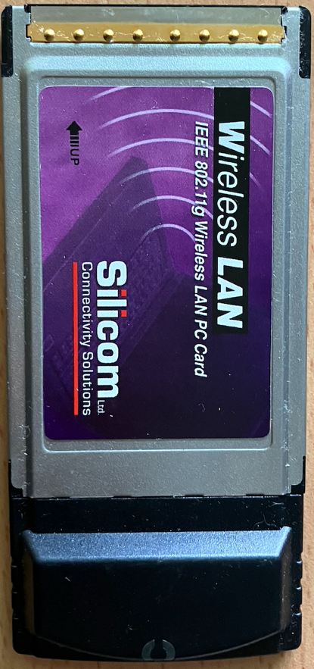
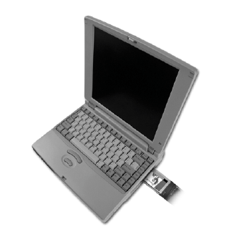
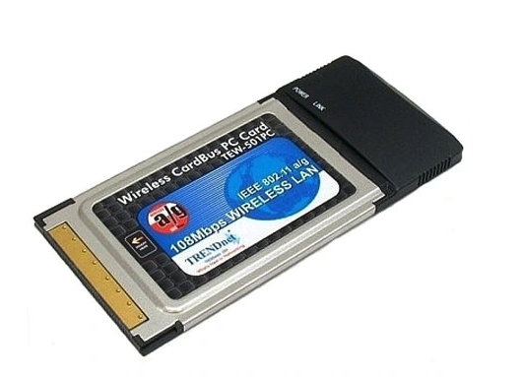

External Wi-Fi cards
At the beginning external PC Wi-Fi cards were used to interconnect machines to Wi-Fi network

Slide 6
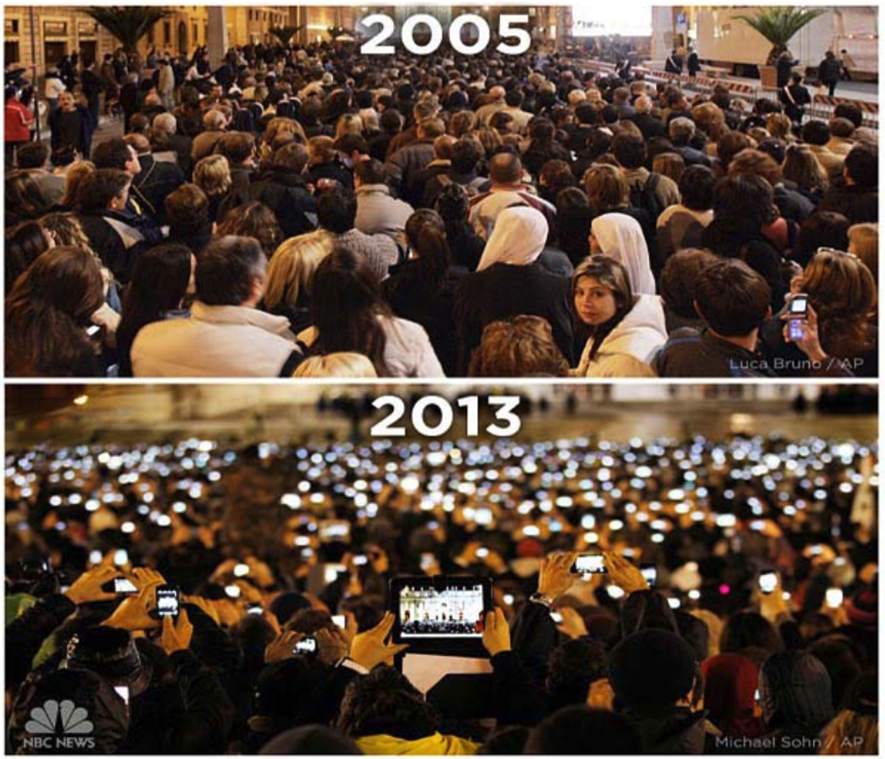
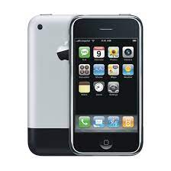
The Day which changed everything
Apple announces iPhone -> 2007
Things went fast afterwards…
  Global smartphone adoption
  Laptops without ethernet ports

Slide 7
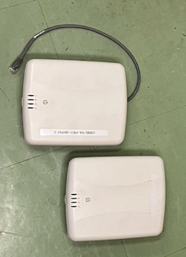
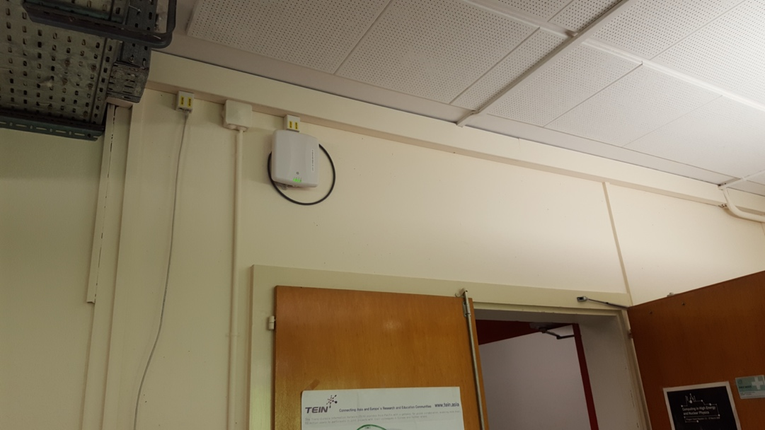
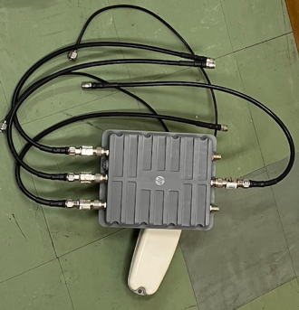
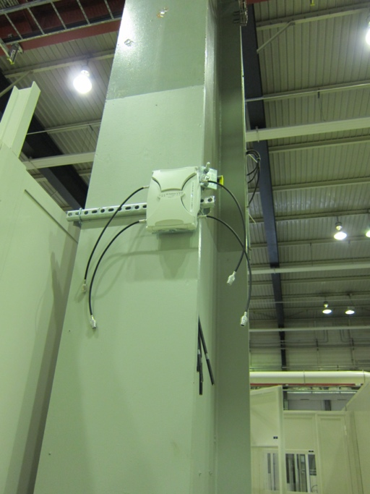
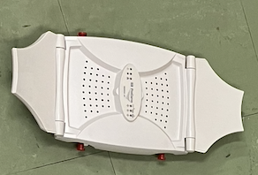
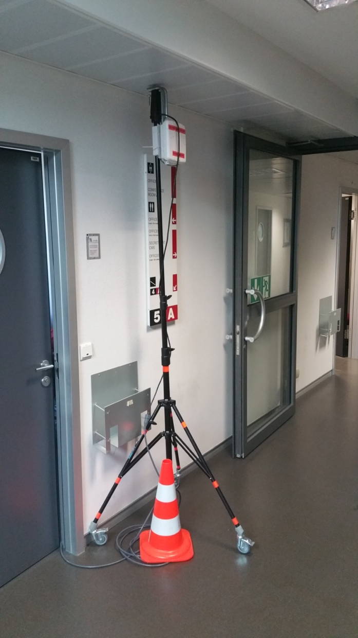

Evolution
Infrastructure based on 802.11n compatible HP APs
Structured deployment process
More than 1000 autonomous APs deployed across CERN campus around 2014
APs deployed on corridors of office buildings and in on-demand locations in technical areas
Central configuration and management developed in CFMGR
Manual channel and power assignment on the radios
WIND - Openlab project to develop monitoring tools for Wi-Fi infrastructure

Slide 8

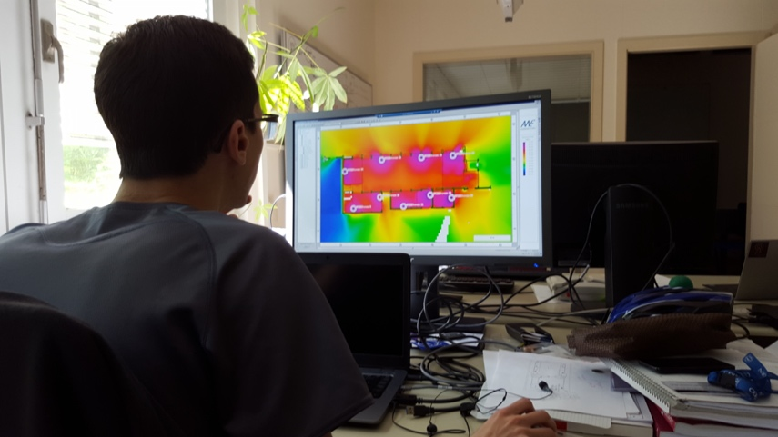
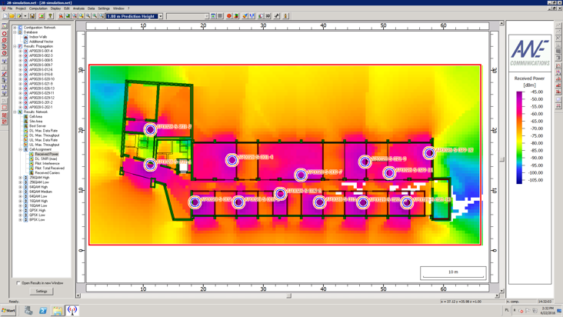
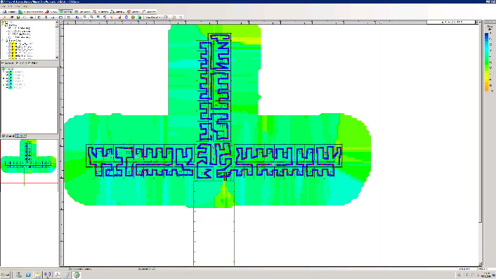
Revolution
Tender to supply Wi-Fi controller-based solution supporting 802.11ac standard was launched in 2015
Full coverage of all office buildings across CERN campus
High density coverage with APs inside offices (1 AP per 3 offices)
Dedicated cabling for Wi-Fi infrastructure
RF simulations, pre-deployment and post-deployment site surveys

Slide 9
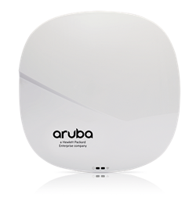
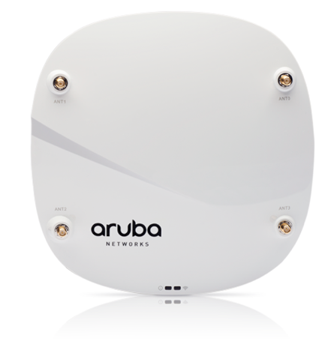
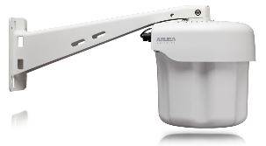
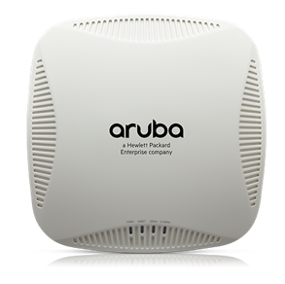
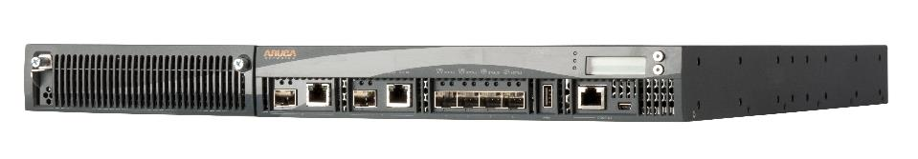
Revolution
Indoor
Outdoor

Slide 10
Wi-Fi service at CERN
200 fully covered buildings
Almost 300 dedicated switches
Around 8000 UTP outlets cabled
Around 250 000 m² covered (indoor)
Outdoor coverage for main pedestrian paths and CMS site
On demand coverage in underground areas
Up to 14,000 unique devices per day
More than 9,000 simultaneous users every day

Slide 11
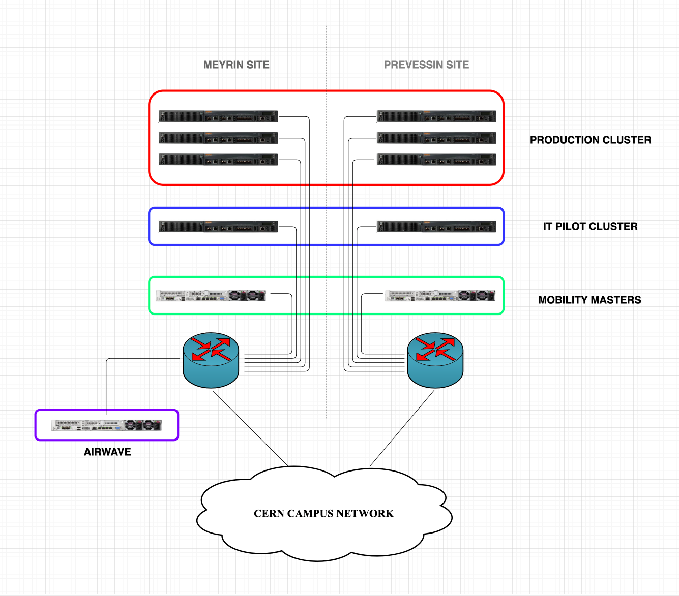
Wi-Fi service at CERN
2 zones across CERN campus
9 controllers
Around 5000 APs deployed
802.11ac and 802.11ax standards
3 SSIDs
  CERN
  eduroam
  CERN-Visitors
Roaming inside buildings and popular outdoor areas
Bluetooth IoT support
Additional monitoring with dedicated sensors

Slide 12

Future
Wireless is the future of campus network
Wireless tender will be launched to renew Wi-Fi infrastructure
The newest 802.11 standard
Adoption of new 6GHz band
Wireless Infrastructure
Tender
LT
Deployment

Slide 13

Different challenges over the years
Poor implementation of the 802.11 standards on users’ devices
Manual channel and power assignments
Interferences and rouge APs on 2.4GHz band
Moving people to 5GHz band
Problems with DFS channels
Management of huge network of autonomous APs
Underground deployments exposed on radiation
From coverage-oriented deployment to one focused on the capacity
Building automation for controller-based solution
Reliability of controller-based solution
Deliver enough electrical power to run Wi-Fi APs

Slide 14
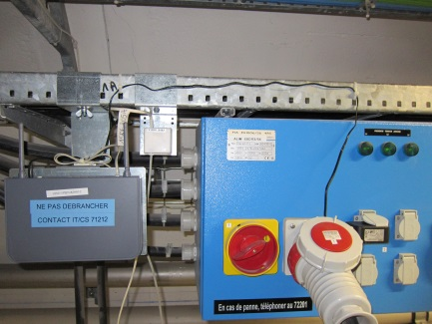
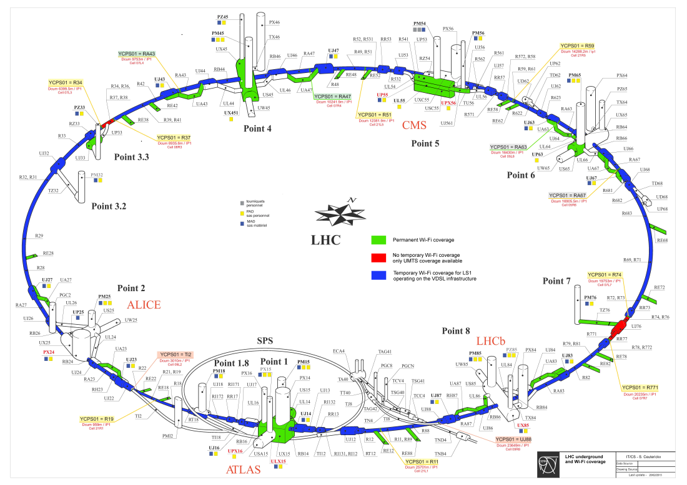
VDSL & Wi-Fi in LHC tunnel
A Wi-Fi/VDSL modem in LHC
VDSL2 : Very high bit rate Digital Subscriber Line version 2
Temporary Wi-Fi/VDSL modems deployment for the period of LS1
278 Wi-Fi/VDSL modems deployed in LHC tunnel
  802.11bgn (2.4GHz) up to 80Mbps half-duplex shared
GPN plugs available every 100m

Slide 15
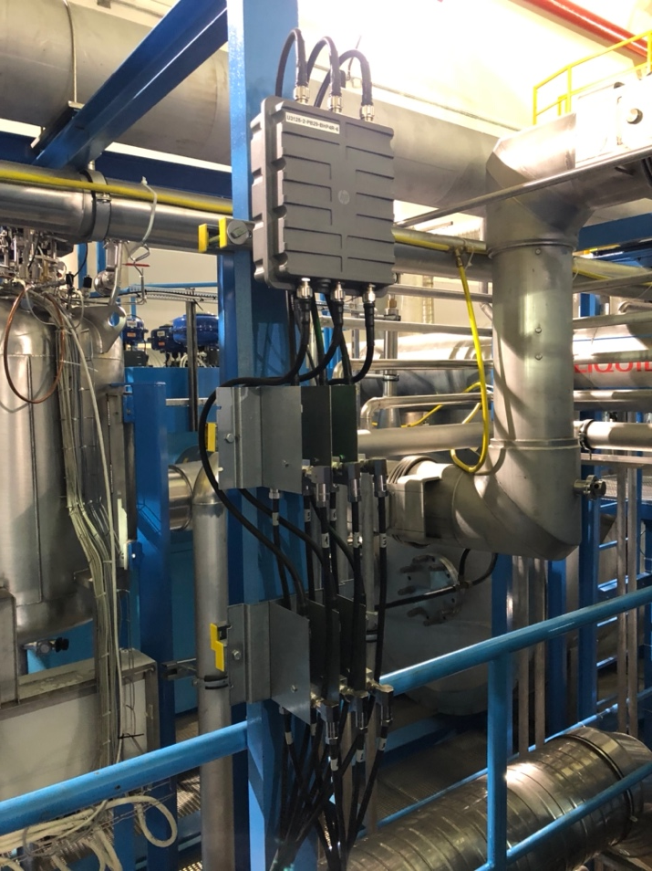
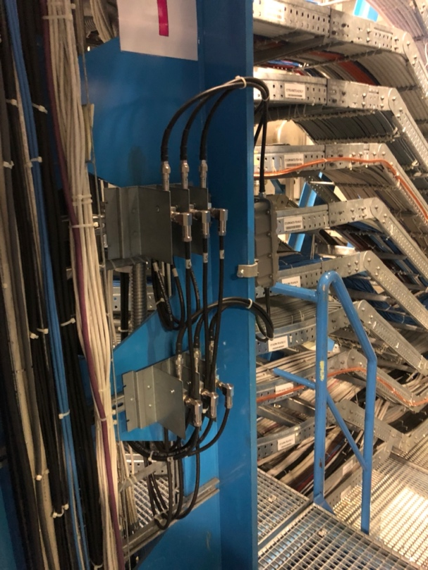
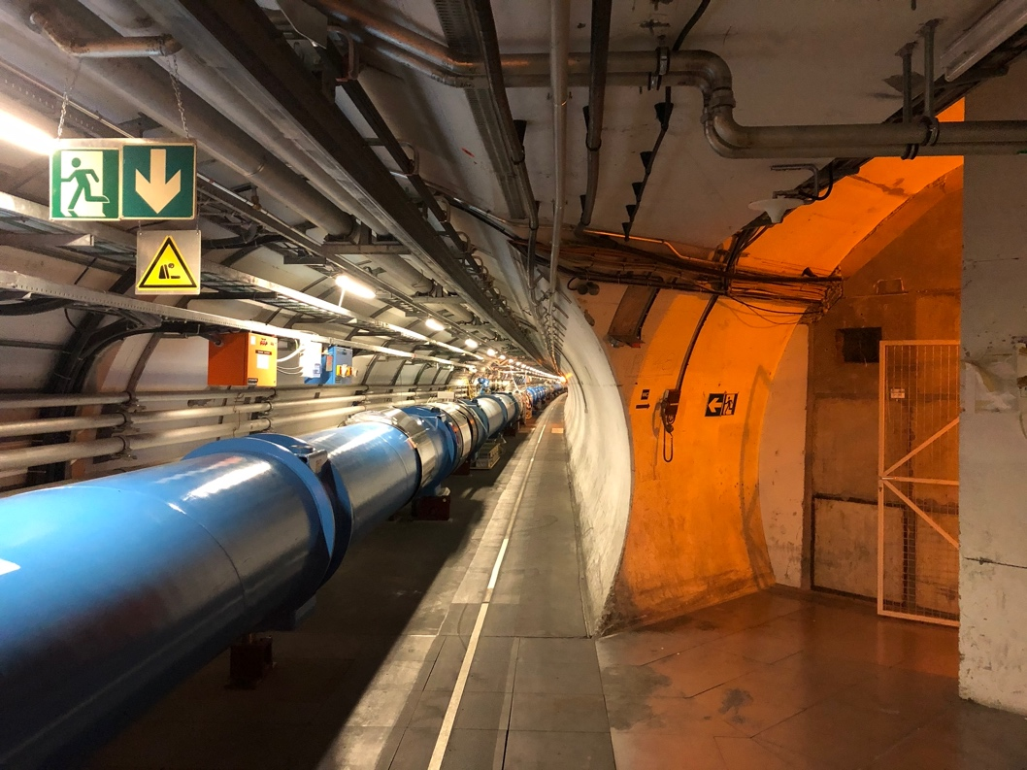
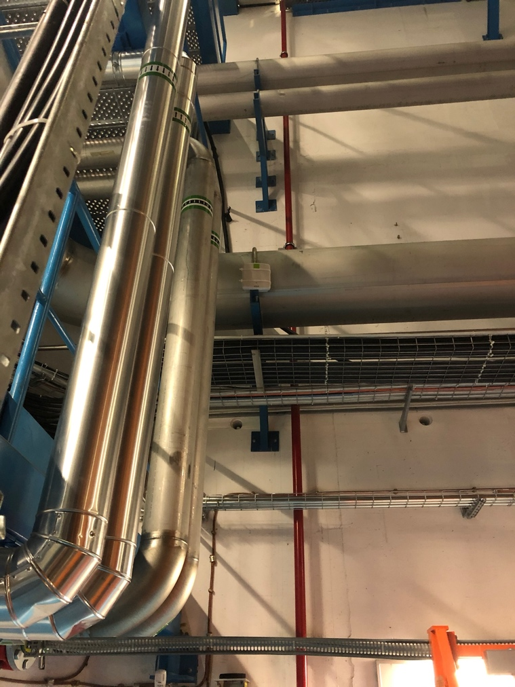
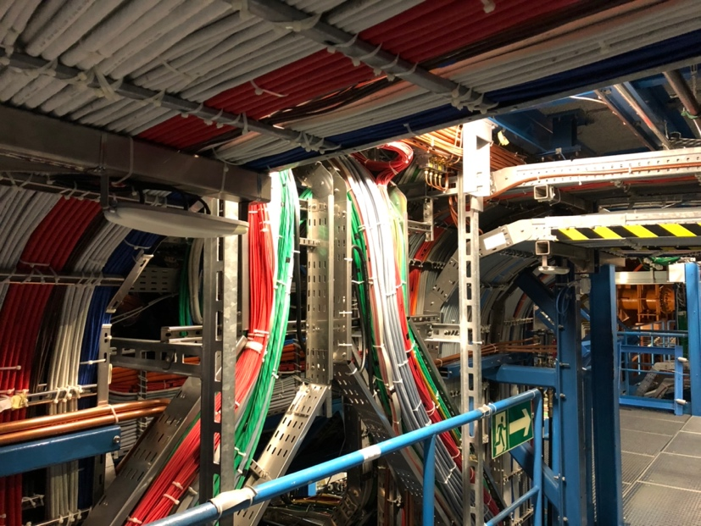
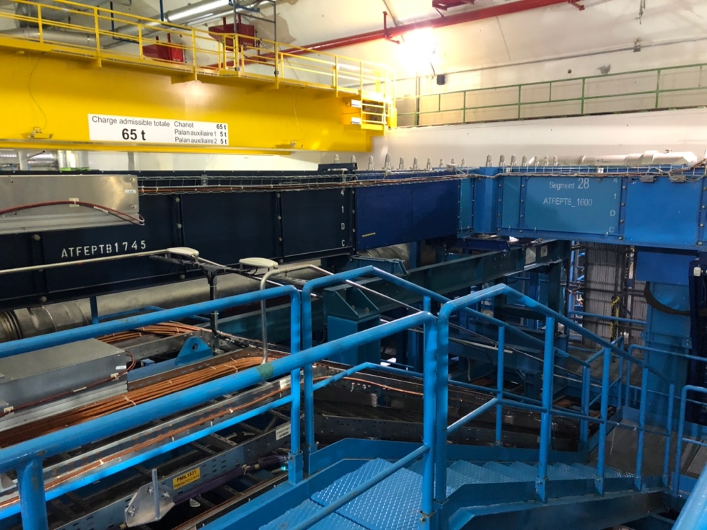
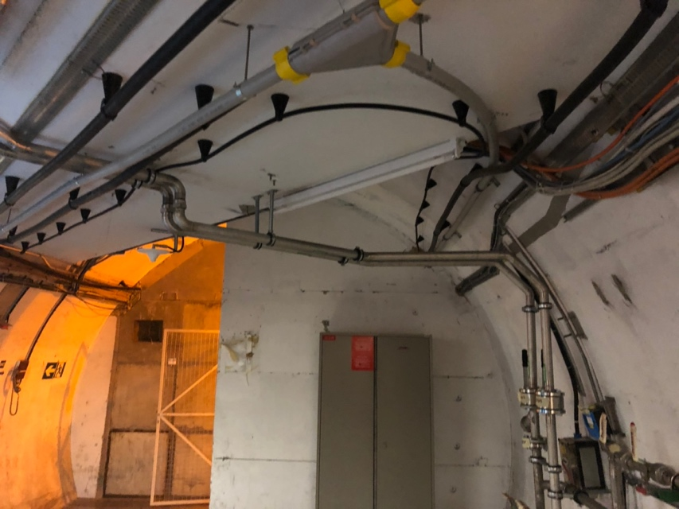
Underground areas

Slide 16
Underground areas

Slide 17
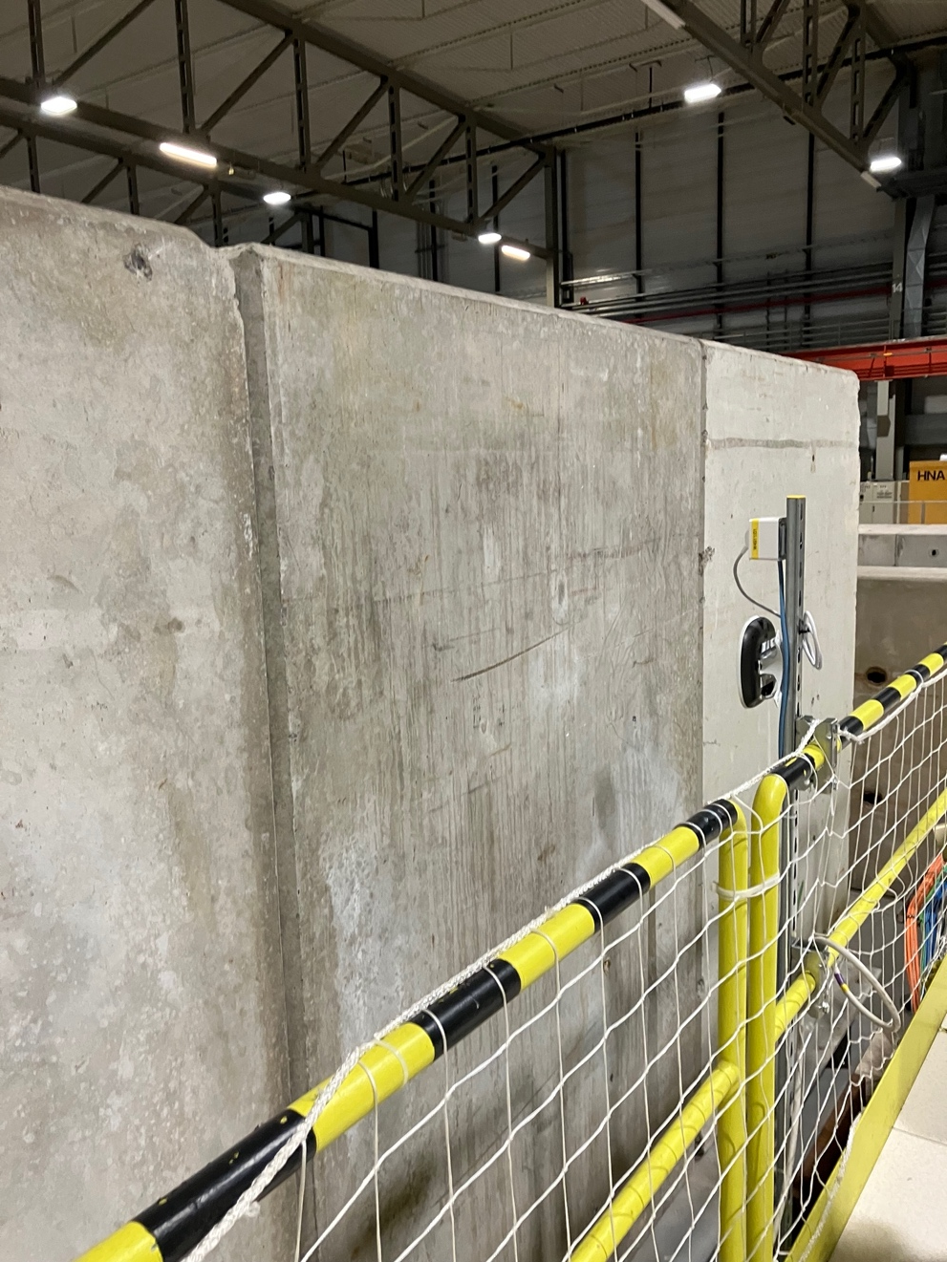
Environment changes…

Slide 18
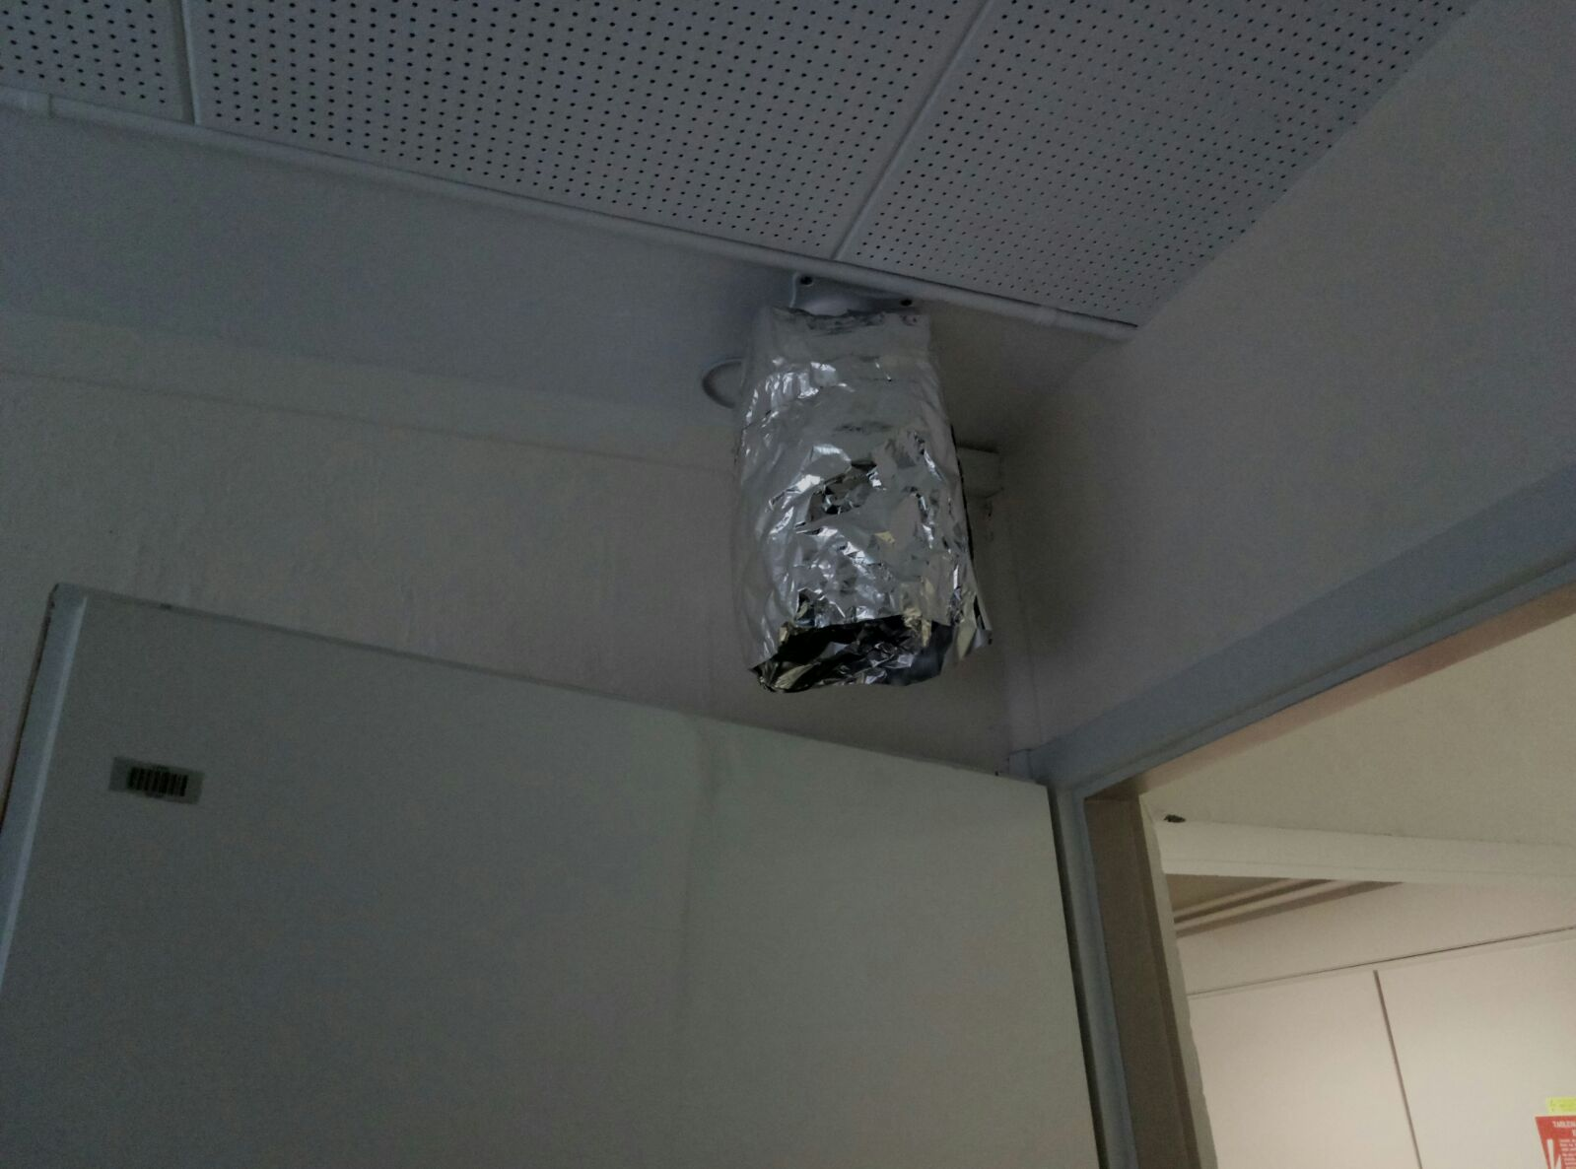
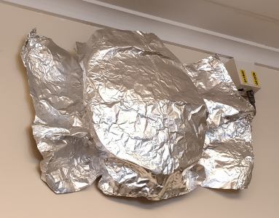
Not everybody likes Wi-Fi…

Slide 19
Thank you!

