Slide 1
Fixed telephony service
Evolution over the last 40 years
?? (on behalf of many colleagues over the last 25 years)
01.11.2023

Slide 2
Agenda
  Where we are
  Where are we going now
  SWOT (not SWAT) analysis
  Bright future – where are we planning to be

Slide 3
Agenda
  There was a time before Alcatel (and CS)
  A Ferrari in the 90s
  That needed some tunning over time
  To leave place to his replacement
  And start its retirement

Slide 4
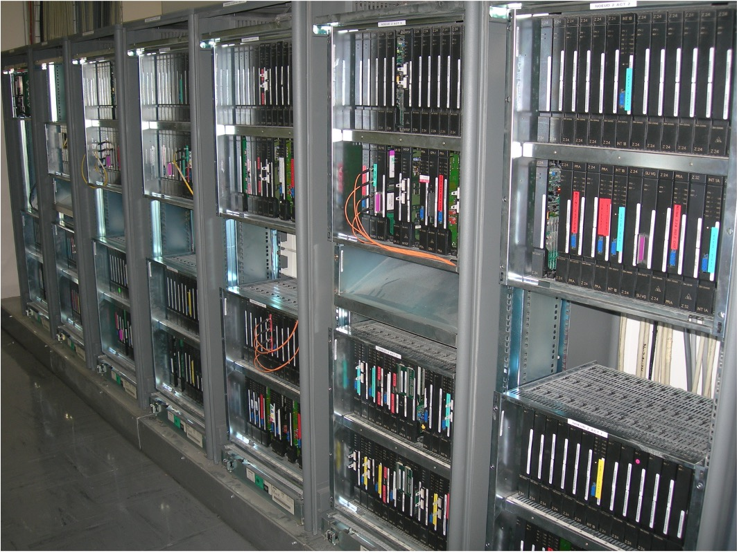
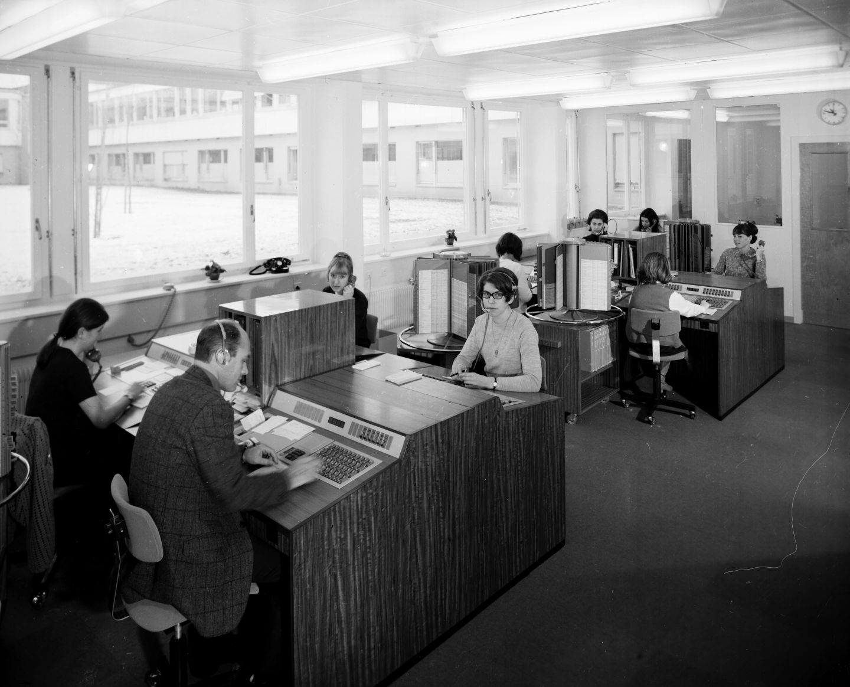
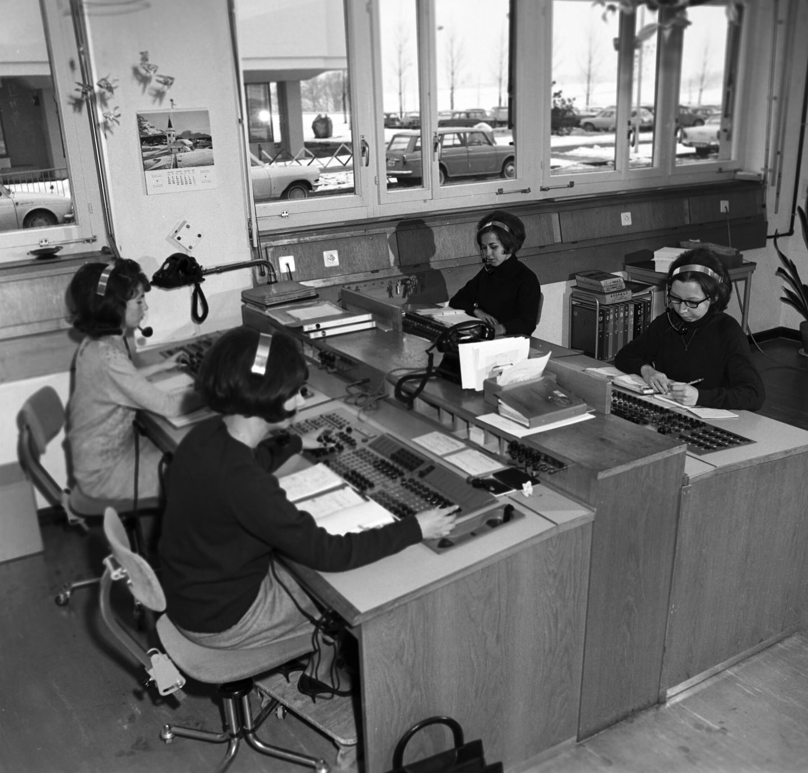
There was a time before Alcatel (and CS)
  Some may remember, many were not even born
  Postal Telegraph and Telephone (PTT) assured telephony in the 50s
  PTT installed a first Swiss Hasler HS 31 electromechanical telephone exchange in 1961
  The Hasler was upgraded in 1968 and owned by CERN
  The Hasler was replaced in 1987 by a Norwegian STK (Standard Telefon OG Kabelfabrik) digital exchange.
  Alcatel arrived in 1994 and introduced the current numbering plan

Slide 5
A Ferrari in the 90s
  Alcatel commissioning
  Features
  Cabling

Slide 6
That needed some tunning over time
  Least cost routing for outgoing calls
  Integration with the mobile service
  Switchboard evolution – Service Desk since 2017
  Infrastructure to IP (2003) and appliance servers (2006)
  First call center for IT HelpDesk (2006)
  Web-based audioconference service (2007)
  IP phones (2009) – end of analogue lines installation
  Fax over IP (2010) – end of analogue faxes

Slide 7
And a long path to find the right softphone
  Alcatel softphone solution trial - 2005
  Nortel softphone solution trial - 2006
  Skype integration & Asterisk assessment - 2007
  Microsoft Office Communications Server assessment and integration – 2008
  Voicemail to Exchange as a service - 2010
  Lync as a service - 2012
  WebRTC assessment - 2013
  BRAINS (Boîte pour Reduire l'Alcatel et Introduire des Nouveaux Services) - 2014
  TONE (Telephony Open-source Network Evolution) - 2015

Slide 8
And start its retirement (roughly 8 years)
  Backend: TONE
    Has replaced the Alcatel functionalities since 2016
    Has replaced the call centers in 2023
  Frontend and clients:
    DIAL (frontend solution developed by IT-CDA)
    Skype for Business (default client solution until Malt)
    CERNphone (frontend and client solution since 2020)

Slide 9
Just a word about TONE & CERNphone
Modern infrastructure based on open-source and standard IT components
Service based on open standards and protocols
Focused on software-based solutions
Capacity to easily develop and customize new services
Low TCO and operational costs
Future proof

Slide 10
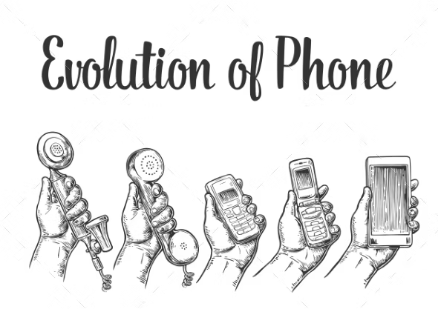
Questions?

