Slide 1
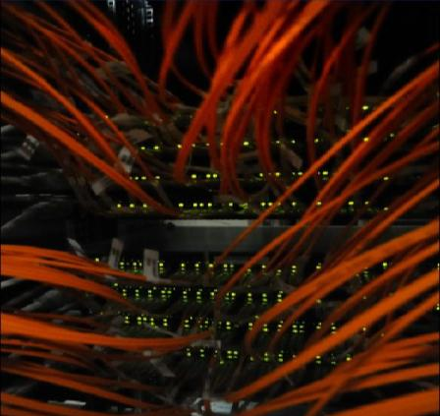
CS Group
and the
Internet
Anecdotes
Notes:
Thank you. Good afternoon everyone. I will try to make this talk at the same time fun and intelligent and it's sometimes good to combine qualities, and I will give you 2 examples. To be honestly, the web inventor was a first class expert in two domains. He was an expert in document format and This is why he invented HTML, and he was an expert in networking and This is why you invented HTTP. And if it works so well together, this is because they can form the same brain. And often in science and technology major advances, major breakthrough come from people who master excellently more than one domain dot intelligent but not fun.
The second example is, the second example is sorry I forgotten, this is Alzheimer. But you know there are three good things with Alzheimer. That you make new friends every day. The second one is that at Easter you can hide your eggs yourself. And the third one is, you make new friends every day. Fun but not intelligent.

Slide 2
The emergence of A&R Networks
Europe
78
Norway: UNINETT

Slide 3
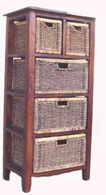
Layering principle
Functions clustered into layers
Each layer has only two neighbors
Changing one layer => changing two interfaces only
Application
7
Presentation
6
Session
5
Transport
4
Network
3
Link
2
Physical
1

Slide 4
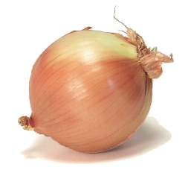
On Metaphors
Application
Application
7
Presentation
6
Phy
Session
5
Transport
4
Network
3
Link
2
Graphical Presentation from Norway, 1976
Physical
1
Notes:
The metaphor for representing of the layering principle was cupboard, where draws represent the layers.
But this was not the only metaphor. The Norwegians who like onions with herrings as we know, had proposed the onion metaphor, already in 76.

Slide 5
Perception
Peripheral
Application
High Level
Application
7
Presentation
6
Session
5
Phy
Transport
4
Network
3
Link
2
Core
Low Level
Physical
1

Slide 6
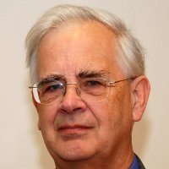
The emergence of A&R Networks
Europe
81
UK: JANet
Full Protocol Stack
Peter Linnington
University of Kent

Slide 7
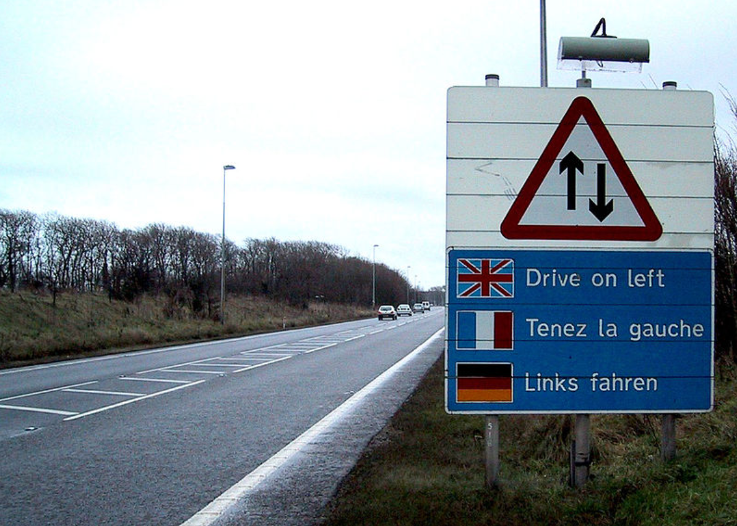
Driving on the Left
Notes:
But from time to time, our British friends like to be a bit different. And for one of the protocols they prefer to drive on the left. When the rest of the world including India, Japan, and these traitors of Australians preferred to drive on the right.

Slide 8
Driving on the Left
81
UK: JANet
British standard for email addresses
bob.smith@UK.AC.UCL
Country:
UK
Domain:
Academic Community
University
University College of London
Notes:
For email the other third the top down hierarchy. Country code first.

Slide 9

backfire
Notes:
This was a nightmare for everyone, and it was decided to have a meeting where each party UK on one side and the rest of Europe would come along with their arguments. I could not attend the meeting. I don't remember if Denise attended.

Slide 10
Driving on the Left
81
UK: JANet
Argument: bob.smith@UK.AC.UCL
  “Follows telephone numbering hierarchy”
  (country code, area code, ……)
Notes:
At that meeting, I will British colleagues said: good guys what is the most used system for interpersonal communication? This is telephone. And our system just follows the telephone numbering hierarchy. Country code first.

Slide 11

shooting
yourself
in the foot
Notes:
But sometimes, arguments backfire.

Slide 12
Driving on the Left
81
UK: JANet
Reason: bob.smith@UK.AC.UCL
  “Follows telephone numbering hierarchy”
  (country code, area code, ……)
Response of the community
“Precisely, this is not telephone, this is mail”
Notes:
The committee replied. But precisely this is not telephone, this is mail.

Slide 13

Att. Mr Robert Smith
University College of London
United Kingdom
Notes:
And how yourself in your country you write mail addresses on your envelopes. Country at the end top down.
Well, after a few months, UK update 4 driving on the right. But for mail only.

Slide 14
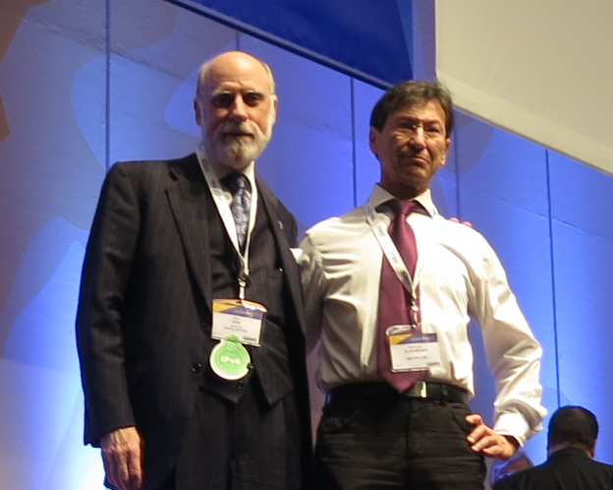
CS and World-wide structures
87
Creation of CCIRN*
May 88
I convene the 2nd meeting in Geneva
* Coordinating Committee for Intercontinental Research Networks
Notes:
The different national networks started their interconnections but in 87 the structure was created to better coordinate those interconnections. I convened the second meeting in Geneva, together with vint cerf, the cool inventor of IP.

Slide 15
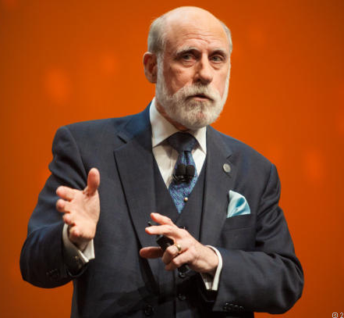
Abandon of power
88
Oct 88
Special CCIRN Meeting,
West Virginia, USA
Focused on
IP Coordination
Vint Cerf:
“We wish you, the Europeans, to set up a structure to allocate IP addresses in Europe.
It is not good we keep doing it for you.”
Notes:
This meeting was followed six months later bye under the special meeting but that time focused on IP coordination worldwide. At the end of the meeting, wind serves looked at the European delegation and said « we've issued Europeans to set up the structure to allocate IP addresses in Europe it's not good we keep doing it for you » this was a miserable delegation only free people.

Slide 16
Abandon of power
88
Oct 88
Second CCIRN* Meeting,
West Virginia
My two European colleagues:
“Sorry, we do not foresee any future for IP in Europe.”
I reassured our American colleagues:
“CERN will look after it ”
Notes:
And my two colleagues said » no sorry we won't do that because we don't foresee any future for IP in Europe »
Huh well, vin surf well the gentleman otherwise he would have said « but why are you there. This is about IP coordination, is it to undermine it?
Vint looked at me, and they said CERN will look after it.
Peter Kaufmann, DFN CTO
Bob Cooper, Janet CEO

Slide 17
Europe: the Protocol War rages
86
TCP/IP
Proponents and opponents fight each other
European Commission, most countries strongly opposed to TCP/IP
They support the OSI technology
Notes:
But why a miserable delegation and my two colleagues saying that? Because of the time the protocol war was raging in Europe. The European Commission and most of the countries were strongly opposed to TCP IP.
They supported another protocol stack, OSI, a complex technology that never worked.

Slide 18
Europe: the Protocol War rages
86
War
TCP/IP
Proponents
Austria
Ireland
Netherlands
Nordic Countries
CERN
OSI
Proponents
Germany
Italy
UK
Switzerland
European Comm.
91

Slide 19
CS Contribution to Internet Structures
88
Oct 88
Second CCIRN* Meeting,
West Virginia
88
Dec 88
Olivier and I call a meeting at CERN to respond to American proposal
Six people attended
Mats Brunel (SE)
Rob Blokzijl (NL)
Daniel Karrenberg (DE)
Enzo Valente (IT)
Olivier and myself (CERN)
Notes:
So back to CERN, I talked to Olivia, and we called a meeting my turn to respond to the American proposal.
Six people attended.

Slide 20
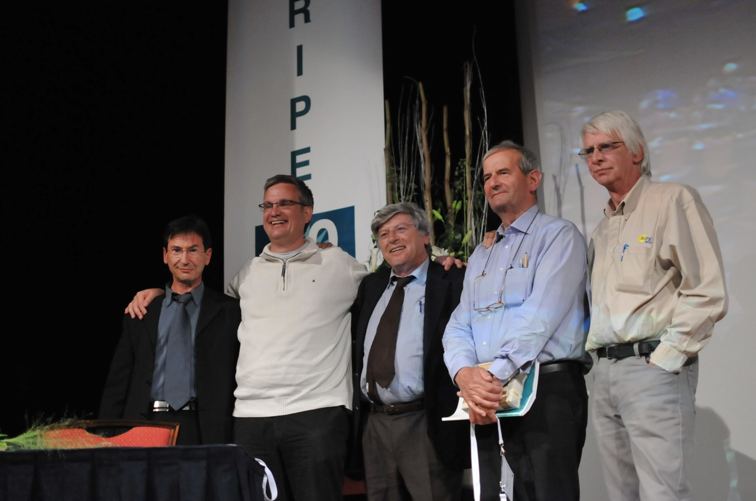
20 years later - Anniversary Celebration
Fluckiger
Karrenberg
Valente
Martin
Blokzijl
Notes:
20 years later, five of the six met in Amsterdam to celebrate that historical meeting.

Slide 21
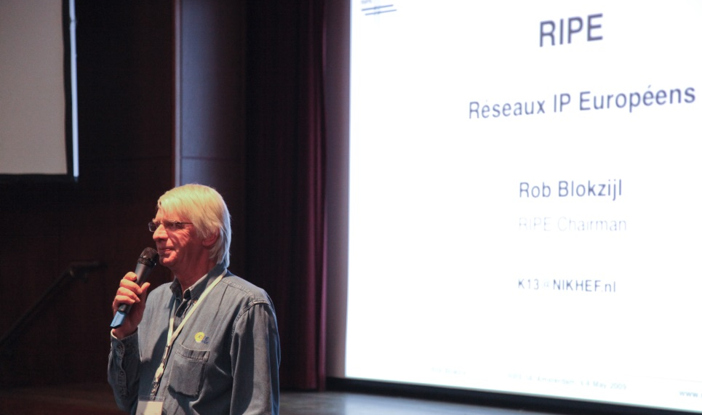
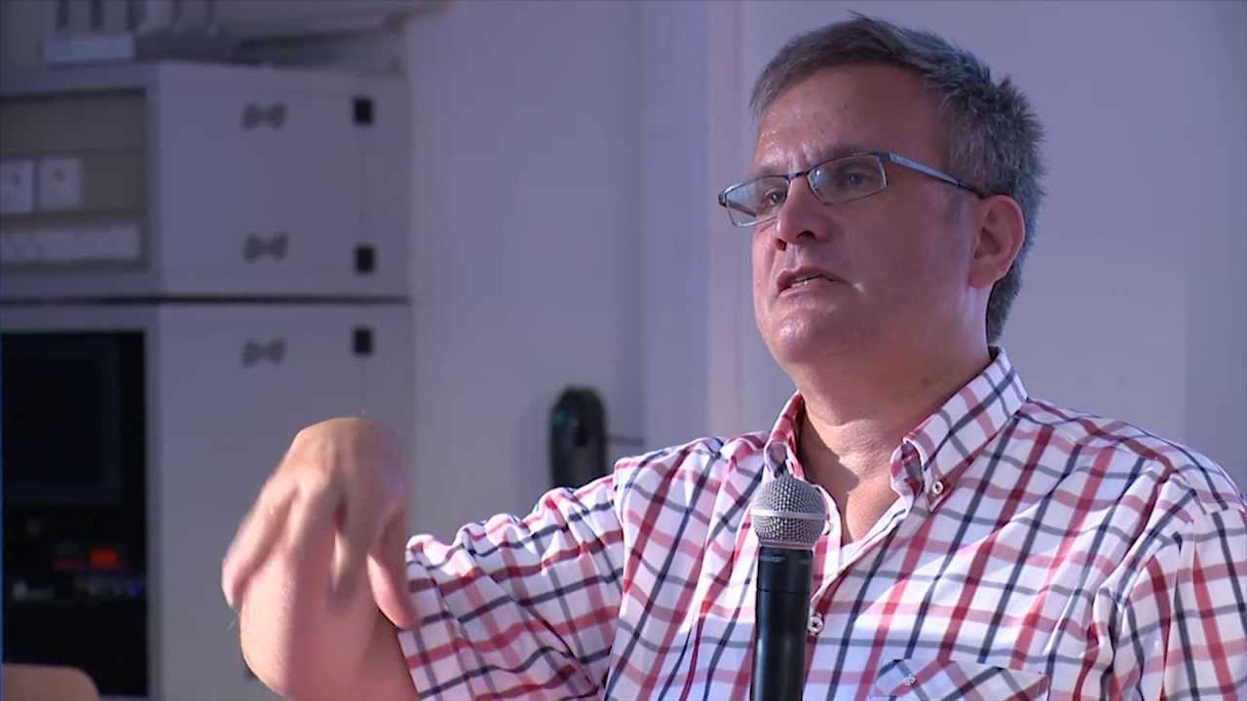
CS Contribution to Internet Structures
89
May 89
Rob chairs the 1st RIPE meeting
Blokzijl
92
May 92
Daniel formally opens the
RIPE NCC
Karrenberg
Notes:
And a few months later, blog zeal and Karen Berg created in Amsterdam the RIPE organisation, which still today is in charge of allocating IP addresses in Europe and part of the Middle East.

Slide 22
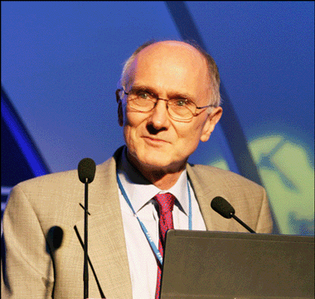
CS Contribution to Internet Structures
IETF
Created
86
Internet Engineering Task Force
The fully open structure no develop Internet Standards
Brian Carpenter, CERN
Chair 2005 -2007

Slide 23
CERN – The IP Star
81
86
War Will Last 5 years
War
89
91
CERN Largest Internet Hub in Europe
Notes:
And at the end of the war which lasted five years, sound had become the largest Internet hub in Europe.

Slide 24
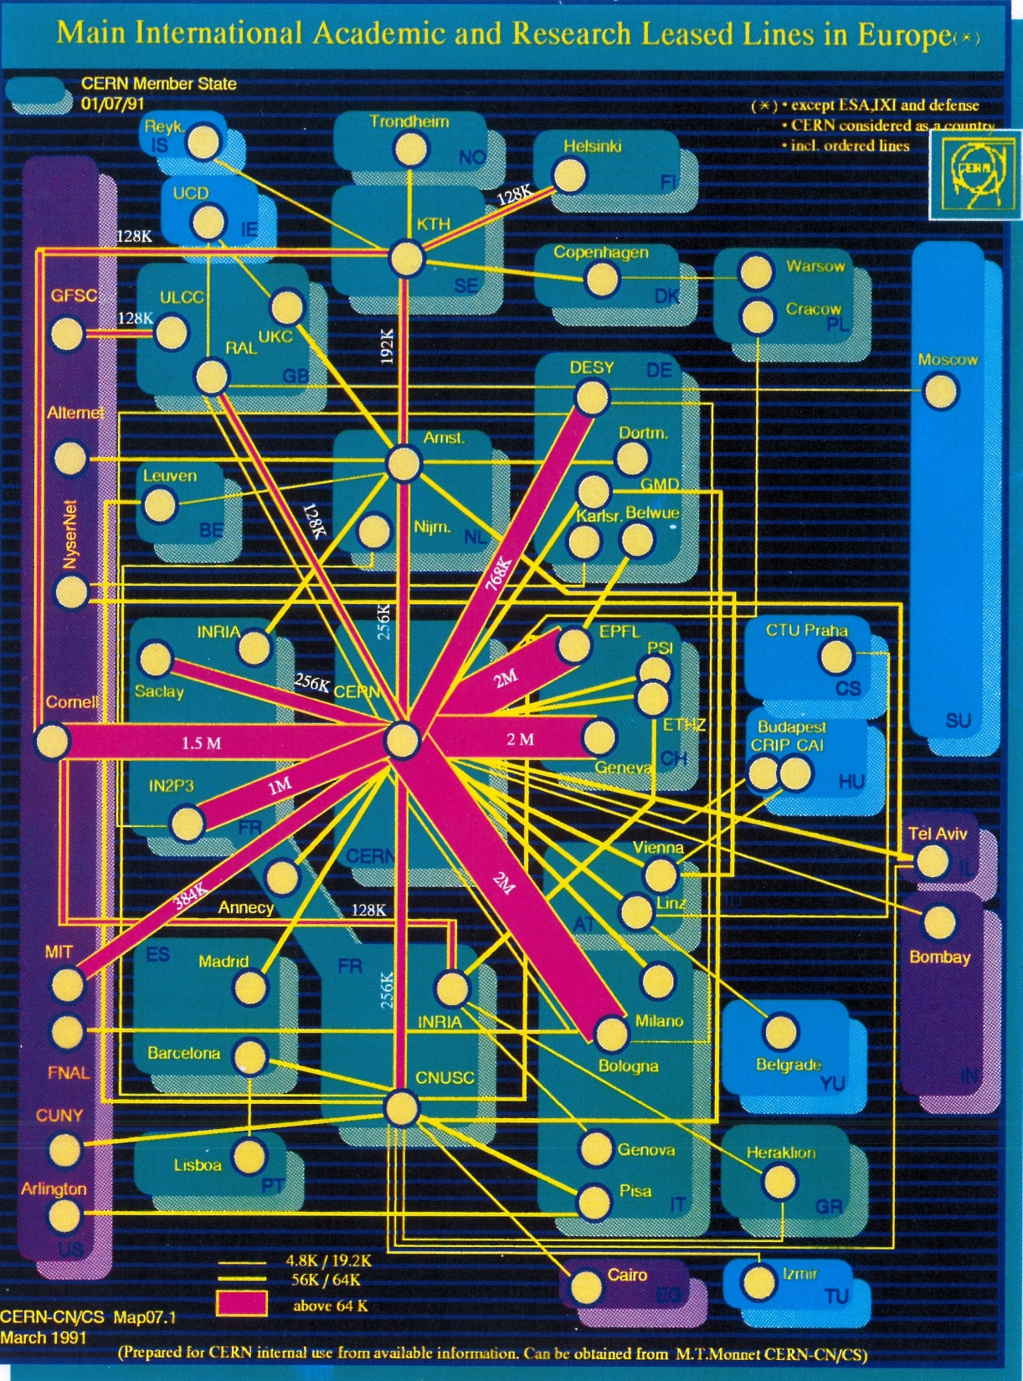
Notes:
This is how the infrastructure looked like in March 91.
So CERN CS has been instrumental in the creation of the IP infrastructure. But amazingly, the key contribution in parallel with the other key contribution of CERN to the Internet, the invention of the web.

Slide 25
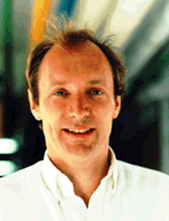
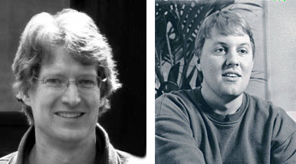
The Dawning of the Web
90
TBL releases
First Web Server
93
Marc Andreessen and Eric Bina release
MOSAIC
First Graphical Browser
University of Illinois
Notes:
Indeed, Tim Berners Lee was not working in the CS group.
In in 90 you release the first web server, and in 93, Marc Andreessen and Eric Bina released, mosaic first graphical browser.

Slide 26
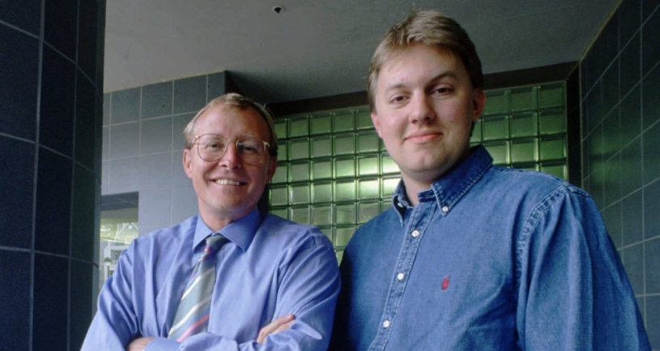
No Industrial Interest !!
… Until
94
Netscape
Jim Clark
founder, Silicon Graphics
Notes:
During that period, the web triggered absolutely no industrial interest. Until mark Andreessen met with Jimmy Clark. Jim Clark was a multi billionaire and the founder of silicon graphics. And Jim Clark so the potential, of the weather and together they created Netscape, the first ever company to sell web products.
But why the Jim Clark so the potential of the web?

Slide 27





In common?
H. Hollerith
S. Jobs
B. Gates
L. Page
S. Brin
M. Zuckerberg
All outstanding Managers and Technicians
Notes:
I give you 6 names. Herman hollerith, Steve Jobs, Bill Gates, Larry Page and Sergey Brin, mark Zuckerberg.
What do they have in common? They are all outstanding managers and technicians. Combining qualities. Ah, dumb, this was my second example.

Slide 28
Industrial Interest?
94
Netscape
Jim Clark
founder, Silicon Graphics
A Programmer
Notes:
So in the end why did they block so the potential of the web? When visiting son in 96, he told us that apart from being a billionaire, he was a programmer. During rainy Sunday afternoon, you liked to to write programmes.

Slide 29
In IT business,
Understanding Technology
is key to success
Notes:
So, my only takeaway of those 20 minutes is: in 80 business understanding technology is key to success. Shut up

Slide 30
When paths
have crossed

Slide 31
15
November
1994

Slide 32
Distribution of CERN WWW software
Francois Fluckiger (fluckiger@vscrna.cern.ch)
Tue, 15 Nov 1994 17:37:15 --100
Group: WWW-Talk
Dear Colleagues,
Some of you asked about the conditions for the distribution of
new versions of the CERN WWW Library of Common Code (libwww), the
CERN Line Mode Browser (www) and the WWW HTTP Daemon (httpd).
The new versions will remain freely available, for general use, and at
no cost.
The only change is that the material distributed will remain
copyrighted by CERN. As a consequence, a copyright notice will have to
appear in copies, but also, the rights of the users will be protected,
in particular by preventing third parties to turn free software into
proprietary software, and deny the users the rights to freely use the
material`.

Slide 33
Distribution of CERN WWW software
Francois Fluckiger (fluckiger@vscrna.cern.ch)
Tue, 15 Nov 1994 17:37:15 --100
Group: WWW-Talk
These principles are those used by most distributors of free software,
including the X consortium.
The proper copyright notice is being ratified and will be available in
a few days.
We hope all those who have trusted CERN WWW software will continue to
do so, and will appreciate that these conditions not only maintain the
free distribution but better protect it.
Francois Fluckiger
Leader, WWW development, CERN

Slide 34
Group: WWW-Talk
On Nov 16 1994, 11:57, Tony Sanders <sanders@...> wrote:
> We hope all those who have trusted CERN WWW software will continue to
> do so, and will appreciate that these conditions not only maintain the
> free distribution but better protect it.
No, I don't buy any such nonsense. It's either free or it's restricted.
Sounds more to me like they are going to start charging for access to the technology.

Slide 35
June
1994

Slide 36
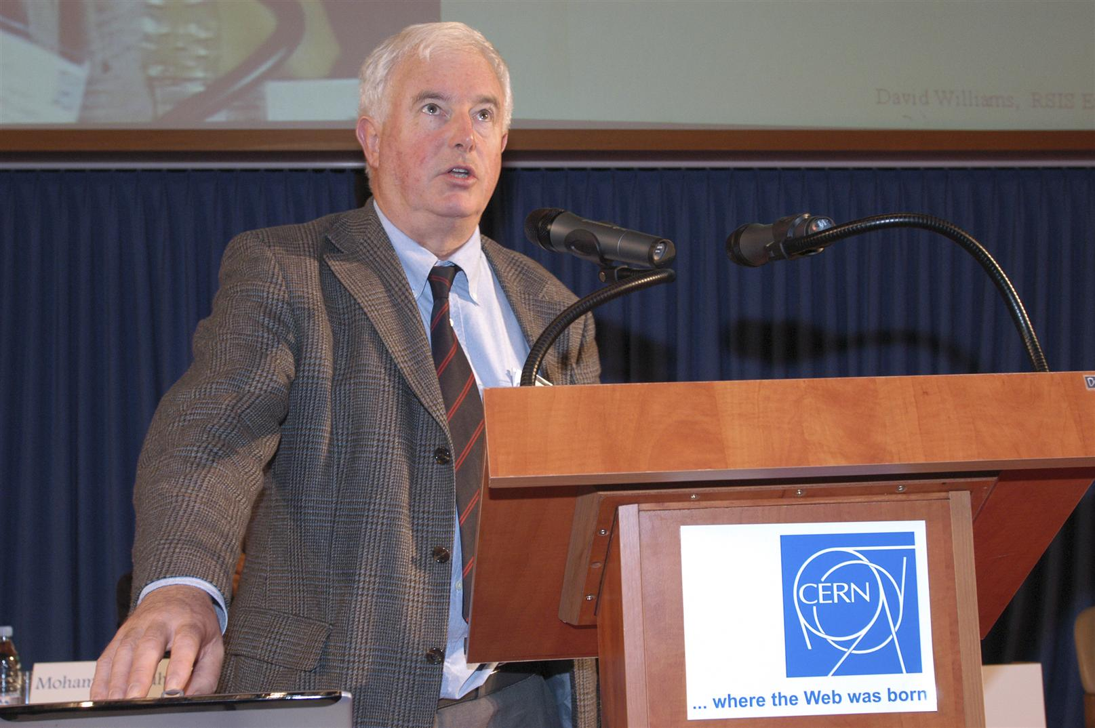
David Williams
Head, CN Division

Slide 37
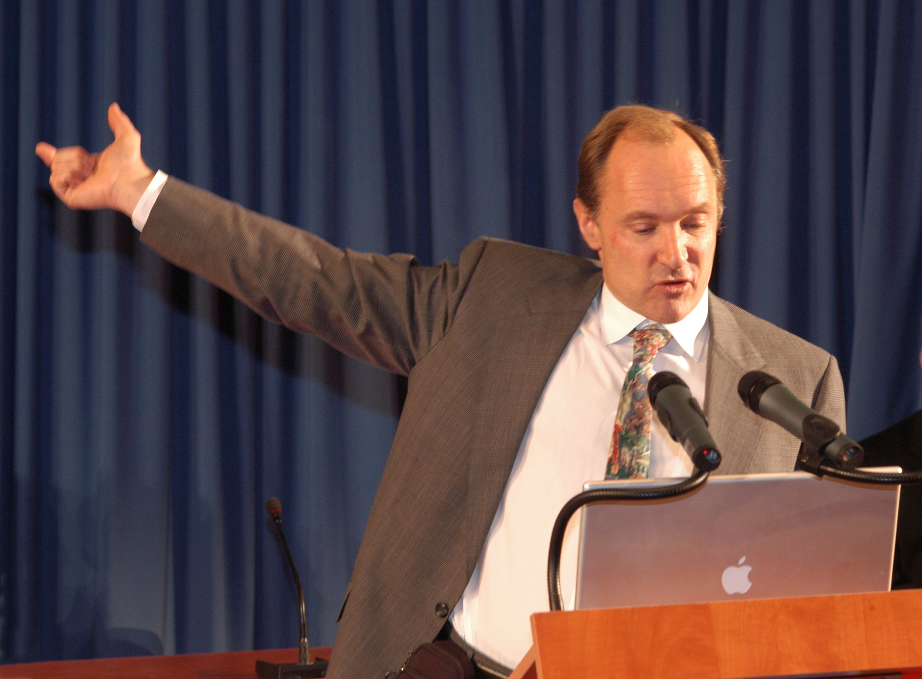
Tim Berners-Lee
Leaving CERN to the W3C, MIT

Slide 38
May
1993

Slide 39
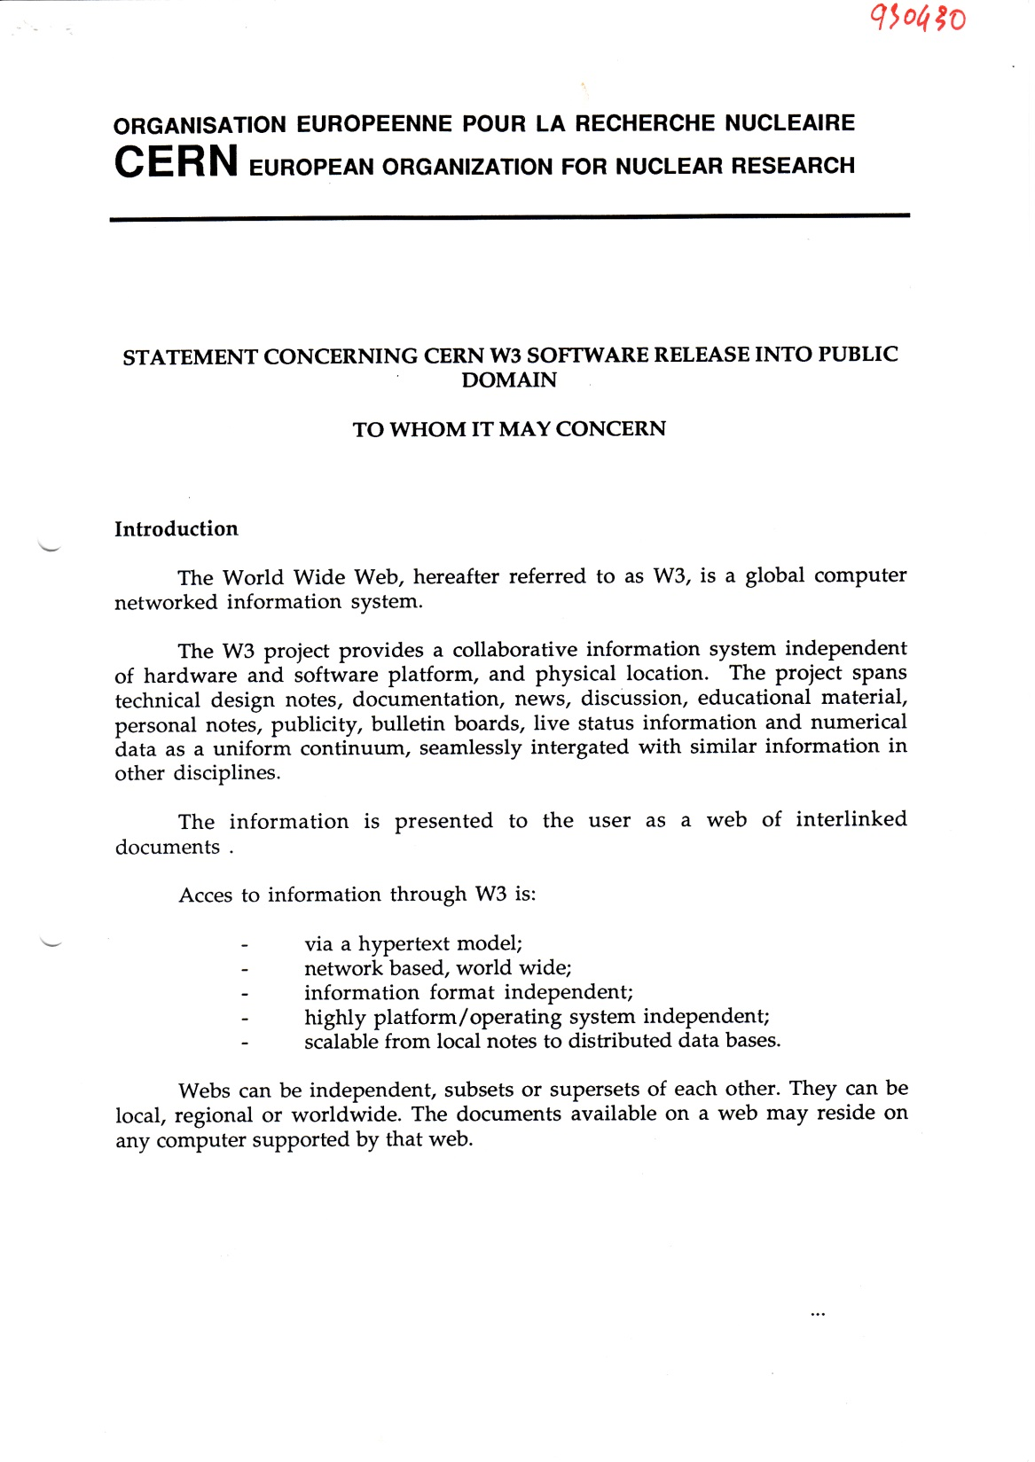

Public
Domain

Slide 40
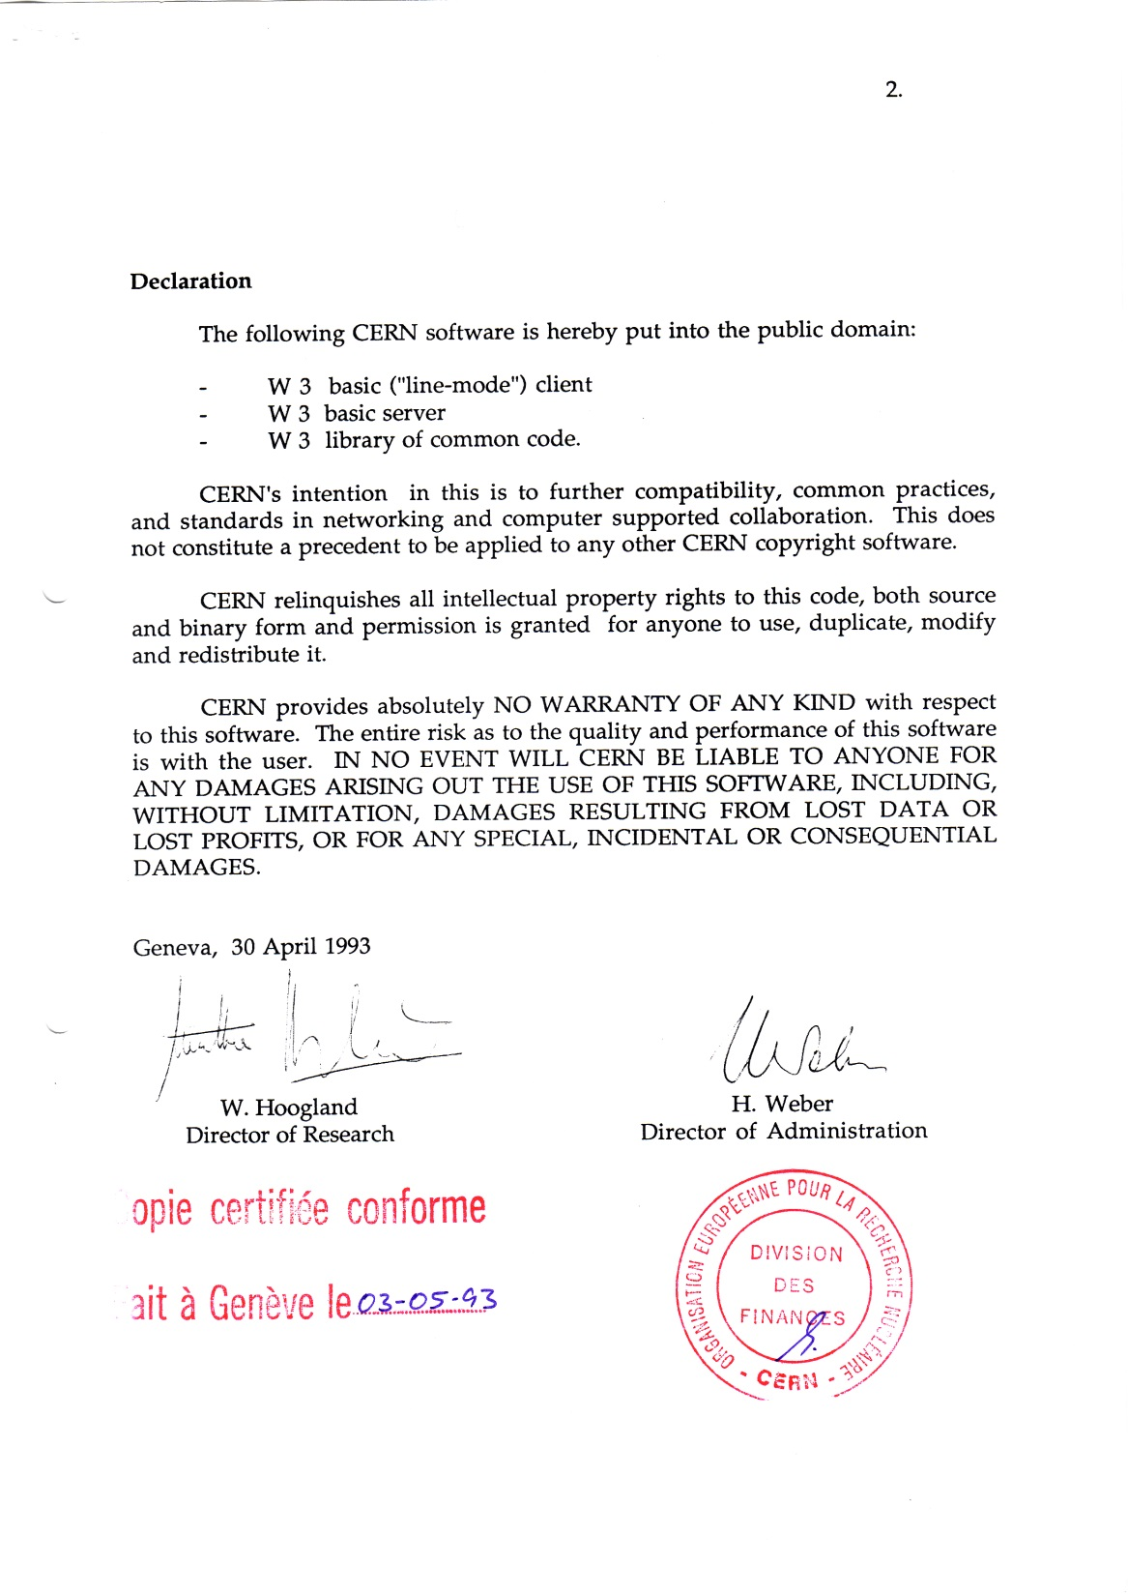

Public
Domain
=
Relinquish
Property Rights

Slide 41
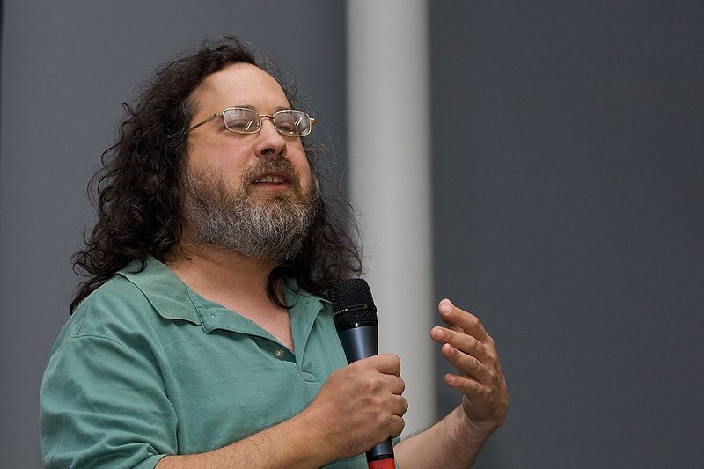
Free Software Movement in its infancy
Free Software Foundation
Richard Stallman

Slide 42
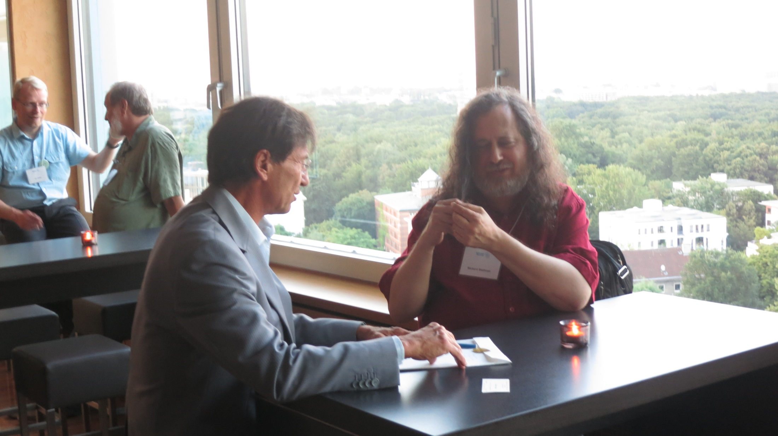
Berlin, 3rd August 2013

Slide 43
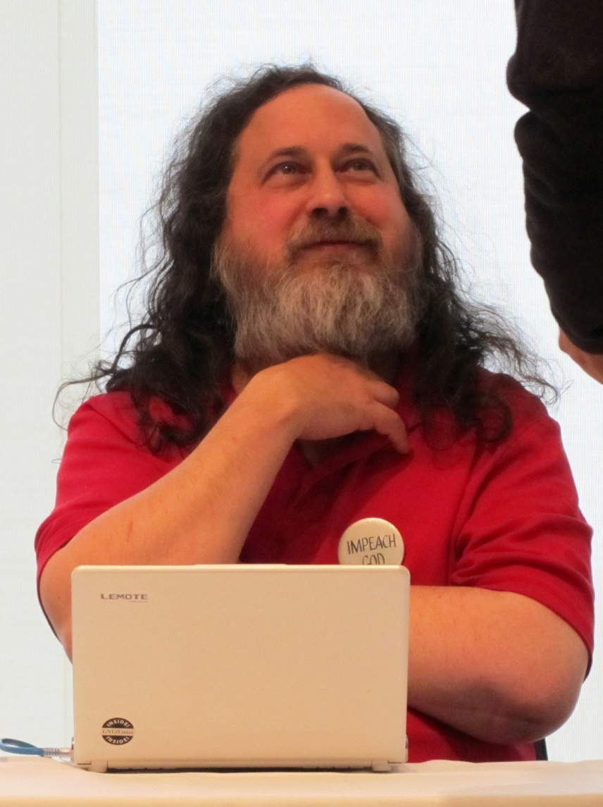
Free Software Principle
Protect freedom by keeping ownership
Grant anyone the
  perpetual
  irrevocable
right to use, copy, distribute, modify

Slide 44
The 1st CERN Open Source Licence
COPYRIGHT STATEMENT
(c) COPYRIGHT CERN 1994
___________________________________
The copyright and all other rights relating to this computer software, in whatever form, including but not limited to the source code, the object code and user documentation, are vested in CERN.
CERN, on a royalty-free and non-exclusive basis, hereby grants permission to use, copy, change, modify, translate, display, distribute and make available this computer software, subject to the following conditions:
this computer software is provided on an as-is basis and CERN provides no express or implied warranties of any kind, including but not limited to those of merchantability, fitness for a particular purpose and non-infringement of the proprietary rights, such as copyrights, patents and trade secrets, of third parties. CERN accepts no liability whatsoever for or in connection with the use of this computer software;
all copies made of this computer software or of parts thereof shall include this copyright statement in full;
however, if this computer software or parts thereof are made available in any other form than their original form, or are included in any other computer software, the following short acknowledgement only must be mentioned in the copyright statement and in the user documentation (or, in the absence thereof, in any other appropriate place) concerning the computer software thus made available or created:
"This product includes computer software created and made available by CERN. This acknowledgement shall be mentioned in full in any product which includes the CERN computer software included herein or parts thereof."

Slide 45
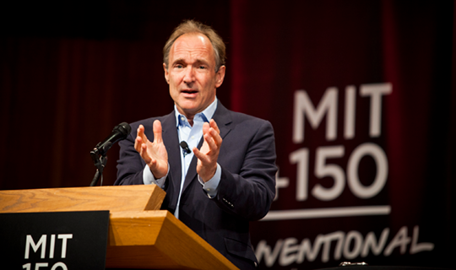

Slide 46
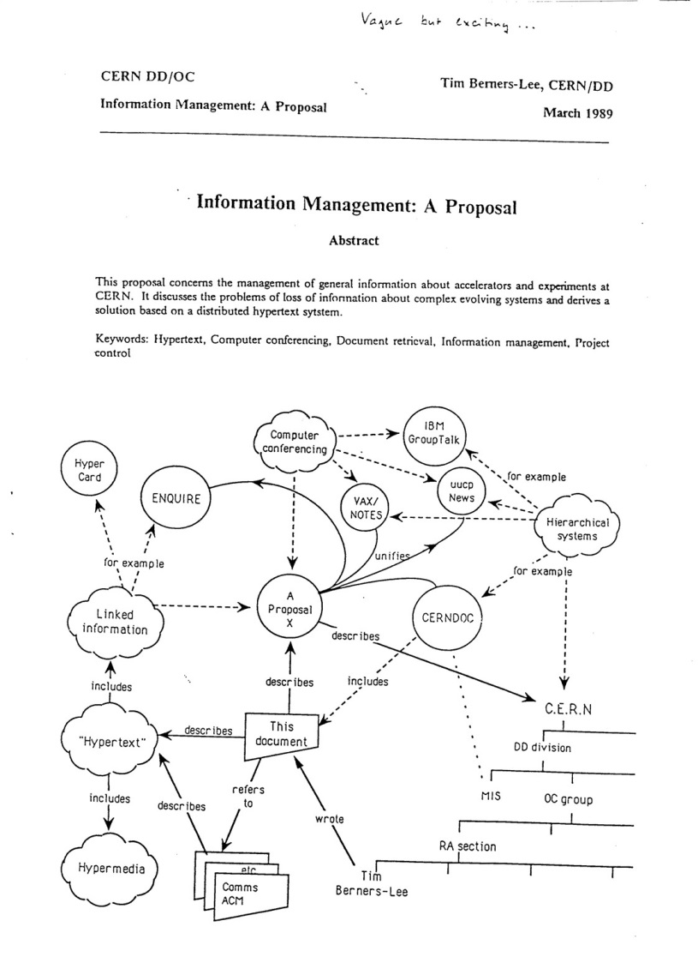
Notes:
I remember in July 93, Tim shozed up in mly oiffice and sazid. François, I you mlay know that I am due tio present the Web at the bif Internet Cobnfernec newt montn in San Franciscxo? Yes, I know, i an, in gthe Programme Community and it’s me who inveited you.
OK, ell, I cant go I have to pogresse my web coding, and yuou replcae me for the presbetation
I replied NO, I cannit. I knos nonting serious abiut tehj web? Dont worry I will giobe yiou allthe matreial.
Nd he gave me a pile of gand xwitten, slides, tyou know thes etransparenies yiou write with permemnt colored pen? Half of them were pictures if this typen form of forms.
Qafter a coiple of days, I returedn to Tim.
I til have yiou hgot a linute? Just to undestand, yiou have herer rectangles and sqiares and ciuréciles? Is there any diufferencv bedtween thme? Na ddiffernent colors?
Qh, well … the suqres and cirrcules … Well Fran,cois, these are dtails, kook at tahte with some distance.
Hum I see distance …
But , hete are arrow between these … these formsq … Do they mean somethiong is trabsfered betwteen theam … are for some dependcy.
Has well, the arrows. But François I told Yohj

Slide 47
Thank You

Slide 48
The Three Pillars …

Slide 49
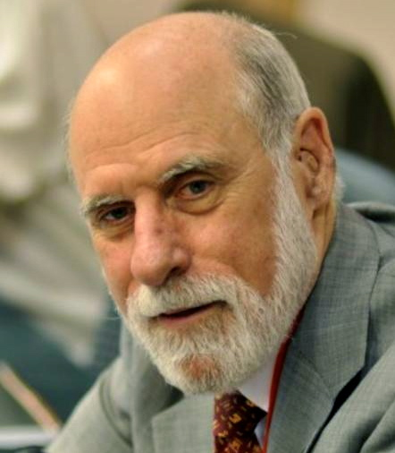
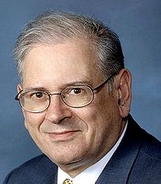
IP
Vint Cerf & Bob Khan

Slide 50
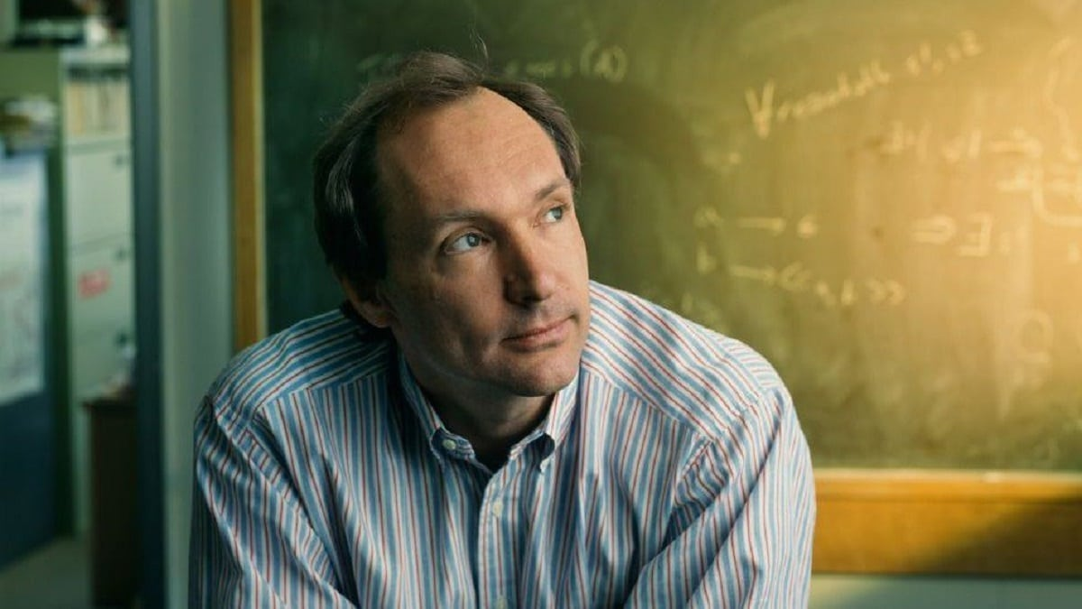
Web
Tim

Slide 51
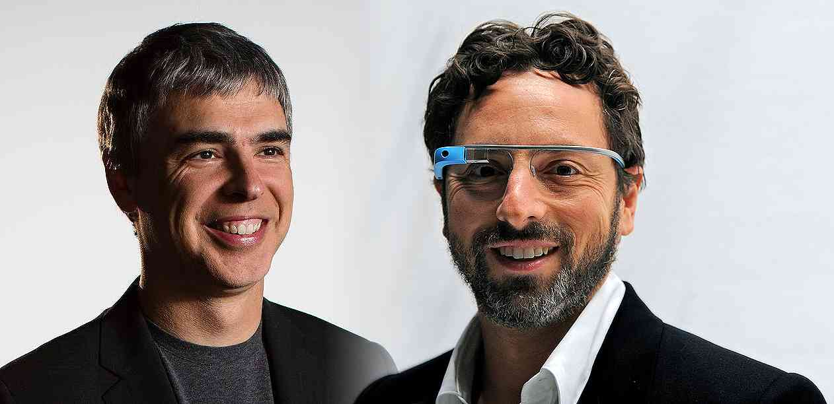
Google Indexing
Larry Page & Sergey Brin

Slide 52
Layering principle
Functions clustered into layers
Each layer has only two neighbors
Changing one layer => changing two interfaces only
Application
7
Presentation
6
Session
5
Transport
4
Network
3
Link
2
Physical
1

Slide 53
On Metaphors
Application
Application
7
Presentation
6
Phy
Session
5
Transport
4
Network
3
Link
2
Graphical Presentation from Norway, 1976
Physical
1
Notes:
The metaphor for representing of the layering principle was cupboard, where draws represent the layers.
But this was not the only metaphor. The Norwegians who like onions with herrings as we know, had proposed the onion metaphor, already in 76.

Slide 54
Perception
Peripheral
Application
High Level
Application
7
Presentation
6
Session
5
Phy
Transport
4
Network
3
Link
2
Core
Low Level
Physical
1

Slide 55
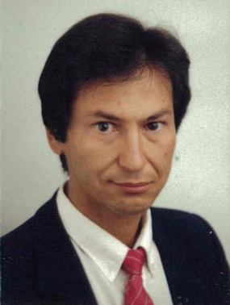
CS Group enters the scene
83
CERN
I am appointed SL for External Networking

Slide 56
CS Contribution to Internet Structures
IETF
Created
86
Internet Engineering Task Force
The fully open structure no develop Internet Standards
Brian Carpenter, CERN
Chair 2005 -2007

Slide 57
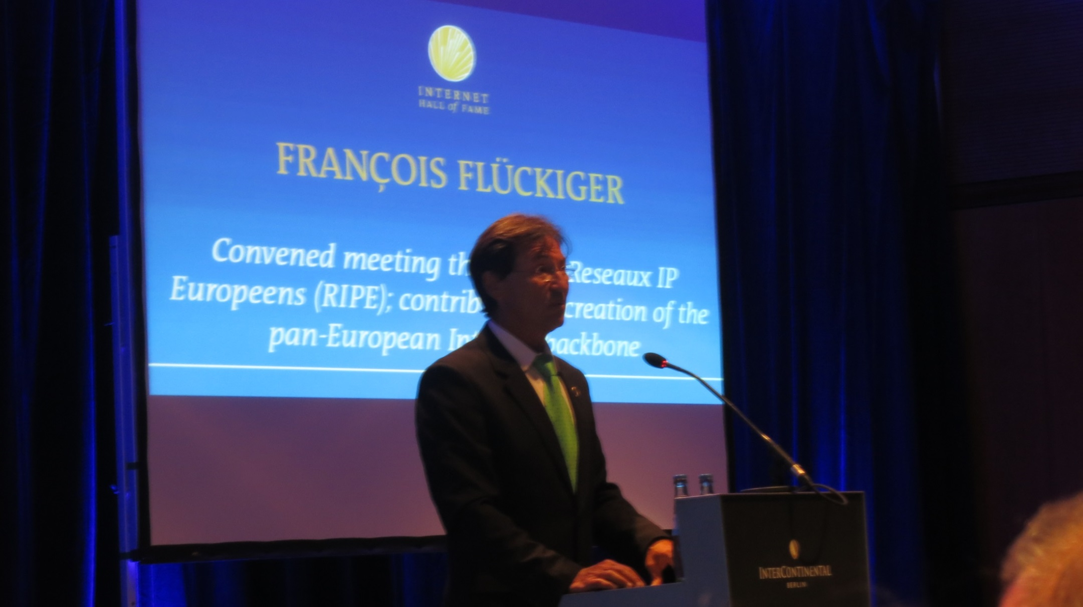
Berlin, 3rd August 2013
Internet Hall of Fame Award

