Slide 1



Super-B Workshop
Welcome!
Andrei A. Seryi
John Adams Institute for Accelerator Science
University of Oxford and Royal Holloway University of London, UK

Slide 2
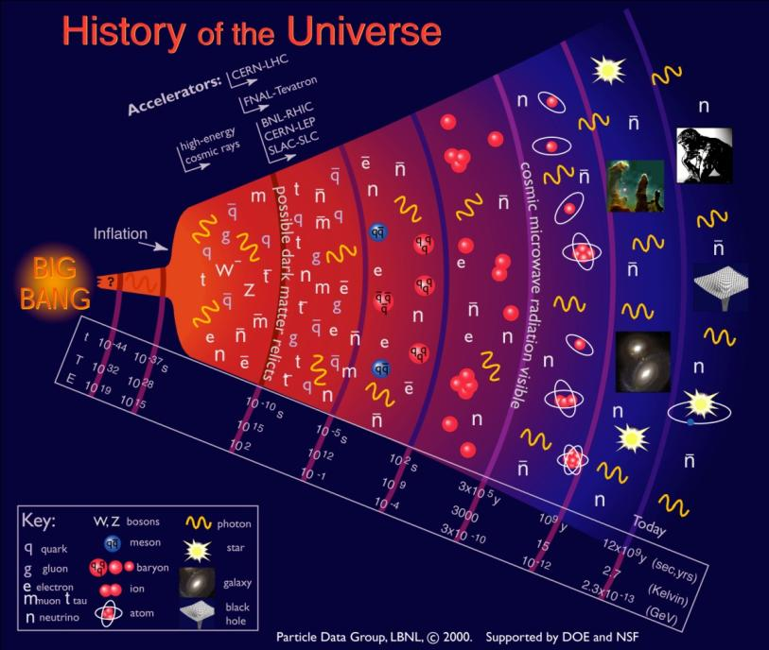
Accelerators help in uncovering the origin of the universe
Big Bang
now
Older ….. larger … colder ….less energetic
2

Slide 3
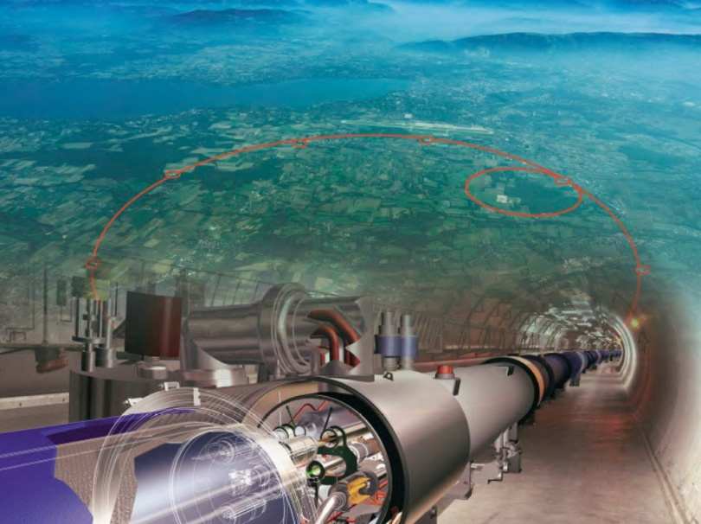
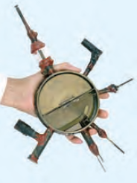

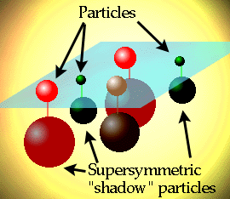
LHC collider will help in answering
the profound questions:
What causes mass?
What is the composition of the universe?
Known Matter
Unknown Matter ~ 90%
DARK MATTER &
DARK ENERGY
What is Dark Matter ?
A new form of elementary particle?

Slide 4
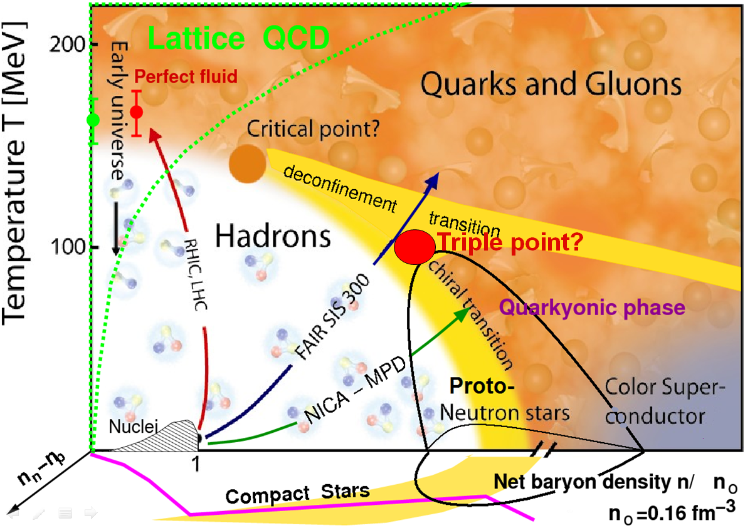
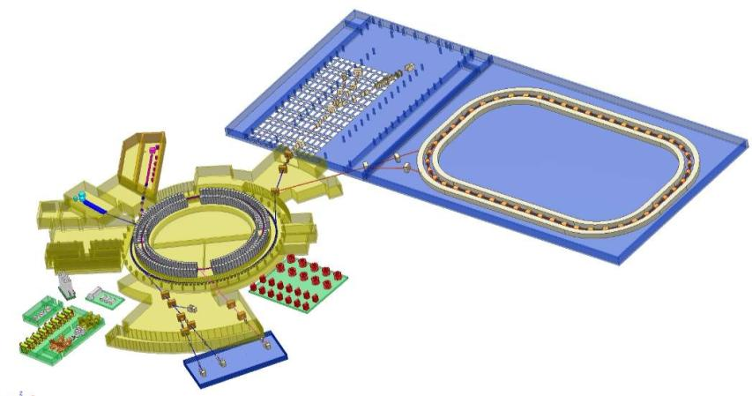
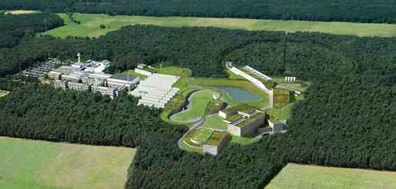
exploring nuclear matter at extreme states
NICA / MPD
Nuclotron-based Ion Collider fAcility
FAIR, Facility for Antiproton and Ion Research

Slide 5
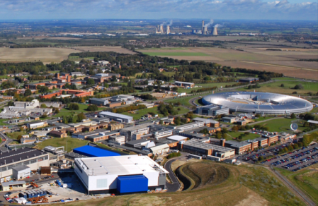
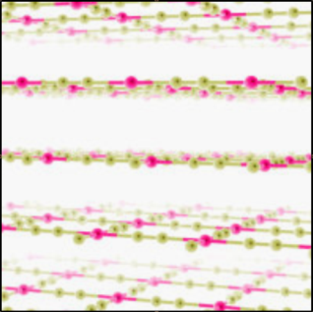
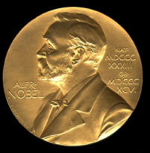


Accelerators & discovery science
Protein structure revealed with help of light sources
ISIS and Diamond neutron and X-ray sources
Harwell, UK
Neutron and X-ray imaging essential for studies of proteins and advanced materials
2-d material (graphene)
Accelerators enabled many discoveries
The fraction of the Nobel prizes in Physics directly connected to accelerators is about 30%

Slide 6
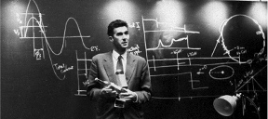
What is JAI
The John Adams Institute for Accelerator Science is a centre of excellence in the UK for advanced and novel accelerator technology, created in 2004 to foster accelerator R&D in the universities
Sir John Adams (24 May 1920 - 3 March 1984) was the 'father' of many accelerators at CERN
JAI Mission:
1) develop novel and advanced accelerator technologies for particle physics and other applications;
2) train a new generation of accelerator scientists and engineers;
3) disseminate knowledge about the benefits of accelerator technology to a wide community;
4) make major contributions to the design and development of new particle physics facilities;
5) make a major contribution to the development of new scientific facilities such as new light and neutron sources;
6) make a major contribution to the development and construction of applied accelerator technologies (medical, energy etc).

Slide 7
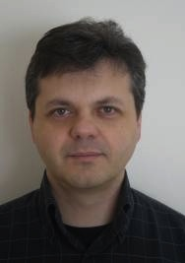
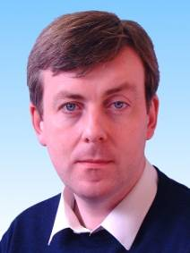
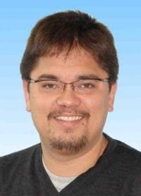
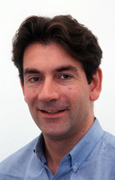
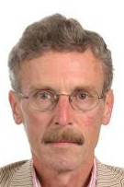
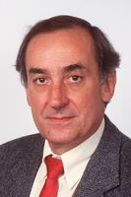
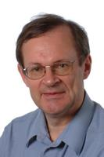
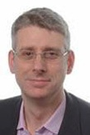

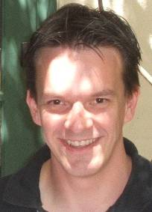
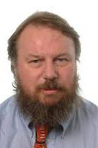
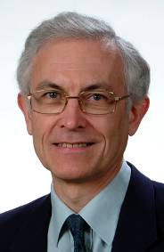
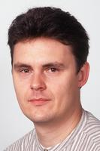
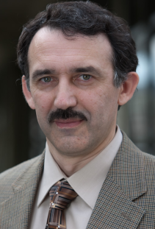
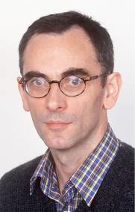
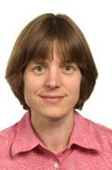
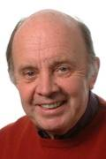

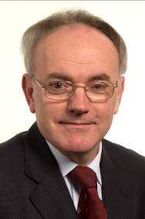
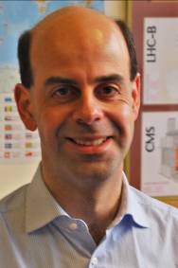

JAI Faculty
Riccardo Bartolini
Grahame Blair
Stewart Boogert
Phil Burrows
John Cobb
George Doucas
Brian Foster
Simon
Hooker
Pavel Karataev
Research Facilitator
[FACETS]
Steve Molloy (now ESS)
Ken Peach
Chris Prior
Armin Reichold
Andrei
Seryi
Roman Walczak
Ted Wilson
CERN
Michele Warren
Particle Therapy Cancer Research institute
~15 Faculty ~12 Research Staff
~12 Technical Staff
~30 Research Students 4 shared Administrative & Secretarial Staff (2/3rd Oxford:1/3rd RHUL)
Bleddyn Jones
Emmanuel Tsesmelis

Slide 8



JAI research
directions
Enabling accelerator
techniques for
scientific, medical and
energy applications
Next generation
compact light sources
and laser-plasma
acceleration FEL
Advanced accelerator
instrumentation,
diagnostics and devices
JAI is moving INTO new directions
Discovery Science
IMPACT
Industry
Energy challenges
Societal benefit
Enhance science, training and impact
Training in Accel. Sci.

Slide 9
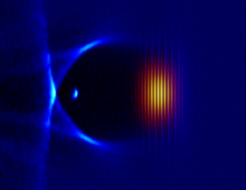
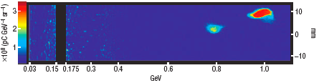
New directions: Laser-Plasma Acceleration
  1GeV acceleration in just 3cm of plasma
  W. Leemans, B. Nagler, A. Gonsalves, C. Toth, K. Nakamura, C. Geddes, E. Esarey, C. B.Schroeder, & S. Hooker, Nature Physics 2006
Simulation of laser-plasma acceleration
Rapid progress in beam energy achieved with laser-plasma acceleration shows that the synergy of accelerators, laser and plasma is revolutionizing the field
Compact X-ray light sources based on laser-plasma accel^{n}
  Aim to develop commercial applications
                Project to be developed in collaboration
                with science centres in UK and worldwide

Slide 10
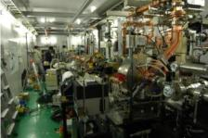
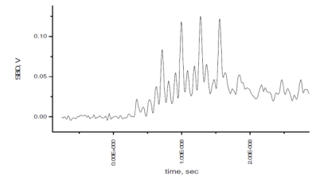
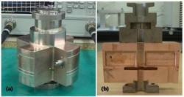
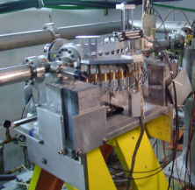
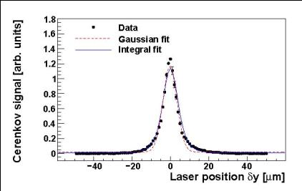
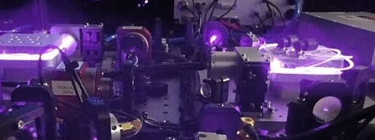
Advanced beam instrumentation
Far-Infrared Coherent Radiation
  CSR, CDR for beam diagnostics
  Soft-X ray and microwave source based on Thomson scattering of CDR (with KEK)
Nano-resolution BPM
  C, S-band (~100nm resol.)
  Special ~nm resolution
Coherent Smith-Purcell radiation
  Longitudinal diagnostics – explore extending it to fs range
Laser – wire
Ultra-fast nanosecond feedback
LUCX at KEK
CDR signal
Laser wire
Smith-Purcell diagnostics at ESA, SLAC [JAI team]

Slide 11
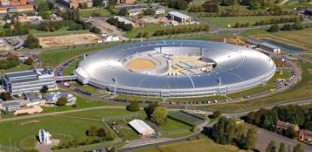
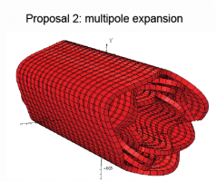

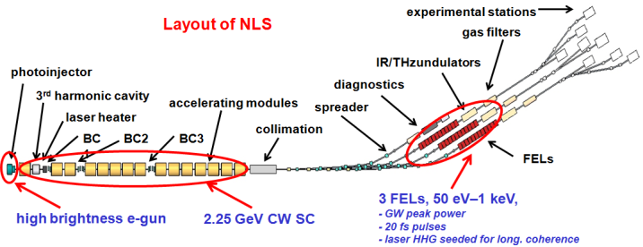
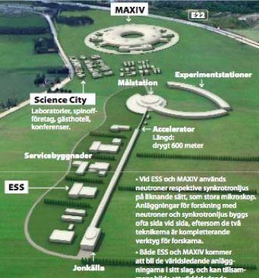

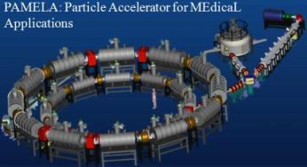
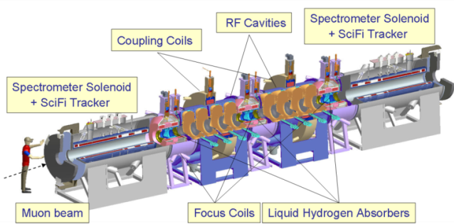
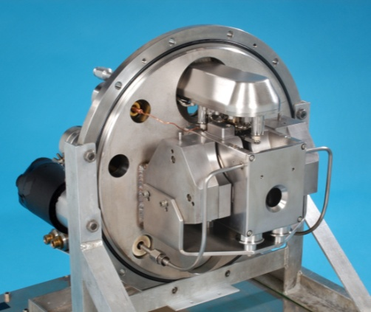
Enabling accelerator techniques
Diamond Light Source
Future Light Source design
European Spallation Source
Muon Cooling & future facilities
EMMA/ PAMELA and cancer therapy
LHC upgrade
LC
ISIS R&D H- source

Slide 12
JAI Portfolio of projects
Advanced Instrumentation, diagnostic and devices
Next generation compact light sources and laser-plasma FEL
Enabling accelerator techniques for scientific, medical & energy applications
Laser Wire
Diamond Light Source
L-P Compact source
ISIS
FONT
Lasers 4 Accelerators
ESS
Seminars
MICE / NF
Smith Purcell
Meetings
L-P towards FEL
PAMELA/EMMA, PTCRi
OUTREACH
Nano BPM
Exhibitions
LHC Upgrade
High f rep laser for LP
Future Light Source
ODR/CDR
Future high W p
LC
Training: Accelerator Science & Laser & Plasma
Graduate Courses
Undergraduate Courses
Schools and Workshops

Slide 13
JAI Portfolio of projects
Advanced Instrumentation, diagnostic and devices
Next generation compact light sources and laser-plasma FEL
Enabling accelerator techniques for scientific, medical & energy applications
Laser Wire
Diamond Light Source
L-P Compact source
ISIS
FONT
Lasers 4 Accelerators
ESS
Seminars
MICE / NF
Smith Purcell
Meetings
L-P towards FEL
PAMELA/EMMA, PTCRi
OUTREACH
Nano BPM
Exhibitions
LHC Upgrade
High f rep laser for LP
Future Light Source
ODR/CDR
Synergy w Super-B
Future high W p
LC
Training: Accelerator Science & Laser & Plasma
Graduate Courses
Undergraduate Courses
Schools and Workshops

Slide 14
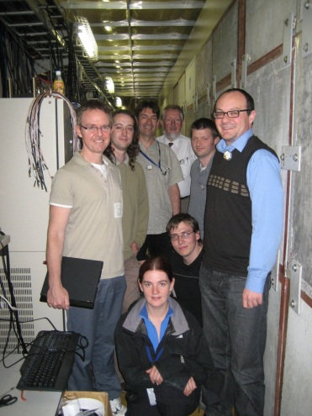
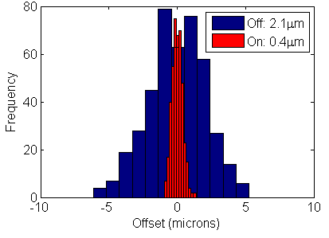
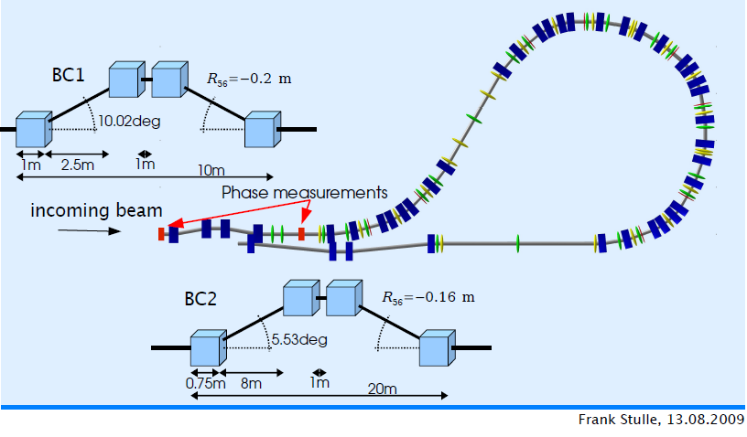
FONT fast feedback R&D
Philip Burrows, Glenn Christian, Javier Resta Lopez, Colin Perry, Ben Constance,
Robert Apsimon, Douglas Bett, Alexander Gerbershagen, Michael Davis, Neven Blaskovic
ILC intra-train FB prototype at ATF2:
ILC goals met: latency, BPM resolution, drive
Beam correction demonstrated to 400nm level
y, y’ coupled-loop FB (ATF goals 1,2) commissioning
ILC + CLIC interaction point collision FB:
Conceptually engineered designs within MDI
Documented in CLIC CDR, design iterations ongoing
Luminosity performance simulations
CLIC drive-beam phase stability FF system:
Conceptual design now documented in CDR
Amplifier design in progress: aiming for CLIC
prototype and beam tests at CTF3 (2014)

Slide 15
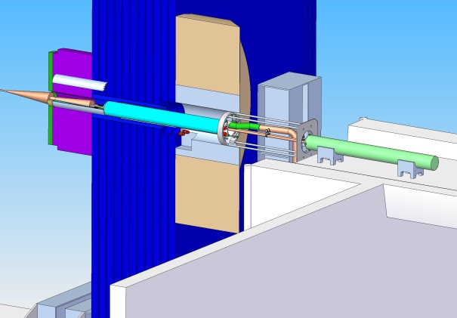
Machine Detector Interface & Final Focus
ILC/CLIC MDI panel establishing parameters for:
IR hall size, layout, access shafts, crane coverage, facilities + services …
push-pull scheme for SiD + ILD detectors (platform, motion system, alignment …)
backgrounds + radiation shielding
detector assembly/access scheme
support scheme for QD0s within detector
QD0 - QD0 relative stability + alignment
QD0 - QF1 interface + alignment
IP feedback integration …
CLIC MDI team (PB) – many common issues
contributed IP feedback sections to MDI
chapter of CDR
Final Focus expertise
Generic expertise applicable to other projects (eg. SuperB, …)

Slide 16

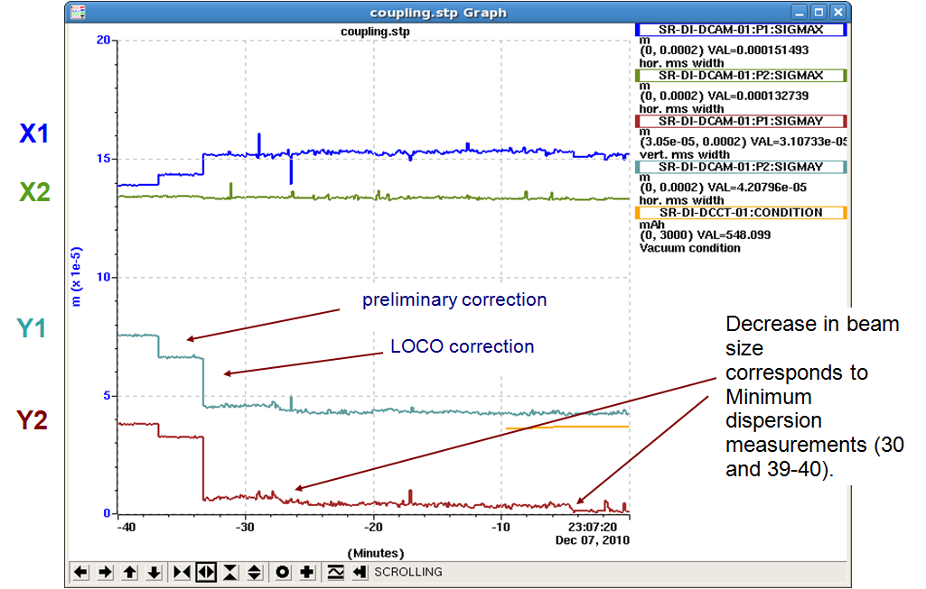
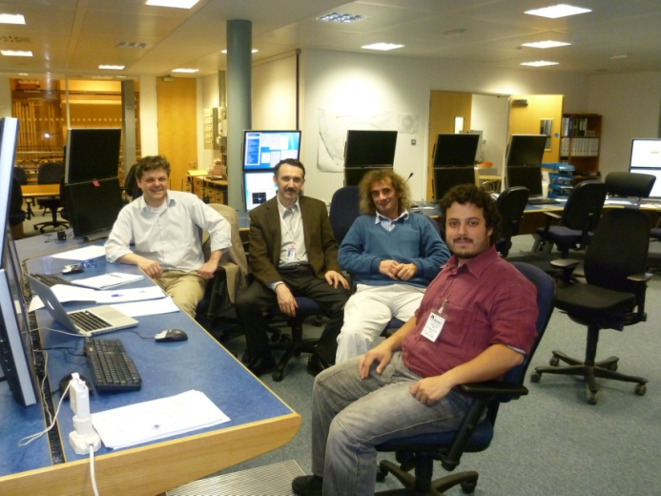
Low emittance tuning at Diamond for SuperB
Last year results on low emittance tuning and the achievement of a vertical emittance of 2.2 pm have sparked quite some interest from the Damping ring community (CLIC and ILC) and from the Super B
In collaboration with the SuperB team (P. Raimondi,. M. Biagini, S: Liuzzo) Diamond has been used as a test-bed for new techniques for low emittance tuning based on dispersion free steering and coupling free steering.
4 MD shifts at DLS
November - February
New JAI PhD student to start in October

Slide 17


Super-B UK mini-workshop
The aim is to explore possible interests in the UK accelerator and detector community in the SuperB
and
to participate in discussion so that anyone with a potential interest in SuperB has to opportunity to step forward and participate

Slide 18
Super-B UK mini-workshop
Strong expertise in accelerator science in
Diamond
Cockcroft Institute
John Adams Institute
ASTEC, RAL
UK Universities
Many synergies with ongoing R&D that will be beneficial for core UK expertise
Hope to have stronger collaboration on Super-B as a result of this meeting

