Slide 1
SuperB Project Overview
P. Raimondi,
INFN-LNF
Oxford, May 18-19, 2011

Slide 2
SuperB History
2005 started SuperB studies
2005 KEK had an KEKB upgrade plan to be completed in 2008
KEK Upgrade never done
2009 KEK Upgrade Plan was reconed to be unfeasible and not Self-Consistent
2009 KEK adopted SuperB design as only possible solution for a KEKB upgrade

Slide 3
SuperB Possible Fall Outs
LHC might adopt the CrabWaist for the LHC-Upgrade
ILC migth upgrade the Damping Rings to the SuperB design
Beijing is studying the possibility to adopt the CrabWaist to improve the Luminosity of the Tau-Charm Factory

Slide 4
SuperB International Collaboration
SLAC (DOE) is ready to contribute to the project with the PEP-B hardware worth more than 150Meuro and SLAC physicist FTEs
Novosibirsk is heavily contributing to the project with physicist FTEs, R&D on critical components and hardware construction (when it will be needed)

Slide 5
SuperB International Collaboration
In Europe the biggest contribution is from France (Orsay, Saclay, Annecy, Grenoble), in hardware (e.g. Bhabha Calorimeter for DAΦNE upgrade), R&D and FTEs
Smaller Contributors are from UK and CERN
SuperKEKB is contributing with FTEs (as well as us toward SuperKEKB)

Slide 6
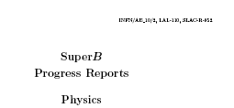
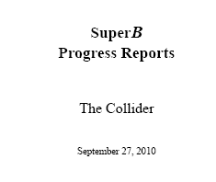
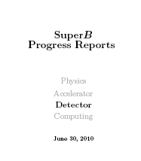
Towards the TDR
Since September 2010 the three SuperB Progress Reports “CDR2s” have been published, it was an important step forward.
Physics updated after the 2008 Valencia document.
Machine layout and parameters much better defined and optimized w.r.t. the original CDR.
Detector is almost frozen.
arXiv:1008.1541v1
arXiv:1007.4241v2
arXiv:1009.6178v1

Slide 7
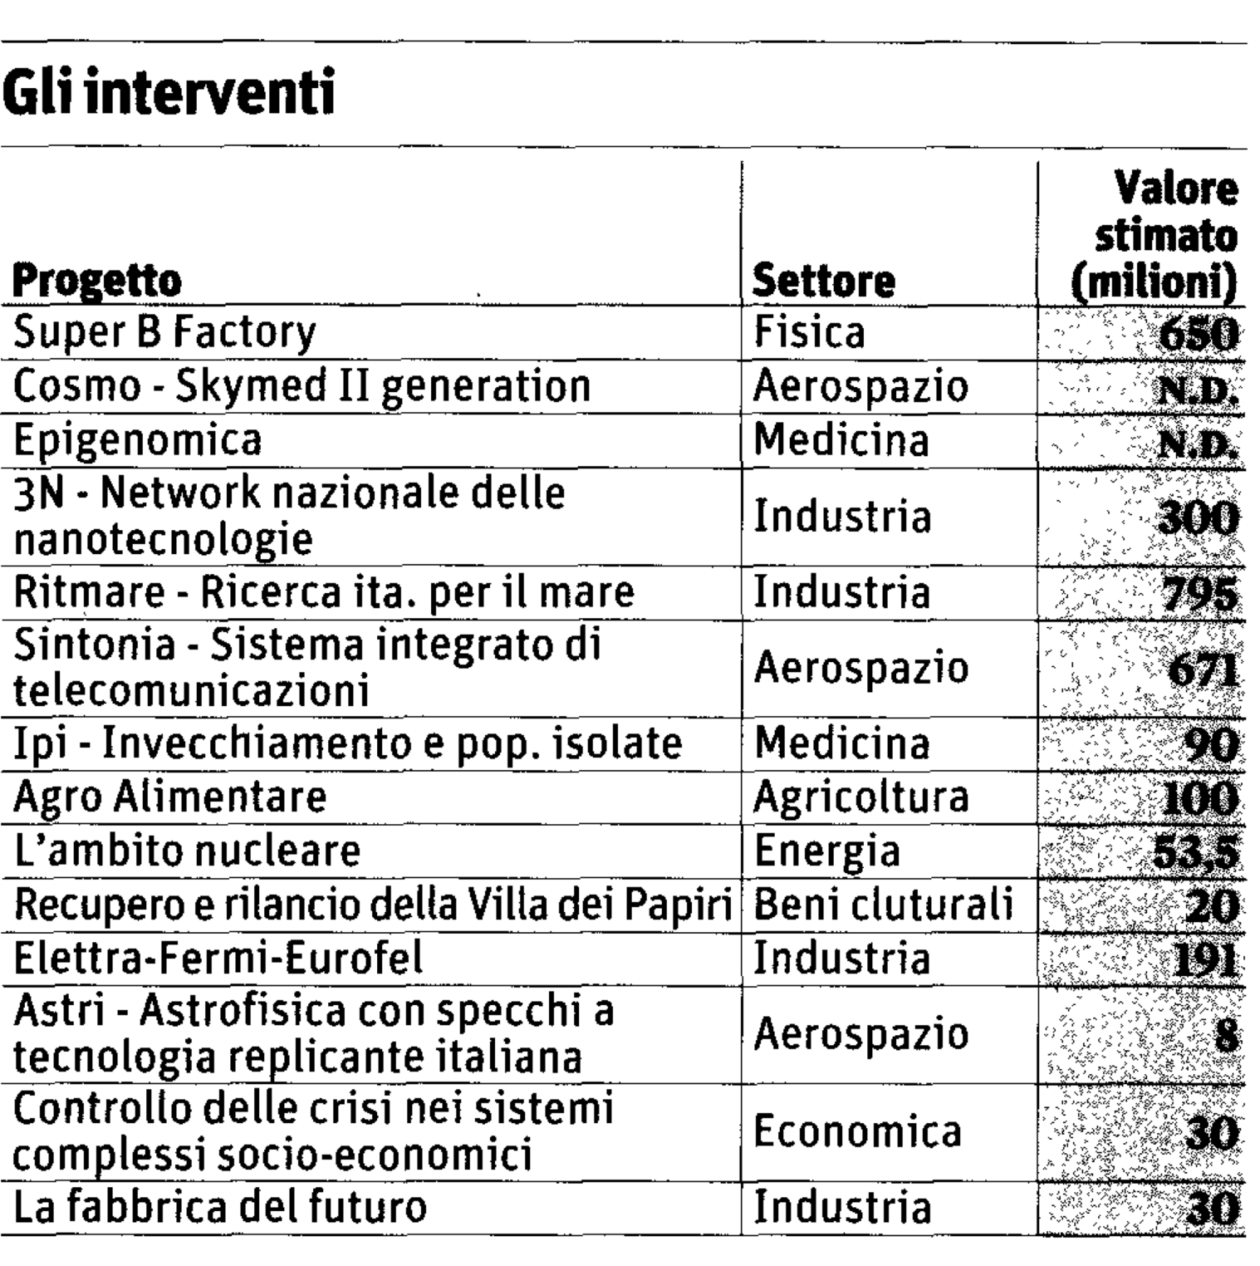
Italian
Flagship Projects

Slide 8
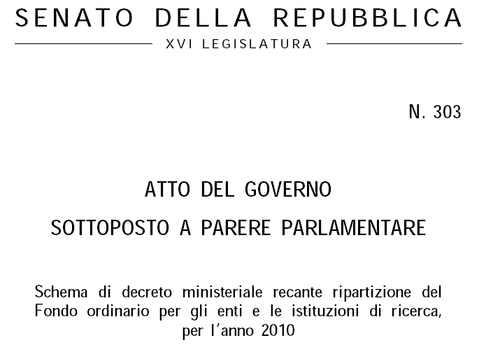
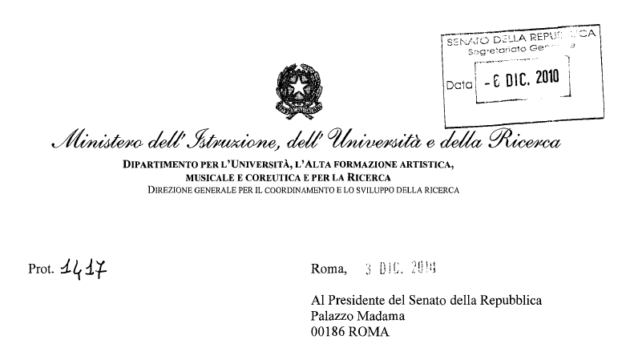
Extracts from official documents of Italian Government and Italian Parliament
Ministerial act sent to parliament on DEC 3 , 2010

Slide 9
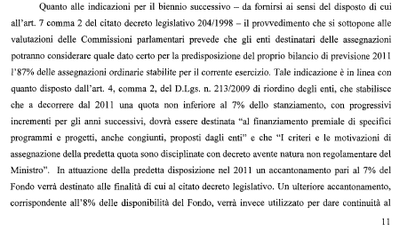
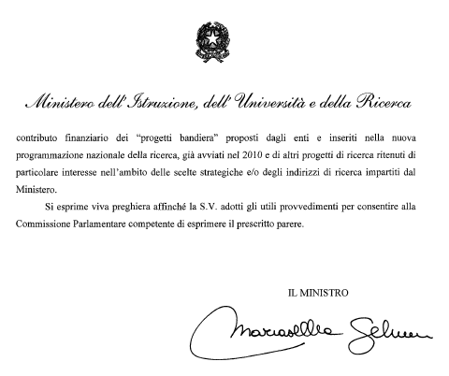
Out of the original 12 Flagship Projects “Progetto Bandiera” as presented by the Ministry of Research at the end of May 2010 and reported on the Italian media, now only 6 are funded.
The act says that 8% of the Full Budget of the Research agencies will be used from now on to ensure the full funding of the multiyear Progetti Bandiera.
SuperB is the only one quoted as multiyear.
The Minister Act was finally approved by the Senate and Chamber on Dec 14 and 15, 2010

Slide 10
In March 2011 CIPE (Inter Ministry Committee) has formally approved the National Research Plan, including the SuperB funding plan

Slide 11
From now ….. Plan for future
Establish the organization necessary to make the SuperB Accelerator TDR
The team will have the charge of the construction Phase as well. Such phase should proceed as much as possible in parallel with the TDR.
Start the recruitment, mainly Accelerator Physicists, Engineers and Technicians.
Finalize the project for a given site. At the moment we are studying the TorVergata one that presents a lot of advantages. We hope that this solution will be feasible.
Prepare for spending a reasonable fraction of the initial contribution in 2011

Slide 12
Move forward
Formalize the Collaboration among the Italian parties, at the moment: INFN, IIT, TorVergata University, Ministry of Research.
Formalize the collaboration with contributing international partners.
Prepare to submit to EU the SuperB infrastructure as an ERIC entity. A draft of governance is ready and under examination.

Slide 13

Cover Page of the Governance Draft
SuperB ERIC Statute
12 October 2010-Draft
DRAFT
Statute of the European Research Infrastructure Consortium SuperB
(SuperB “N. Cabibbo” ERIC)

Slide 14
Moving to next phase
1st General Meeting
Preliminary organization and WBS for Machine TDR and Construction
Initiate the collaboration for Detector Construction
Physics document to establish physics reach w.r.t. LHC (and other) experiments?
Validation of Machine Footprint by a possible MAC/MiniMAC by the end of 2011
La Biodola Isola d’Elba
May 28-June 1 + Appendix June 2 and 3

