Slide 1

Remarks from STFC
John Womersley
Super-B Workshop
Oxford
May 2011
Notes:
1

Slide 2










HM Government &
Notes:
The Science and Technology Facilities Council is an independent, non-departmental public body of the Department for Business, Innovation and Skills (DBIS).
The majority of our funding is public money from DBIS, allocated through the Comprehensive Spending Review.
STFC also receives a capital allocation from government for investment in infrastructure or assets.
STFC receives additional funding from a variety of other sources, including the other Research Councils, the European Space Agency, the European Commission and industry.

Slide 3

Making the case for STFC’s science
in the 2010 comprehensive spending review
UK research is world leading
Knowledge economy
  STEM skills
Inspirational power of
STFC science areas
  90% of undergraduate
  physics students . . .
Quantifiable value of
PhD students to economy

Slide 4

Impact through inspiration

Slide 5
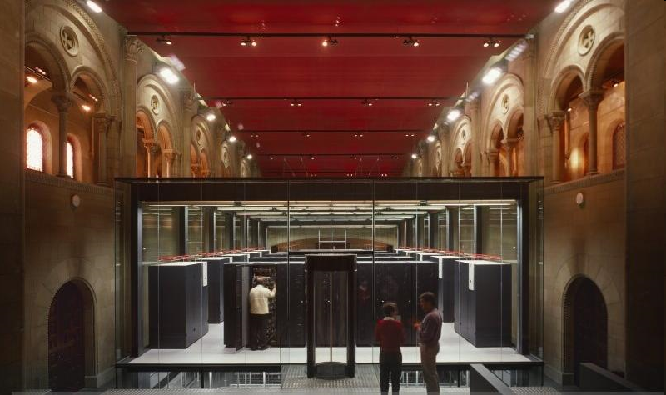
Our science also drives technological innovation:
  optics, detectors, signal processing, wi-fi
  data intensive e-science …

Slide 6
Outcome of the 2010
Comprehensive Spending Review
Overall the settlement was a good one for STFC
  Especially compared to what we were led to expect earlier in 2010
Essentially a flat cash outcome with full support of our international subscriptions
  However, challenging reductions to our capital allocation
Will not require any cuts to our programme or to our grants or studentships compared with our 2009 plans
  However, the 2009 prioritised programme was already quite narrow, and the CSR settlement does not provide any headroom to add new initiatives

Slide 7
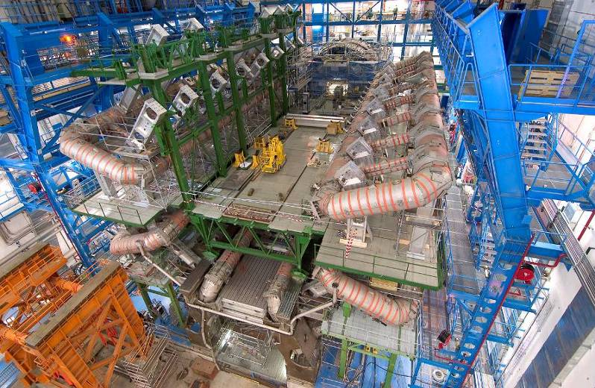
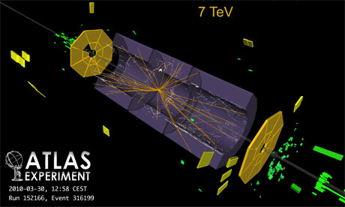
Particle Physics
Our highest priority in particle physics is the exploitation of the Large Hadron Collider at CERN. The LHC will reveal how nature operates at energy scales where the standard model of particle physics breaks down and will transform our understanding of the fundamental rules of the universe
Exploring neutrino mass and mixing with MINOS, T2K and SuperNEMO
John Womersley

Slide 8
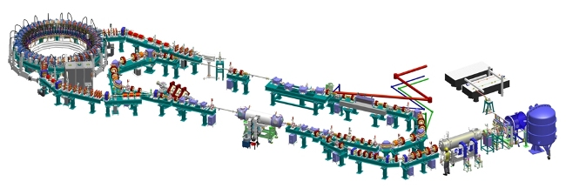
Accelerator R&D
Our new Accelerator Strategy Board provides strategic programme advice
  Set out the programme and future funding level for electron, laser-plasma and proton accelerator R&D
  Will be reviewing future funding for John Adams Institute and High Power Proton Accelerator work this summer, along with a mid-term review of the Cockcroft Institute later this year

Slide 9
What could the UK bring to Super-B? (1)
Broad variety of relevant expertise in accelerator science and technology:
  Large scale electron storage rings
    Diamond
  Test facilities
    ALICE
  In the universities and accelerator Institutes
    MDI, FF, optics …

Slide 10
What could the UK bring to Super-B? (2)
World class detector capabilities especially in silicon tracking and vertex detectors
  In RAL and in the university groups
Leading flavour physics community with a great deal of highly relevant experience in BaBar

Slide 11
Potential hurdles to participation
Funding landscape is tight
  Essentially no headroom for next 3-4 years:
  new projects depend on slippages and squeezes in the programme
  Need to leverage existing effort
  Need to share R&D with other projects where possible
Is the level of community interest increasing, now that Super-B is moving towards realisation?

Slide 12
Areas of collaboration?
Already contributed significantly to design studies
Possible future contributions
Collaboration on the accelerator
A substantial contribution to the pixel vertex detector has been suggested
  O(£5-10M)

Slide 13
Conclusions
Over the next four years, we have to find ways to maintain our scientific position on essentially flat funding while protecting our long term vision and prospects
We need scientifically excellent projects that are imaginative, affordable, and relevant
Is Super-B one of them?
Key questions:
Science excellence
Affordability
Level of community interest
Notes:
13

Slide 14
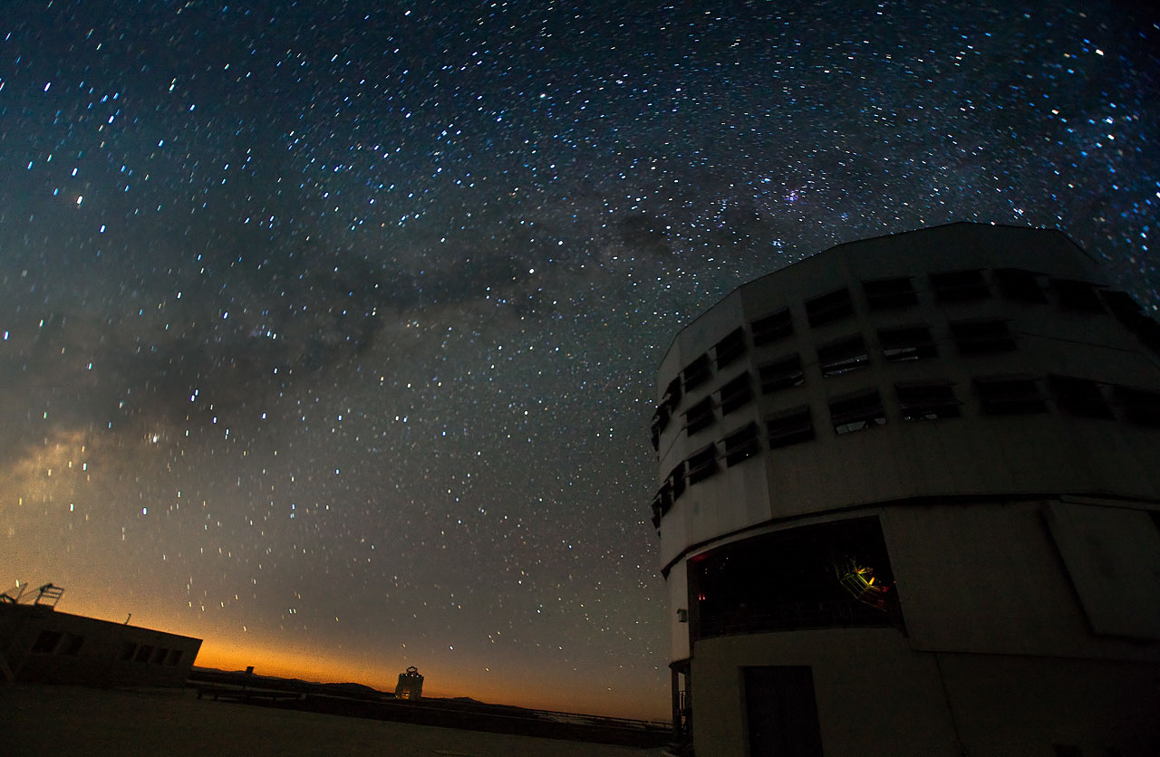
Questions

