Slide 1
Magnet and Wiggler Expertise Within STFC
Jim Clarke
ASTeC, STFC Daresbury Laboratory
SuperB mini-workshop, Oxford, May 2011

Slide 2
Contents
Introduction
Electromagnets
Permanent Magnets
Superconducting Magnets
Facilities & Codes
Summary

Slide 3

Introduction
Key centre of mass for accelerator magnet expertise within the UK resides in the Magnetics & Radiation Sources Group at Daresbury Laboratory
7 physicists who have all worked actively on various magnet projects
Backed up by an experienced engineering team at Daresbury and Rutherford

Slide 4
Conventional Magnets
Dipoles, Quadrupoles, Sextupoles, ...
Kickers & Septums
Recent projects
  Diamond
  ALICE
  EMMA
DC, AC, & Pulsed

Slide 5
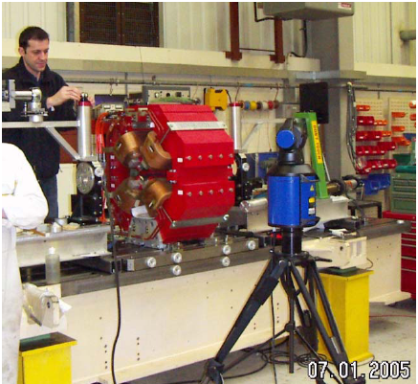
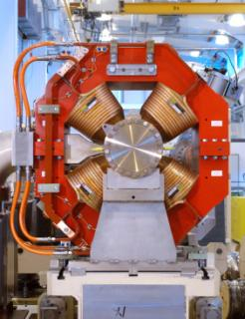
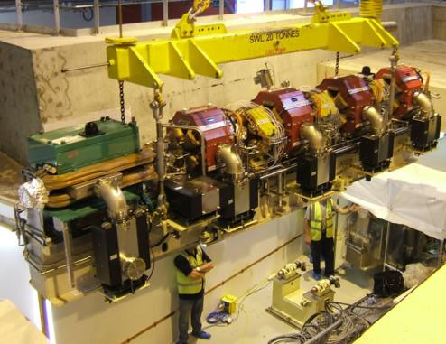
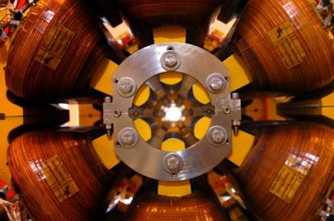
Diamond Storage Ring

Slide 6
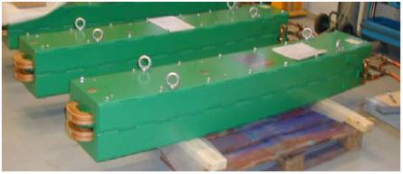
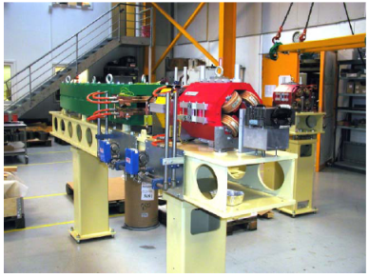
Diamond Booster, 5 Hz

Slide 7
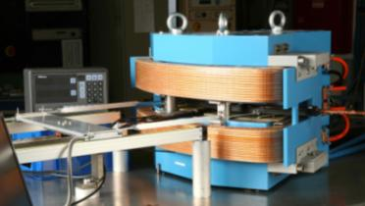
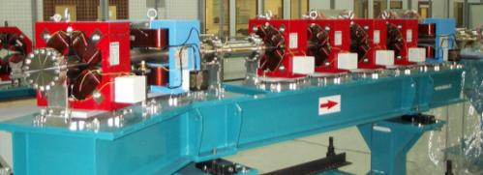
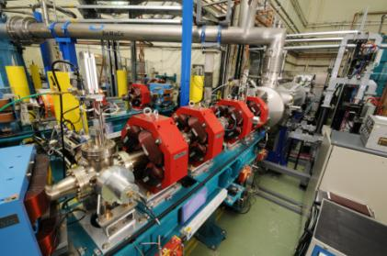
ALICE

Slide 8
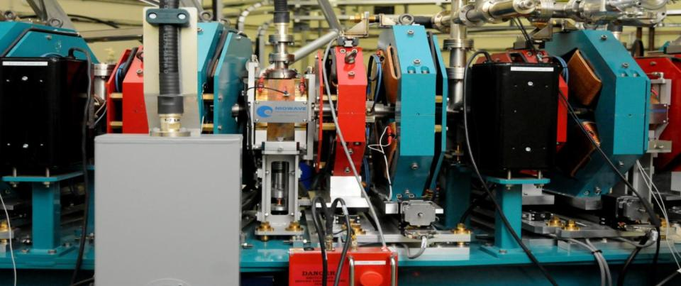
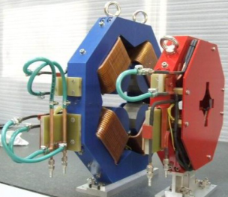
EMMA Quadrupoles
FQUAD
Cavity
DQUAD
Ion
Pump
Girder
Beam direction

Slide 9
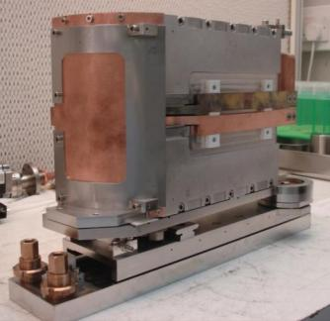
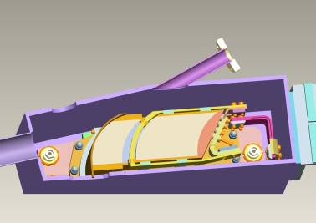
EMMA Septum
Translation
Maximum beam deflection angle | 77 | degrees
Maximum flux density in gap | 0.91 | T
C core magnet gap height | 22.0 | mm
Internal horizontal beam ‘stay-clear’ | 62.5 | mm
Turns on excitation coil | 2
Excitation half-sine-wave duration | 25 | µs
Excitation peak current | 9.1 | kA
Excitation peak voltage | 900 | V
Septum magnet repetition rate | 20 | Hz
Rotation
Septum out of vacuum chamber
Section view of septum in vacuum chamber

Slide 10
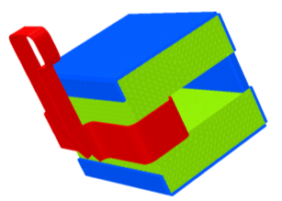
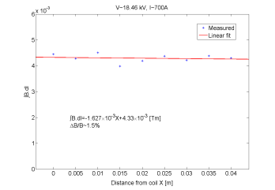
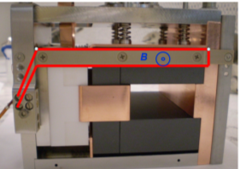

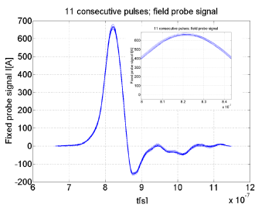
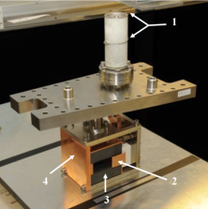
EMMA Kickers
Concept
Field quality
In-situ field probe
Before installation
Max. strength 0.007 Tm
Effective length 130 mm
Field variation 1.5%
Fall time 58 ns
Timing jitter 1.7 ns
Amplitude stability 4%.

Slide 11

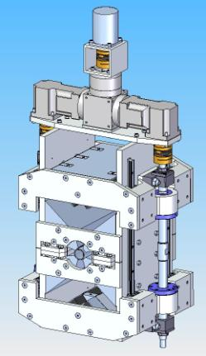
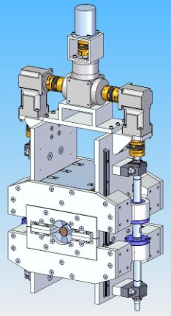
PM Quadrupoles for CLIC
Wide tunability
High gradient
Design has been patented
Prototype to be constructed this year
Fully Open
Fully Closed

Slide 12
Undulators & Wigglers
Recent projects include
  SRS
  Diamond
  ALPHA-X
  ALICE
  ILC
Permanent magnets
Superconducting

Slide 13
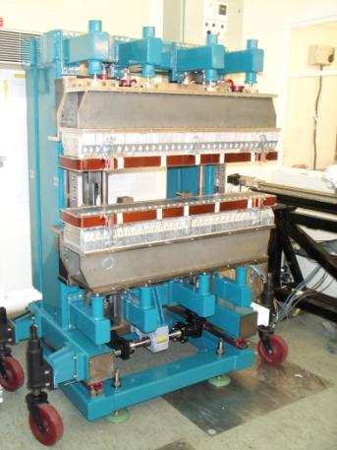
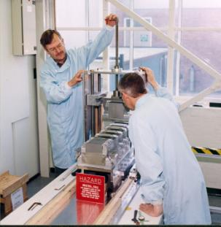
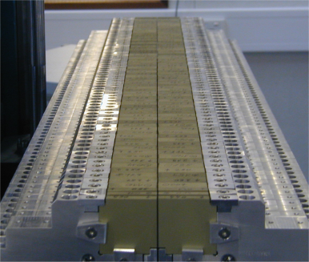
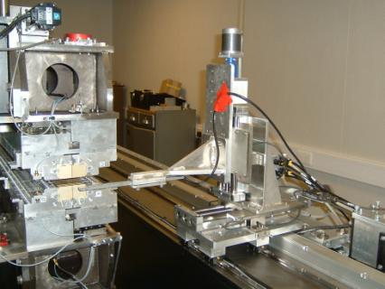
SRS
2.4T PM Wiggler
Undulator

Slide 14
Diamond
In-vacuum undulator
Variable Polarisation
Superconducting Wiggler (built by BINP)

Slide 15
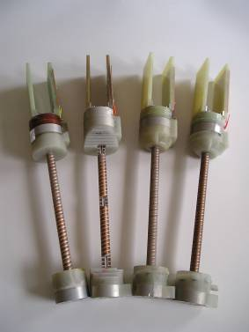
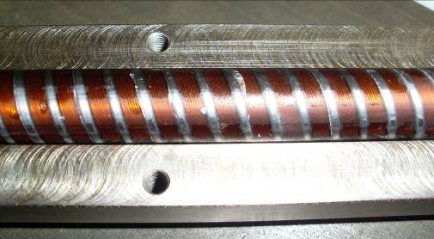
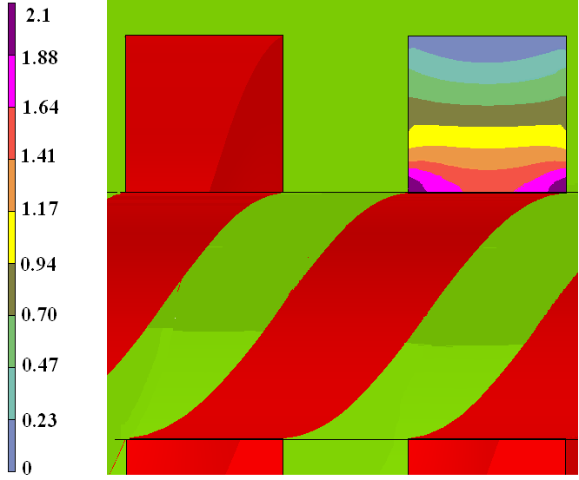
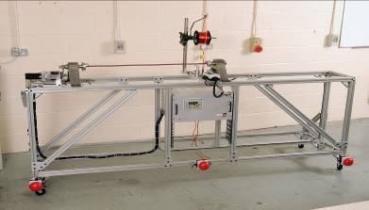
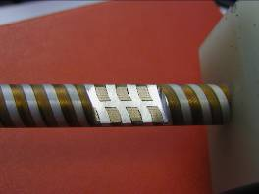
SC Helical Undulators

Slide 16
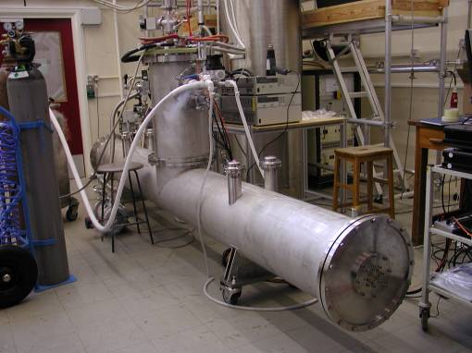
SC Helical Undulator
A 4m module containing 2 x 1.75m helical undulators (11.5 mm period) built by STFC
Closed loop cryo system with cryocooler

Slide 17
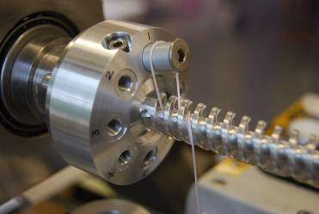
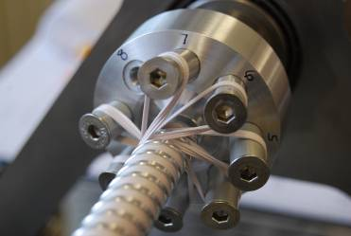
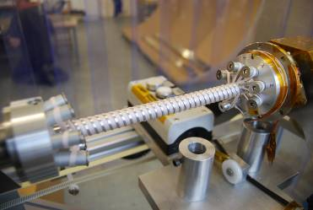
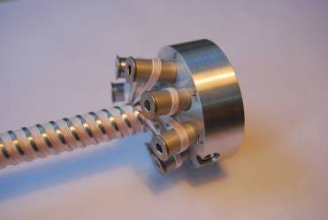
Experience with Nb₃Sn

Slide 18
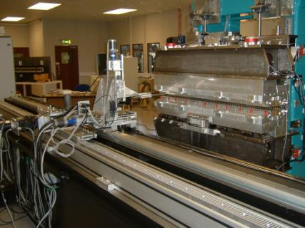
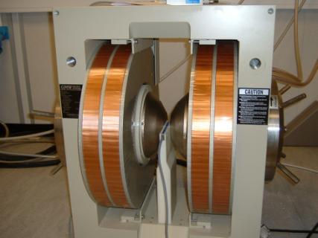
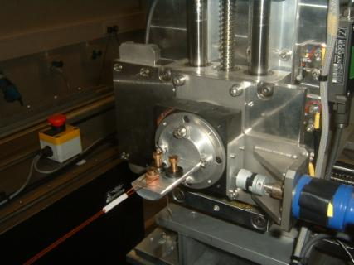
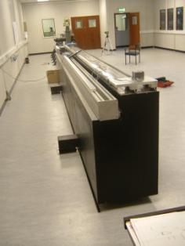
Magnet Test Facilities at Daresbury

Slide 19
Codes
We have access to a wide variety of codes for magnet modelling
  Opera 2D
  Opera 3D
    Tosca
    Elektra
  CST EM Studio (3D)
  RADIA (3D) - very good for PM undulators
There are 7 physicists in the MaRS group and they are all proficient with at least one of these codes

Slide 20
General Remarks
The Magnetics and Radiation Sources Group within STFC is a key UK centre of mass for accelerator magnet expertise
We have skills in all areas of magnets over all technologies
We have access to powerful magnet design codes
We operate a state of the art Magnet Test Laboratory

