Slide 1










The Path Towards
the Future Circular Collider at CERN
Emmanuel Tsesmelis
CERN
Head of Associate Member State and Non-Member State Relations
Convenor of FCC Global Collaboration Working Group
KPS Pioneer Session - Present and Future of the LHC Programme at CERN
Changwon, Republic of Korea
26 October 2023
LHC
PS
SPS
FCC
http://cern.ch/fcc
Work supported by the European Commission under the HORIZON 2020 projects EuroCirCol, grant agreement 654305; EASITrain, grant agreement no. 764879; iFAST, grant agreement 101004730, FCCIS, grant agreement 951754; E-JADE, contract no. 645479; EAJADE, contact number 101086276; and by the Swiss CHART program
photo: J. Wenninger

Slide 2

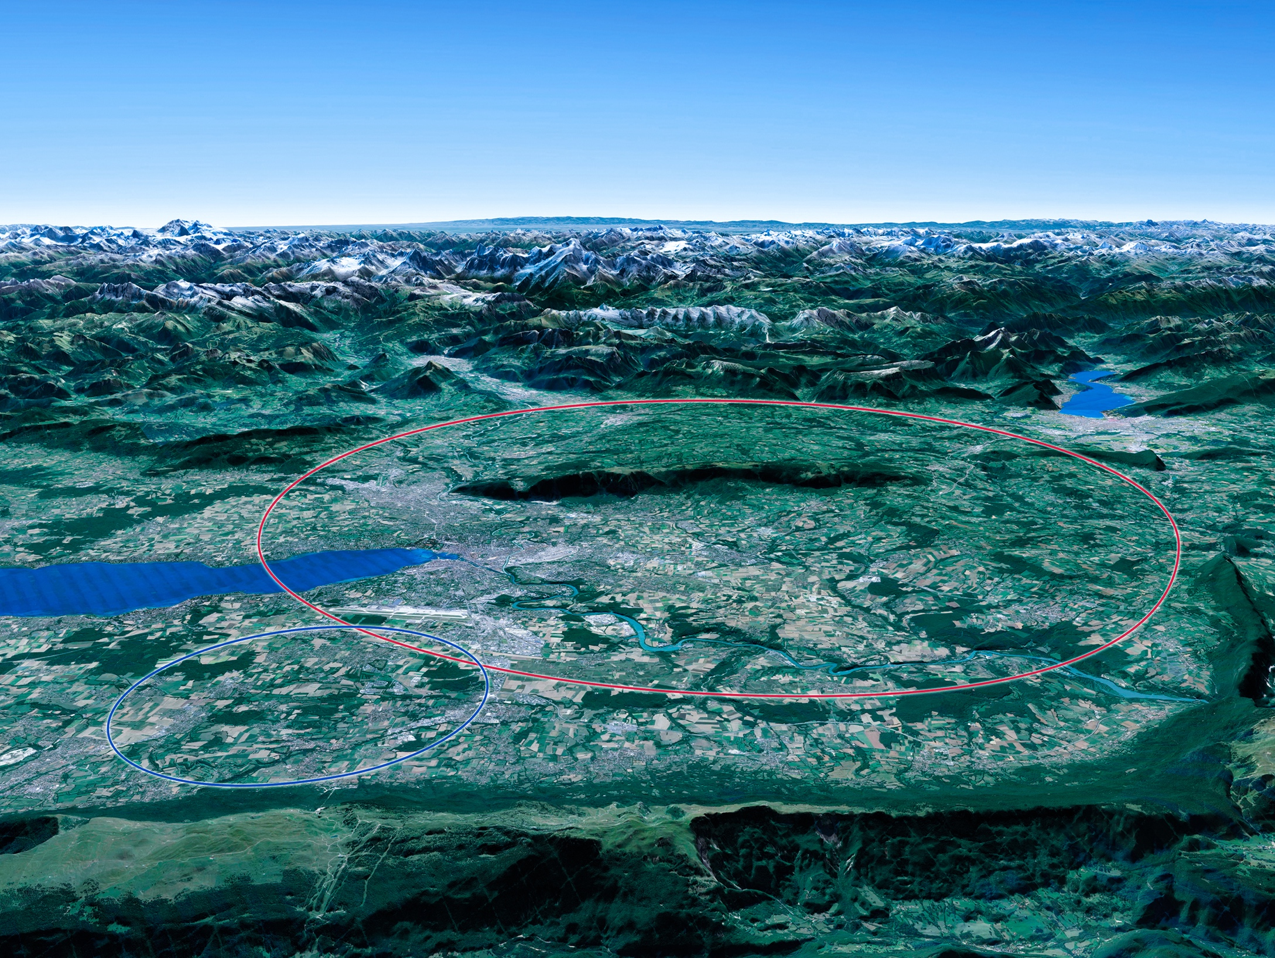

CERN Scientific Priorities for the Future
Implementation of the recommendations
of the 2020 Update of the European Strategy for Particle Physics:
Fully exploit the LHC & HL-LHC.
Build a Higgs factory to further understand this unique particle.
Investigate the technical and financial feasibility of a future energy-frontier 100 km collider at CERN.
Ramp up relevant R&D.
Continue supporting other projects around the world.
LHC
Notes:
For information, the ESPPU recommendations in more detail:
Full exploitation of the HL-LHC
An electron-positron Higgs factory is the highest priority after the LHC
Ramp up R&D efforts for advanced accelerator technologies
Support long-baseline neutrino projects in Japan and US
Investigation of feasibility of a future 100 TeV hadron collider at CERN
THIS IS THE LAST SLIDE IN THE “RESEARCH” SECTION

Slide 3

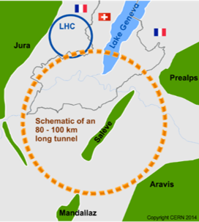
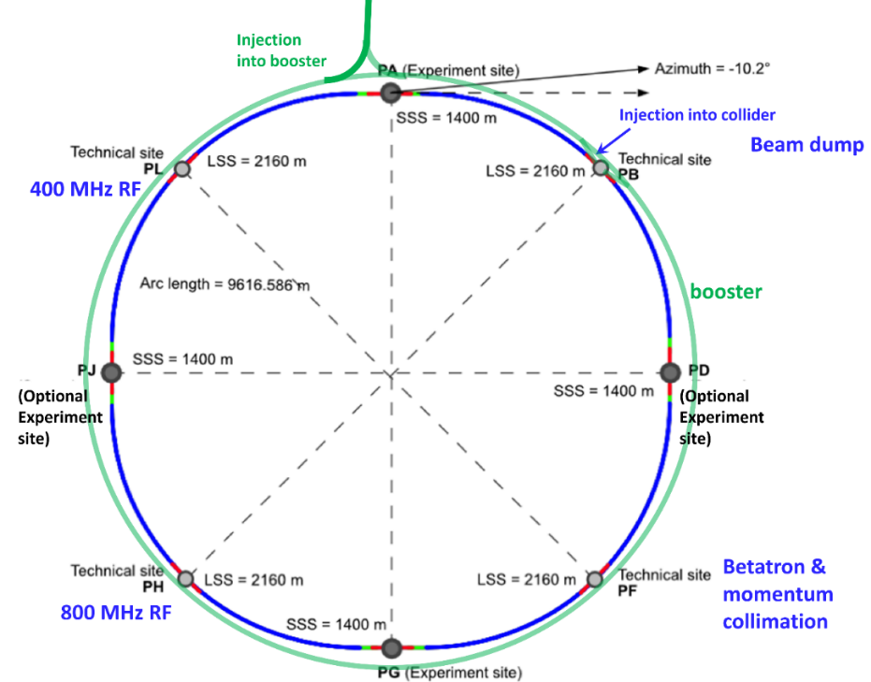
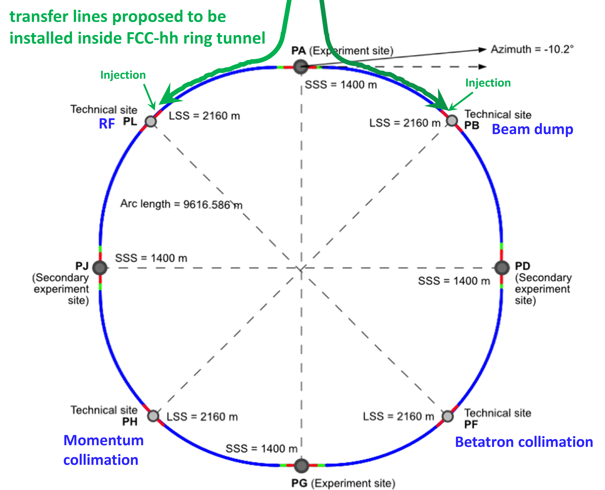
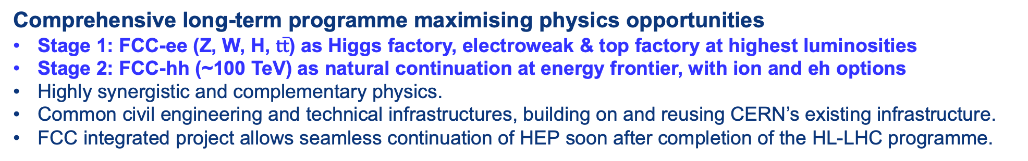
The FCC Integrated Programme
Inspired by Successful LEP – LHC Programmes at CERN
Comprehensive long-term programme maximising physics opportunities
Stage 1: FCC-ee (Z, W, H, $\text{t}\overline{\text{t}}$) as Higgs factory, electroweak & top factory at highest luminosities
Stage 2: FCC-hh (~100 TeV) as natural continuation at energy frontier, with ion and eh options
Highly synergistic and complementary physics.
Common civil engineering and technical infrastructures, building on and reusing CERN’s existing infrastructure.
FCC integrated project allows seamless continuation of HEP soon after completion of the HL-LHC programme.
FCC-ee
FCC-hh
2020 - 2040
2045 - 2063
2070 - 2095
A similar two-stage project CEPC/SppC is under study in China

Slide 4


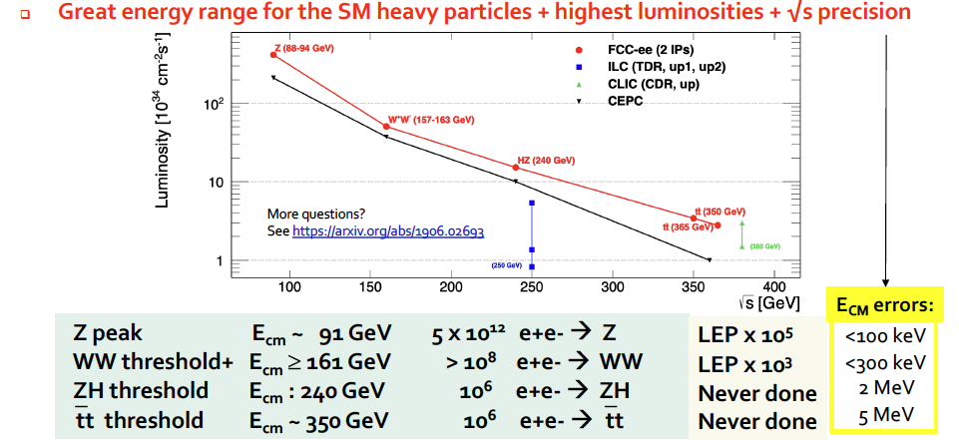
FCC-ee Higgs and Electroweak Factory
Increasing international collaboration as a prerequisite for success:
links with science, research & development and high-tech industry will be essential to further advance and prepare the implementation of FCC
P. Janot

Slide 5
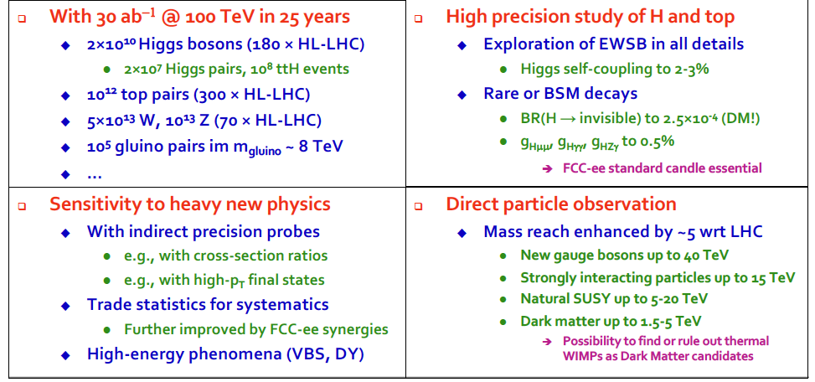
Physics Opportunities with FCC-hh
Increasing international collaboration as a prerequisite for success:
links with science, research & development and high-tech industry will be essential to further advance and prepare the implementation of FCC
P. Janot

Slide 6
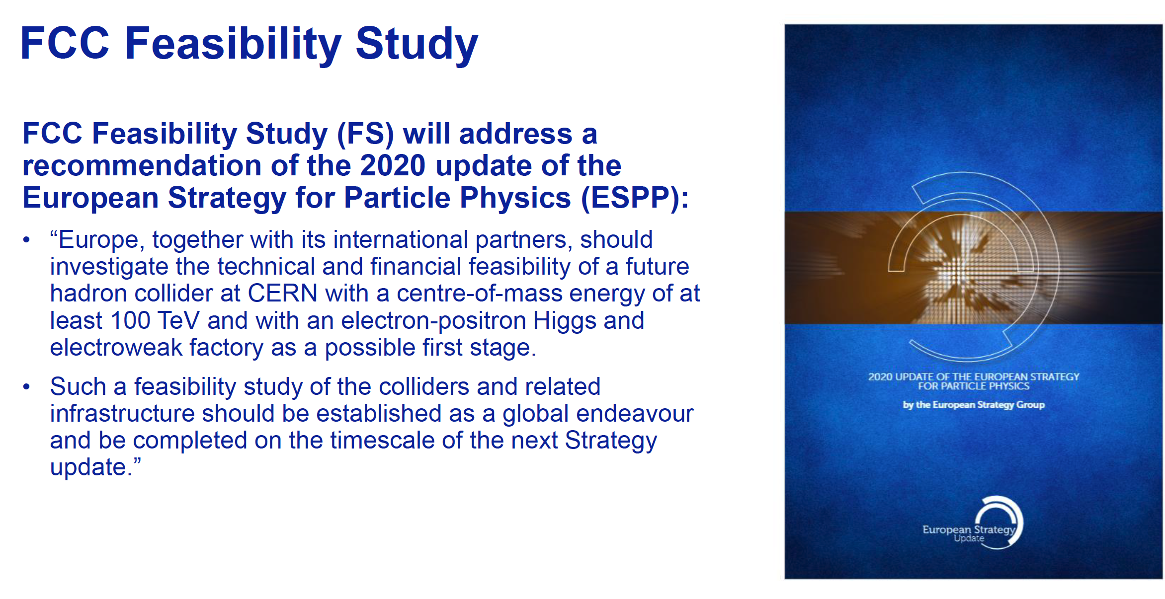
FCC Feasibility Study
Increasing international collaboration as a prerequisite for success:
links with science, research & development and high-tech industry will be essential to further advance and prepare the implementation of FCC
FCC FS is organised as an international collaboration.
The FCC FS and a possible future project will profit from CERN’s decades-long experience with successful large international accelerator projects, e.g. the LHC and HL-LHC, and the associated global experiments, such as ATLAS and CMS.

Slide 7
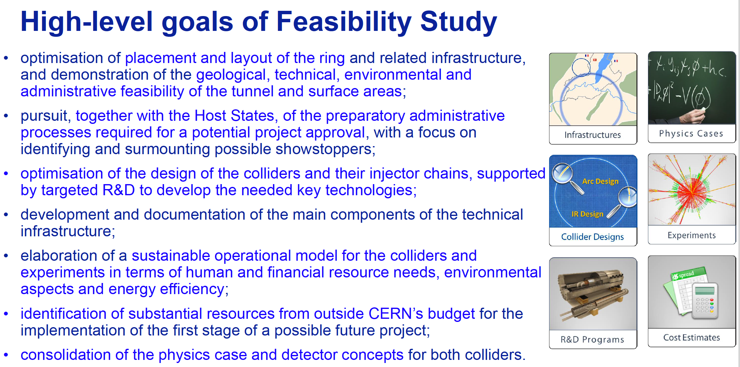
High-level Goals of Feasibility Study
Increasing international collaboration as a prerequisite for success:
links with science, research & development and high-tech industry will be essential to further advance and prepare the implementation of FCC

Slide 8

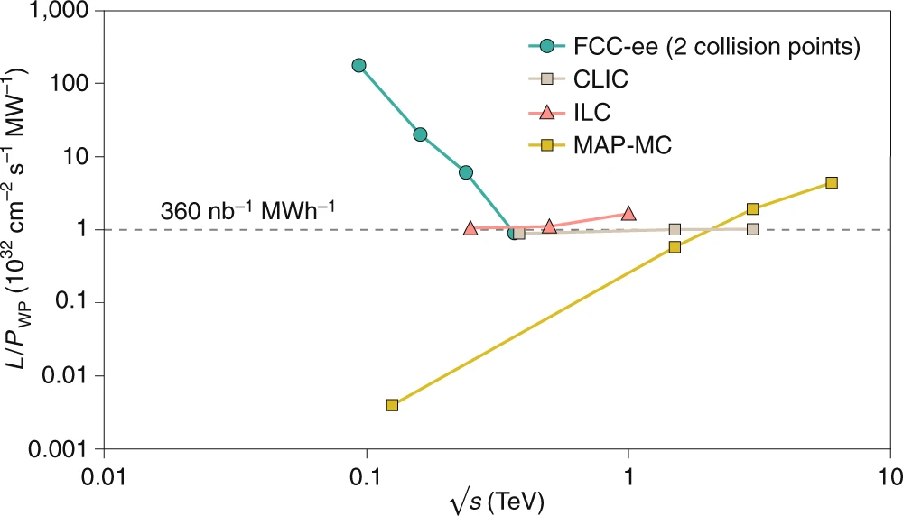
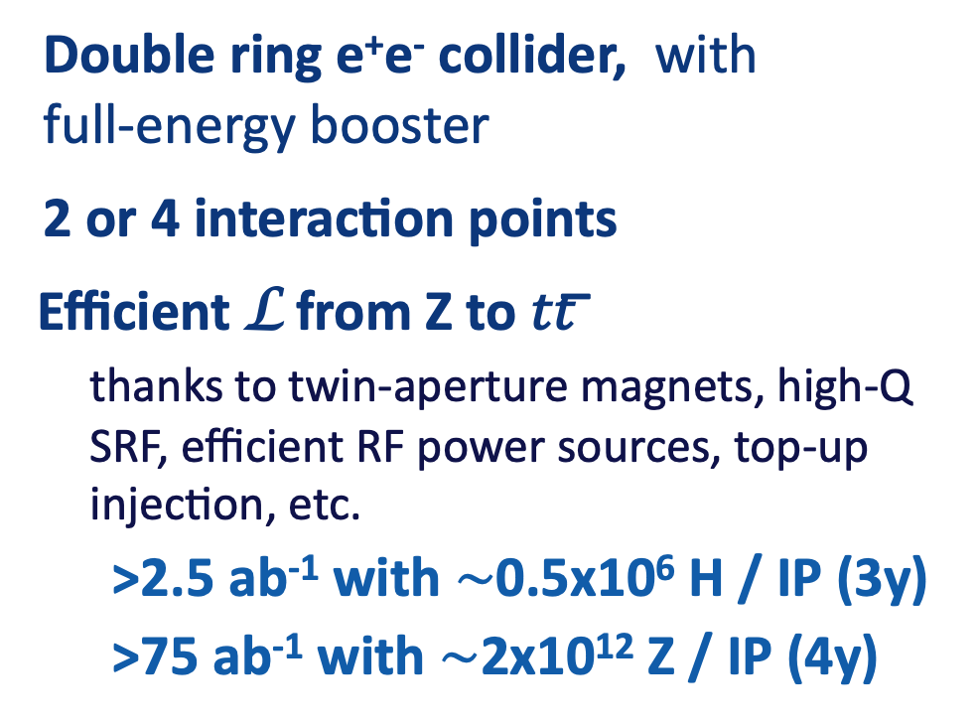
Stage 1: FCC-ee Highest Luminosity Lepton Collider
Double ring e⁺e⁻ collider, with full-energy booster
2 or 4 interaction points
Efficient L from Z to 𝑡𝑡 ̅
  thanks to twin-aperture magnets, high-Q SRF, efficient RF power sources, top-up injection, etc.
>2.5 ab⁻¹ with $\sim$0.5x10⁶ H / IP (3y)
>75 ab⁻¹ with $\sim$2x10¹² Z / IP (4y)
Luminosity vs. Electricity Consumption
Enormous performance increase:
collects LEP data statistics in few minutes
Highest lumi/power of all H fact. proposals
Nature Physics 16, 402–407 (2020)

Slide 9
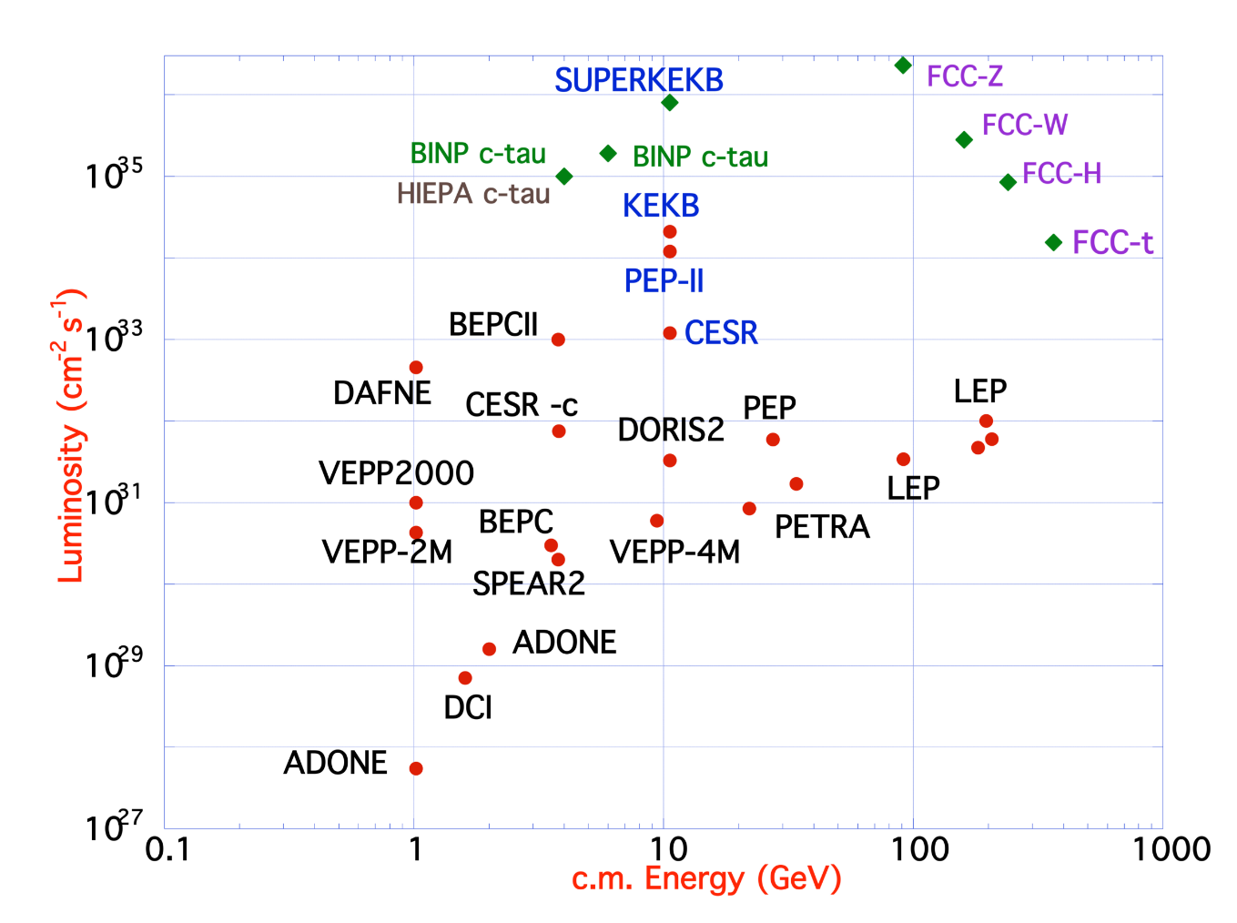
FCC-ee Design Concept
Based on lessons and techniques from past colliders (last 40 years)
B-factories: KEKB & PEP-II:
double-ring lepton colliders,
high beam currents,
top-up injection
DAFNE: crab waist, double ring
S-KEKB: low β_{y}*, crab waist
LEP: high energy, SR effects
VEPP-4M, LEP: precision E calibration
KEKB: e⁺ source
HERA, LEP, RHIC: spin gymnastics
Marica Biagini
Marica Biagini
combining successful ingredients of several recent colliders → highest luminosities & energies

Slide 10
Stage 1: FCC-ee Collider Parameters
Parameter | Z | WW | H (ZH) | ttbar
beam energy [GeV] | 45.6 | 80 | 120 | 182.5
beam current [mA] | 1270 | 137 | 26.7 | 4.9
number bunches/beam | 11200 | 1780 | 440 | 60
bunch intensity [10¹¹] | 2.14 | 1.45 | 1.15 | 1.55
SR energy loss / turn [GeV] | 0.0394 | 0.374 | 1.89 | 10.4
total RF voltage 400/800 MHz [GV] | 0.120/0 | 1.0/0 | 2.1/0 | 2.1/9.4
long. damping time [turns] | 1158 | 215 | 64 | 18
horizontal beta* [m] | 0.11 | 0.2 | 0.24 | 1.0
vertical beta* [mm] | 0.7 | 1.0 | 1.0 | 1.6
horizontal geometric emittance [nm] | 0.71 | 2.17 | 0.71 | 1.59
vertical geom. emittance [pm] | 1.9 | 2.2 | 1.4 | 1.6
horizontal rms IP spot size [μm] | 9 | 21 | 13 | 40
vertical rms IP spot size [nm] | 36 | 47 | 40 | 51
beam-beam parameter ξ_{x} / ξ_{y} | 0.002/0.0973 | 0.013/0.128 | 0.010/0.088 | 0.073/0.134
rms bunch length with SR / BS [mm] | 5.6 / 15.5 | 3.5 / 5.4 | 3.4 / 4.7 | 1.8 / 2.2
luminosity per IP [10³⁴ cm⁻²s⁻¹] | 140 | 20 | 5.0 | 1.25
total integrated luminosity / IP / year [ab⁻¹/yr] | 17 | 2.4 | 0.6 | 0.15
beam lifetime rad Bhabha + BS [min] | 15 | 12 | 12 | 11
Currently assessing
technical feasibility
of changing operation
sequences
(e.g. starting at ZH energy)
4 years
5 x 10¹² Z
LEP x 10⁵
2 years
> 10⁸ WW
LEP x 10⁴
3 years
2 x 10⁶ H
5 years
2 x 10⁶ tt pairs
x10-50 improvements on all EW observables
Up to x 10 improvement on Higgs coupling (model-indep.) measurements over HL-LHC
x10 Belle II statistics for b, c, τ
Indirect discovery potential up to ~ 70 TeV
Direct discovery potential for feebly-interacting particles over 5-100 GeV mass range
Up to 4 interaction points → robustness,
statistics, possibility of specialised detectors
to maximise physics output
F. Gianotti

Slide 11
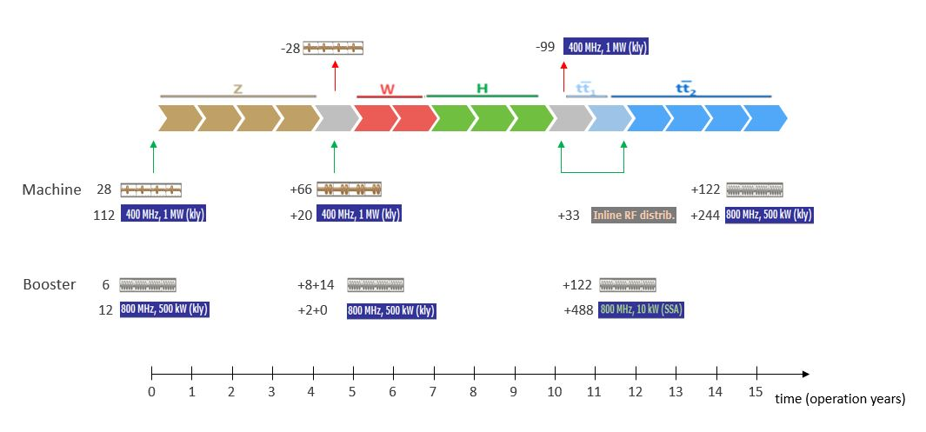
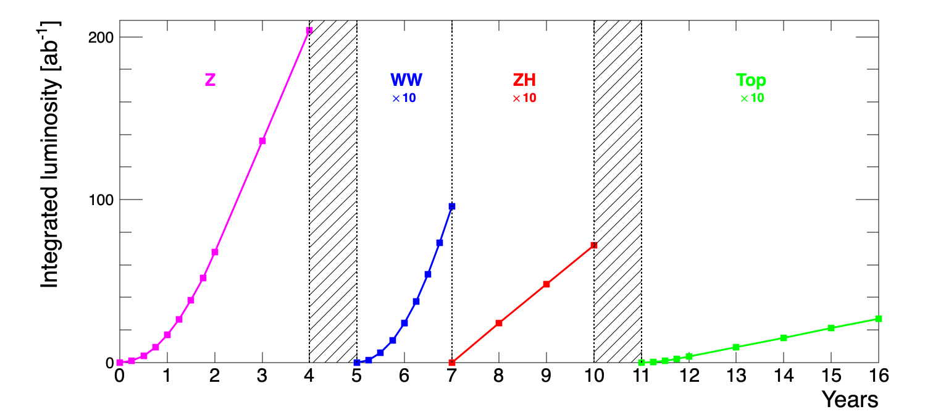
FCC-ee RF Staging Scenario
Baseline Operational Sequence Starting from Z
“Ampere-class” machine
Three sets of RF cavities to cover all options for FCC-ee & booster:
High intensity (Z, FCC-hh): 400 MHz mono-cell cavities (4/cryom.)
Higher energy (W, H, t): 400 MHz four-cell cavities (4/cryomodule)
ttbar machine complement: 800 MHz five-cell cavities (4/cryom.)
Installation sequence comparable to LEP ( ≈ 30 CM/shutdown)
WP | V_{rf} [GV] | #bunches | I_{beam} [mA]
Z | 0.1 | 16640 | 1390
W | 0.44 | 2000 | 147
H | 2.0 | 393 | 29
ttbar | 10.9 | 48 | 5.4
“high-gradient” machine
O. Brunner, F. Peauger
Notes:
“Continuous flow” operation: succession of 8 months operation, 4 months installation shutdown (LEP-like)
Three sets of cavities to cover all options (+ booster):
high intensity (Z, FCC_hh): 400 MHz mono-cell cavities, ≈1MW RF source
high energy (H, t): 400 MHz four-cell cavities -> will be used for the W machine
booster and t machine complement: 800 MHz four-cell cavities (400 MHz would do the job as well)
High energy set for the W-machine not optimal (20-30% reduction of beam current) – building & installing 48 specialized CM would impact more (>>1 year delay)
Optimize the re-use of the 100MW, 400MHz RF power & controls hardware installed for the ‘Z-machine’
design an easily adaptable and modular RF power distribution system

Slide 12

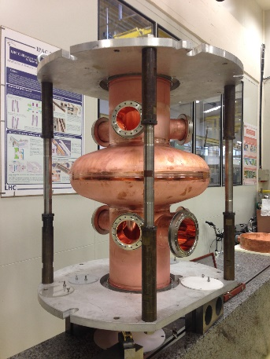
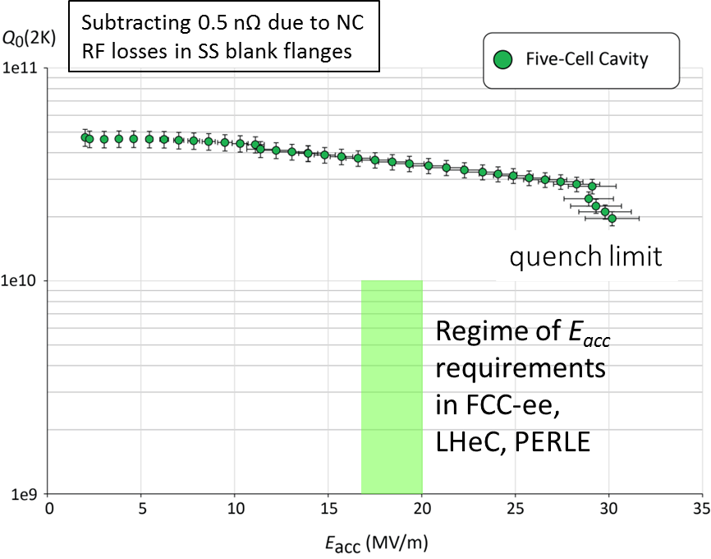
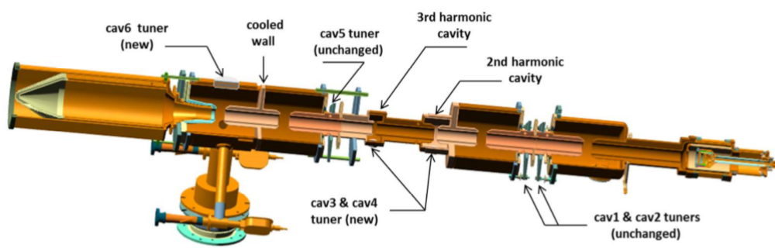
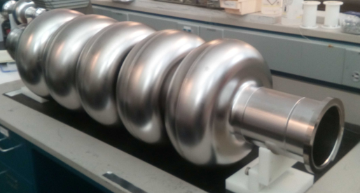
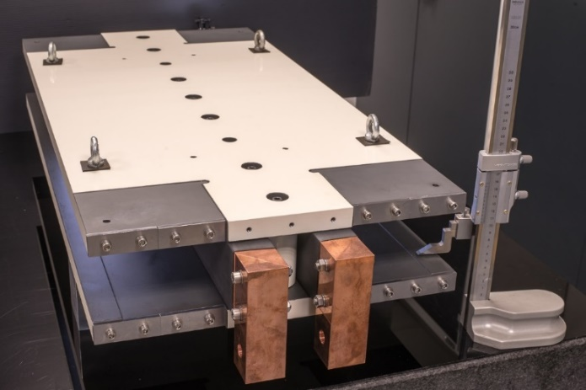
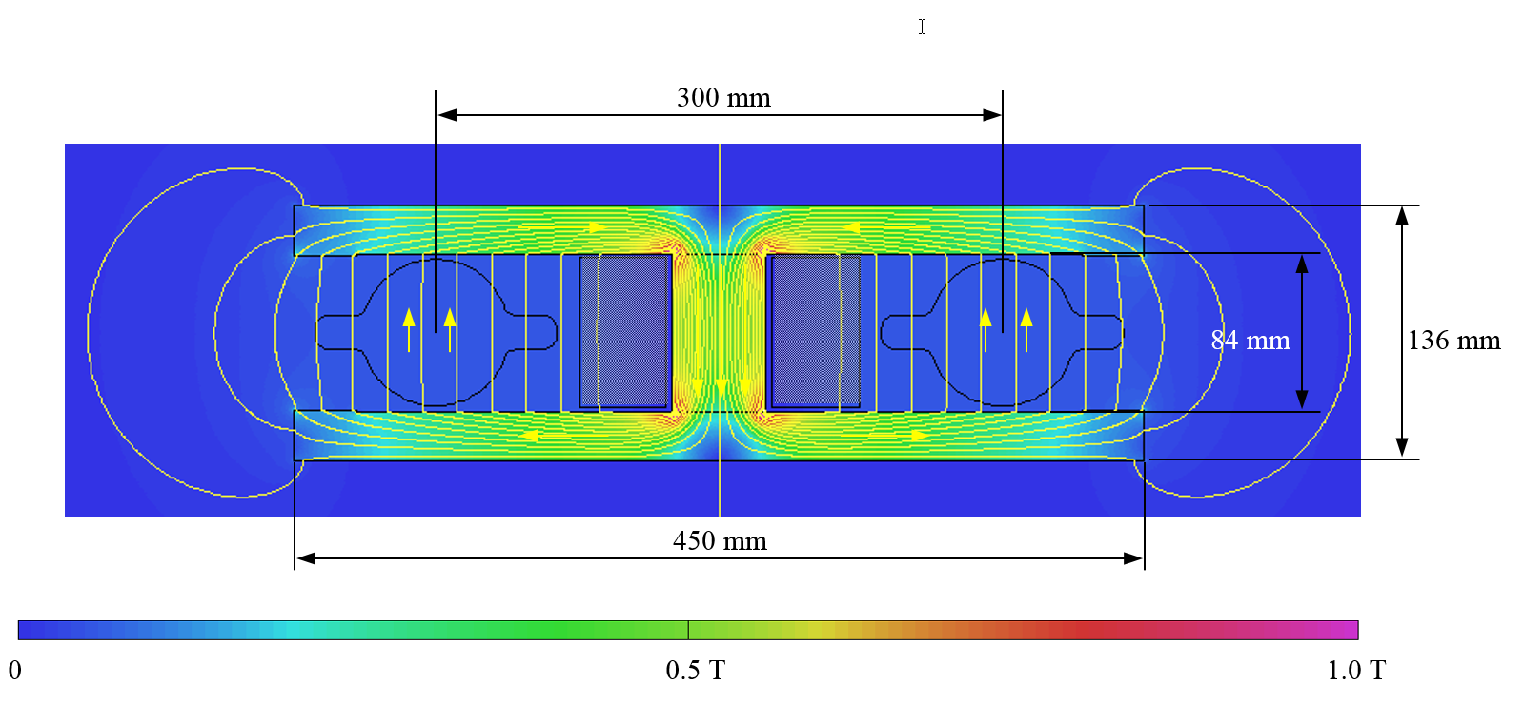

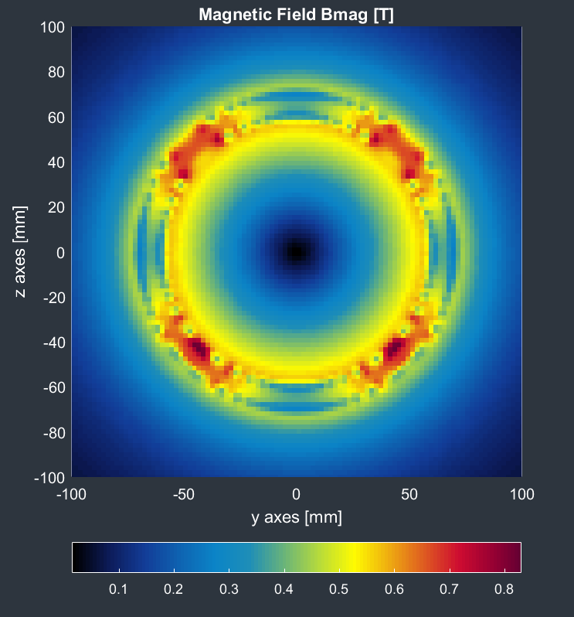
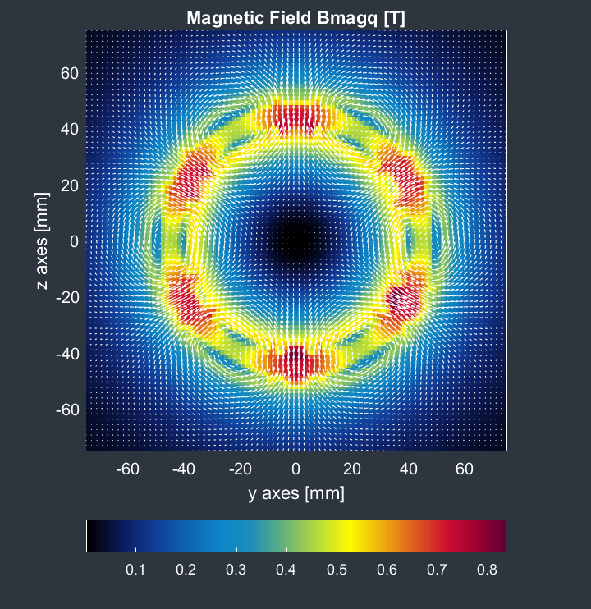
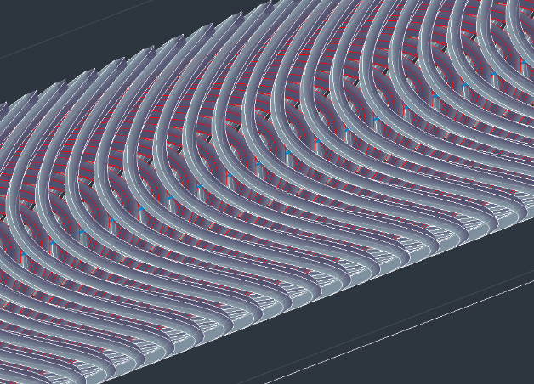

FCC-ee Accelerator R&D Examples
Efficient RF power sources
(400 & 800 MHz)
Efficient SC cavities
I. Syratchev
400 MHz 1-,2- & 4-cell Nb/Cu , 4.5 K
F. Marhauser
800 MHz 5-cell Nb
prototype / JLAB, 2 K
FPC & HOM coupler, cryomodule, thin-film coatings…
Energy efficient twin aperture arc dipoles
Under study: CCT HTS quads & sexts for arcs
A. Milanese
M. Koratzinos

Slide 13
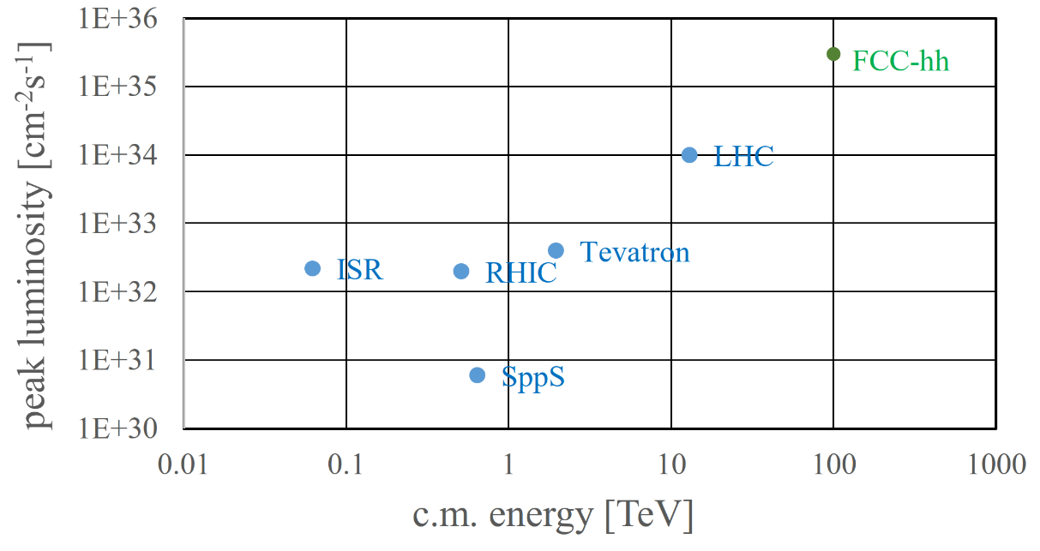
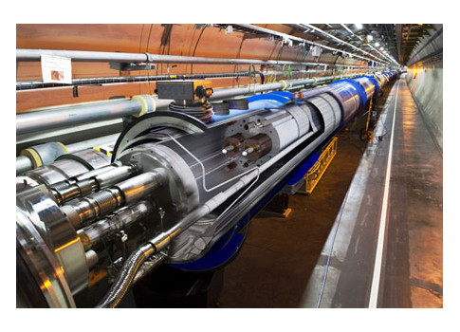
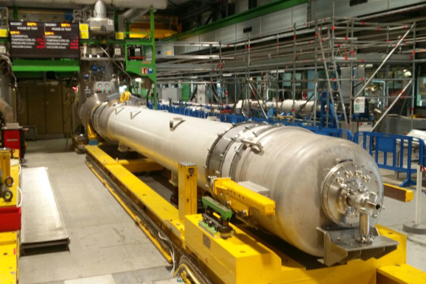
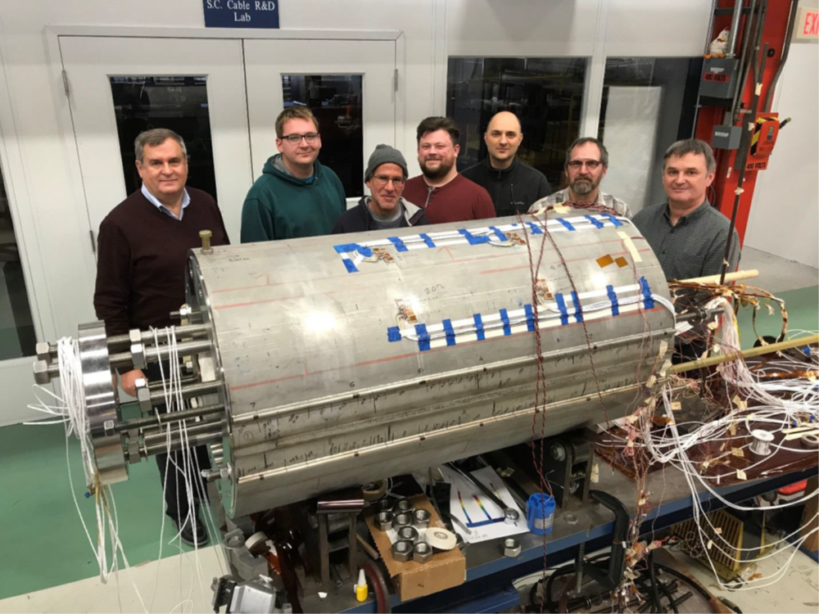
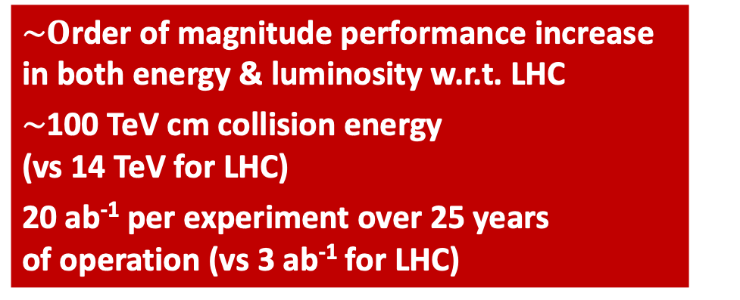
Stage 2: FCC-hh Highest Collision Energies
$\sim O$rder of magnitude performance increase in both energy & luminosity w.r.t. LHC
$\sim$100 TeV cm collision energy (vs 14 TeV for LHC)
20 ab⁻¹ per experiment over 25 years of operation (vs 3 ab⁻¹ for LHC)
Similar performance increase as from Tevatron to LHC
Key technology: high-field magnets
from
LHC technology
8.3 T NbTi dipole
via
HL-LHC technology
12 T Nb₃Sn quadrupole
FNAL dipole demonstrator
4-layer cosϑ
14.5 T Nb₃Sn in 2019
HTS technology
Hybrid Nb-Ti/HTS

Slide 14
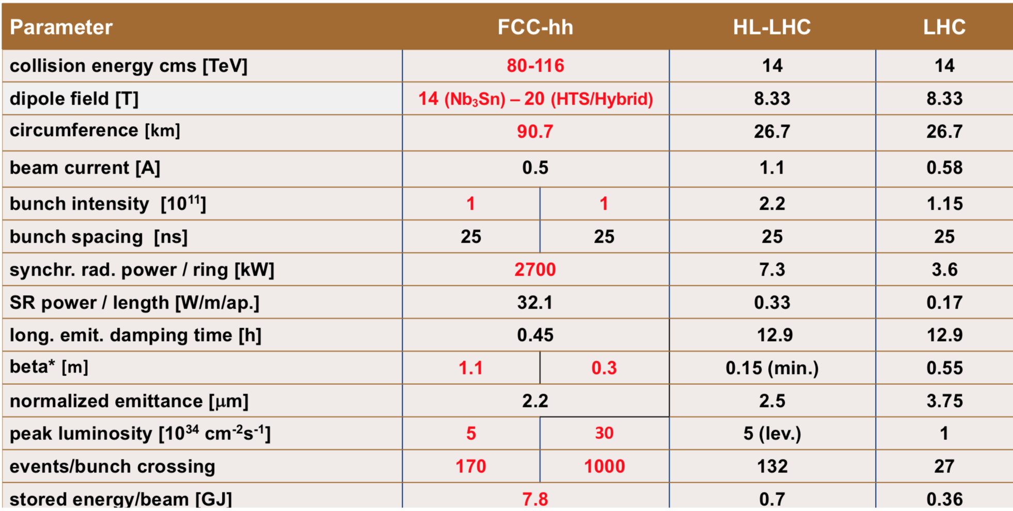
FCC-hh: Main Machine Parameters
F. Gianotti
Formidable challenges:
High-field superconducting magnets: 14 - 20 T
Power load in arcs from synchrotron radiation: 5 MW → cryogenics, vacuum
Stored beam energy: 8 GJ → machine protection
Pile-up in the detectors: ~1000 events/xing
Energy consumption: 4 TWh/year → R&D on cryo, HTS, beam current, …
Formidable physics reach, including:
Direct discovery potential up to ~ 40 TeV
Measurement of Higgs self to ~ 5% and ttH to ~ 1%
High-precision and model-indep (with FCC-ee input)
measurements of rare Higgs decays (𝛄𝛄, Z𝛄, µµ)
Final word about WIMP dark matter

Slide 15
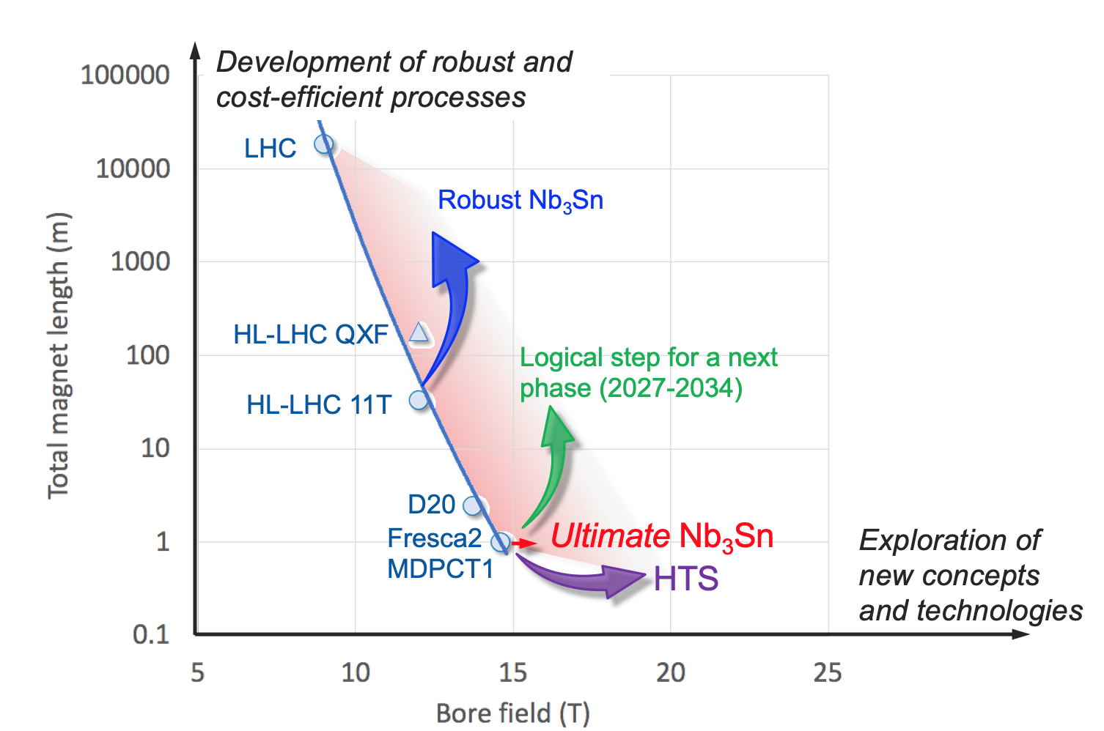
High-field Magnet R&D: First steps towards FCC-hh
In parallel to FCC Study, HFM development programme as long-term separate R&D project
Main R&D activities:
materials: goal is ~16 T for Nb₃Sn, at least ~20 T for HTS inserts
magnet technology: engineering, mechanical robustness, insulating materials, field quality
production of models and prototypes: to demonstrate material, design and engineering choices,
industrialisation and costs
infrastructure and test stations: for tests up to ~ 20 T and 20-50 kA
Global collaborations already established during FCC CDR phase.

Slide 16
World-wide FCC Nb₃Sn Programme
Main development goal is wire performance increase:
J_{c} (16T, 4.2K) > 1500 A/mm² →50% increase wrt HL-LHC wire
Reduction of coil & magnet cross-section
5400 mm²
3150 mm²
~1.7 times less SC
After 1-2 years development, prototype Nb₃Sn wires from several new industrial FCC partners already achieve HL-LHC J_{c} performance
~10% margin
HL-LHC
~10% margin
FCC ultimate
FCC conductor development collaboration:
Bochvar Institute (production at TVEL), Russia
Bruker, Germany, Luvata Pori, Finland
KEK (Jastec and Furukawa), Japan
KAT, Korea, Columbus, Italy
University of Geneva, Switzerland
Technical University of Vienna, Austria
SPIN, Italy, University of Freiberg, Germany
2019/20 results from US, meeting FCC J_{c} specs:
Florida State University: high-J_{c} Nb₃Sn via Hf addition
Hyper Tech /Ohio SU/FNAL: high-J_{c} Nb₃Sn via artificial pinning centres based on Zr oxide.

Slide 17
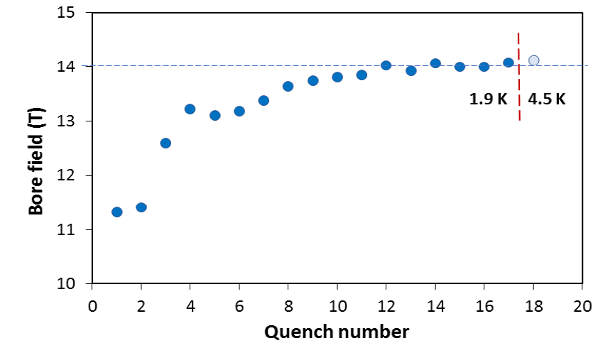
US – MDP: 14.5 T Magnet Tested at FNAL
84% on the laodline at 1.9 K
92% on the loadline at 4.2 K
60-mm aperture
4-layer graded coil
15 T dipole demonstrator
Staged approach: In first step pre-stressed for 14 T
Second test in June 2020 with additional pre-stress reached 14.5 T

Slide 18
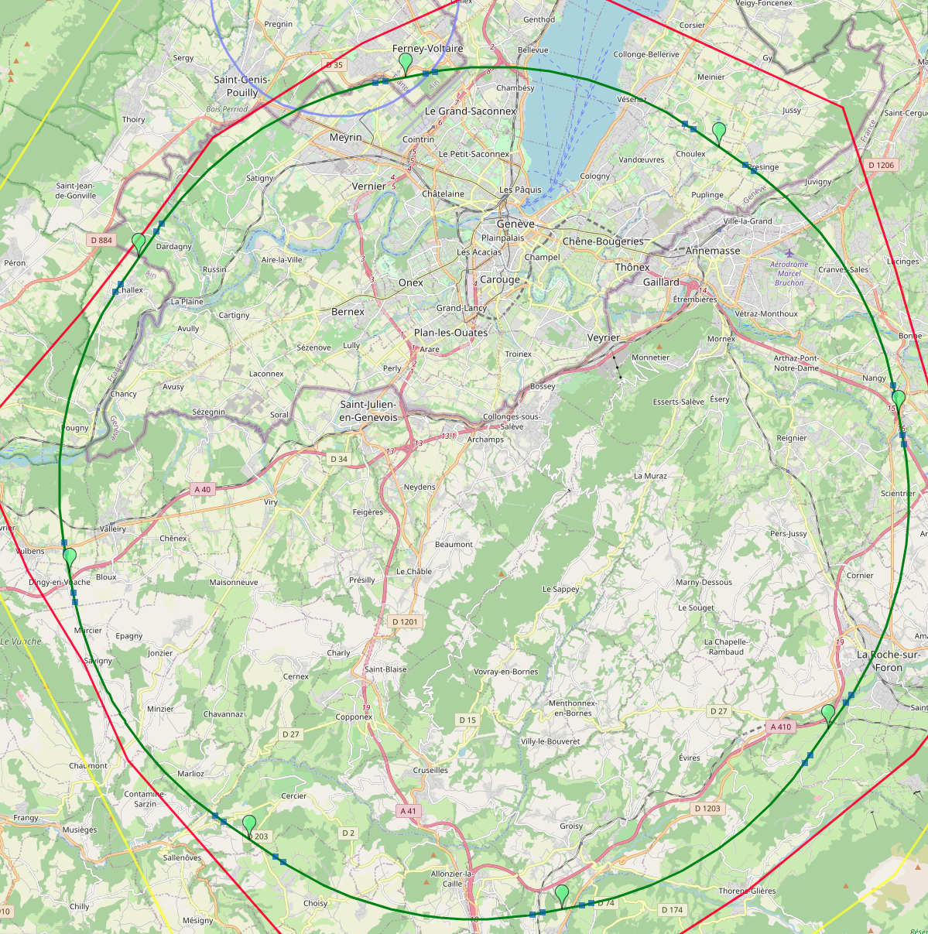

Optimised Placement and Layout
Major achievement: optimisation of the ring placement
Layout chosen out of ~ 50 initial variants, based on geology and
surface constraints (land availability, access to roads, etc.), environment
(protected zones), infrastructure (water, electricity, transport), etc.
“Éviter, reduire, compenser” principle of EU and French regulations
PA: Experiment
PB: technical
Baseline ring: 90.7 km ring, 8 surface points
Whole project now being adapted to this placement
Site investigation: 9 areas with uncertain geological conditions
to be further investigated (~40 drillings and 100 km of seismic lines)
PL: technical
PD: experiment
Number of surface sites | 8
LSS@IP (PA, PD, PG, PJ) | 1400 m
LSS@TECH (PB, PF, PH, PL) | 2032 m
Arc length | 9.6 km
Sum of arc lengths | 76.9 m
Total length | 90.6 km
PJ: experiment
FCC-ee layout
PF: technical
PH: technical
18
PG: experiment

Slide 19
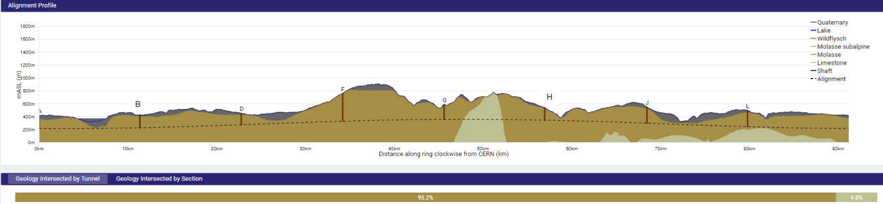
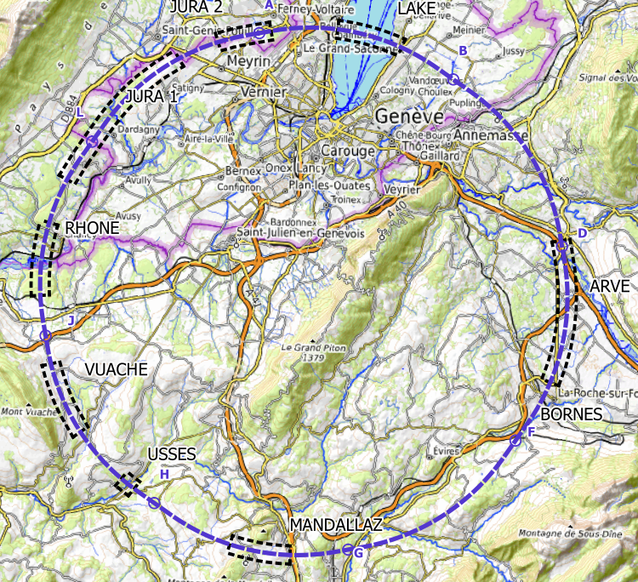
FCC Implementation - Footprint Baseline
Present baseline implementation
91 km circumference
95% in molasse geology for minimising tunnel construction risks
8 surface sites with ~5 ha area each.
Site investigations planned for 2024 and 2025 in areas with uncertain geological conditions:
Limestone-molasse border, karstification, water pressure, moraine properties, water bearing layers, etc.
~40-50 drillings, 100 km of seismic lines

Slide 20
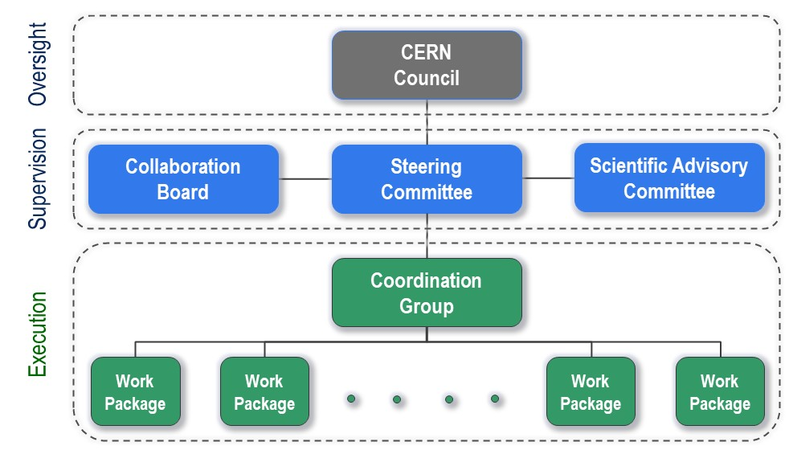
FCC Feasibility Study Organisational Structure
FCC Organisational Structure
  Ownership of the Feasibility Study by the Council.
  Effective and timely supervision.
  Integration of scientific and technical advice.
  Participation of stakeholders that can potentially make significant financial and technical contributions to a possible future project.
  Execution of Feasibility Study.

Slide 21
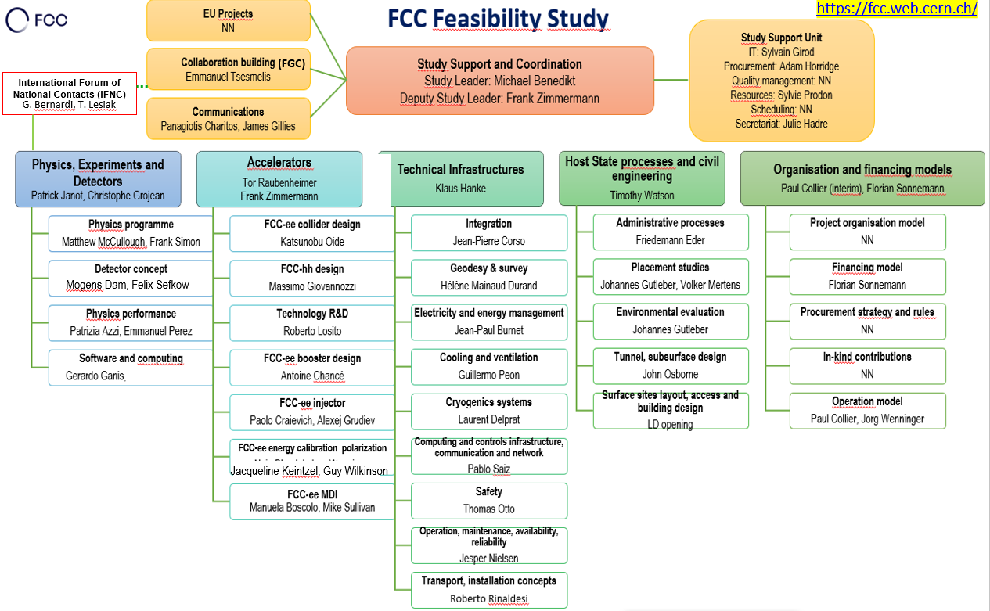
FGC and IFNC

Slide 22
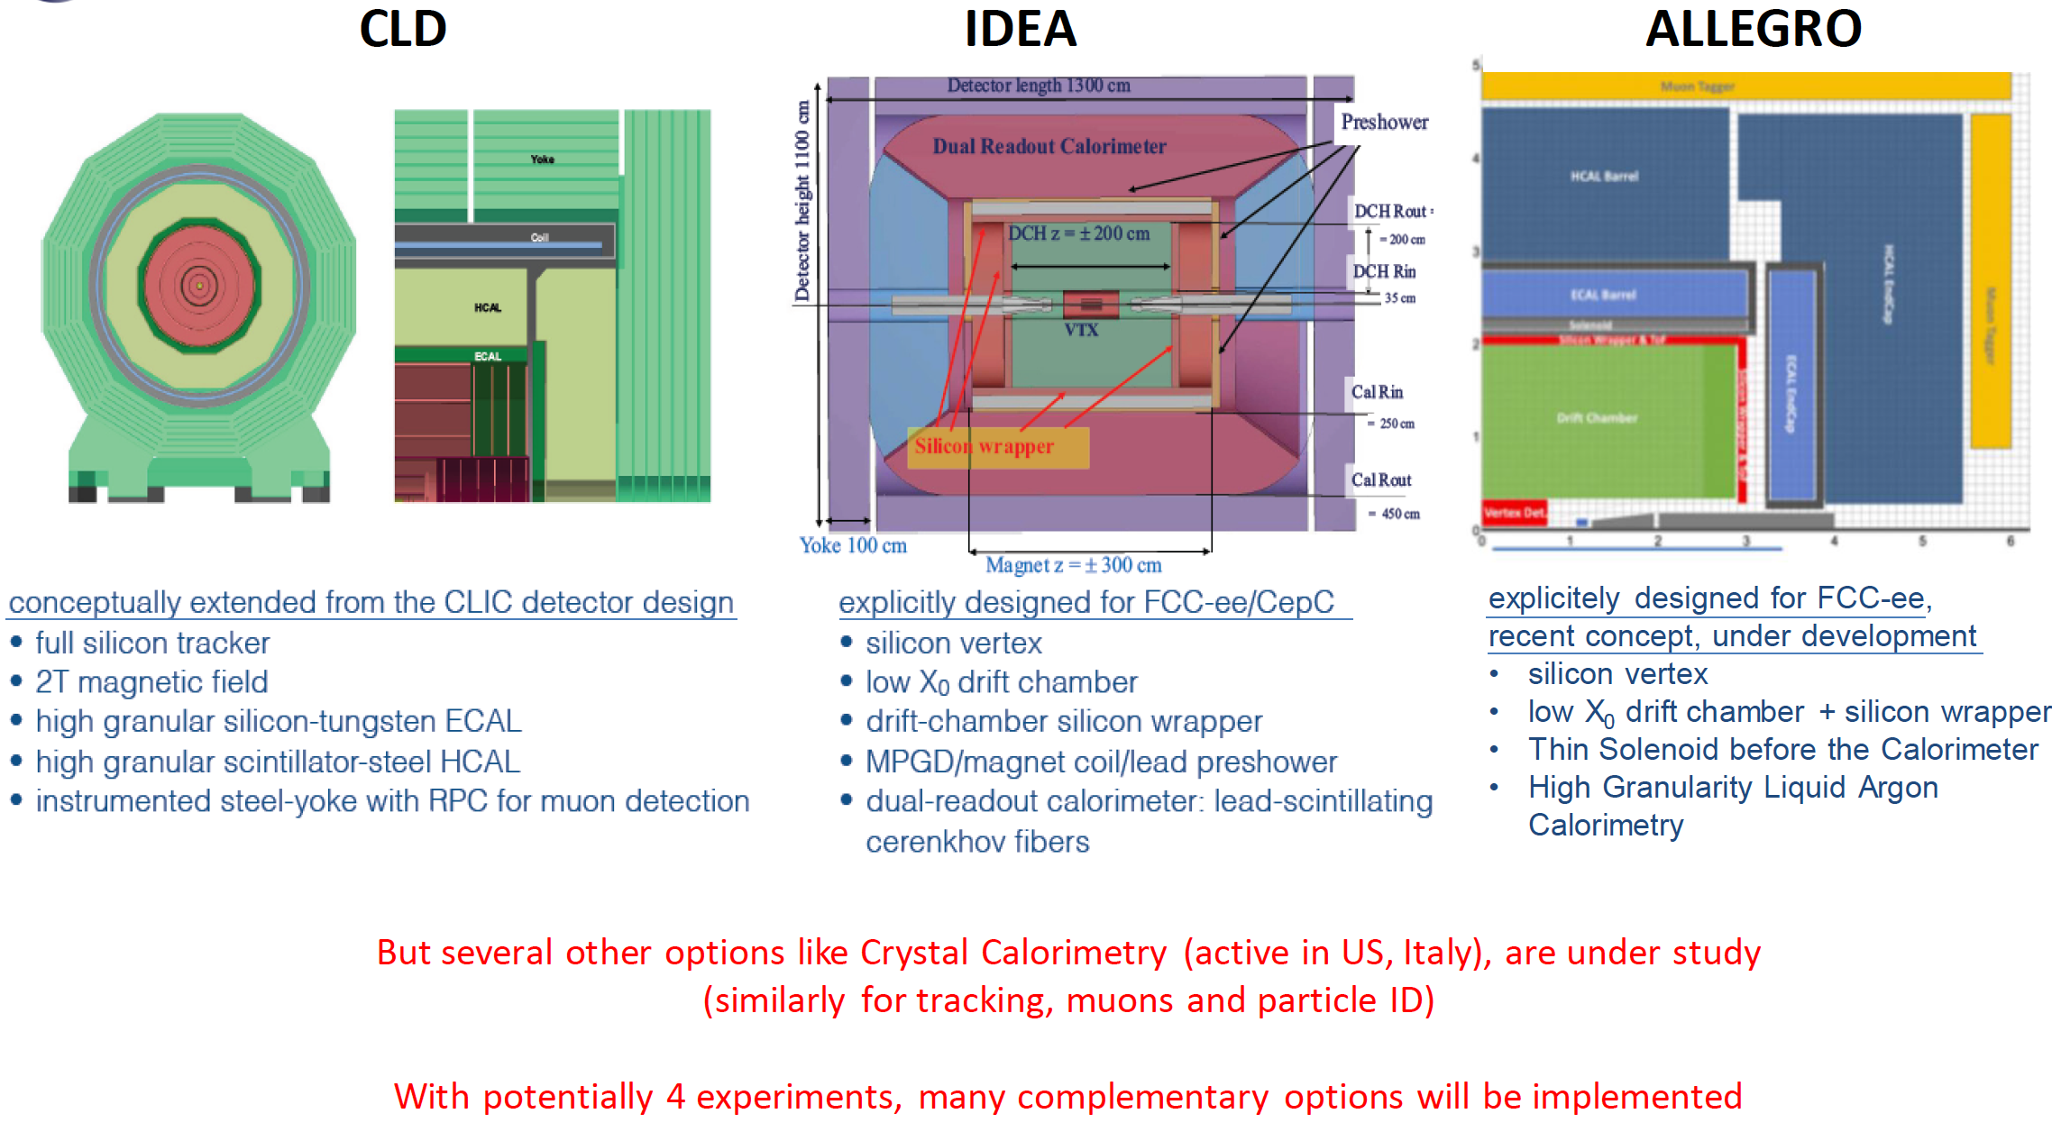
Detectors Under Study for FCC-ee
Increasing international collaboration as a prerequisite for success:
links with science, research & development and high-tech industry will be essential to further advance and prepare the implementation of FCC

Slide 23
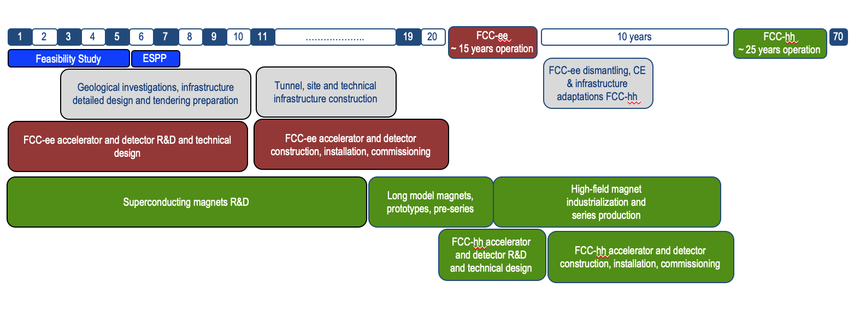
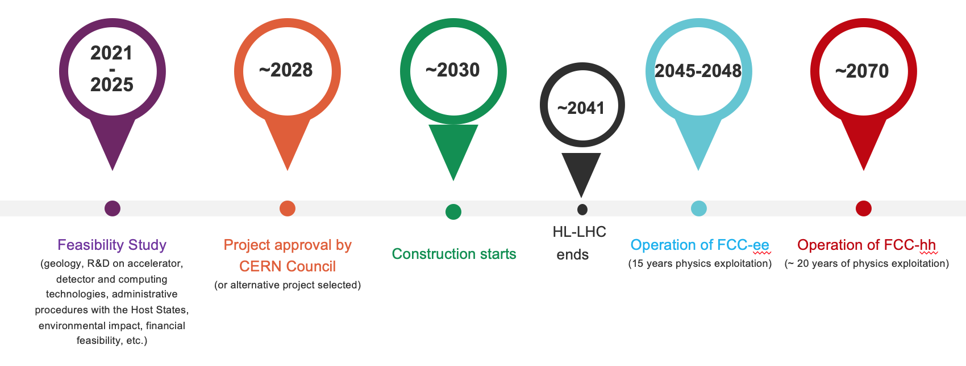
FCC Timeline
Note: FCC Conceptual Design Study
started in 2014 leading to CDR
in 2018
Technical schedule:
FCC-ee could start
operation in 2040 or earlier
Realistic schedule takes into account:
CERN Council approval timeline
Past experience in building colliders at CERN
HL-LHC will run until ~ 2041
ANY future collider at CERN cannot
start physics operation before 2045-2048
(but construction will proceed in parallel to
HL-LHC operation)
F. Gianotti

Slide 24
Start of FCC-ee Physics Run
2047 –
2046 –
2045 –
2044 –
2043 –
2042 –
2041 –
2040 –
2039 –
2038 –
2037 –
2036 –
2035 –
2034 –
2033 –
2032 –
2031 –
2030 –
2029 –
2028 –
2027 –
2026 –
2025 –
– 2047
– 2046
– 2045
– 2044
– 2043
– 2042
– 2041
– 2040
– 2039
– 2038
– 2037
– 2036
– 2035
– 2034
– 2033
– 2032
– 2031
– 2030
– 2029
– 2028
– 2027
– 2026
– 2025
Start accelerator commissioning
Start detector commissioning
End of HL-LHC
Start detector installation
Start accelerator installation
Industrialisation and component production
Technical design & prototyping completed
Detector component production
Four detector TDRs completed
Start of ground-breaking and CE at IPs
Detector CDRs (>4) submitted to FC³
End of HL-LHC upgrade: more ATS personnel available .
End of HL-LHC upgrade: more detector experts available
FCC Approval: Start of prototyping work .
FC³ formation, call for CDRs, collaboration forming
European Strategy Update: FCC Recommendation
FCC Feasibility Study Report
Detector EoI submission by the community
FCC-ee Accelerator
Key dates
FCC-ee Detectors

Slide 25

Status of FCC global collaboration
Increasing international collaboration as a prerequisite for success
FCC Engagement Meeting with Republic of Korea
held on 3 September 2021
150
Institutes
32
Companies
34
Countries
EC
H2020
FCC Feasibility Study: Aim is to increase further the collaboration, on all aspects,
in particular, on Accelerator and Particle/Experiments/Detectors (PED).

Slide 26

FCC and the Republic of Korea
Increasing international collaboration as a prerequisite for success:
links with science, research & development and high-tech industry will be essential to further advance and prepare the implementation of FCC
Members of FCC Collaboration through MoU (& Addenda) from the Republic of Korea
  Gangneung-Wonju National University (GWNU, Gangneung)
  Korea Advanced Institute of Science and Technology (KAIST, Yuseong-gu)
  Korea Institute for Advanced Study (KIAS, Seoul)
  Korea University (KU, Seoul)
  Korea University (KUS, Sejong)
  Pohang Accelerator Laboratory (PAL, Pohang)
  Yonsei University (YU, Seoul)
  Kyungpook National University (KNU, Daegu)
  University of Seoul (UOS, Seoul)
  Pusan National University (PNU, Busan)
  Sungkyunkwan University (SKKU, Seoul)
  Hanyang University (HUY, Seoul)
  Kyunghee University (KHU, Seoul)

Slide 27
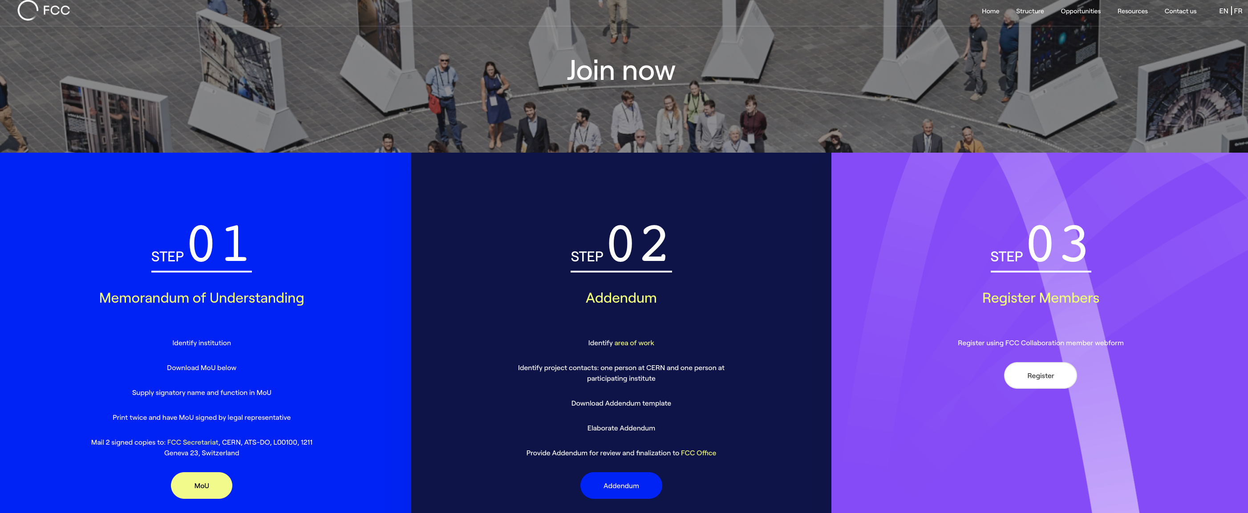
FCC Feasibility Study Collaboration Membership
Participation in FCC through MoU and Addenda.
The FCC MoU for the first phase of the study is being updated to cover the Feasibility Study.
The current participating institutes who wish to take part in the Feasibility Study can continue to participate on the basis of the previously signed MoU until the updated MoU is signed.
https://fccis.web.cern.ch/join-now

Slide 28
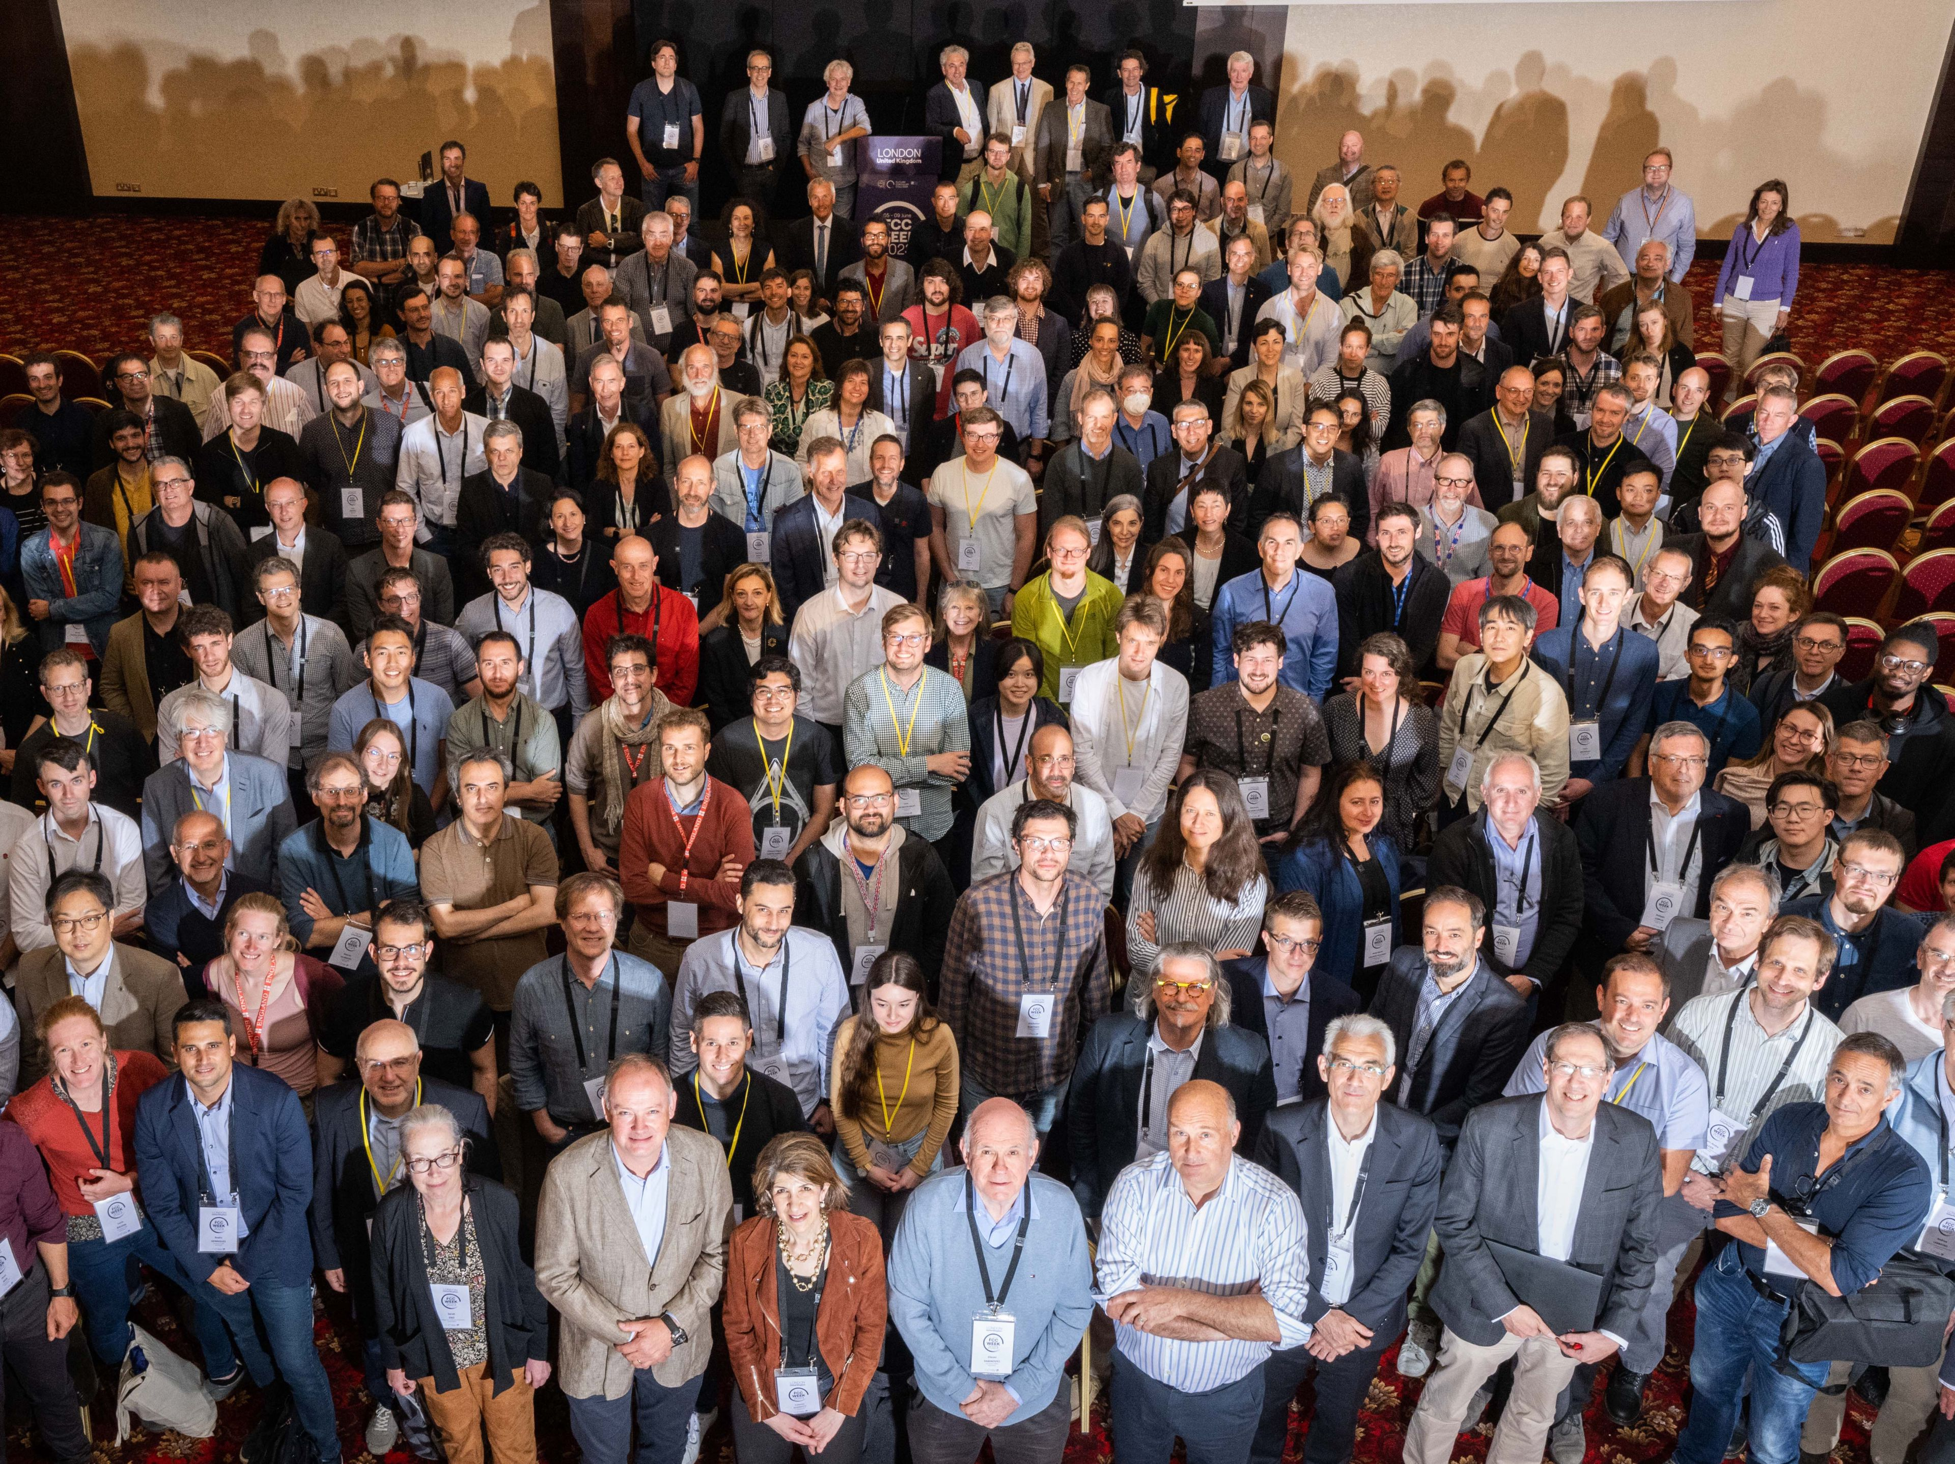
FCC Week 2023 London, UK
473 participants
362 in person and 111 remote
Courtesy P. Charitos

Slide 29
Outlook
Comprehensive R&D programme and implementation preparation is presently being carried out in the frameworks of FCC FS, the EU co-financed FCC Innovation Study, the Swiss CHART programme, and the CERN High-Field Magnet Programme.
Goal: demonstrate FCC feasibility by 2025/26.
Plenty of opportunities for collaborations and for joint innovative developments with international partners !
The first stage of FCC could be approved within a few years after the 2027 European Strategy Update, if the latter is supportive. Tunnel construction could then start in the early 2030s and FCC-ee physics programme could begin in the second half of the 2040s, a few years after the completion of the HL-LHC physics runs, expected by 2041.
Long-term goal: world-leading HEP infrastructure for 21st century to push particle-physics precision and energy frontiers far beyond present limits.

Slide 30

FCC Summary
The European Strategy Update in 2020 issued the request for a feasibility study of the FCC integrated programme to be delivered by end 2025.
The main activities of the FCC Feasibility Study are:
  Local/regional implementation scenario in collaboration with Host State authorities.
  Accompanied by machine optimisation, physics studies and technology R&D.
  Performed via global collaboration and supported by EC H2020 Design Study FCCIS.
  In parallel High-Field Magnet R&D programme as separate line, to prepare for FCC-hh.
Long term goal: world-leading HEP infrastructure for 21st century to push the particle-physics precision and energy frontiers far beyond present limits.
Success of FCC relies on strong global participation.
Everybody interested is warmly welcome to join the effort!

Slide 31

Thank you

