Slide 1
Electrical Safety Project Review
WP2 «HSE Branch» Report
ESP Review
15th December 2023

Slide 2
ESP – WP2 «HSE Branch» structure
ESP WP2 HSE
PL: Ch. Delamare
WP2.1
Rules
WPL: A. Henriques
WP2.2
Certification
WPL: J. Gascon
WP2.3
Qualification
WPL: I. Neuhold
WP2.4
Inspections & NCs
WPL: Ch. Delamare
~2-3 FTE
Concept (referential, cluster outline, principles)
Definition of electrical safety roles in the CERN context, incl. interfaces with existing roles
Rules
Templates/check-lists (e.g. intervention procedures)
Framework for consultancy to support CE certification
Approval Process to justify non-CE certifiable installations
Technical guidelines (minimum requirements) for non-CE certifiable installations
Classification of machines
Identification of CERN specific needs (w.r.t facilities/ personnel status)
Specification of trainings
Development of trainings
ELECNCSOL up to 2029
SAILOR-ELEC
Dept Coordinators
Dept Programs of Work (incl. 100% of new installations inspected)
Frequency and “protocol” to be adapted to the lifecycle of the installations

Slide 3
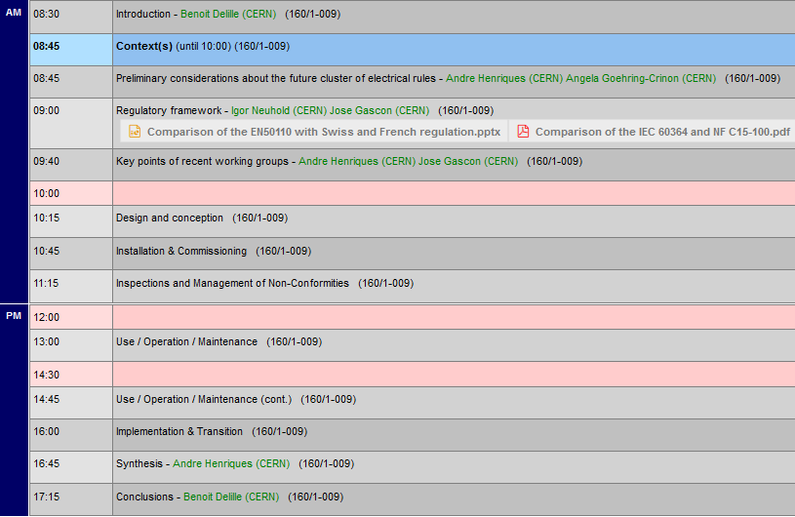
Workshop on electrical safety rules
14th June
HSE, ATS and RCS participants
Very intense and fruitful exchanges
Valuable “material” to start drafting the concept of SR-EL cluster
Objective: concept ready for approval end-2023

Slide 4
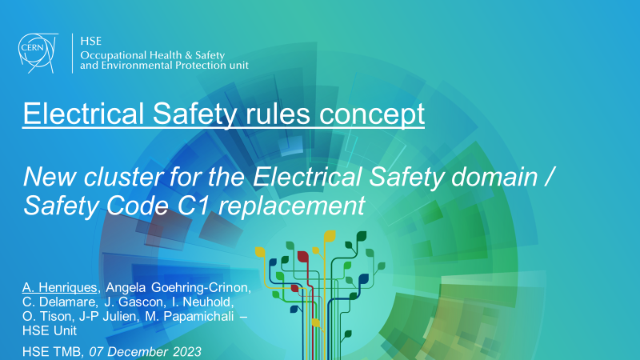
Electrical Safety Rules Concept Proposal
Presented to the HSE Technical Management Board Thursday 7th Dec.
Key Points
  Objective of the ‘Concept’
  Cluster
  Key definitions (e.g. equipment, network)
  Electrical Safety objectives
  Roles & Responsibilities @CERN
  Personnel Accreditation / Certification (“Habilitation”) @CERN
  Design/manufacture of equipment/network @CERN
  Electrical & Non-Electrical works (in the vicinity of elec. installations) @CERN

Slide 5



Objective of the ‘Concept’
Courtesy A. Henriques
Define the ‘General principles’ of the rule’s cluster
Cover the strategic points and main technical considerations
Shall cover the needs of all CERN sectors / Departments
Foresee implementation challenges
Basis for the writing of the rules
Revision of Electrical Safety Rules.
Replaced by a ‘cluster’
Safety Code C1
IS 24, IS 5
Issued in 1990
+30 years of lessons learnt

Slide 6
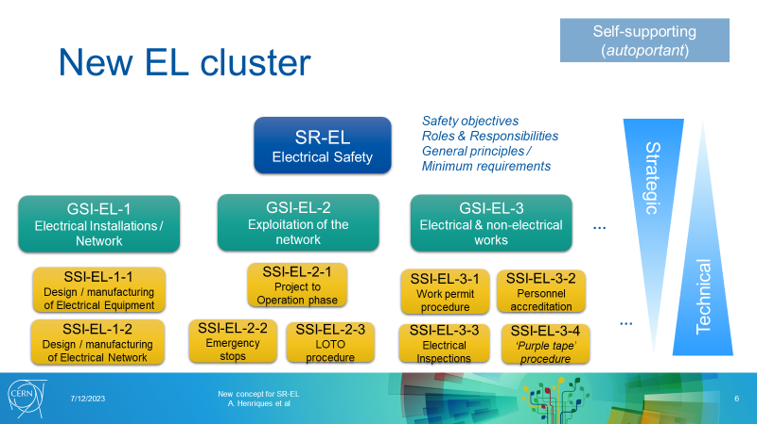
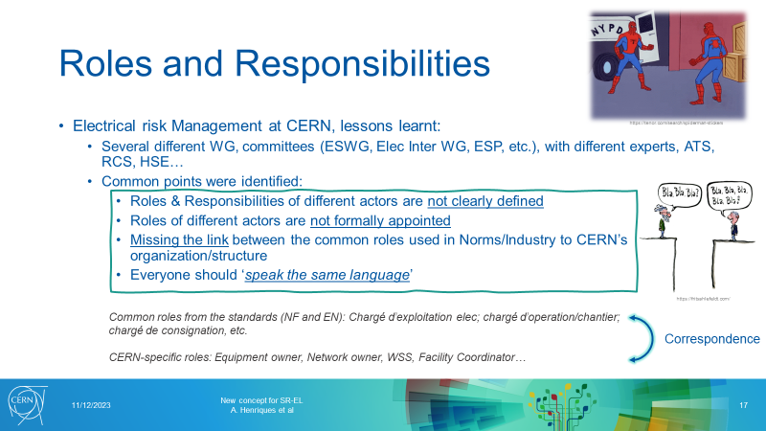
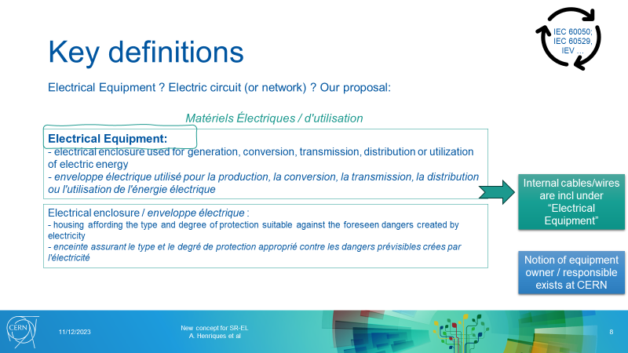
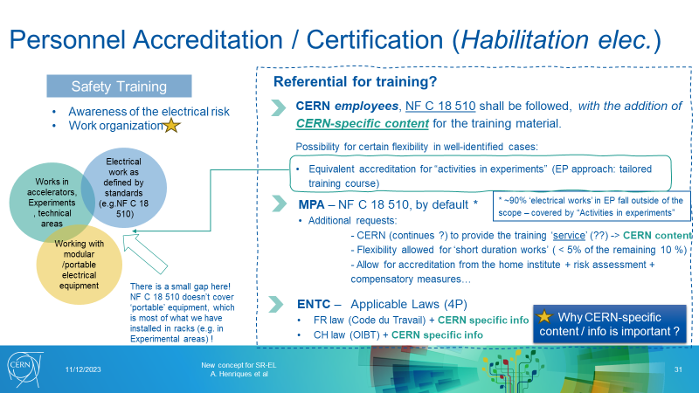
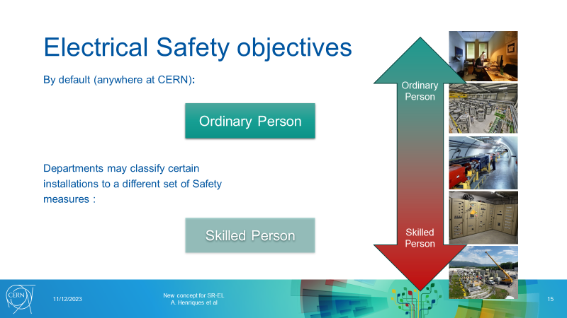
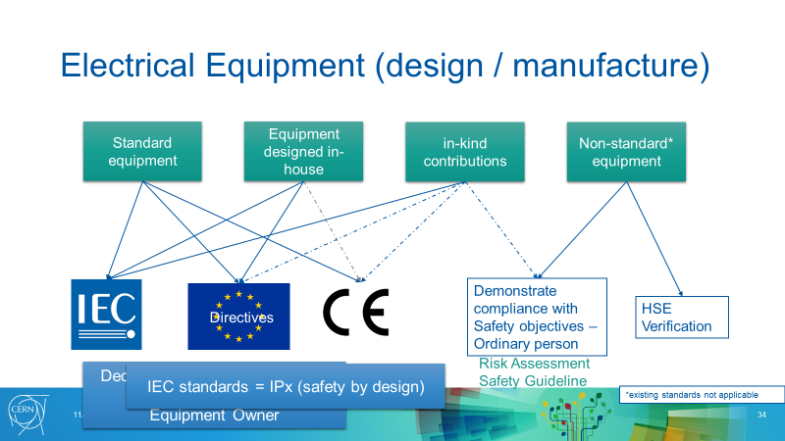
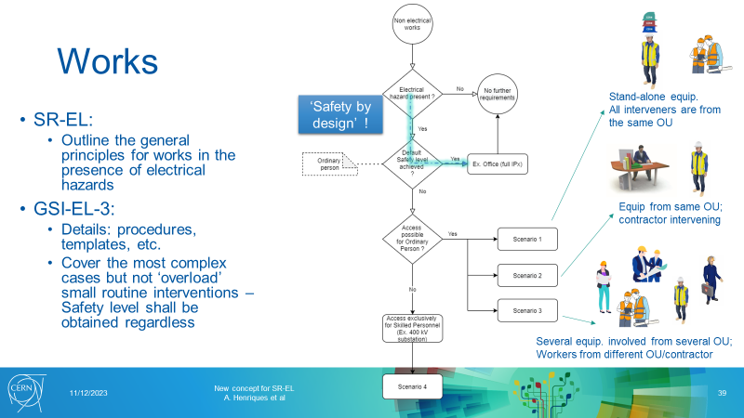
Electrical Safety Rules Concept Proposal

Slide 7
Electrical Safety Rules Concept - Schedule
2023 |  |  | 2024 |  |  |  | 2025
Q2 | Q3 | Q4 | Q1 | Q2 | Q3 | Q4 | Q1 | Q2 | Q3 | Q4
Workshop
Concept drafting
Presentation to the HSETMB
Concept Approval
Convergence with stakeholders
Workshops
Pilots
«Replays»
Exchanges
Responses to implementation challenges
Concept
Formal Approval
Rules, Guidelines, Templates, Check-lists
Writing

Slide 8
Electrical Safety Rules Concept – Coming months
The next phase Convergence with stakeholders is key
Some foreseen “events”
  With WP3
    Workshop REX CE Certification @CERN
    Workshop Elec. Inspections & Compliance
    Exchanges about Concept w.r.t. Certification/Compliance
    Implementation challenges and solutions
  With WP4
    Exchanges about Concept w.r.t. Roles, Works, etc.
    «Replays» of interventions
    Implementation challenges and solutions
  …
This phase will also give detailed input for WP2.2 Certification and WP2.3 Qualification

Slide 9
Electrical Safety Inspections & Non-Conformities
ELECNCSOL project since 2018-2019
Key stakeholders so far: SCE & EN-EL
Satisfactory results so far
MTP 2023 request made by HSE to pursue the project ELECNCSOL from 2025 to 2029: allocated
  One of the key points: EN-EL works during LS3
    On-going discussion. ~1 FTE needed (EN-EL? ESP?) in addition to the current manpower (profile: technical supervisor)
“Backlog” of NCs should decrease dramatically by 2029

Slide 10
Electrical Safety Inspections & NCs
Key Takeaways – HSETMB 5th Oct. 2023
Accompanied Inspections are necessary
  Requires joint planning from the beginning
Significant increase of NCs (compared to non acc. Inspections)
Programmes of Work of the stakeholders must be adapted to the reality of the field
  Access refused, power cuts, manpower, analysis of the current needs, supervision
  Good example: on-going inspections of EN-EL electrical cabinets
Technical supervision on the field is critical
  At least as important as the material budget
It takes time to fix NCs (and to get confirmation)
Many challenges ahead
  Put SAILOR-ELEC into production (esp. «Resolver»)
  Prepare future programmes of work (esp. during LS3)
  Involve stakeholders other than SCE & EN-EL
  Develop links with Consolidation programmes
  Adapt periodicity of inspections to the lifecycle/reality of the Accelerators and Experiments (=> WP2.1 Rule)
  Establish sustainable, recurrent and funded plans from 2029 onwards

Slide 11
Electrical Safety Inspections - SAILOR-ELEC - Status
SAILOR Tool | Users by role | Core functionality | State
 | CERN Inspector manager, Project managers PM, Electrical installation owners Contractors | Planning of inspections Agenda of inspections. Sending the invitations to participants. | Technical specification completed. To be developed
 | Contractors CERN inspectors | Uploading inspection reports and non-conformities by contractors. Automatic verification of coherence (ex. buildings, installations, etc.) Review and validation of inspection reports by CERN inspectors | In production since 7th Dec. 2023
 | CERN inspectors | Writing of inspection reports Inspections and Non-conformities database Automatic upload of inspection reports to EDMS Notification to installation owners Launches non-conformities resolutions: SAILOR-Resolver, InforEAM or ServiceNow | Development completed. Goes to production this week
 | Electrical installation owners Safety officers | Follow-up and traceability of non-conformities resolution: SAILOR-Resolver: traceability of actions to remove the non-conformities. Monitoring the advancement of work-orders/non-conformities in InforEAM Monitoring the advancement of tickets/non-conformities in ServiceNow Alternative tool or complement to InforEAM | Development completed. Preparing pilot test with EN-EL. Discussions with SCE and SY. SY might also use the inspector tool for the follow-up of their own inspections (of their equipment)
 | HSE (involved personnel) Safety Officers (concerned) Installation owners | Visualizes all electrical inspections and non-conformities Search and statistics by several criteria Criteria ex.: time period, status, location, department, type NC, severity, etc. | In test phase.
Planning tool
Importing tool
(for contractors)
Inspector tool
(CERN inspectors)
Resolver tool
Review, statistics & reporting tool

Slide 12
Conclusion
WP2.1 Rules
  Electrical Safety Rules Concept covers the main strategic points and general principles of the future SR-EL cluster
  Choices considered possible implementation challenges, lessons learnt and input from previous WGs
  Time for detailed exchanges with stakeholders!
    ESP contributors (esp. WP3 & WP4) will be instrumental
    RCS already involved and this will continue
    SCE will be informed (contribution welcome)
WP 2.2 Certification & WP 2.3 Qualification
  General principles proposed in the Concept above
  Detailed input to be collected in the coming months
WP 2.4 Electrical inspections and non-conformities
  Good progress (ELECNCSOL project)
  Long-term effort with identified challenges ahead

Slide 13
Questions?

