Slide 1
Electrical Safety Project
First Review
15/12/2023
V. Barbet, B. Lefort, C, Mugnier, J.Ridewood, R. Tegas.

Slide 2
Project Structure
WP1
Project Management
WPL: A. L. Perrot
WPL deputy: C. Mugnier
WP2
HSE Branch
WP3
Systems Compliance with Standards
WP4
Intervention Management
WP5
Electrical Distribution Network
WP6
Electrical Data Management
WPL: C. Delamare HSE-TS
WPL: L. Scibile
TE-HDO
WPL: B. Lefort
BE-OP
WPL: G. Podoleanu
EN-EL
WPL: L. Pater
EN-IM
WP2.1: Rules
(WPL: A. Henriques HSE-OHS)
WP2.2: Certification
(WPL: J. Gascon HSE-OHS)
WP2.3: Qualification
(WPL: I. Neuhold HSE-OHS)
WP2.4: Inspection &
Non- Conformities
(WPL: C. Delamare HSE-TS)
WP4.1: Electrical Risks (identification / classification)
(WPL: R. Tegas)
WP4.2: Processes
(WPL: B. Lefort BE-OP)
WP4.3: Lock-out
(WPL: C. Mugnier – ESP CT*)
WP5.1: Equipment
Responsibility
(WPL: K. Papastergiou SY-ABT)
WP5.2: Drawings &
Schematics
(WPL: K. Zielinski EN-EL)
WP5.3: Identification in field (WPL: C. Mugnier – ESP CT*)
WP6.1: Documentation
(WPL: t.b.d.)
WP6.2: Data Bases &
Electrical Safety
Portal
(WPL: L. Pater EN-IM)
WP6.3: Electrical
Knowledge
Dissemination
(WPL: ESP CT*)
(*) ESP CT: Electrical Safety Project Core Team

Slide 3
WP4: Intervention Management
WP4 Contributors | Dept. Group
B. Lefort, J. Ridewood, V. Barbet | BE
J. Panigoni, N. Mornand, J. Etheridge | EN-ACE
O. Crespo, S. Deleval | EN-CV
D. Ribiollet | EN-EL
J. Borburgh, V. Montabonnet, R. Tegas | SY
M. Pezzetti, T. Barbe | TE-CRG
D. Bozzini (G. d’Angelo) | TE-MPE
t.b.d. | TE-MSC
G. Pigny, R. Ferreira | TE-VSC
J. Fernandez | On behalf of ATS DSOs
O. Beltramello, J. Devine, L. Di Giulio, | EP-DI
G. Velazquez, L. Roy | LEXGLIMOS
C. Delamare, J. Gascon | HSE
C. Mugnier, A. L. Perrot, | ESP Project Office

Slide 4
WP4 – Scope and Mandate
MANDATE:
  Deploy integrated start-to-end methodology / protocols to mitigate risks from electrical hazards during interventions on machines and facilities during all operational phases (i.e., operation, TS, YETS, LS).
SCOPE:
  Accelerator equipment:
    Accelerators complex: injectors, LHC and transfer lines.
    Experimental areas: EA, NA, ISOLDE/HIE- ISOLDE, CLEAR, NTOF, AD, HiRadMat.
    ATS projects: HL-LHC, AWAKE, NA-CONS.
    Machine buildings linked to the accelerators complex.

Slide 5
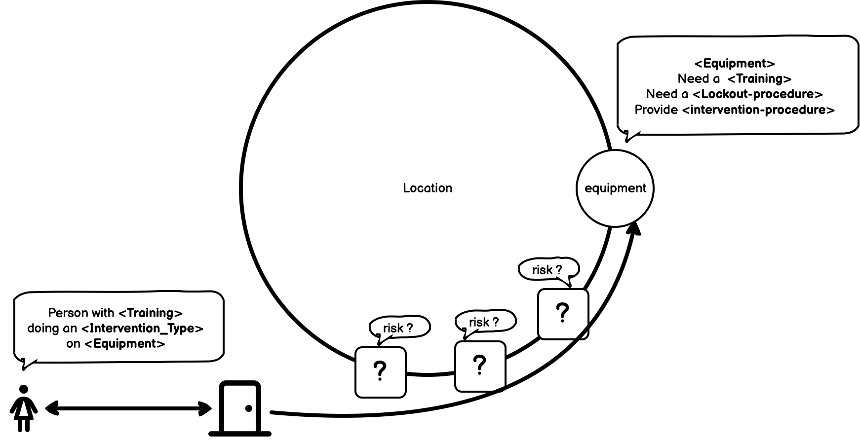
Problematic
.

Slide 6
WP4 – Deliverables
D4.1.: Definition and then deployment of processes to allow groups to identify, evaluate and classify the electrical risks and the corresponding safety procedures / measures to mitigate the electrical risk;
D4.2.: Definition and allocation of the roles with respect to electrical safety within the intervention processes;
workflow and procedure to deliver work permits should be clearly defined.
D4.3.: Definition of lock-out procedures (sources and worksite) and validation of the existing ones.
D4.4.: Definition of the required conditions to allow access / work in an area where an electrical risk is identified.
D4.5.: Definition of access management process in working area where an electrical risk is identified.
D4.6.: Set-up of the Electrical Safety Expert (ESET) to support the implementation of the electrical safety by the ATS groups in the long term.
D4.7.: Support to processes implementation / update

Slide 7


What we have done so far…
26 Sep. 23
ESP Project Kick-off
6 Oct. 23
First WP4 Meeting (presentation of the WP)
19 Oct. 23
Meeting with all WP Leaders
29 Oct. 23
Meeting with all WP4 contributors
15 Dec. 23
First Review
.

Slide 8

Step #1 : Brainstorming
HOW:
Test-Driven Development, using no prior knowledge
ON WHAT:
Our ideal way of authorizing works from CCC
WHAT FOR:
Get an idea on the basic requirements

Slide 9
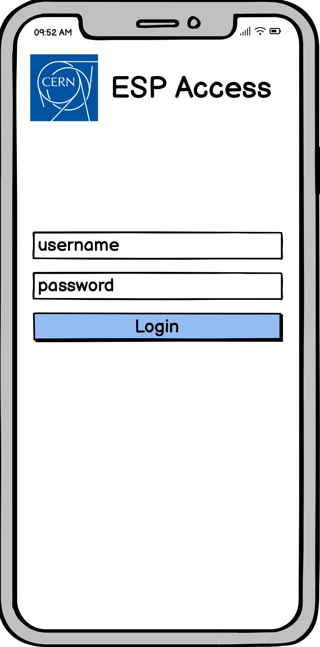
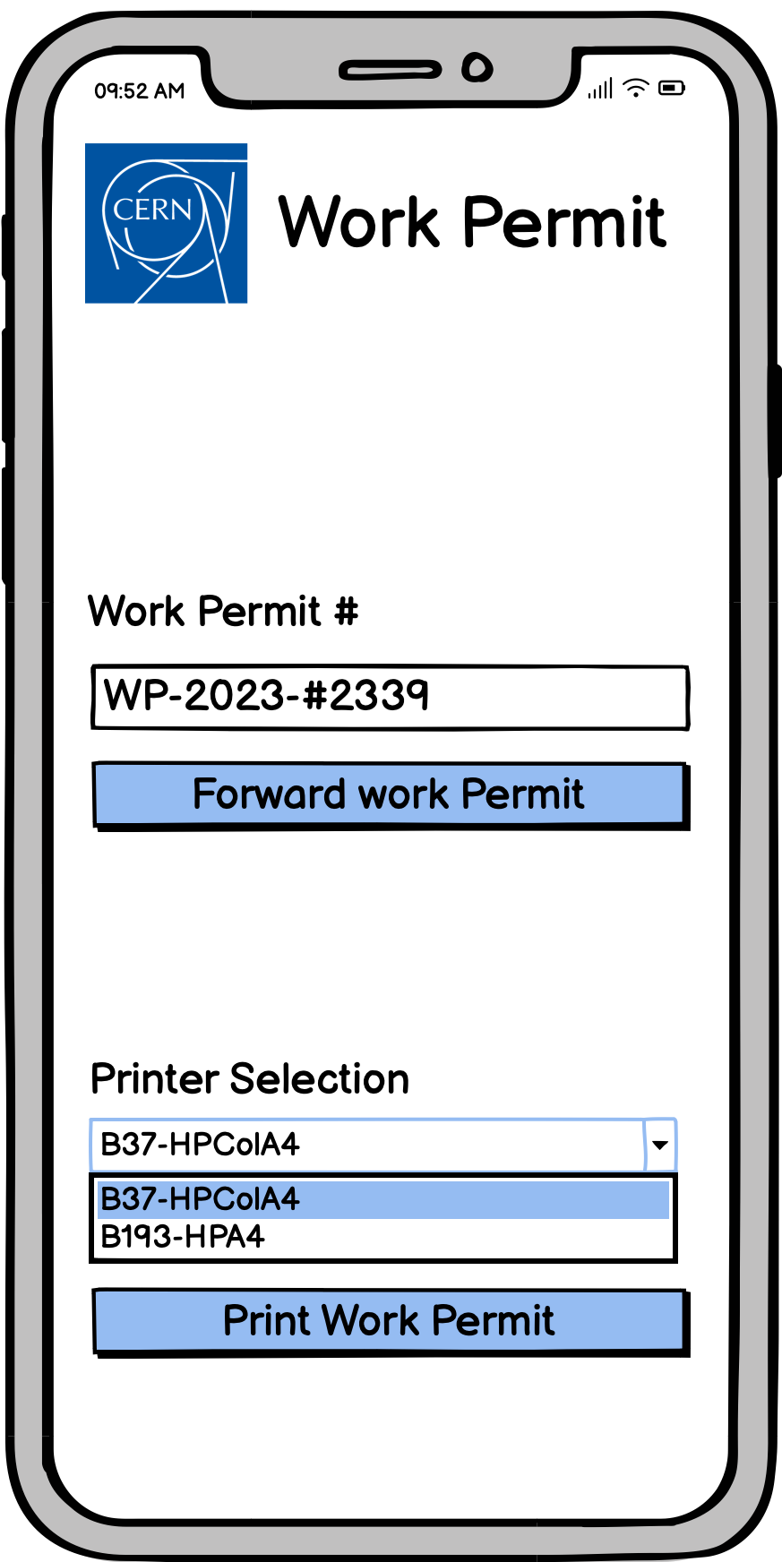
Dreamy App…
KISS*, "Keep it super simple!"
* KISS principle states that most systems work best if they are kept simple rather than made complicated; therefore, simplicity should be a key goal in design, and unnecessary complexity should be avoided.

Slide 10
Step #2 : Existing Literature
  Electrical Intervention Working Group (J. Gascon, C Mugnier and al.) (link)
  SY Electrical Safety Team (J. Borburgh, A. Frassier and al.) (link)
  EDF : Centrale du Bugey (feedback after the visit)
  Procédure Opérationnelle de Mise en Sécurité des équipements au LHC (J. Panigoni) (link)
  Procédure Opérationnelle de Mise hors tension partielle (C. Mugnier and al.)(link)

Slide 11
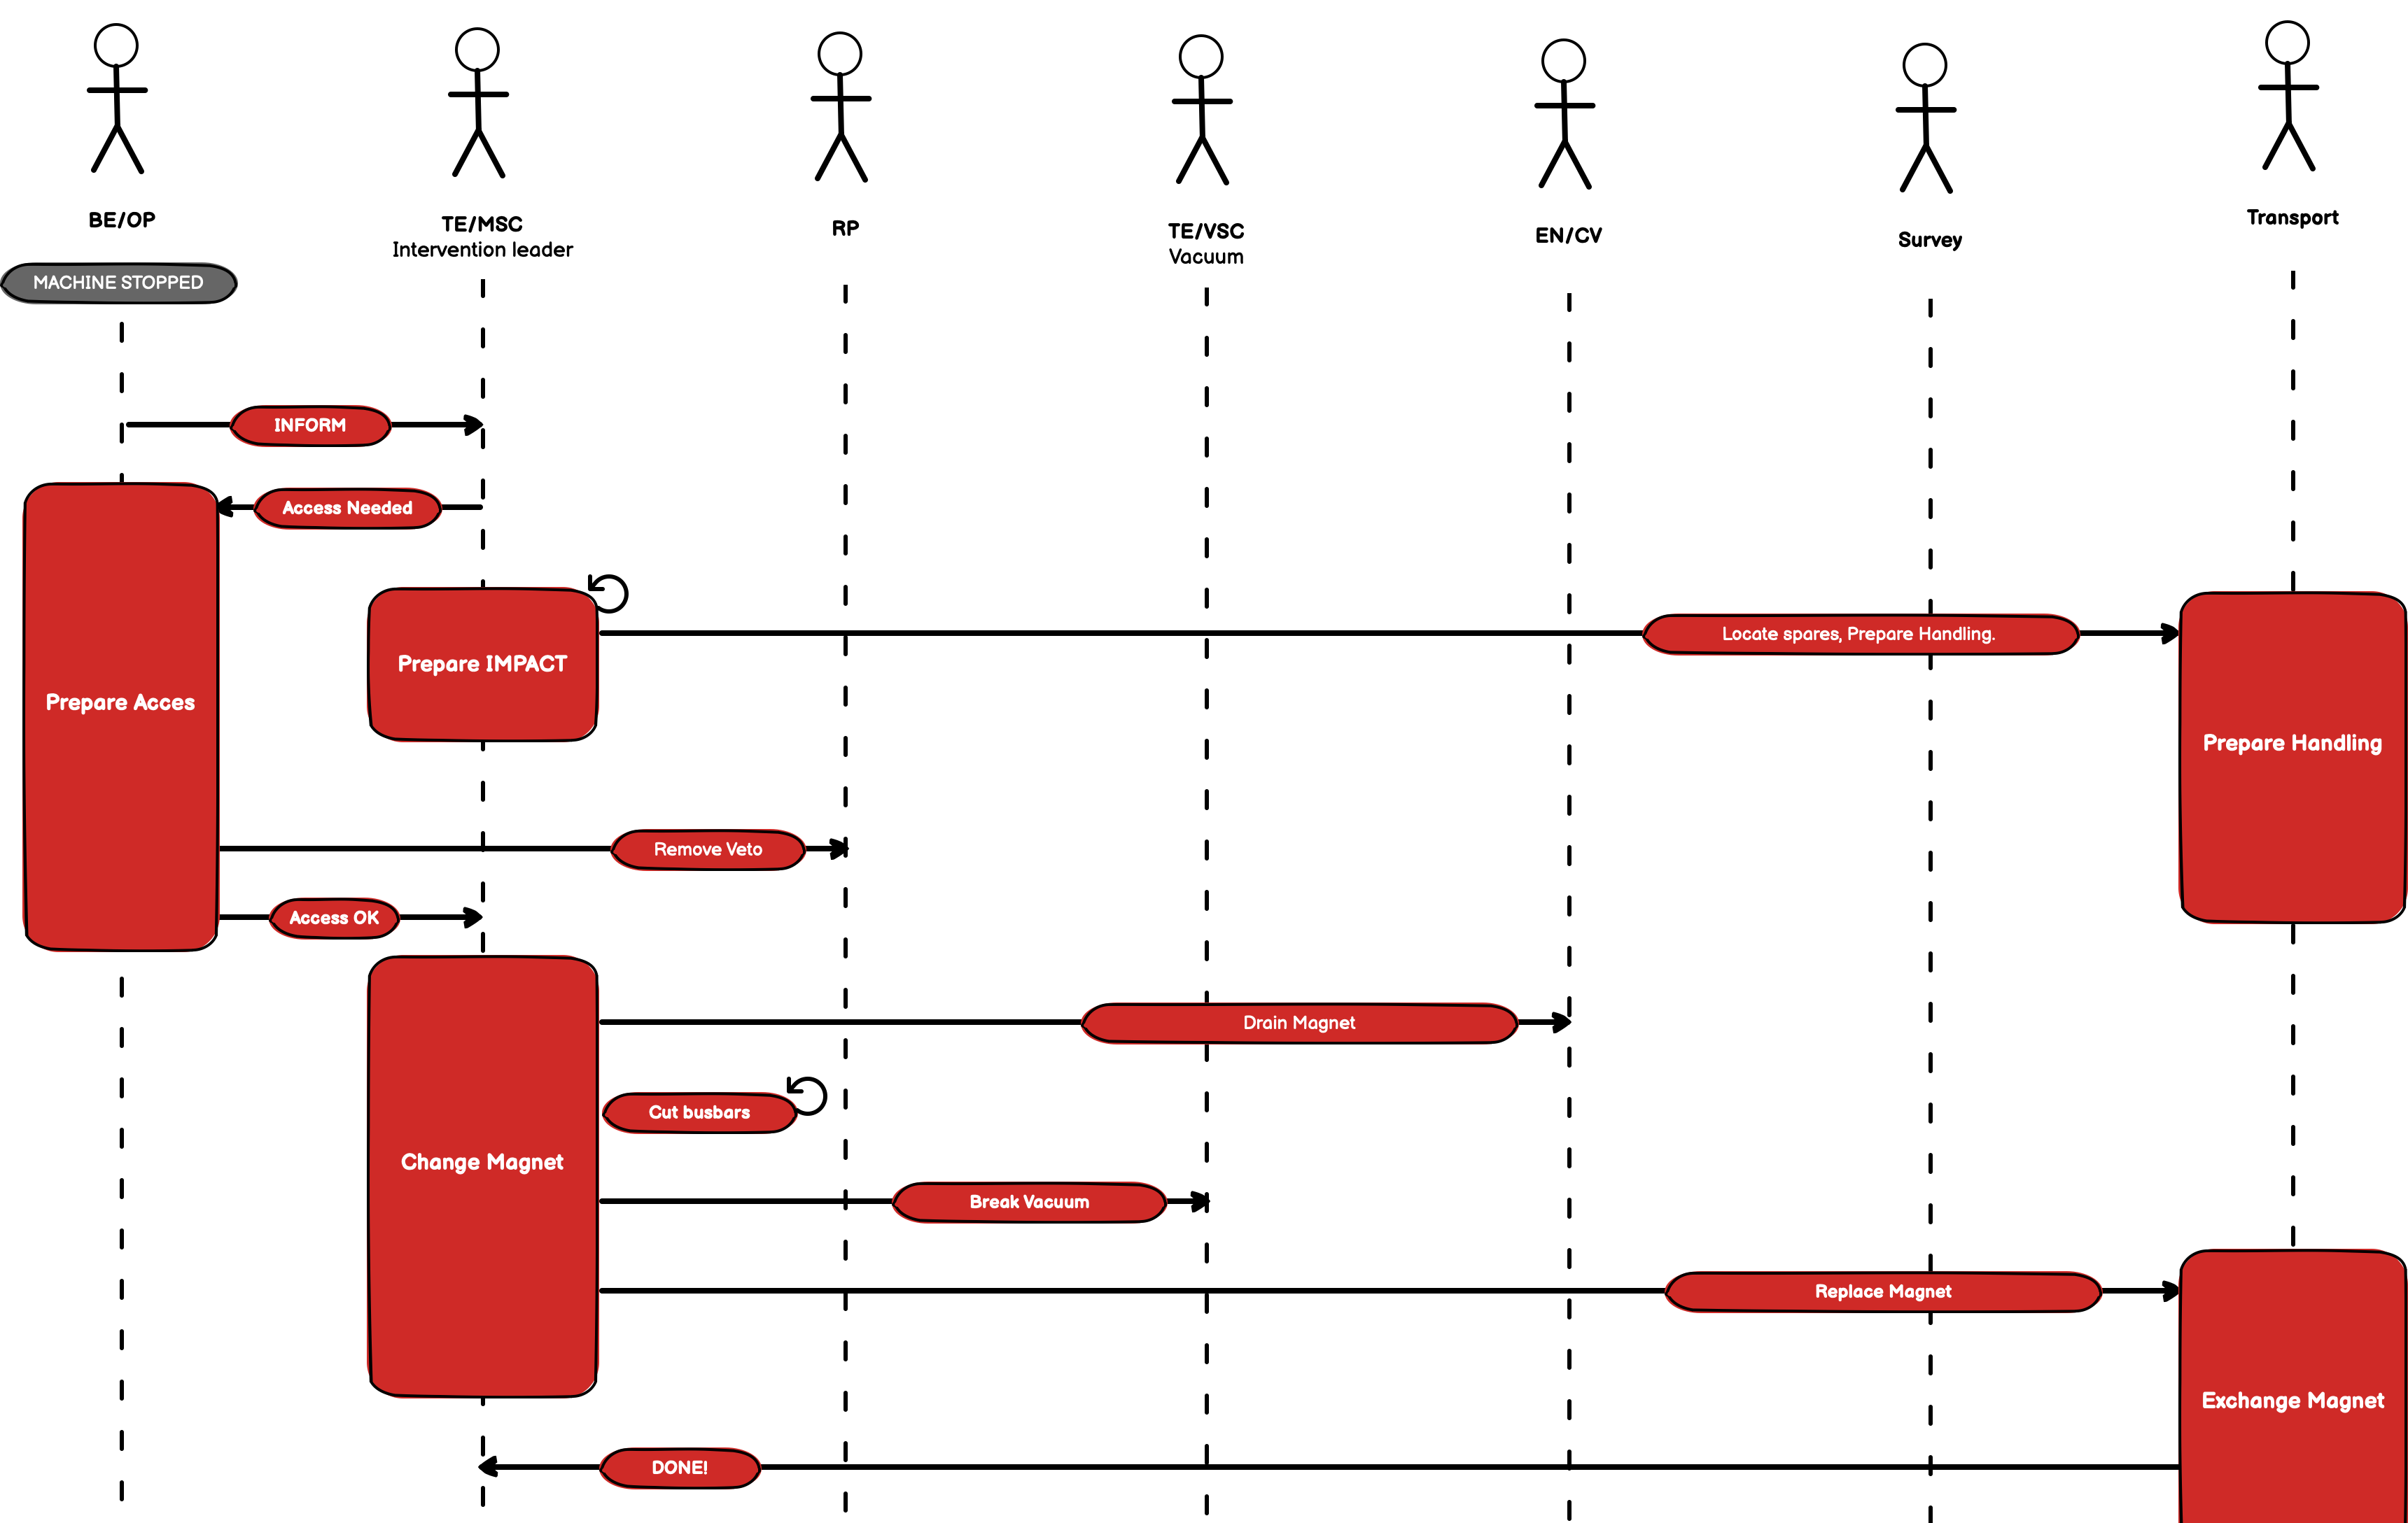
Step #3 : Real Life Scenarios
.

Slide 12
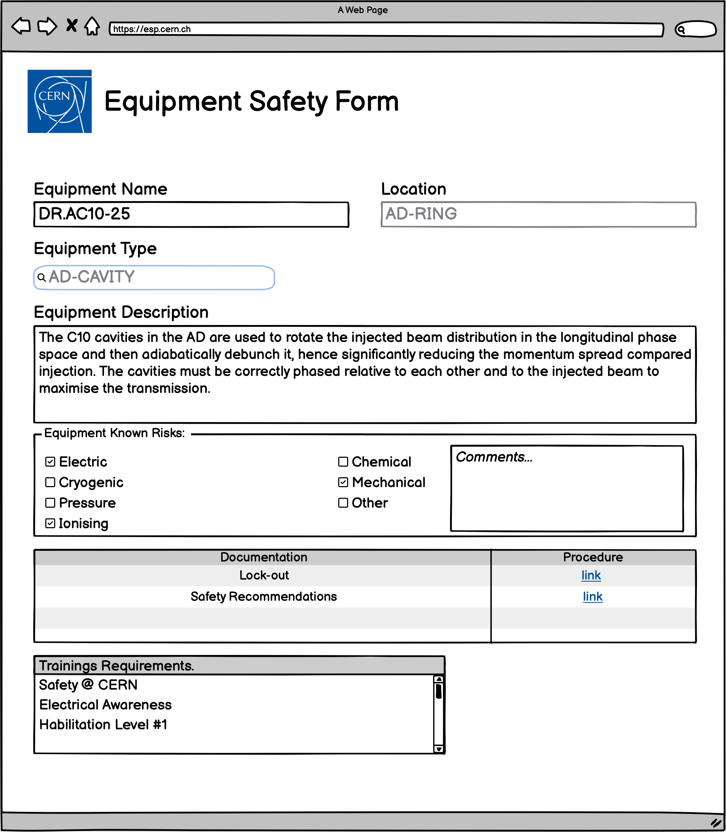
Concept #1: Electrical Safety Form
FAKE
.

Slide 13
Results: Straight Forward Outcomes
Dependencies (other WP)
Electrical Safety Roles
Risk Classification
Training needs
Functional needs
Reactive System
Dynamic Habilitation* process
Dynamic Equipment Status
Dynamic work permit delivery
Data requirements
Equipment
Location
Training
…
Equipment and Location Safety Form
Lockout
*Habilitation : a recognition of the capacity of a person to carry out, in safety on a given installation and for a defined period, activities presenting risks for himself/herself and/or its environment.

Slide 14
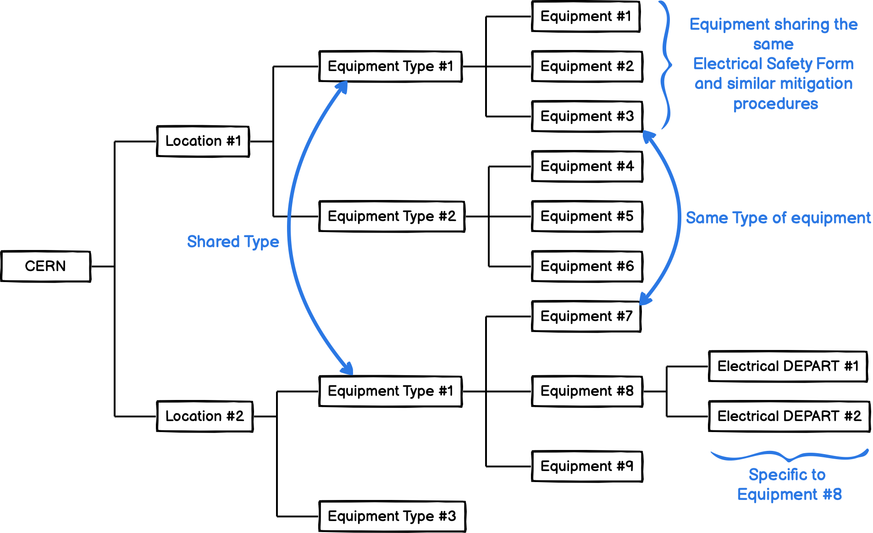
Concept #2 : Equipment Tree
.
FAKE

Slide 15
2024 Timeline
.

Slide 16
WP4.1: Electrical Risks
Jan. 2024
Groups Survey (risks, use-cases, procedures…)
(GROUPS → WP4.1)
Mar. 2024
Risk Classification
(WP2 ←→ WP4)
Apr. 2024
Testing classification on real equipment / data
Mid Apr. 2024
HSE Validation
Sep. 2024
End of 2024
Manpower transfered
4.1 → 4.2 for process definition (TBC)
Electrical Safety Form Requirements (for both equipment and location).
(WP4 → WP6)
(WP2 → WP4)
.
Equipment & Location DB creation
Testing the processes before LS3 (Nov. 2024) → manpower needed beginning of 2024!

Slide 17
WP4.2: Processes
Jan. 2024
Converge on Roles & Responsibilities (WP2→WP4)
Mar. 2024
Understand lockout modus-operandi (based on WP4.3 and with WP2 agreement)
Apr. 2024
Define / Understand training requirement vs risk (as defined by WP4.1)
May 2024
Define an intervention Logic
June 2024
Confirm data requirement feasibility (WP6 → WP4)
Oct. 2024
Define intervention
workflow / process
End of 2024
Draft of the Functional requirements
(WP4 → WP6)
.

Slide 18
WP4.3: Lockout
Jan. 2024
Define roles, scope of responsibilities.
Collect lockout procedures.
Draft of the Lockout data requirement.
Mar. 2024
Decide on a homogeneous Lockout approach
Apr. 2024
Gather Lockout Data
& Equipment tree data
(GROUP→WP4)
May 2024
Define centrally manage site's lock-out logic.
June 2024
Confirm data requirement feasibility (WP6 → WP4)
Oct. 2024
Lockout Procedure DB mock-up ready
Definition of an Equipment tree
(WP4 ←→ WP6)
End of 2024
Write functional specifications to be able to centrally manage site's lock-out
Contribute with W4.2 to define an intervention Logic
.
Lockout Procedure DB
→ manpower beginning of 2024!

Slide 19
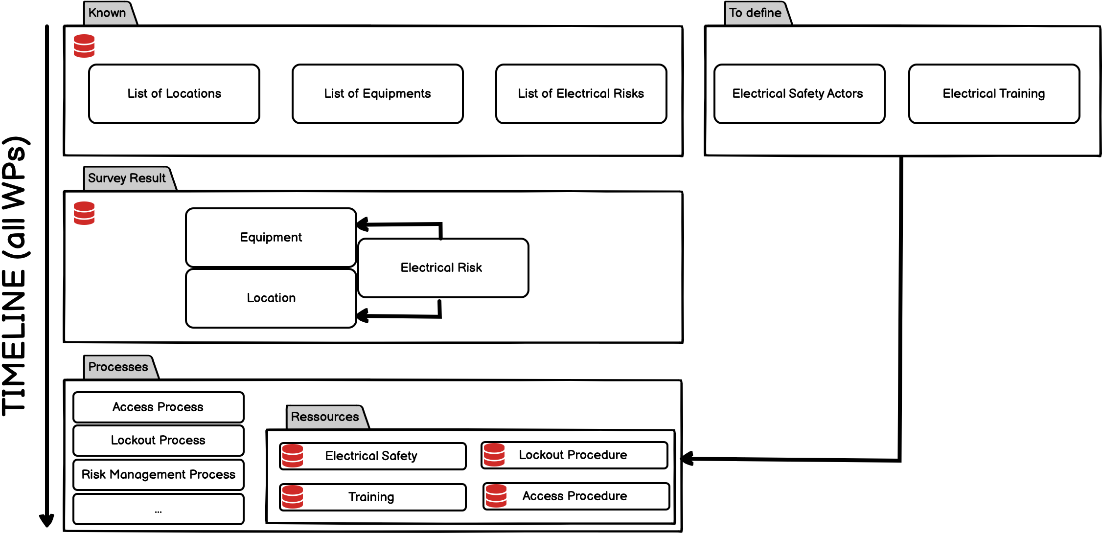
Global Timeline
.

Slide 20
CONCLUSIONS
WP4 scope is well defined
  KISS processes to allow access / work in an area where an electrical risk is identified.
Strong links with the other WPs have been identified
  Roles & Responsibilities definition blocking (WP2)
  Heavy data requirements, paradigm shift may be needed when it comes to save data.
Ressource Estimation
  0.4 FTE divided between involved equipment groups (0.2 for WP4.1 survey, 0.2 for WP4.3 Lockout procedure)
  0.5 FTE always available at WP6 to create web forms, setup DBs, import/merge existing data.
Next steps are (even if it seems crazy and too ambitious)
  Create web forms
  Gather Electrical Safety Information
  Be nice with WP2 (as we badly need them)

