Slide 1
Electrical Safety - Oil & Gas Platform Case
Melania Averna SY-STI-RBS
15 December 2023

Slide 2
Table of Contents
Career Overview in O&G
Safety in O&G
Regulations & Class Rules
Electrical Safety in O&G
Permit to Work in O&G

Slide 3
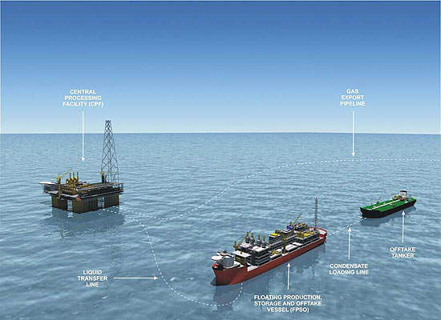
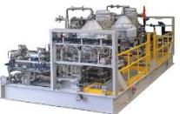
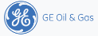
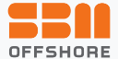
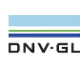
Career Overview prior CERN – O&G
12+ year experience in Electrical and Safety Critical Systems Design
Lead Electrical Engineer
Managed & Delivered multi MM Projects
Notified Body – Offshore Class Certificate
  Interpretation
  Equivalent level of safety
2004
2007
2013
2016
20XX
Master of Science from Turin Polytechnic, Italy
12+years experience in Design and Installation of Main Power and Emergency Generation and distribution, Safety and Control systems on Floating Production Storage and Offloading platforms
9/29/2020

Slide 4
Regulations & Class rules
Internationally recognised standard
Independent verification: risk-based approach
Compliance with International Maritime Regulations ( IMO) / Flag State requirements
Main Class - Prescriptive approach
Regulations, Verification
Flag
DNV-Class
Requirements
Work Scope

Slide 5

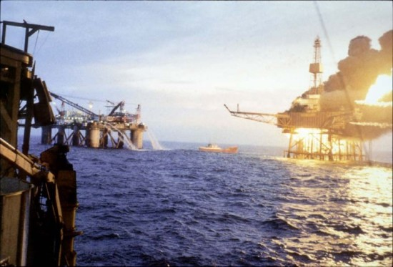
Safety in Oil &Gas Industry
2010: Deep Water Horizon
11 fatalities
Ecocide
Reputation/Bankruptcy
The flammable and toxic nature of key processes in the oil and gas industry necessitates extreme caution and risk management from extraction, to separation, storage and transportation
Accidents: why do we want to identify risks?
1988: Piper Alpha
167 fatalities
Safety Case
Reputation

Slide 6
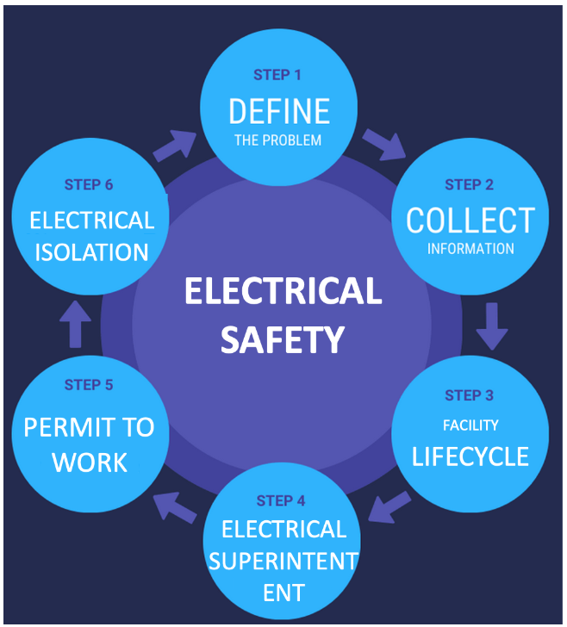
Electrical Safety in O&G
RISK IDENTIFICATION
EMN

Slide 7
Electrical Safety – Step 1
Risk identification and risk analysis:
systematically identify hazards
assess the risks and consequences of those hazards being realised
put in place suitable procedures and measures to reduce risks
Implementing strategies to identify, assess, monitor, and revaluate risks.

Slide 8
Electrical Safety – Step 2
  Collecting information and populating the risk register -> Electrical Maintenance Network
  PFD process flow diagram / PID
  Key single line diagram
  Equipment list
  Maintenance plan
  Safeguards in place
  Frequency of inspection
  Facility Layout

Slide 9
Electrical Safety – Step 3
  Rigorous and consistent throughout the facility lifecycle
  Inherently safe design
  Management of Change
  Traceability
  Documentation QA/QC

Slide 10
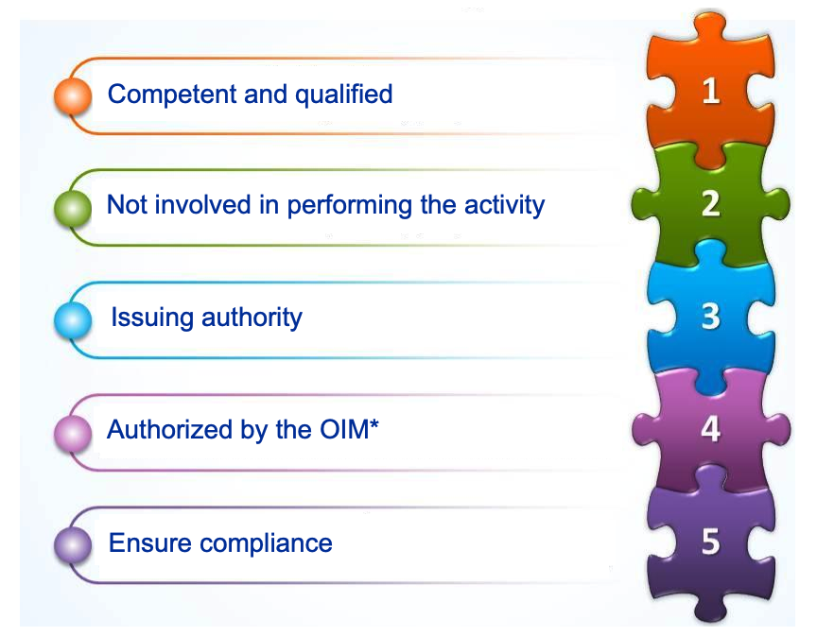

Electrical Safety – Step 4
  Who is in charge?
  Courtesy of S. Desban
  *Offshore Installation Manager (ATS Directorate)

Slide 11
Electrical Safety – Step 5
  Permit to work (PTW or e-PTW)
  For non-routine hazardous work, to be carried out in the safest possible manner, the Operator (duty holder) shall ensure that such work is carried out only in accordance with the written instructions ( ‘permit to work’) issued by a person authorized by the Offshore Installation Manager
  formal, signed, documented system
PTW aims to:
  ensure proper planning & precautions are in place
  define and control risk reduction measures
  reduce risk to ALARP
  enhance safety culture
  formalise communication between parties ( site management, supervisors, operators & those who carry out the job)
  define the responsibilities of various personnel involved in execution of the particular work activities
  specify the place, date, time and duration of such work, the precautions to be taken, the parameters to be monitored during the work and the persons responsible for compliance

Slide 12
Electrical Safety – Step 6
  Electrical Isolation Permit
For work on electrical systems, it means the disconnecting of the electrical supply to electrical installation to make the electrical system dead. Once the electrical supply to electrical installation has been isolated, the sources of isolation must then be protected so that plants or equipment cannot be negligently or intentionally made functional again: LOTO (lock out tag out)

Slide 13
Permit to Work System in the Oil & Gas Sector
It is a digital management system that ensures that work is done safely and efficiently, providing the procedures for requests, review, authorization, documentation, and hazard mitigation, all of which are necessary to protect the front-line workers
PTW is needed for better risk control
Performing a hazard assessment is crucial and often requires a list of all permits that may be needed for each job and its specific environment
Assessing its effectiveness, there are a few key elements that must be predefined for each job. This checklist ensures that the right permits and processes are used for each unique situation

Slide 14
Permit to Work System in the Oil & Gas Sector
Some of the commonly used permits in the sector:
Hot Works
Confined Space
Excavation or Ground Disturbance Permit
Hazardous Materials Safety
Electrical Isolation
Drilling Permit – drilling a new well or completing an existing producing well
Cold Work Permit – general chemical safety

Slide 15
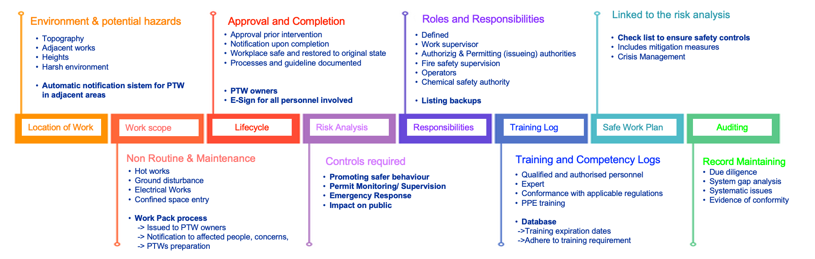
Permit to Work System in the Oil & Gas Sector
The key elements of a PTW System should be provided in a documented Permit to Work procedure - not in a chronological order

Slide 16
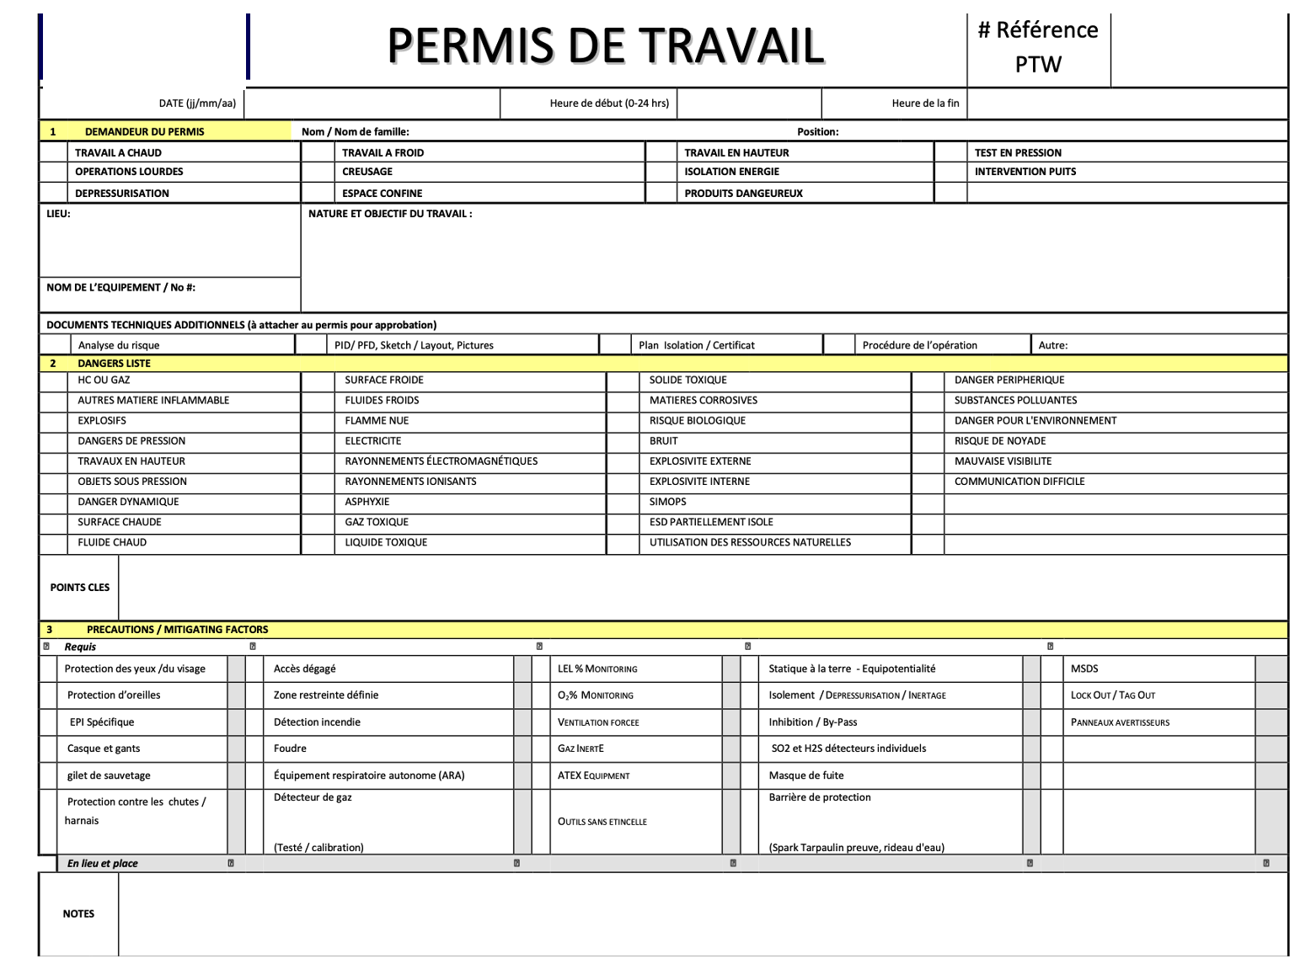
Electrical Safety – PTW
  Courtesy of L. Pasquio

Slide 17
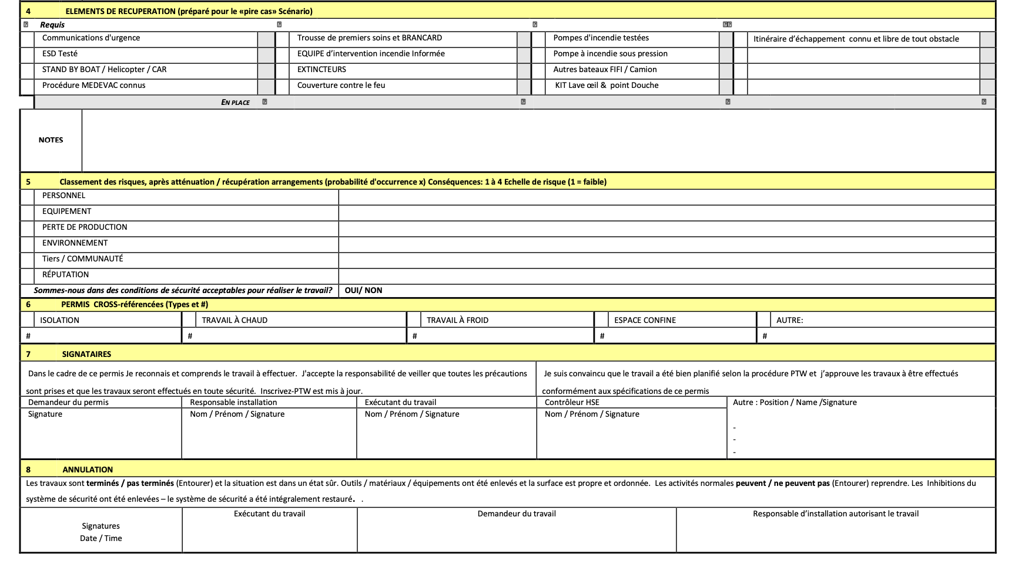
Electrical Safety – PTW

