Slide 1


Centre for Computational
Personalised Medicine
International Research Foundation
We create computational technologies
for optimised healthcare
Seamless Integration of Data Sharing Repositories with High-Performance Computing Simulation Platform
Taras Zhyhulin, Karol Zając, Marek Kasztelnik, Maciej Malawski, Jan Meizner, Piotr Nowakowski, Piotr Połeć
Notes:
scientific programmer at the Sano Centre for Computational Medicine in Poland.
dedicated to enhancing medical research through developing tools and models for it in collaboration with High-Performance Computing infrastructure.
the development of part of our toolkit designed to leverage high-performance computing infrastructure for medical research which
involves Integration of Data Sharing Repositories with HPC Simulation Platform.

Slide 2



Technical Problems in Research
HPC – not easy to use
Model, input and output data needs to be shared
Storing input and output data locally – a lot of memory used
Secure rule-based data sharing
Results need to be published
Notes:
concept of the digital twin—a digital model of a real object or system scientists use for simulations and predict real-world behavior—is gaining popularity.
demand significant computational power, making HPC resources an attractive solution.
utilizing HPC requires technical expertise, posing a challenge for some scientists.
simulation models necessitate substantial input data and produce large output files, which must be securely stored and shared among research team members to prevent any data breaches.

Slide 3


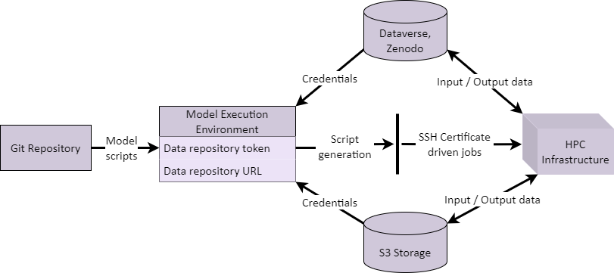
We have a solution!
Notes:
solution – Model Execution Environment and toolkit integrated with it.
provides scientists with handy interface for executing models on HPC, allows to structurize and organize workflows and data.
user can benefit from model versioning mechanism for the model scripts with Git Repository integration. This allows to keep scripts up to date automatically and ease sharing of them between team members.
They are executed on the HPC infrastructure using SSH driven jobs and inputs and outputs for the simulations are stored on integrated storages like S3 or Dataverse and Zenodo data repositories, providing users with possibility to stage data in and out from computations directly.

Slide 4
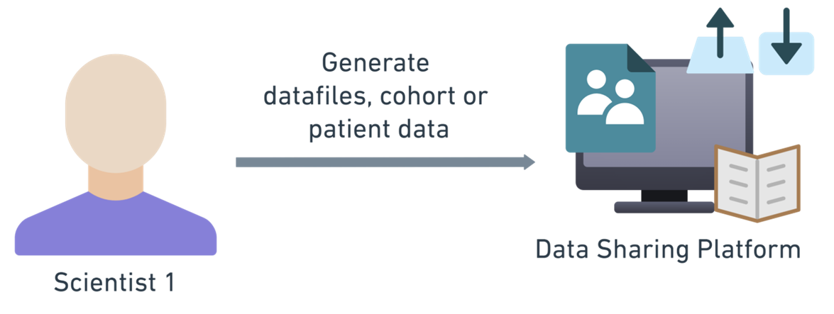

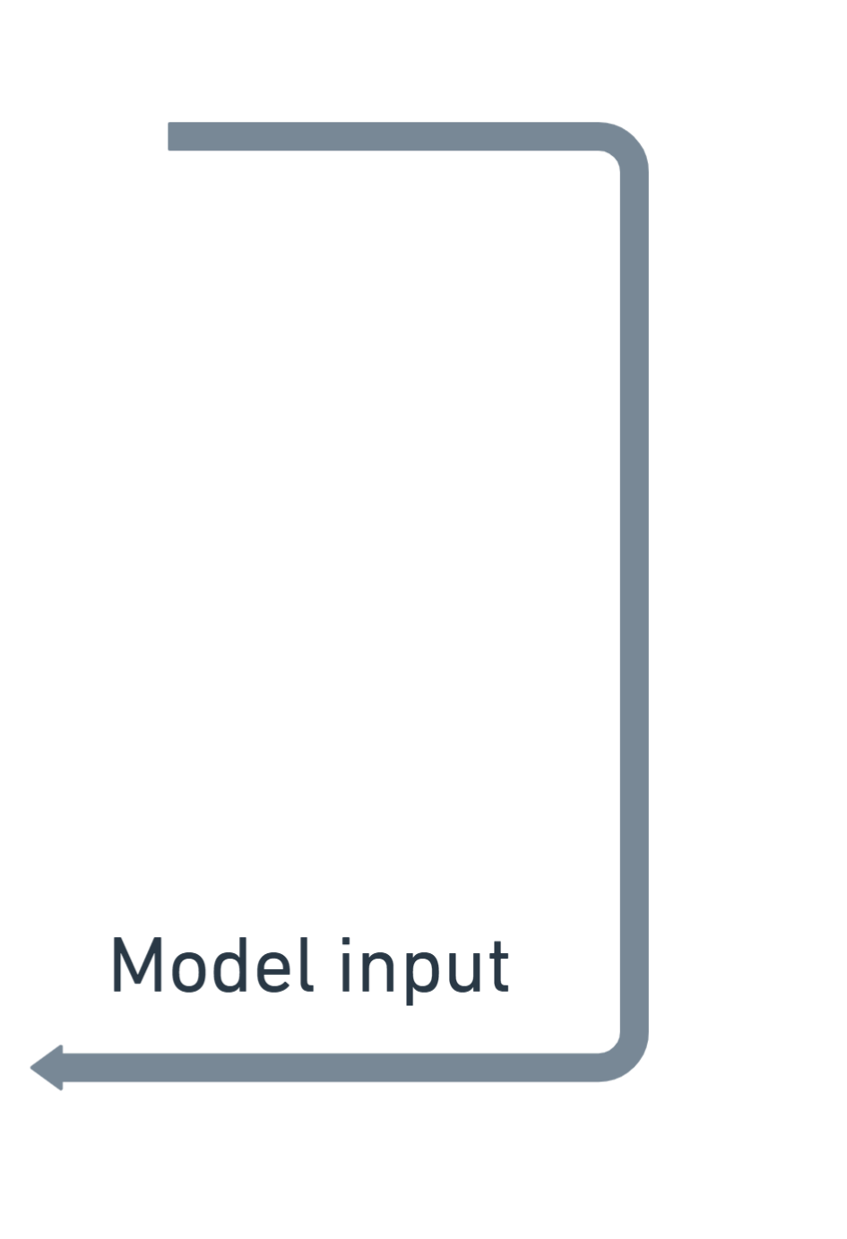
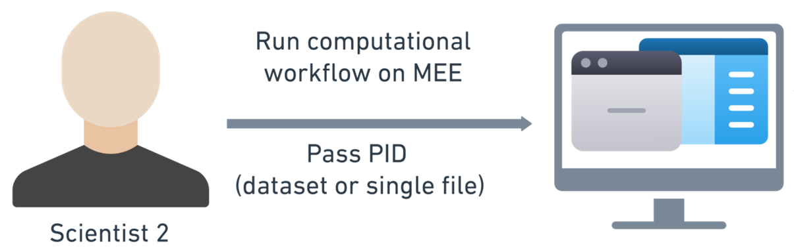
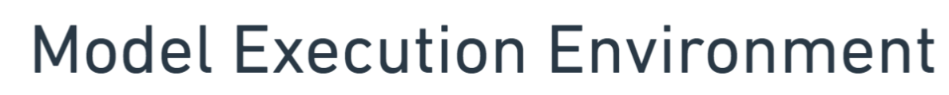
Data Repositories and MEE Workflow
Notes:
Benefits of data repositories usage may be presented in such use case.
A scientist derives and publishes some patient data needed for model execution.
another scientist wants to run a simulation using this data on MEE.
he or she should pass a persistent identifier of the published dataset as an argument of a computation in MEE
data will be staged in automatically and processed on the HPC.
results of a computation can be uploaded back to the data repository and update previous version of the dataset or create a new one. After this, they can be easily published and used in next computations in the same way.

Slide 5
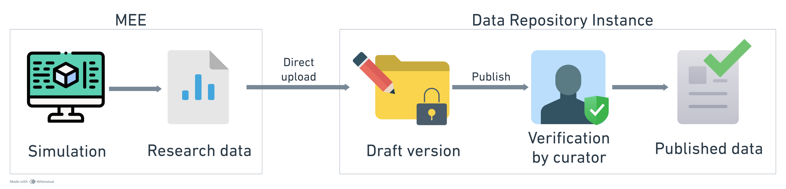
Data Repositories and MEE Workflow
After upload data is not published – stored in draft dataset
Draft accessible only to dataset owner and admin
Access can be granted to research team members
Notes:
file is uploaded to the dataset, a new draft version of the dataset is created, including the added file.
Admin of DATAVERSE (Dataverse) or COMMUNITY (Zenodo), where the dataset resides, can review if the file needs to be published.
approve the draft version to become a new public version of the dataset.
prevents misuse of our integration by uploading non-valuable data to the Dataverse.
Before a draft version is published, it is accessible only to the user, who created it, by uploading data to the dataset.
may grant access to the draft for team
modify it without it being accessible to the public, ensuring the privacy of the research process.
When final results are derived, they can be easily published without the need to re-upload them.

Slide 6

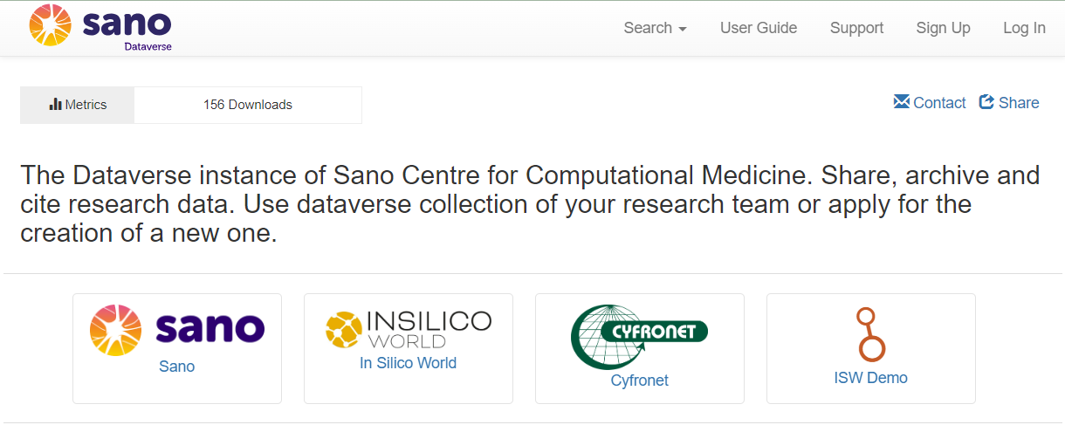
Sano Dataverse
Sano Dataverse instance
Sub-Dataverses
Header of the Sano Dataverse instance
Notes:
An example of where this practice is being introduced is our Sano’s Dataverse instance
research teams upload the results of their simulations, performed utilizing our integration, share input data for them, etc.

Slide 7
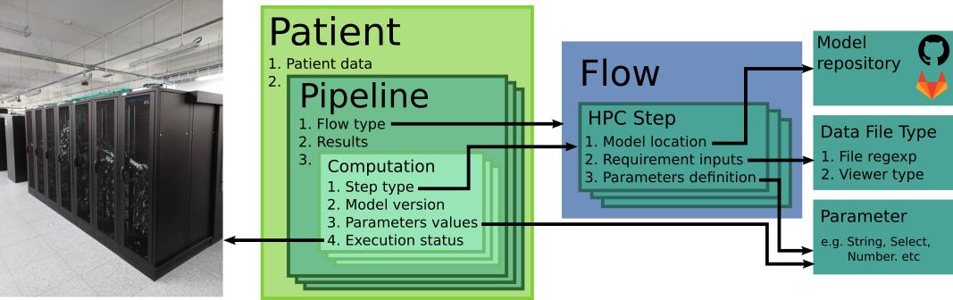
Model Execution Environment
Notes:
To better understand the computational workflow in MEE, let me outline its structure.
patients rather represent abstract entities upon which computations are performed.
each pipeline has a flow type and is built using the pattern of a selected flow.
flow consists of steps, which in turn are blueprints for individual computations.
When all the such inputs are provided, each computation is executed one after another on HPC.
This structured approach makes the simulation process easily configurable.

Slide 8
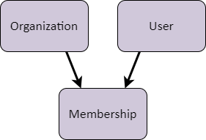

Model Execution Environment
Organization
    Name, Logo, Description
    Git config
    Data repository config
    PLGrid team id
User
    Name, Email
    PLGrid user login
Membership
    Data repository token
Notes:
Additionally, there is a structure for user accounts in MEE that allows to delineate access to HPC resources and integrated services for different research teams and single users.
PLGrid team ID—an identifier for a team in the HPC managing infrastructure used in Poland to manage access for research groups and ensure security
A membership is an entity that connects a single user with a single organization and stores data specific to their pairing, such as a data repository token.
It is an API token from the data repository instance, which is used to perform communication with it and can be found in the User Account section on either Dataverse or Zenodo.

Slide 9
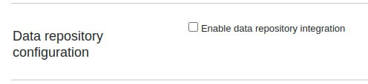
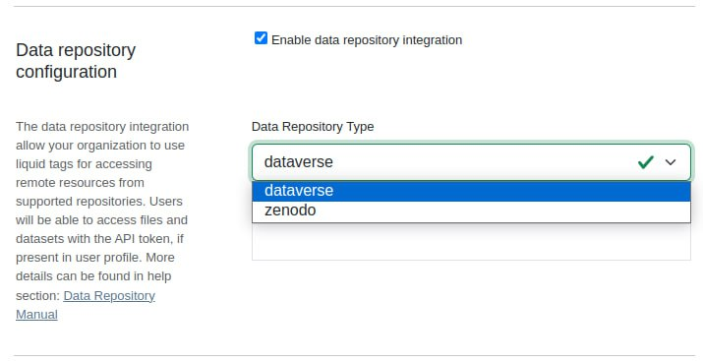

MEE and Data Repository Integration
Data Repository Instance Configuration
    In „Organization Details”
    Configured by admin
Data repository token
    Configured only if Data Repository integration in current organization is turned on
    Unique for every instance
    Configured by user in each organization
Notes:
Data repository config may be turned on only by admin
consists of data repository type, which can be either dataverse or zenodo by now and
data repository url, where url of an instance, admin wants to integrate this organization with, should be provided.

Slide 10
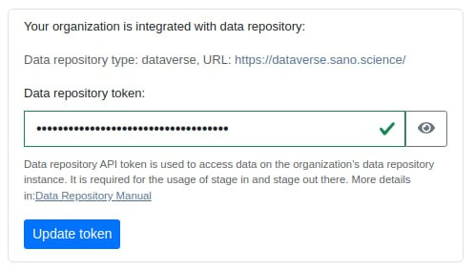
MEE and Data Repository Integration
Data Repository Instance Configuration
    In „Organization Details”
    Configured by admin
Data repository token
    Configured only if Data Repository integration in current organization is turned on
    Unique for every instance
    Configured by user in each organization
Notes:
membership’s data repository token, can be entered by user only if some data repository instance is configured in current organization.
tokens are unique for each instance, organization and user.

Slide 11
MEE and Data Repository Integration
filePath: The path to the file that you want to upload to Dataverse.
persistentID: The identifier for the target file or dataset in Dataverse, provided in a specific format, for example DOI (e.g., "doi:10.12326/shoulder/23GF4H").
metadata: An optional parameter that can be included in JSON format to provide additional file metadata. (OPTIONAL)
For example:
{"directoryLabel":"dir1/subdir","categories":["Data"], "restrict":"false"}
target: The name of the file where downloaded content should be saved.(zip archive in case of dataset downloading) (OPTIONAL)
Script features – liquid tags
Notes:
Moving on, to the implementation of described integration from script writers perspective.
Using data repository features is possible by adding interpolated tags to the model scripts.
This tags are substituted in the scripts on the script generation stage by the codes, which interact with data repository and retrieve or send data there.
Each type of repository has three tags: two for stage in and one for staging out data.
FILES CAN BE UPLOADED TO BOTH UNPUBLISHDE AND PUBLISHED DATASETS

Slide 12
MEE and Data Repository Integration
filePath: The path to the file that you want to upload to Zenodo.
depositID: The identifier for the upload deposition in Zenodo (may be unpublished).
recordID: The identifier of the record (dataset) containing the file or a target to upload to in Zenodo .
filename: The filename of the file that you want to download.
target: The name of the file where downloaded content should be saved.(zip archive in case of dataset downloading) (OPTIONAL)
Script features – liquid tags
Notes:
FILES CAN BE UPLOADED TO BOTH PUBLISHED RECORDS AND UNPUBLISHED ONES WHICH ARE CALLED DEPOSITS
These tags are sufficient to manage data on repositories from the script level, which allows scientists to benefit from automatical data flow from the user perspective.

Slide 13
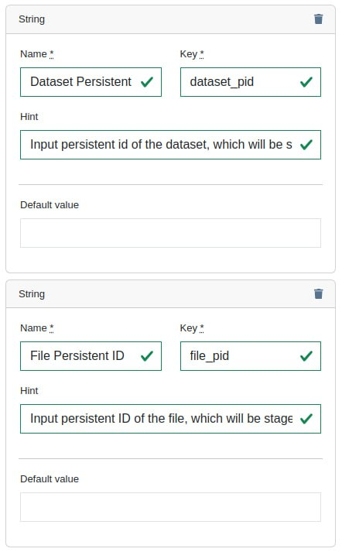
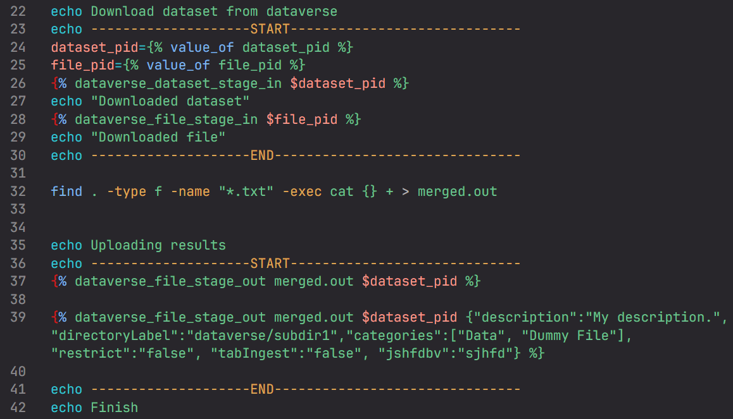
Integrated Simulation Workflow
Example basic script and step configuration
Notes:
Several liquid tags inserted, that stage in a file and a dataset, and upload a file to the instance in two versions: one with metadata and one without. File includes accumulated content of all the downloaded text files.
To execute this script using MEE, we create a step, associated with it, and
in order to specify which specific file and dataset need to be downloaded, we define text parameters in the step, where we can input persistent identifiers before pipeline execution.

Slide 14
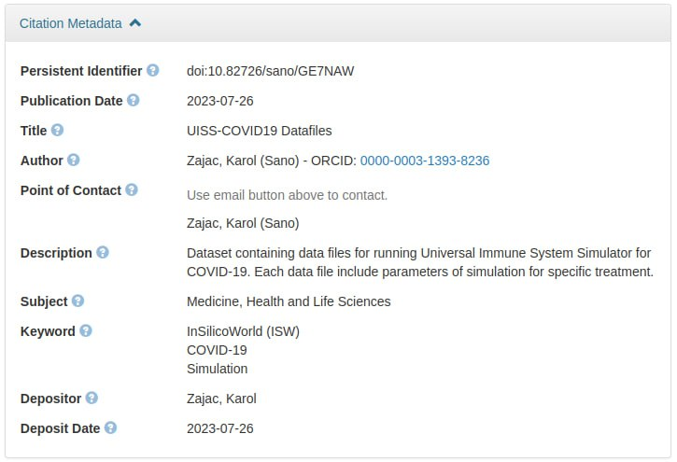
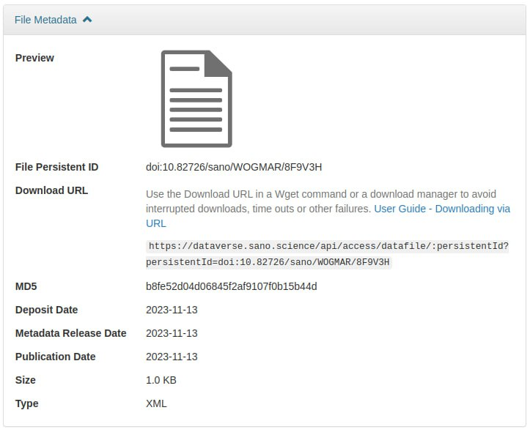
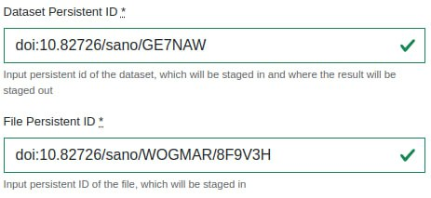
Integrated Simulation Workflow
Input data example
Notes:
We obtain the persistent identifiers in DOI format from the file and dataset metadata on the Sano Dataverse instance and input them into the fields of the previously defined parameters.

Slide 15
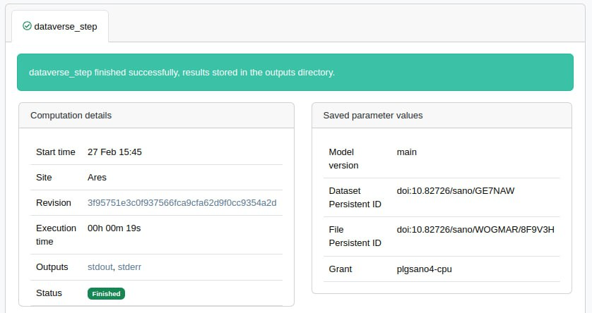
Integrated Simulation Workflow
Simulation execution result
Notes:
The script is then generated with them and passed to the HPC, where it is successfully executed.

Slide 16
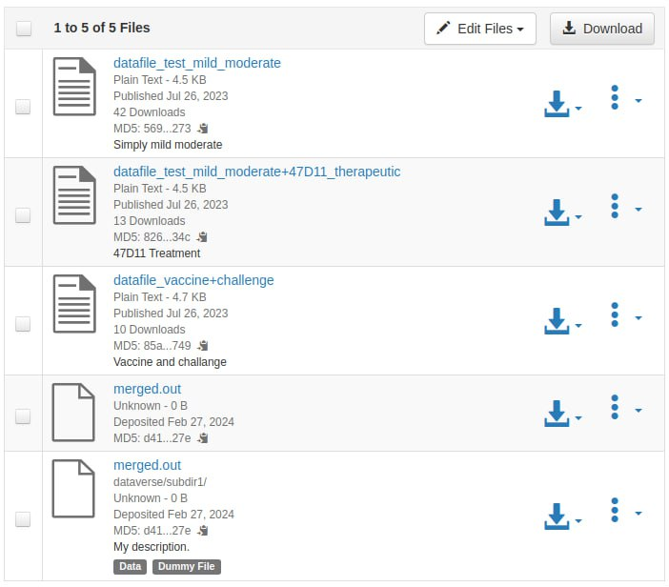
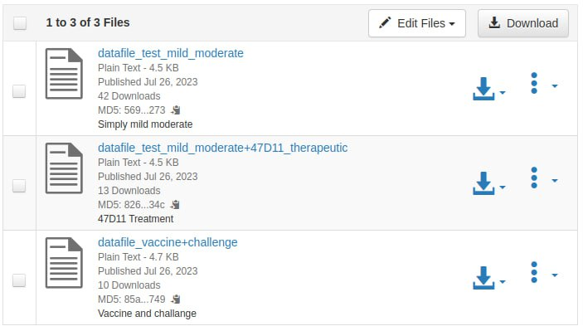
Integrated Simulation Workflow
Simulation execution result
Notes:
new draft version of the dataset we staged out files to on our Sano Dataverse.
new files have the same names, but they have different metadata, such as labels, description, and path, which then affect the directory structure of the dataset.
Thus, with just a few steps, we fetched, processed and uploaded back the data from the Dataverse instance by adding several lines to a script and using the MEE utility possibilities.

Slide 17
Next steps
Investigate ideas for rule-based data sharing
Develop universal liquid tags for any repository type
Collaborate with InSilicoWorld and perform simulations
Notes:
willing to investigate some more advanced ideas for rule-based data sharing to introduce an incentive aspect to it, in order to motivate researchers to publish BENEFICIAL data.
lanning to develop universal liquid tags that do not require any configuration of an API token and instance.
we are collaborating with the InSilicoWorld project by executing simulations on their models using our integration, and we want to continue doing so.

Slide 18


Taras Zhyhulin
t.zhyhulin@sanoscience.org
This publication is (partly) supported by the European Union’s Horizon 2020 research and innovation programme under grant agreement ISW No 101016503. We gratefully acknowledge Polish high-performance computing infrastructure PLGrid (HPC Centers: ACK Cyfronet AGH) for providing computer facilities and support within computational grant no. PLG/2023/016227.

