Slide 1

Humanitarian action in the digital age
CS3 2024 @CERN

Slide 2
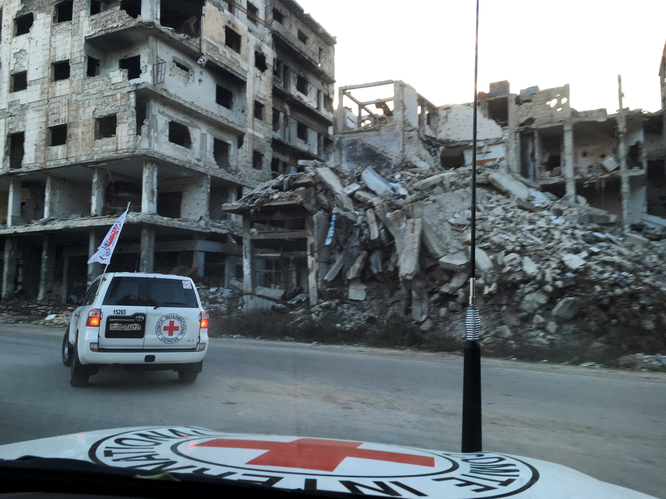

Slide 3
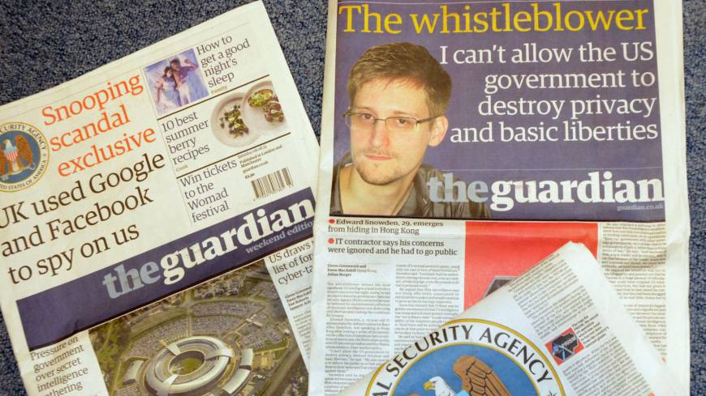
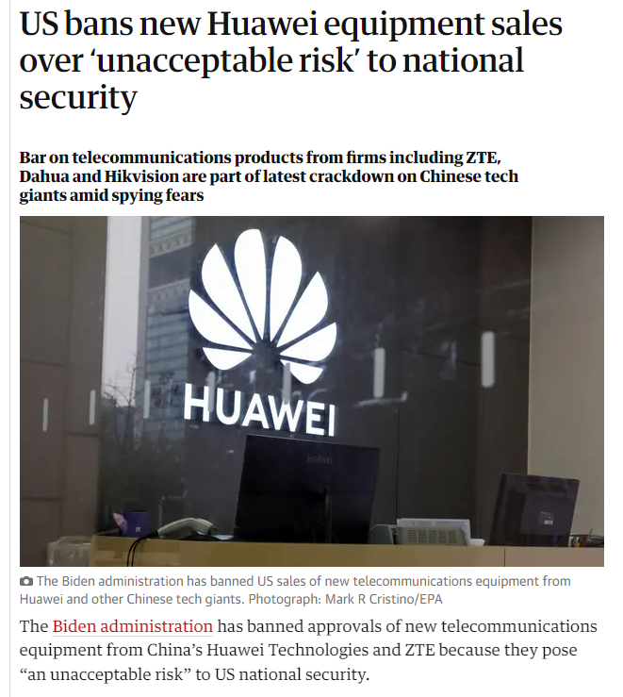
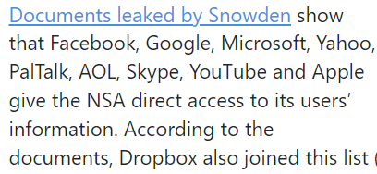
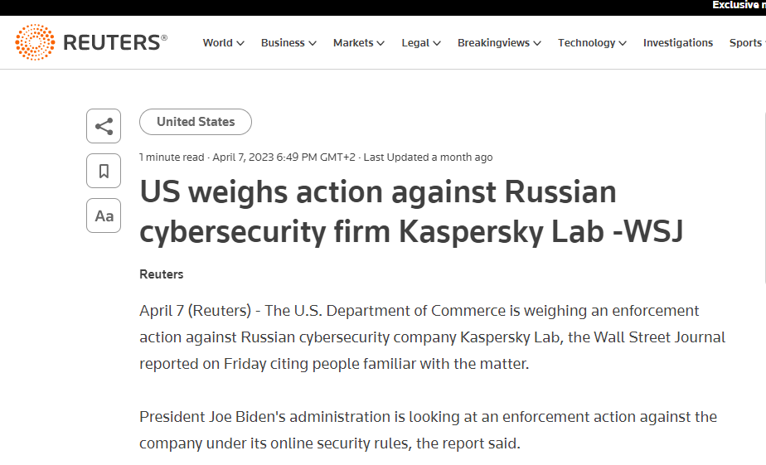

Slide 4
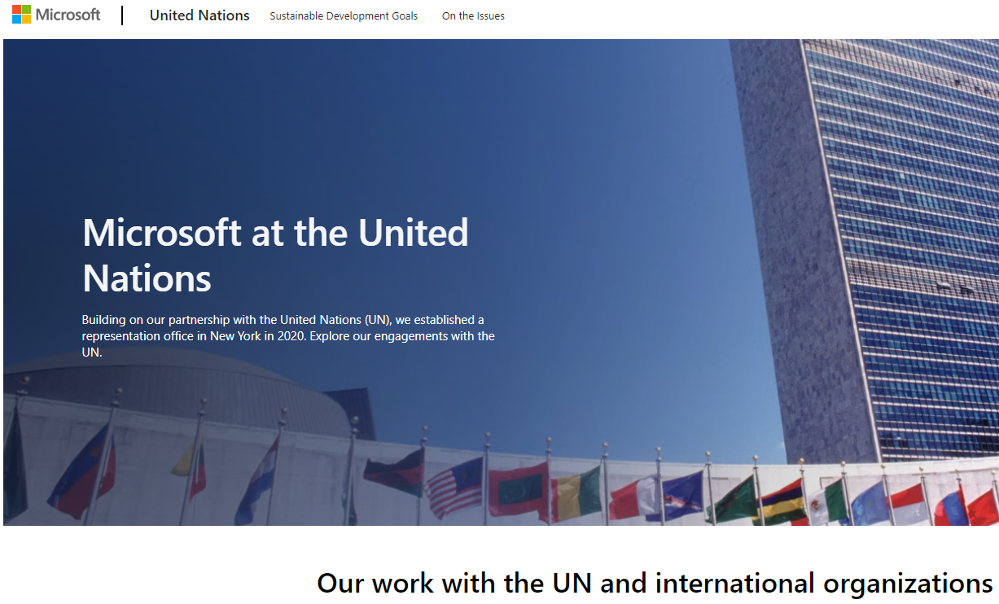
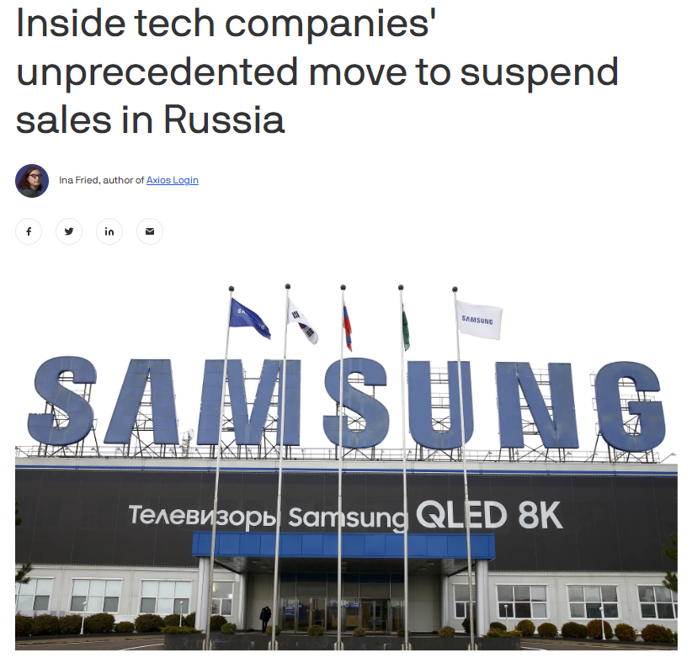
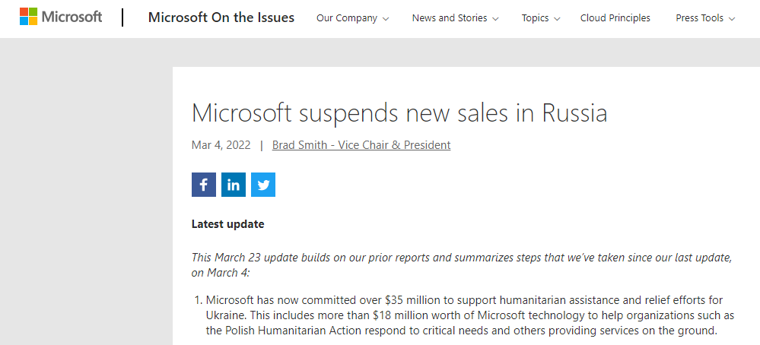

Slide 5
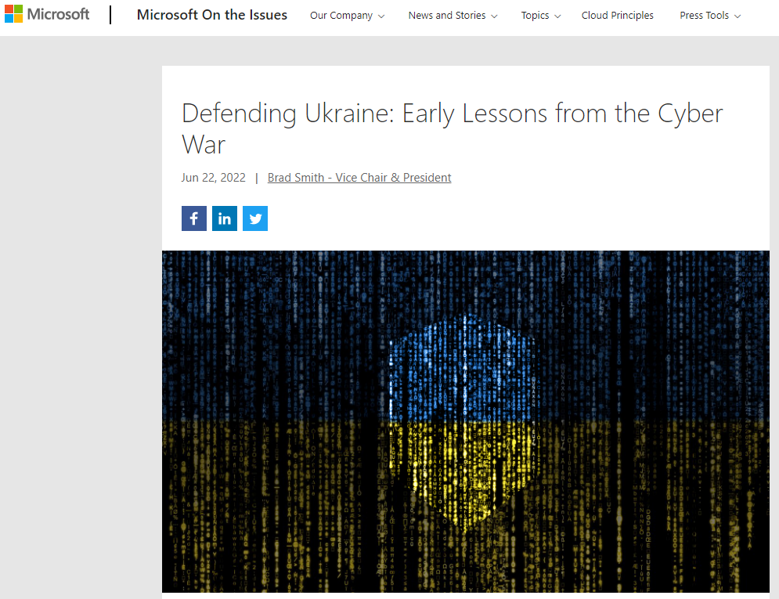
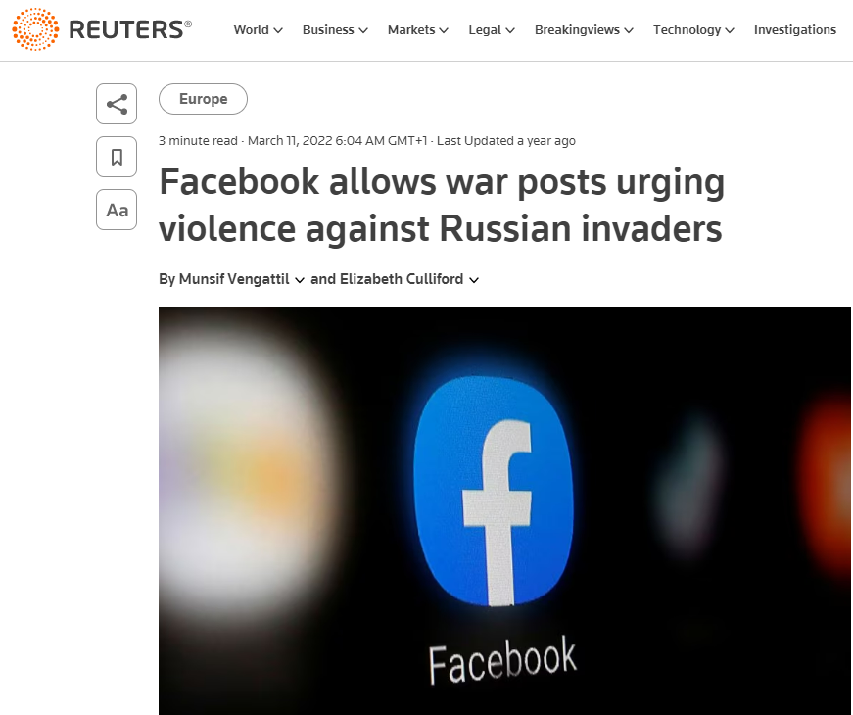

Slide 6
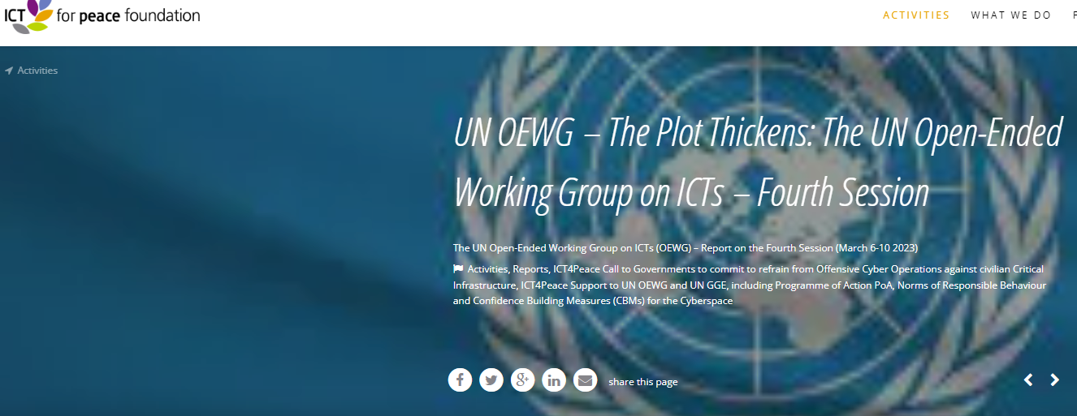
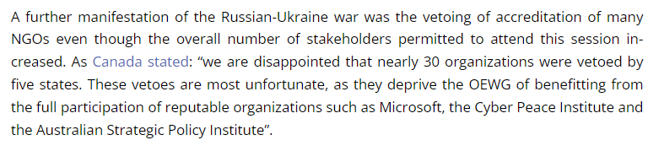

Slide 7
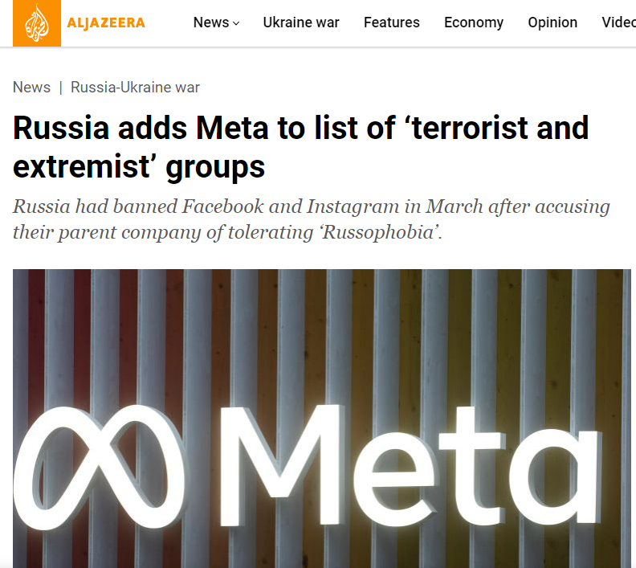

Slide 8
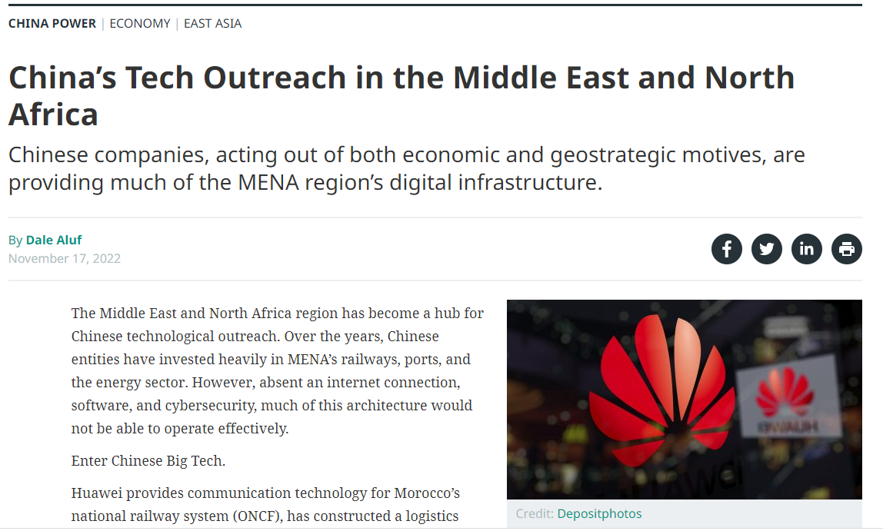
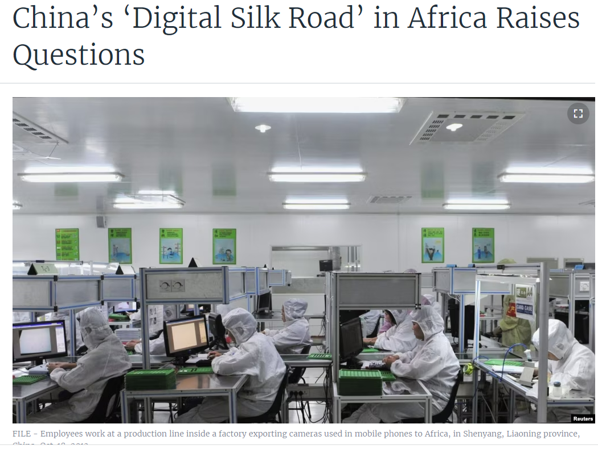

Slide 9
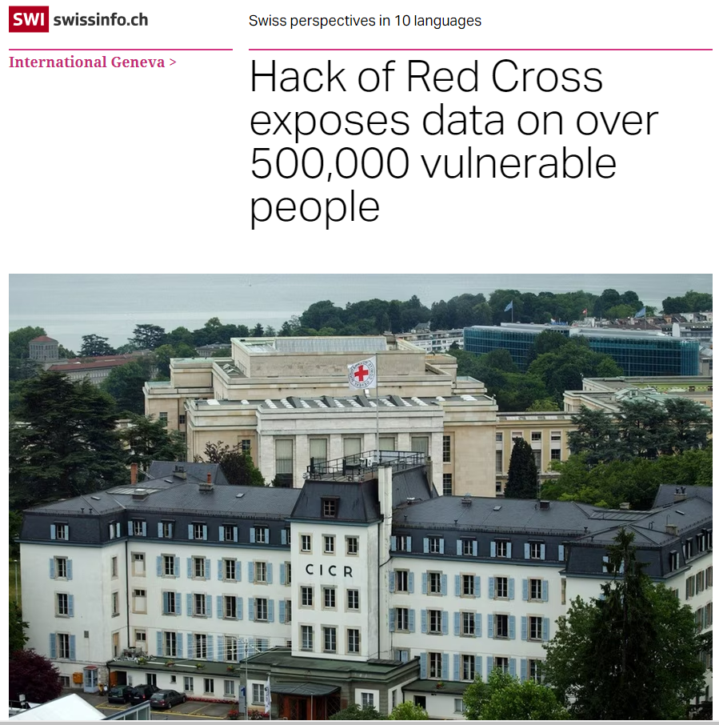
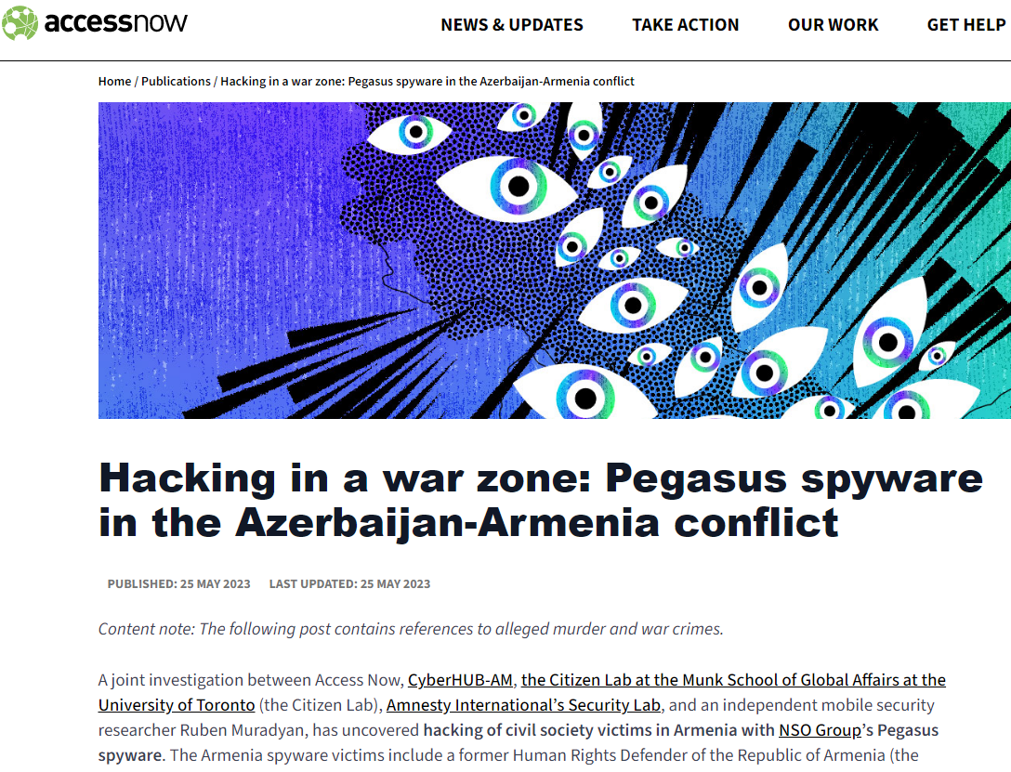

Slide 10
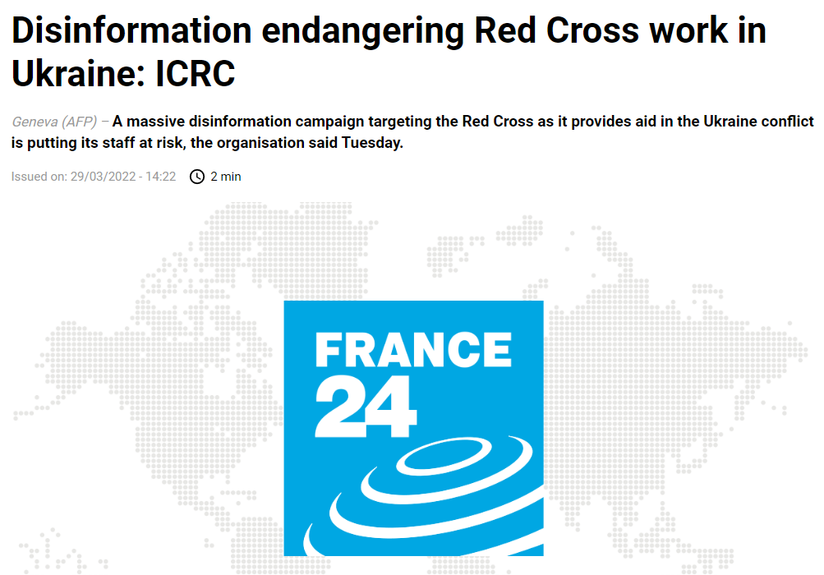
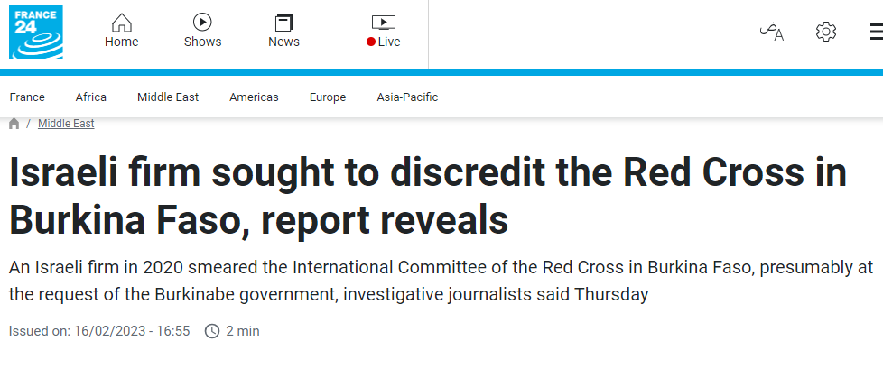

Slide 11
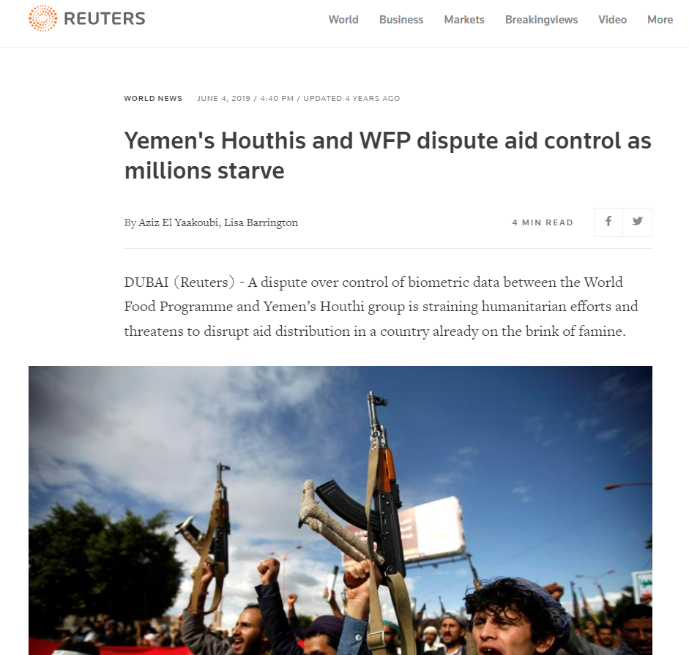

Slide 12
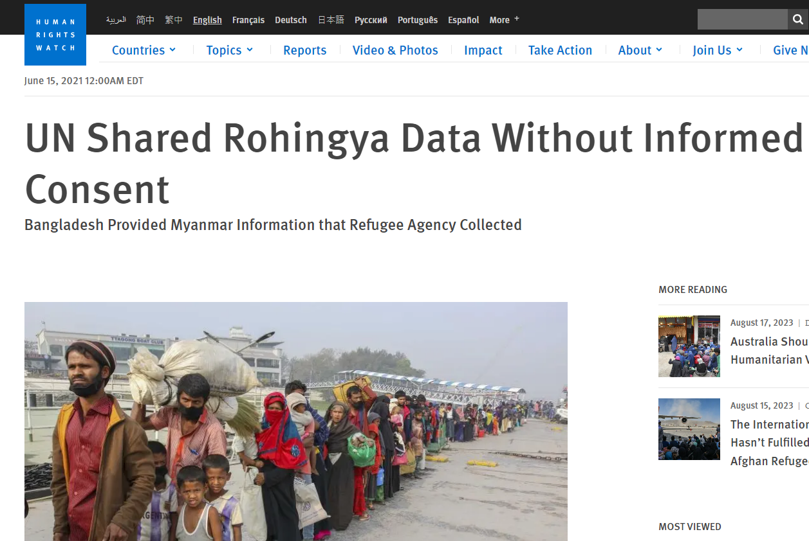
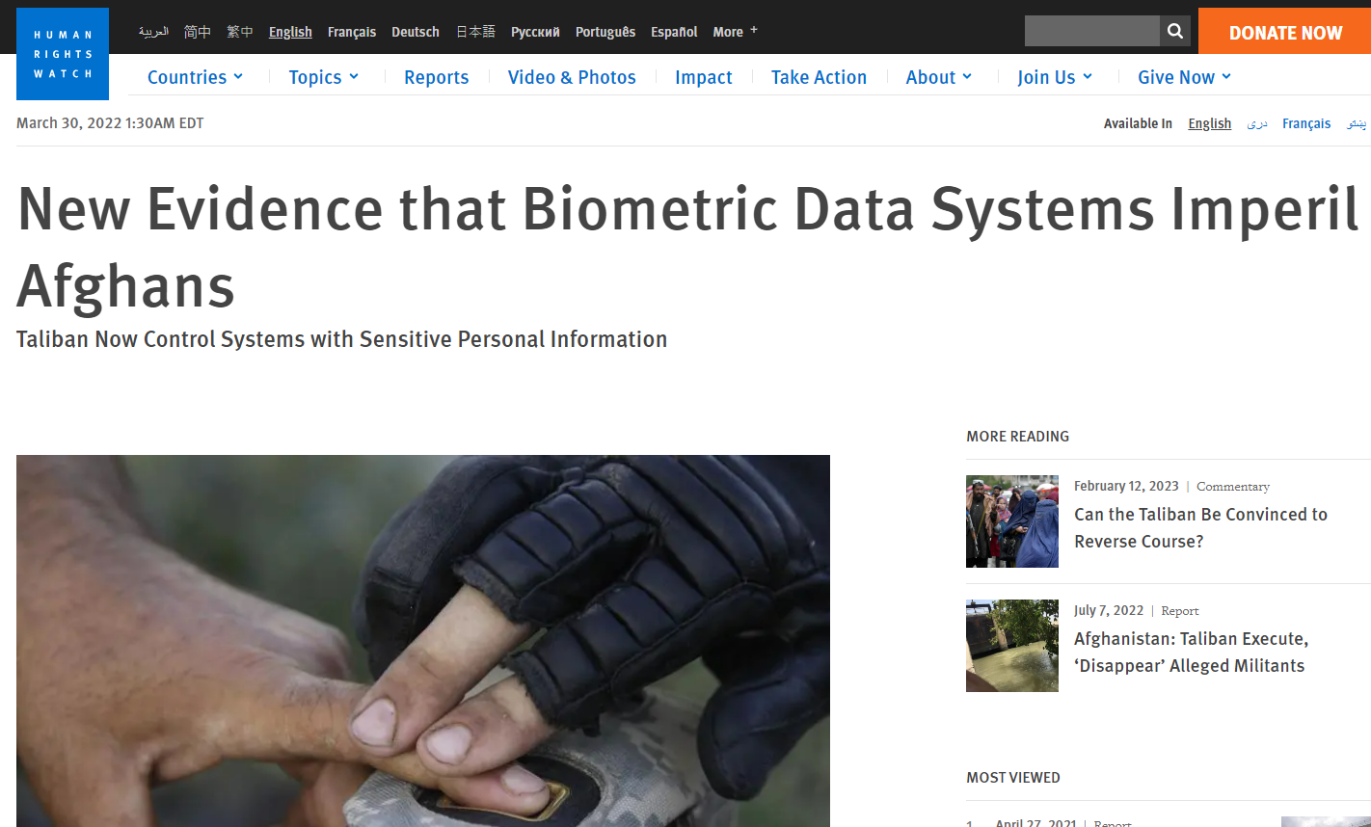

Slide 13

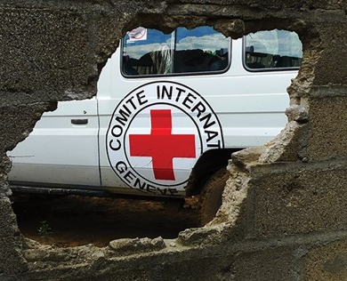
Digital transformation Humanitarian Sector

Slide 15

The vision
The ICRC places great emphasis on ensuring that the use of digital technologies aligns with the Movement’s Fundamental Principles, as well as with the ICRC’s own working methods.
This commitment ensures accountability to conflict-affected individuals, secures the protection of data entrusted to the organization and provides transparency to donors.
It further guides the choice of the ICRC’s technologies, infrastructure and partnerships.
ICRC Institutional Strategy SO 7.5 “Leading by Example”

Slide 16







The pillars to get there
Policy & Law
Tech r&d
Community
Training
OPERATIONS

Slide 17
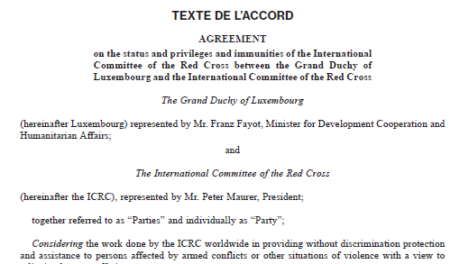


Policy & Law

Slide 18






Tech R&D for NIIHA

Slide 19
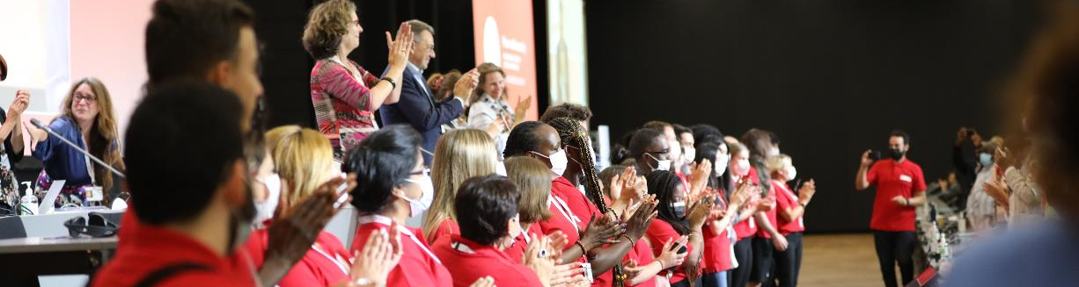
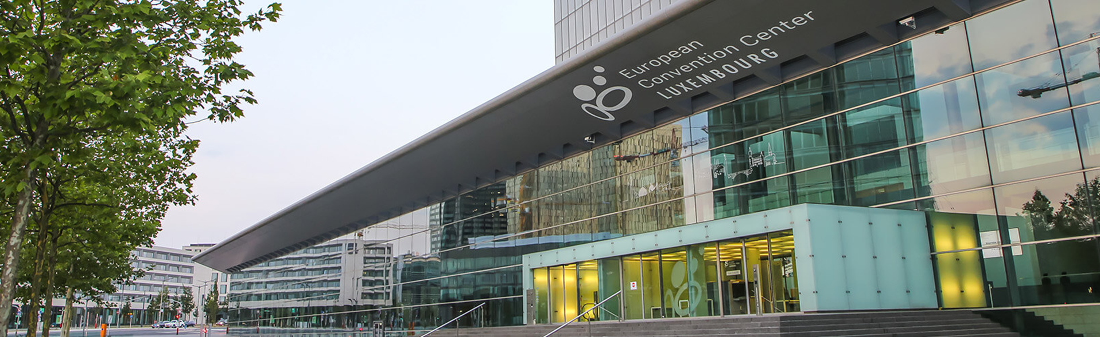
Community

Slide 20


training
.

Slide 21


OPERationalising
in CYBER & PROTECTION

Slide 22

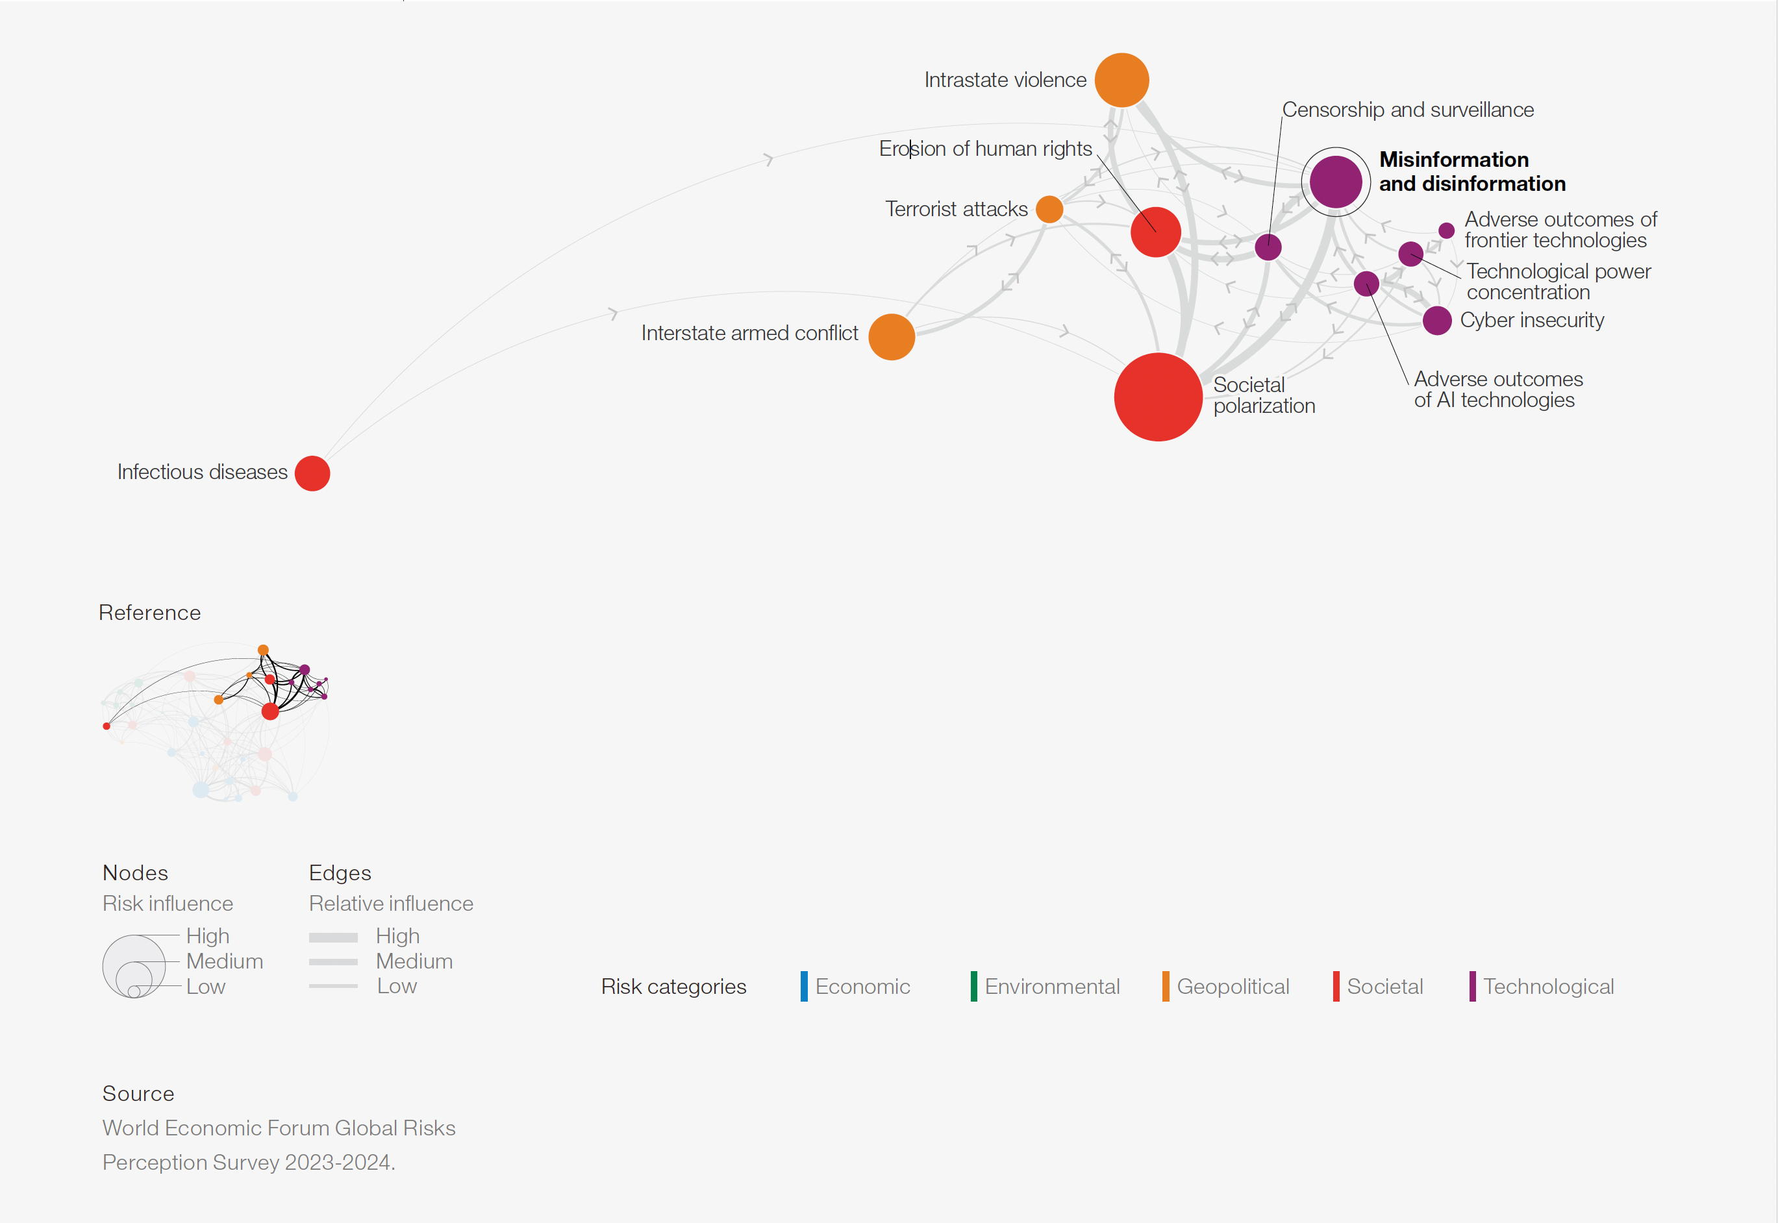
Researching new
Domains of warfare
Cognitvie Warfare
CW is the most advanced form of human mental manipulation
Influence not only what the target population thinks, but also how the target population thinks and through that how it acts.
Fracture the notion of objective truth destabilizing the public and epistemic institutions.
Targeting of entire populations as opposed to targeting military objectives. Civilians not only as targets, but also as means.
Reliance on weaponized cognitive neurosciences and other NBIC (Nano-technology, Bio-technology, Information technology and Cognitive sciences).
Delegation for cyberspace in Luxembourg
Notes:
We picture the world and things of the world not in a predefined and static way. Everyone has a different representation. The world is represented through the exchange of information. Whether sensory, linguistic or semantic. And nowadays, most of this information is exchanged through cyberspace.

Slide 23
Researching new
Domains of warfare
Cyber Warfare
Cyber Technological Warfare
Cyber Cognitive Warfare
Offense
Defense
Offense
Defense
Malware
Exploits
Phishing
Compromise Hardware Supply Chain
Credential Abuse
…
Antivirus
Endpoint Protection
M/N/XDR
IDS
Firewall/Proxy
Autonomous SOC
…
Psychological targeting
Cognitive hacking
Synthetic media
Microtargeting
Social/Economic environment destabilisation
…
?????????
Delegation for cyberspace in Luxembourg

Slide 24
Researching frontier technologies’ risks
AI, Quantum, Biotech, Nanotech
Researching AI form a risk perspective to humanitarian orgs, deployment during armed conflicts and the civil society as a whole: GenAI, AWS.
Researching biotechnologies from a risk perspective to humanitarian orgs, deployment during armed conflicts and the civil society as a whole: Brain-Computer Interfaces, Bioprinting, Biohacking.
Delegation for cyberspace in Luxembourg

Slide 25


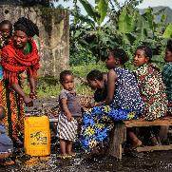
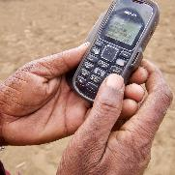

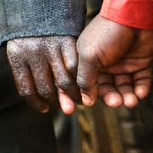

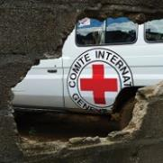
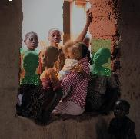


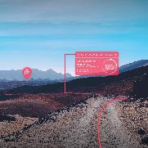
Thank you!
Delegation for cyberspace in Luxembourg

