Slide 1
Developing EFSS for Research in Ireland
Joint CS3/SIG-CISS
11th March 2024
Roberto Sabatino

Slide 2
Some history and context…
HEAnet – the Irish NREN
  Connectivity, Identity, Brokerage, Security
  Support to research done on “I know them” basis, or obvious national cases
    I-LOFAR
    EUMETCast with Met Eireann
    Research in networking (TSSG, TCD, SFI-CONNECT)

Slide 3
National context
No national service at present in Ireland for storing and sharing active research data
Support for research, from digital infrastructure/IT perspective, best described as “patchy”. For both:
  Institutes
    Server under desk managed by post-doc
    Silos. Within and between institutes
  Funders
    National RI strategy ? What’s that ??

Slide 4
But not all is bleak
Open Science, FAIR RDM gained momentum in Ireland through NORF
And to some degree EOSC
Funding to bootstrap activities across the Open Science spectrum in 2022 and 2023.
  Culture, Open Access, Infrastructure
  ~1.8M/year
  Up to 200K per project

Slide 5
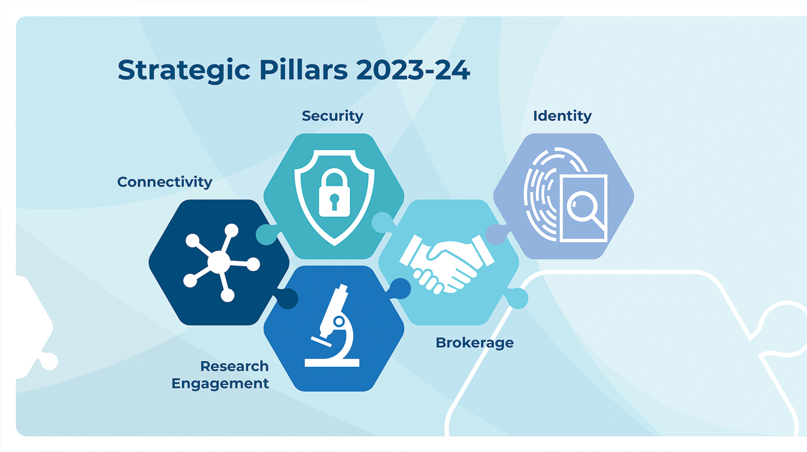
And from 2020 HEAnet is a fully fledged NREN
Addressing silos in Research Support and leading to a first sectoral national collaboration

Slide 6





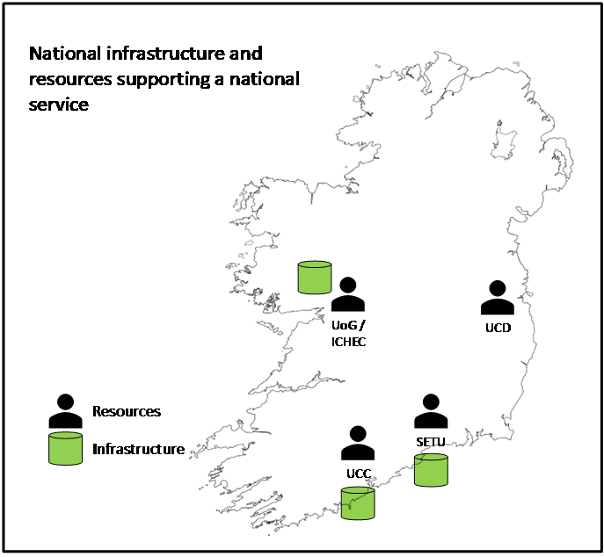




: National Shared Storage Service
NORF Open Research Fund 2022
Partners:
HEAnet: co-ordinator
EUDAT: expertise and technology provider
ICHEC, SETU, UCC, UCD: expertise and infrastructure providers
11 Use cases from:
GeoData
IoT for smart roads
Material sciences
Social Sciences
Humanities
Life Sciences
Wider sector engagement through Stakeholder Advisory Forum
Next meeting April 2024
Contact: Roberto.Sabatino@heanet.ie
Develop and run a pilot for a national service for active research data. Leverage findings to develop the specification of a national production-quality and sustainable service.
Phase 1
Verify services on EUDAT European infrastructure with 2 use cases.
Phase 2
Onboard pilot users on
national infrastructure
Phase 3
Develop specification for a national production quality and sustainable service
Design and implement national pilot infrastructure

Slide 7
The challenges ?
Technically, it’s straightforward and proven
Demand planning hence service dimensioning
  From short pilot only so much you can determine: many stars have to line up.
  Pilot users need to change their way of working for a limited time without funding
Outreach
Sourcing additional resources: A more general challenge
  Market competition, short term contracts
  Headcounts

Slide 8
Our path
Informed by discussions with our Stakeholder Advisory Forum and sessions with other NRENs
Full service definition based on nextcloud + B2Drop done by October 2024
  Includes Build vs Buy analysis
  Business and operational model
Likely to have a 5 year plan based on 1 central national service
  Serving the average users
  During 5 year period evaluate case for evolving towards, for example, SUNET Drive/Research Drive models
Preference appears to be for hybrid funding model
  Part centrally funded
  Part user (Institutional) fees
  Very large users/groups maybe treated separately ?

Slide 9
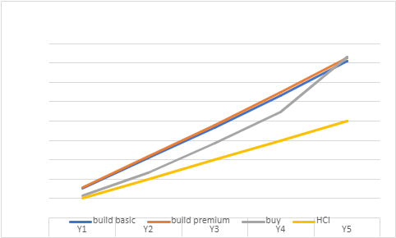
Build v Buy
Example 5 year scenario based on:
  progression from 100 users, 100TB to 1000 users, 500TB
  Leveraging hypothetical existing HW and HW support staff.
    But get the data right !
Cheapest or MEATest ?
  Importance of HCI ?

Slide 10
We’d love your input
Especially on service dimensioning and forecasting
I’m around the next few days – let’s talk !

Slide 11
Thank you
Any questions?

