Slide 2
RD4 forum – meeting #3

Slide 3
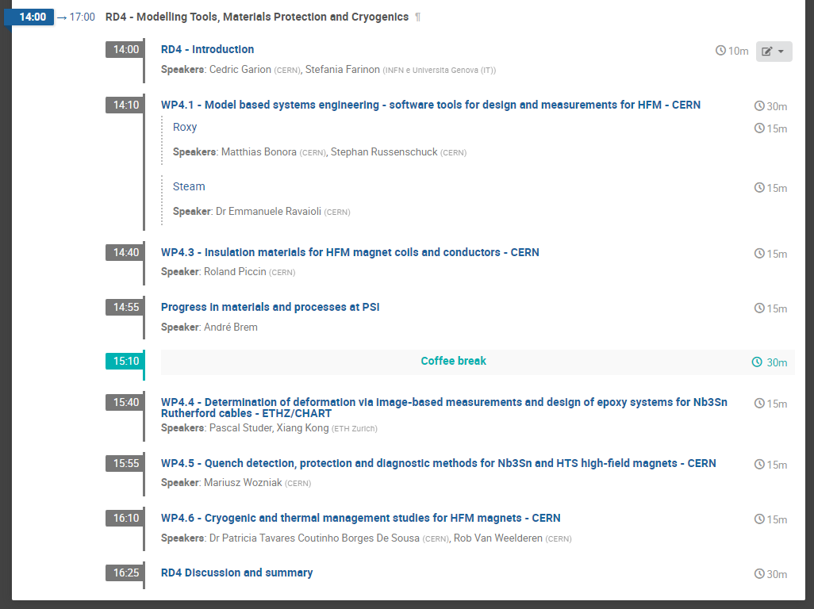
General news
Next RD4 forum dates:
  5th December 2023
  5th March 2024
Annual meeting
The meeting will be held from October 30 to November 2, 2023, at CERN
https://indico.cern.ch/event/1302031/
RD4 session is scheduled Wednesday afternoon, 1st November.

Slide 4
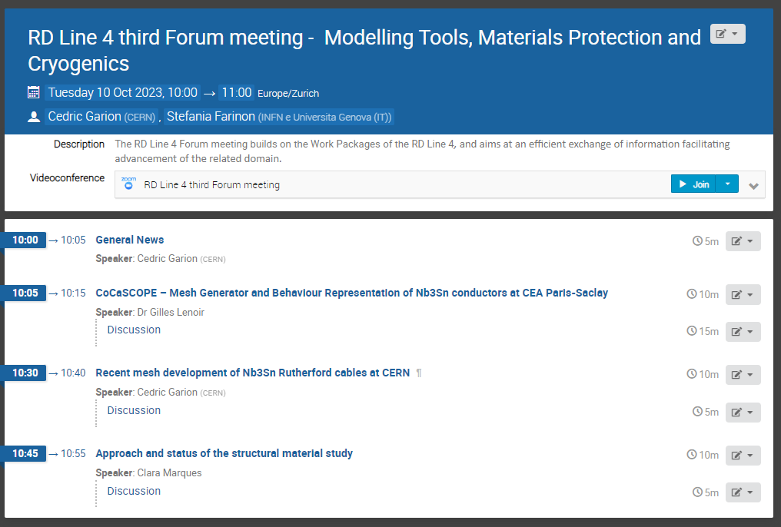
Today agenda
https://indico.cern.ch/event/1332860/

