Slide 2
Recent mesh development of Nb3Sn Rutherford cables at CERN

Slide 3
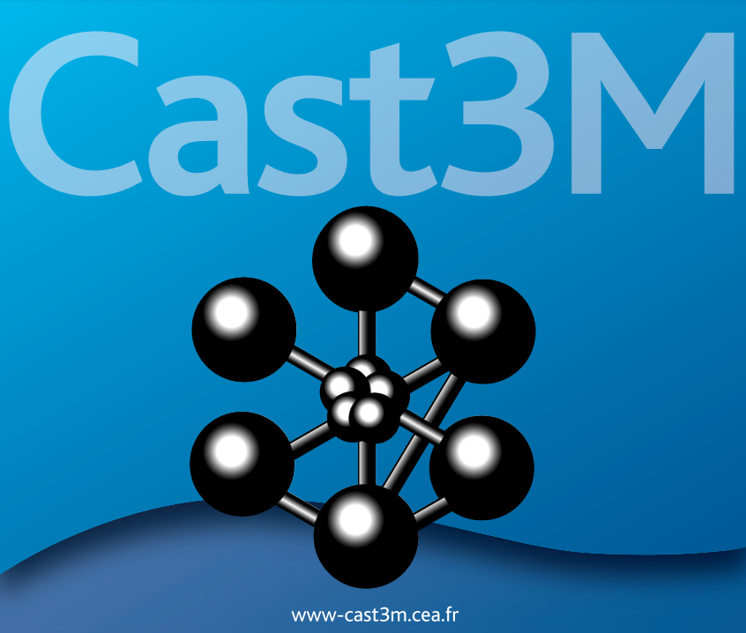
Some general considerations
Primary aim of the model:
Assess the behaviour of the cable before impregnation
Software used for the study: Cast3M from CEA
Main parameters for the cable geometry:
Number of wires
Transposition pitch
Wire diameter

Slide 4
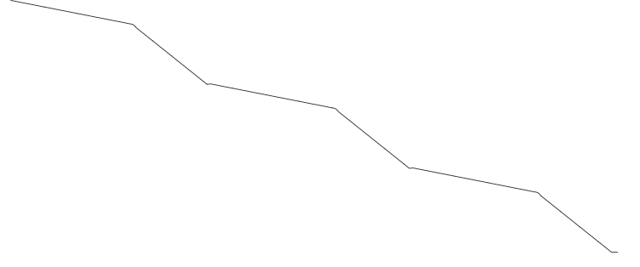
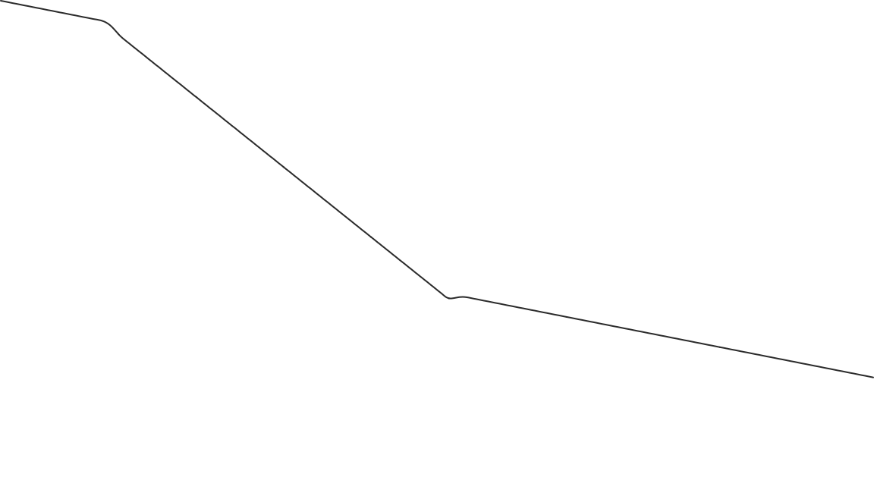
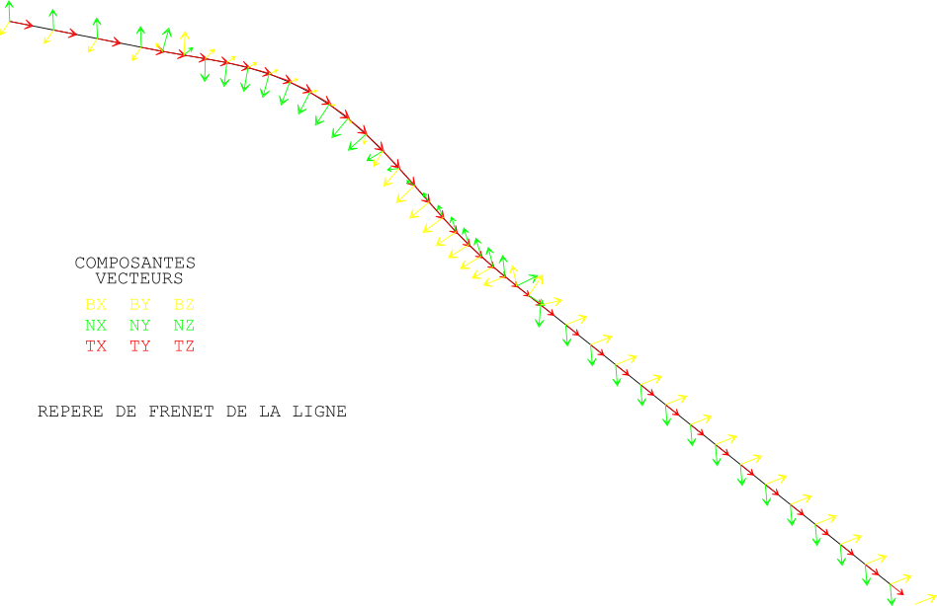
Mesh Construction (1)
Approach to define the geometry and the mesh:
Geometry and mesh of a wire
Helice
Lines
→ The wire axis is defined with a 1D mesh from lines and helicoidal curves.
Definition of the Frenet frame along the wire axis
→ Tangential and normal vectors to the wire axis.

Slide 5
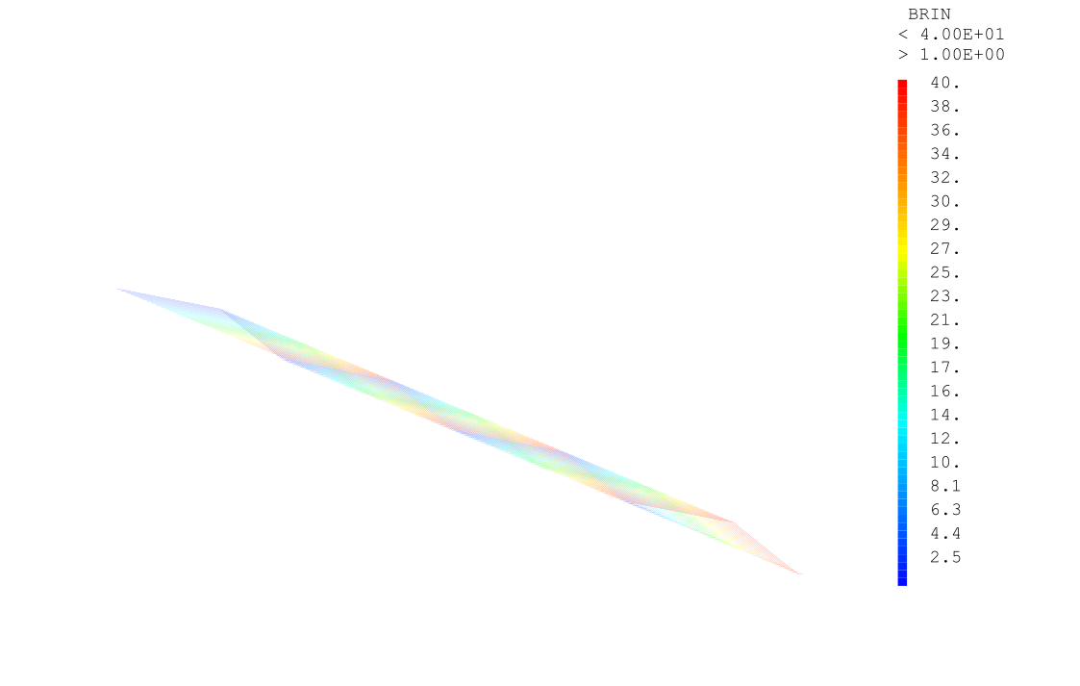

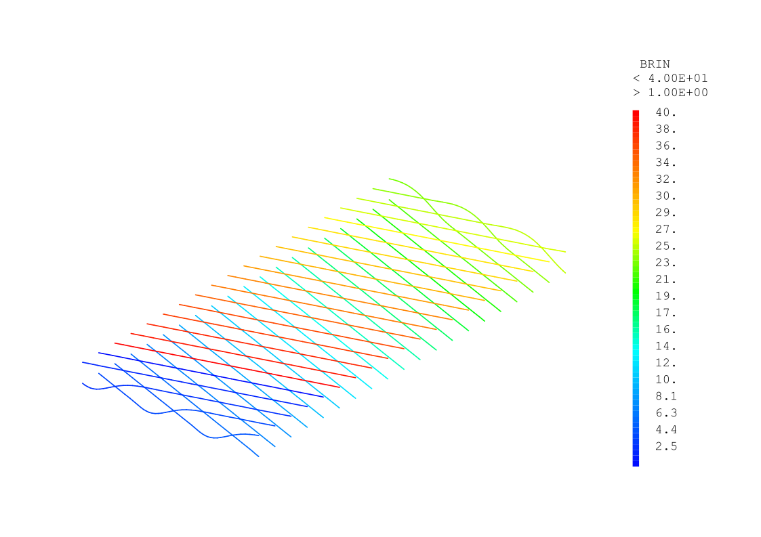
Mesh Construction (2)
Definition of the cable by wire axis obtained by translations of the reference wire axis
Frenet frames are also defined along each wire.
Definition of the cable length of interest and cut of the wire axes by two planes.

Slide 6
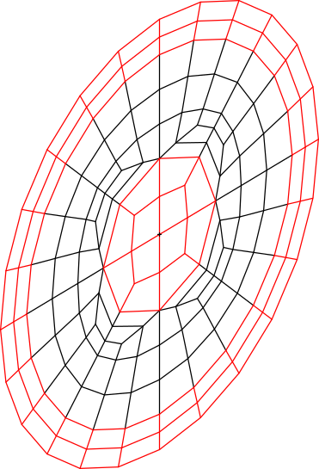
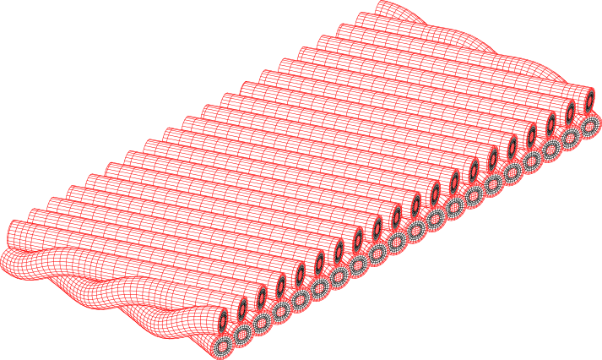
Mesh Construction (3)
Definition of the cable cross-section with two domains (in view of a bi-metallic model)
3D mesh of the cable obtained by sweeping of the cross-section along the wire axes.

Slide 7
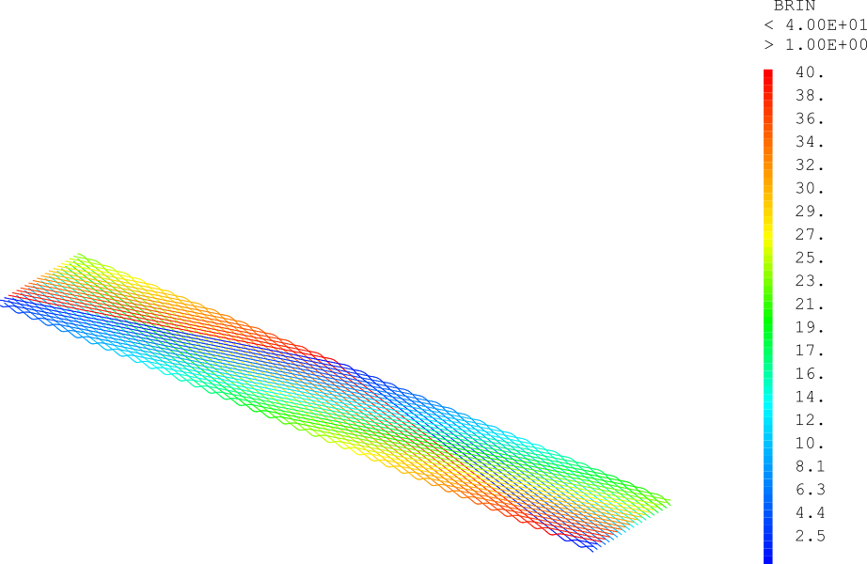
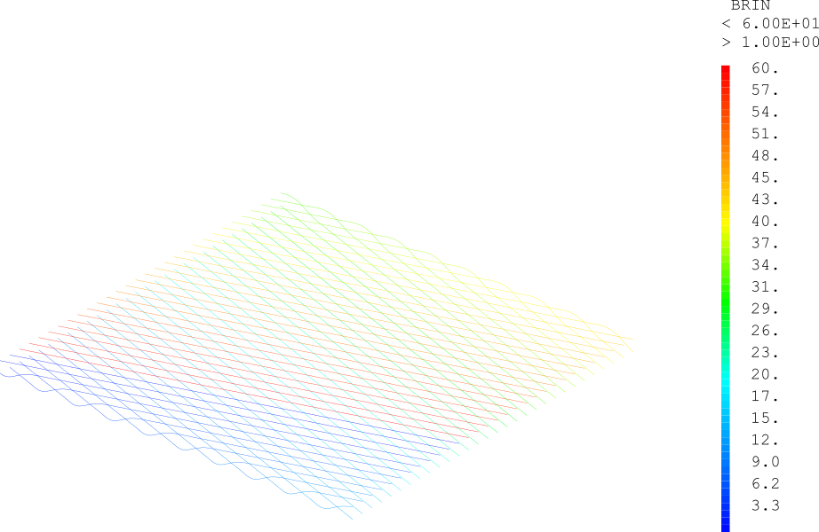
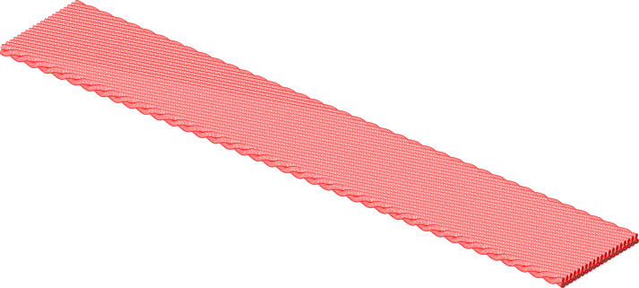
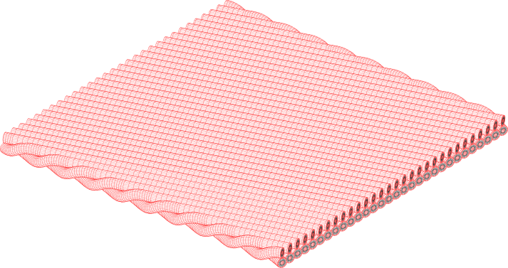
Mesh is parametrized and is generated automatically.

Slide 8
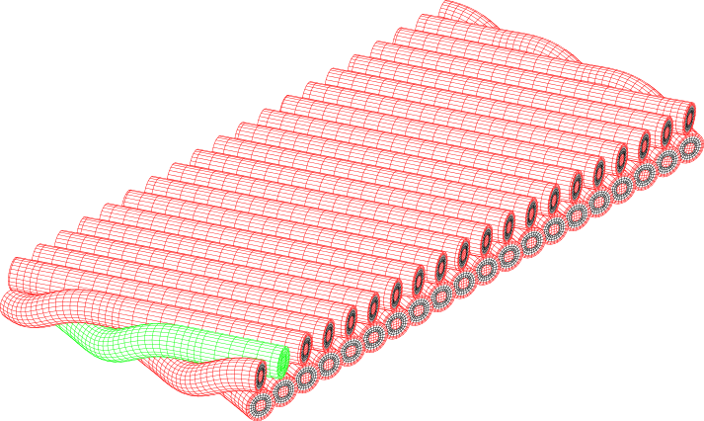
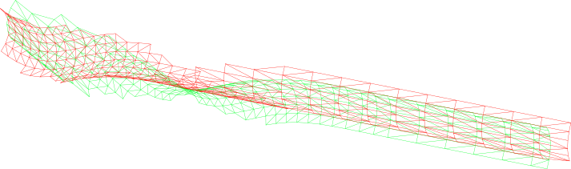
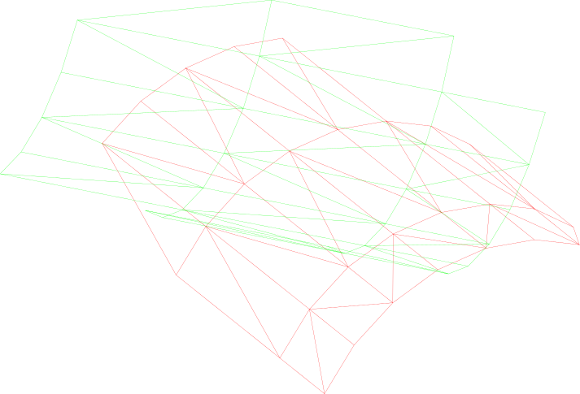
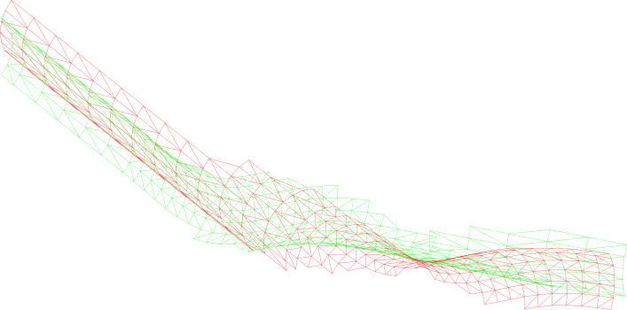
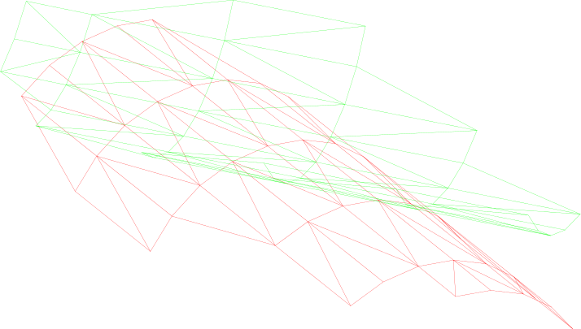
Determination of the contact areas between the different wires.

Slide 9
Boundary conditions (periodic) to get coherent displacements on faces facing each other.

Slide 10
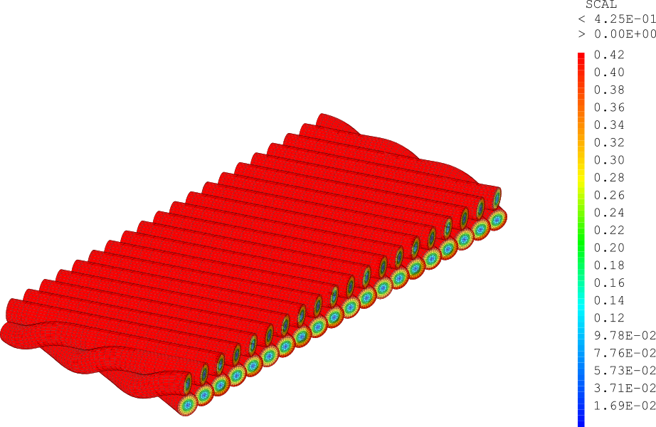
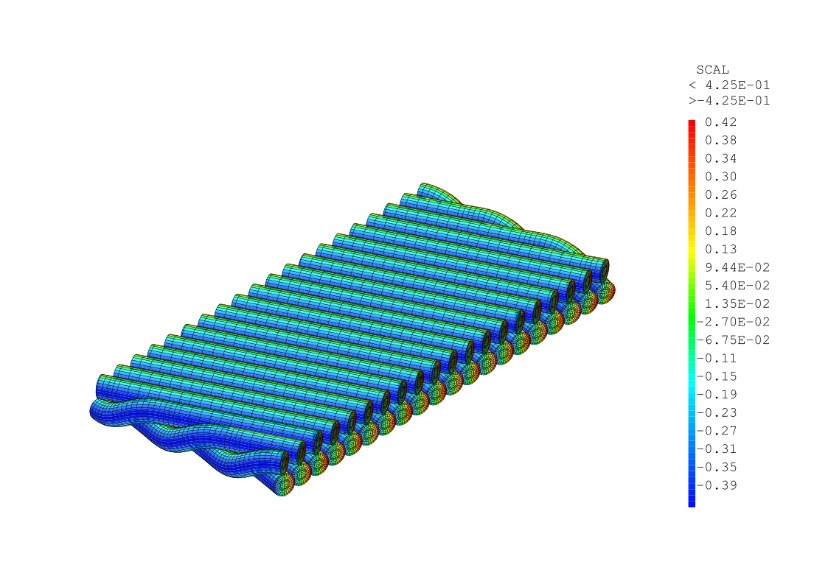
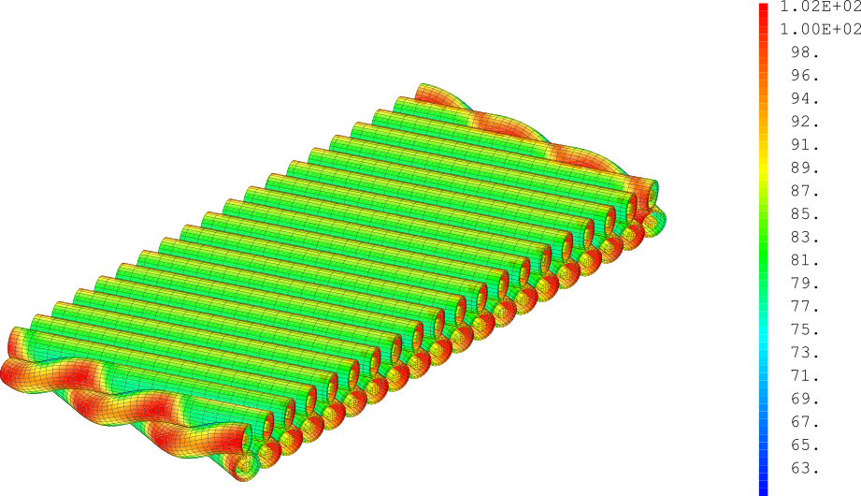
Local coordinates are extracted and may be used to define fields in local or global frames.

Slide 11
Summary and perspectives
A parametrized mesh of Rutherford cable is proposed in view of unimpregnated cable behaviour assessment.
It enables different features for the wires:
  Bi-material modelling.
  Contact.
  Definition of non-uniform fields.
Elastic plastic models will be implemented for the wire materials and first analysis of the overall behaviour of the cable will be done.

