Slide 1
RD53 pixel chips for the ATLAS and CMS Phase-2 upgrades at HL-LHC
Flavio Loddo - I.N.F.N. Bari
on behalf of the RD53 Collaboration

Slide 2
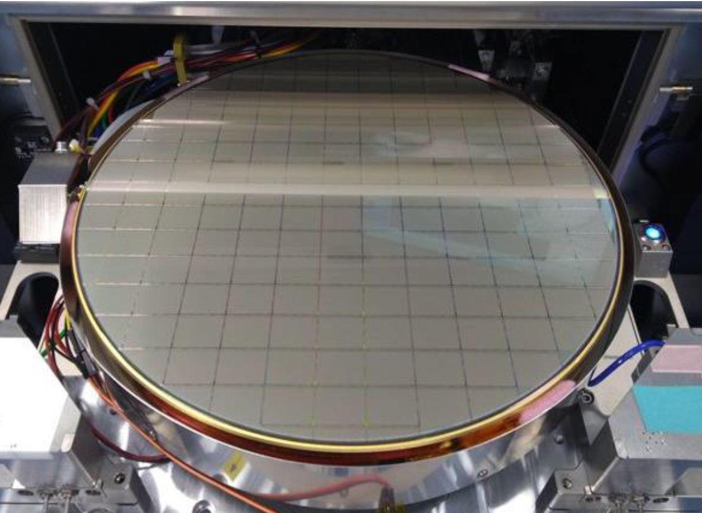
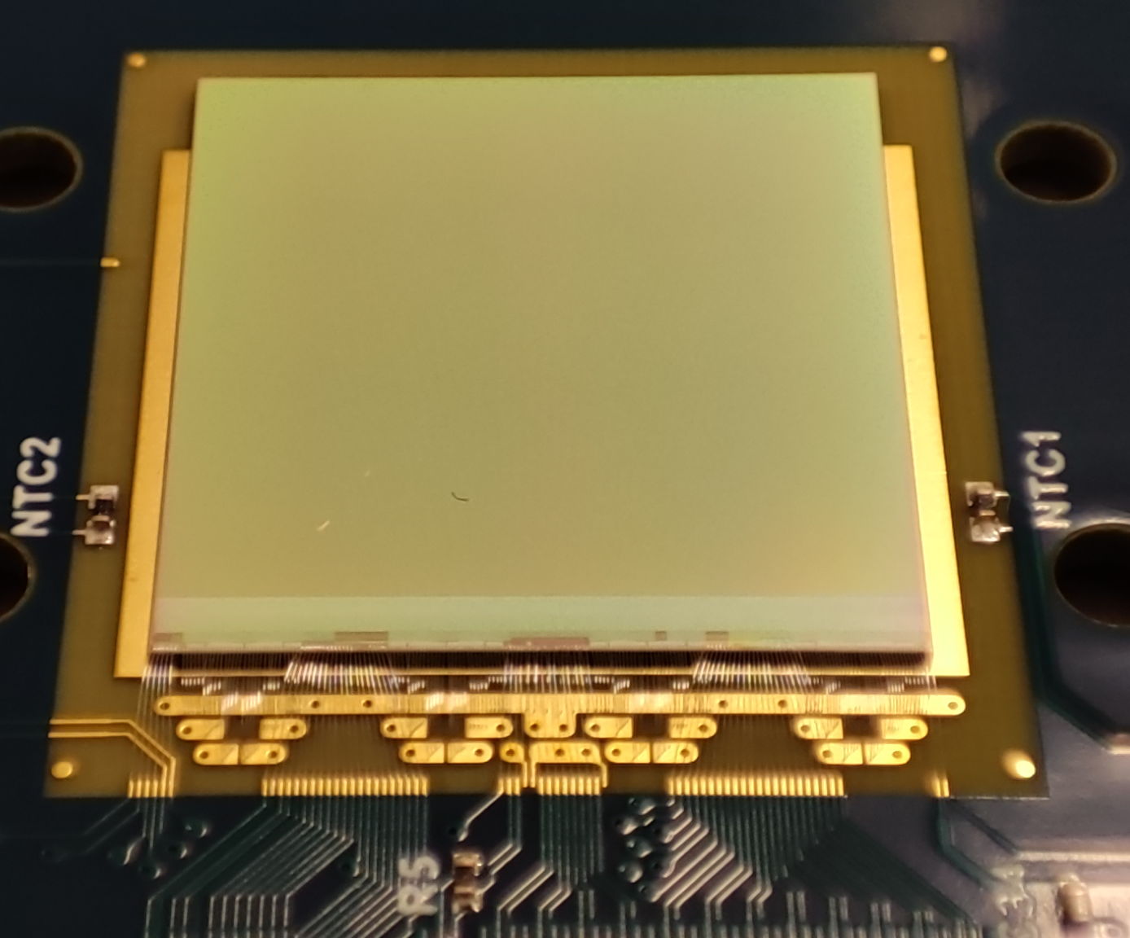
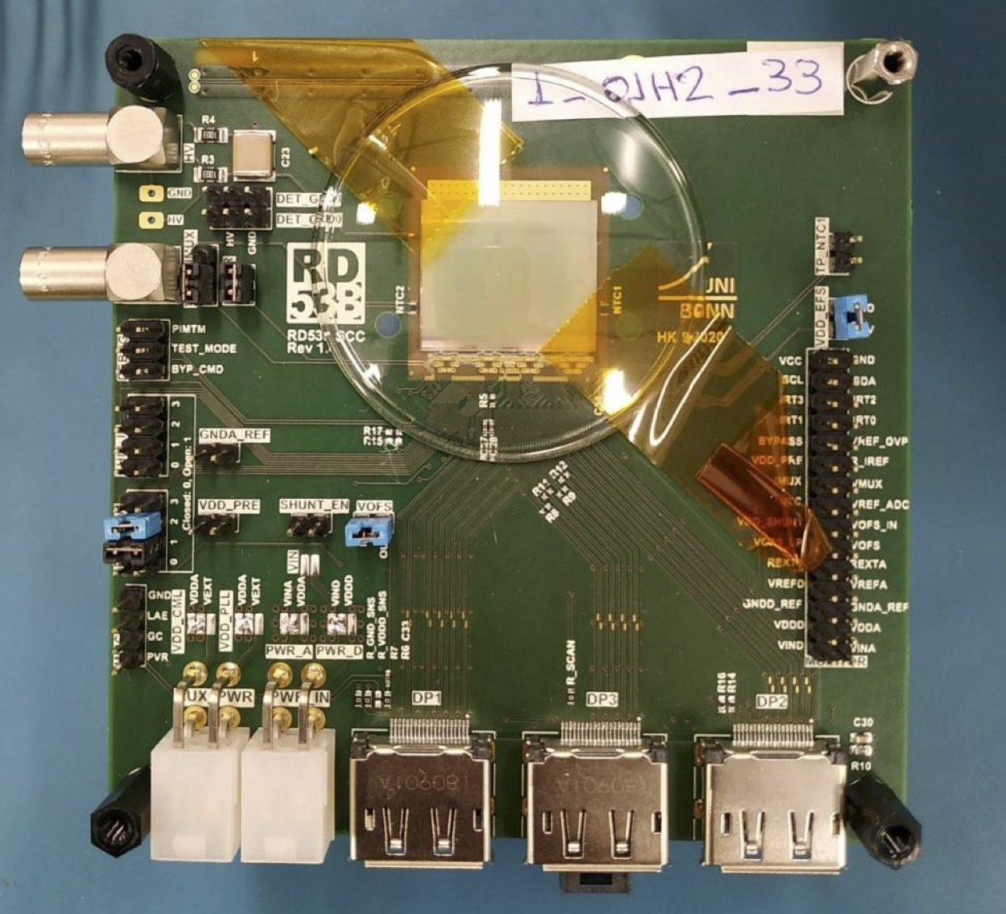
Outline
Introduction to the RD53 Collaboration: mandate and deliverables
Requirements
Floorplan
I/O interface
Multi-chip data merging
Serial powering
Analog Front-end
Pixel digital architecture
Data flow
Radiation hardening
SEE strategy
Verification plan
Conclusions

Slide 3
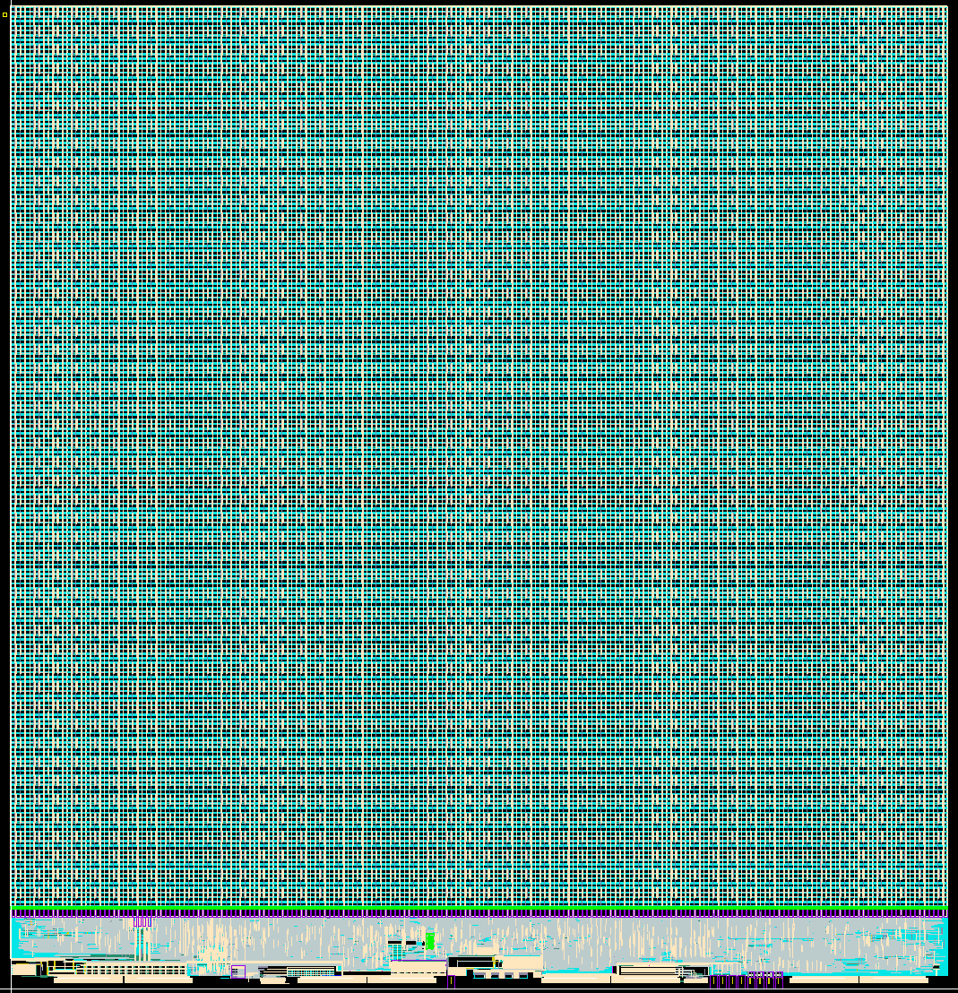
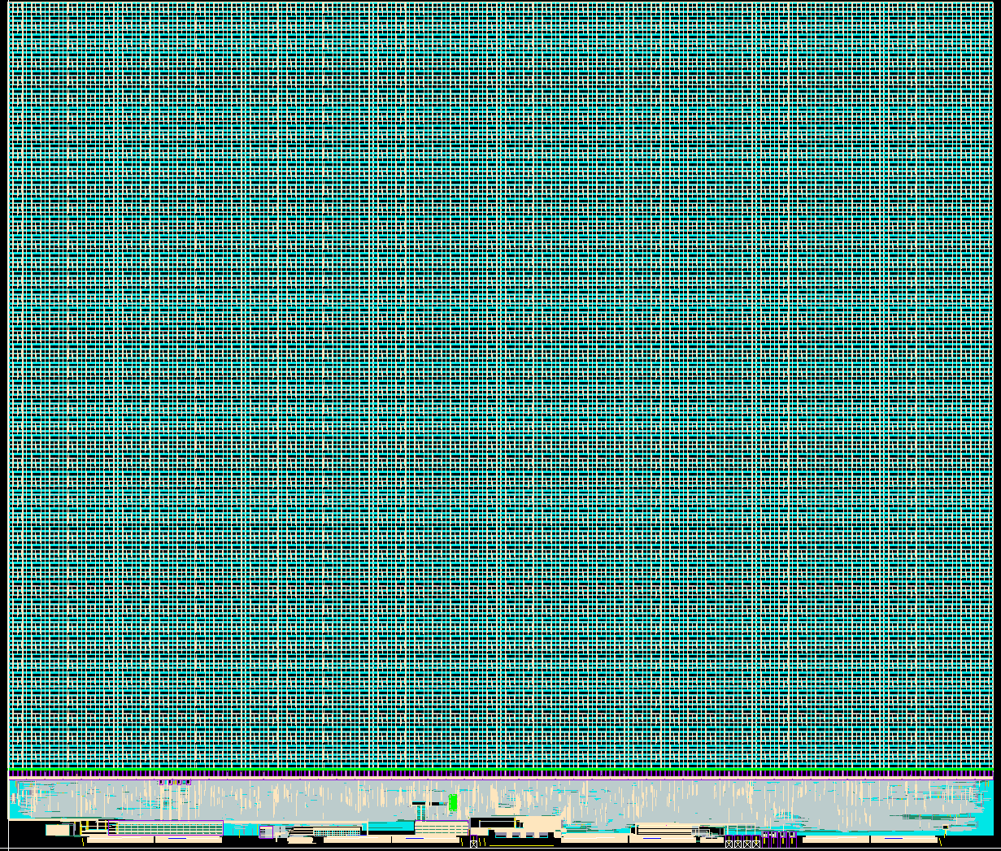
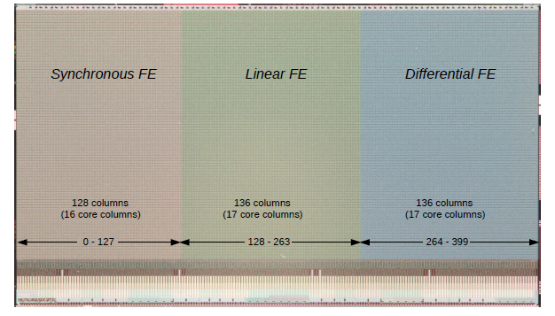
RD53 Collaboration
RD53 Collaboration is a joint effort from ATLAS and CMS Institutes to develop readout chips for the HL-LHC pixel detectors
24 institutes, started in 2013
Characterization of TSMC 65nm CMOS technology in radiation environment
Design of a rad-hard IP library (Analog front-ends, DACs, ADCs, CDR/PLL, high-speed serializers, RX/TX, ShuntLDO, …) qualified through a series of test chips
Design and characterization of half-size pixel chip demonstrator (RD53A) with design variations (3 Analog Front-Ends, 2 pixel readout architectures)
Design of pre-production (RD53B) and production (RD53C) pixel readout chips
ATLAS and CMS chips are two instances of the same common design, having different size and Analog Front-End, according to specific
requirements of the experiments
RD53A
August 2017
RD53B-ATLAS (ItkPix1)
March 2020
RD53B-CMS (CROCv1)
June 2021
RD53C-ATLAS (ItkPix2)
March 2023
See Maria Mironova’s presentation
RD53C-CMS (CROCv2)
Sept. 2023

Slide 4
Design requirements
Parameter | Value (CMS/ATLAS )
Technology | 65 nm CMOS
Max. hit rate | 3.5 GHz/cm²
Trigger rate | 750 kHz / 1 MHz
Trigger latency | 12.5 µs
Pixel size (chip) | 50 x 50 µm²
Pixel size (sensor) | 50 x 50 µm² or 25 x 100 µm²
Pixel array | 432 x 336 pixels / 400 x 384 pixels
Chip dimensions | 21.6 x 18.6 mm² / 20 x 21 mm²
Detector capacitance | < 100 fF (200fF for edge pixels)
Detector leakage | < 10 nA (20nA for edge pixels)
Min. threshold | < 1000 e-
Radiation tolerance | 1 Grad over 10 years at -15°C
SEE tolerance | SEU rate, innermost: ~100Hz/chip
Power | < 1W/cm², Serial powering
Readout data rate | 1-4 links @ 1.28Gbits/s = max 5.12 Gbits/s
Temperature range | -40°C ÷ 40°C
RD53B Design manual and user guides: https://cds.cern.ch/record/2665301
RD53B requirements: https://cds.cern.ch/record/2663161

Slide 5
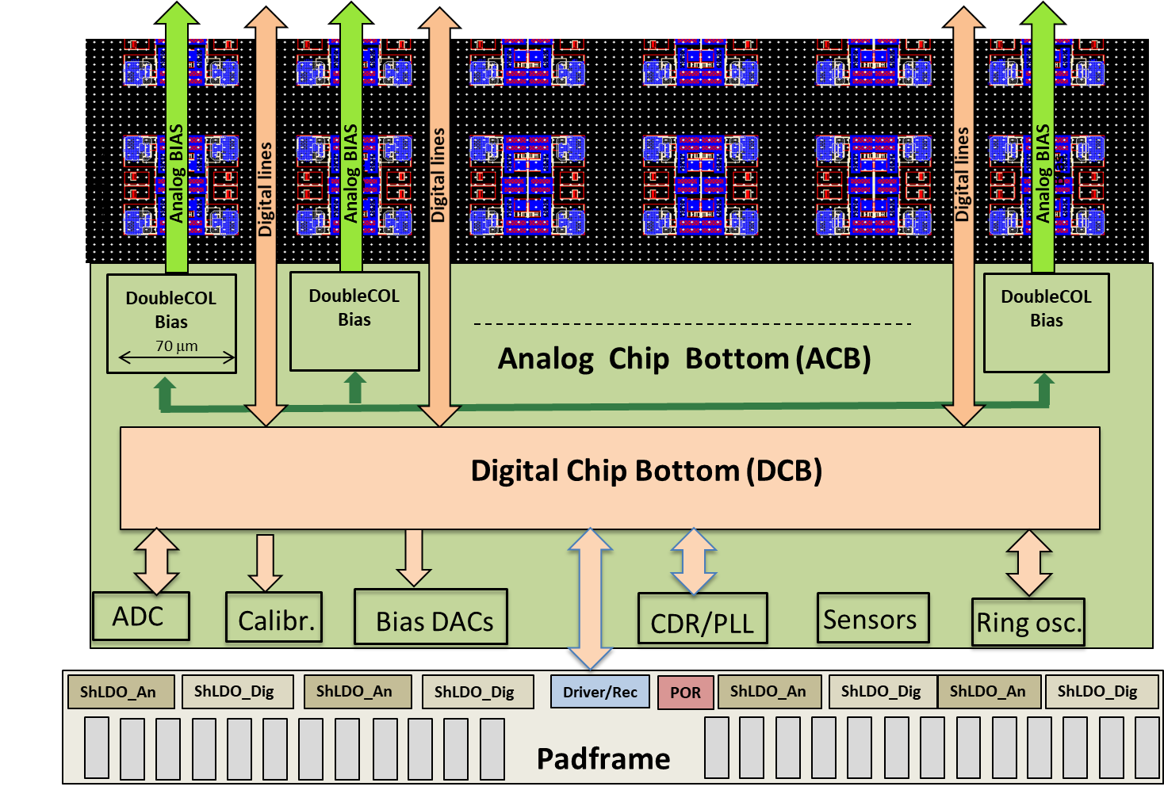
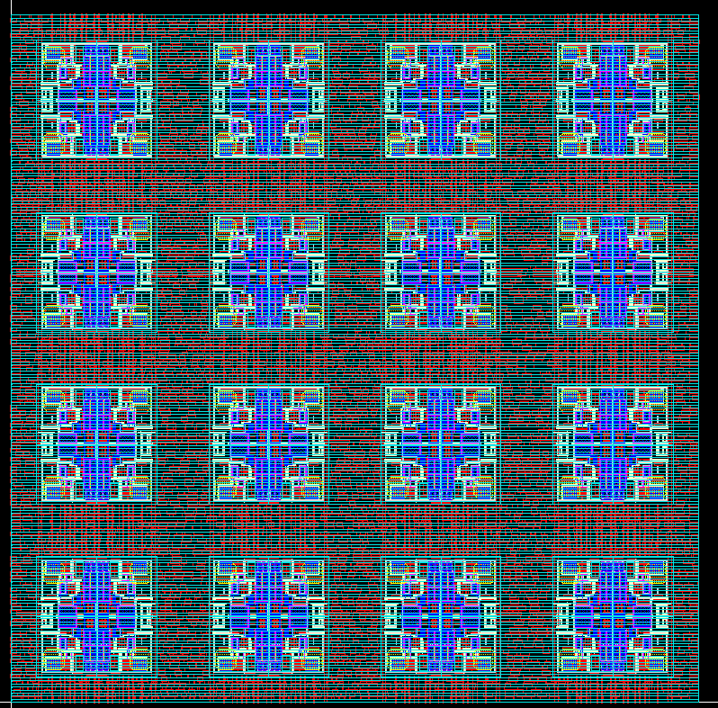
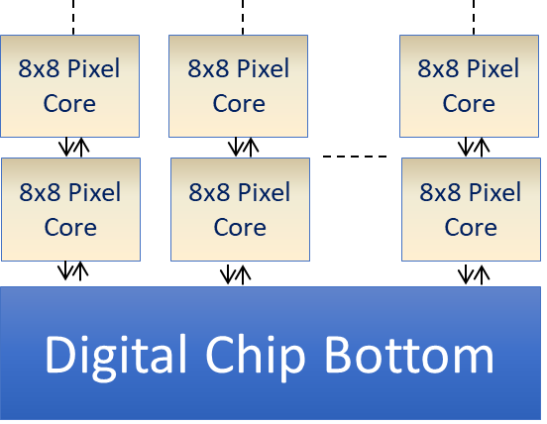
Floorplan
1 pixel
50 x 50µm
4 pixels
= Pixel Quad
8 x 8 pixels
= 1 Pixel Core
Digital logic
Analog island
FE
35
15
Core Column
Chip periphery
Analog Chip Bottom (ACB): contains all analog and mixed/signals building block for Calibration, Bias, Monitoring and Clock/Data recovery
Digital Chip Bottom (DCB): synthesized logic for communication to/from chip, readout and configuration
Padframe (common to ATLAS/CMS): complex macro containing all I/O blocks with ESD protections and distributed ShuntLDO regulator for serial powering
Pixel array
Digital logic synthesized for 8 x 8 pixels to form a Pixel Core
All Cores are identical → efficient hierarchical implementation and verification
The number of Cores is a parameter of the common RTL netlist

Slide 6
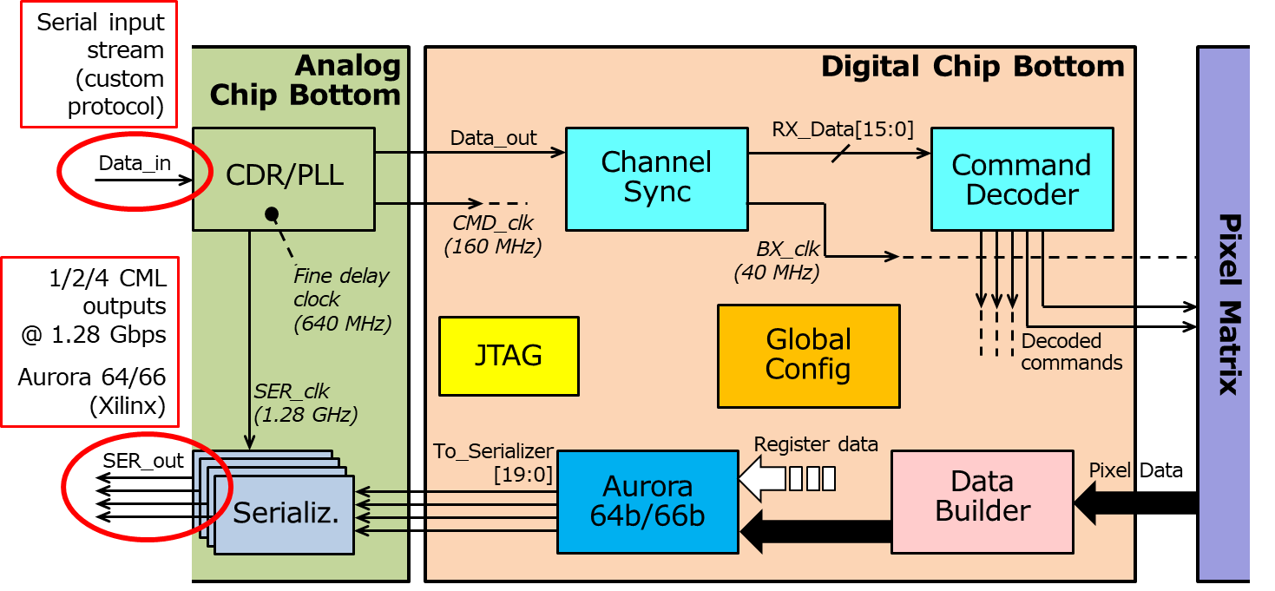

I/O interface
I_in
SLDO-A
VDDA
I_out
SLDO-D
VDDD
In short, extremely complex pixel readout ASIC designed to have a minimal I/O interface:
Input: command, control and timing
  One single 160 Mb/s differential serial link, driving up to 15 chips (4 bit addressing + broadcast)
  CDR/PLL recovers Data and Clock
Output:
  Up to 4 x 1.28 Gb/s CML serial links for data readout (hit data + service data) compatible with LpGBT and using Aurora 64b/66b encoding
Power:
  Input/output currents for serial powering

Slide 7
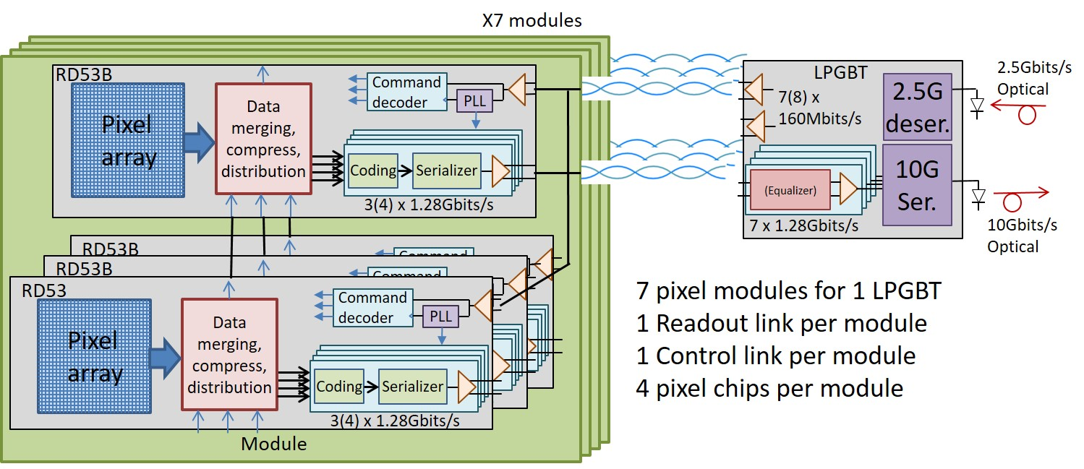
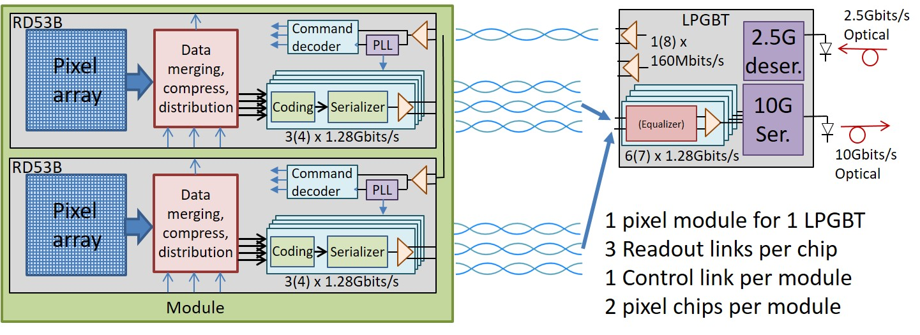
Multi-chip data merging
Single Chip case
2 → 1 Data Merging
1.28 Gbit/s
Aurora outputs
320 Mb/s Aurora x 2
Data merging is used to optimise the number of e-links sent off a module.
In the outer layers, one chip of the module can be configured as “primary” to aggregate serial data from one or more other “secondary” chips and merge them with its own output
Data from the secondary chip(s) is merged with data from the primary chip in a simple round robin
Primary
Secondary
Primary
1.28 Gbit/s
Aurora output
FE
FE#1
FE#2
Control
Link
Control
Link
Control
Link
4 → 1 Data Merging
Secondary
320 Mb/s Aurora
Primary
1.28 Gbit/s
Aurora output
Secondary
320 Mb/s Aurora
Secondary
320 Mb/s Aurora
FE#1
FE#4
FE#2
Control
Link
Control
Link
FE#3
Control
Link
Control
Link
CMS 2x1 Module (Inner)
CMS 2x2 Module (Outer)

Slide 8
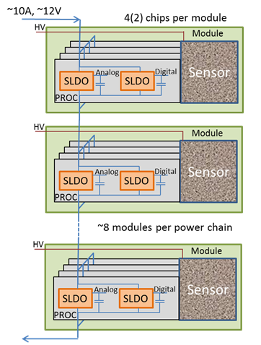
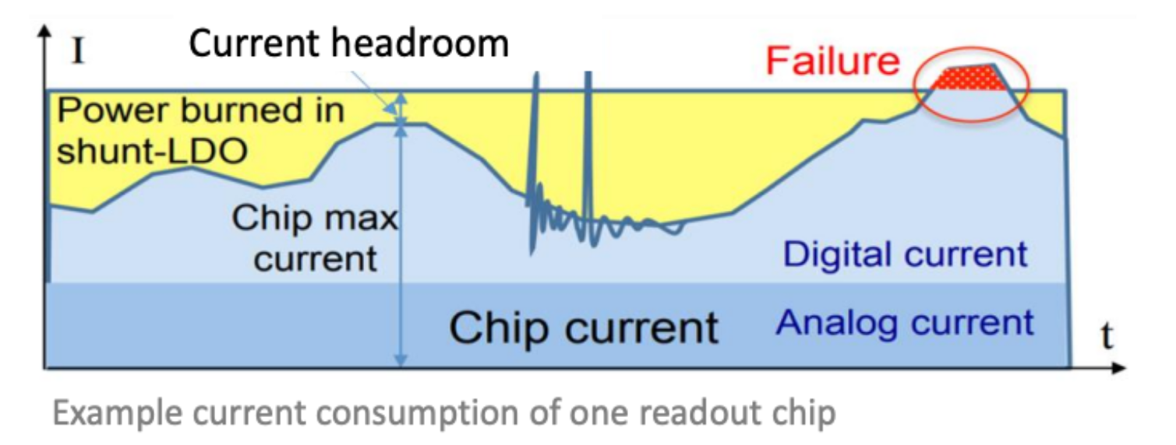
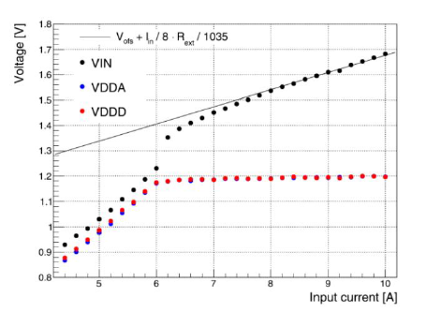
ShuntLDO for Serial powering
Both ATLAS and CMS will adopt the innovative serial-powering scheme:
Based on ShuntLDO regulators in the readout chips (1 x Analog, 1 x Digital)
Constant input current shared between chips (2÷4) on the same module
Modules are in serial chains: “recycle” current from one module to another
Input current dimensioned to satisfy the highest load, with ~20-25% headroom for stable operation to be absorbed by the Shunt device
In case of chip failure, its current can be absorbed by the other chips of the module
Not sensitive to voltage drops (low mass & compact power routing)
On-chip regulated supply voltages, low noise
Radiation hardness (1 Grad)
Current sharing defined by the Voffset and Slope, all set by external resistors (no SEU)
Up to 14 modules per chain
Protections:
Over-voltage protection: V_{IN} clamped to 2 V
Under-shunt protection: V_{OUT} decreased in case shunt current goes below a certain threshold (due to excess load current)
V/I curve parameters (Voffset, slope) defined by external resistors
V_{OUT} tunable by chip configuration

Slide 9
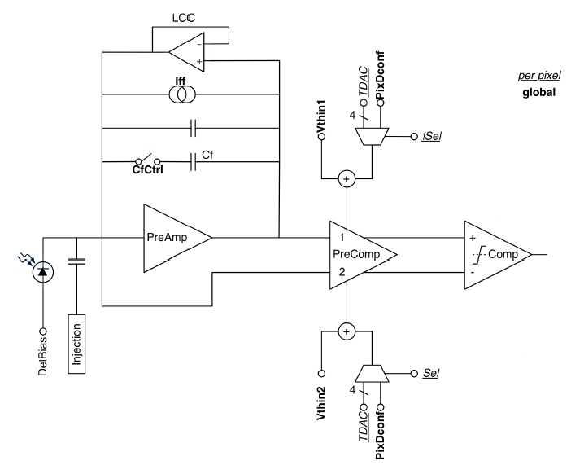
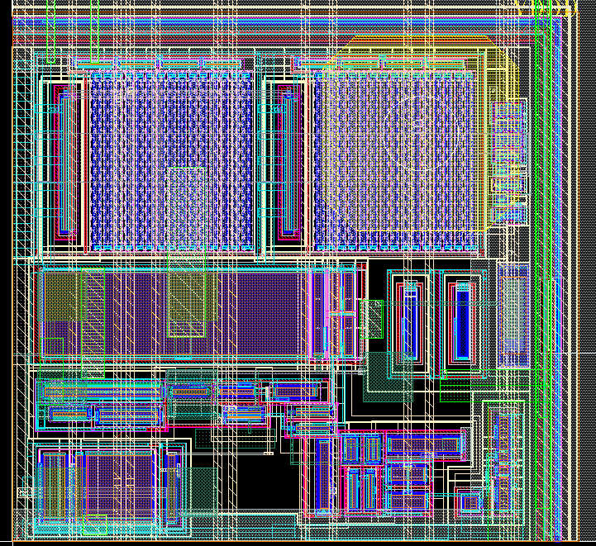
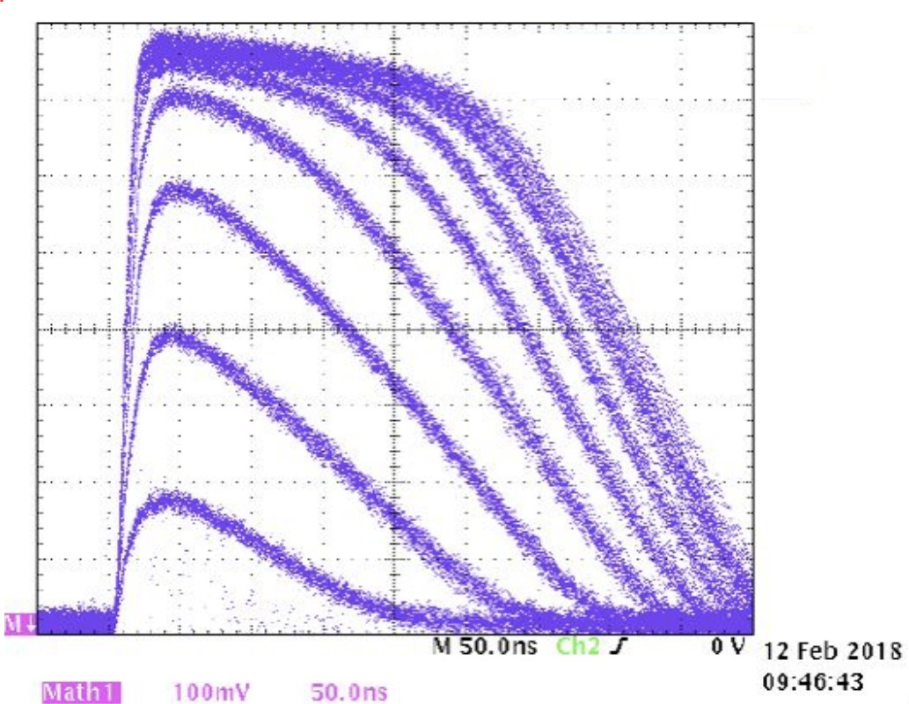
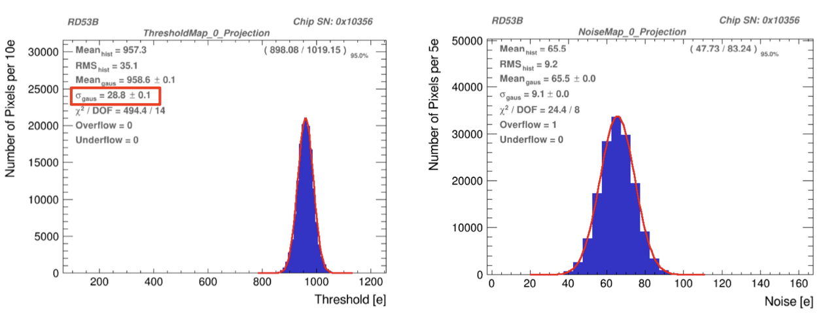
Differential Front-End (ATLAS)
35 µm
Continuous reset integrator first stage with DC-coupled pre-comparator stage
Leakage current compensation circuit (LCC) for additional optional feedback in case of I_{leakage} > 2 nA
Two-stage open loop, fully differential input comparator
10-bit DAC for global threshold
4+1 bit local trimming DAC (TDAC) for threshold tuning
35 µm
ItkPix1 (planar sensor)
ItkPix1 (planar sensor)
Thr. ~ 1000 e-
Thresh. Disp.: ~ 30 e-
Noise: 65 e-

Slide 10
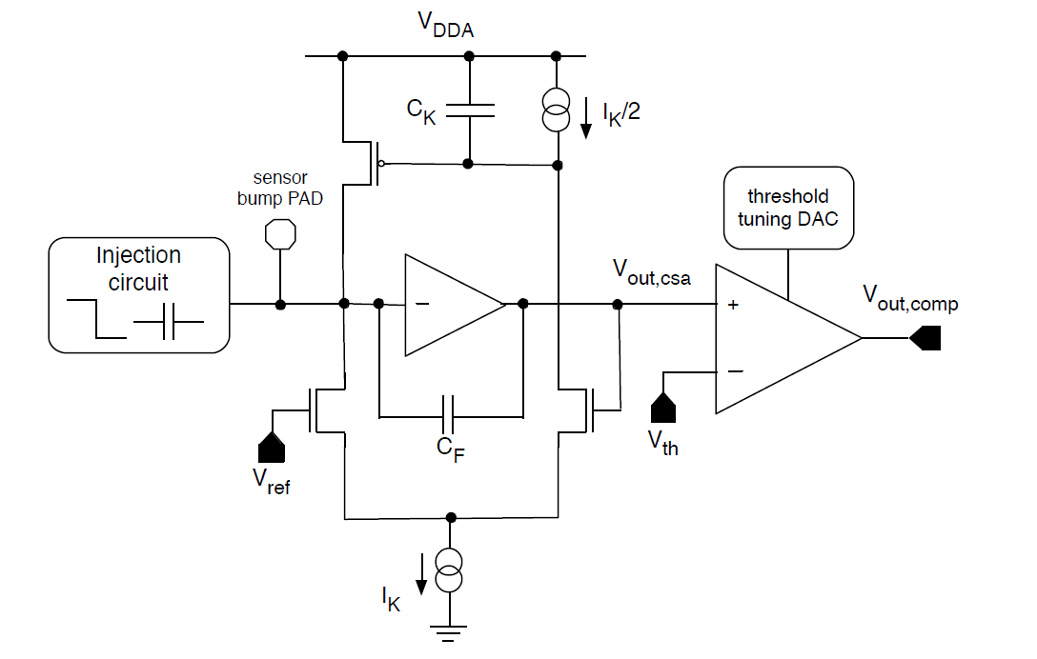
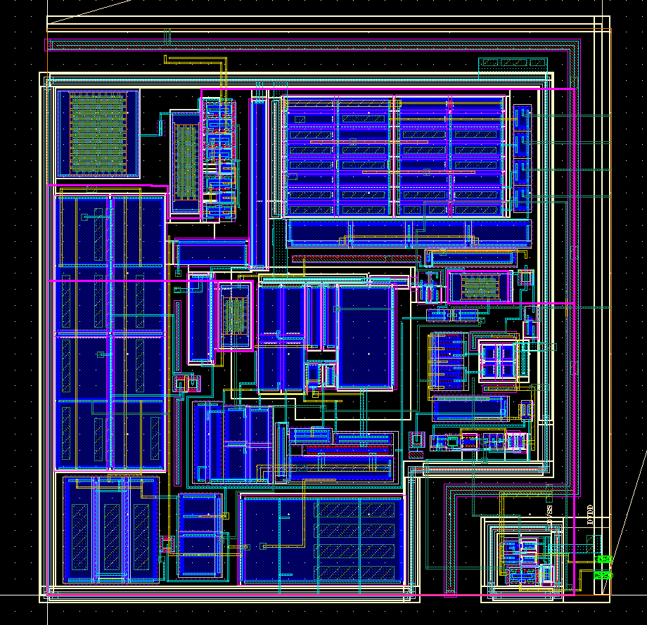
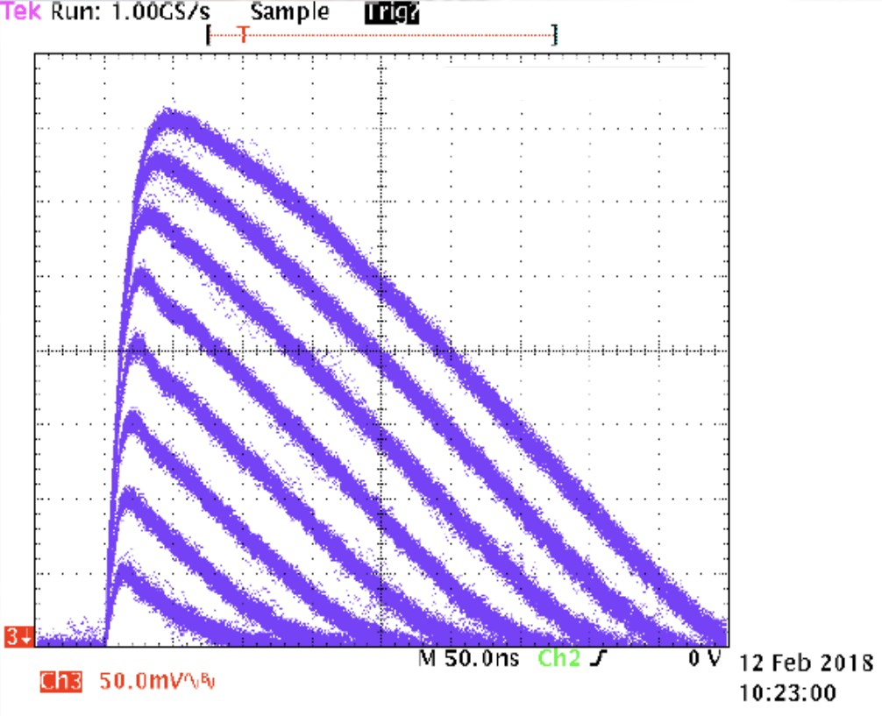
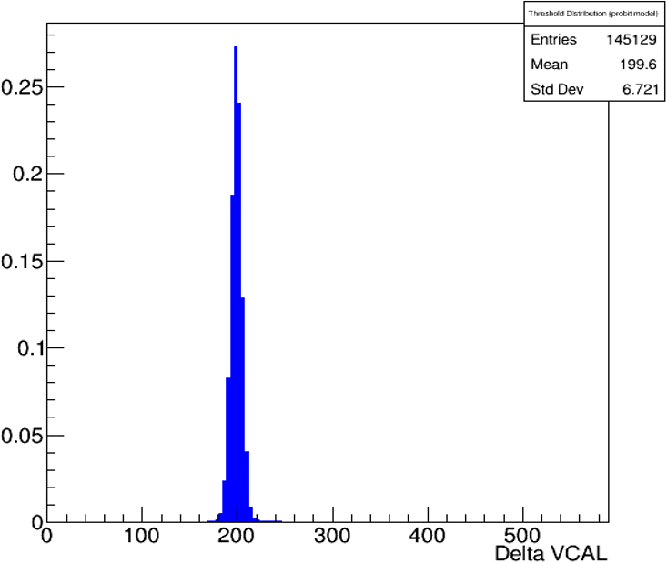
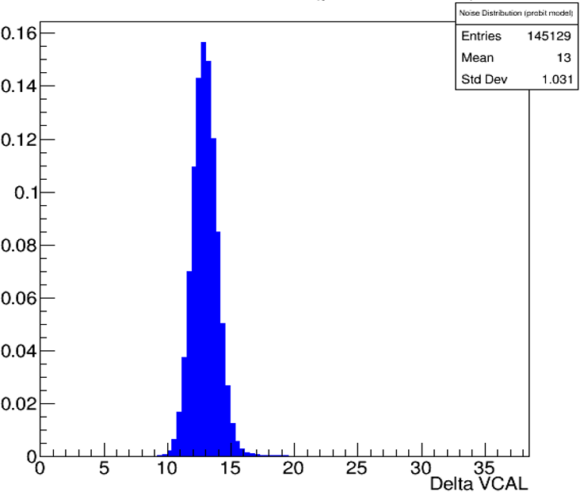
Linear Front-End (CMS)
35 µm
Charge sensitive amplifier
Krummenacher feedback for return to baseline and leakage current compensation
Comparator
10-bit DAC for global threshold
5-bit local trimming DAC (TDAC) for threshold tuning
35 µm
Threshold distribution
Noise distribution
Thr. ~ 1000 e-
Thresh. Disp.: ~ 50 e-
Noise: ~70 e-

Slide 11
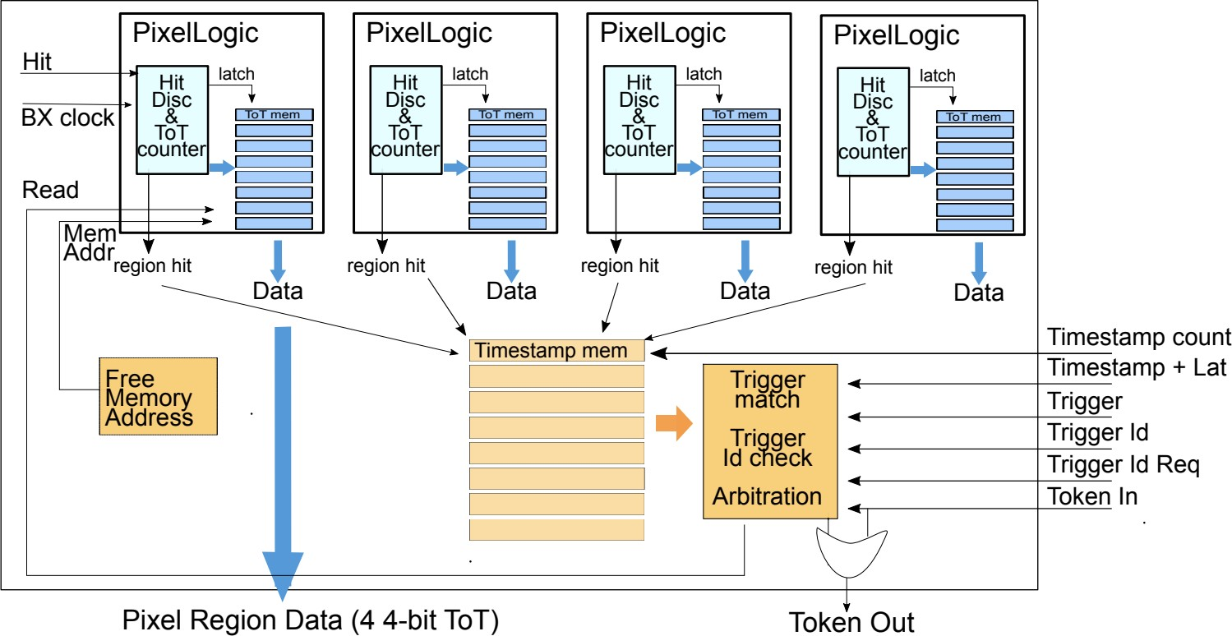
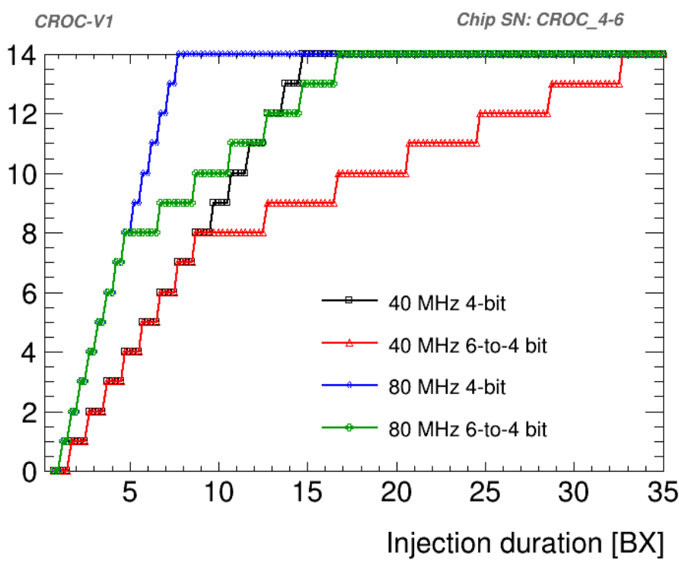
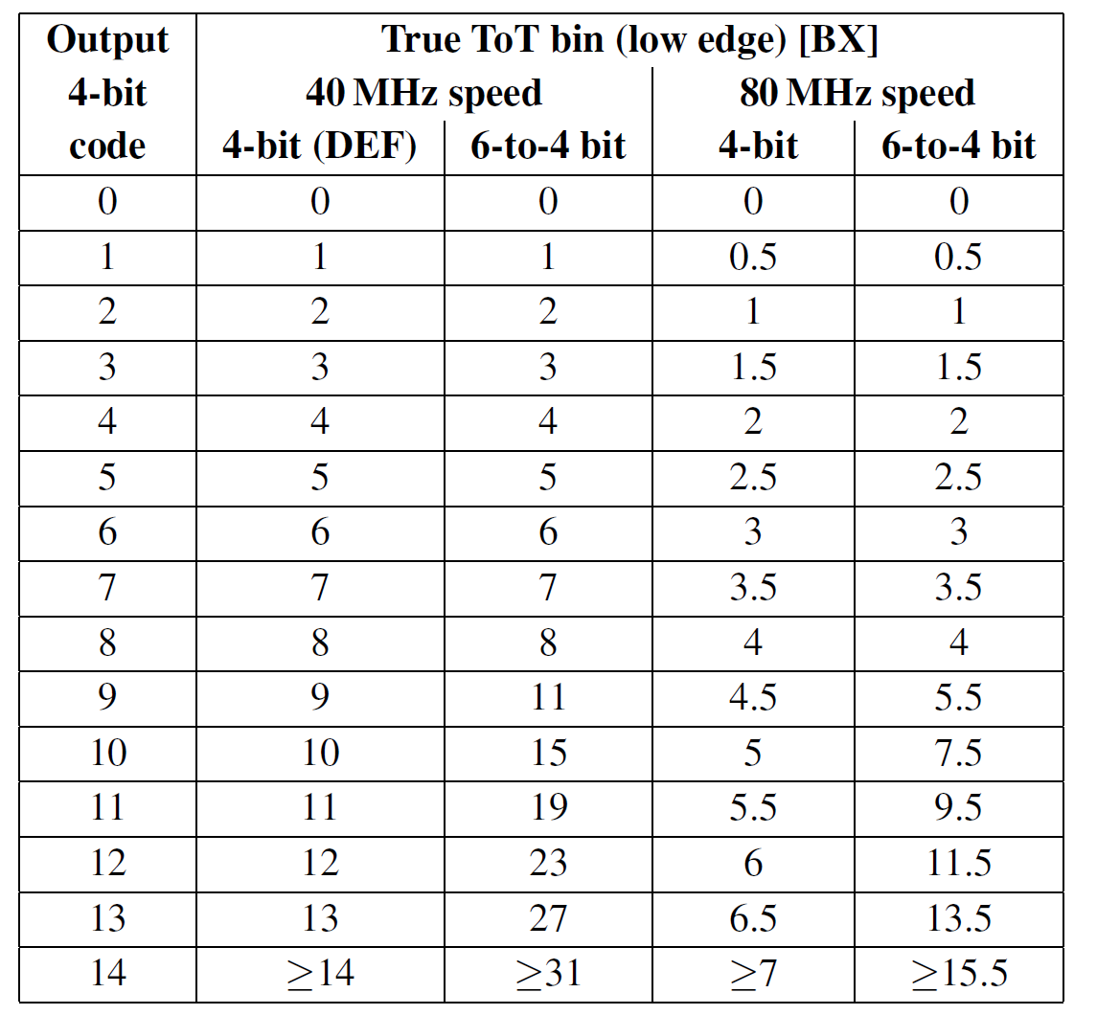
Pixel digital architecture
Hits are stored as Time-over-Threshold, associated to a time stamp
6-bit ToT counter, but only 4 bits are stored and read-out
  Selectable counting clock: 40 MHz or 80 MHz (dual-edge)
  Selectable ToT dual-slope 6-to-4 mapping for charge compression
Each pixel has 8x4-bit ToT memories
The time stamp memory is shared among 4 pixels of the same 4x1 Pixel Region
Trigger-matching performed with programmable 9-bit trigger latency (max. 12.5 µs)
Hit-OR network for:
  Programmable self-triggering
  11-bit Precision ToT (PTOT) + 5-bit ToA counters at 640 MHz in the chip periphery for precise AFE measurements and sensors characterization
ToT code

Slide 12
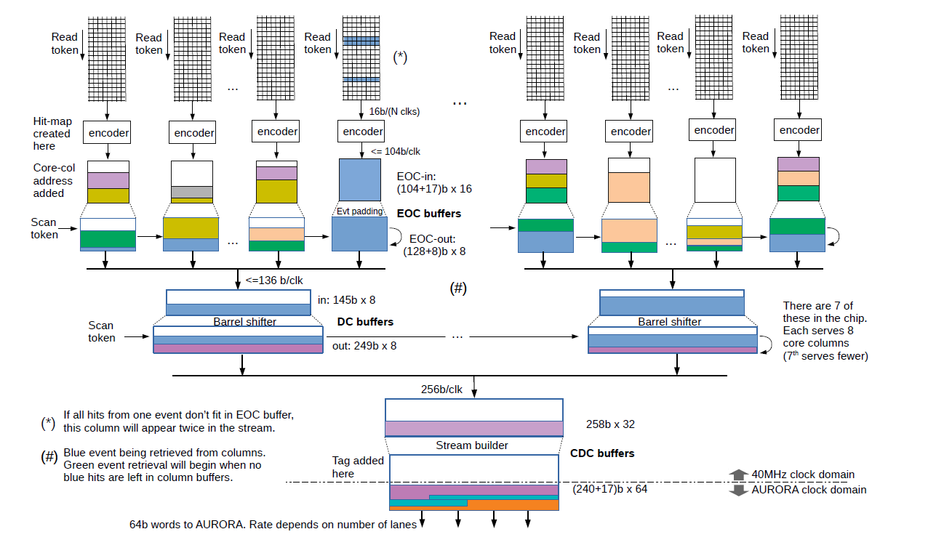
Digital data flow
Token based readout of hits in parallel for each Core Column as soon as a valid Trigger is received
Data are stored in a FIFO at the end of each column and compressed using Binary Tree Encoder (up to factor of 2)
Multiple levels of data processing, event building, data buffering and formatting
Registers are read on command and periodically (“Service data”) interleaved with Physics data in a set ratio (default: 1 in 50)
Aurora frames are built and sent to the high speed serializers

Slide 13
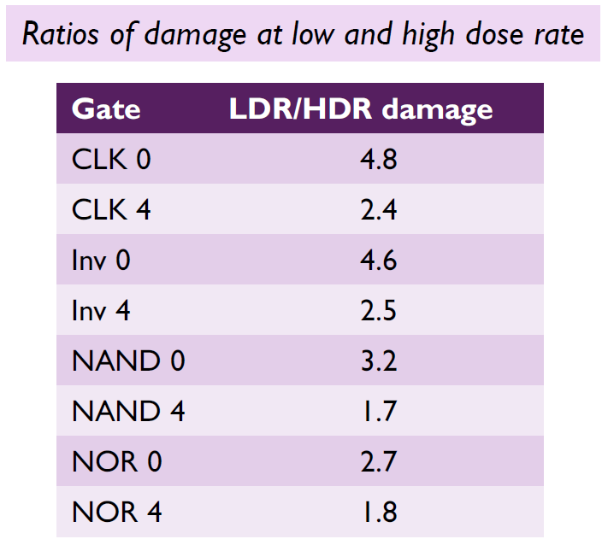
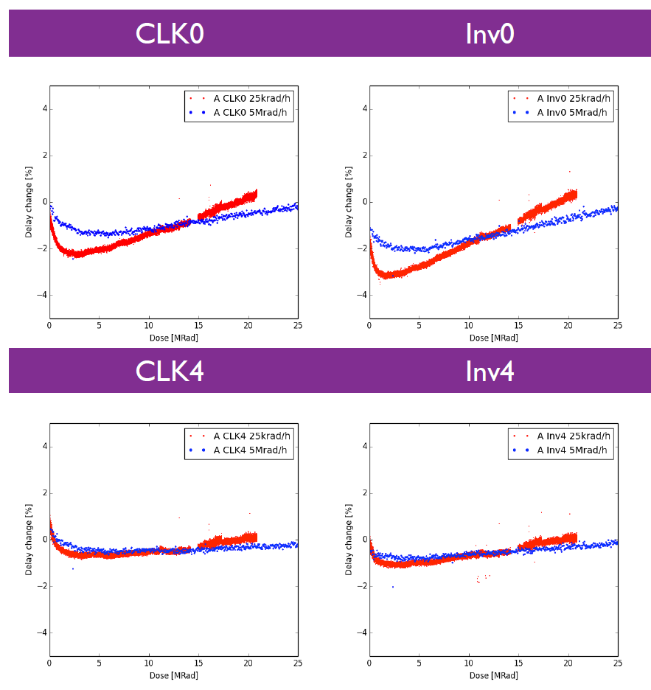
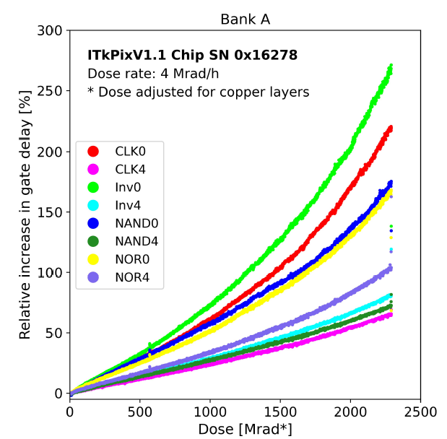
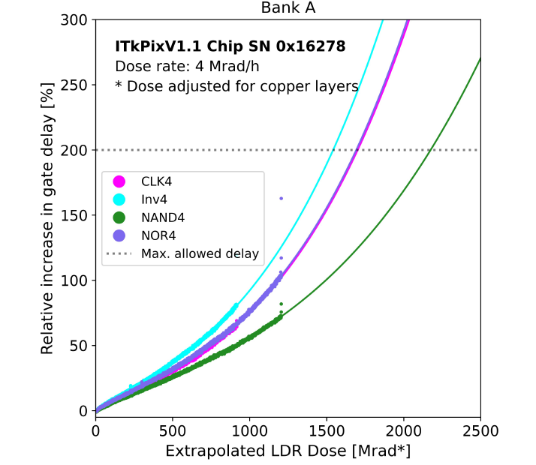
Radiation hardness
Extensive TID X-ray tests on RD53A/B and small prototypes to qualify IPs, analog FEs and digital standard cells
The TID damage concerns essentially the digital design because of the small area devices (min L, small W) → more severe for “strength 0”
From measurements on Ring Oscillators: gate delay degradation larger at low dose-rate (LDR): more severe for “strength 0”
Delay change at 5 Mrad/h and 25 krad/h
Gate delay at HDR X-ray to 2.3 Grad
Estimated behaviour at LDR of strength 4 gates
Delay change [%]
Delay change [%]
Dose [Mrad]
Dose [Mrad]
Delay change [%]
Delay change [%]
Dose [Mrad]
Dose [Mrad]
No minimum size digital cells (strength 0)
Irradiation corner models and extreme corners from the foundry used to predict the TID effect and design to guarantee good timing for the digital design
Tests done at low temperature (-20°C) and high dose-rate, extrapolating the behaviour using the LDR/HDR correction factor, give confidence that RD53 chips will meet TID specifications (at least 1 Grad) if operated at cold temperature.
Irradiated chips must be cooled while under power, since room or high temperature annealing is detrimental

Slide 14
Single Event Effect (SEE) protection
The expected rate per chip of Single Event Upsets (SEUs) is ~ 100 Hz in the innermost layer
Target behaviour:
  Stable operation: biasing and the Clock and Data Recovery (CDR) as critical for the overall chip functionality should be very SET robust
  No power cycling: need to recover without power-cycling (detrimental for a serially powered system)
  Occasional hit/event is allowed to be lost
Principle: protect with triplication vital circuitry (configuration registers, state machines, memory pointers ) as far as feasible within space limits (but cannot protect everything!)
  Note: at these SEE densities, no protection is perfect, so the command protocol includes:
  a CLEAR command for fast recovery from residual SEE or operational issues
  provision for continuous reprogramming of global registers and pixel configuration
Design strategy:
Intensive SEE simulations of both digital logic (RTL, Gate-level) and critical analog IPs (bandgap, drivers, PLL, biasing blocks)
Test campaigns with Heavy Ions, protons, laser
  Both simulations and tests are needed to identify sensitive nodes of IPs and critical digital circuits needing improvements for the production chips
  As an example, a critical fault condition was found with SEU simulations that could never been found with testing, because it requires high trigger rate, high hit rate, and high SEU rate all at once

Slide 15
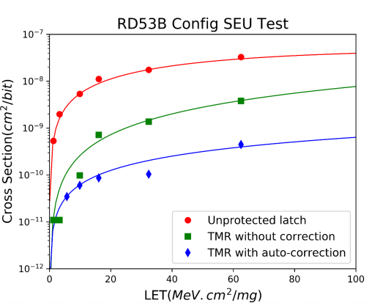
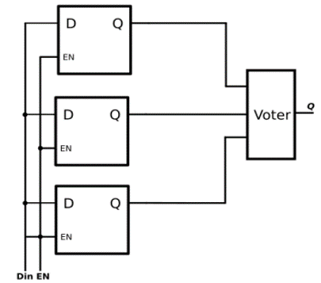
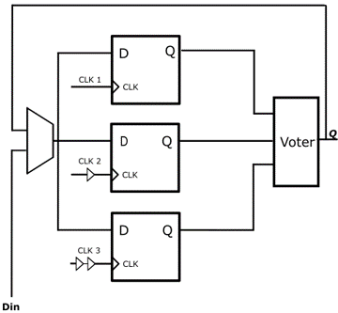
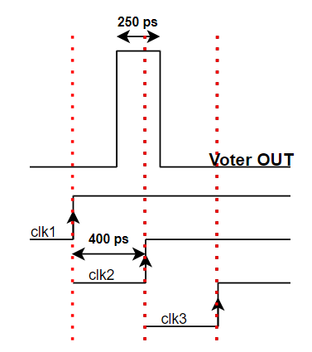
Single Event Effect (SEE) protection
Pixel Configuration
8 bits → 1.28 Mbit/chip
No space to protect all bits
3 less critical bits unprotected
5 more relevant bits protected with TMR without self-correction
  With protons: 100 x more SEE tolerant than unprotected
Global Configuration and state machines
~90 kbit/chip
TMR with self-correction and triplicated clock with skew (ΔT ~ 400ps) for Single Event Transient filtering
  With protons: 400 x more SEE tolerant than unprotected
SEU cross-section comparison from heavy-ion testing:
SET filtering
CLK 1
CLK 2
CLK 1
CLK 3
CLK 2
CLK 3

Slide 16
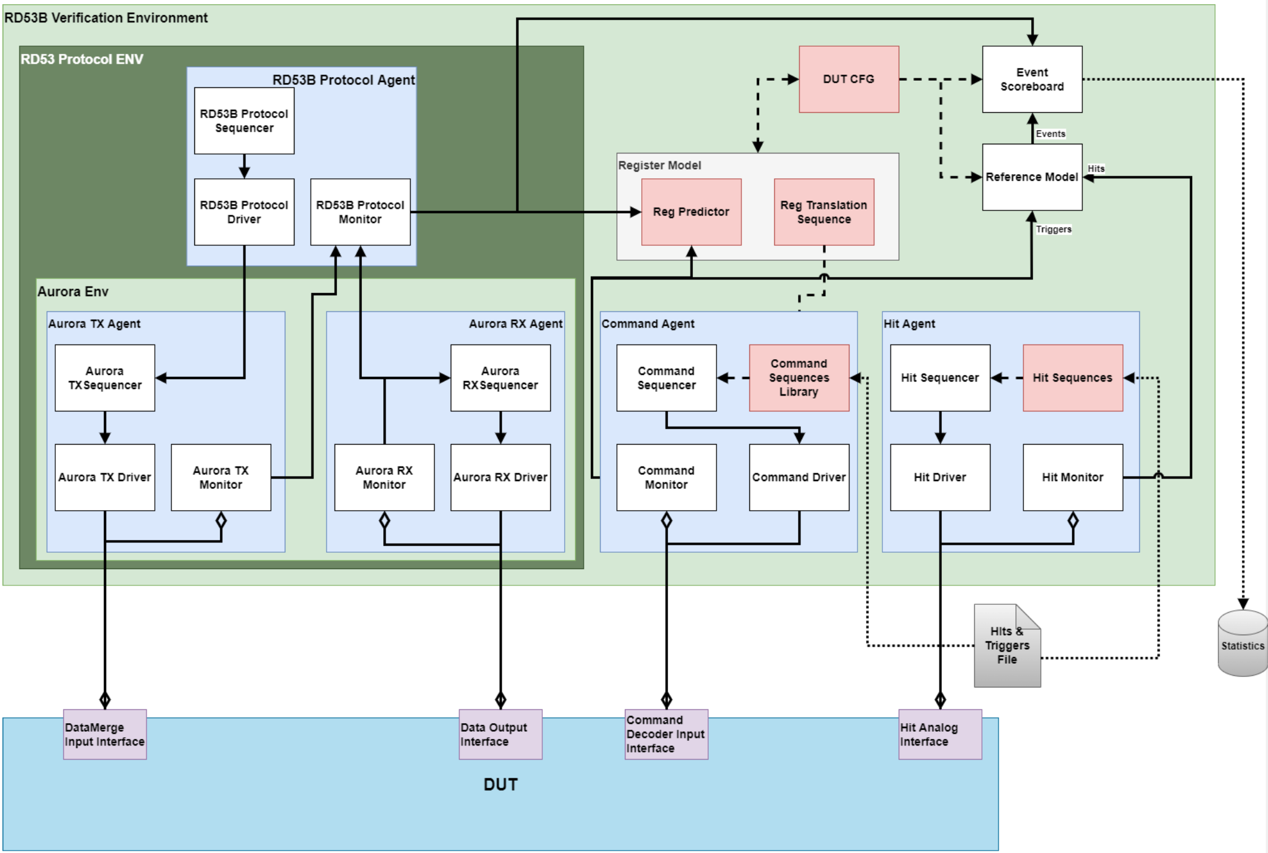
RD53 verification framework
Very complex digital architecture:
  Universal Verification Methodology (IEEE Std. 1800.2-2020)
  industry-like approach, well-supported by tool vendors
RD53 verification framework
verify that chip outputs match outputs predicted by the framework, for randomised configurations and inputs
Initial framework version used for architecture studies and RD53A-RD53B verification
Improved version implemented for final functional and SEU verification of production chips
Metric-driven verification: simulate until the desired coverage is reached (goal is 100%)
  Functional coverage: the features of the chip
  Code coverage: blocks of exercised, toggling of signals
Use constrained randomization to test all feasible combinations of configuration and inputs plus some directed tests for specific block verification
Regressions with > 1700 tests to reach coverage goals
Also used for SEU injection simulations
Event Scoreboard
Events
Reference Model
Hits
Triggers
Data
merging
inputs
Chip
readout
(output)
Control
input
Hits
Device Under Test (DUT) = RD53 chip

Slide 17
Conclusions
The readout chips for the ATLAS and CMS HL-LHC pixel detectors are being developed by the RD53 Collaboration on 65 nm CMOS technology since 2013
Collaborative design across ~24 institutes around the world
The first half-size prototype RD53A has been crucial to initially explore design variations and to understand how to cope with the complexity of implementing such large and complex pixel chips operating in such harsh environment
  RD53A was extensively used by the two experiments to characterize sensors
The final chips are two different ”instances” of a common design having different sizes and different Analog Front-End
Full-size pre-production chips RD53B-ATLAS (ITkPix1) and RD53B-CMS (CROCv1) implementing all requested functionalities requested have been produced in 2020 and 2021
Verification is crucial in all its different aspects: functional, SEE, analog and M/S, power
The ATLAS final production chip ITkPixV2 has been recently received and is currently under test
The submission of the final CMS chip CROCv2 is estimated to take place in few weeks

Slide 18
Thank you for your attention!

Slide 19
Backup slides

Slide 20
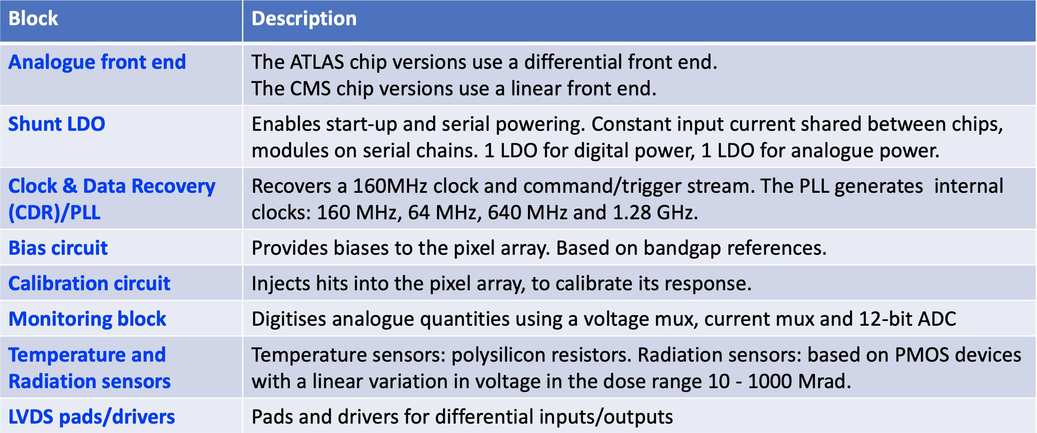
Analog and M/S blocks summary

Slide 21
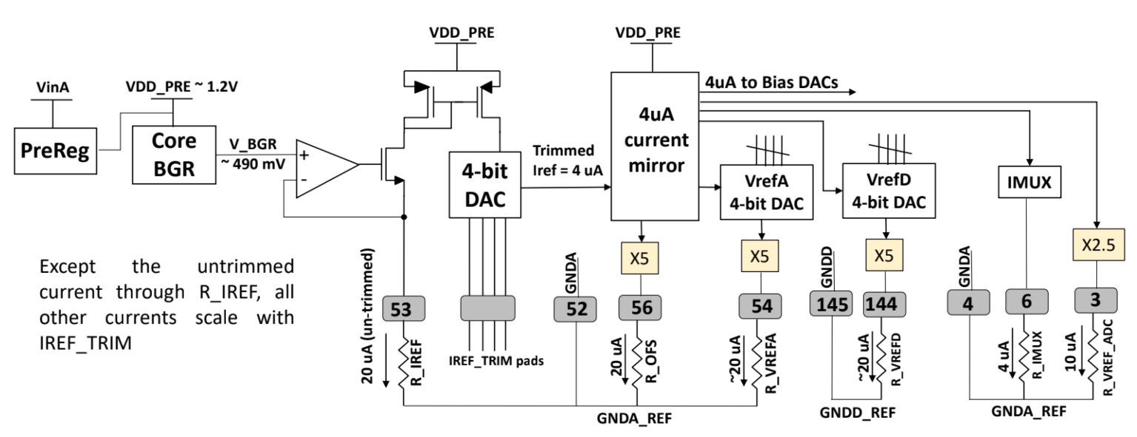
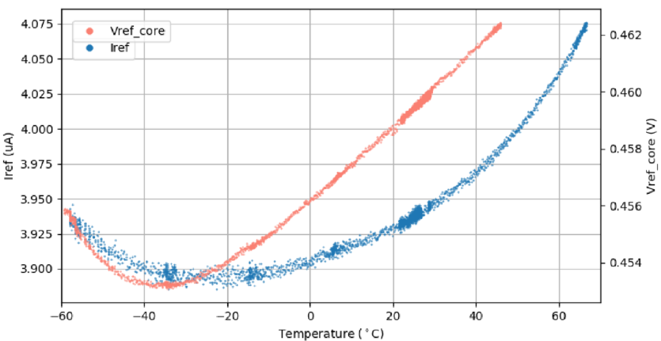
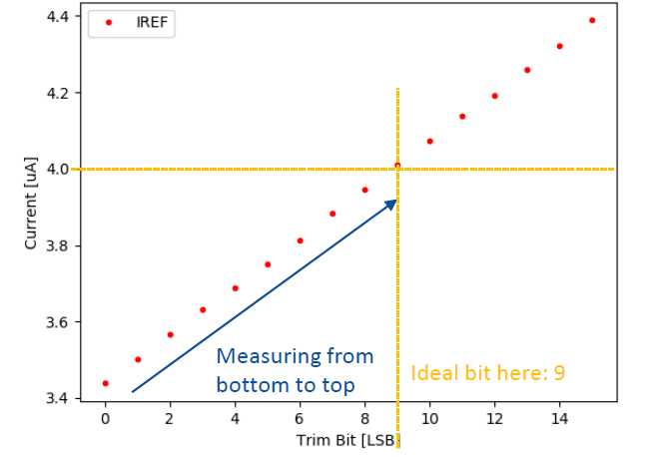
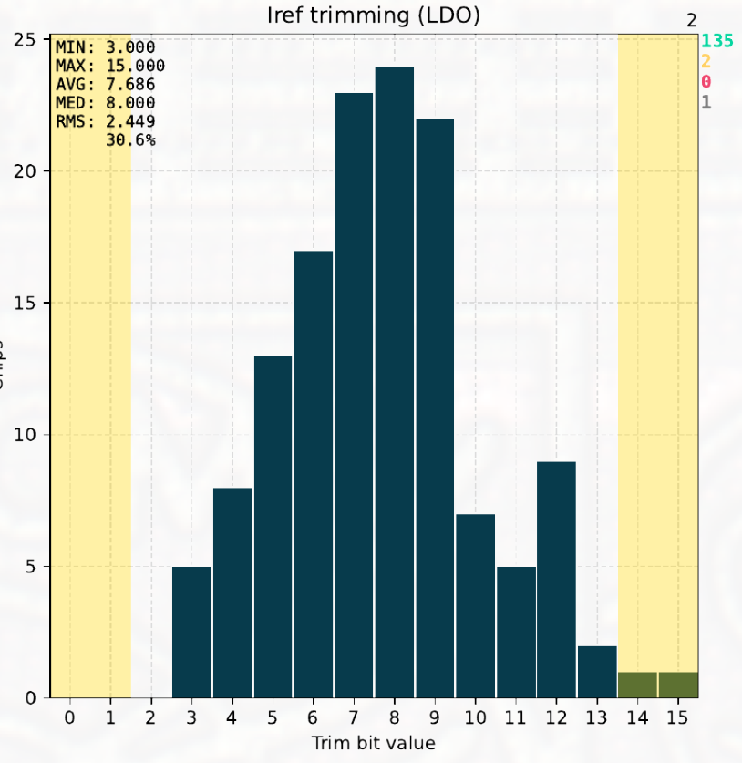
Bias circuit
BIAS network is based on Bandgap reference circuits, to provide a reference voltage/current with low sensitivity to temperature variations
Tuning by means of 4 wire-bond trimming pads (no risk of SEU bit flips), whose optimal value is found during wafer probing
The tuned current I_{ref} is replicated and used as reference to 23 Digital-to-Analog converters to bias the analog Front-end, the CDR and other IPs
4% difference over 120°C temp. range

Slide 22
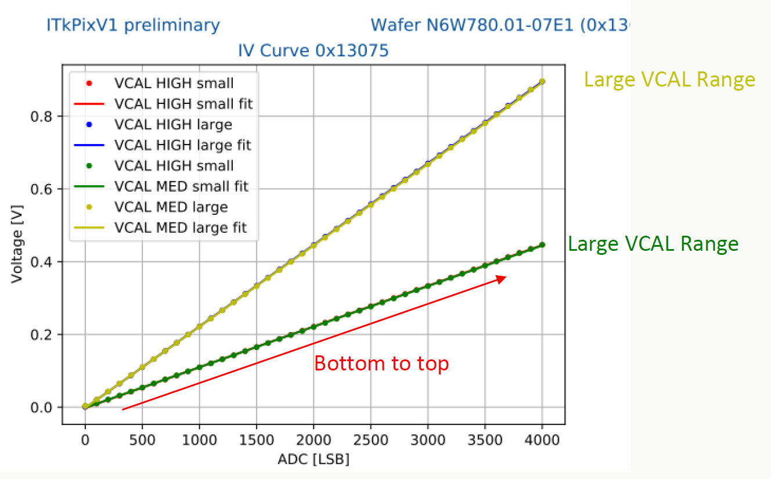
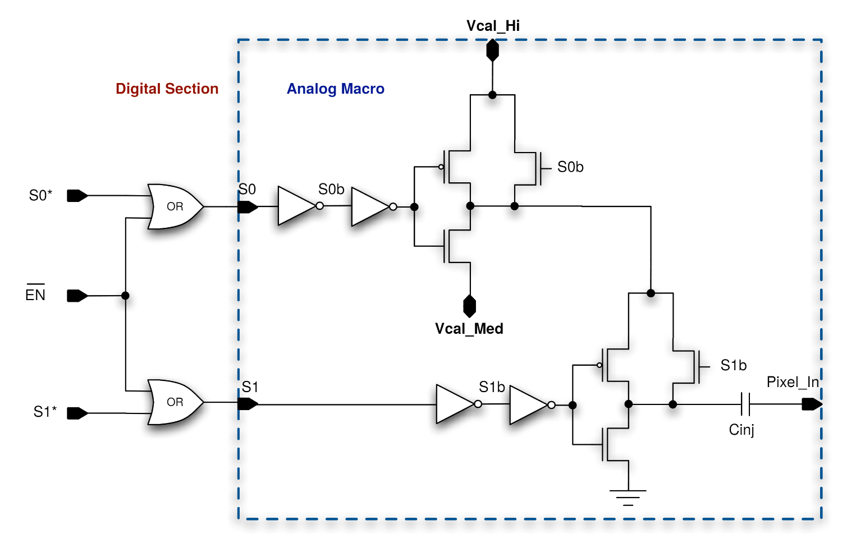
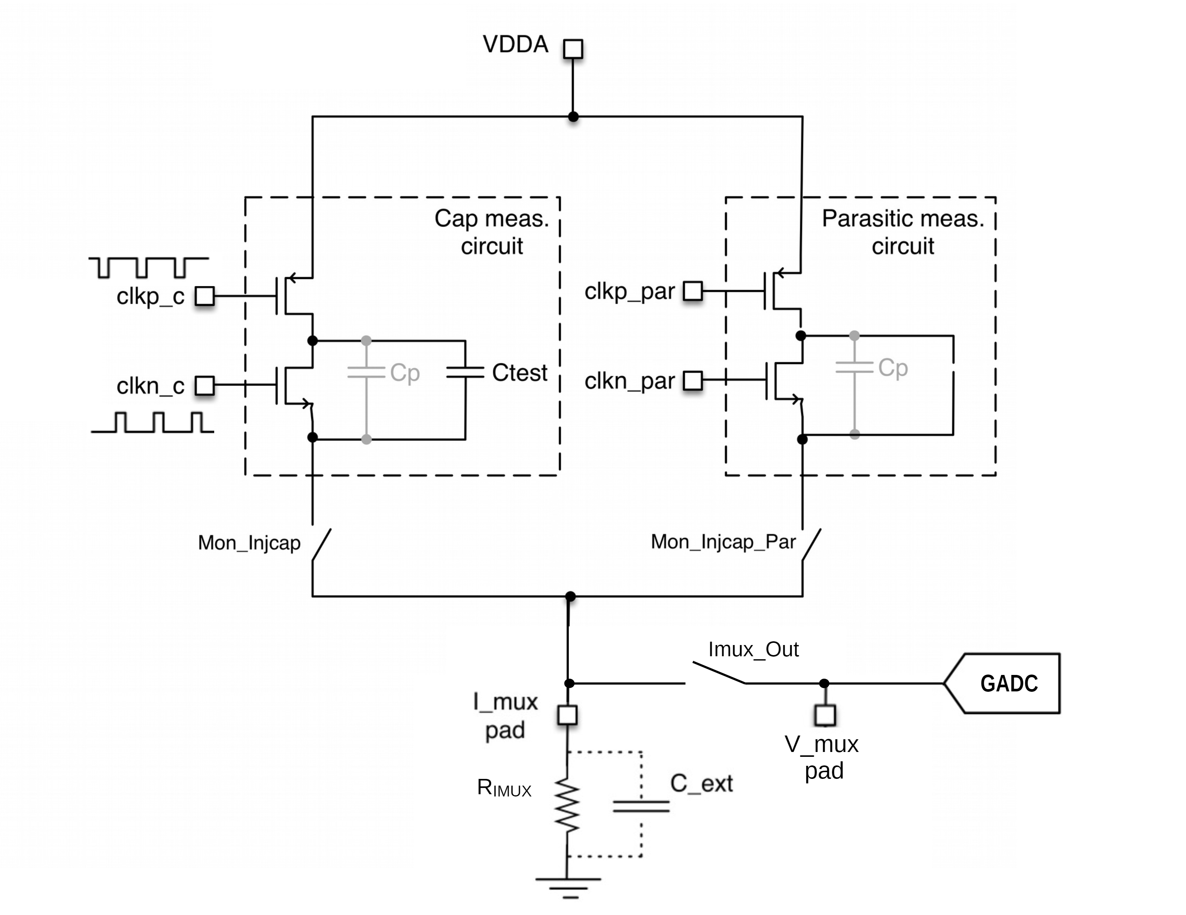
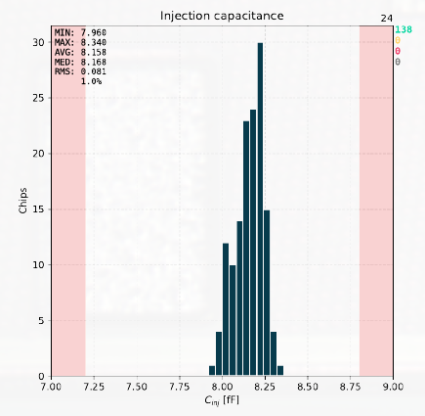
Calibration circuit
Each pixel is equipped with a calibration injection circuit for test and calibration purpose
The analog injection uses two distributed voltages, provided by two 12-bit voltage DACs, to generate a precise voltage step fed to an injection capacitor
Two selectable ranges
Large VCAL range
Small VCAL range
DAC [LSB]
Possibility to measure the value of injection capacitor using a dedicated circuit to define precisely the injection step

Slide 23
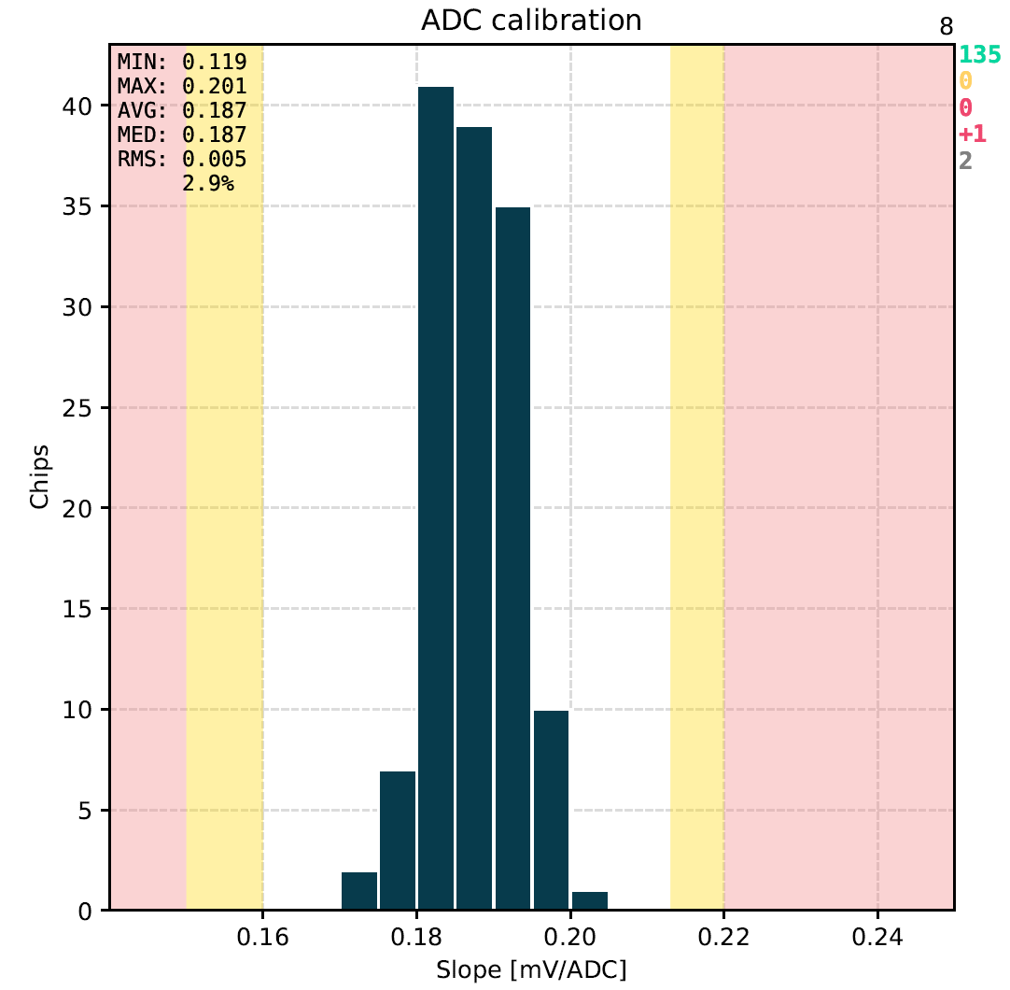
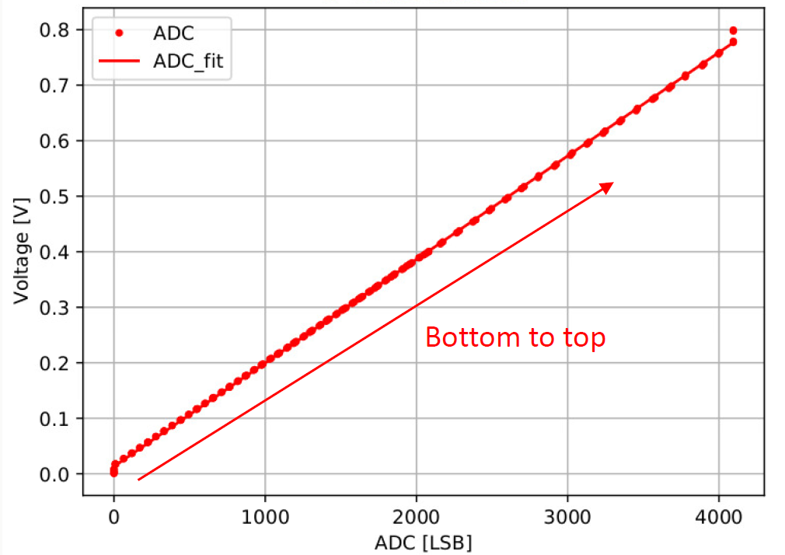
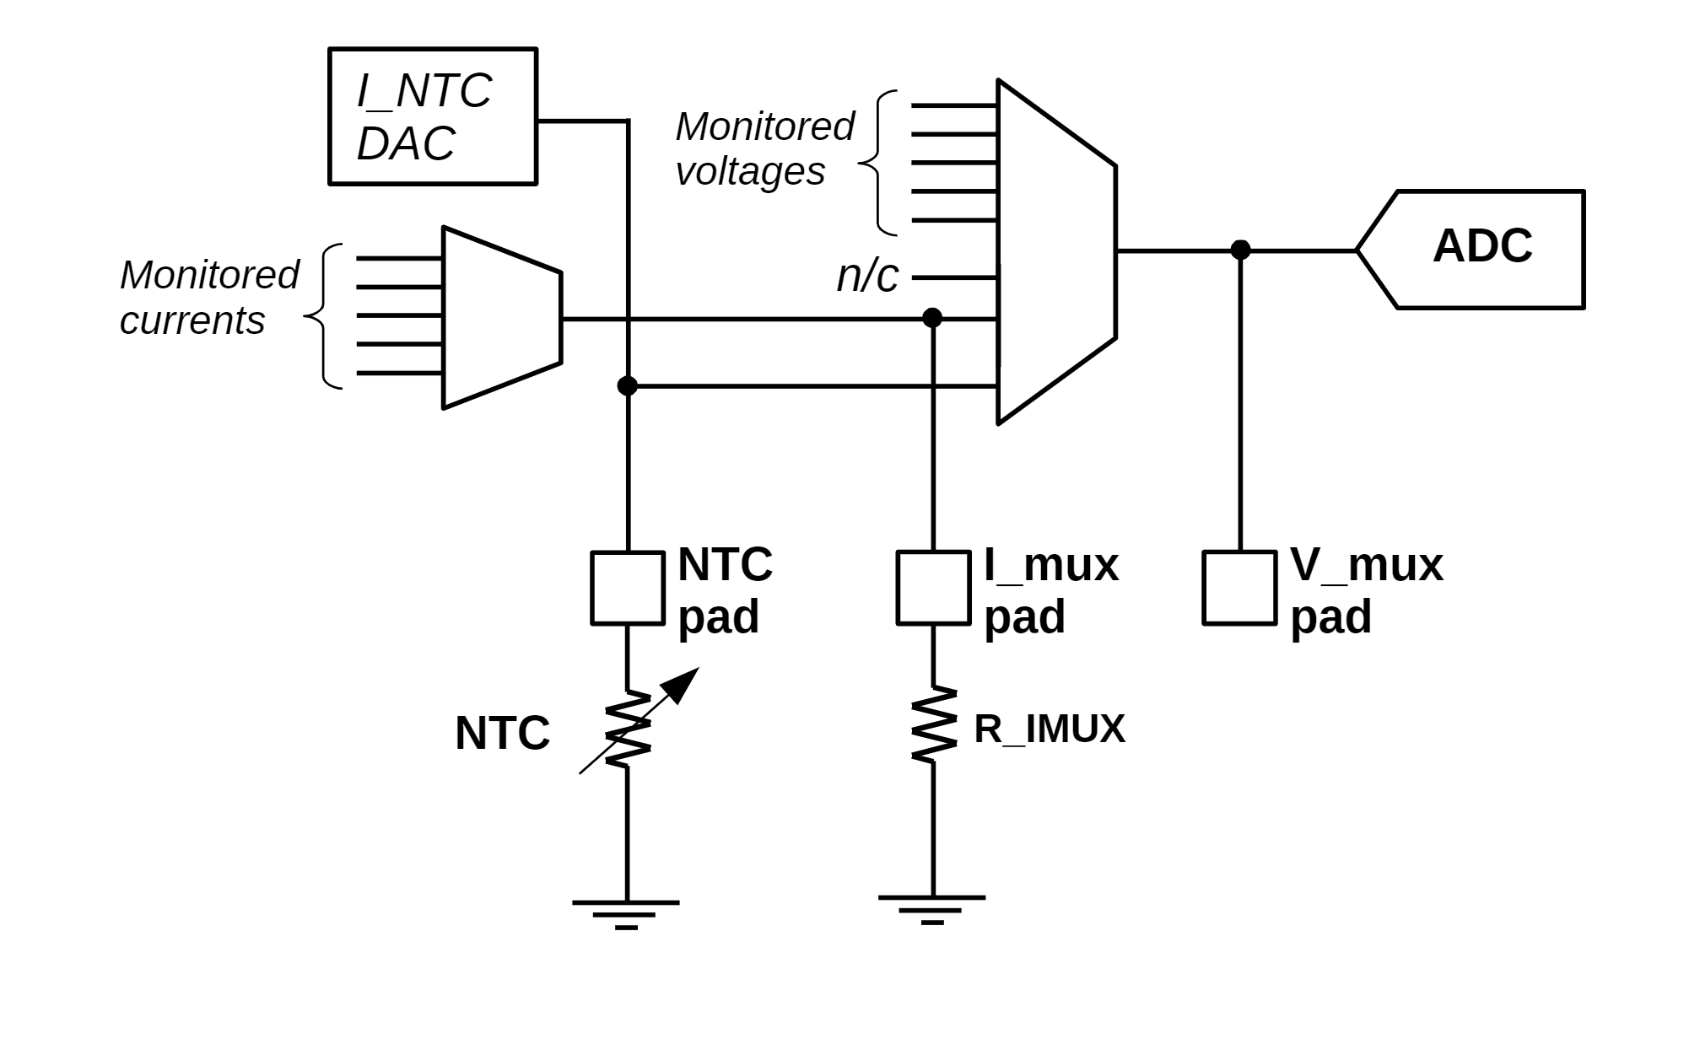
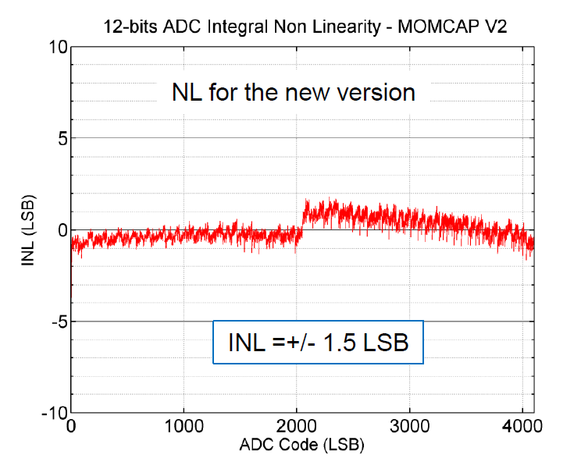

Monitoring block
The Monitoring block enables digitization and readout of internal parameters (T, voltages and currents from different parts of the chip)
Consists of a current mux, a voltage mux and a 12-bit Analog to Digital Converter (ADC)
Monitoring can be performed at any time, also during data-taking, via the normal data output links
5 temperature sensors in different positions (near the ShLDOs, in the centre of periphery, top/bottom of the matrix)
Ring oscillators → measurements of digital cells speed degradation with TID
I Mux
V Mux

Slide 24



Test and debugging features: Self Trigger
Flexible auto trigger function, based on a Hit-OR network from the pixel array
Hit-OR network consists of 4 OR lanes per Core Column, with a mapping such that neighbor pixels are mapped on different lines
At the end of Core Column, the 4 lanes are combined to build the global Hit-OR with programmable patterns

Slide 25




Precision ToT and ToA
PTOT module can be used for high resolution Time over Threshold and Time of Arrival measurement of the HitOR lines, using 640 MHz counting clock (1.5625ns resolution)
  11-bit PToT counters
  5-bit PToA counters, measuring the phase difference from HitOr leading edges and next BX clock rising edge
Each Core Column is equipped with a PTOT module. Can be triggered for readout via the normal path, just like a Pixel Core
Can be used to make precision measurements of analog front-end, like time walk
Allows to reconstruct the amplifier output waveform (sort of oscilloscope)
Working in ItkPixv1, bugged in CROCv1, fixed for final chips
Inject fixed calibration pulse
Scan the threshold
Sample PToA and PToT at each step

Slide 26


Clock and reset strategy

Slide 27
Data reduction and debug options
There are several ways to reduce the amount of Physics data by chip configuration:
Binary readout: leave out the ToT bits, ~25% bandwidth saved
Event truncation: for each Core Column, if the size of the event is over a threshold, trim it
Timeout truncation: for each event, if it takes too long to read out, trim it using a timeout
There are debug options to add information:
Raw output: output a simple hit map (do not use the Binary Tree compression)
CRC: append a 32-bit Cyclic Redundancy Check to the end of a Stream
BCId and Level1 ID: add 16 bits containing the Bunch Crossing ID, or Level 1 ID, or both.
Isolated hit removal
Pixels in red are considered isolated
It is only easy to look within the data for one Core Column at a time, so pixels touching vertical boundaries are not removed.

Slide 28
Chip interfaces: control link
Fast Commands = 16 bits, 100 ns to send
Slow Commands = variable length, up to some ms to send
The RD53 control protocol was designed to meet these needs:
  High radiation environment:
    The protocol symbols are a Hamming distance of 2 bit flips apart, allowing error detection
    To speed up recovery from errors, the CLEAR command, which resets the data path, is a minimum-sized Fast Command
    Fast Commands can be interleaved by DAQ during Slow Commands such as Write Register
    Write Register commands have features to auto-increment register addresses and to broadcast to up to 15 chips on a shared bus, to speed up chip configuration
    These together mean that the chip can be continuously reconfigured in ~100 ms
  High trigger rate:
      Trigger commands are minimum-sized Fast Commands
  Minimise cabling and material in the detector:
      Both commands and the main 160MHz clock are recovered from this 1 differential pair
      The periodic Sync command guarantees sufficient transitions to recover the clock
40 MHz clock
Control stream
with Fast Command inserted

Slide 29



Chip interfaces: data output and formats
Hit data readout and compression
Triggers cause hit data to be read out from the Pixel Array using tokens
Data is stored in a FIFO at the end of each column
Hit data from columns is compressed using Binary Tree Encoder (up to factor of 2)
Event building and Streams
Data is collected from all Core Columns and formatted in order to form a full event. This is done in a multi level event building stage.
Each event is full contained and referenced by the associated Trigger Tag
All events are built preserving trigger order (NO event mixing)
Events are encapsulated into a variable length Stream due to Binary Tree encoding and zero suppression
Formatting within Streams
Streams are split into 64-bit words (Aurora data frames)
The first bit shows if the current frame is the last of the stream (End of Stream/EoS bit)
The next 8 bits are the Event Tag (only in the 1st frame of that event)
Next: 6-bit address of the core column (“ccol” in the diagram)
Next: 6-bit address of the core row (“crow”)
2x8 region Binary Tree Encoded address (“BT” in the diagram)
Next: the Time Over Threshold data (4 bits) for each hit pixel (“ToT”)
Once the event is ﬁnished we close the Stream padding with zeros or insert a new event separating it from the previous one with a three bit separator (111) that never can occur in event data.
Event building
Binary tree encoding
Encoding of Physics and Register (“Service”) data

