Slide 1
Subcooling HEX Contract Kick Off Meeting
Introduction to CERN and High Luminosity project
V. Gahier
CERN, 06/10/2023

Slide 2
Outline
Introduction to CERN
Introduction to Hi-Lumi project
Cryogenic system for Hi-Lumi project

Slide 3
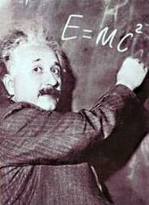



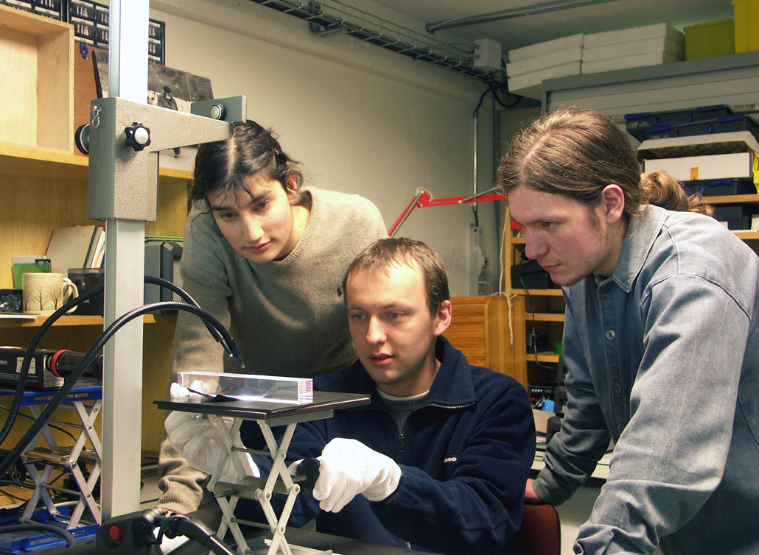
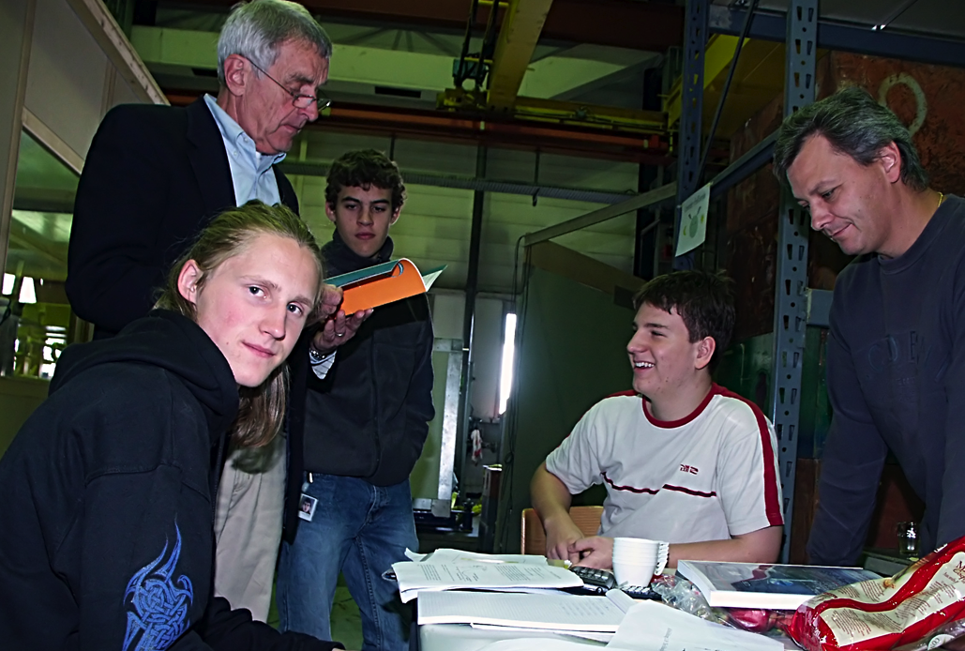
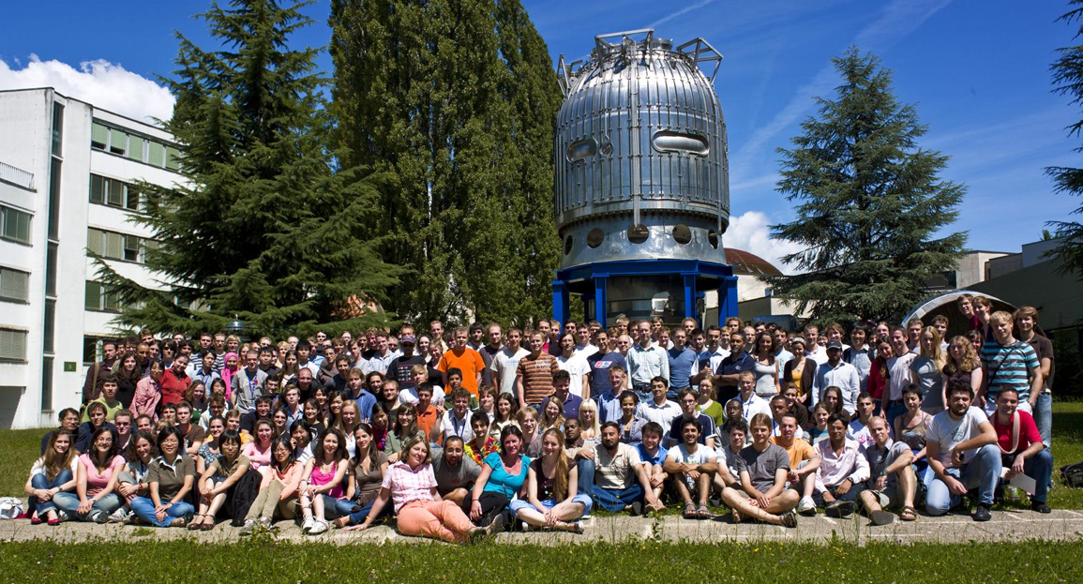
The Mission of CERN
Push forward the frontiers of knowledge
E.g., the secrets of the Big Bang …what was the matter like within the first moments of the Universe’s existence?
Develop new technologies for accelerators and detectors
Information technology - the Web and the GRID
Medicine - diagnosis and therapy
Train scientists and engineers of tomorrow
Unite people from different countries and cultures
Notes:
3

Slide 4
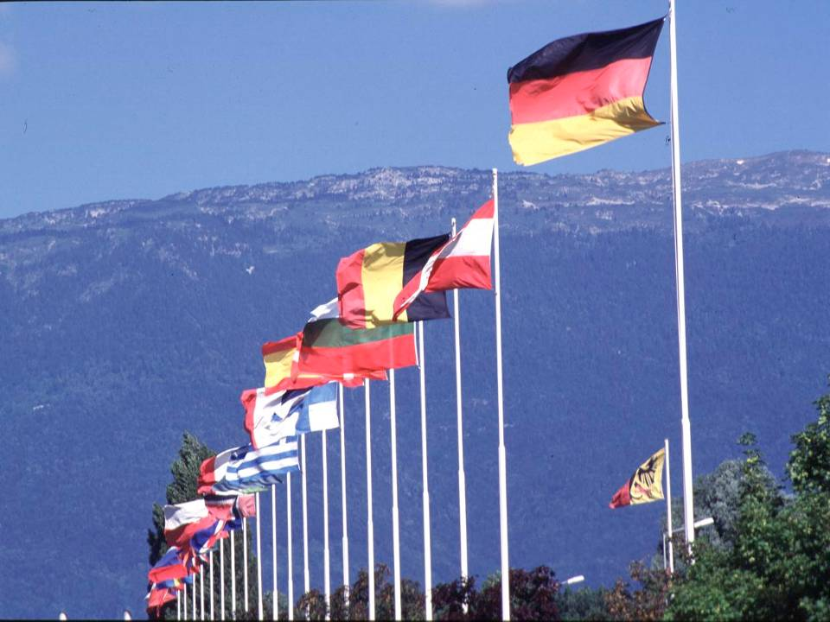

CERN was founded 1954: 12 European States
“Science for Peace”
Today: 23 Member States
Employees: ~2 700 staff, 800 fellows
Associates: ~11 800 users, 1 300 others
Budget (2019) ~ 1 200 MCHF
Member States: Austria, Belgium, Bulgaria, the Czech Republic, Denmark, Finland, France, Germany, Greece, Hungary, Israel, Italy, the Netherlands, Norway, Poland, Portugal, Romania, Serbia, Slovakia, Spain, Sweden, Switzerland and the United Kingdom
Associate Members in Pre-Stage to Membership: Cyprus, Slovenia
Associate Member States:
Croatia, India, Lithuania, Pakistan, Turkey and Ukraine
Applications for Membership or Associate Membership: Brazil, Estonia, Latvia
Observers to Council: Japan, Russia, United States of America; European Union, JINR and UNESCO
Notes:
4

Slide 5


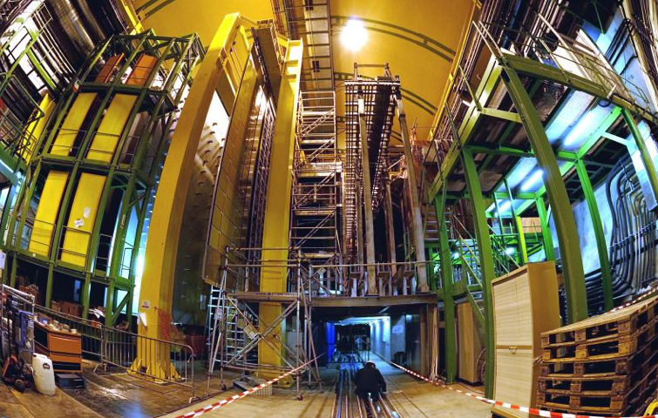


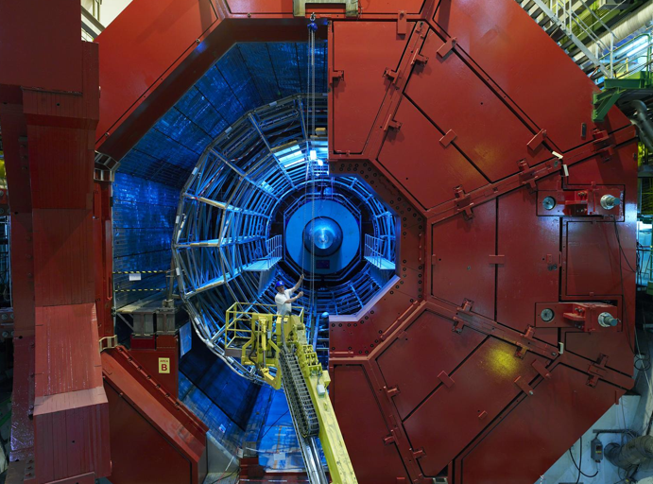

Accelerating Science and Innovation
LHCb
CMS
ATLAS
ALICE
LHC ring:
27 km circumference
Notes:
5

Slide 6
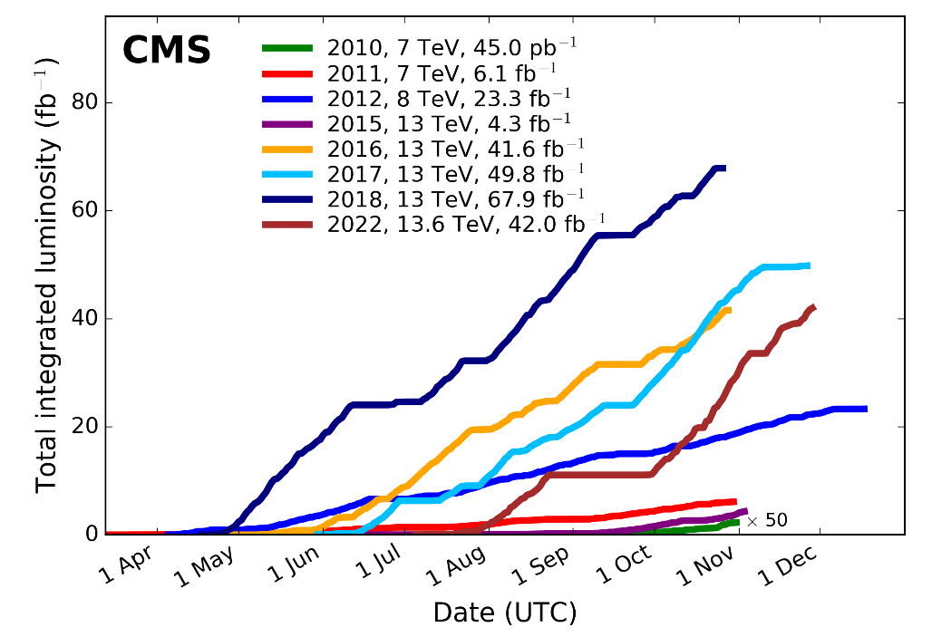

Why the High Luminosity LHC project ?
Many questions remain !
Higgs properties [coupling]
More than one Higgs?
Beyond Standard Model Physics? Dark Matter & Dark Energy?
Need more Data and Statistics!!
The final focusing magnets will also need to be replaced because of radiation damage.
HL-LHC Goals
Extend the LHC lifetime by 15+ years
Prepare the machine for producing in that period 10 times more data as compared to the nominal LHC operation period
$$\frac{ⅆR}{ⅆt}=Lσ_{p}$$
dR/dt : number of events per second
L : luminosity
σ_{p} : event production cross section
NB: doubling the accuracy for the experiments would require 4 times the data volume (over 20 Years of operation with current peak performance after end of Run 3)

Slide 7
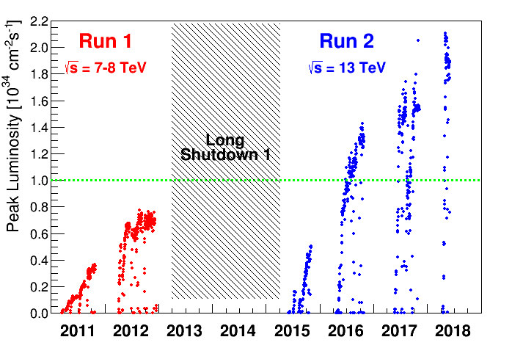
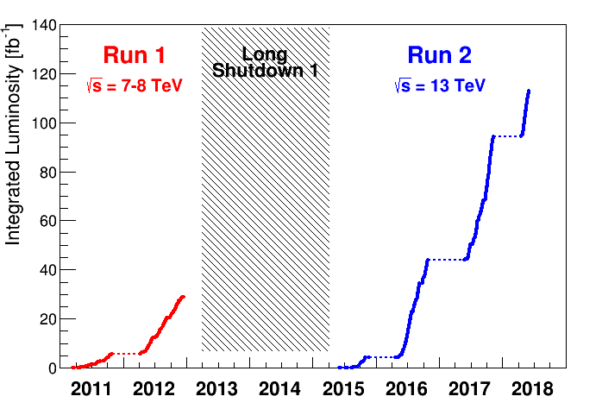
Basic performance indicators
of a particle collider
Peak Luminosity
=> Performance
Integrated Luminosity
=> Qualification – Global availability - Time
Nominal luminosity
“ The potential of the facility”
“What allows science” (statistics)

Slide 8
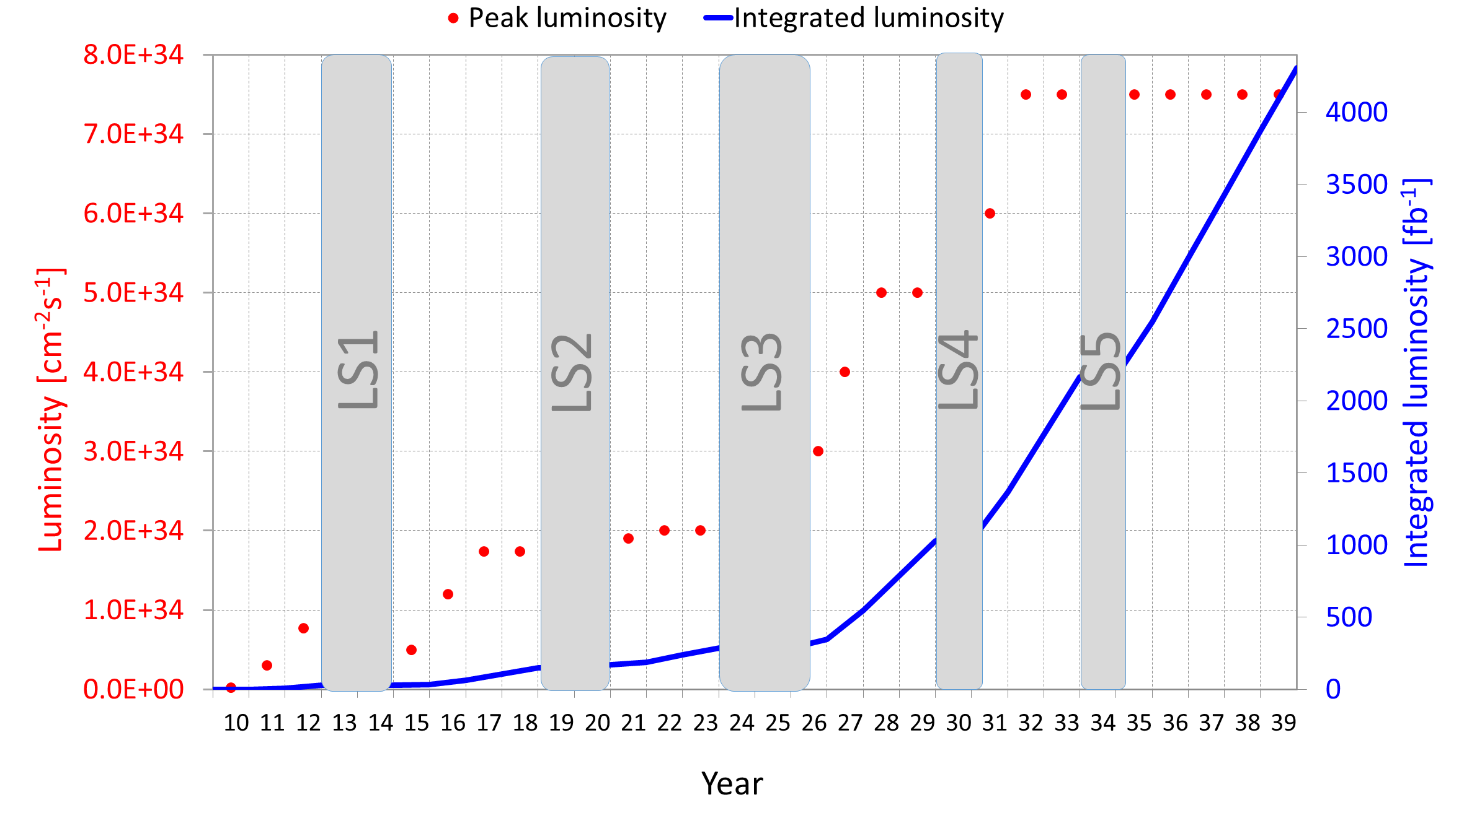
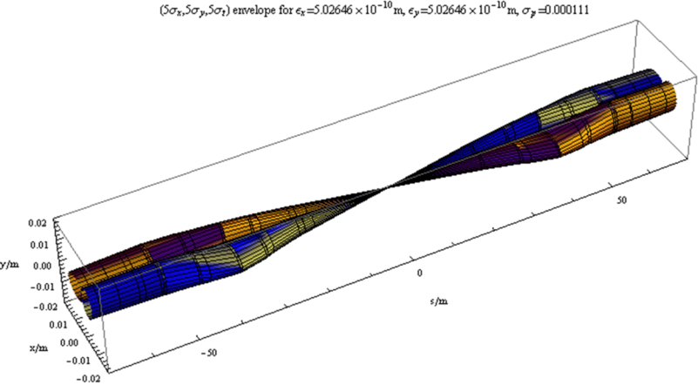


Towards higher collision rates
New discoveries and precision measurements need integrated luminosity !!!
Luminosity = f * N² / 4π σ²
Need for more protons in a smaller cross section !!!
Target for physics:
doubling integrated Luminosity for each new run
stronger focusing
More intensity
LIU
NB. Plans as defined a few years ago, timing not up-to-date
more powerful final focusing !

Slide 9
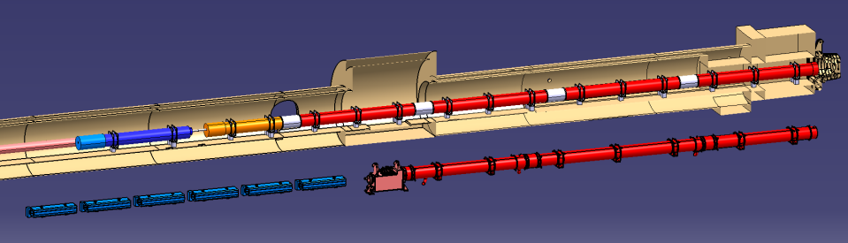
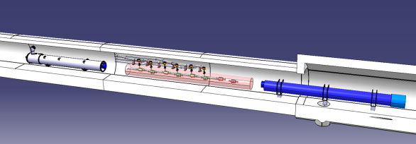
Final focussing at P1 and P5: from LHC to HL-LHC
Q2a
Q1
Corrector
Package
Q2b
SC D1
Q3
Existing LHC
NC D1
HL-LHC relies on more powerful final focussing quadrupoles, associated recombination dipoles and crab cavities.
Local heat loads expected x5 w.r.t LHC
Q4
CC
D2

Slide 10
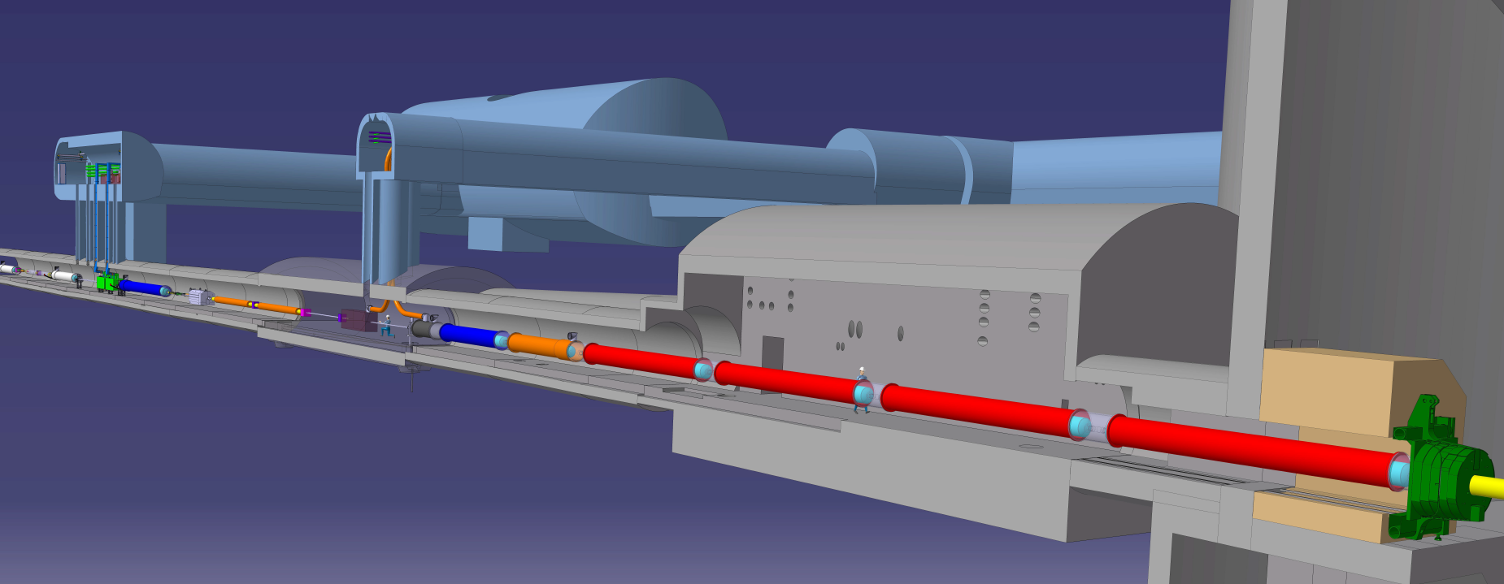








View of underground configuration at IP5
Connection to LHC (UL)
Service gallery (UR)
UA Gallery
Service cavern
DFHX
DFHM
Q4
Collimators
SC Links
D2
Crab cavities
D1
CP
TAXN
DFX
Q3
Q2b
DFM
Q2a
Q1
TAXS
A truly international collaboration !

Slide 11
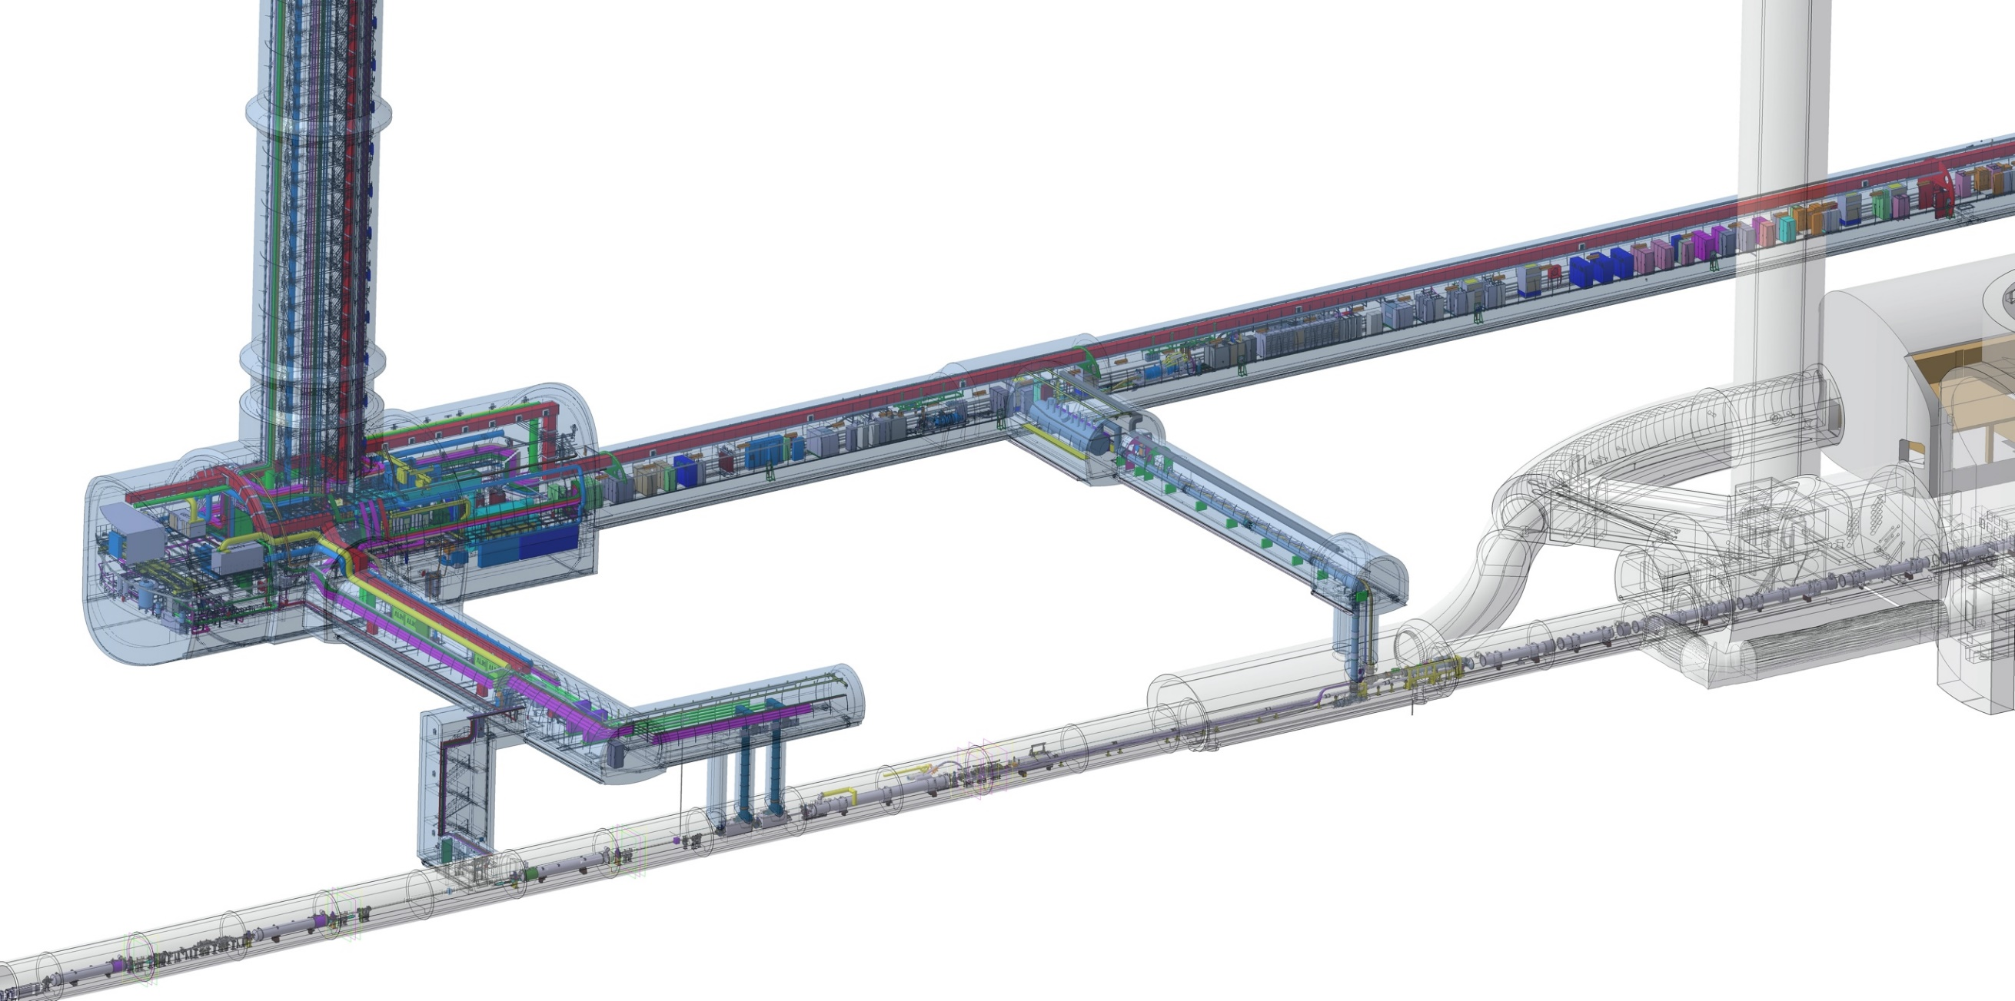
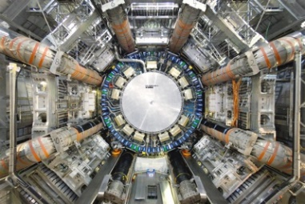
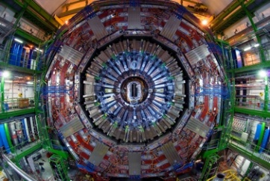
View with the technical galleries
QDS
UR55
Warm Diodes
CLIQ
PIC,BIS
CDBs
OC EE
Valve box
DFHX
D2 OC PCs
DFHM
OC PCs
US57
D2 PC
D1 PC
UW57
PC IT
PCs IT Trims
CDBs
DSHX
D2 OC EE
UL57
Cold box
DSHM
UA57
D1
CP
Q3
Q2B
Q2A
Q1
RF Powering
DFM
DCM
Cooling and Ventilation
DFX
UPR57
Cold Diodes
TAXN
D2
DQHDS
Crab
Cavities
Q4
Q5
Q6

Slide 12
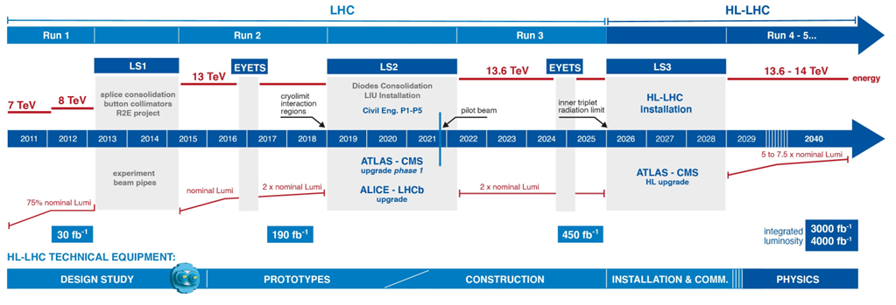
Timeline of LHC and HL-LHC
Approval of
HL-LHC project
Today
HL-LHC operation
Eu funded design
study
Series production is well underway - or ready to be launched - for all components!
Ca. 1.1BCHF
Ca. 75% committed

Slide 13
What needs to be cooled
Connection to LHC (UL)
Service gallery (UR)
UA Gallery
Service cavern
DFHX
DFHM
Q4
Collimators
SC Links
D2
D1
CP
Crab cavities
Q3
Q2b
TAXN
DFM
DFX
Q2a
Q1
TAXS
1.9 K
4.5 K
4.5 K – 20 K
20 K – 300 K
SC magnets beam screens are cooled at 60-80 K

Slide 14
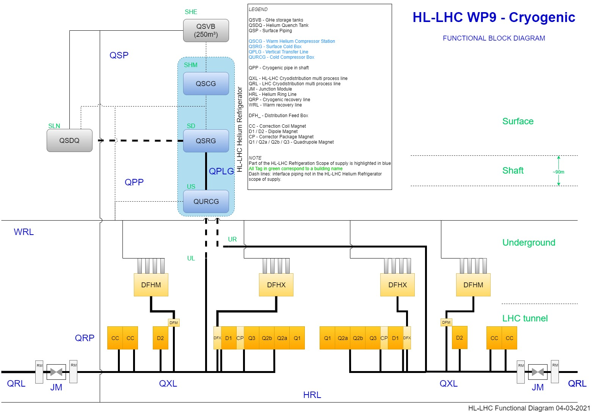
HL-LHC P1/P5 Cryogenic architecture
QSRG : Compressor station providing gaseous helium 20 B
QSRG : 4.5K refrigerator providing supercritical helium at 3 bara and 4.6 K
QXL : Distribution line distributing C,E and returning B,D,F
70 m for the common branch
270 m for the long branch
60 m for the short branch
QPLG : Vertical transfer line (~100 m height)
QURCG : Cold compressor box providing cooling capacity at 1.8 K
RM/JM : Return module and junction module at extremities for transient handling and back-up
Users at tunnel level

Slide 15
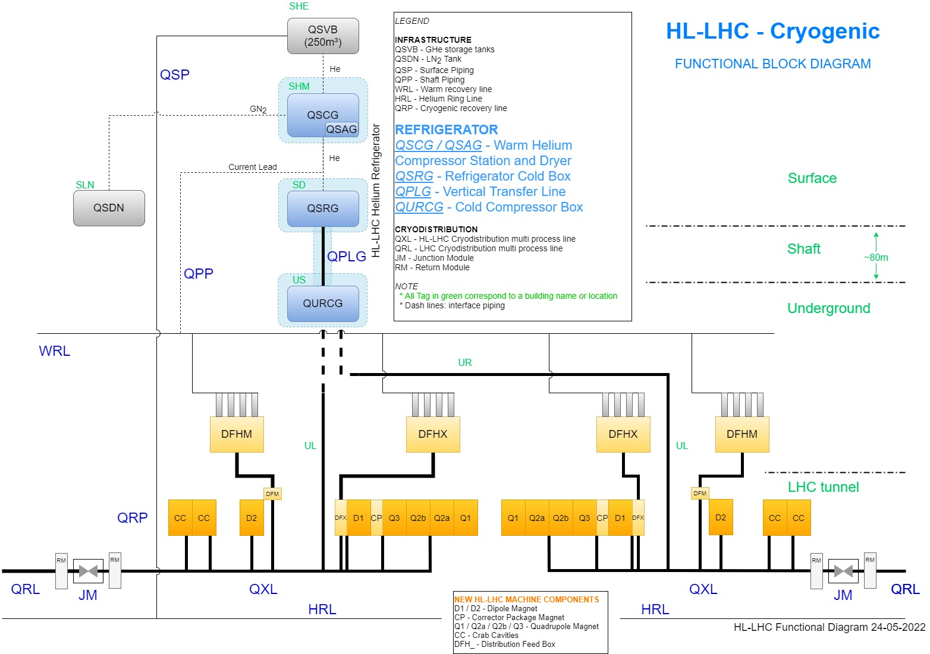
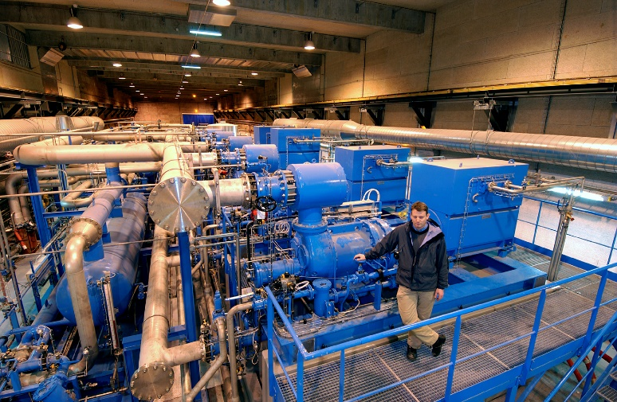
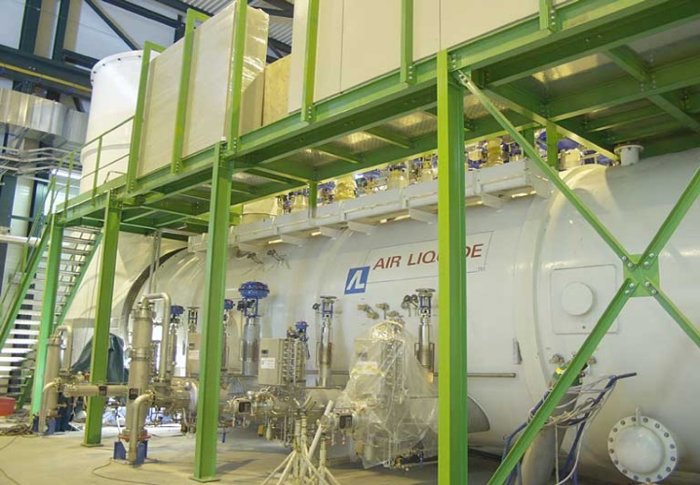
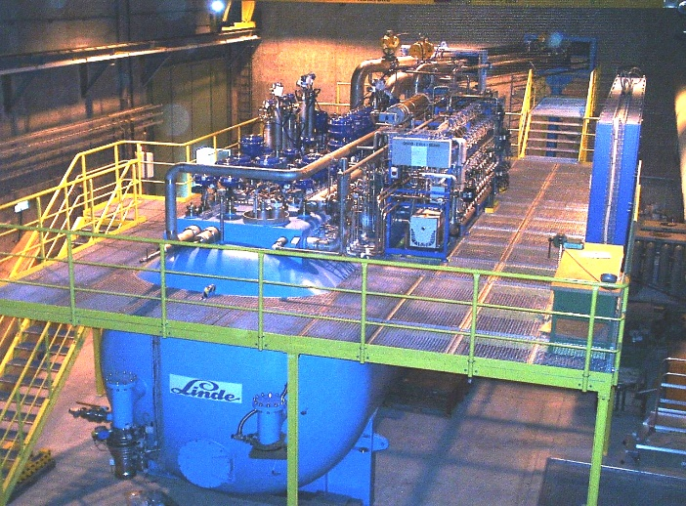
Helium Refrigerators at LHC P1 and P5 for HL-LHC
P1-P5 Cryogenic Architecture
Helium Refrigerators
2 x 14kW@4.5K, including 3.25kW@1.9K
LHC Helium Refrigerators
similar capacity required
for P1 and for P5,
in addition to 8 existing ones
Compressor station
(100t, 4MW input power)
Cold boxes from world wide leading industries
(>100t, Heat exchangers, expansion turbines, valves, controls)

Slide 16
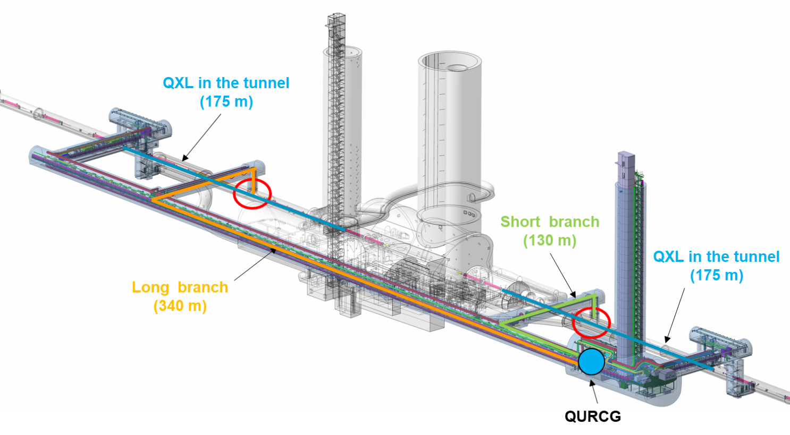
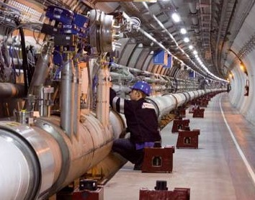
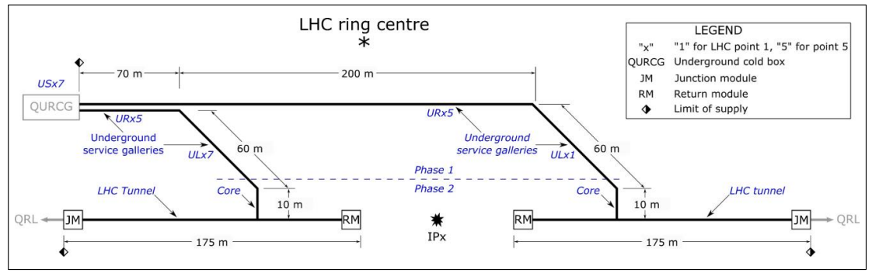

Cryogenic distribution line at P1 and P5
2 x 750 m, 5 process pipes, vacuum insulated lines
Lines diam. 40 - 273 mm, 650 mm - 800 mm
LHC Line
~145 t
per point
Gallery
Tendering process Q1-Q2_2022
Contract signed Dec’22 with KrioSystem (PL)
LHC tunnel

Slide 17
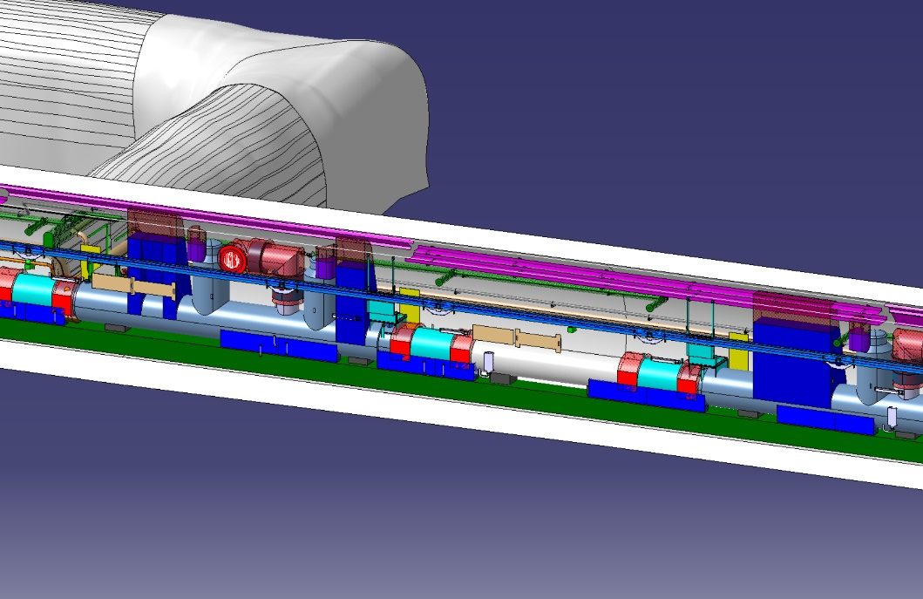
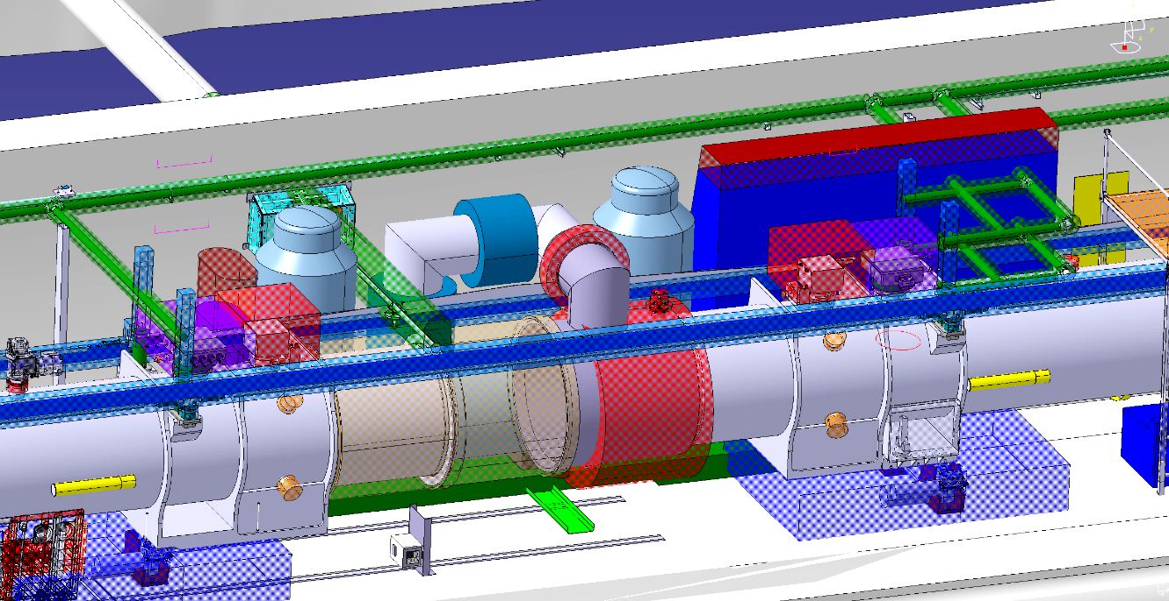
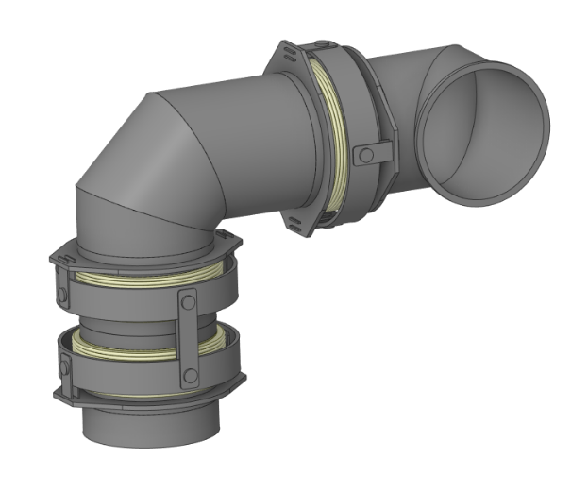
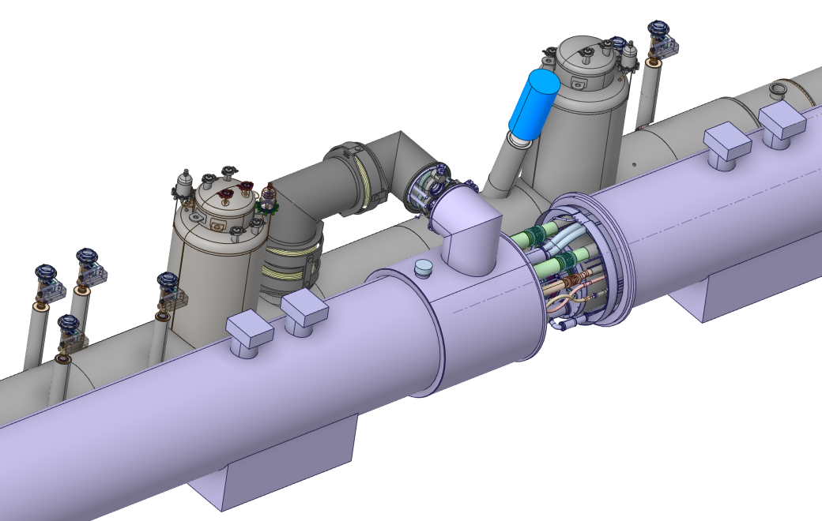
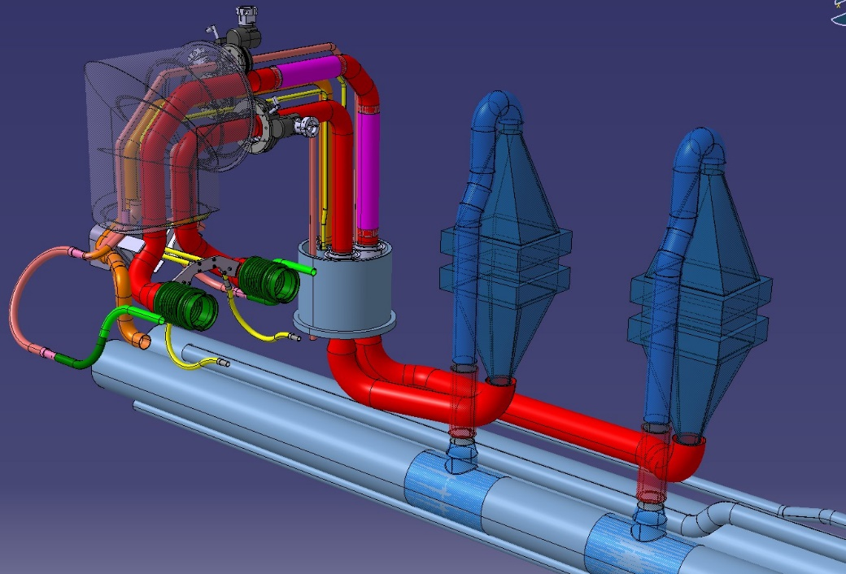
Cryogenic distribution line at P1 and P5: some details
DN400
gimbal joint
DN400
double gimbal joint
HXI dome
Jumper interconnection
QXL Service Module
Jumper elbow (IT side)
Existing HXI
HXI dome
XB lines
(pumping)
ISO DN65
New HXI
Q2B magnet Service Module
LD line
(quench)
Magnet interconnection
E_{H}E’_{H} line
(thermal shield)
CY lines
(injection)
Interface to the magnet HX

Slide 18
Thank you for your attention

