Slide 1

WADAPT-Alpes
Fatah Rarbi, Brice Gogué-Meunier, Fairouz Malek, Marc Marton, Jean-François Muraz, Olivier Rossetto, Patrick Stassi

Slide 2
Multi-channel readout electronics
Objectives: Design of an integrated multi-channel readout electronics for detectors to be interfaced to the multi gigabit wireless data transmission module
  ADC design:
    CMOS 65nm (available) or CMOS 28nm (NDA process)
    10 bits resolution, 40 MSPS, ultra low power
      Event driven ADC/Asynchronous architecture
      SAR architecture
    Interface with WADAPT module: 8b/10b encoding
  PCB design and test characterization
    Design a generic evaluation board for ADC

Slide 3
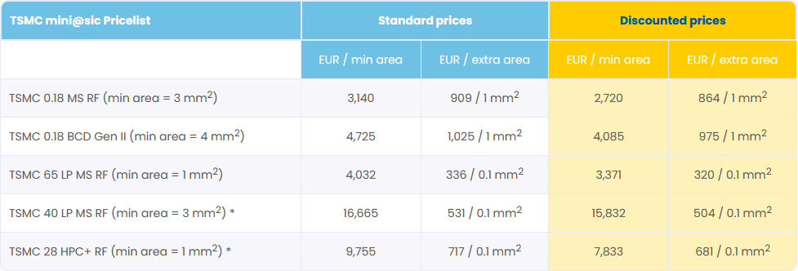
ADC design + PCB design and test
3 years Engineering through apprenticeship (CNRS fund)
  Start on Sept. 2023
  1st year:
    PCB design + software design for test part
Which technology?
  65nm already available
  28nm still waitng for NDA
https://europractice-ic.com/schedules-prices-2022/

Slide 4
WADAPT-Alpes
Fatah Rarbi, Brice Gogué-Meunier, Fairouz Malek, Marc Marton, Jean-François Muraz, Olivier Rossetto, Patrick Stassi

