Slide 1
Vacuum Instrumentation Integration study LSS5L EDMS 2962839
UPDATE AUGUST 2023
DRAFT FOR DISCUSSION
G. Aparicio (WP15), in collaboration with M. Sisti and J. Perez Espinos
Symmetric solution applied to LSS1R
04/08/2023

Slide 2
TE-VSC inputs from 2021
Courtesy of J. Perez Espinos

Slide 3
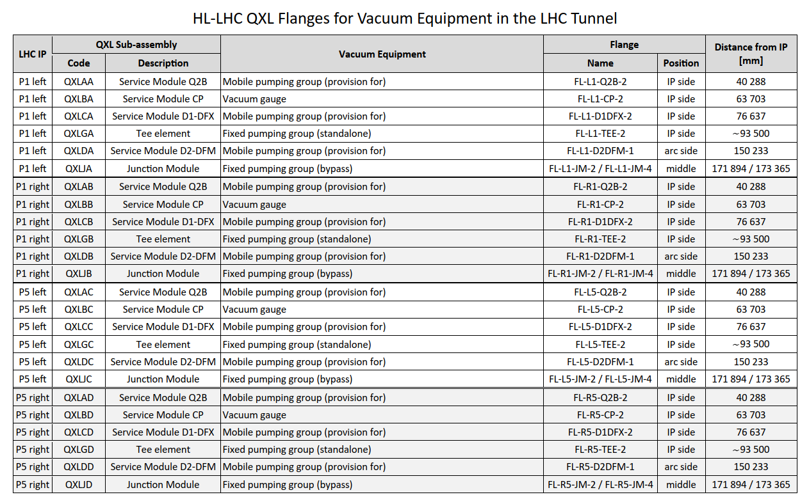
TE-CRG inputs from 2023

Slide 4
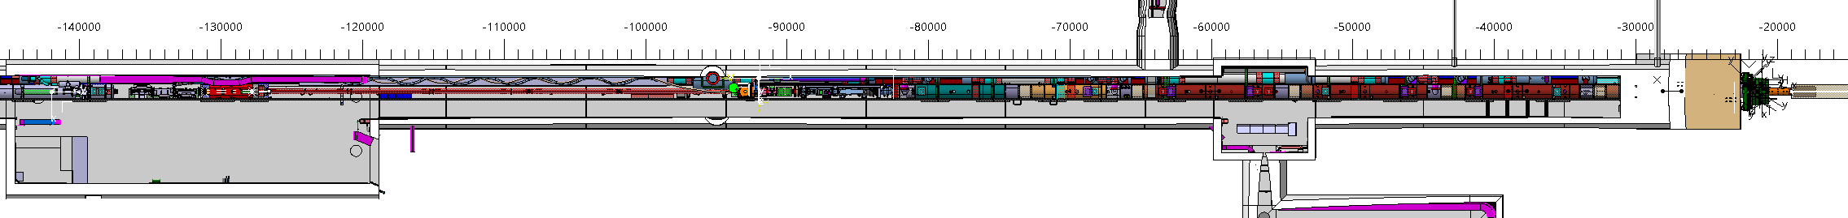
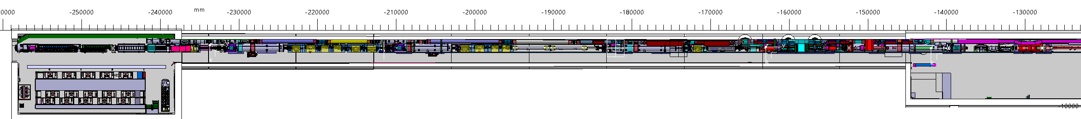
Top view of LSS5L
UJ53
R541
RZ54
R542
DFX
DCM
D1
CP
Q3
Q2b
Q2a
TAXN
R532
Q6
Q5
Q4
CC2
CC1
D2+DFM
TAXN

Slide 5
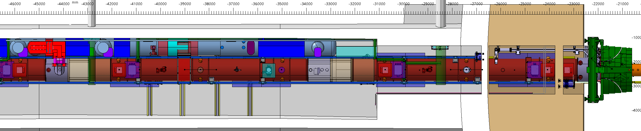
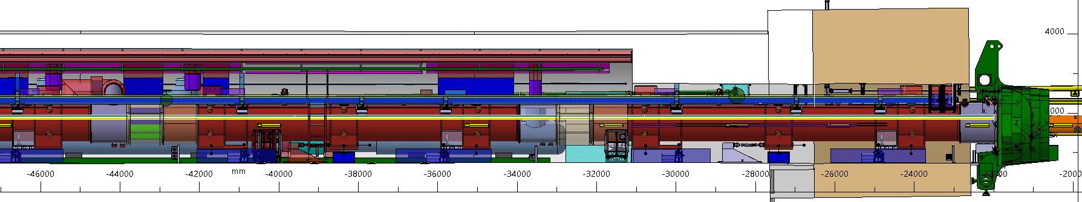
Vacuum Instrumentation along LSS5L
UJ53
R541
RZ54
R542
DFX
DCM
D1
CP
Q3
Q2b
Q2a
TAXN
DRAFT FOR DISCUSSION
MOBILE
PUMPING GROUP
Reserved
Q2a
Q1
MOBILE PUMPING GROUP
SV200
GAUGE GROUPING
MOBILE PUMPING GROUP
FP200
MOBILE
PUMPING GROUP
MOBILE PUMPING GROUP
GAUGE GROUPING
MOBILE PUMPING GROUP
SV200
FP200
Q2a
Q1
Volume trolley
Volume trolley
Volume trolley

Slide 6
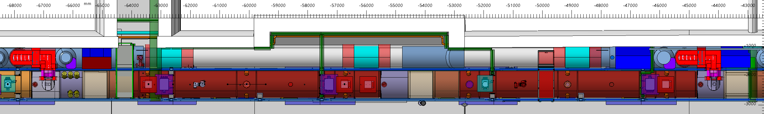
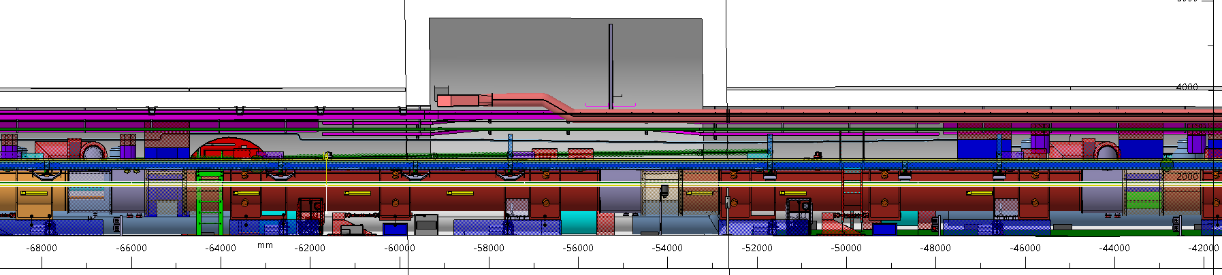
Vacuum Instrumentation along LSS5L
UJ53
R541
RZ54
R542
DFX
DCM
D1
CP
Q3
Q2b
Q2a
TAXN
DRAFT FOR DISCUSSION
GAUGE GROUPING
Q3
Q2b
FIX PUMPING GROUP
SV200
MOBILE PUMPING GROUP
SV200
GAUGE GROUPING
FIX
PUMPING GROUP
MOBILE PUMPING GROUP
SV200
SV200
Q3
Q2b
Primary pump
rack
Volume trolley
Volume trolley

Slide 7
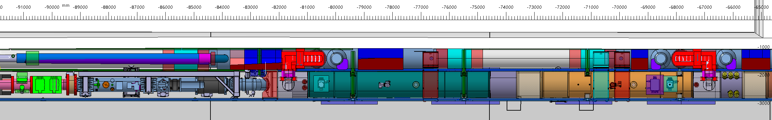
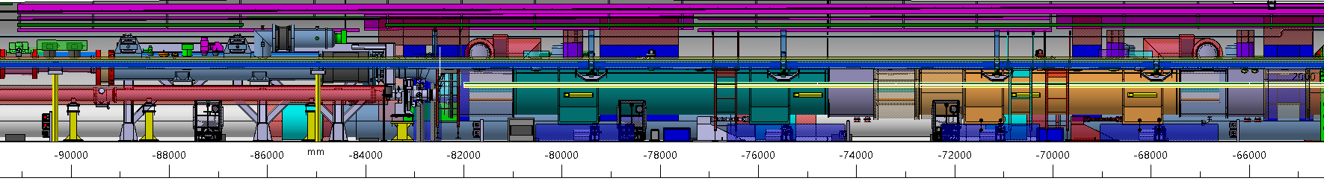
Vacuum Instrumentation along LSS5L
UJ53
R541
RZ54
R542
DFX
DCM
D1
CP
Q3
Q2b
Q2a
TAXN
DRAFT FOR DISCUSSION
Mobile pumping group on QXL
FORSEEN FOR 76637 according slide 3
MOBILE
PUMPING GROUP
SV200
D1
CP
MOBILE PUMPING GROUP
FIX PUMPING GROUP
SV200
MOBILE PUMPING GROUP
GAUGE GROUPING
SV200
MOBILE PUMPING GROUP
MOBILE
PUMPING GROUP
GAUGE GROUPING
FIX
PUMPING GROUP
MOBILE PUMPING GROUP
SV200
SV200
SV200
D1
CP
Volume trolley
rack
Volume trolley
Primary pump
Volume trolley

Slide 8
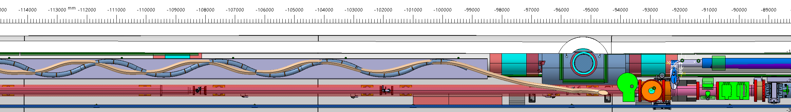
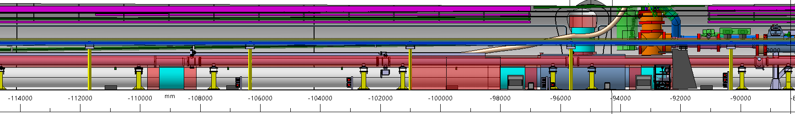
Vacuum Instrumentation along LSS5L
UJ53
R541
RZ54
R542
DFX
DCM
D1
CP
Q3
Q2b
Q2a
TAXN
DRAFT FOR DISCUSSION
FIX
PUMPING GROUP
MOBILE/FIX PUMPING GROUP
FIX
PUMPING GROUP
GAUGE GROUPING
MOBILE/FIX PUMPING GROUP
SV90
FP200
GAUGE GROUPING
rack
rack
Volume trolley
Primary pump
Primary pump

Slide 9
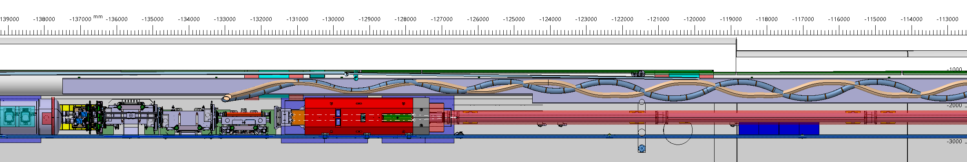
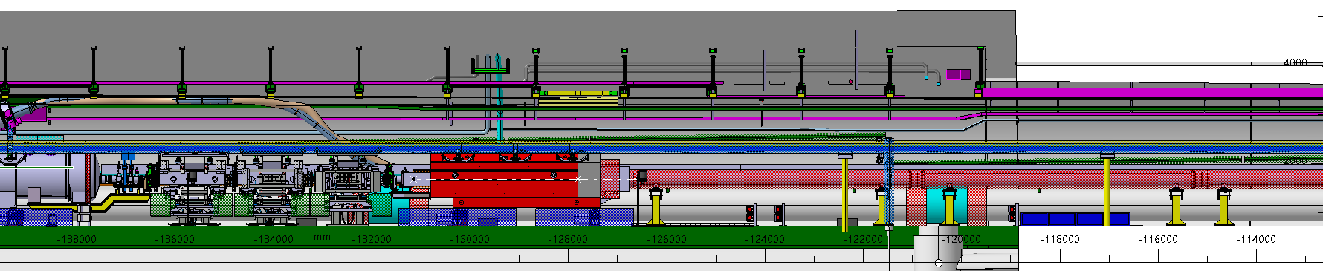
Vacuum Instrumentation along LSS5L
UJ53
R541
RZ54
R542
DFX
DCM
D1
CP
Q3
Q2b
Q2a
TAXN
DRAFT FOR DISCUSSION
TAXN
TAXN

Slide 10
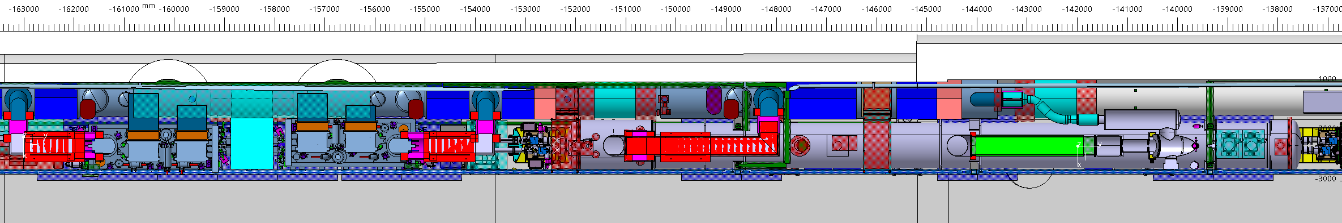
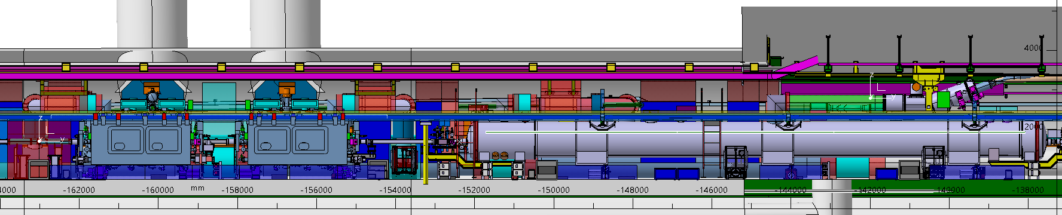
Vacuum Instrumentation along LSS5L
R532
Q6
Q5
Q4
CC2
CC1
D2+DFM
TAXN
DRAFT FOR DISCUSSION
MOBILE
PUMPING GROUP
CC2
CC1
FP160
D2
FP160
GAUGE GROUPING
FIX PUMPING GROUP
FIX PUMPING GROUP
FIX PUMPING GROUP
FP200
MOBILE PUMPING GROUP
GAUGE GROUPING
GAUGE GROUPING
MOBILE/FIX PUMPING GROUP
FIX
PUMPING GROUP
FIX
PUMPING GROUP
FIX
PUMPING GROUP
MOBILE
PUMPING GROUP
MOBILE PUMPING GROUP
FP160
GAUGE GROUPING
FP160
FP160
FP200
SV90
GAUGE GROUPING
GAUGE GROUPING
CC2
CC1
D2
GAUGE GROUPING
rack
rack
Volume trolley
rack
Volume trolley
rack
Volume trolley
Primary pump
Primary pump
Primary pump
Primary pump
Volume trolley

Slide 11
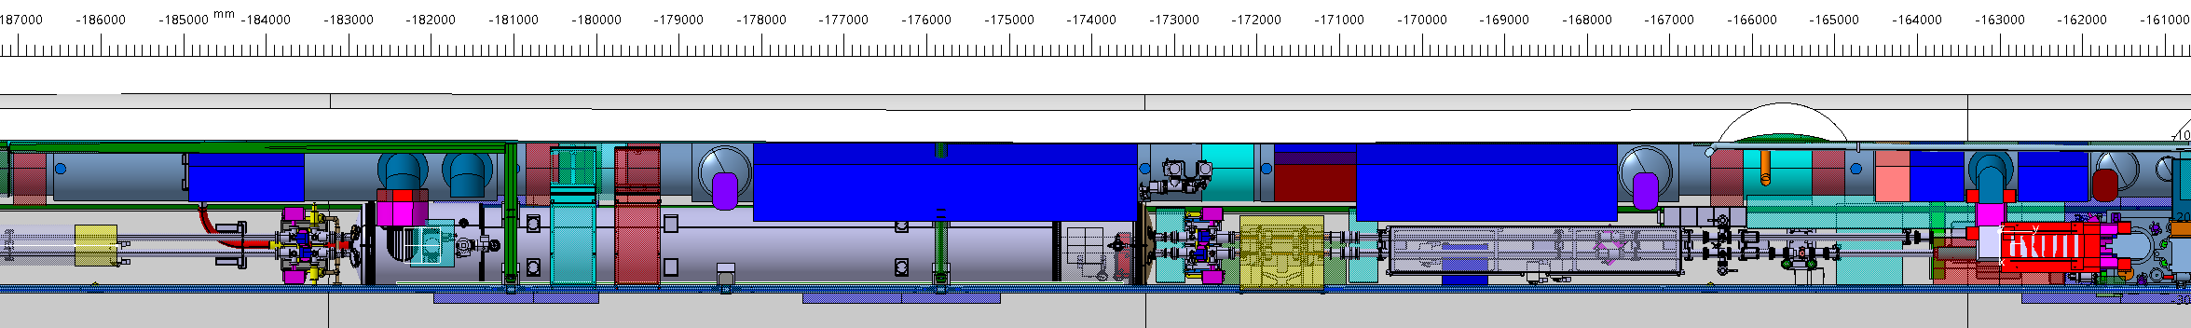

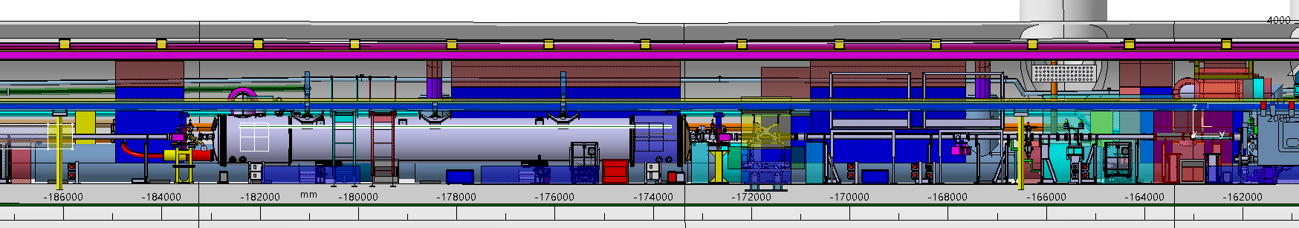
Vacuum Instrumentation along LSS5L
R532
Q6
Q5
Q4
CC2
CC1
D2+DFM
TAXN
DRAFT FOR DISCUSSION
FIX
PUMPING GROUP
bypass
Q4
2xSV160 +SV90
FIX PUMPING GROUP
GAUGE GROUPING
Vacuum gauge according to slide 3. Position of mobile pumping group to be updated by J. Metseelar.
FIX
PUMPING GROUP
bypass
FIX
PUMPING GROUP
GAUGE GROUPING
2xSV160 +SV90
Q4
rack
rack
Primary pump
Volume trolley
Primary pump
Volume trolley
Q4 – NOT YET DESIGNED
Pumping down from gauge grouping.

Slide 12
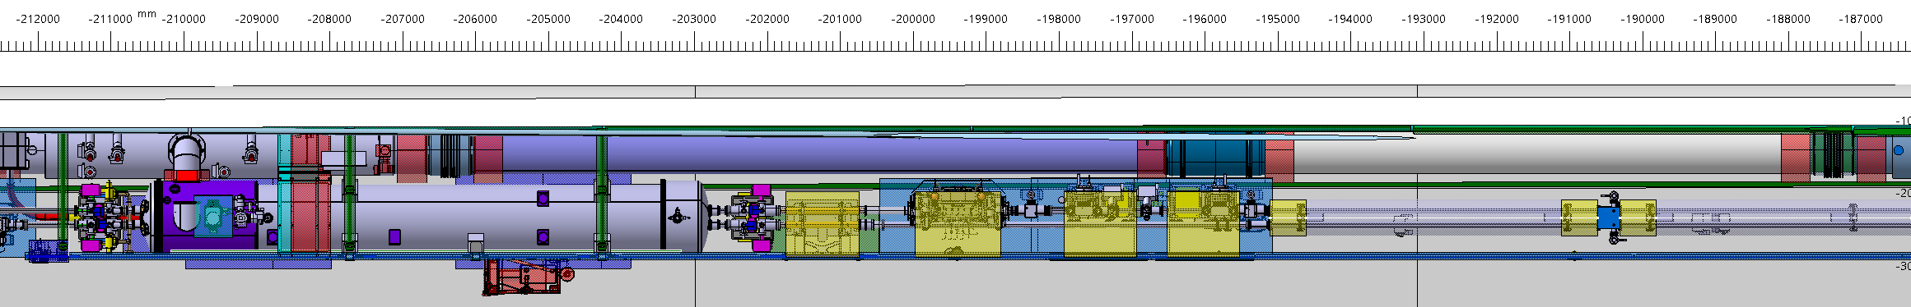
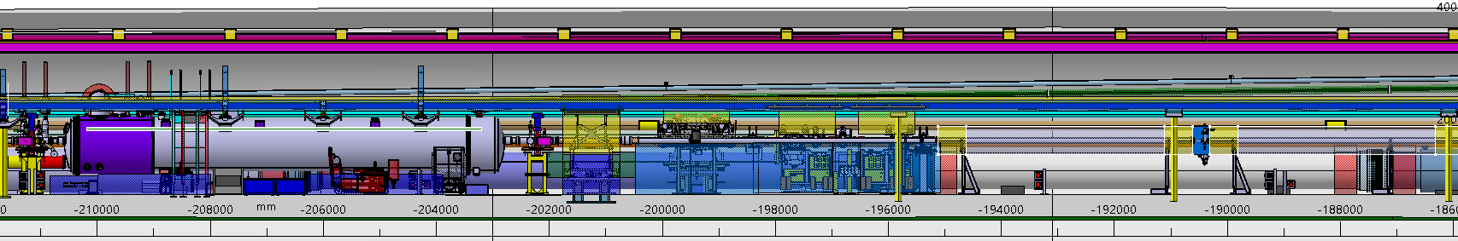
Vacuum Instrumentation along LSS5L
R532
Q6
Q5
Q4
CC2
CC1
D2+DFM
TAXN
DRAFT FOR DISCUSSION
Reserved
Mobile pumping group
Q5
2xSV160 +SV90
FIX PUMPING GROUP
GAUGE GROUPING
FIX
PUMPING GROUP
Reserved
Mobile pumping group
GAUGE GROUPING
2xSV160 +SV90
rack
Volume trolley
Primary pump
Volume trolley

Slide 13
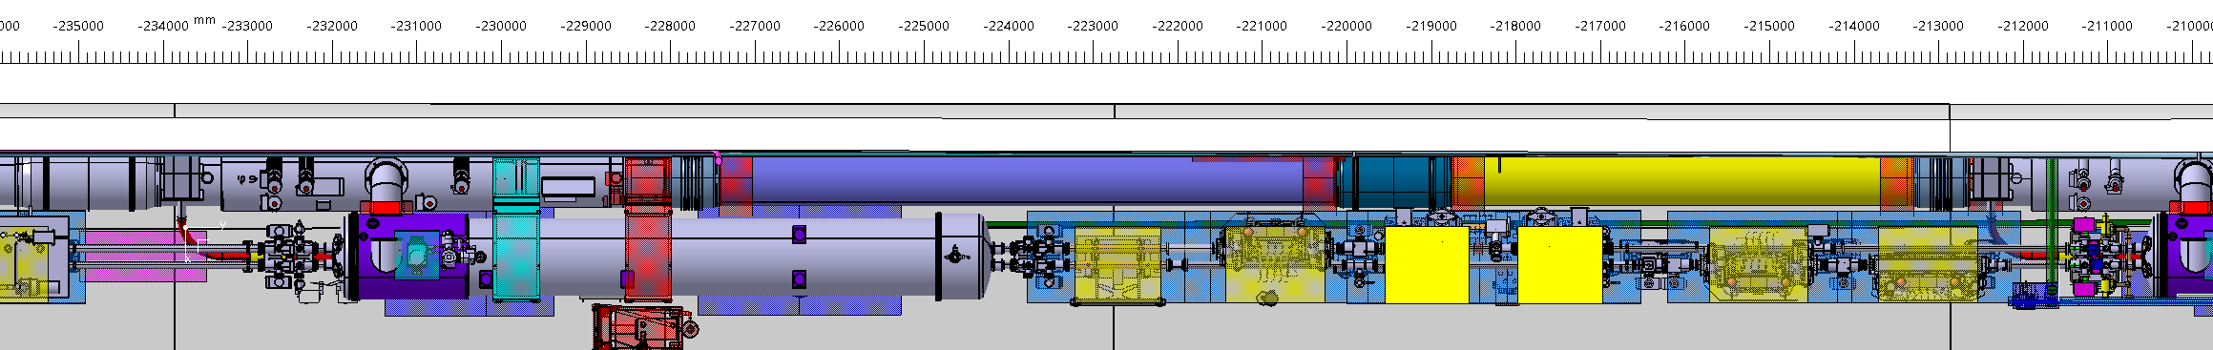
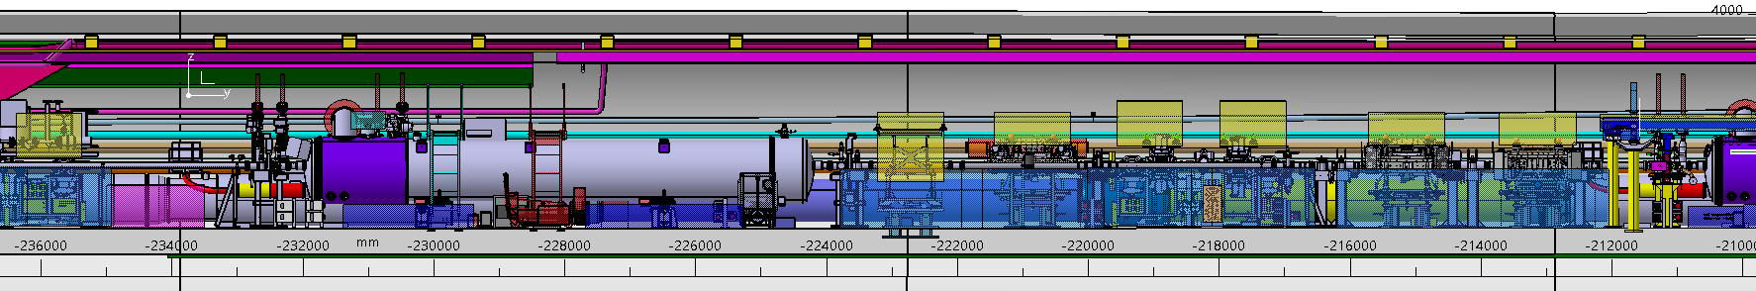
Vacuum Instrumentation along LSS5L
R532
Q6
Q5
Q4
CC2
CC1
D2+DFM
TAXN
DRAFT FOR DISCUSSION
GAUGE GROUPING +
Mobile pumping group
Q6
SV160 + FP160 +SV90
FIX PUMPING GROUP
GAUGE GROUPING +
Mobile pumping group
GAUGE GROUPING
SV160 + FP160 +SV90
FIX
PUMPING GROUP
GAUGE GROUPING
Q6
rack
Volume trolley
Primary pump
Volume trolley

