Slide 1
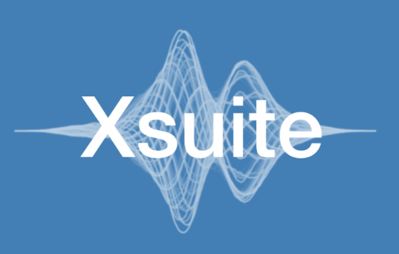

An Integrated Beam Physics Simulation Framework
G. Iadarola, R. De Maria, S. Łopaciuk,
A. Abramov, X. Buffat, D. Demetriadou, L. Deniau, P. Hermes, P. Kicsiny, P. Kruyt, A. Latina,
L. Mether, K. Paraschou, G. Sterbini, F. Van Der Veken, CERN, Geneva, Switzerland
P. Belanger, TRIUMF, Vancouver, Canada
D. Di Croce, T. Pieloni, L. Van Riesen-Haupt, M. Seidel, EPFL, Lausanne, Switzerland
P. Niedermayer, GSI, Darmstadt, Germany
Work supported by:
https://xsuite.web.cern.ch

Slide 2
Outline
Introduction
  Motivation
  Design goals and constraints
  Architecture
  Agile development
  Xsuite capabilities
Lattice modeling, simulation and optimization
  Lattice modeling
  Single-particle tracking
  Dynamic parameter control
  Multi-objective optimizer
  Synchrotron radiation
Who uses Xsuite and for which applications
Discontinuation of legacy tools (status)
Next steps

Slide 3
Outline
Introduction
  Motivation
  Design goals and constraints
  Architecture
  Agile development
  Xsuite capabilities
Lattice modeling, simulation and optimization
  Lattice modeling
  Single-particle tracking
  Dynamic parameter control
  Multi-objective optimizer
  Synchrotron radiation
Who uses Xsuite and for which applications
Discontinuation of legacy tools (status)
Next steps

Slide 4


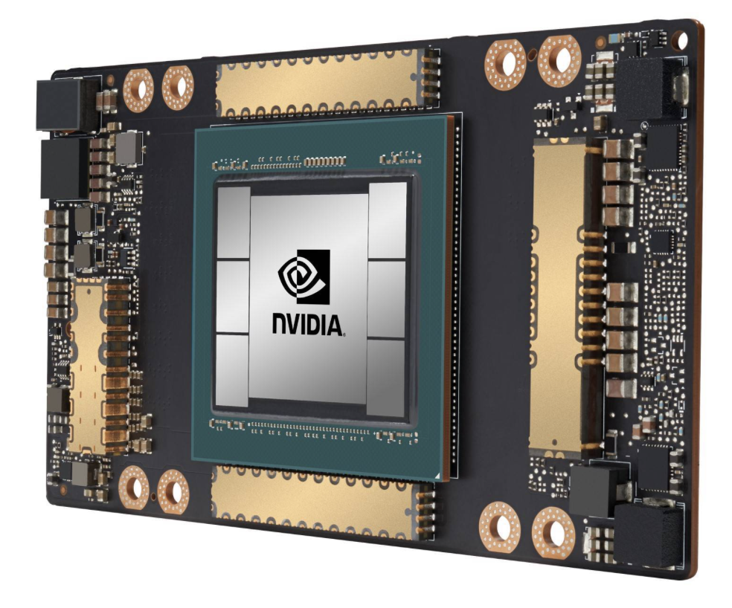
Motivation
Over the years in our simulations stuires we started to face needs that could not be easily fulfilled with our legacy tools (MAD-X, Sixtrack, COMBI etc).
Integration: difficult to combine features from different codes to simulate complex heterogeneous effects
User interface: need to move away from custom interfaces (text files / ad-hoc scripting) towards standard Python packages
  Present de-facto standard in scientific computing
  Easy to combine in notebooks and or in more complex Python codes
  Allows leveraging an ever-growing arsenal of general-purpose Python libraries (statistics, linear algebra, frequency analysis, optimization, plot, etc.)
    Boosted by substantial investments from general industry (big data, AI)
GPU acceleration: mandatory for several applications but cumbersome to retrofit in the existing codes
4

Slide 5
Xsuite
This led to the launch of the Xsuite project in 2021
Main goal: bring into a modern Python toolkit the know-how built in developing and exploiting MAD, Sixtrack, COMBI, PyHEADTAIL etc.,
Designed for seamless integration among the different components and for extensibility
Designed to support different computing platforms, including multicore CPUs and GPUs from different vendors
Design constraints:
Need to cover a large spectrum of phenomena and applications (flexibility!)
Need developer learning curve to be short as possible
  Features developed directly by field
Need to grow the code in a “sustainable” way, being managed and maintained by a small core team experts integrating (in a clean way!) contributions by a wide developer community
5

Slide 6


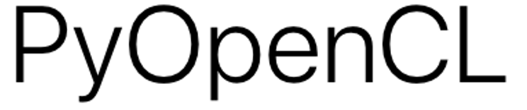



Xsuite – architecture
Xpart
generation of particles distributions
Xtrack
single particle
tracking engine
Xfields
computation of EM fields from particle ensembles
Xdeps
Dependency manager,
deferred expressions
Physics modules
Xcoll
Particle-matter interaction and collimation
Xobjects
interface to different computing plaforms
(CPUs and GPUs of different vendors)
Lower level libraries
(external, open source)
Hardware

Slide 7
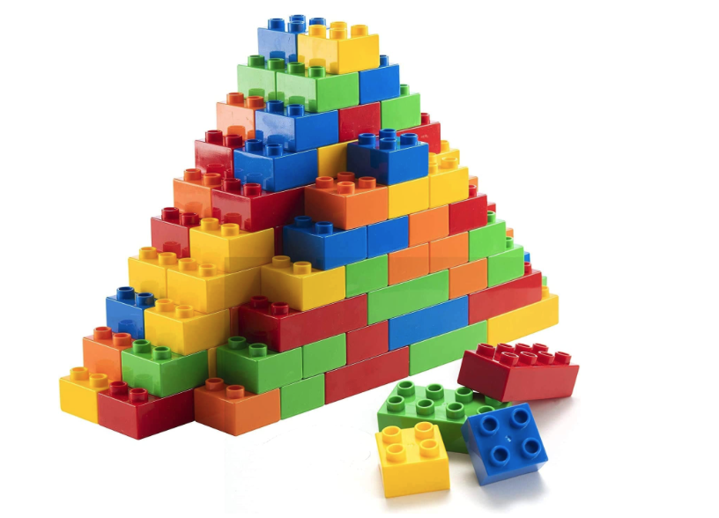
Orthogonal design
Project employs an “orthogonal” design strategy:
Ensure that each functional block remains well-isolated and interacts with the others through clearly defined interfaces
This approach has two key advantages:
  Enables contributors to modify or expand specific components without full knowledge of other parts nor of underlying software infrastructure
  Minimize codebase complexity, ensuring that it increases linearly rather than exponentially as new features are added
7

Slide 8
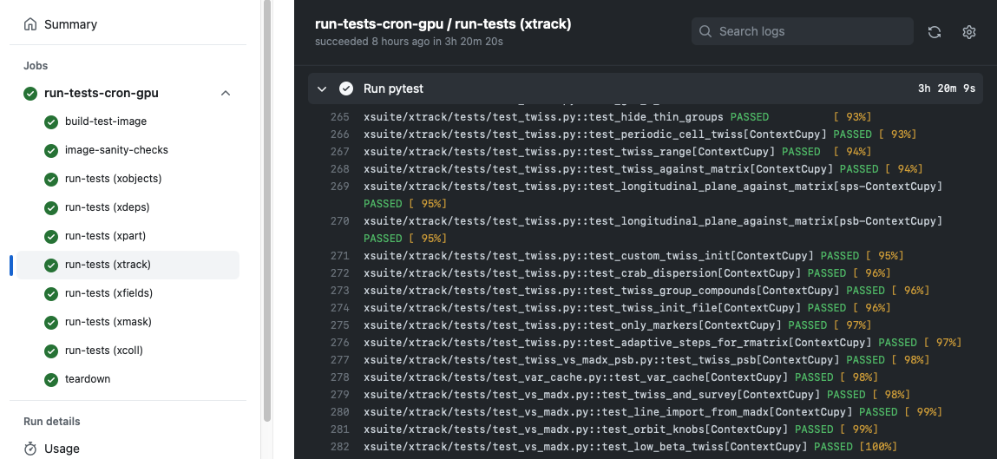
Agile development
Our development follows the agile principles:
Since early states we engaged with the user community, encouraging and supporting users to test and exploit available features in full-scale studies
Code evolves incrementally, promptly applying needed fixes and improvements
Rely on fast release cycle (new versions released multiple times per month) while ensuring no disruption due to version changes on the user’s side.
Made possible by large investment automatic testing: each version of Xsuite undergoing over a thousand automatic checks (on CPU and GPU)
8

Slide 9
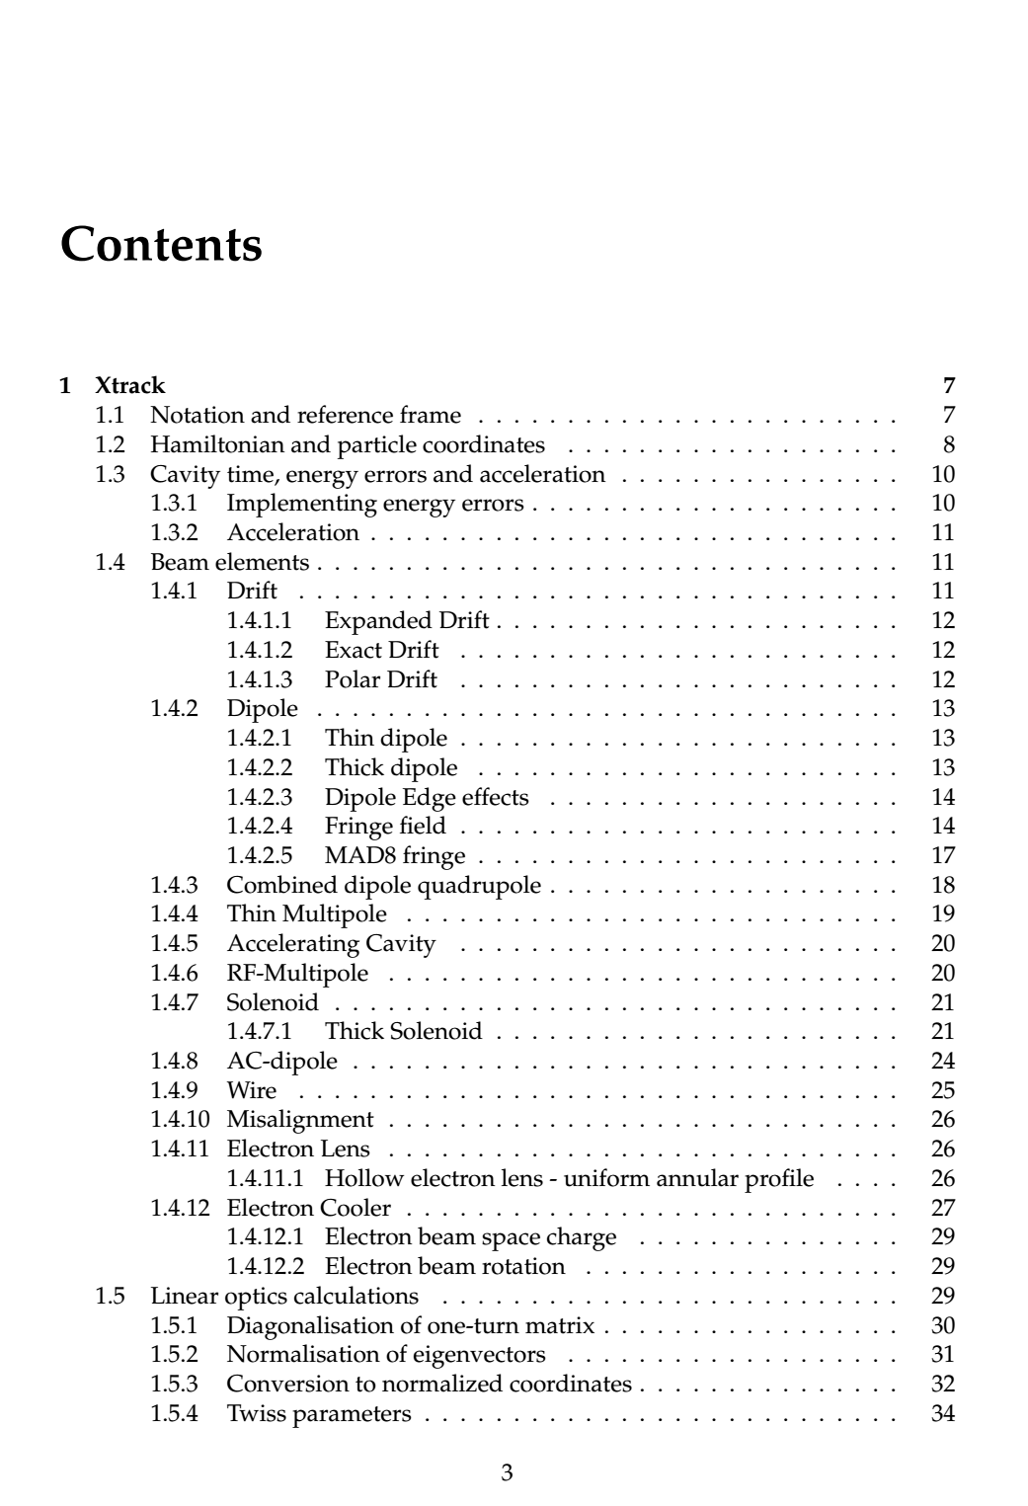
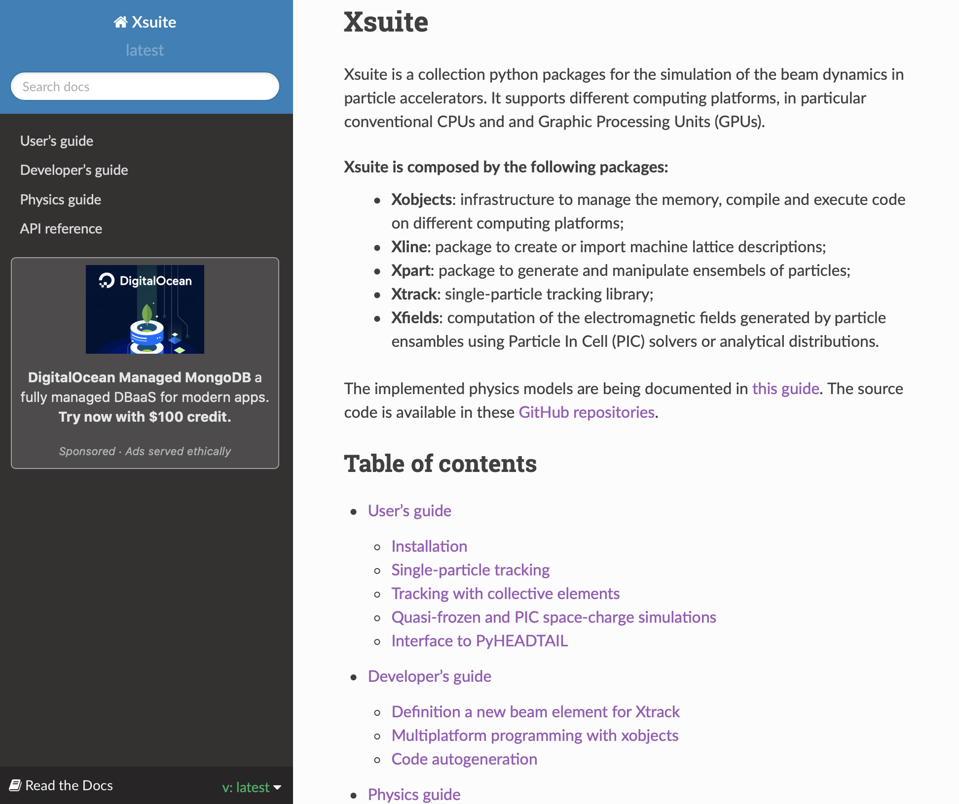
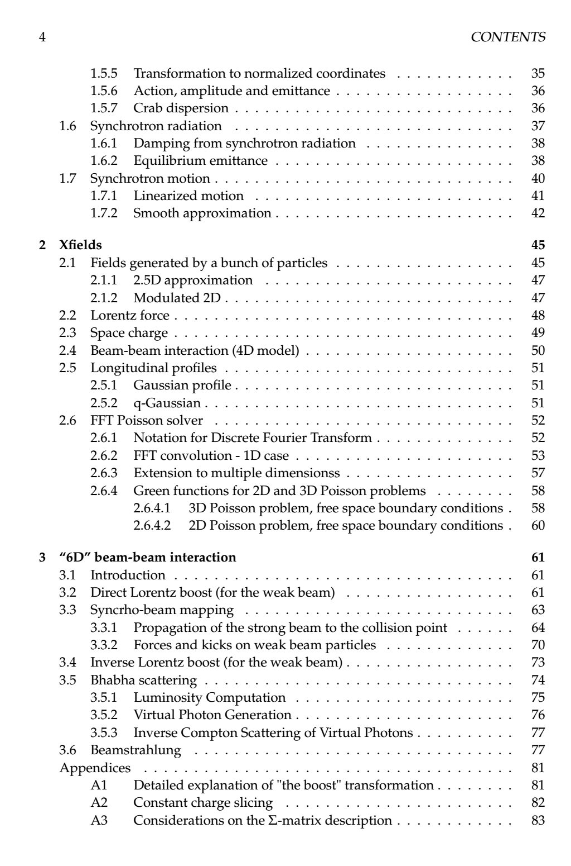
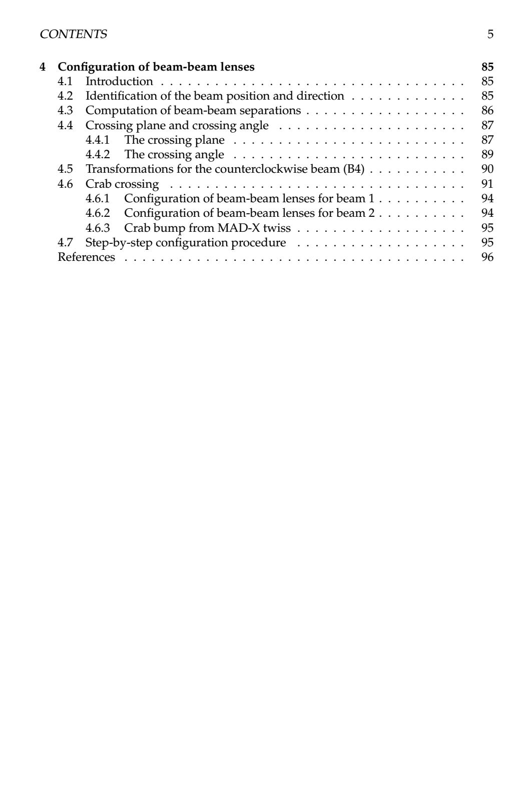
Documentation
Xsuite offers different complementary documentation sources:
User’s guide: describes how to install and use the code for different applications
Physics guide: described implemented physical models and numerical methods
Developer’s guide: provided information on code internals and describes how to add new features
Docstrings associated to each class and method, which are accessible directly in the Python interpreter or note- book and are collected in the Xsuite API reference.
User’s guide
(web)
Physics guide
(pdf, ~100 pages)
9

Slide 10
Xsuite capabilities (in one slide)
Covered in this presentation
Single-particle tracking
  Thin tracking (is our workhorse0
  Optionally thick bends and quads
  Dipole fringes
  Tilts, misalignments, field errors
Twiss computations (including coupling and chromatic effects)
Support for deferred expression and dynamic changes of element properties
Optimization tool (match orbit, optics, etc.)
Syncrotron radiation
  Tracking
  Damping and equilibrium emittance computation
  Energy loss compensation (Tapering + RF phasing)
Footprint/stability diagram/FMA
High-accuracy loss localization (aperture interp.)
Particle-matter interaction (Xcoll)
  Internal engine (Everest)
  Geant4/Fluka interfaces
Impedances and wakefields (PyHEADTAIL interf.)
Beam-beam
  4D and 6D
  Beamstrahlung and Bhabha
  Weak-strong and strong-strong (pipeline MPI parallelization)
  Automatic configuration tools (replacing large parts of the old “mask”)
Space-charge
  Frozen, quasi-frozen and PIC
  Automatic configuration tools (setup of beam sizes, grid steps etc.)
Incoherent e-cloud effects (basec on tricubic symplectic interpolation)

Slide 11
Outline
Introduction
  Motivation
  Design goals and constraints
  Architecture
  Agile development
  Xsuite capabilities
Lattice modeling, simulation and optimization
  Lattice modeling
  Single-particle tracking
  Dynamic parameter control
  Multi-objective optimizer
  Synchrotron radiation
Who uses Xsuite and for which applications
Discontinuation of legacy tools (status)
Next steps

Slide 12
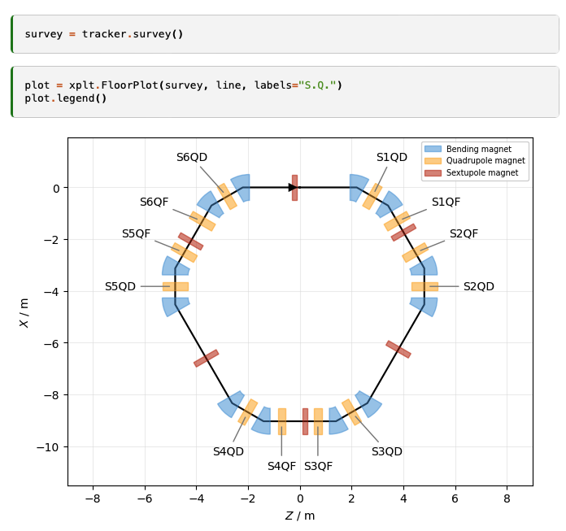
Lattice modelling
Xsuite model of a ring
(represented with the Xplt package)
The beam line is represented as a sequence of Python objects, each corresponding to an accelerator element or to other physical processes (e.g. magnets, cavities, aperture restrictions, etc.).
  Can be defined manually or imported from MAD-X
  Including tilts, misalignments and multipolar errors
We provide:
“Thin” lattice integration, largely based on the Sixtrack and Sixtracklib experience
“Thick” maps for bending and quadrupole magnets are also available:
  For bends, we provide a “full” map (appropriate for small rings), and an “expanded” map (for large rings and small bending angles).
Dipole edge effects including fringe fields can be modeled either in their linearized form or as full non-linear maps (same fringe model as in MAD-NG and PTC).
12

Slide 13
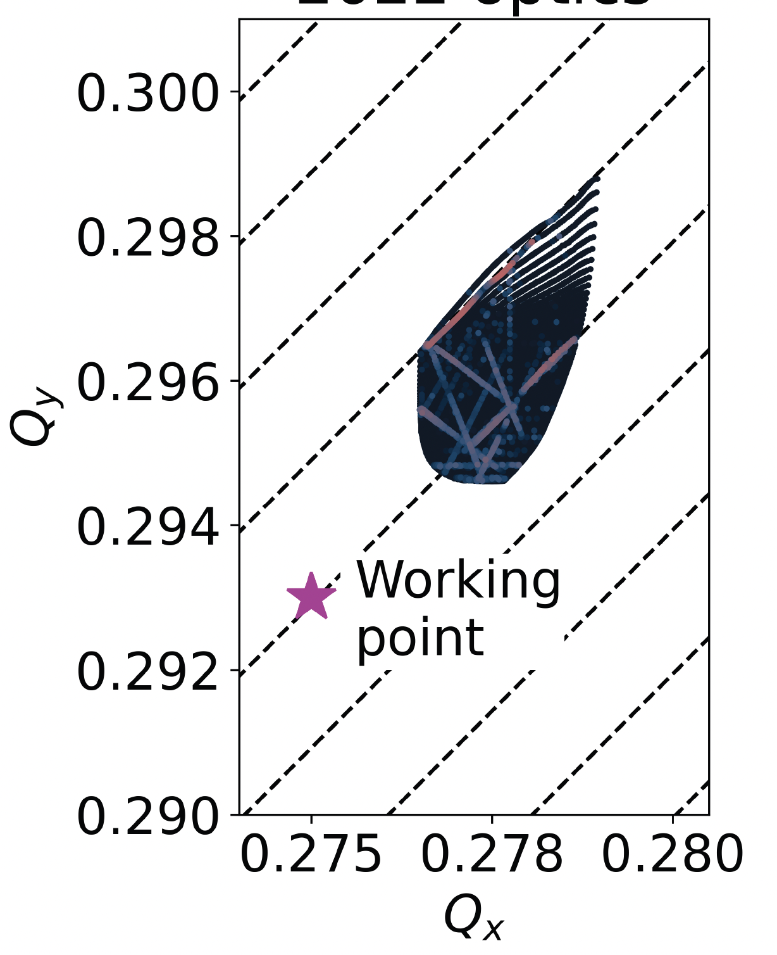
Single particle tracking
To speed up tracking simulations, Xsuite assembles and compiles a C kernel (callable from Python) optimized for the given beamline and specialized for the chosen platform (CPU or GPU)
  The tra cking speed is found to be similar to Sixtrack for single-core CPU and about two orders of magnitudes faster than that on high-end GPUs
  Developments are well advanced to deploy Xsuite on the LHC@Home volunteer computing platform
FMA produced with Xsuite
Tracking time for a typical LHC simulation
Platform | Computing time
CPU (single core) | 190 (μs/part./turn)
GPU (NVIDIA V100, cupy) | 0.80 (μs/part./turn)
GPU (NVIDIA V100 pyopencl) | 0.85 (μs/part./turn)
13

Slide 14
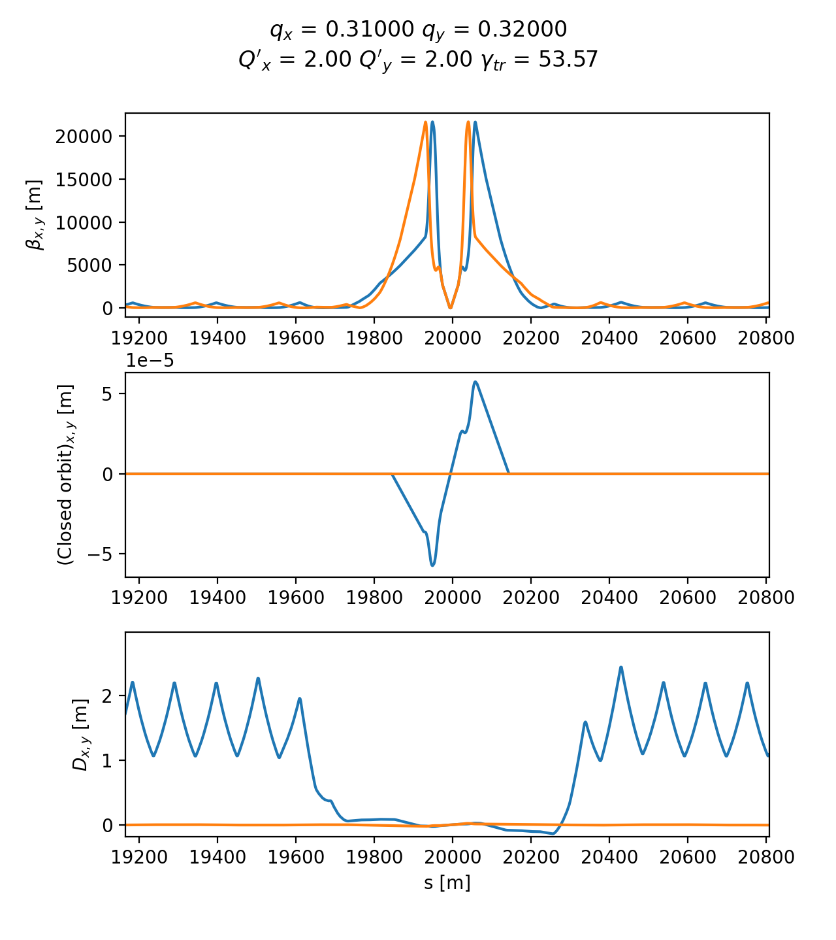
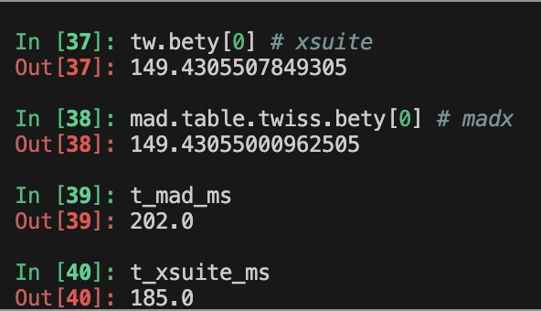
Twiss module
The Xsuite Twiss module can be used to extract lattice functions of a ring or a beamline
The calculation probes the lattice simply by tracking particles:
  Closed orbit obtained by applying a Python root finder on the tracking
  The Jacobian matrix obtained by tracking (central differences)
  Compute “Linear Normal Form” of the Jacobian matrix (diagonalization)
  Propagate eigenvectors by tracking
  Obtain from the eigenvectors Twiss parameters (𝛼, 𝛽, 𝛾) , dispersion functions, phase advances, coupling coefficients
Computation can be done with assigned beam momentum to get off-momentum beta-beating, non-linear chromaticity etc.
HL-LHC optics
Accuracy compared to MAD-X: Δβ / β << 10⁻³
Computation time is very similar
14
Example

Slide 15
Twiss module
Computation of Twiss parameters based on the tracking has two main advantages:
Any physical model included in the tracking is automatically usable in Twiss
  Without additional development effort
Twiss becomes a powerful diagnostics tool on the built tracking model
  Allows measuring directly on the tracking model tunes, chromaticities, closed orbit, beta functions, etc.
  Can be done effortlessly and without exporting or manipulating the model.
  Used daily to for validating simulation models, catching mistakes, investigating issues
Accuracy compared to MAD-X: Δβ / β << 10⁻³
Computation time is very similar
15

Slide 16
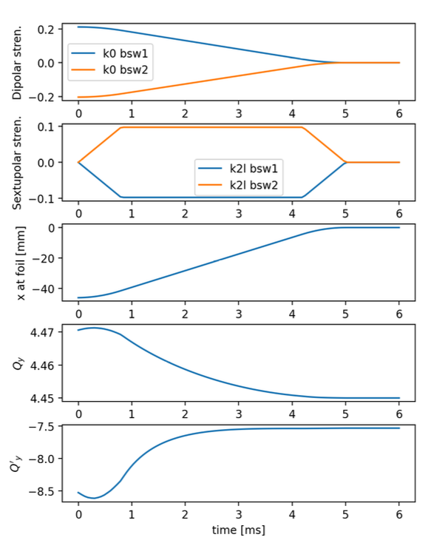
Dynamic control of beam line parameters
Simulation of a fast orbit bump used for the H⁻ injection into the CERN PS Booster
In accelerators often a single high-level parameter can be used to control groups of components with complex dependency relations. (e.g. magnets in series, groups of RF cavities, etc.)
The Xdeps module provides the capability to include such dependencies in the simulation model (as done by MAD-X deferred expressions)
Example, LHC crossing angle knob:
  At any time, the user can set:
lhc.vars[’on_x1’] = 160 # murad
  which automatically changes the strength of 40 dipole correctors to get the required crossing angle
User can also use “Time functions”, i.e. time dependent knobs that are updated automatically during the simulation
For more details: S. Lopaciuk, THBP32
16

Slide 17
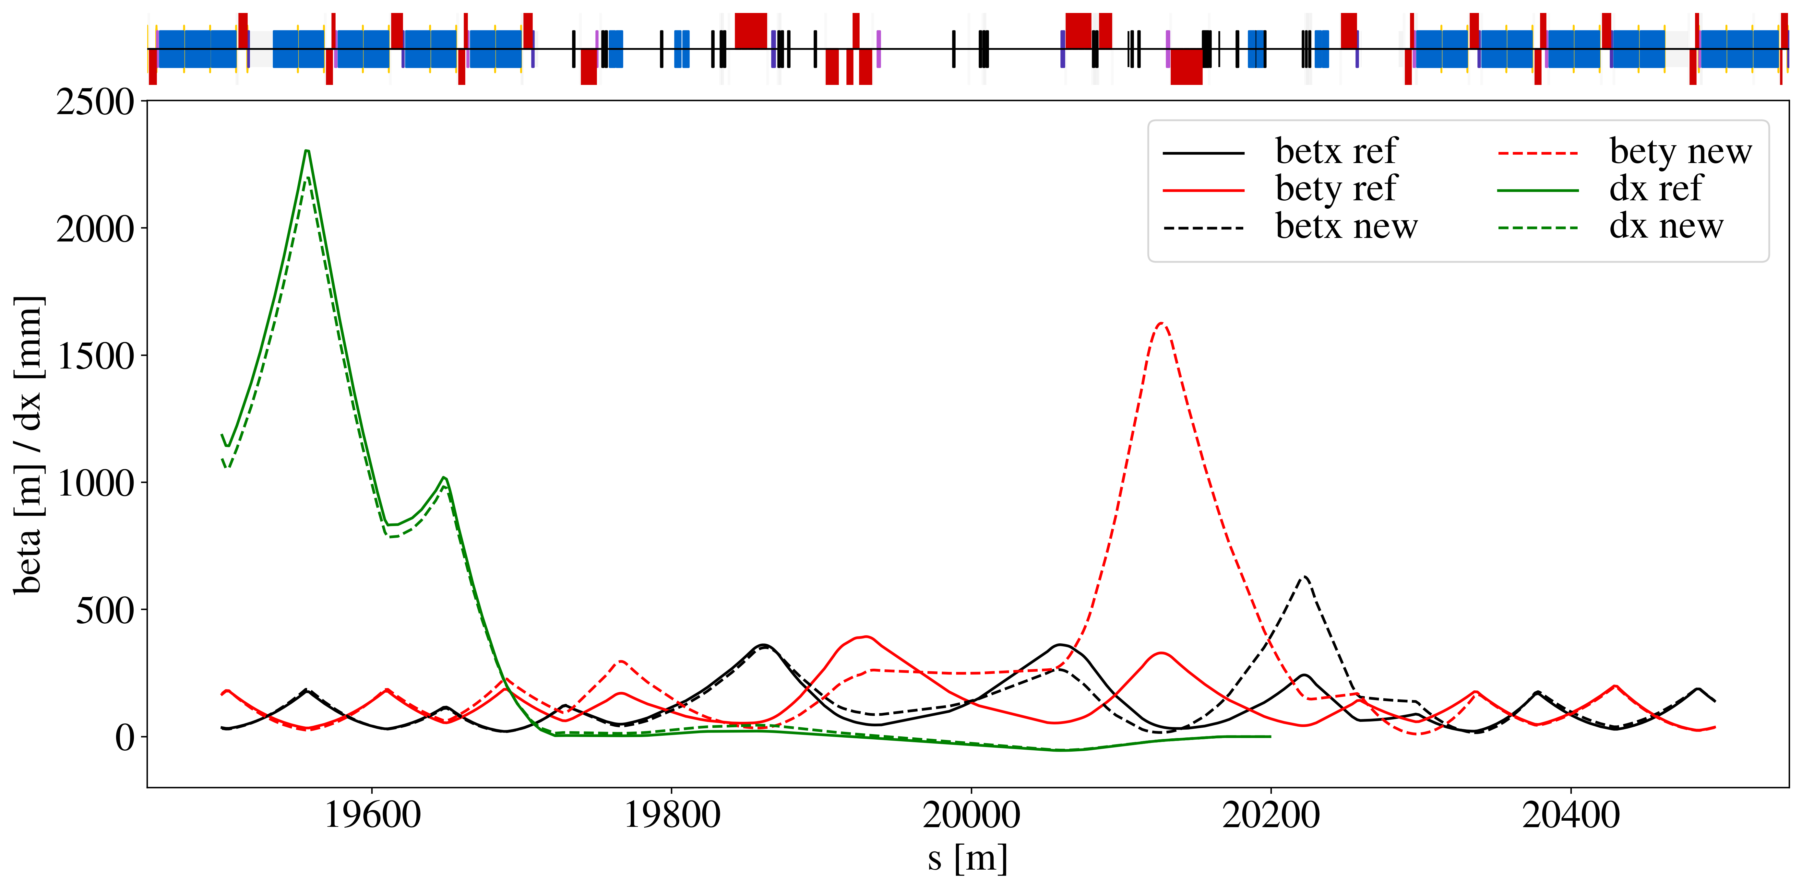
Optimizer
Xsuite provides a multi-objective optimizer to "match" model parameters to assigned constraints (e.g. control tunes, chromaticity, build orbit bumps, modify the optics)
Based on the extensive experience of MAD-X → Uses the same optimization algorithm (Jacobian, proven robustness)
The optimizer can be used to synthesize knobs
Optimizations can involve targets and knobs from multiple beam lines (colliders)
Interface designed for usage flexibility. User can intervene in the optimization by:
  Enabling/disabling targets or knobs
  Rolling back optimization steps
  Changing knob limits, target values, convergence tolerances
Optimized optics for the LHC collimation area (designed with Xsuite)
Used for optics matching of the LHC and of FCC-ee colliders
Proved capability of handling large problems with several constraints and degrees of freedom.
From B. Lindstrom, HB2023, TUC4C2
17

Slide 18
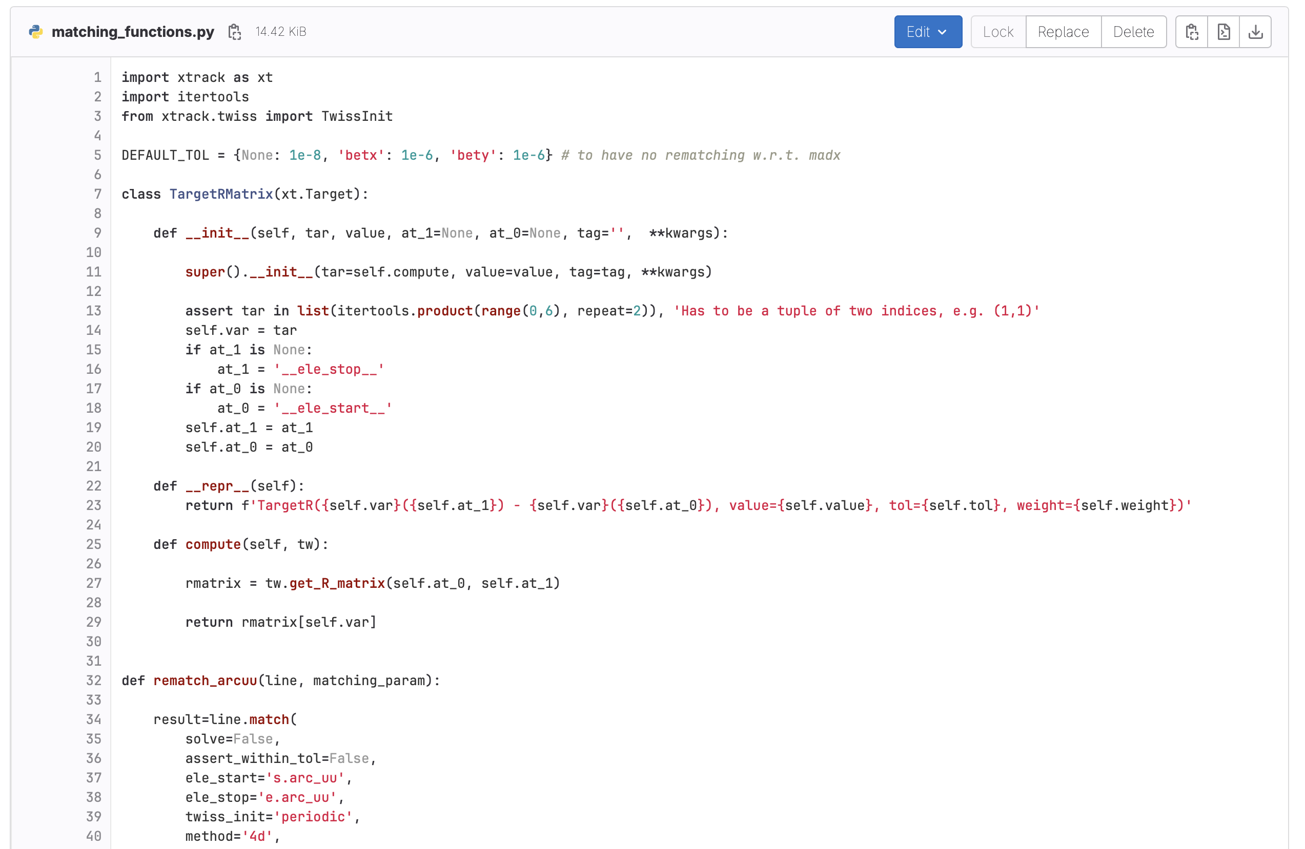
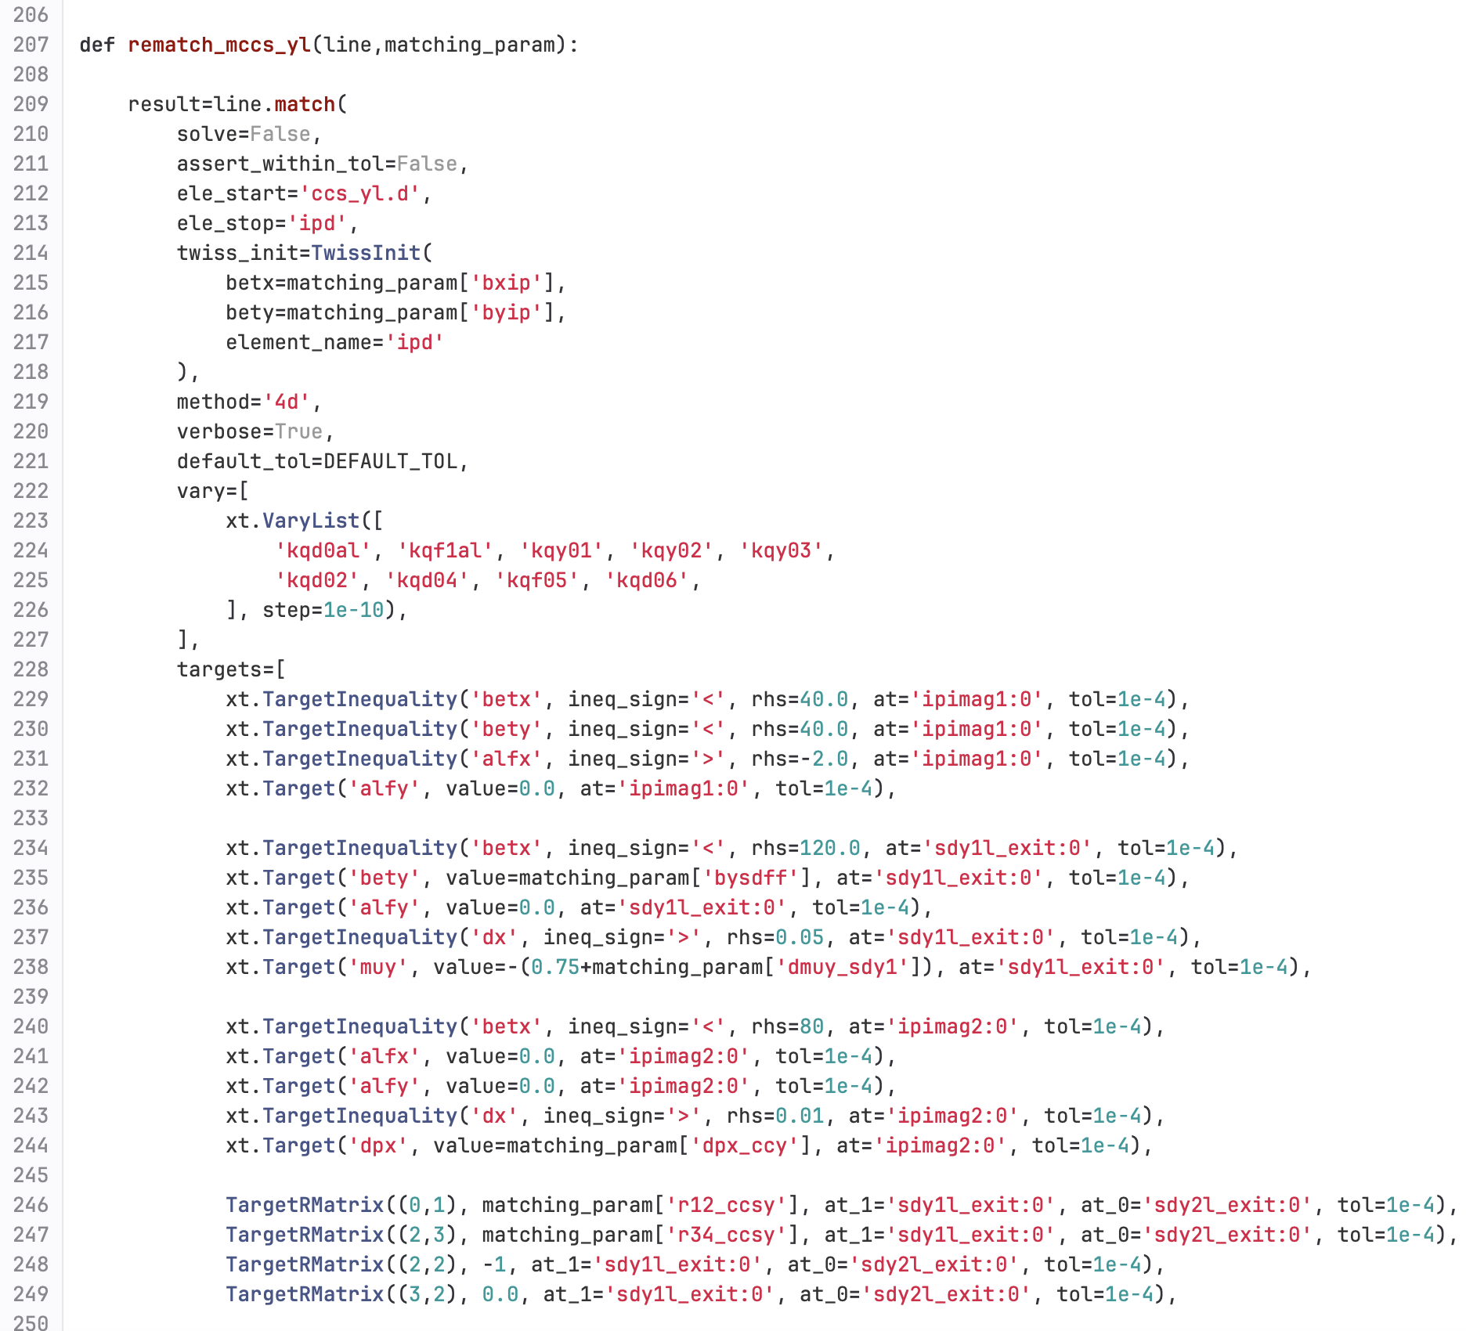
Optimizer
Xsuite provides a multi-objective optimizer to "match" model parameters to assigned constraints (e.g. control tunes, chromaticity, build orbit bumps, modify the optics)
Based on the extensive experience of MAD-X → Uses the same optimization algorithm (Jacobian, proven robustness)
The optimizer can be used to synthesize knobs
Optimizations can involve targets and knobs from multiple beam lines (colliders)
Interface designed for usage flexibility. User can intervene in the optimization by:
  Enabling/disabling targets or knobs
  Rolling back optimization steps
  Changing knob limits, target values, convergence tolerances
Full optics desing for FCC-ee HFD lattice ported to Xsuite (from MAD8)
https://gitlab.cern.ch/mihofer/xample_hfd_matching
Used for optics matching of the LHC and of FCC-ee colliders
Proved capability of handling large problems with several constraints and degrees of freedom.
M. Hofer
18

Slide 19
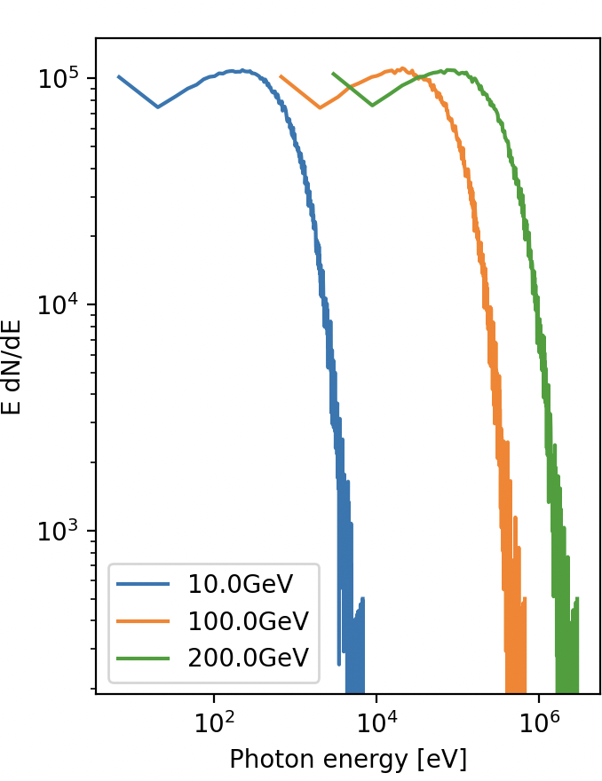
Synchrotron radiation
The effect of synchrotron radiation can be included in Xsuite tracking simulations. Two models available:
The “mean” model, for which the energy loss from the radiation is applied particle by particle without accounting for quantum fluctuations;
The “quantum” model for which the actual photon emission is simulated⁽¹⁾.
Photon energy spectrum
Plots courtesy Leon Van Riesen-Haupt, EPFL
⁽¹⁾ Based on H. Burkhardt, “Monte Carlo generator for synchrotron radiation”, 1990. Implementation ported from PLACET (A. Latina)
⁽²⁾ E. Forest, From tracking code to analysis: generalised Courant-Snyder theory for any accelerator model. Springer, 2016
19

Slide 20
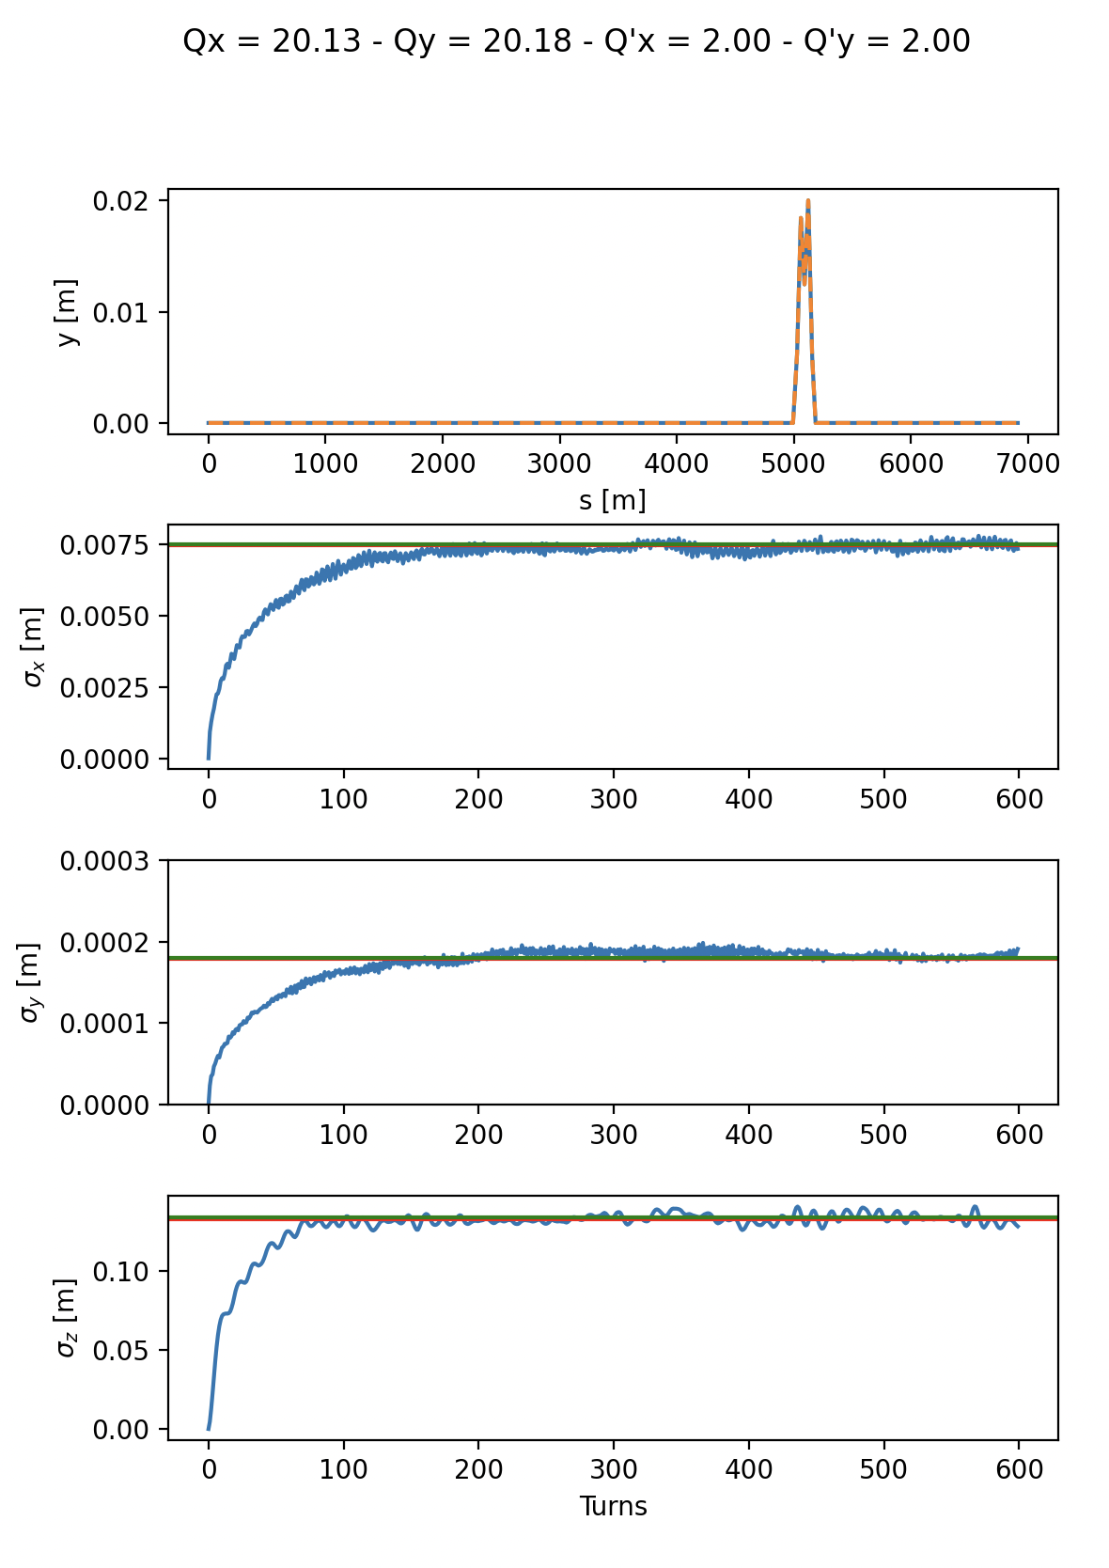
Synchrotron radiation
Equilibrium emittance (twiss vs track)
The effect of synchrotron radiation can be included in Xsuite tracking simulations. Two models available:
The “mean” model, for which the energy loss from the radiation is applied particle by particle without accounting for quantum fluctuations;
The “quantum” model for which the actual photon emission is simulated⁽¹⁾.
The Xsuite Twiss also includes:
Dedicated algorithm for non-symplectic one-turn map⁽²⁾
Computation of radiation energy loss, damping times and equilibrium emittances
An automatic tool is provided for phasing the RF cavities and adjusting magnet strengths to compensate the radiation energy loss (“tapering”)
Twiss (fast)
Twiss (full)
Tracking (300 particles)
⁽¹⁾ Based on H. Burkhardt, “Monte Carlo generator for synchrotron radiation”, 1990. Implementation ported from PLACET (A. Latina)
⁽²⁾ E. Forest, From tracking code to analysis: generalised Courant-Snyder theory for any accelerator model. Springer, 2016
20

Slide 21
Outline
Introduction
  Motivation
  Design goals and constraints
  Architecture
  Agile development
  Xsuite capabilities
Lattice modeling, simulation and optimization
  Lattice modeling
  Single-particle tracking
  Dynamic parameter control
  Multi-objective optimizer
  Synchrotron radiation
Who uses Xsuite and for which applications
Discontinuation of legacy tools (status)
Next steps

Slide 22
Who uses Xsuite and for which applications?
[Activities that are already in production, or for which testing work is ongoing]
LHC and HL-LHC
Tracking for DA - lattice only (M. Le Garrec, E. Maclean, C. E. Montanari , T. Pugnat, D. Veres)
Crab-cavity noise studies(A. Fornara, Uni. Manchester)
Beam-beam weak-strong (G. Sterbini, S. Kostoglou, C. Droin, E. Lamb, D. Christie Uni. Manchester)
Beam-beam strong-strong (X. Buffat)
Wire compensation studies (P. Belanger, D. Kalchev TRIUMF)
Collimation studies (F. Van Der Veken, N. Triantafillou, B. Lindstrom, M. D’Andrea, P. Hermes)
Optics/orbit matching, including RDT matching (B. Lindstrom, K. Paraschou, C. Droin, S. Kostoglou, Y. Angelis)
Non-linear corrections calculation (J. Dilly)
Hollow e-lens studies (P. Hermes + students)
Incoherent e-cloud effects (K. Paraschou)
Beam instrumentation studies (D. Alves, K. Lasocha, SY-BI)
Injector complex (PSB, PS, SPS, LEAR, AD, ELENA)
Space-charge studies (F. Asvesta, T. Prebibaj)
Cooling studies (D. Gamba, P. Kruyt)
Instabilities with wakes and space-charge (X. Buffat)
Slow extraction studies at PS and SPS (P. Arrutia Sota, T. Bass, F. Velotti, SY-ABT)
Ion studies (E. Waagaard)
Beam transfer simulations (F. Velotti, SY-ABT)
MTE simulations, optics+tracking (A. Huschauer, starting)
Light sources (Petra IV, Elettra, Bessy III)
Tracking and DA
FCC
FCC-ee optics matching, tapering + RF phasing (M. Hofer, J. Keintzel, P. Kicsiny (L. Van Riesen-Haupt)
FCC-ee DA studies (M. Hofer, L. Van Riesen-Haupt, EPFL)
FCC-ee and FCC-hh beam-beam -SS&WS (P. Kicsiny, D. Di Croce, EPFL)
Beamstrahlung, Bhabha (FCC-hh beam beam studies (P. Kicsiny)
FCC-ee and FCC-hh collimation studies (A. Abramov, G. Broggi)
FCC-ee vibration studies (J.P. Salvesen, M.Hofer, LAPP Annecy collab.)
Compton scattering studies (A. Abramov, I. Debrot, M. Hofer)
Collective effects (M. Migliorati, A. Ghribi - Uni Sapienza, A. Rajabi – Desy)
GSI/FAIR
Space-charge simulations (A. Oeftiger and team)
Slow extraction simulations - SIS18 and SIS100 (P. Niedermayer, C. Cortes)
BTF studies (C. Cortes)
Medical accelerators
Slow-extraction for PIMMS (R. Tailor)
Slow-extraction for MedAustron (F. Kuehteubl, E. Renner, et al.)
BNL - RHIC and EIC
Optics calculations and tracking
Collimation studies
Fermilab – Main Injector, Recycler, IOTA
Tracking studies
Impedance + space-charge simulations
Training (Universiy of Rome and EPFL)

Slide 23
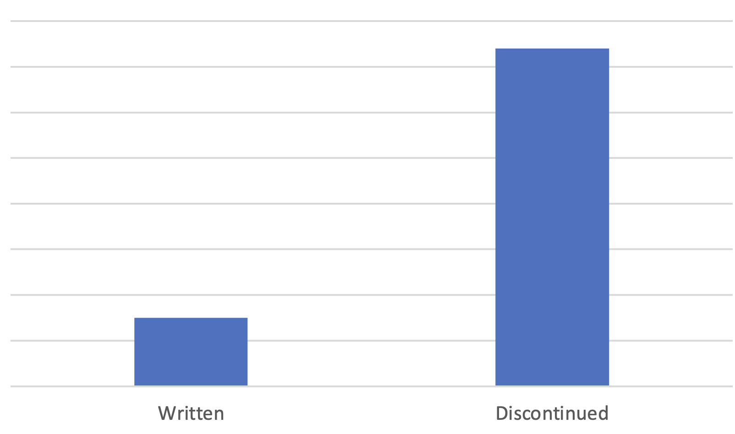
Discontinuation of legacy tools
In 2022-23 we have essentially discontinued the development and, to a very large extent, the usage of the following tools:
  Sixtrack
  Sixdesk
  Sixtracklib
  COMBI
  PySSD
  DistLib
This led to a massive simplification of our code base.
Lines of code
370k
75k
Written
(Xsuite)
Discontinued
(Legacy tools)

Slide 24
Some numbers and next steps
Core team | 3 persons
Contributing developers | 15 persons
User community | ~80 users
Publications including Xsuite simulations (in 2022-23): | 25 papers
Some numbers:
What next:
Most importantly (and this is a quite some work!): user support, fixes and improvements based on user feedback, keep good quality documentation and testing
Additional features (coming in 2023-24):
  Handling energy ramp functions
  Faster reload of deferred expressions (cython)
  Implementation of chromatic “W functions” in twiss
  Native implementation of wakefields (with MPI parallelization)
  RFTrack interface for tracking in fieldmaps
  Intra-beam scattering model
  Approximated 2D PIC (a la pyorbit, good compromise accuracy/speed)
  Strong-strong beam-beam with PIC
24

Slide 25
Thanks for your attention!
25

