Slide 1
Experiment Overview: sPHENIX
Christof Roland / MIT
For the sPHENIX Collaboration

Slide 2
sPHENIX highlights in three acts
The sPHENIX Experiment
  Mission and Goals
Commissioning for Physics
  Remeasuring Standard Candles
  First Physics Publications
A new quality of data
  First results of the pp run
  Progress towards physics goals

Slide 3
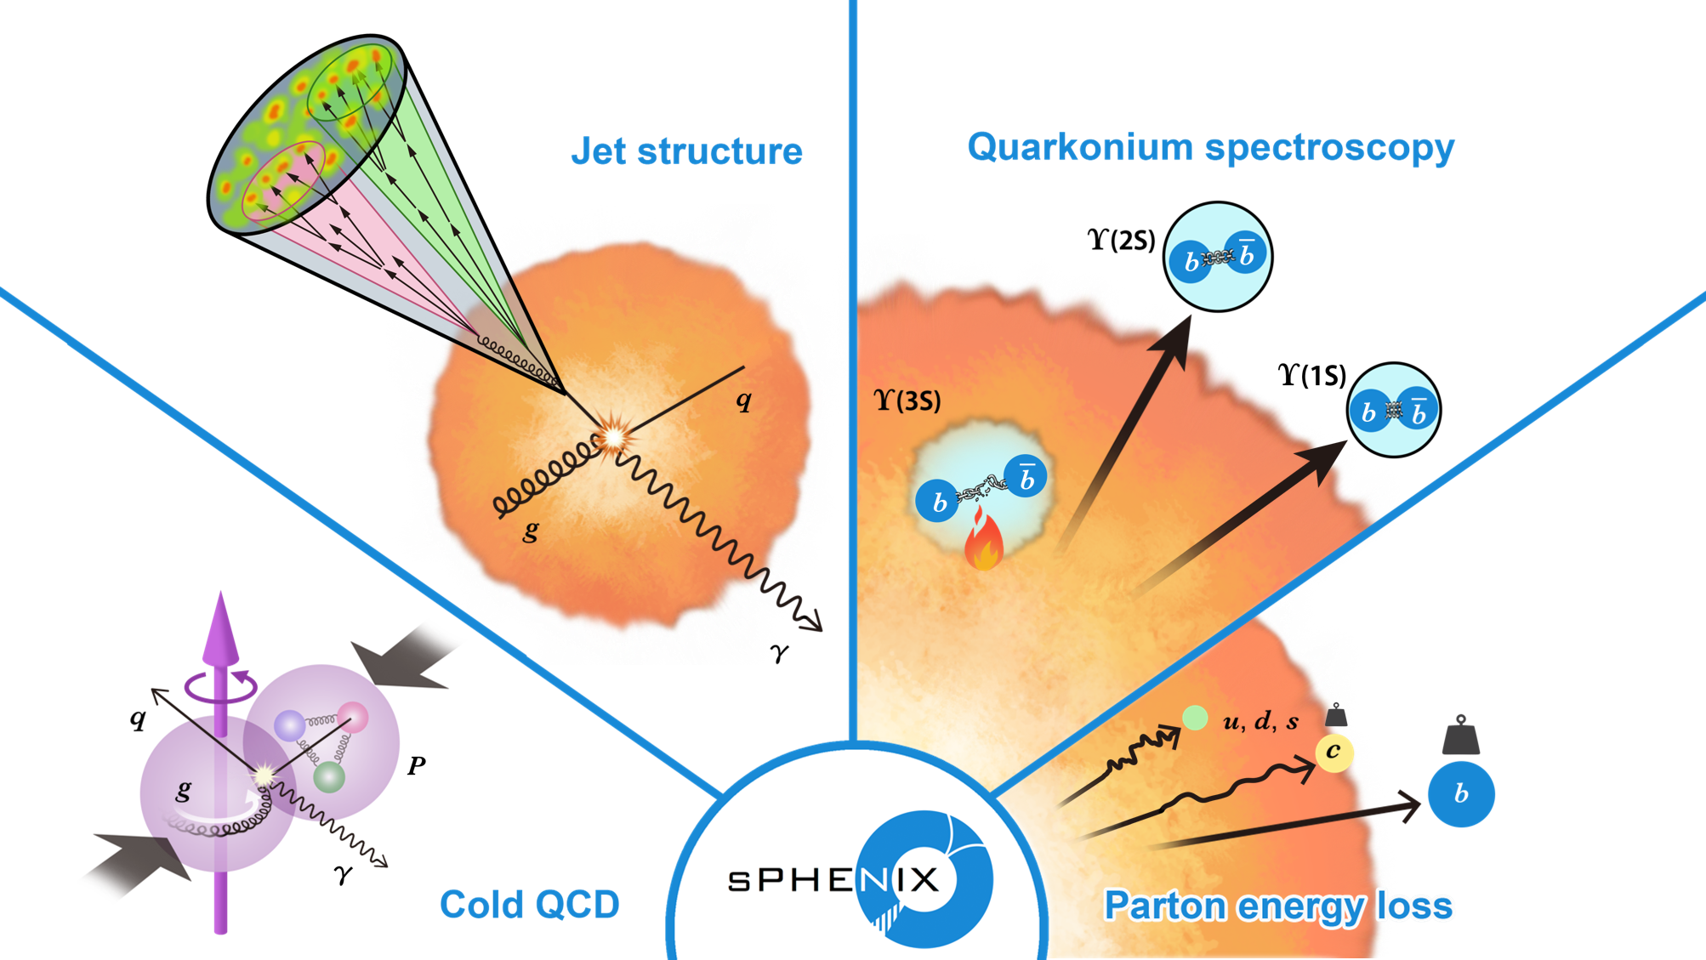
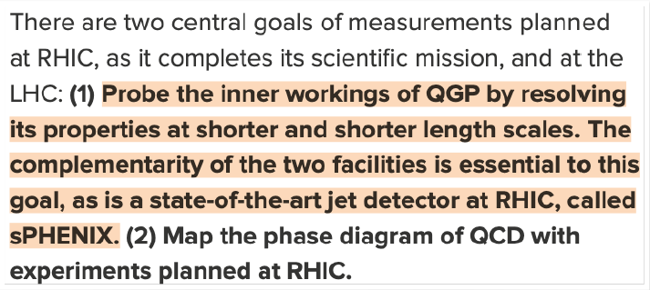
The sPHENIX Mission
The Science Pillars of sPHENIX
2015 US NP LRP

Slide 4
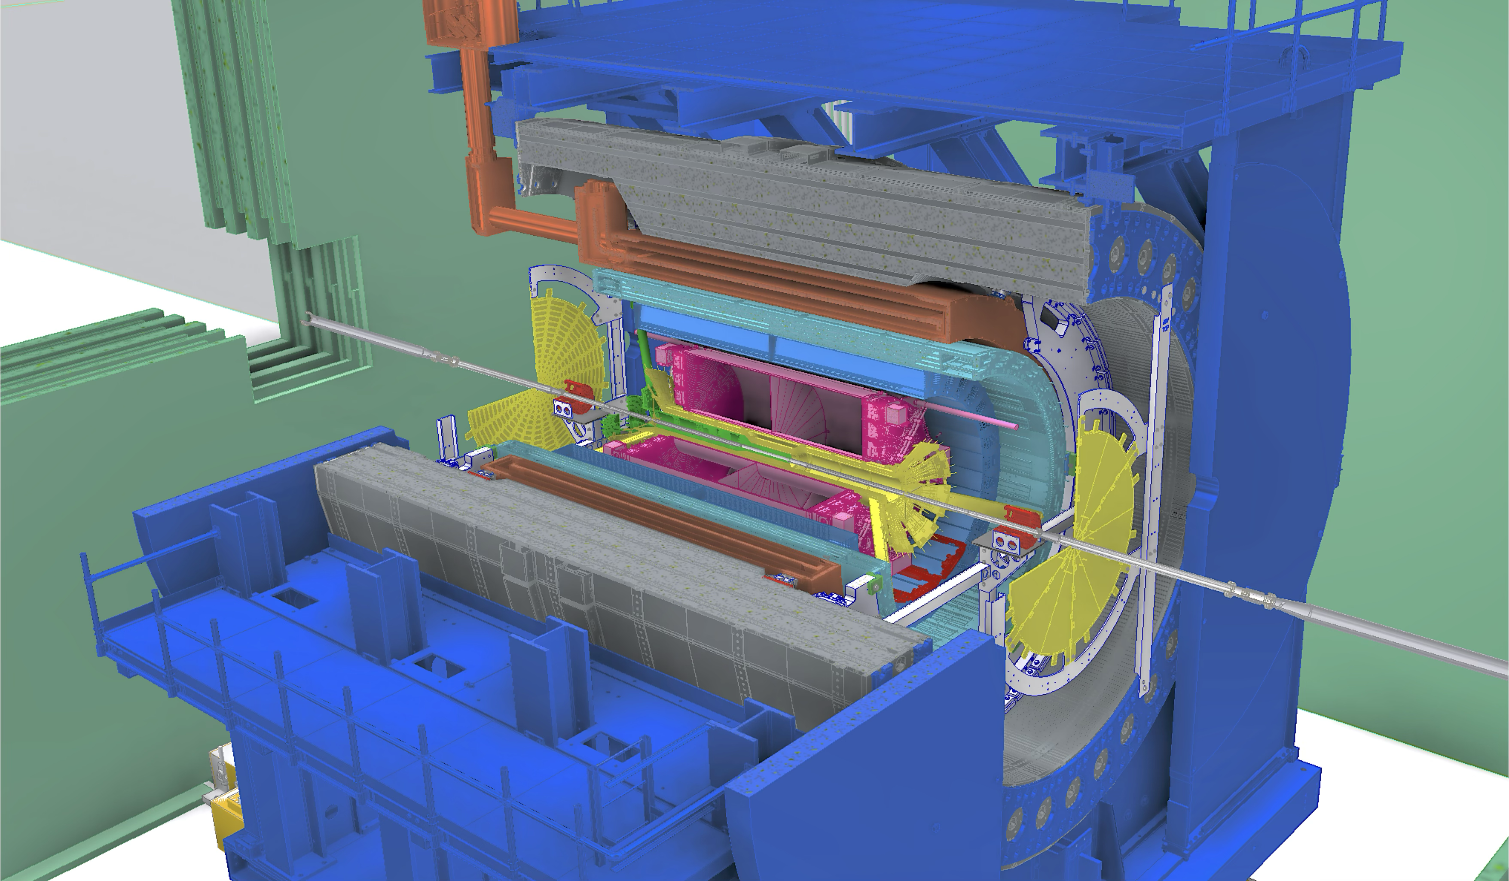
The sPHENIX Detector
1.4T MAGNET
Outer HCAL
MVTX
MAPS,Precision vertexing
Inner HCAL
INTT
SiStrips, bx resolution
EM CAL
TPC
GEM based, momentum+dE/dx
Hermetic EM + HCAL
Coverage in |η|<1.1
TPOT
TPC calibration
All Tracking detectors capable
of streaming readout
sEPD
Event Plane
MBD
Min.Bias + Vertex

Slide 5
The sPHENIX Detector
1.4T MAGNET
Outer HCAL
MVTX
MAPS,Precision vertexing
Inner HCAL
INTT
SiStrips, bx resolution
EM CAL
TPC
GEM based, momentum+dE/dx
TPOT
TPC calibration
High DAQ rate 15 kHz
Trigger system - jets and photons
Extended readout tracking detectors allows to sample unbiased pp collisions at ~200kHz
sEPD
Event Plane
MBD
Min.Bias + Vertex

Slide 6
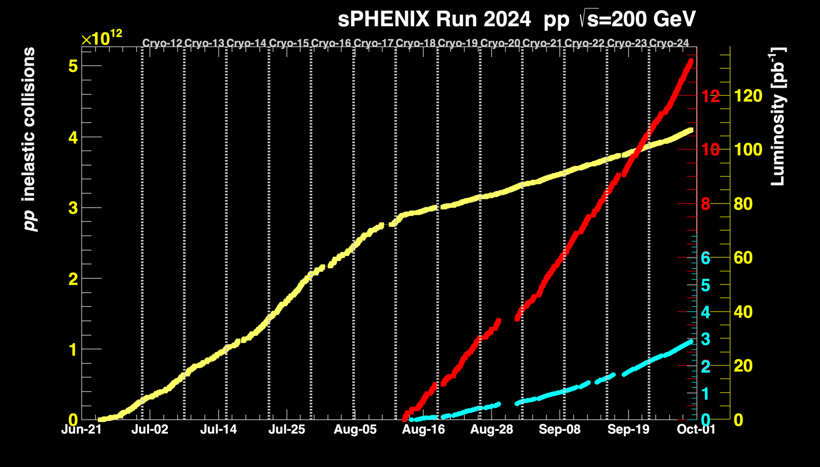
sPHENIX Timeline and Data Taking
2023
  Calorimeter data: 107.4 pb⁻¹
  Triggered data full detector: 13.28 pb⁻¹
  Tracker Streaming Data: 2.9pb⁻¹
Detector installation
completed
Au+Au Commissioning run
Cut short by accelerator
incident
2024
p+p production run
Finalize commissioning
of tracking detectors
Short Au+Au run
2025
Au+Au production run
Target Luminosity 7nb⁻¹

Slide 7
sPHENIX Projections: Physics Objects
sPHENIX Beam Use Proposal
Yield / 2.5 GeV
R_{AA}
p_{T} [GeV]
p_{T} [GeV]
Goal: overlapping parton kinematics with LHC measurements

Slide 8
sPHENIX Projections: Au+Au Physics
Photon - Jet p_{T} balance
sPHENIX Beam Use Proposal
(1/N_{γ})/(dN/dx_{Jγ})
Photon+Jet x_{Jγ}
Defined parton kinematics and flavor for parton energy loss studies
Notes:
With the target luminosity, sPHENIX can measure the modifications in detail

Slide 9
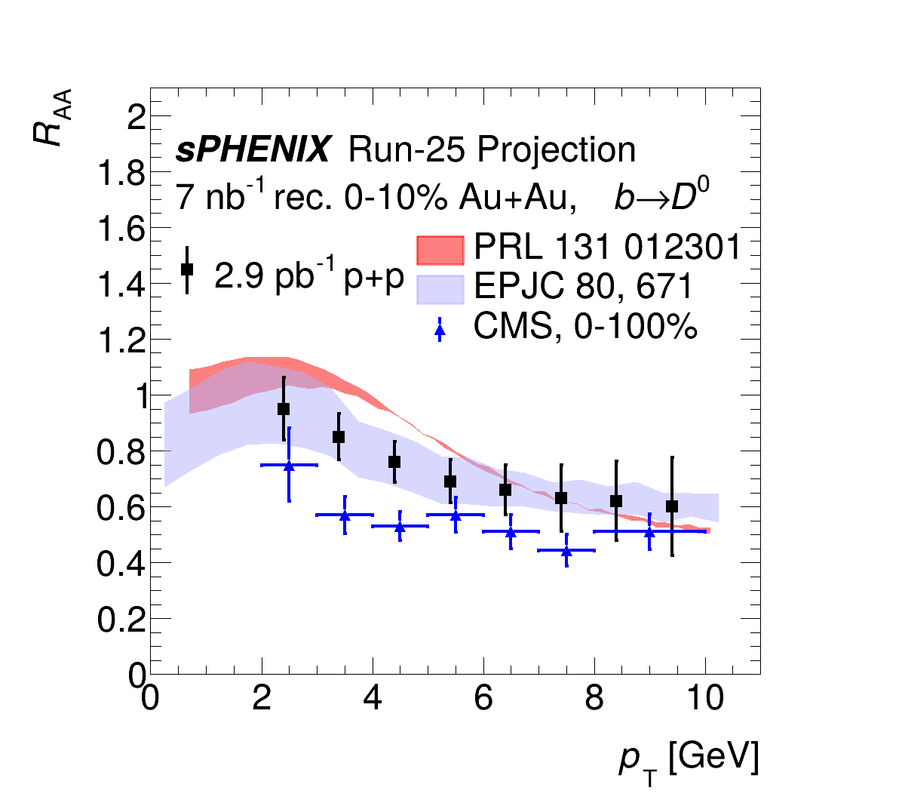
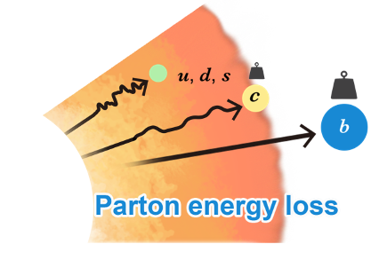
sPHENIX Projections: Au+Au Physics
sPHENIX Beam Use Proposal
R_{AA} of non-prompt b → D⁰’s
R_{AA}
p_{T} [GeV]
Constrains heavy quark diffusion coefficients
Notes:
With the target luminosity, sPHENIX can measure the modifications in detail

Slide 10
sPHENIX highlights in three acts
The sPHENIX Experiment
  Mission and Goals
Commissioning for Physics
  Remeasuring Standard Candles
  First Physics Publications
A new quality of data
  First results of the pp run
  Progress towards physics goals

Slide 11

Bulk Observables: Au+Au dN_{ch}/dη
Run 24 Au+Au
Paper
Also see
Presentation:
H.-R. Jheng
4/10/25, 9:40am
Poster:
Jaein Hwang
arXiv:2504.02240
dN_{ch}/dη
Pseudorapidity η
N_{part}
Charged particle multiplicity traces total entropy production
Exhibits characteristic energy independent N participant dependence

Slide 12
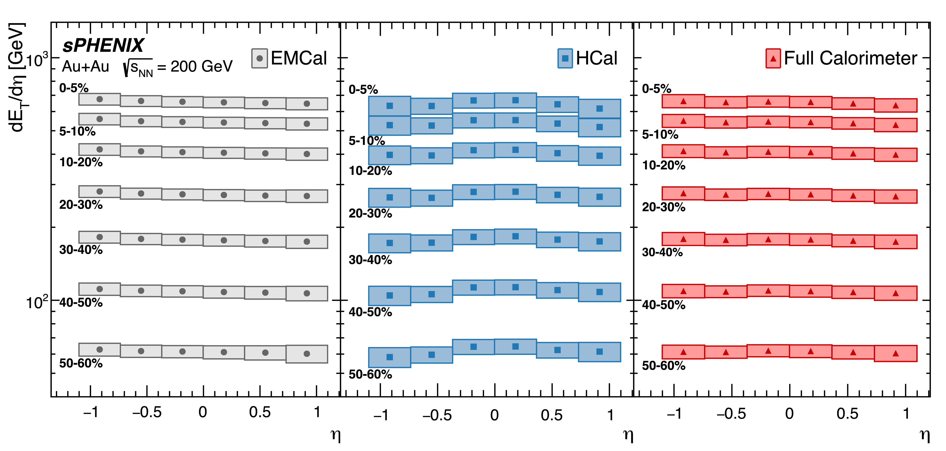
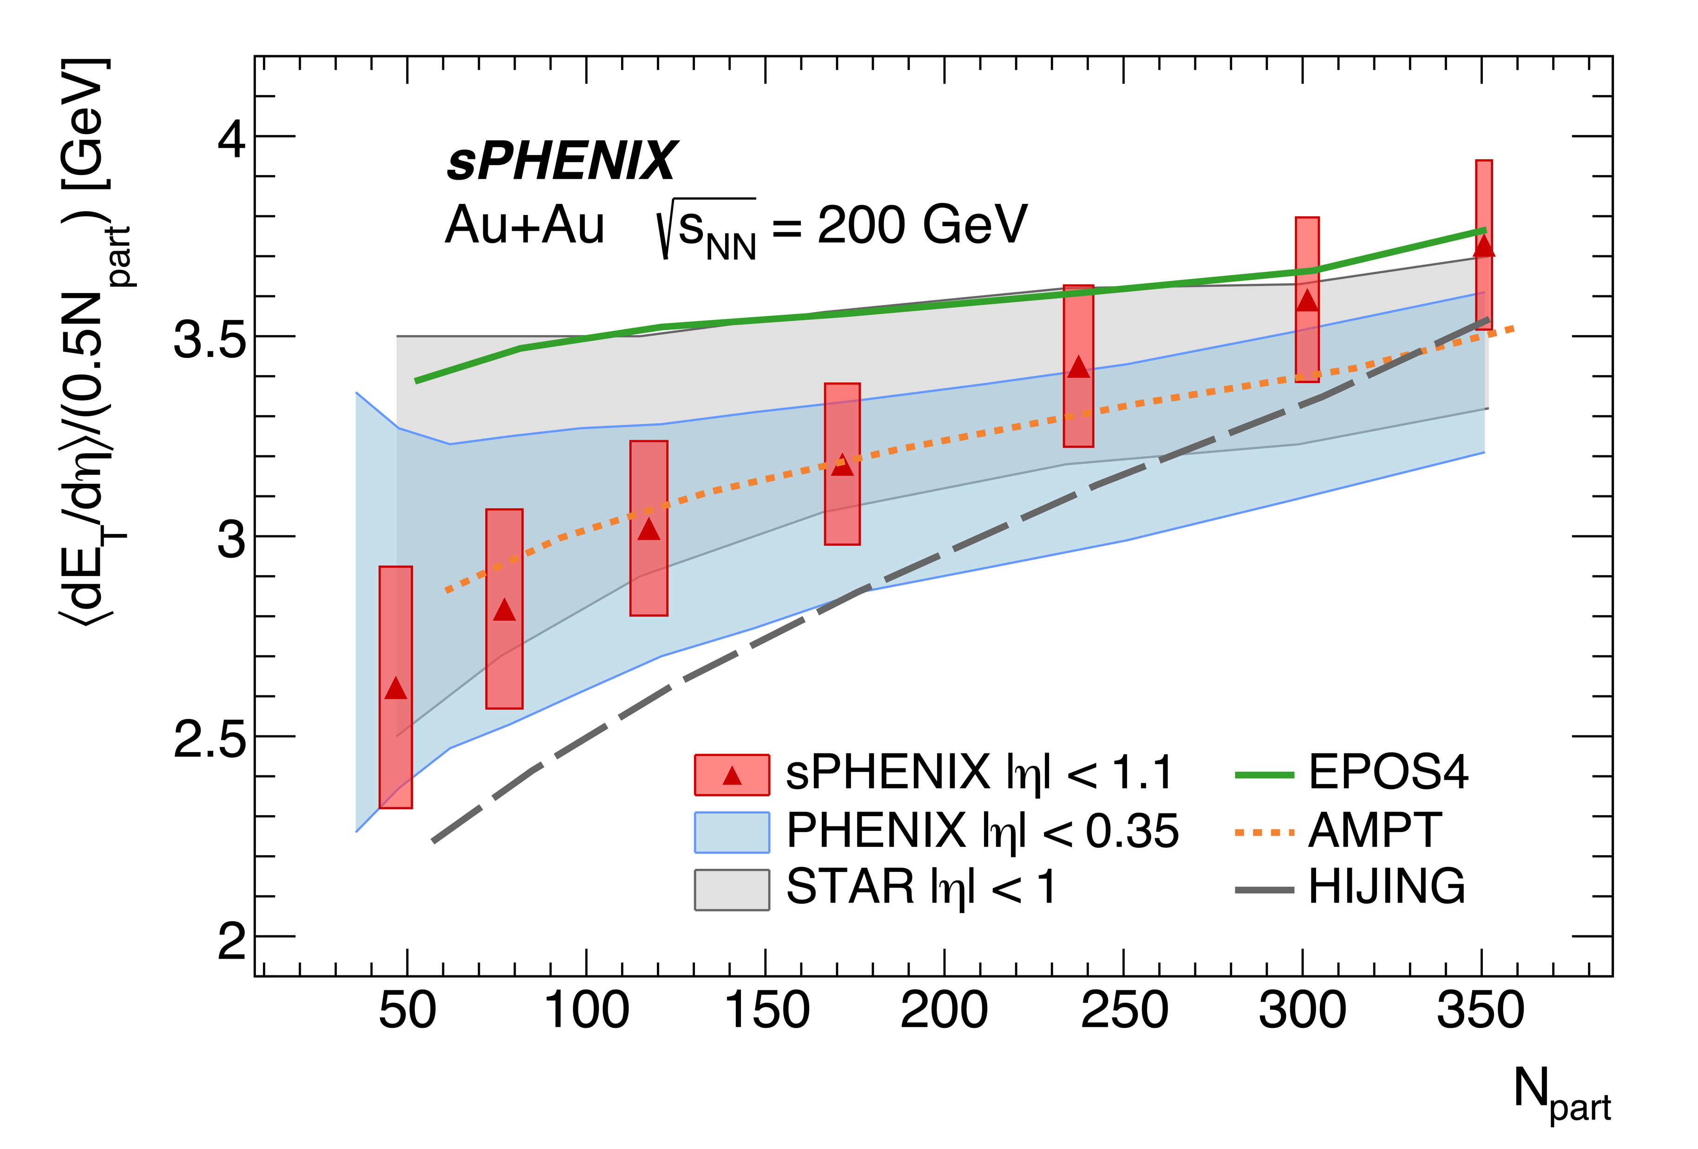
Bulk Observables: Au+Au dE_{T}/dη
Run 24 Au+Au
Paper
arXiv:2504.02242
dE_{T}/dη [GeV]
<dE_{T}/dη>/(0.5N_{part})[GeV]
Pseudorapidity η
N_{part}
Also see
Presentation:
H.-R. Jheng
4/10/25, 9:40am
Poster:
E. McLaughlin
  Measured with EM and Hadronic calorimeters
  dE_{T}/dη gives estimate of initial energy density

Slide 13
sPHENIX highlights in three acts
The sPHENIX Experiment
  Mission and Goals
Commissioning for Physics
  Remeasuring Standard Candles
  First Physics Publications
A new quality of data
  First results of the pp run
  Progress towards physics goals

Slide 14
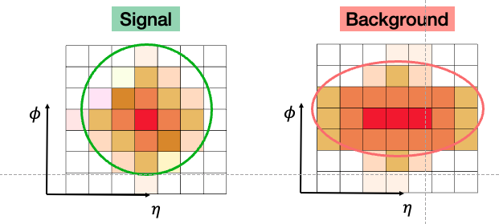
High p_{T} particles: Isolated Photons in p+p
sPH-CONF-JET-2025-02
Shower Shape - EMCAL
Also see
Presentation:
J. Park
4/10/25, 9:40 AM
Poster:
B. Seidlitz
Prompt Photons
Decay Photons
γ
γ
γ
π⁰
Isolation – EMCAL + HCAL
d²σ/dηdE^{γ}_{T}[pb/GeV]
E^{γ}_{T} [GeV]
Only 15% of full luminosity
used for this analysis
Run 24 p+p
Preliminary
    Used to Constrain initial state PDFs and NLO calculations
    Reference for Au Au

Slide 15
Jets: Inclusive spectra in p+p
sPH-CONF-JET-2025-03
Large acceptance calorimetry
Also see
Presentation:
V. Bailey
Poster:
A. Narde
EMCal
IHCal
OHCal
Sum
Corrected for jet p_{T} scale
Unfolded to MC final
state particle level
Run 24 p+p
Preliminary
  Unprecedented p_{T} reach at RHIC
  Only 15% of full luminosity used for this analysis

Slide 16
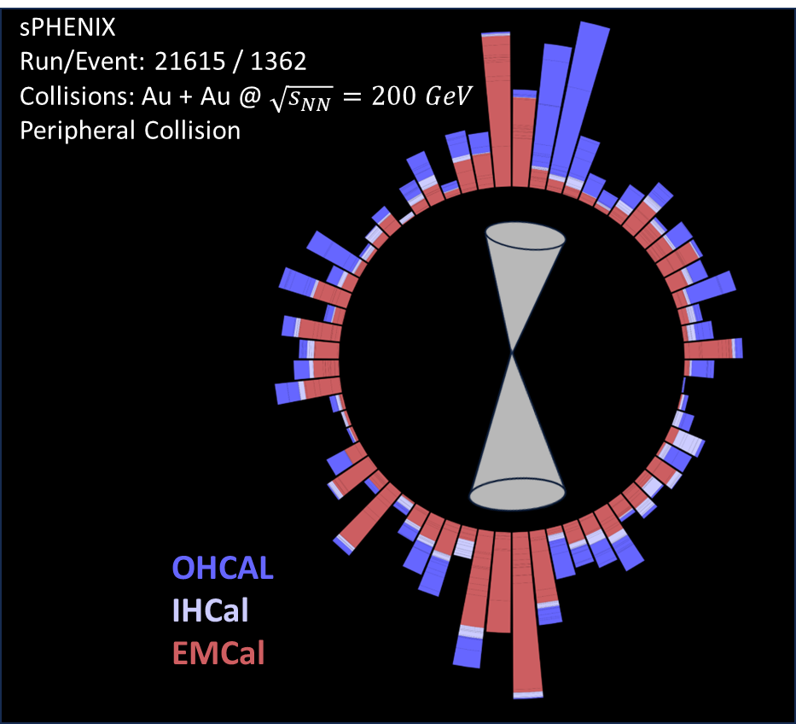


Jets: Dijet correlations in pp
Run 24 p+p
Preliminary
sPH-CONF-JET-2025-01
Also see
Presentation:
V. Bailey
4/8/25, 8:40am
Poster:
D. Lis
Dijet p_{T} balance $x_{J}=p_{T}^{2}/p_{T}^{1}$
Dijet angular correlation
$$Δφ$$
Corrected for jet p_{T} scale
Unfolded to MC final state
particle level
x_{J}
Δφ
Data well described by PYTHIA
Important reference for Au+Au

Slide 17
Jets in AuAu: Underlying event
Run 24 Au+Au
Preliminary
sPH-CONF-JET-2025-04
Also see
Presentation:
V. Bailey
4/8/25, 8:40am
Centrality [%]
Underlying event characterization for jet reconstruction
Comparisons of jet background fluctuations between subtraction methods

Slide 18
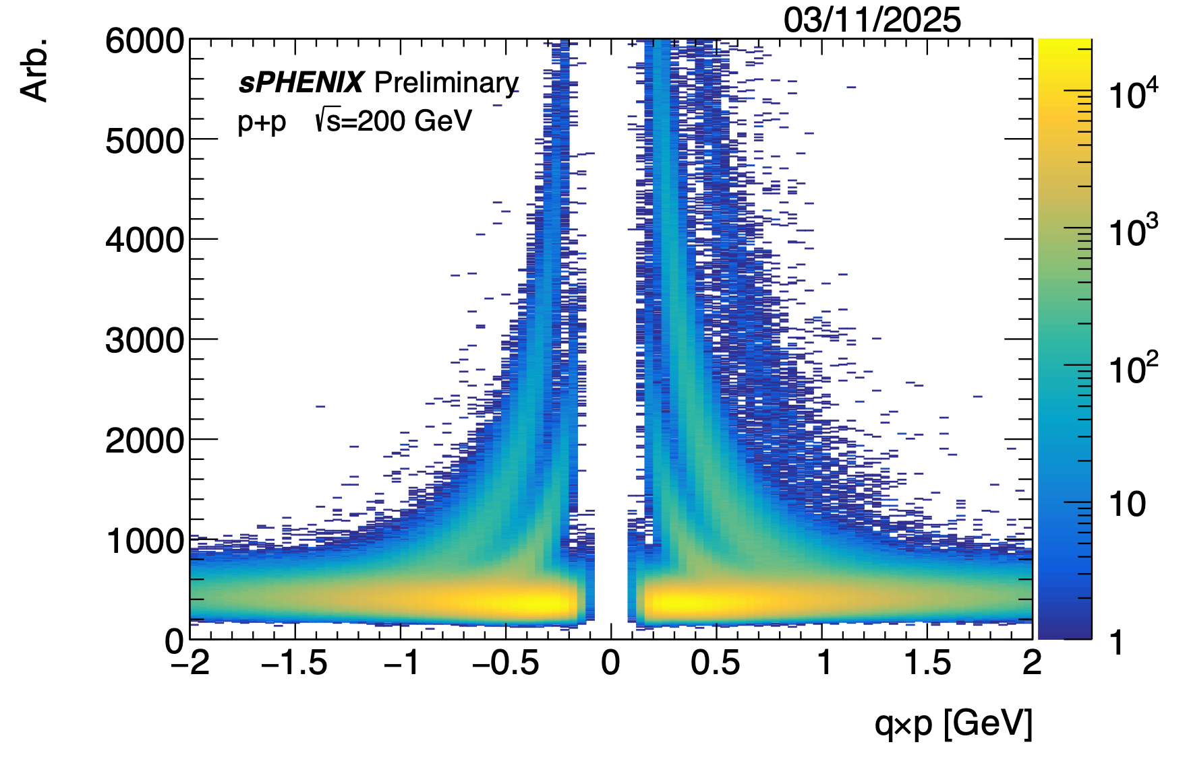
Towards Heavy Flavor Physics: Tracking
sPHENIX-Performance
Run 24 p+p
Performance
K⁰ π⁺π⁻
d
p
K
dE/dx [a.u.]
π
m(π⁺π⁻) [GeV]
q x p [GeV]
Early alignment, calibrations and distortion corrections
Vertex reconstruction from matching to Silicon detectors
TPC provides momentum and dE/dx for PID

Slide 19
Towards Heavy Flavor Physics: Strangeness
Also see
Presentation:
J. Osborn
4/10/25, 9:00am
Poster:
T. Hachiya
T. Marshal
G. Ottino
S. Bathe
D. Stewart
sPHENIX-Performance
Λ p±π±
φ K⁺K⁻
Ξ⁻ Σ⁻ Λ⁰π⁻
m(p±π±) [GeV]
m(K∓K±) [GeV]
m(Λ⁰π⁻) [GeV]
Run 24 p+p
Performance
Early alignment, calibrations and distortion corrections
Vertex reconstruction from matching to Silicon detectors
TPC provides momentum and dE/dx for PID

Slide 20
Towards Heavy Flavor!
Run 24 p+p
Performance
sPHENIX-Performance
Also see
Presentation:
J. Osborn
4/10/25, 9:00am
Poster:
T. Hachiya
T. Marshall
G. Ottino
S. Bathe
D. Stewart
D⁰ K⁻π⁺
Λ_{c} pK⁻π⁺
m(K⁻π⁺) [GeV]
Observe first signal of D⁰ and Λ_{c}decays!!
from ~1 hour of pp data and early stage calibrations

Slide 21
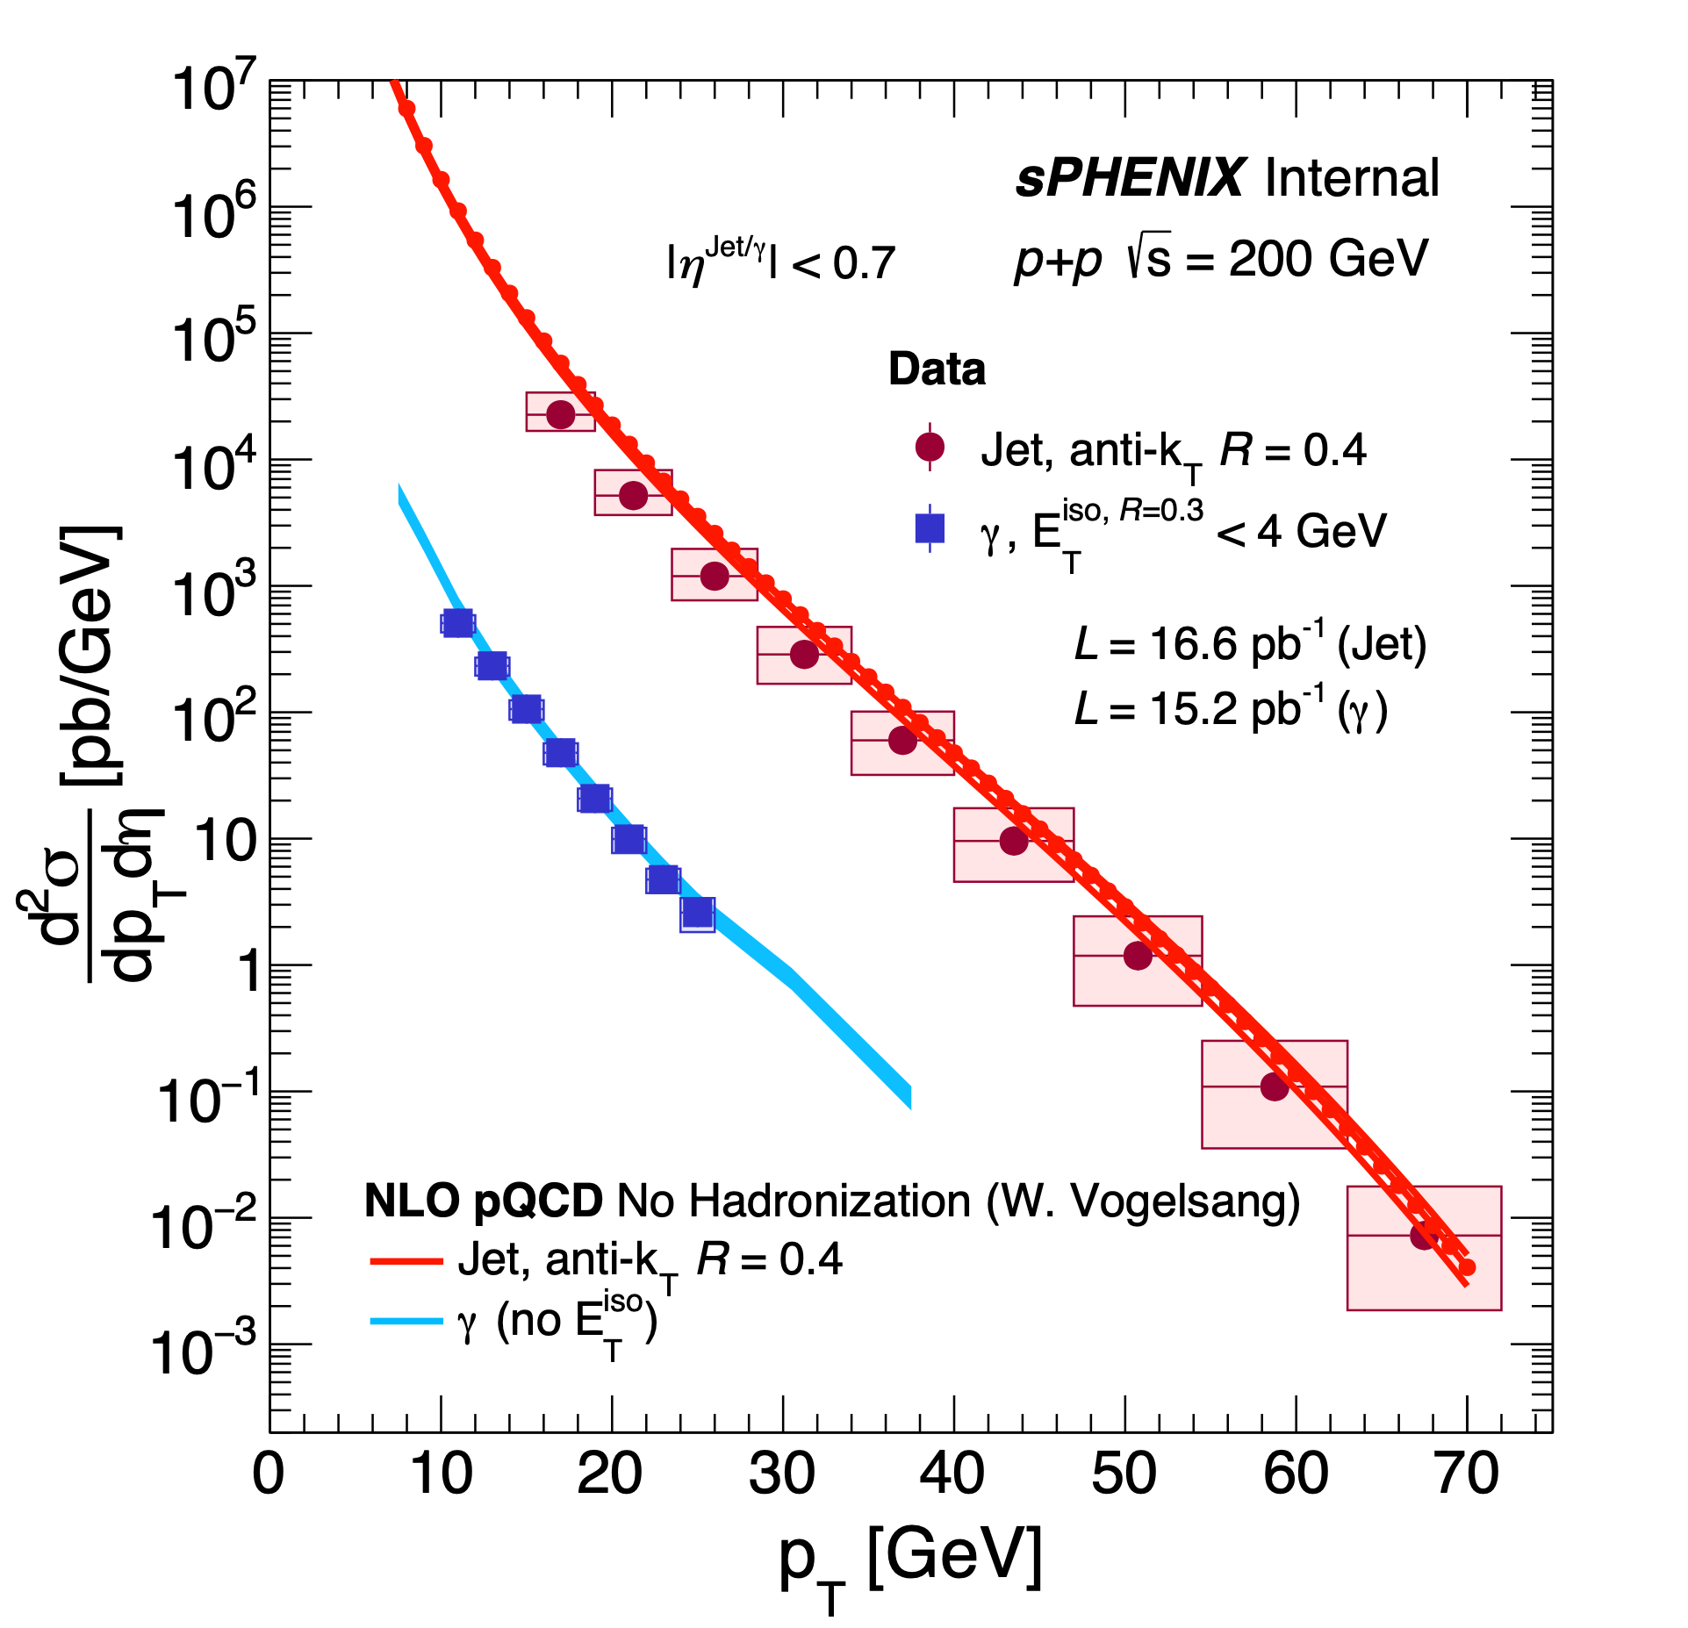
Summary
Photons, Jets in pp
Au+Au
sPHENIX is fully commissioned and producing physics
  Recorded substantial pp reference dataset in 2024
  Demonstrated
    jet, photon and track reconstruction
    physics analysis capability of large scale datasets
      Remeasure standard physics candles
      First publications submitted
  Well equipped to complete the RHIC science mission
  Looking forward to a successful AuAu run in 2025!
D⁰ K⁻π⁺
dE/dx (TPC)
d
p
K
π
sPHENIX Public Results

Slide 22
Talks at QM2025
sPhenix presentations
sPHENIX measurement of dijet correlations in p+p collisions over a large kinematic range
  Virginia Bailey (Georgia State University) - 4/8/25, 8:40 AM
sPHENIX measurement of the L_{c}/D⁰ ratio in p+p collisions at RHIC
  Joe Osborn (Brookhaven National Laboratory) - 4/10/25, 9:00 AM
sPHENIX measurements of collective behavior in small and large systems
  Hao-Ren Jheng (Massachusetts Inst. of Technology (US)) - 4/10/25, 9:40 AM
sPHENIX measurements of high-pT neutral mesons and isolated photons in p+p collisions
  Jaebeom Park (University of Colorado Boulder) - 4/10/25, 9:40 AM
sPhenix posters
Ejiro Naomi Umaka Yuko Sekiguchi Jaein Hwang Thomas Marshal Gregory Ottino Weihu Ma; Jingyu Zhang Bade Sayki Ming Xiong Liu Xuan Li Skaydi Grossberndt Virginia Bailey Daniel Lis Emma McLaughlin Stefan Bathe Apurva Narde David Stewart Yeonju Go Dylan Neff Nihil Kumar Blair Seidlitz Xudong Yu Hanna Bossi | sPHENIX charged hadron v_2 for Au+Au collisions at 200 GeV sPHENIX measurement of long-range two-particle correlations in high-multiplicity p+p collisions sPHENIX Performance of the Intermediate Si tracker sPHENIX Data-Driven Calculation of Tracking Efficiency sPHENIX Alignment of the MVTX Tracking Detector sPHENIX electron ID with machine learning sPHENIX Electron Identification for Prompt $J/\psi$ Decays using CNN Algorithms sPHENIX Event Multiplicity Dependence of Heavy Flavor Jet Production in p+p Collisions sPHENIX Heavy Flavor Jet Studies with Machine Learning Algorithm in p+p Collisions sPHENIX measurement of Large $R_L$ Energy-Energy Correlator on Calorimeters in Dijet events in pp at 200 GeV sPHENIX photon-jet measurements in proton-proton collisions sPHENIX Measurement of Dijet Correlations in pp sqrt(s) = 200 GeV sPHENIX measurement of dET/dη in Au+Au Collisions at 200 GeV sPHENIX commissioning with proton and nuclear beams sPHENIX measurement of the first full calorimeter jet spectrum in p+p collisions at RHIC sPHENIX track reconstruction in streaming-readout data sPHENIX Novel Jet Background Subtraction and Full Detector Simulation Using Self-Supervised Generative AI Models sPHENIX measurement of neutral meson transverse single spin asymmetry in high-statistics polarized p+p collisions sPHENIX measurement of high-p$_T$ neutral meson production in p+p collisions sPHENIX measurements of isolated photon production in p+p collisions sPHENIX high-statistics measurements of D meson production in p+p collisions sPHENIX machine learning on FPGAs for event selection

