Slide 1

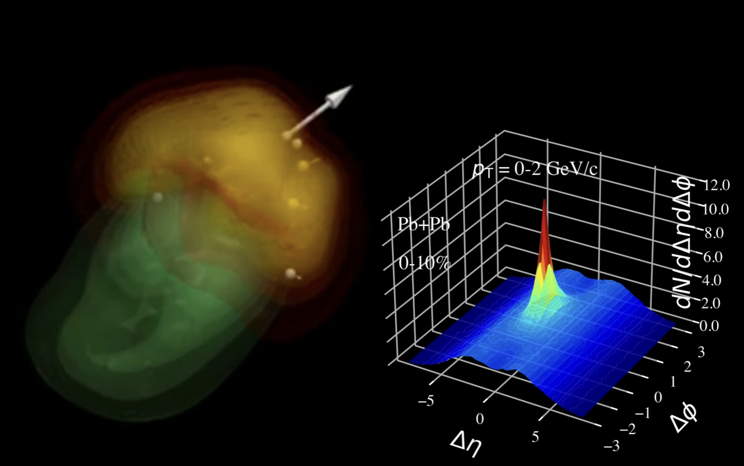
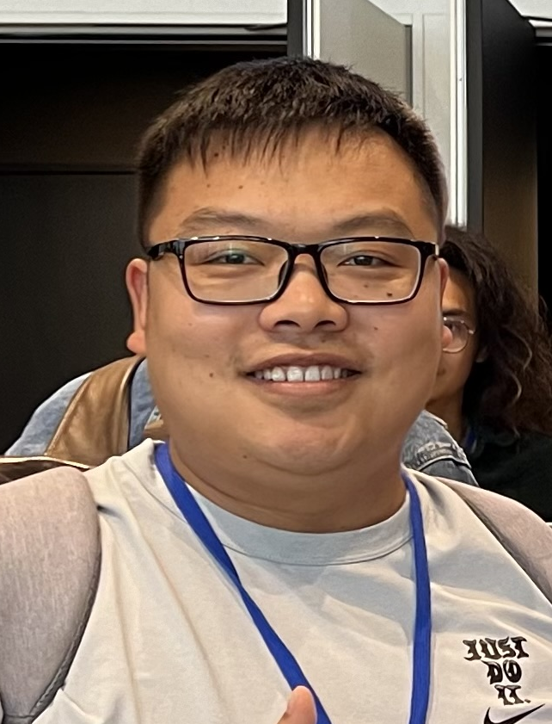
3D Structure of Jet-induced Diffusion Wake
Quark Matter 2025, Frankfurt, April 6-12, 2025
Zhong Yang
Vanderbilt University
Xin-Nian Wang
Central China Normal University

Slide 2
Jet energy loss and medium response
Jet quenching in the open (since 2001)
Where does the lost energy loss go?
How is the lost energy redistributed?
Notes:
Argument for jet measurement: not affected by hadronization, but

Slide 3

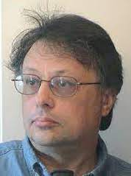


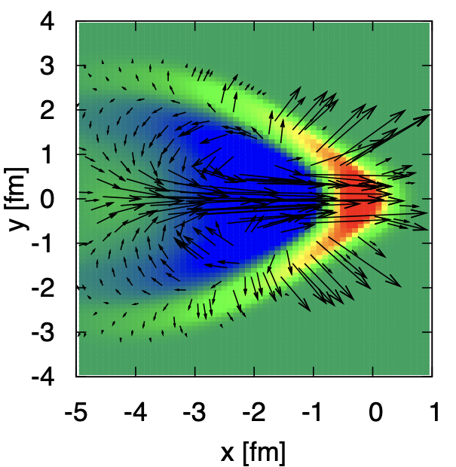
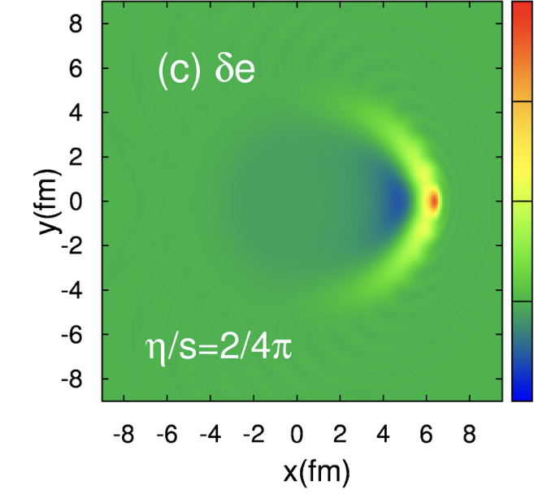
Jet-induced medium excitation
Casalderrey-Solana, Shuryak & Teaney (2005), Stoecker (2005)
Jet induced Mach-cone in QGP
c_{s}
v
Hydrodynamic approach
energy-momentum
deposited by jet
Betz, Noronha, Giorgio, Gyulassy,
Mishudtin, Rischke (2009)
Li Yan, S. Jeon, C. Gale (2018)
Diffusion wake

Slide 4
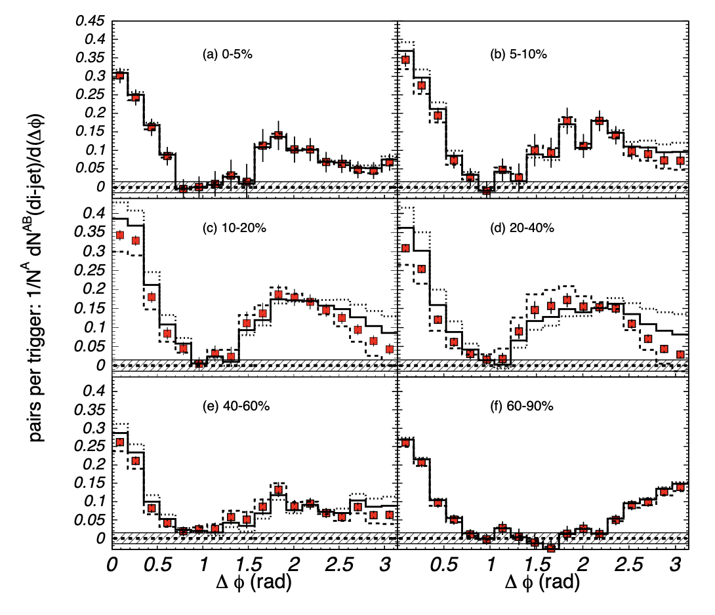
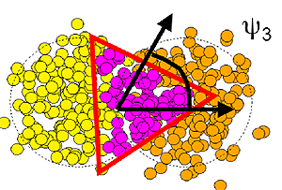
Fake Mach-cone
Di-hadron correlation
θ
Mach-cone?
Triangular
flow
Alver and Roland, Phys. Rev. C 81, 054905 (2010)
PHENIX, Phys. Rev. Lett. 97, 052301 (2006)
No show such angular structure from numerical simulations of Mach-cone !

Slide 5
Resurrection of jet-induced Mach-cone
Energy distr. of medium response in a static medium from Linear Boltzmann Transport (LBT) model
He, Luo, XNW & Zhu, PRC91 (2015) 054908
Notes:
f_i(p_i)=\frac{1}{e^{p_i\cdot u/T}\pm 1} (i=2,4)
f_i(p)=(2\pi)^3\delta^3(\vec p_i-\vec p_0)\delta^3(\vec x-\vec x_0-t\vec v_i) [i=1,3]
\frac{dN_g}{dzd^2k_\perp dt}=\frac{2\alpha_s N_c}{\pi k_\perp^4} P(z)
(\hat p\cdot u) \hat q \sin^2(\frac{t-t_0}{2\tau_f})

Slide 6
Microscopic picture of Mach wake
LBT: Linear Boltzmann Transport
Induced radiation
jet parton
pQCD elastic and radiative processes (high-twist)
Transport of medium recoil partons ( and back-reaction)
CLVisc 3+1D hydro bulk evolution
Back-reaction
(particle hole)
recoil parton
He, Luo, Zhu & XNW, PRC 91 (2015) 054908
Notes:
f_i(p_i)=\frac{1}{e^{p_i\cdot u/T}\pm 1} (i=2,4)
f_i(p)=(2\pi)^3\delta^3(\vec p_i-\vec p_0)\delta^3(\vec x-\vec x_0-t\vec v_i) [i=1,3]
\frac{dN_g}{dzd^2k_\perp dt}=\frac{2\alpha_s N_c}{\pi k_\perp^4} P(z)
(\hat p\cdot u) \hat q \sin^2(\frac{t-t_0}{2\tau_f})
p_1\cdot \partial f_1=-\int dp_2dp_3dp_4(f_1f_2-f_3f_4)|M_{12 \rightarrow 34}|^2(2\pi)^4\delta^4(\sum_i p_i) + {\rm inelastic}
\frac{dN_g}{dzd^2k_\perp dt} \approx \frac{2C_A\alpha_s}{\pi k_\perp^4}P(z) \hat q (\hat p\cdot u) \sin^2\frac{k_\perp^2 (t-t_0)}{4z(1-z)E}

Slide 7
CoLBT-hydro
(Coupled Linear Boltzmann Transport hydro)
Concurrent and coupled evolution of bulk medium and jet showers
LBT for energetic partons (jet shower and recoil)
Hydrodynamic model for bulk and soft partons: CLVisc
Parton coalescence (thermal-shower)+ jet fragmentation
Hadron cascade using UrQMD
Chen, Cao, Luo, Pang & XNW, PLB777(2018)86
Notes:
\partial_\mu T^{\mu\nu}(x) = j^\nu (x)
\delta f(p,x) \ll f(p,x)
j^\nu(x) = \sum_i p^\nu_i \delta^{(4)}(x-x_i) \theta(p^0_{cut}-p\cdot u)
j^\nu(x) = \sum_a\int \frac{d^3p}{(2\pi)^3}\frac{p^\nu}{p^0}f_a(p)\theta(p\cdot u - p^0_{cut})
p\cdot \partial f(p) =- C(p) \;\;\; p\cdot u > p_{cut}^0

Slide 8
Medium response of Z/γ-jet in CoLBT-hydro
Before
After hydro background subtraction

Slide 9
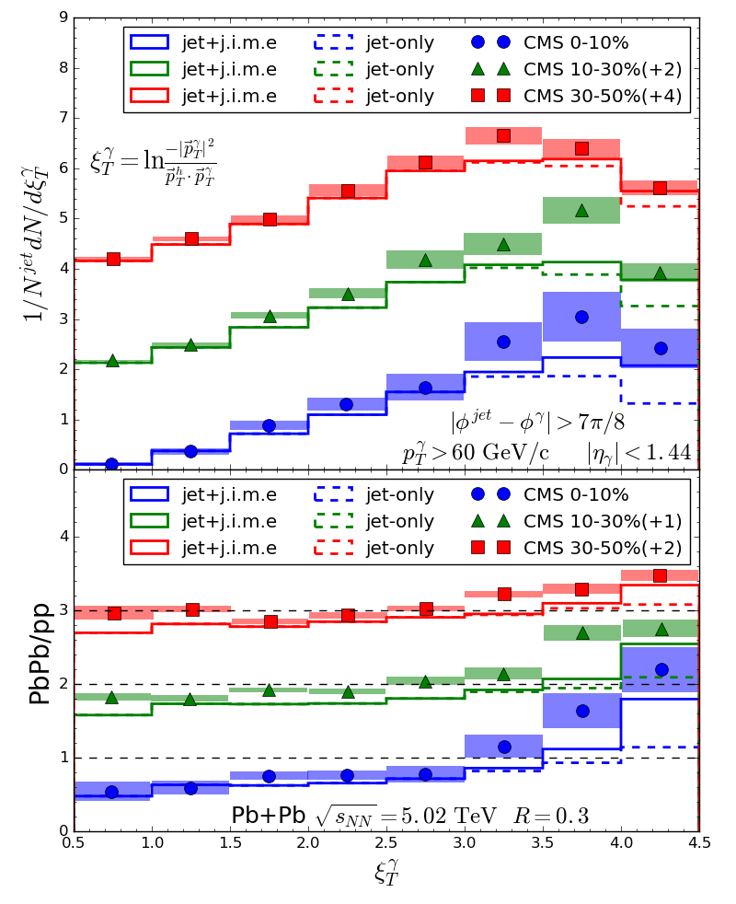
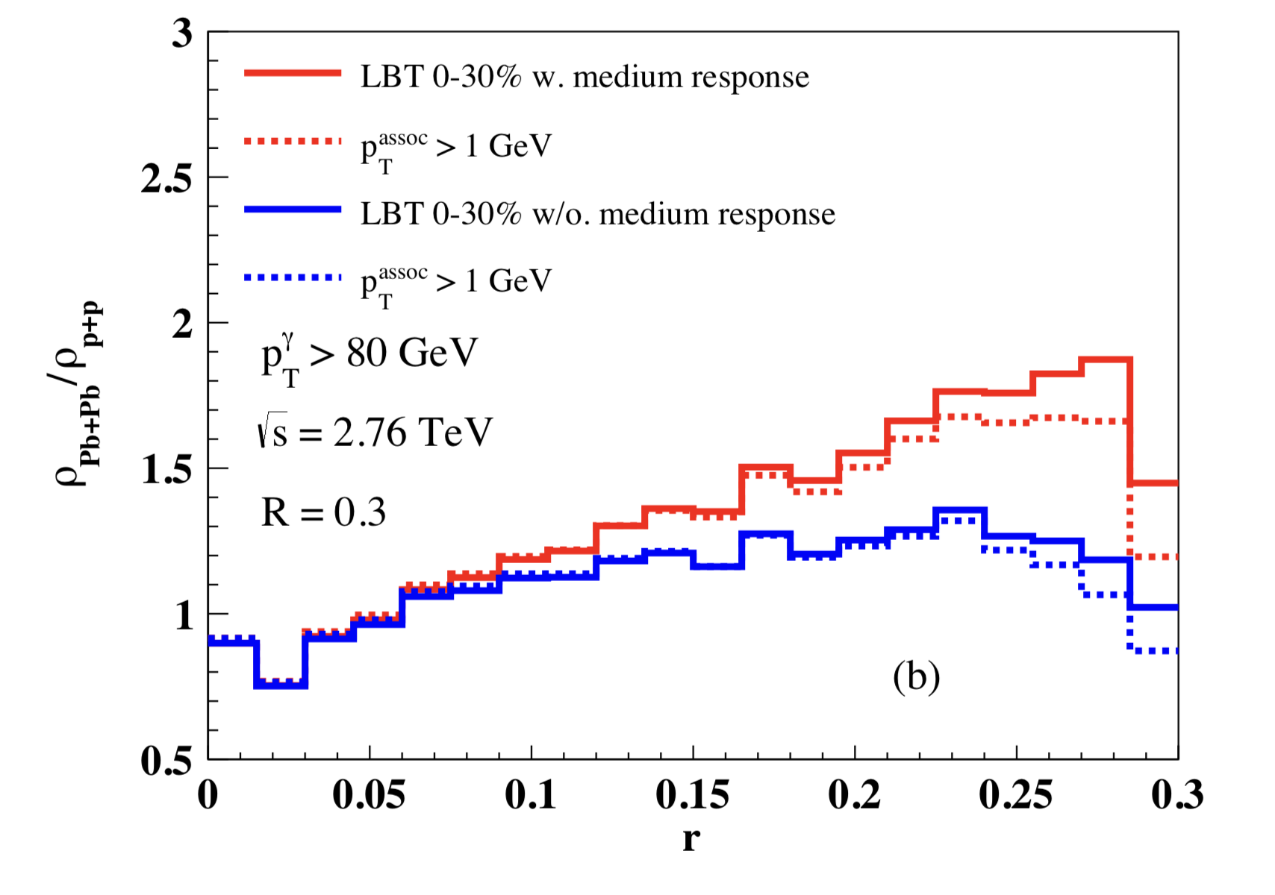
Medium modification of γ-jets
Enhancement of soft hadrons in large angles
r
With recoil
w/o recoil
Luo, Cao, He & XNW, arXiv:1803.06785
Chen, Cao, Luo, Pang & XNW, 2005.09678

Slide 10
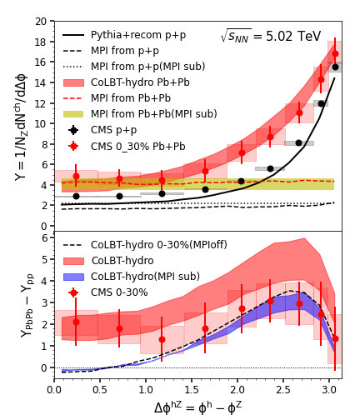
MPI background and diffusion wake in Z-jets
Mixed event subtraction
Chen, Yang, He, Ke, Pang and XNW, PRL 127 (2021) 8, 082301

Slide 11
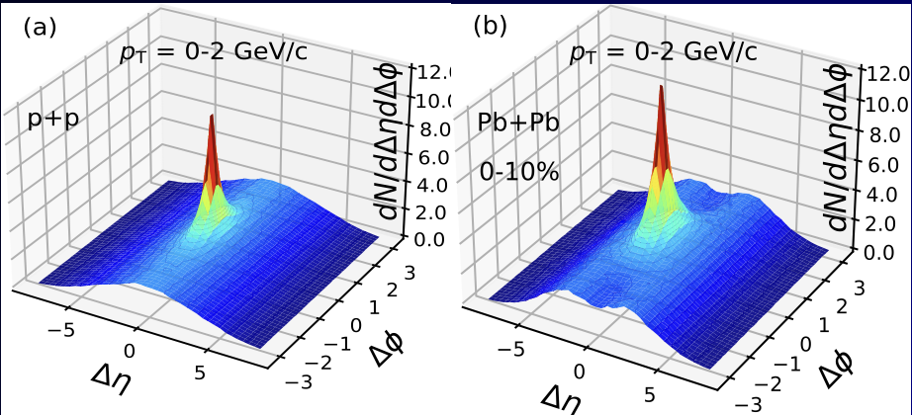
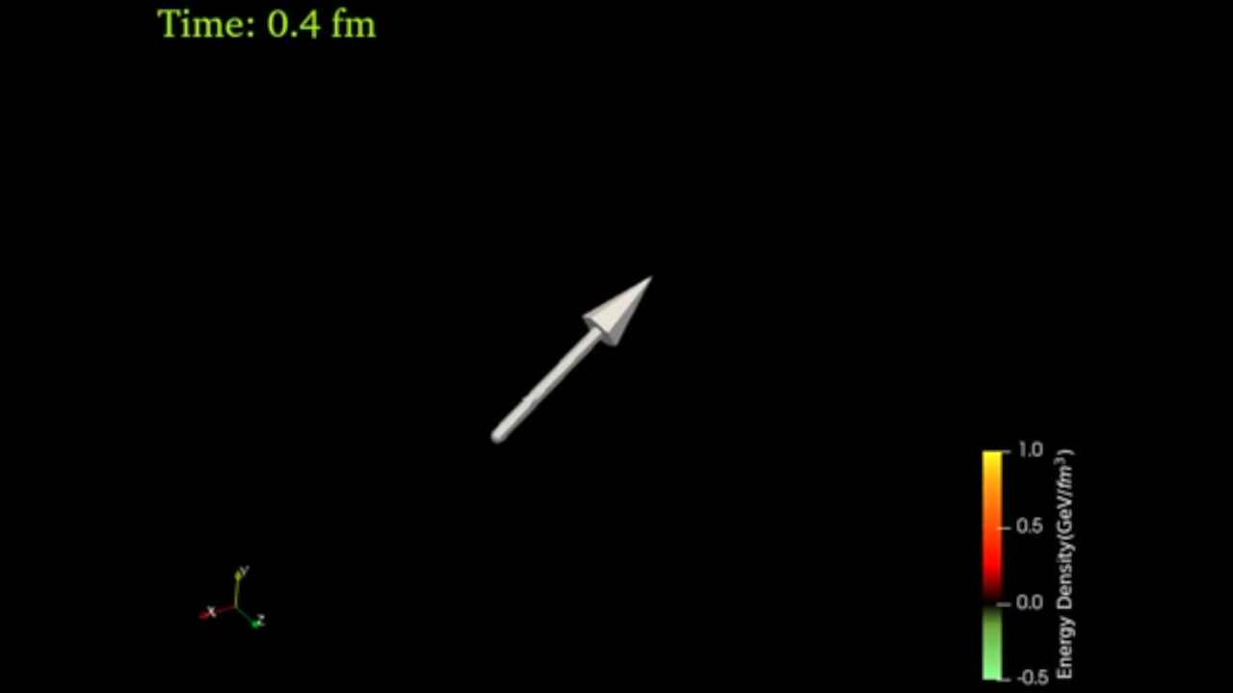
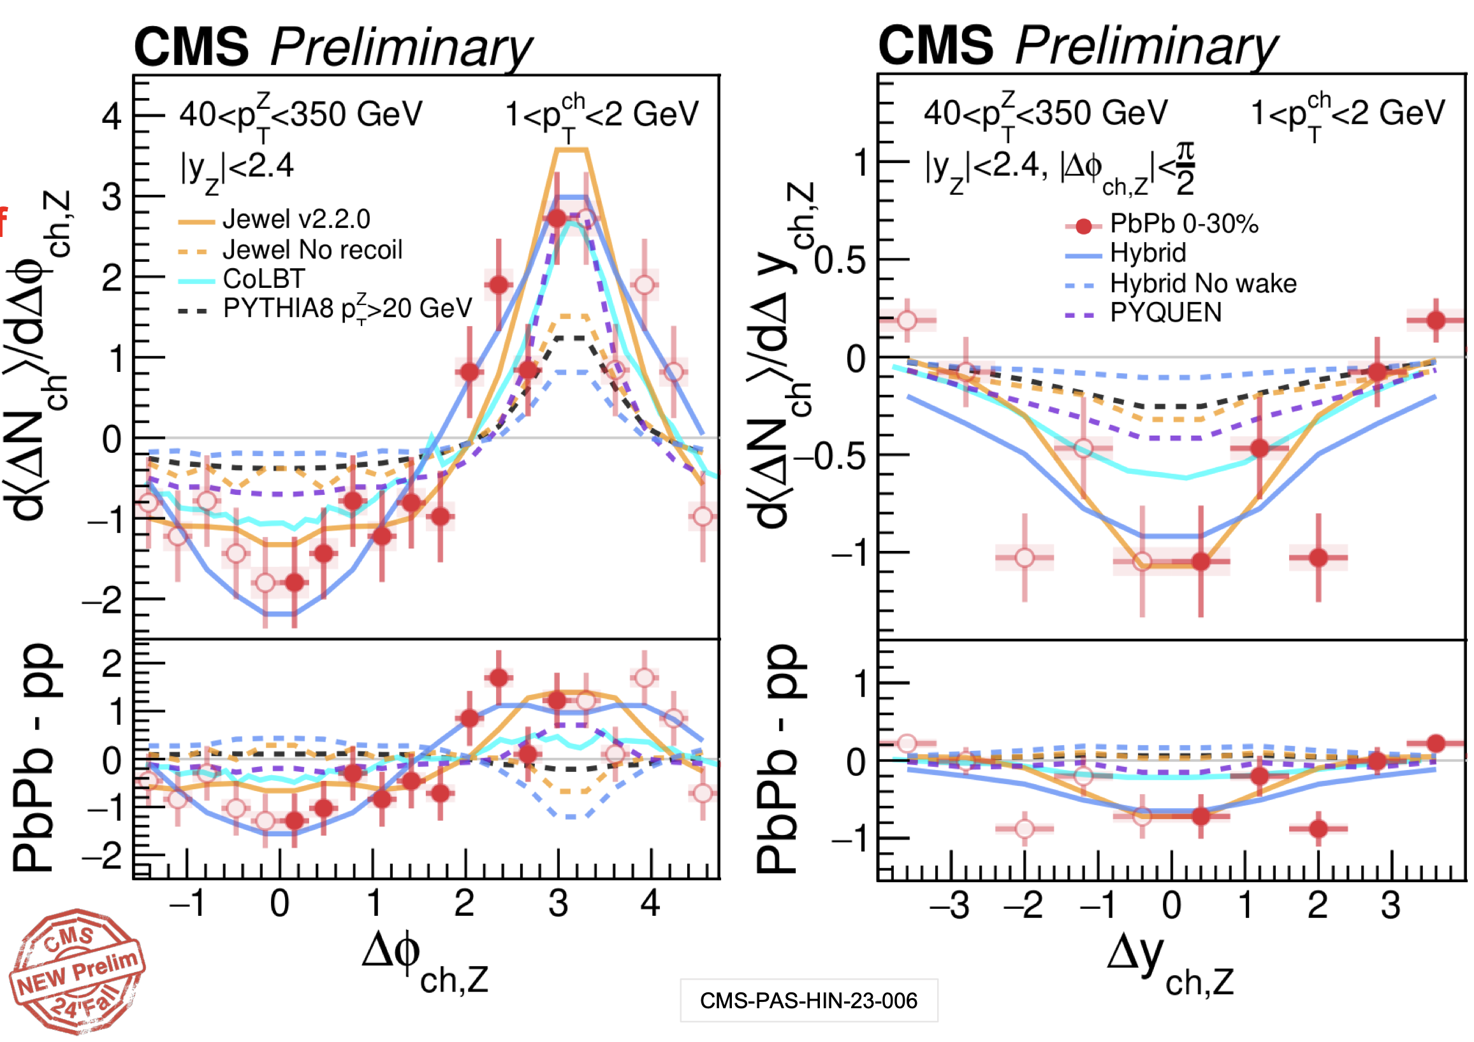
3D structure of diffusion wake
Jet-hadron correlation in γ/jet events
MPI ridge: independent multiple mini-jets
Diffusion wake → rapidity valley
on top of the MPI ridge
Yang, Luo, Chen, Pang and XNW, PRL 130, 052301 (2023)
Y. Lee
talk at
HP24

Slide 12
Diffusion wake and jet energy loss
Longitudinal tomography
γ-jet asymmetry p_{T}^{jet}/p_{T}^{γ} : proxy of jet energy loss
p_{T}=1-2 GeV/c
Yang, Luo, Chen, Pang and XNW, PRL 130, 052301 (2023)
Zhang, Owens, Wang and XNW, PRL 103, 032302 (2009)

Slide 13
Diffusion wake in di-jets
Rapidity ordering convention:
Jet-hadron correlation without rapidity gap
Jet-hadron correlation with rapidity gap

Slide 14
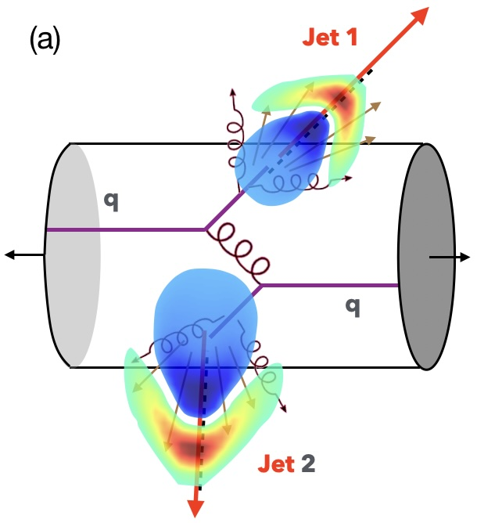
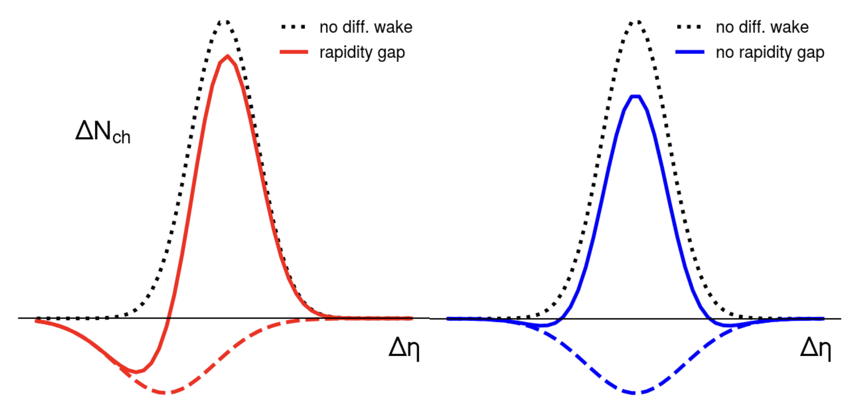
Diffusion wake in di-jets
Jet-hadron correlation in
di-jets with and without rapidity gap

Slide 15
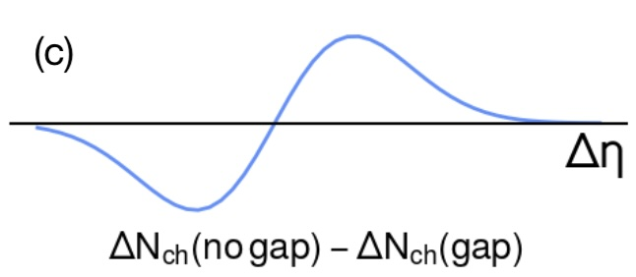
Diffusion wake in di-jets
Jet-hadron correlation in
di-jets with rapidity gap

Slide 16
Rapidity asymmetry as robust signal of diffusion wake
Medium modification of jet-hadron correlation
Rapidity Asymmetry
Zhong Yang and XNW, 2501.03419
Notes:
\Delta N_{\rm AA}=\int d\Delta\phi\left[\frac{dN_{\rm AA}}{d\Delta\phi d\Delta\eta} - \frac{dN_{\rm pp}}{d\Delta\phi d\Delta\eta}\right]

Slide 17
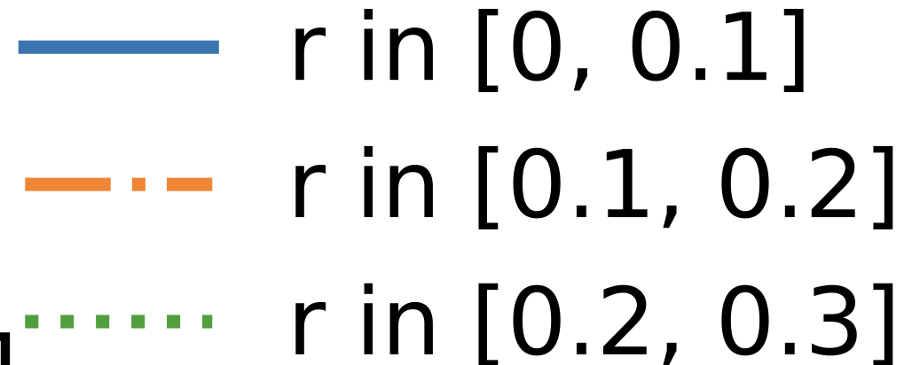
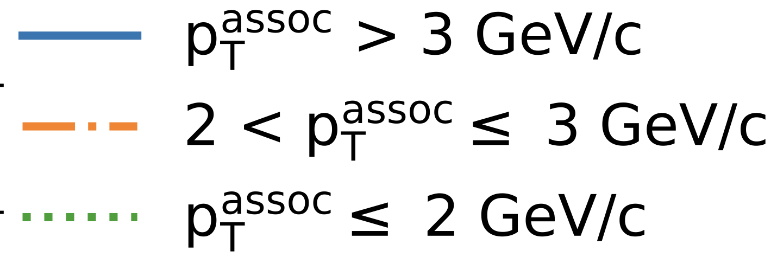
Asymmetric jet shape: azimuthal dependent
Energetic hadrons at the core of jet are deflected away from center
Soft hadrons from medium response at large angle flow into center
φ
r
Xiao, He, Pang, Zhang and XNW PRC 109 (2024) 5, 054906

Slide 18
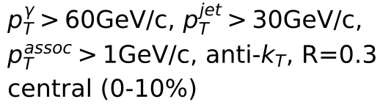
Asymmetric jet shape at finite rapidity
Jet and longitudinal-flow coupling
φ
r
η
Xiao, Zhang and XNW to be published
1.0
1.0
Against the longitudinal flow
Along the longitudinal flow

Slide 19
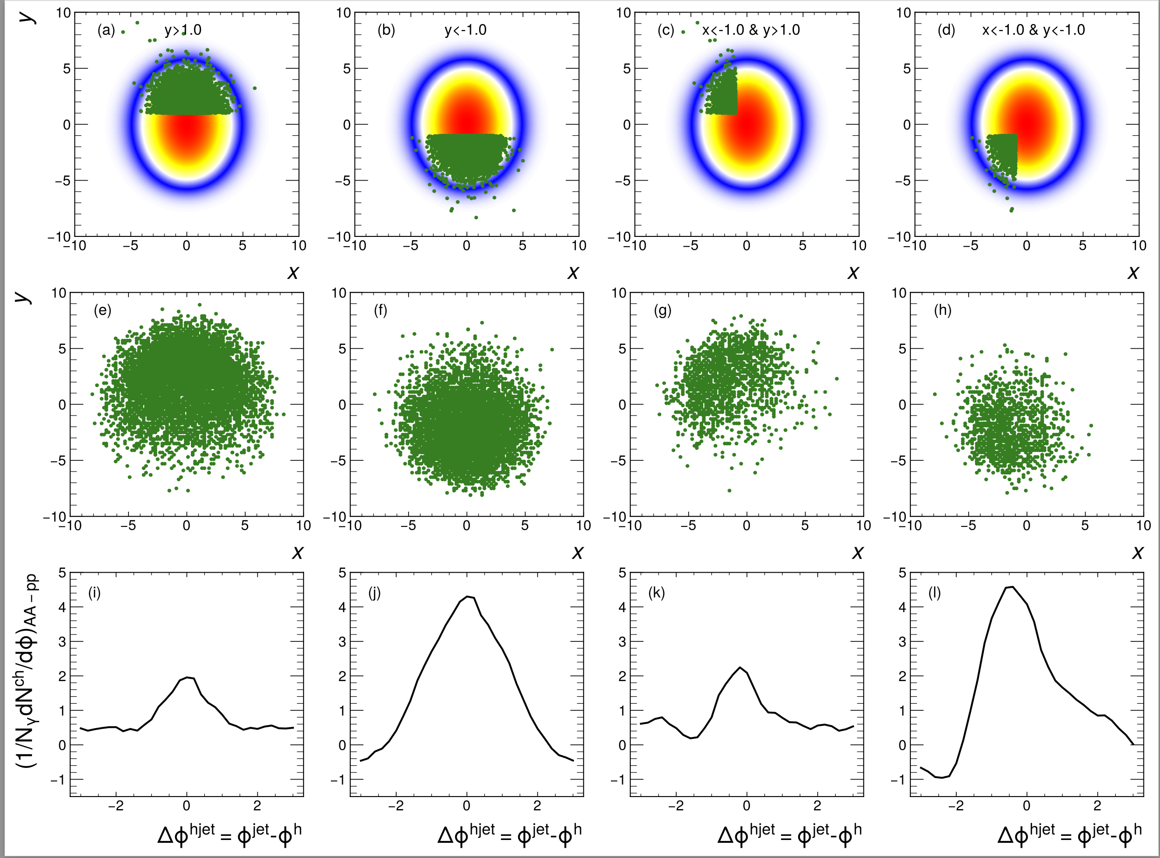
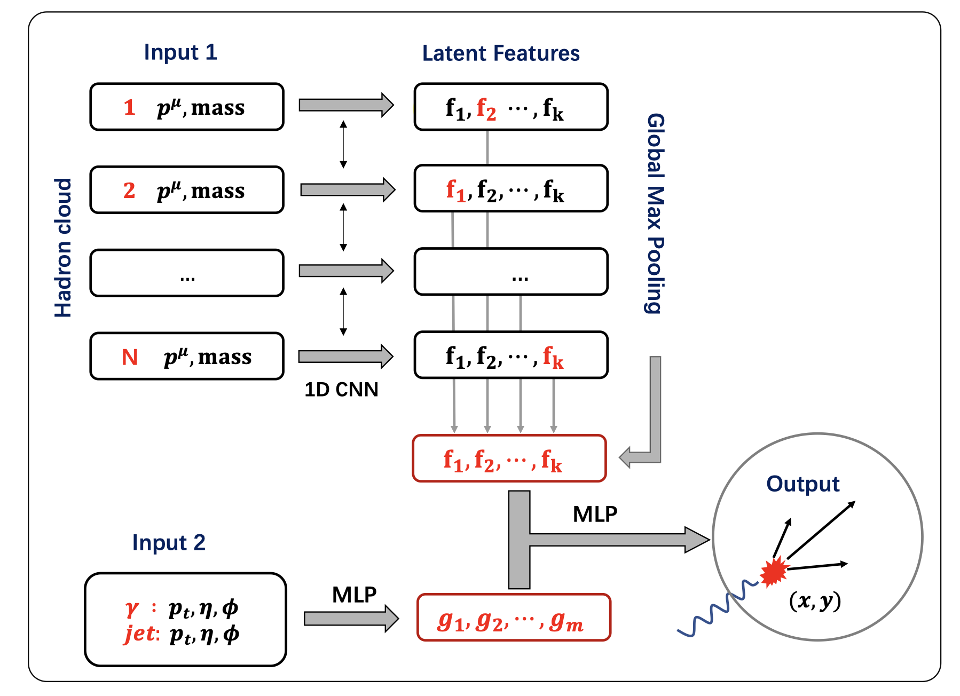
Deep learning assisted jet tomography
PCN (point cloud network)
DL network selection
Actual distribution
Eur.Phys.J.C 83 (2023) 7, 652
γ-soft hadron correlation
Yang, He，Chen，Ke，Pang & XNW
Notes:
Recently, the point could network as been applied to predict the transverse position of the initial jet production vertices

Slide 20
Summary
Medium response leads to
  enhancement of soft hadrons in jet direction
  depletion of soft hadron on the away side
Unique 3D structure of diffusion wake
Use 2D jet tomography to reveal the angular structure of Mach-cone excitation
Rapidity asymmetry as a robust signal of diffusion wake
Future studies: ML improved 2D tomography and constraint on EoS, transport coefficients

Slide 24
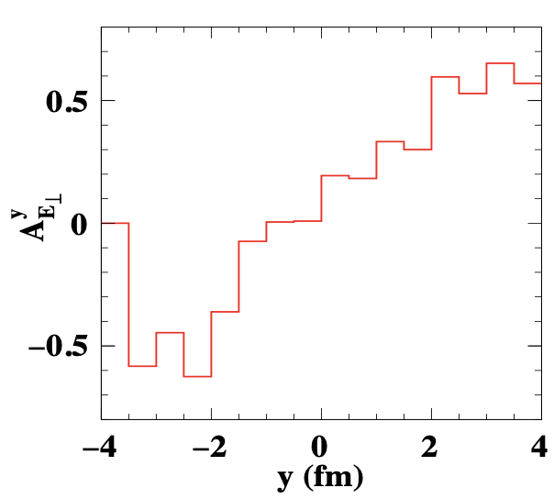
Transverse gradient tomography
(p_{T}>3 GeV/c)
drift due
to transverse
gradient along y
y
γ
jet
x
He, Pang & XNW, PRL 125 (2020) 12, 122301
Jet energy loss → propagation length → initial jet position in x: Longitudinal tomography
Notes:
A_{E_\perp}^{\vec n}=\frac{\int d^3rd^3pf_a(\vec p,\vec r) \vec p_T\cdot \vec n}{\int d^3rd^3pf_a(\vec p,\vec r)}

Slide 25
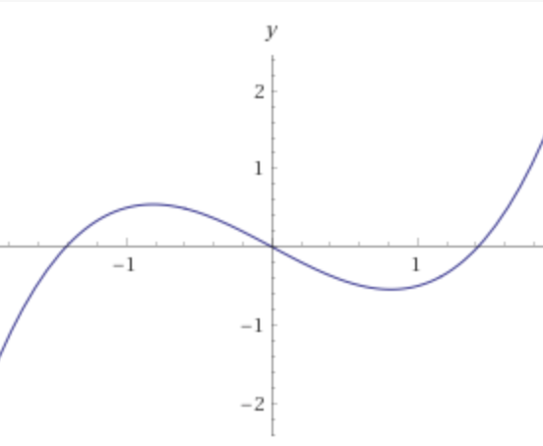
Asymmetric p_{T} broadening in non-uniform medium
y
Deflection due
to transverse
gradient along y
γ
jet
Momentum asymmetry
x

Slide 26
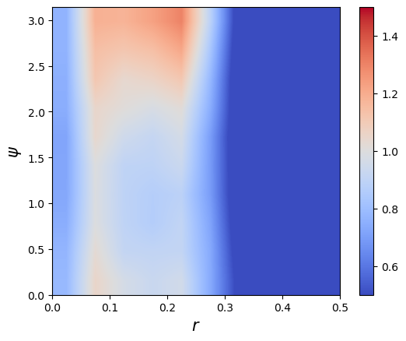
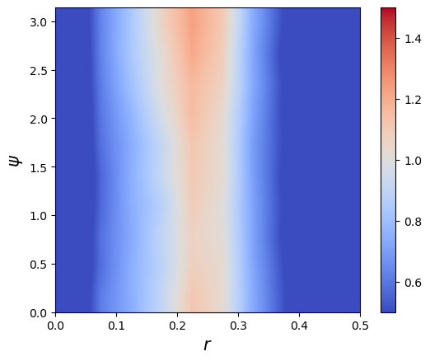
Seeing Mach-cone through 3p Azimuthal Correlation
p+p (γ+jet) p_{T}>40 GeV/c
0-10%Pb+Pb (γ+jet)
ψ
r
)
Back-to-back correlation due to momentum conservation of parton splitting
Azimuthal uniform correlation due to medium-response: Mach-cone – sound velocity?
r=(r1+r2)/2

Slide 27
Enhancing the diffusion wake
Chen, Yang, He, Ke, Pang and XNW, Phys. Rev. Lett. 127 (2021) 8, 082301

Slide 28
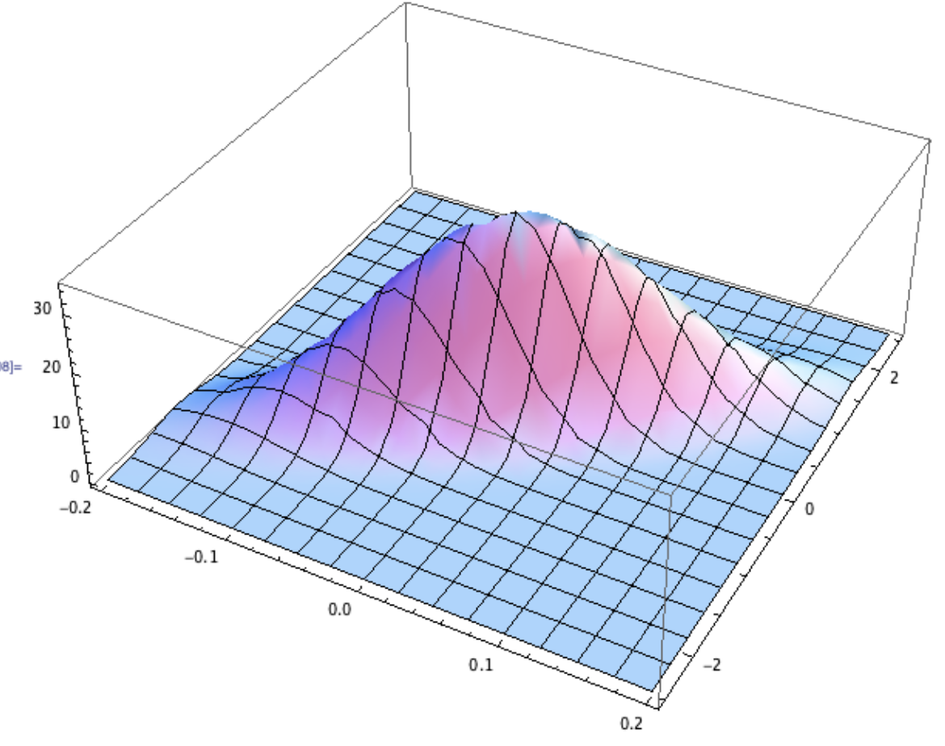
Drift-diffusion equation: uniform medium
Boltzmann equation under approximation of small angle elastic scattering, no drag:
Initial distr.
x
p_{x}
He, Pang & XNW, PRL 125 (2020) 12, 122301
Notes:
\frac{\partial f}{\partial t}+\frac{\vec p_\perp}{E}\cdot \frac{\partial f}{\partial \vec r_\perp}=\frac{\hat q(\vec r_\perp}{4}\vec\nabla_{p_\perp}^2 f(\vec p,\vec r)
f=3\left(\frac{4E}{\hat q t^2}\right)^2
\exp\left[-(\vec{r}_\perp-\frac{\vec p_\perp}{2E}t)^2\frac{12E^2}{\hat q t^3}-\frac{p_\perp^2}{\hat q t}\right]
f(\vec p,\vec r)_{t=0}=(2\pi)^2\delta^2(\vec{r}_\perp)\delta^2(\vec{p}_\perp)
\frac{1}{\pi \hat q t}\exp\left(-\frac{p_\perp^2}{\hat q t}\right)
\int \frac{d^2r}{(2\pi)^2}

Slide 29
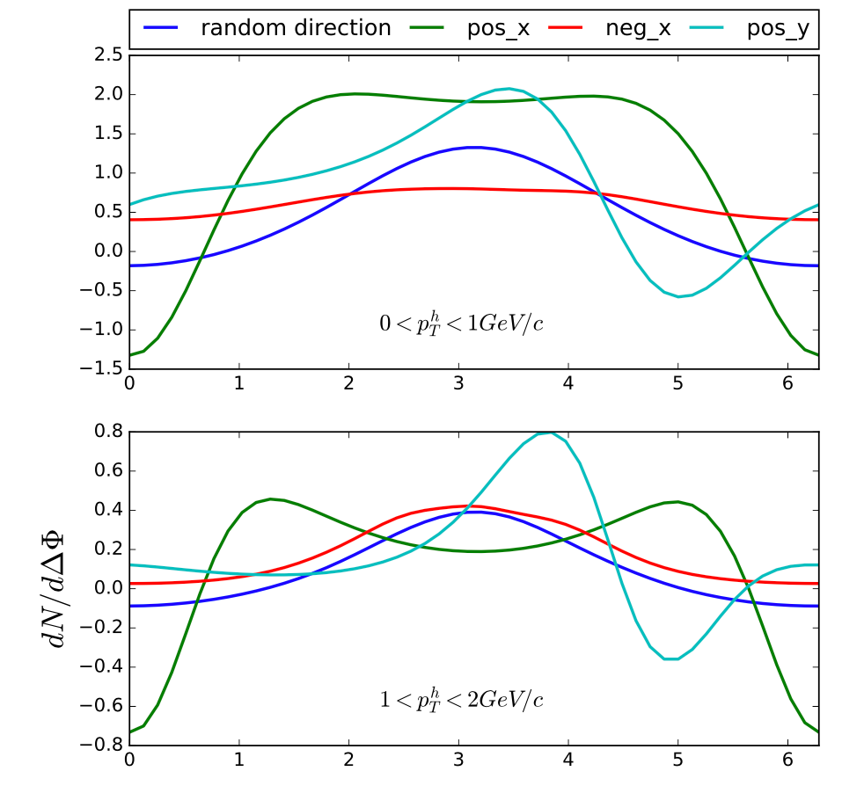
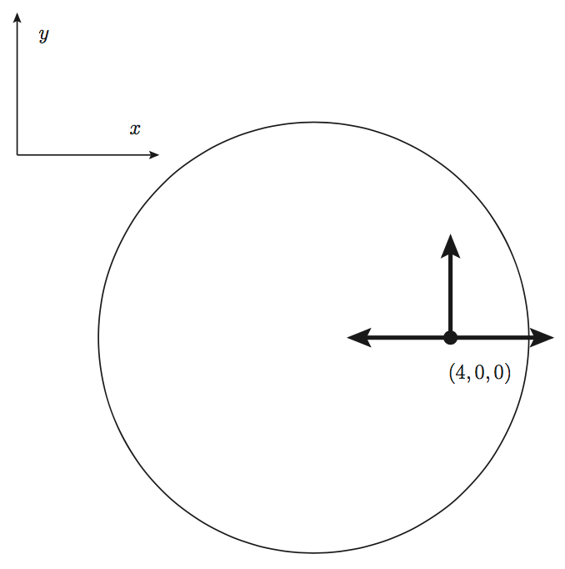
Initial position & azimuthal correlation
γ-hadron correlation
W Chen & XNW (2018)
Li, Liu, Ma, XNW and Zhu, Phys. Rev. Lett. 106, 012301 (2011)
ΔΦ
Tachibana, Shen & Majumder 2001.08321 (2020)

Slide 30
Longitudinal jet tomography
Zhang, Owens, Wang and XNW, Phys. Rev. Lett. 103, 032302 (2009)
length dependence of parton Energy loss
γ-jet asymmetry x_{γjet}=p_{T}^{jet}/p_{T}^{γ}
Can be used to select
propagation length <L>

Slide 31
Jets in heavy-ion collisions
Multiple scattering
Transverse momentum broadening
Jet 1
q
q
Parton energy loss
Jet suppression
Jet 2
A-A collision

Slide 32

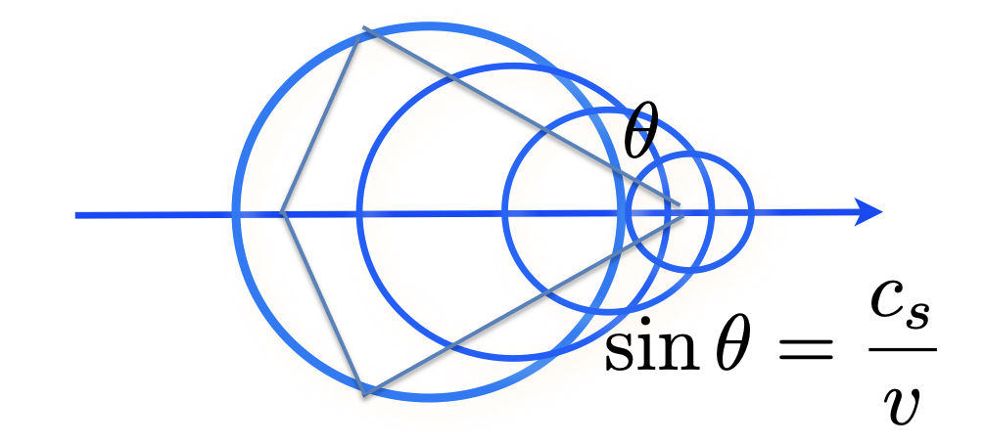
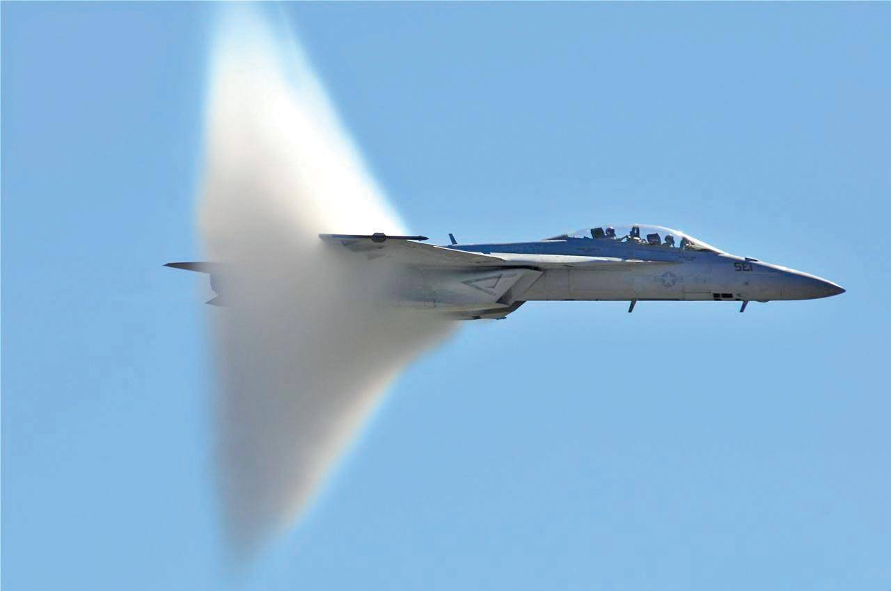
Bow waves, Mach waves

Slide 33
Double peak structure in η
|Δφ|>π/2
Jet-distr
MPI
DF-wake

Slide 34
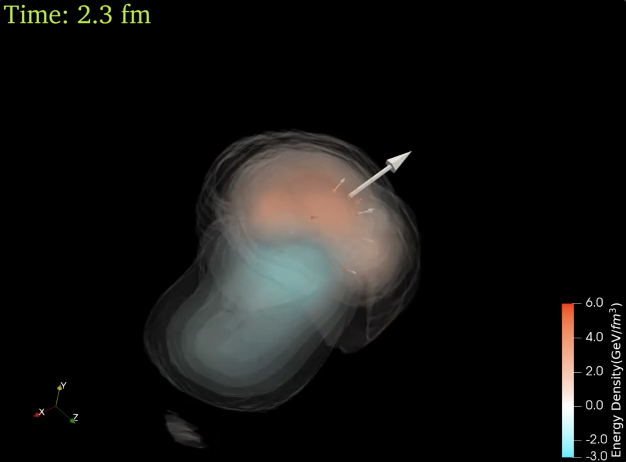
3D structure of diffusion wake
y
x
η

Slide 35
Signal of diffusion wake
Depletion of the background
In the γ direction
Chen, Cao, Luo, Pang, XNW,
PLB777(2018)86

Slide 36
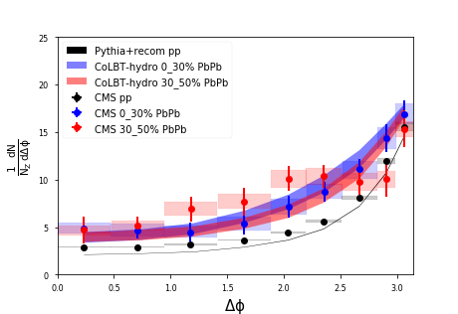
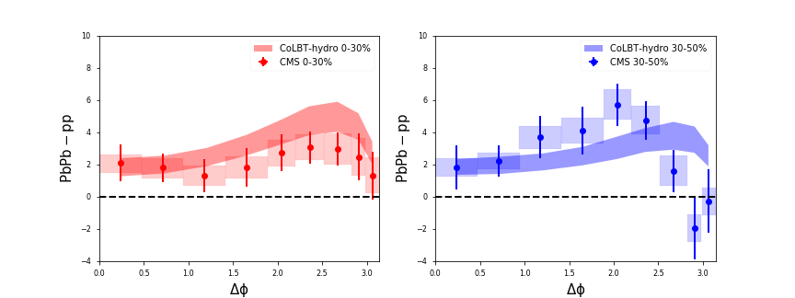
Z-hadron correlation
enhancement
of the away-side
background
enhancement
and broadening
of the jet peak
Chen, Yang, He, Ke, Pang and XNW, 2101.05422

Slide 37
MPI: Multiple parton interaction
XNW & Gyulassy (1991)
Multiple jet production in pp:
Probability of multiple jets (p_{T}>p₀) with at least one jet with p_{T}> p_{T}^{trig}
Enhanced multiple minijet
Production in triggered jet events
Notes:
g_j(b,p_T)=\frac{[\Delta\sigma (p_T)T(b)]^j}{j!} e^{-\Delta\sigma (p_T)T(b)}
g_j(b)=\frac{[\sigma (p_0)T(b)]^j}{j!} e^{-\sigma (p_0)T(b)}
g_j^{\rm trig}(b)=\frac{[\sigma (p_0)T(b)]^j}{j!} \left\{ 1-\frac{[(\sigma(p_0)-\sigma(p_T^{\rm trig})]^j}{\sigma(p_0)^j} \right\} e^{-\sigma (p_0)T(b)}
\approx j \frac{\sigma(p_T^{\rm trig})}{\sigma(p_0)} g_j(b)

Slide 38
MPI subtraction in Z-hadron correlation
Mixed event subtraction

Slide 39
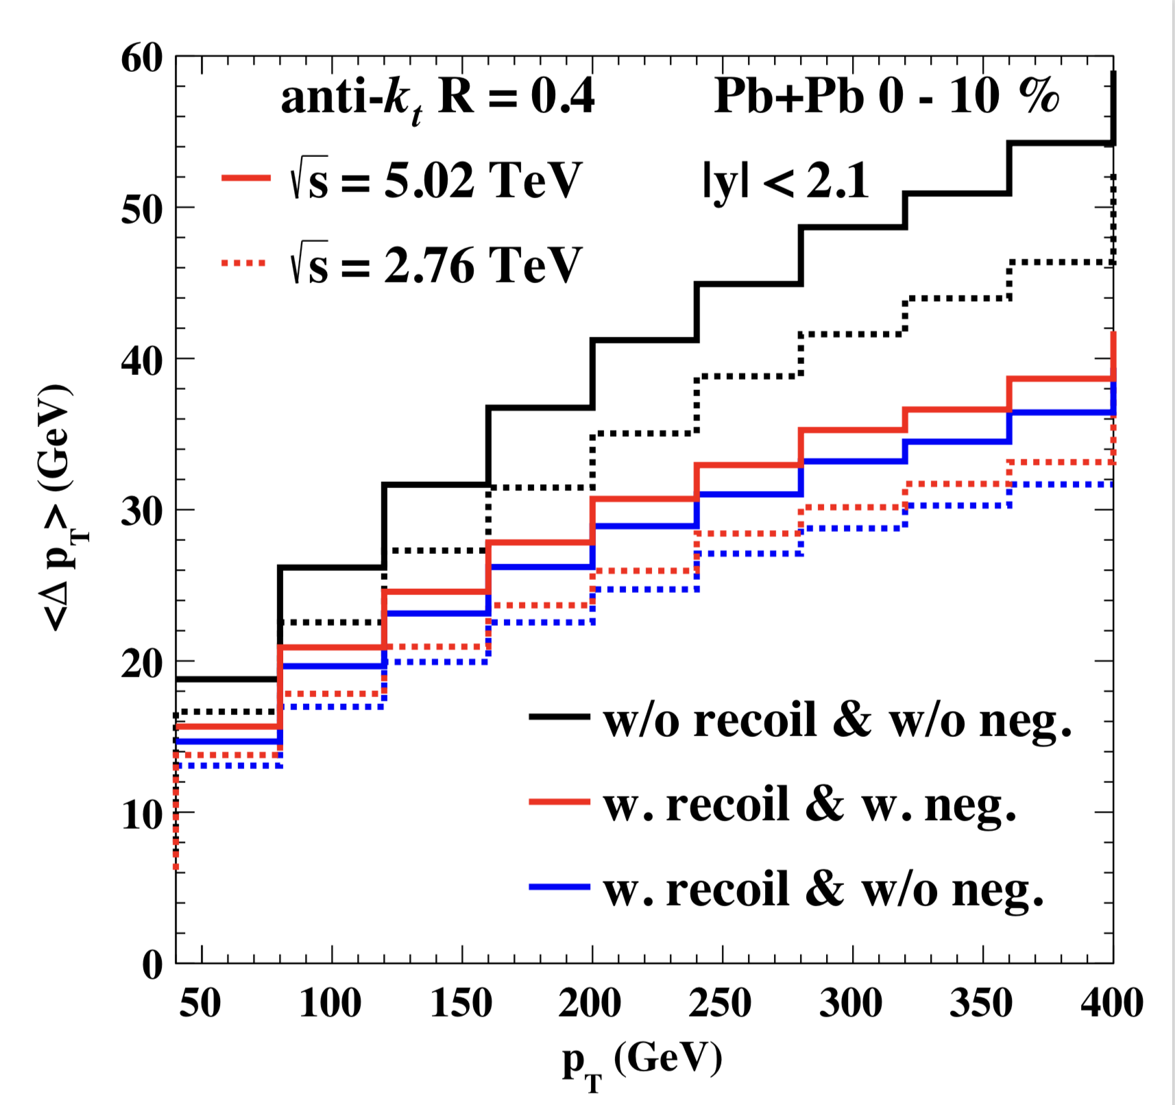
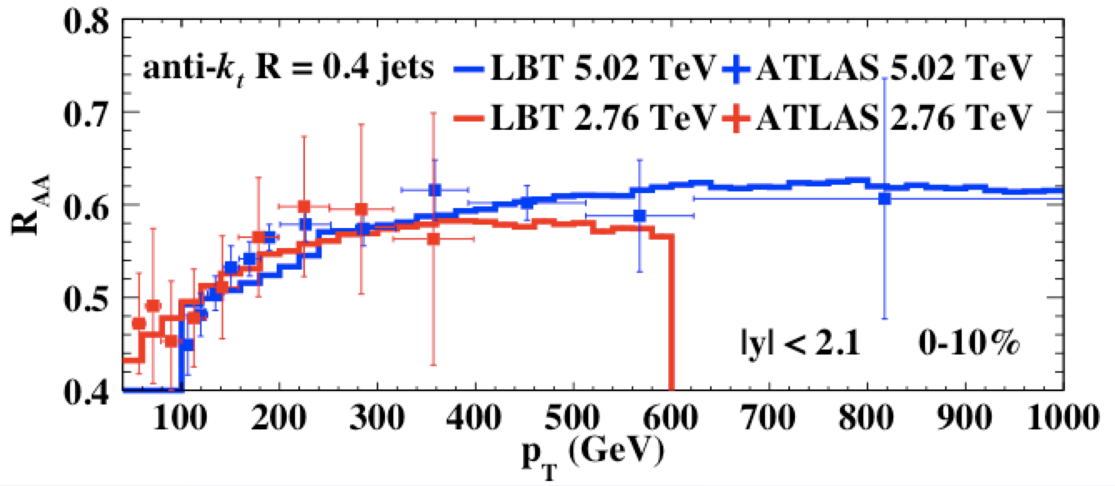
Jet suppression and energy loss
Weak p_{T} dependence: initial jet spectra and p_{T} dependence of energy loss ΔE
Week energy dependence: increase of jet energy loss and the slope of initial spectra
Medium response reduce jet net energy loss
He, Cao, Chen, Luo, Pang & XNW 1809.02525

Slide 40
Energy loss in γ/Z-jet at LHC
Suppression of leading and multiple jets
Zhang, Luo, XNW, Zhang, arXiv:1804.11041
Luo, Cao, He & XNW, arXiv:1803.06785

Slide 41
Hadron spectra from low to high p_{T}
CoLBT-hydro:
Hydro : p_{T}<2 GeV/c
Coal.: 2<p_{T}<6 GeV/c
Frag.: p_{T}>5 GeV
pT<2 GeV/c: radial flow
2<pT<6 GeV/c: coalescence
pT>10 GeV/c: energy loss
Zhao, Ke, Chen, Luo & XNW,
PRL 128 (2022) 2, 022302 (2103.14657 )

Slide 42
Solving R_{AA}-v₂ puzzle
Zhao, Ke, Chen, Luo & XNW,
PRL 128 (2022) 2, 022302 (2103.14657 )

Slide 43
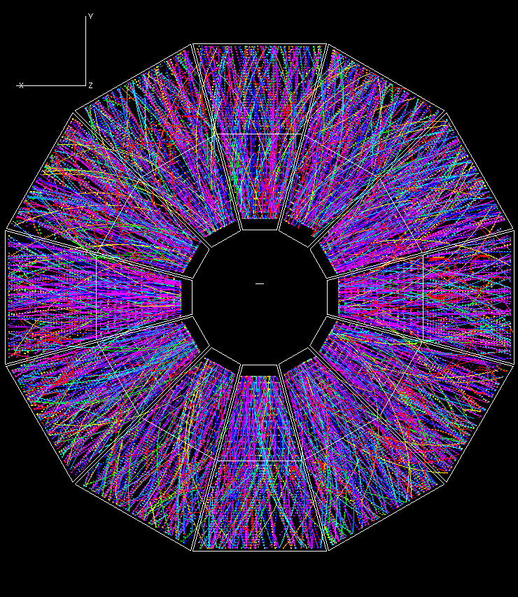
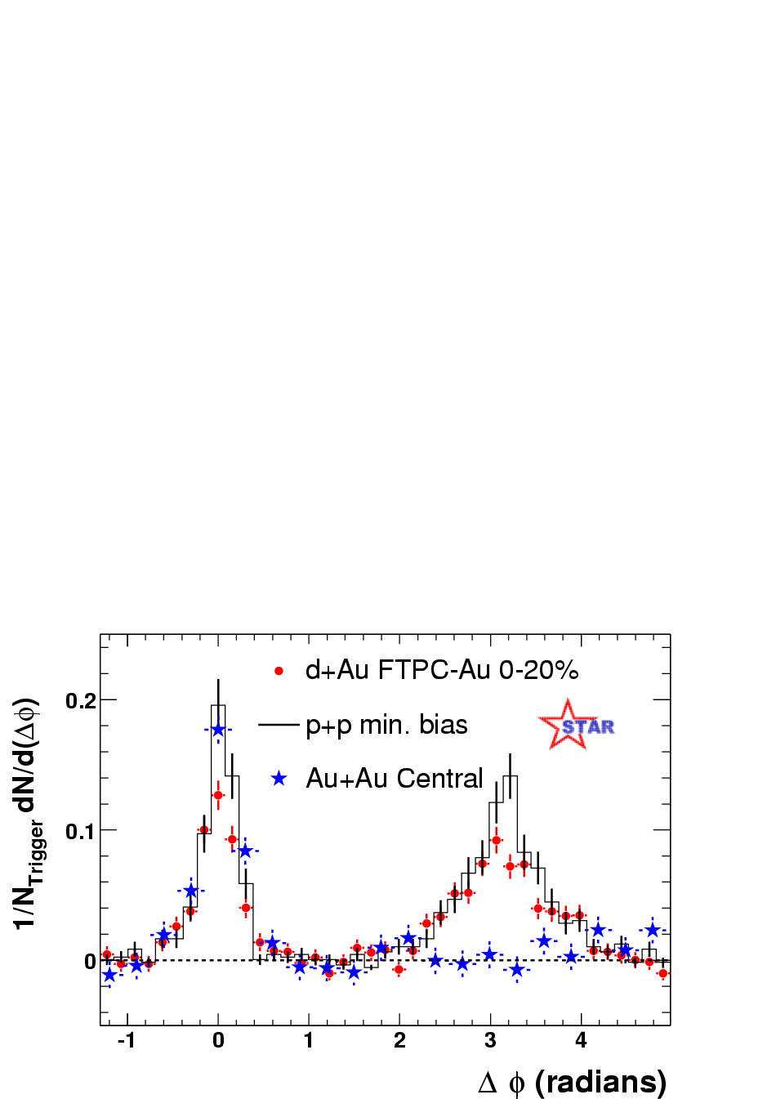
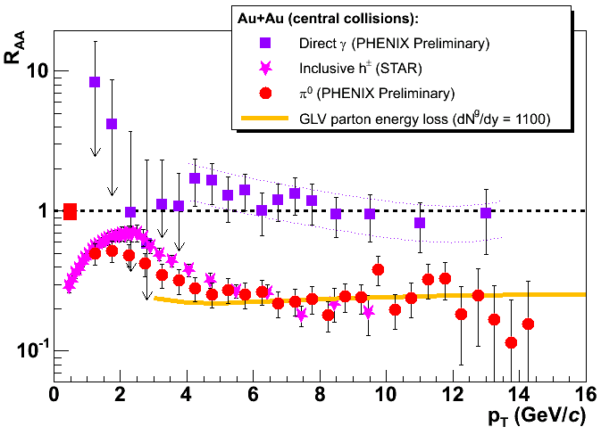
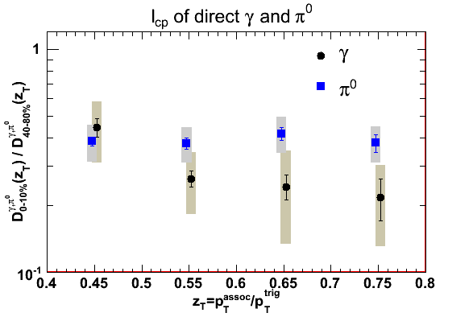
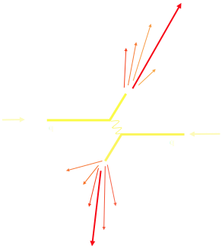
Jet Quenching phenomena at RHIC
Pedestal&flow subtracted
STAR Preliminary
Notes:
RHIC experiments marked a milestone for jet quenching, from a theoretical concept to a reality.

Slide 44
Medium response & soft gluon radiation
Medium response:
Medium-induced gluon radiation:
Formation time:
Mean-free-path
limits the formation time
Notes:
\tau_f=\frac{2\omega}{k_T^2}
k_T^2\approx \tau_f \hat q, \tau_f\approx \sqrt{2\omega/\hat q}
\tau_f \le \lambda \sim 1/T
\omega \approx \lambda^2\hat q/2 \sim T

Slide 45
Diffusion wake and EoS
p_{T}=1-2 GeV/c

Slide 46
Diffusion wake and viscosity
p_{T}=1-2 GeV/c

