Slide 1




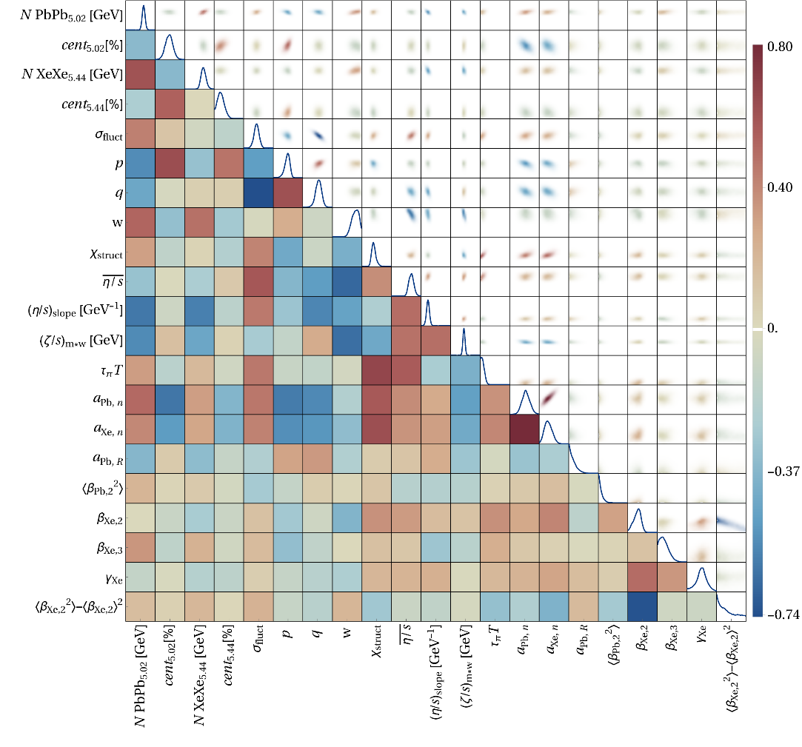
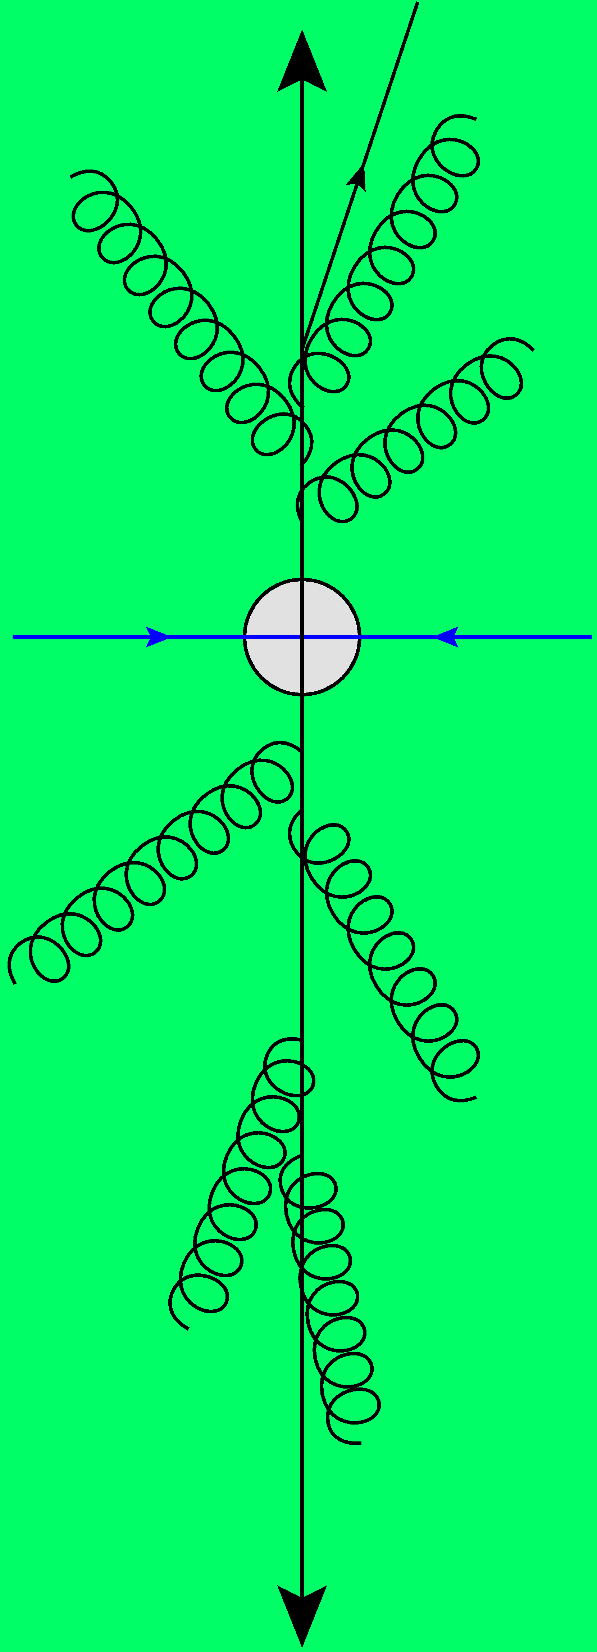
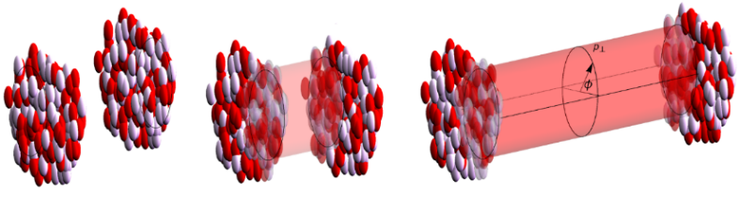
A global analysis of the shapes of
Xe-129 and Pb-208 at the LHC
Towards a precision analysis of heavy ion collisions
Work with Govert Nijs and Giuliano Giacalone
Wilke van der Schee
XXXI Quark Matter
Frankfurt, 8 April 2025

Slide 2

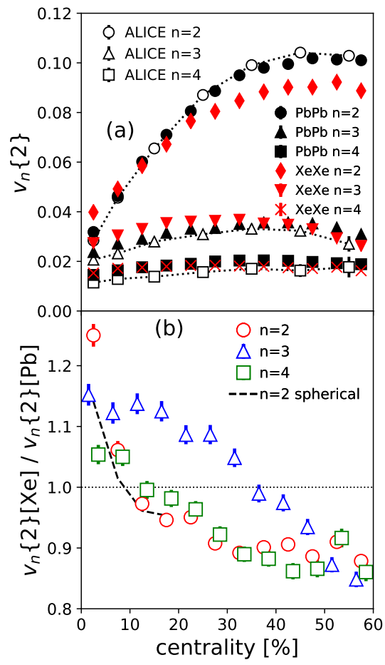
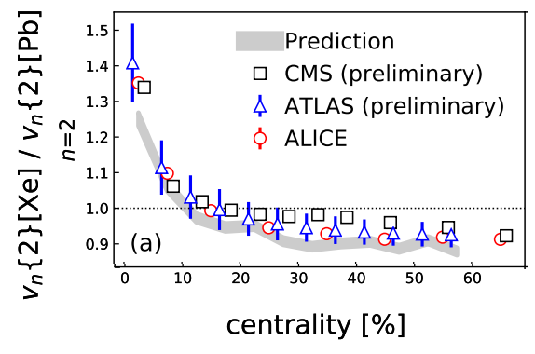
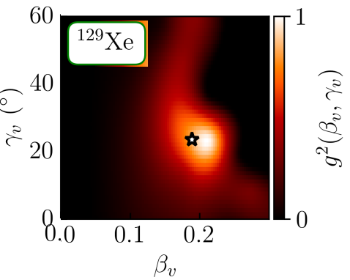
Prediction
Experiment
Xenon-129: a deformed nucleus
Elliptic deformation (β₂):
Was known from nuclear structure (0.16)
Prediction (MSc thesis Giacalone)
Xenon 6 (!) hour LHC run: slightly bigger effect
Sophisticated nuclear structure (PGCM)
confirms slightly larger β₂ (0.19)
Improved theory
Giuliano Giacalone, Jacquelyn Noronha-Hostler, Matthew Luzum and Jean-Yves Ollitrault, Hydrodynamic predictions for 5.44 TeV Xe+Xe collisions (2017)
Giuliano Giacalone, Jacquelyn Noronha-Hostler, Matthew Luzum, Jean-Yves Ollitrault, Confronting hydrodynamic predictions with Xe-Xe data (2018)
Benjamin Bally, Michael Bender, Giuliano Giacalone and Vittorio Soma, Evidence of the triaxial structure of ¹²⁹Xe at the Large Hadron Collider (2021)

Slide 3
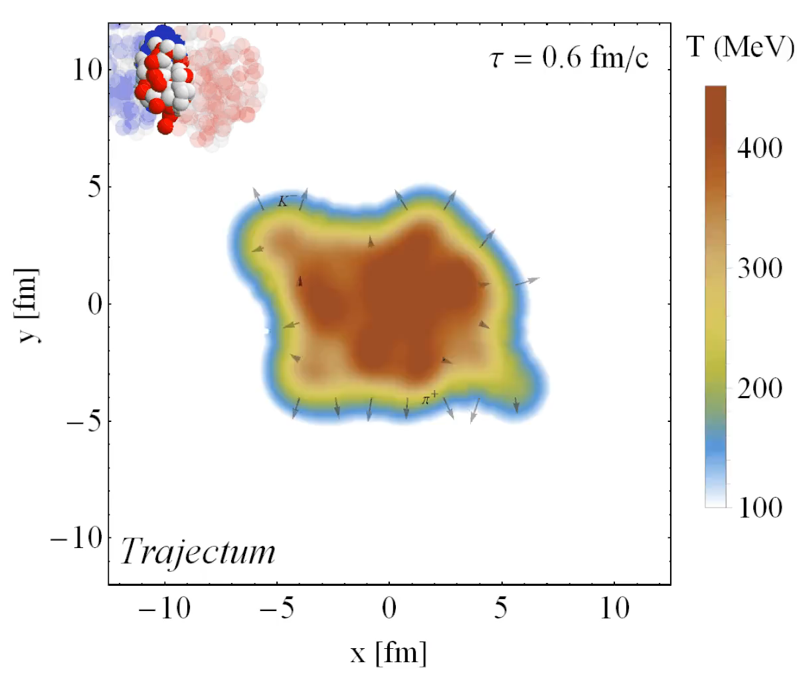
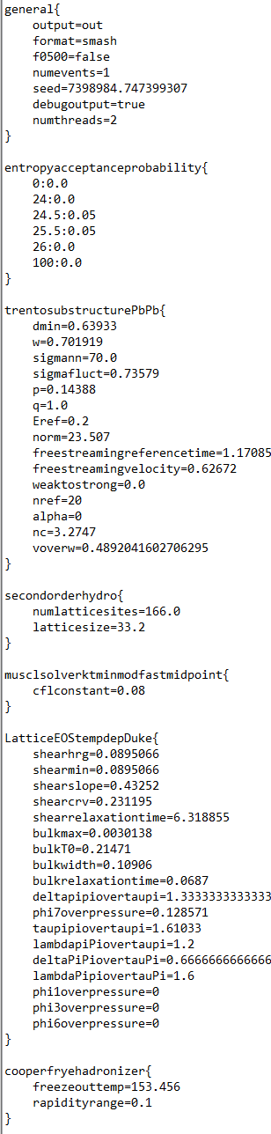
Quark-gluon plasma
Trajectum (Trento + hydro + freeze-out)
  Parallelised: can analyse unlimited
  number of events
Two important features
  Initial geometry determines momentum anisotropy: elliptic flow
  Smaller droplets expand faster:
  higher mean p_{T}
http://sites.google.com/view/govertnijs/trajectum
http://wilkevanderschee.nl/trajectum

Slide 4
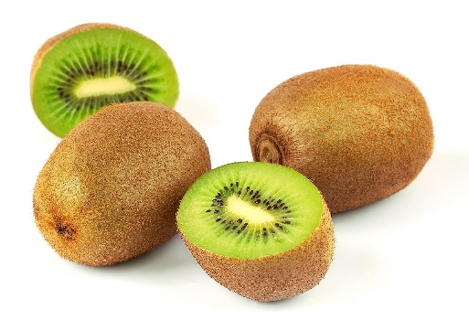
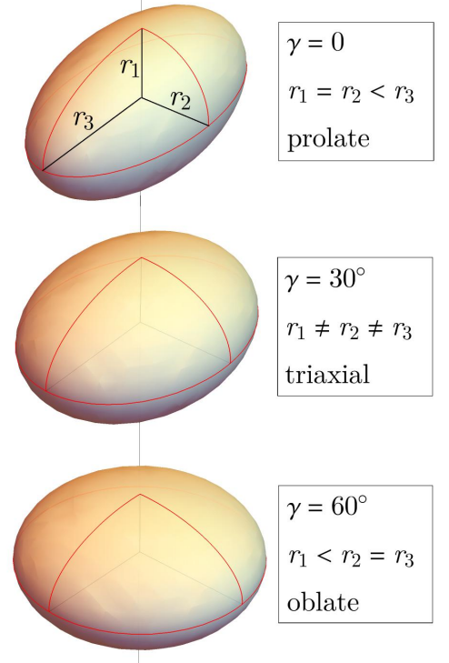
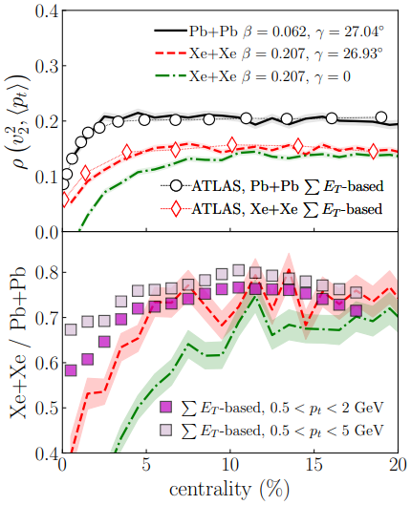
Xenon-129: a triaxial nucleus and ρ₂ (elliptic flow-mean p_{T} correlation)
Elliptic deformation (β₂):
Prolate or oblate: still has symmetry axis
Triaxial: all axes are independent
ρ₂ observable sensitive
  Measures correlation between
  elliptic flow and mean p_{T}
What’s happening?
Benjamin Bally, Michael Bender, Giuliano Giacalone and Vittorio Soma, Evidence of the triaxial structure of ¹²⁹Xe at the Large Hadron Collider (2021)

Slide 5
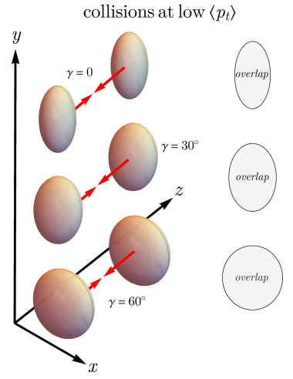
Xenon-129: a triaxial nucleus: what’s happening
Smart trick: two selections
Central and large (full overlap, low p_{T})
Prolate: large v₂ (negative ρ₂)
Oblate: small v₂ (positive ρ₂)
Conclusion ρ₂ determines γ
Alternatively:
Central and spherical (full overlap, low v₂)
Prolate: small area, high p_{T} (negative ρ₂)
Oblate: large area , low p_{T} (positive ρ₂)
Conclusion ρ₂ determines γ
Note: just v₂ doesn’t work, β₂ gives v₂ in both cases (!)
Benjamin Bally, Michael Bender, Giuliano Giacalone and Vittorio Soma, Evidence of the triaxial structure of ¹²⁹Xe at the Large Hadron Collider (2021)

Slide 6

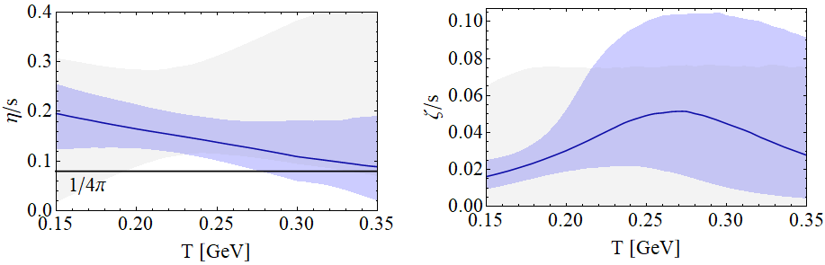

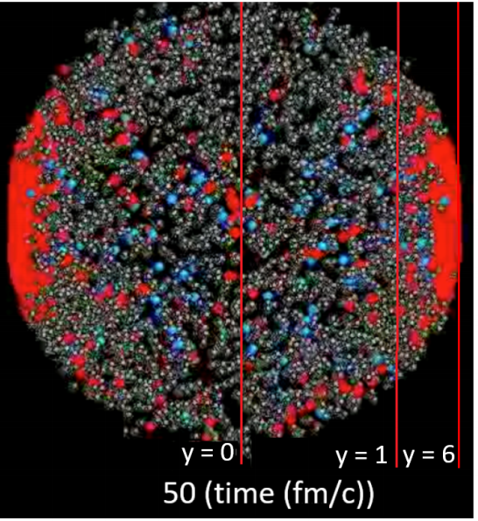
Standard model of heavy ion collisions
Wilke van der Schee, CERN/Utrecht
(# parameters)
Initial stage (15)
Viscous hydrodynamics (4)
Cascade of hadrons
SMASH
Subnucleonic structure? (6)
with hydrodynamised initial stage
Fluctuations? (1)
Shape (3 Pb, 5 Xe)
Shear viscosity (2)
Bulk viscosity (1)
Second order transports: 1
Jonah Bernhard, Scott Moreland and Steffen Bass, Bayesian estimation of the specific shear and bulk viscosity of quark–gluon plasma (2019)
Govert Nijs, WS, Umut Gursoy and Raimond Snellings, A Bayesian analysis of Heavy Ion Collisions with Trajectum (2020)

Slide 7
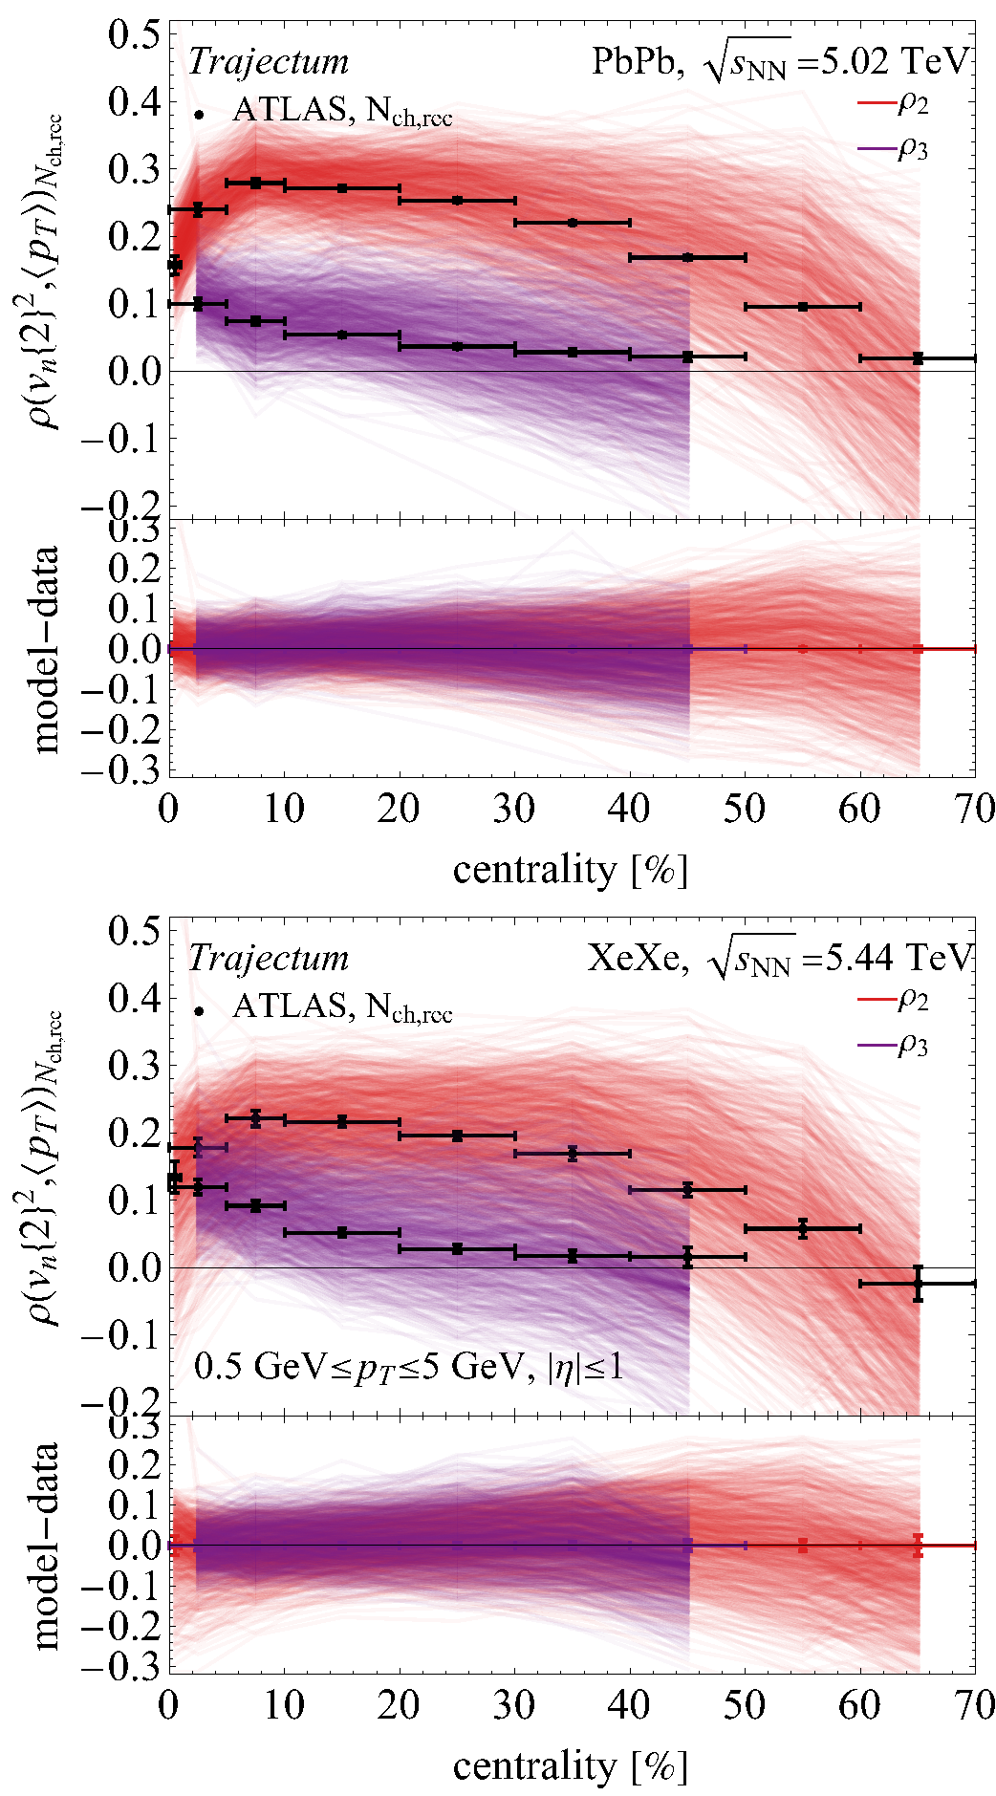
Lead and Xenon collisions and the ρ₂ observable
Run model at 750 semi-random points in parameter space
  Relatively nice spread of model around ATLAS data
  Relatively good statistics (oversampling ultracentral)
  Xenon a bit wider if looking carefully (0-1%)
See talk by Emil Nielsen, Mon 16:50

Slide 8
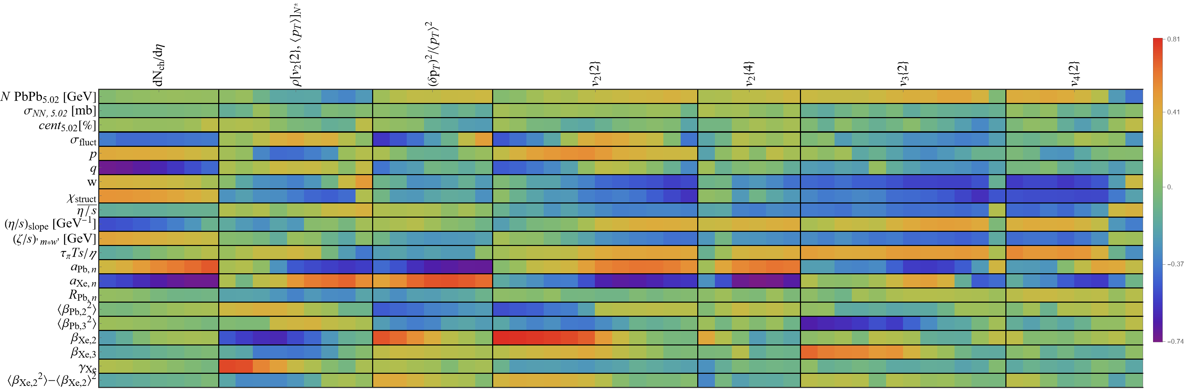
Xenon/Lead ratio, all observables, all parameters
Ratio: mostly sensitive to nuclear structure parameters
  Central ρ₂ observable uniquely sensitive to γ parameter
  Xenon a bit wider if looking carefully (0-1%)

Slide 9
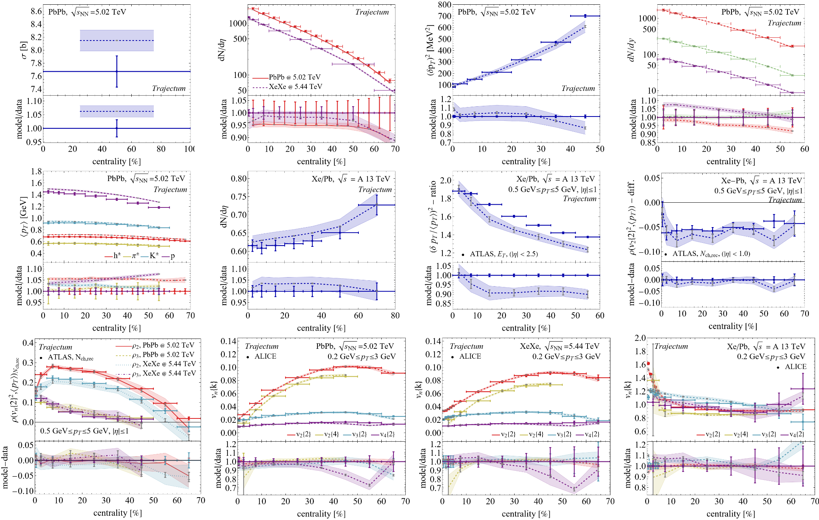
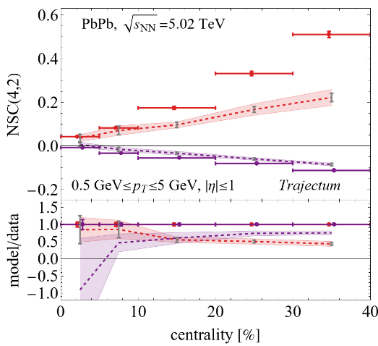
All observables fitted
Exception: SC(2,n):

Slide 10
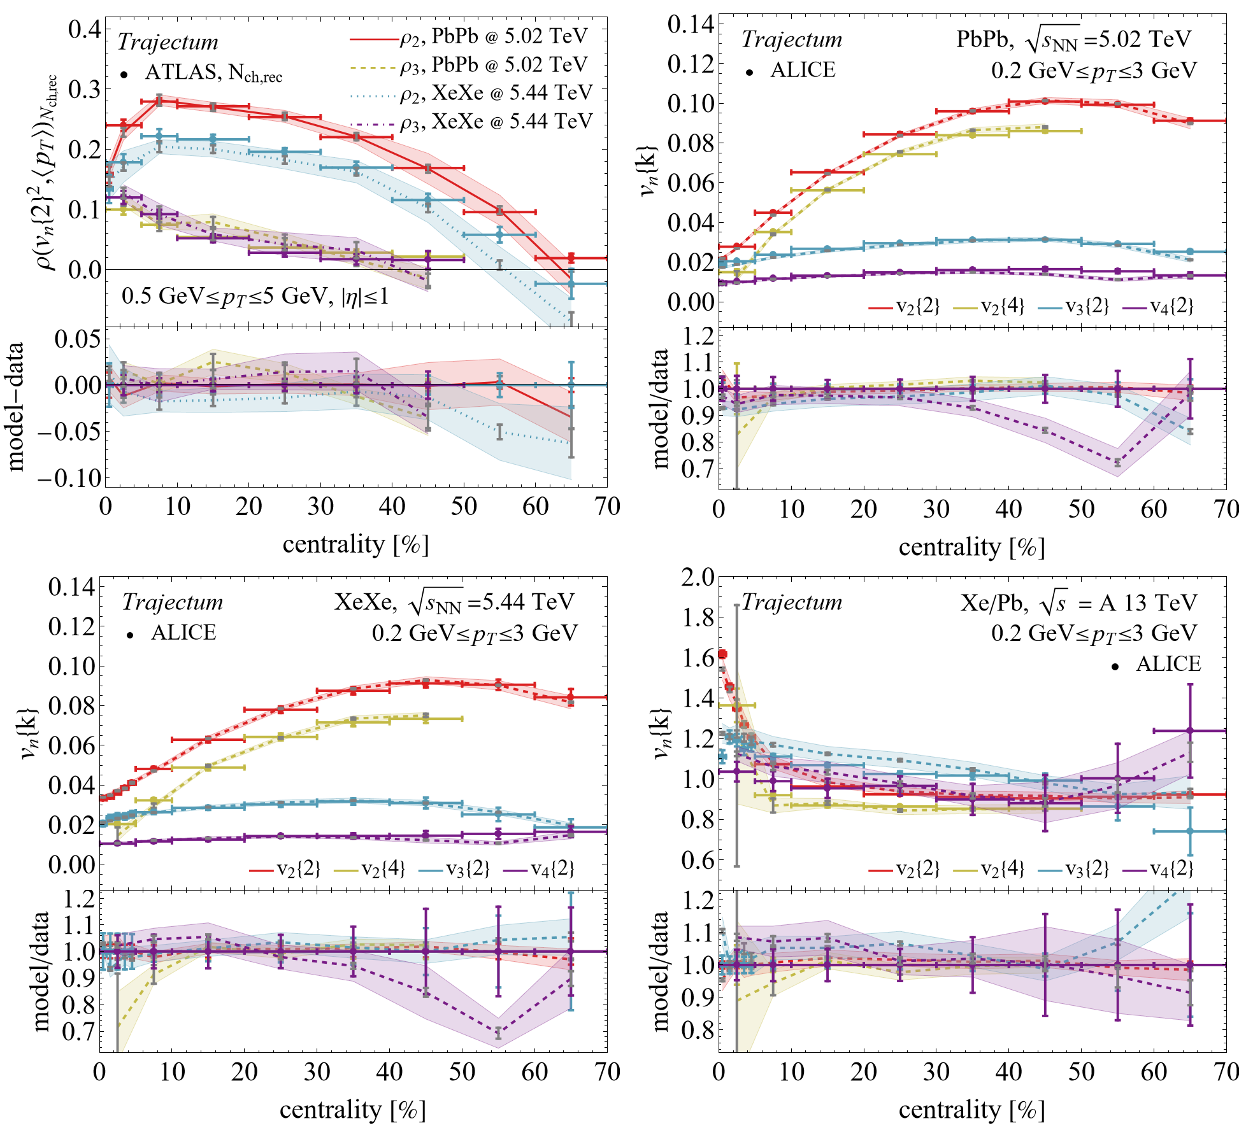
Highlighted observables
Anisotropic flow and
ρ_{n} correlator

Slide 11
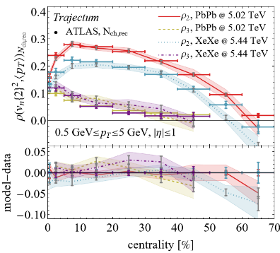
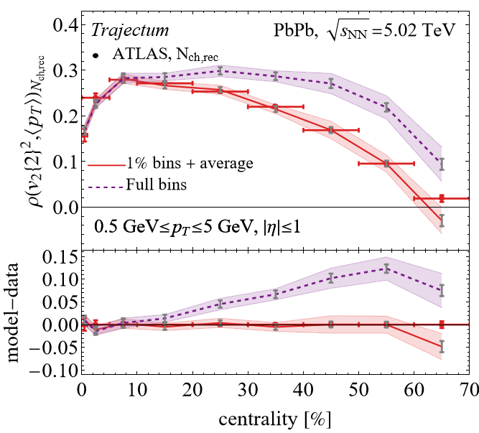
Intermezzo: Centrality selection: details matter?
I skipped an important detail
  The correlator is done in small centrality bins (1% for us)
  Obtain larger bins by averaging
  Relatively big effect (up to 0.1, exp uncert. is 0.01)
How to define centrality?
  Impact parameter is old-fashioned
  Event activity; but how and where?

Slide 12
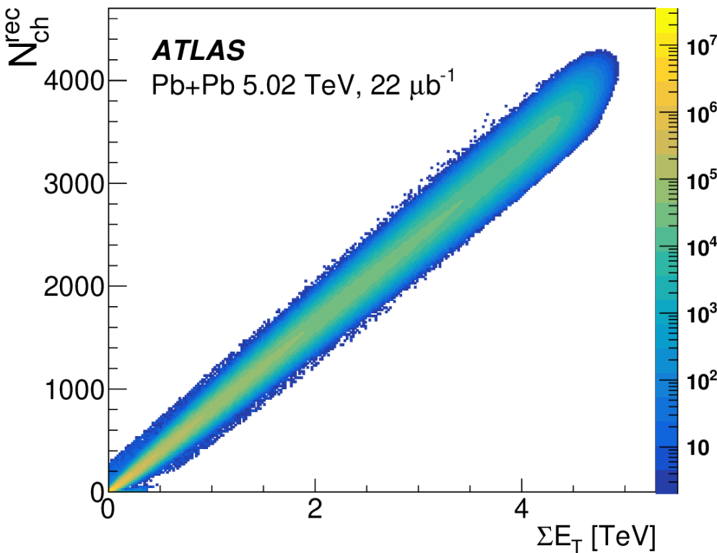
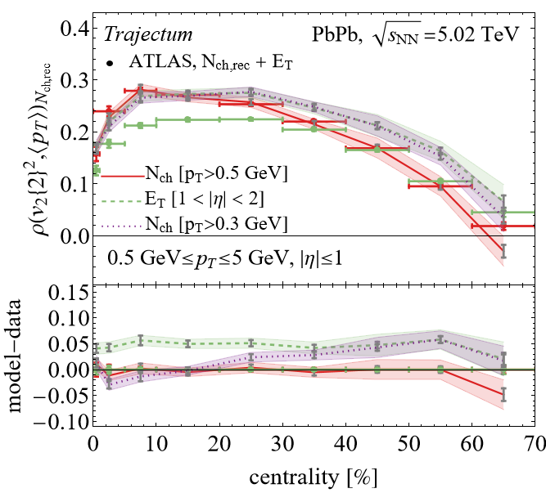
Centrality selection: details matter?
Forward (E_{T}) versus mid-rapidity (Nch)
  Forward considered `better’ (ATLAS, lower spread)
  Mid-rapidity closer to our model (boost invariant)
Credit to ATLAS: HEPdata has 445 tables (!) that allows to figure these things out
Somewhat ironic:
ATLAS sees big effect at central collisions
Trajectum has big effect at peripheral collisions
Trajectum: big effect p_{T} cut on N_{ch} (purple)
ATLAS, Correlations between flow and transverse momentum in Xe+Xe and Pb+Pb collisions at the LHC with the ATLAS detector: a probe of the heavy-ion initial state and nuclear deformation (2022)

Slide 13
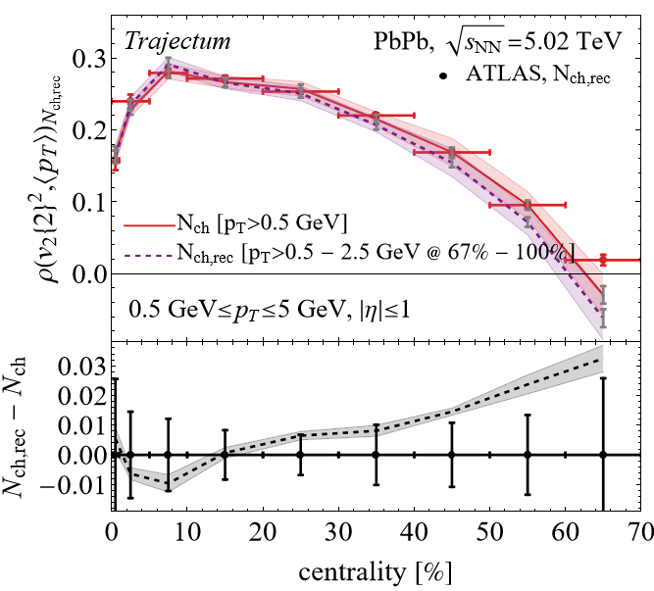
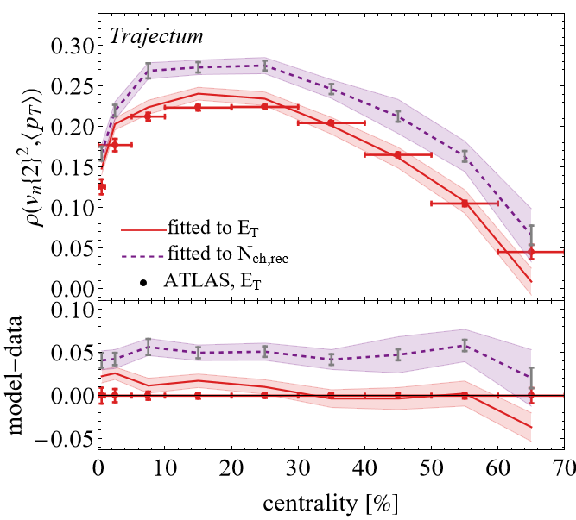
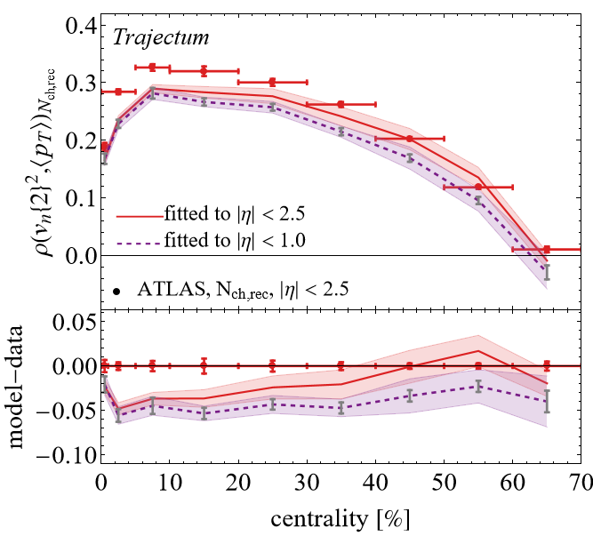
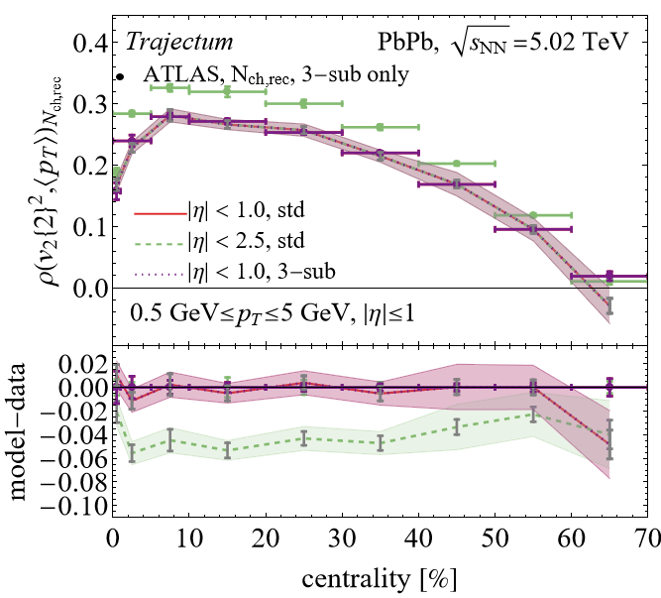
More details (ask me later if interested)
Detector effects potentially important (N_{ch} versus N_{ch,rec})
Refitting model to E_{T} selected (works) or eta range 2.5 (does not work)
Standard versus 3-sub event method: equal for Trajectum, fits better for ATLAS 3-sub (less non-flow at peripheral)

Slide 14
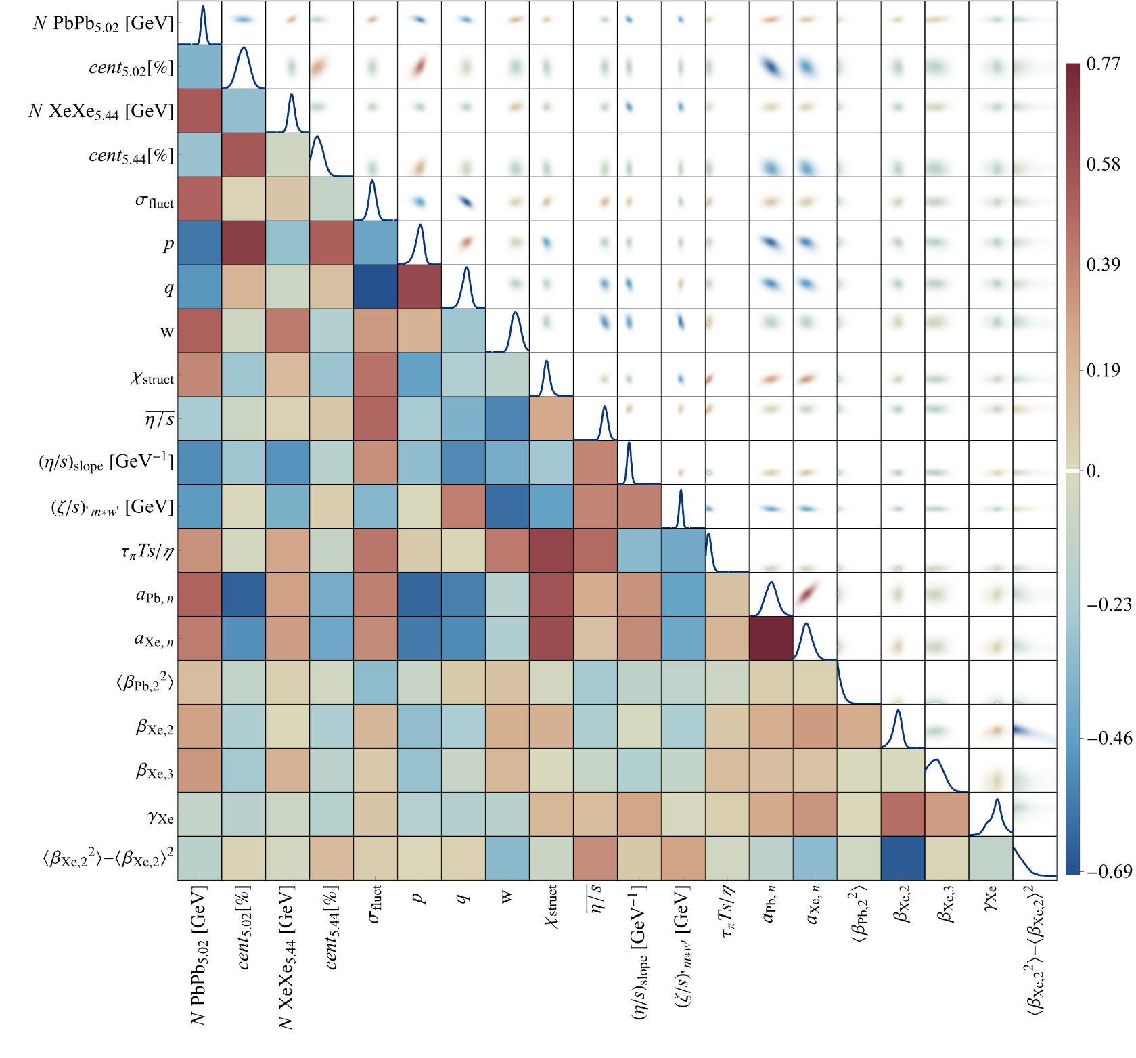
Posterior correlations
Mostly here for completeness
  Strong correlation neutron skin Pb and Xe
  Not many correlations Xe shape
    Extraction more robust

Slide 15
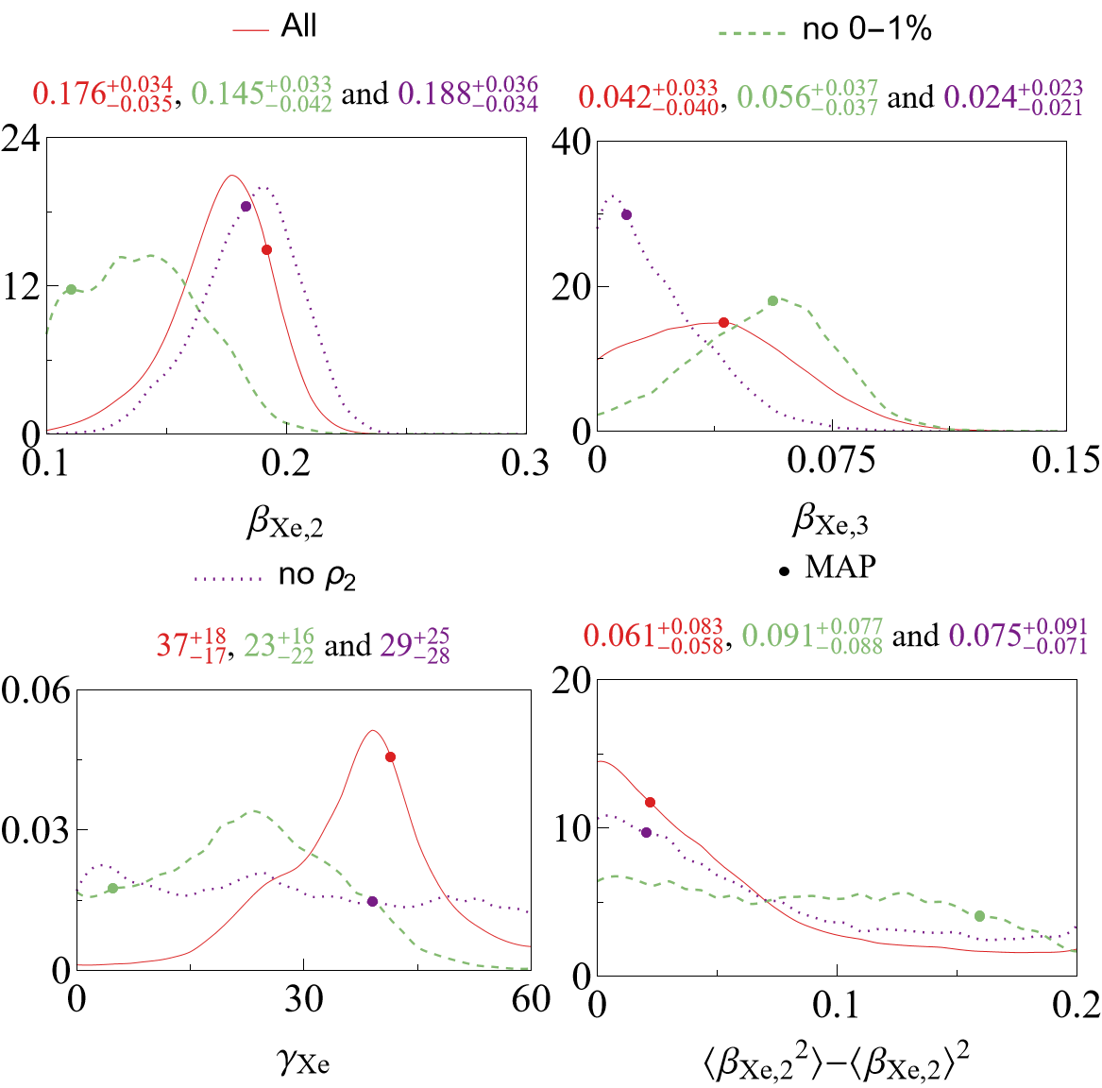
Xenon deformation: three posterior distributions
Main chain (red),
  Xenon is a highly deformed triaxial nucleus (!)
Without 0-1% ultracentral collisions (green),
  Essential to get constraint on elliptic deformation
Without ρ_{n} anisotropic flow – mean pT correlator (purple)
  No constraint on triaxiality

Slide 16
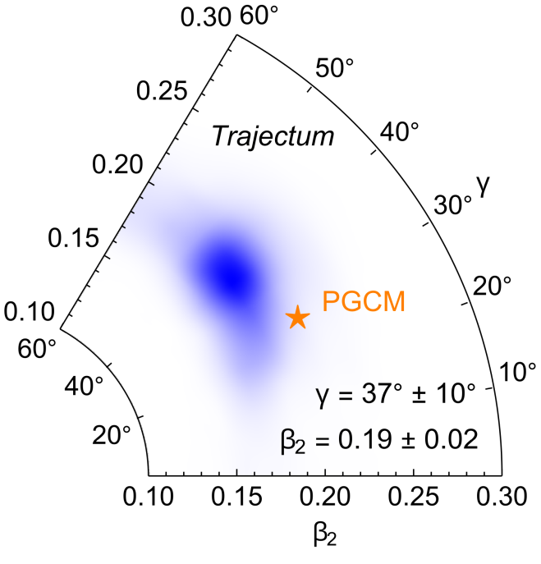

Xenon deformation: main result
See talk by Govert Nijs, Thu 18:00
LHC [Trajectum]
First quantitative measurement of Xenon triaxiality
Matches well with theoretical PGCM estimate
Theory [PGCM]
Benjamin Bally, Michael Bender, Giuliano Giacalone and Vittorio Soma, Evidence of the triaxial structure of ¹²⁹Xe at the Large Hadron Collider (2021)

Slide 17
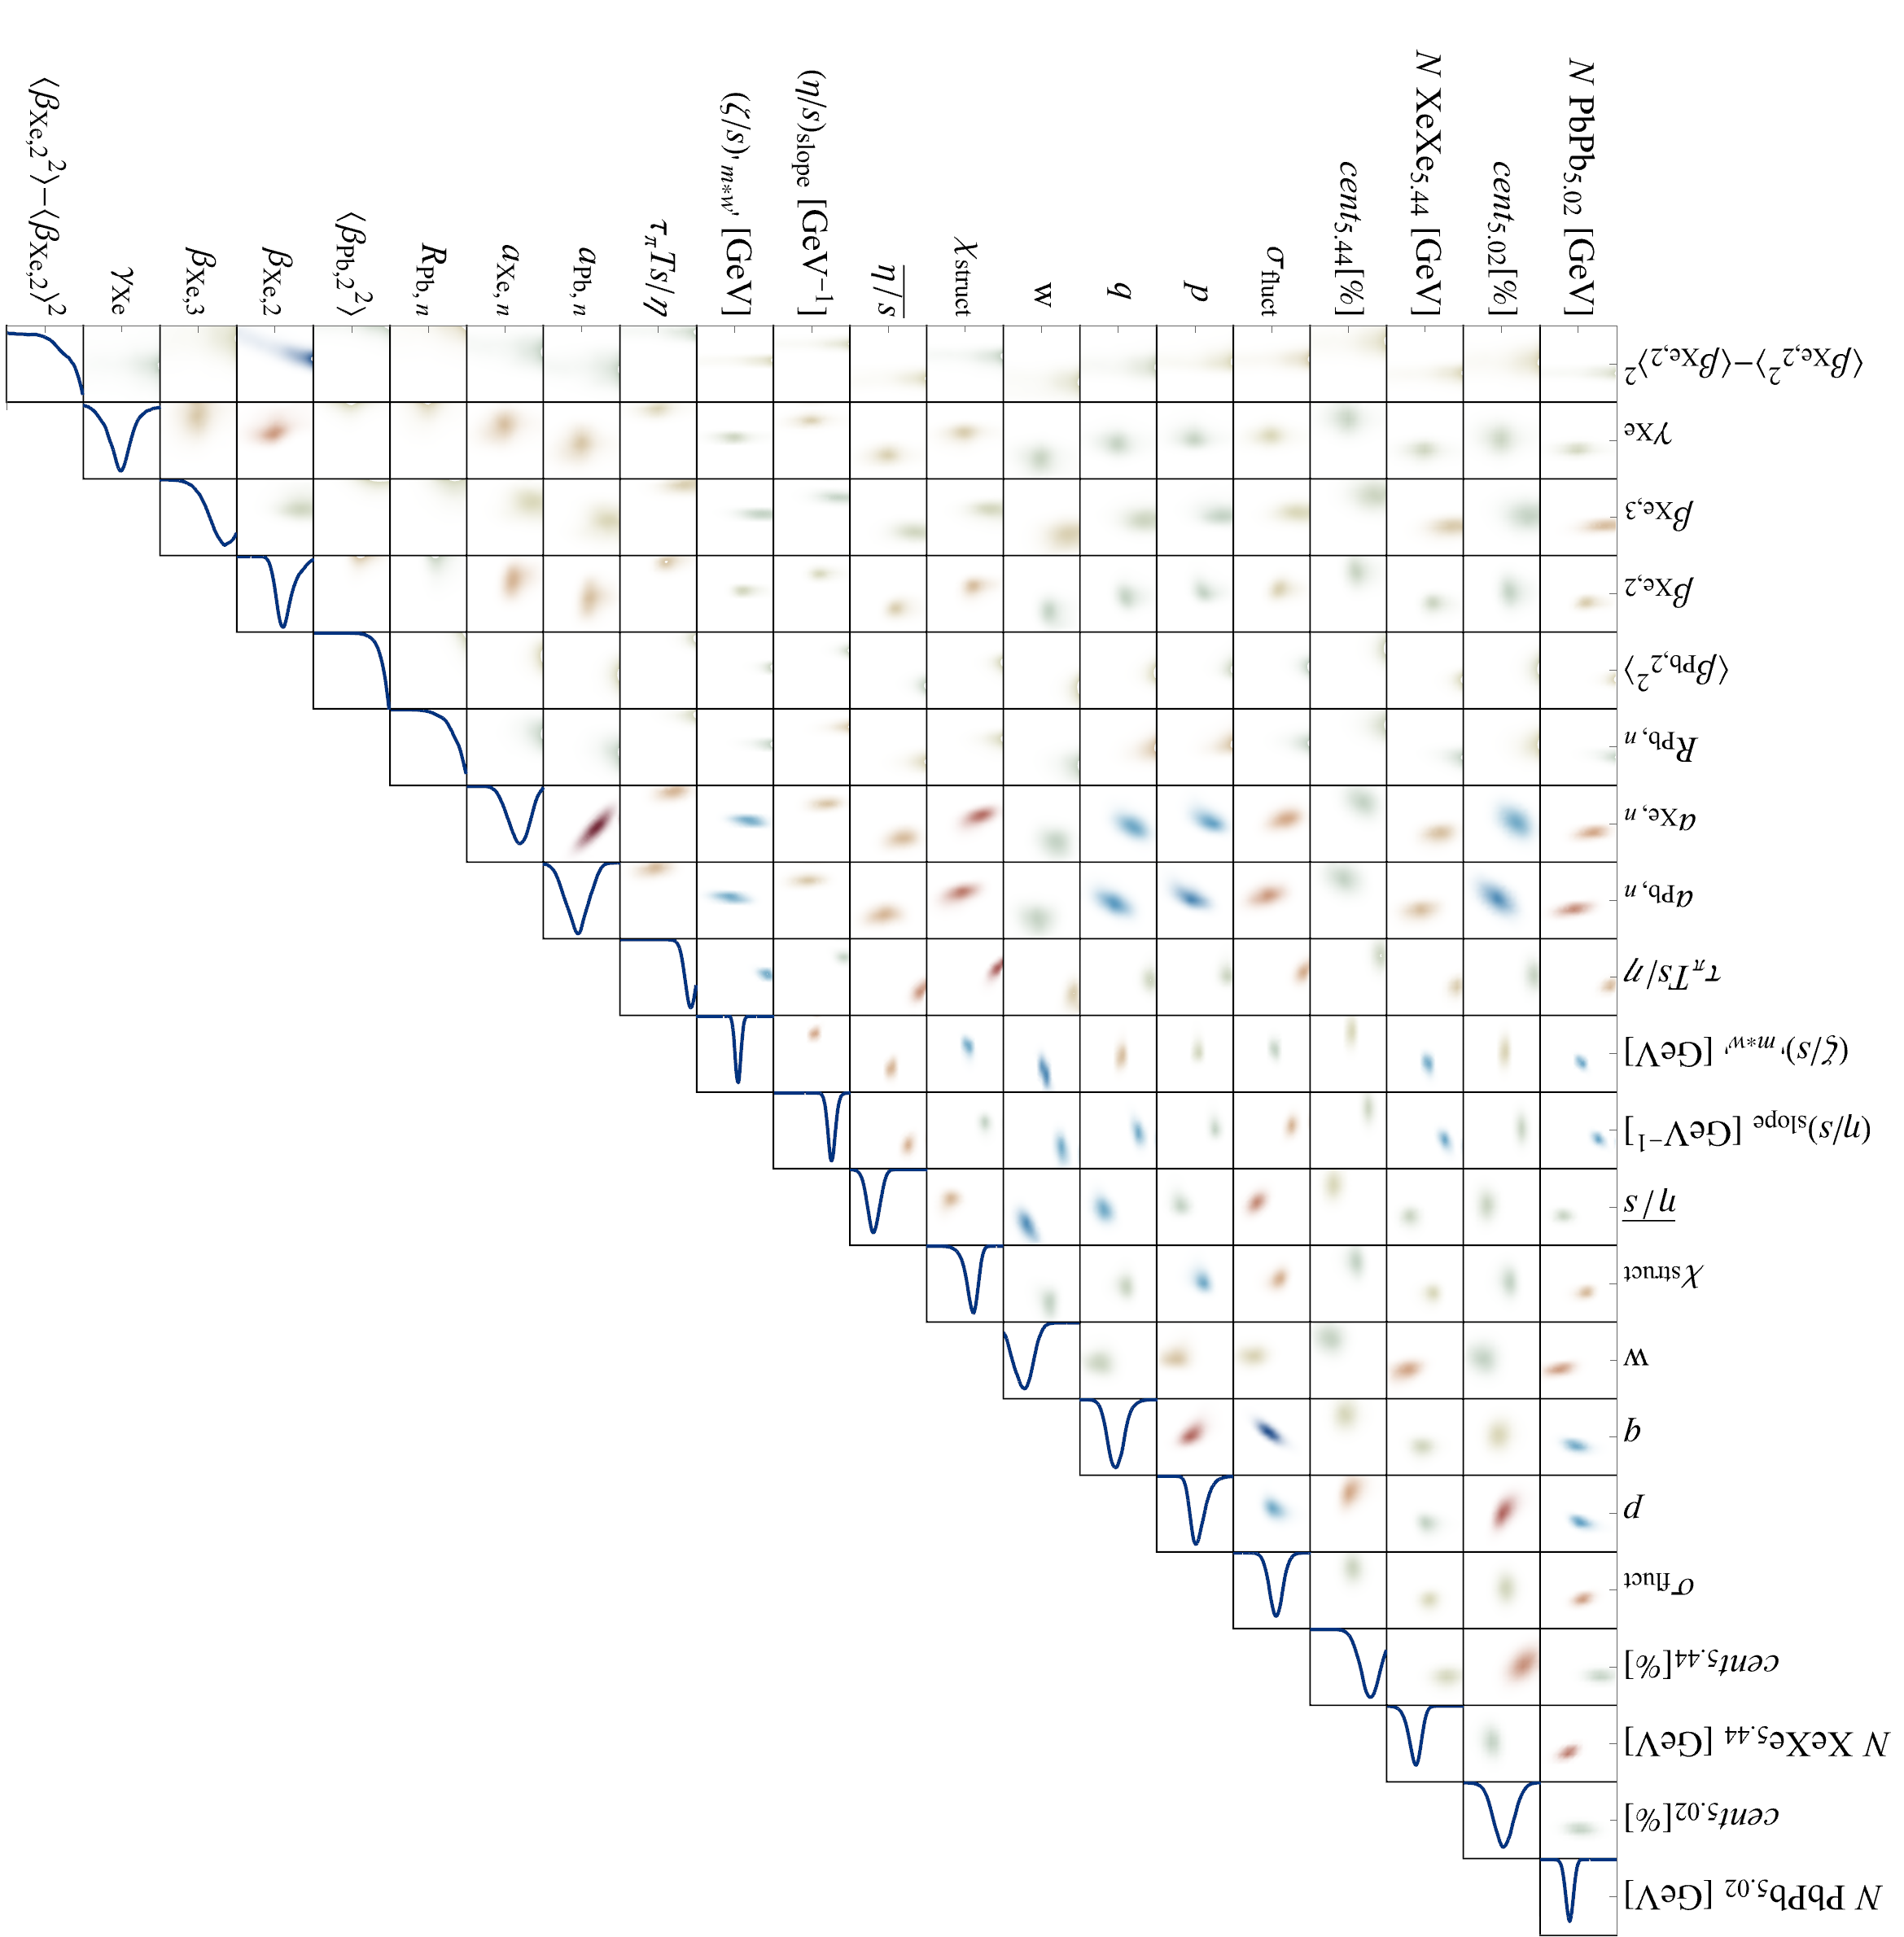

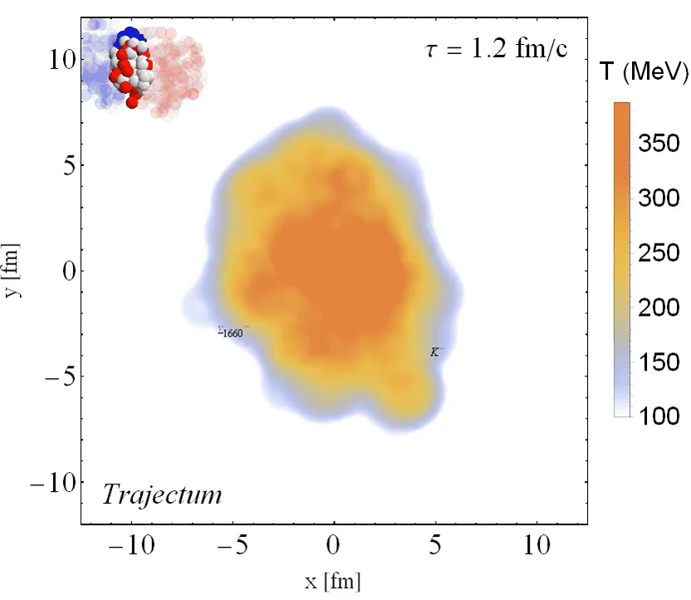
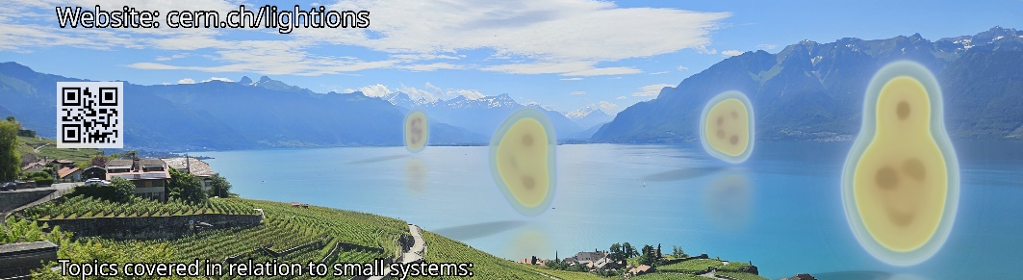
Discussion
First quantitative measurement of Xenon-129 triaxiality
  Comprehensive global analysis, tight constraint on ellipticity
  Constraints by ultracentral anisotropic flow and ρ_{n} correlator
¹⁶Oxygen & ²⁰Neon collisions to be performed at the LHC summer 2025!
  Much better control over small system `flow’
  Can we understand nuclear structure? Alphas?
  QGP flow and nuclear structure will go hand in hand

Slide 18
Back-up

Slide 19
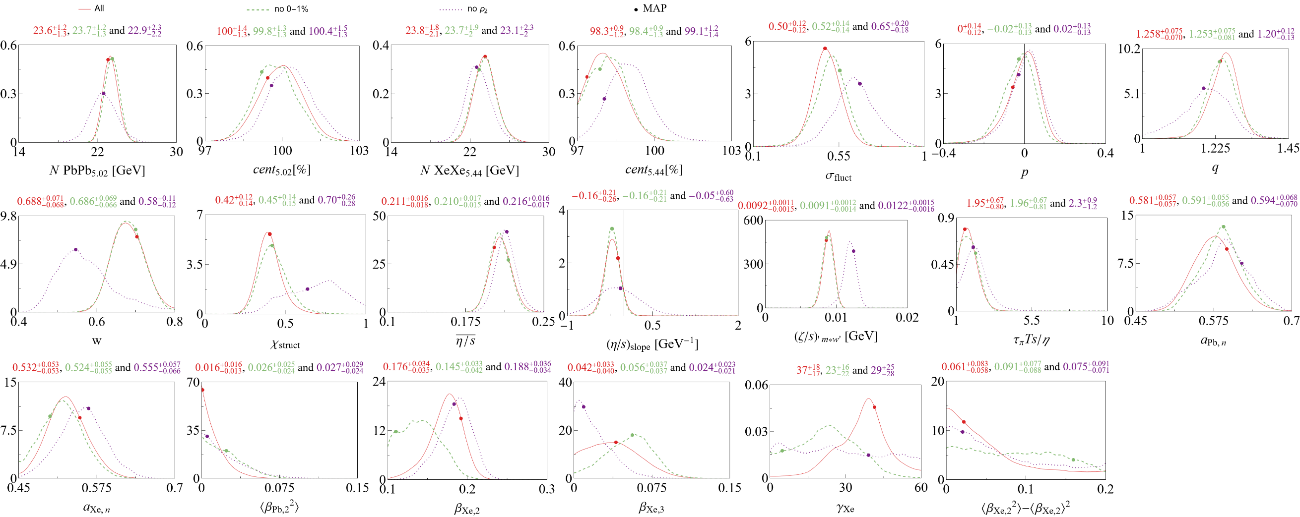
Full posterior

Slide 20
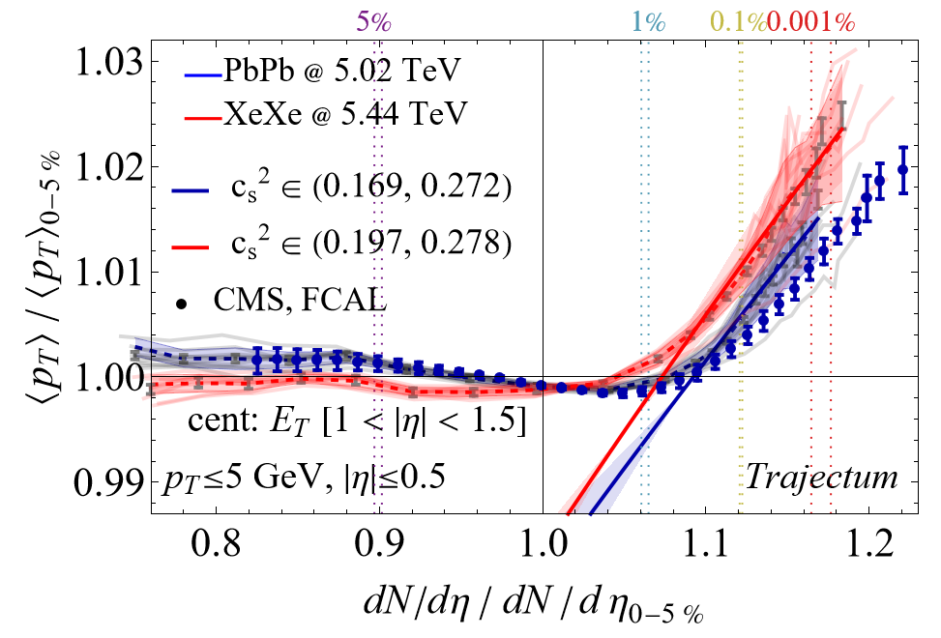
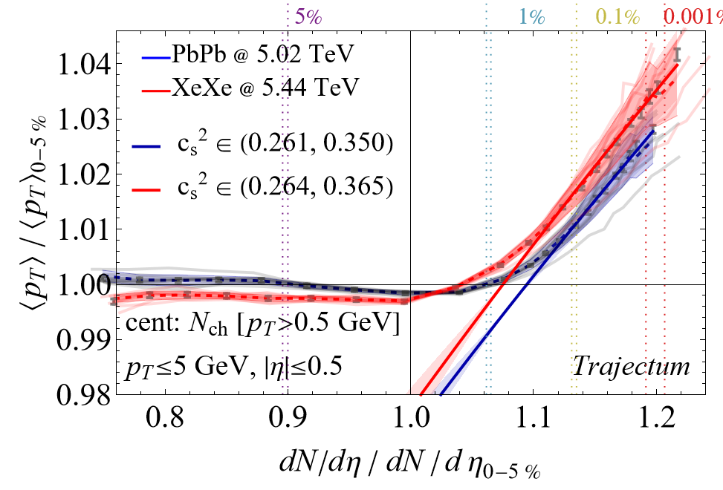
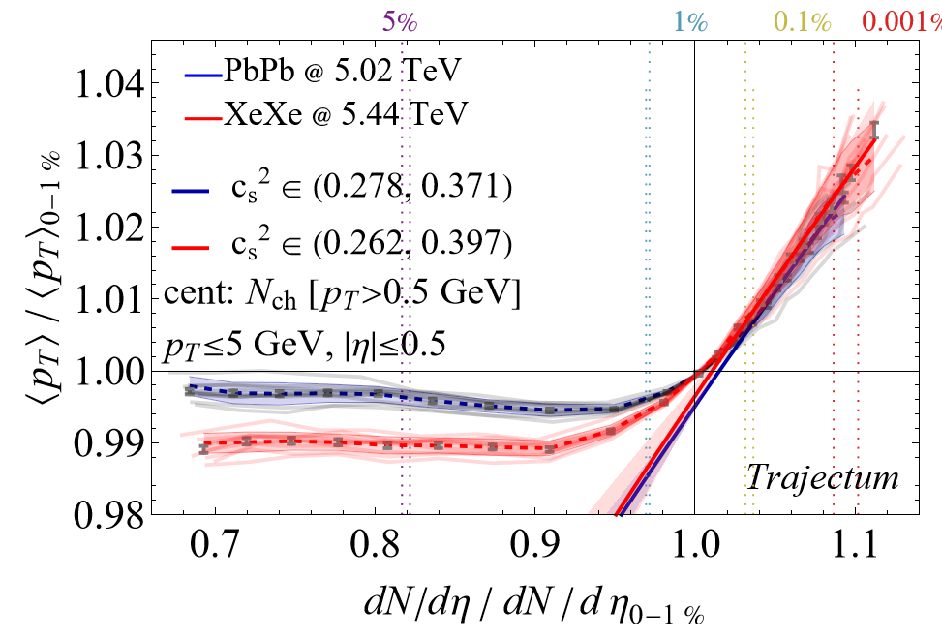
Ultracentral mean transverse momentum

Slide 21
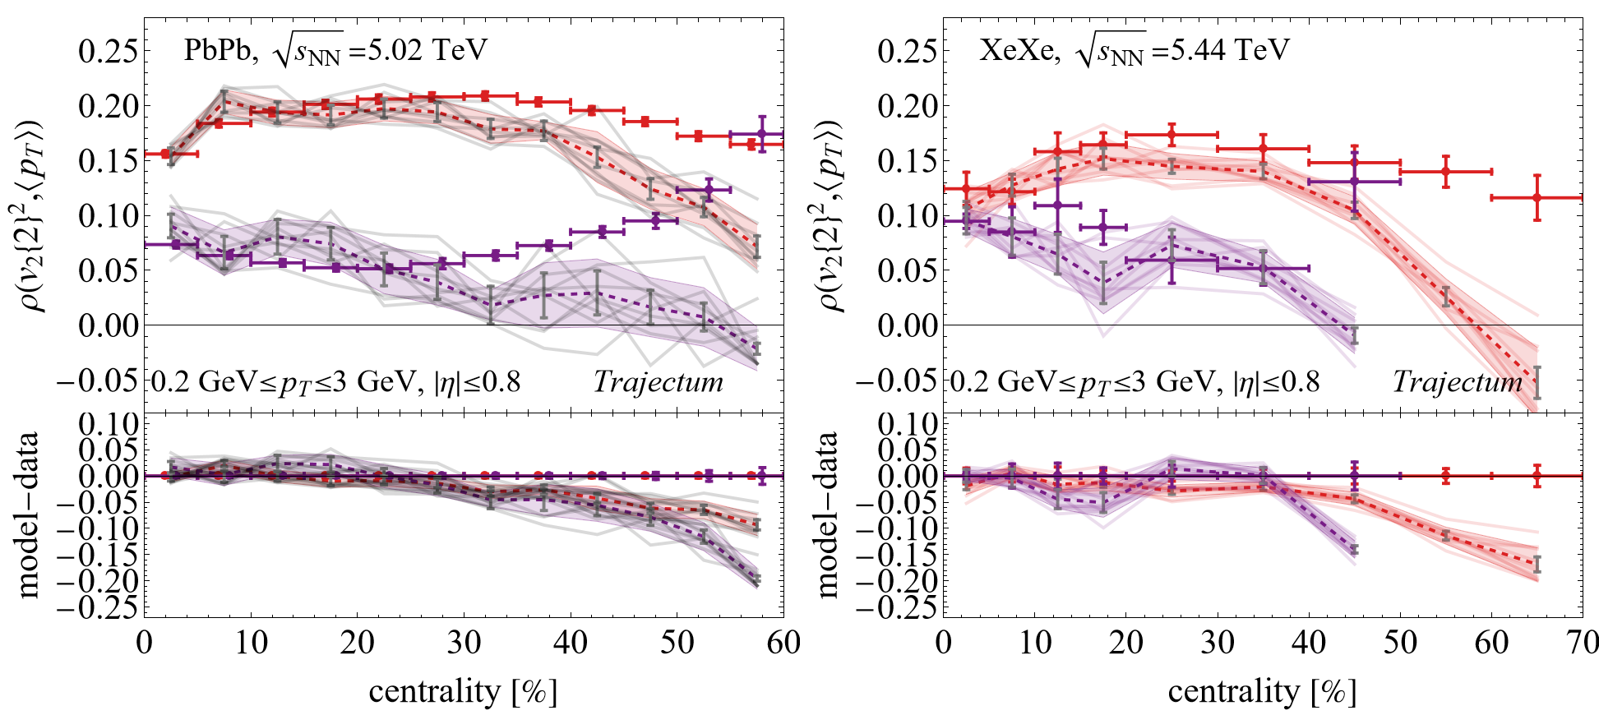
Comparison with ALICE; small tension with ATLAS peripheral? Centrality selection?

Slide 22
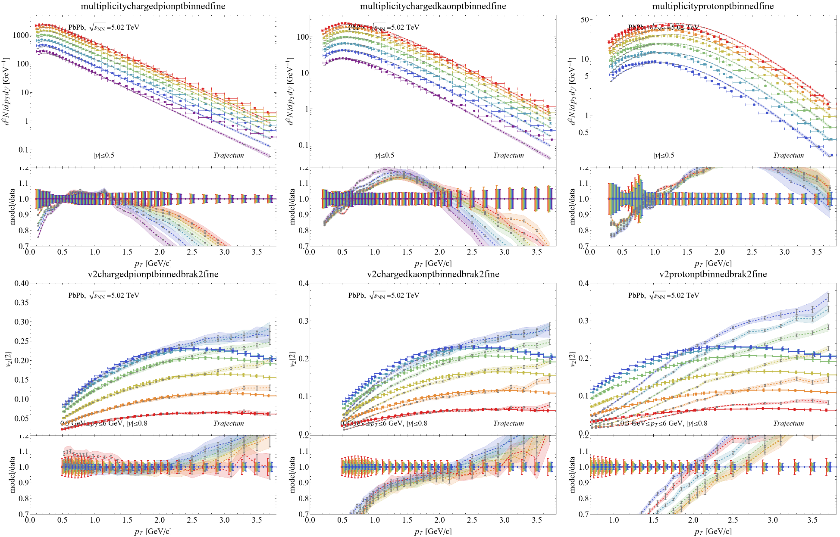
Spectra Pb

Slide 23
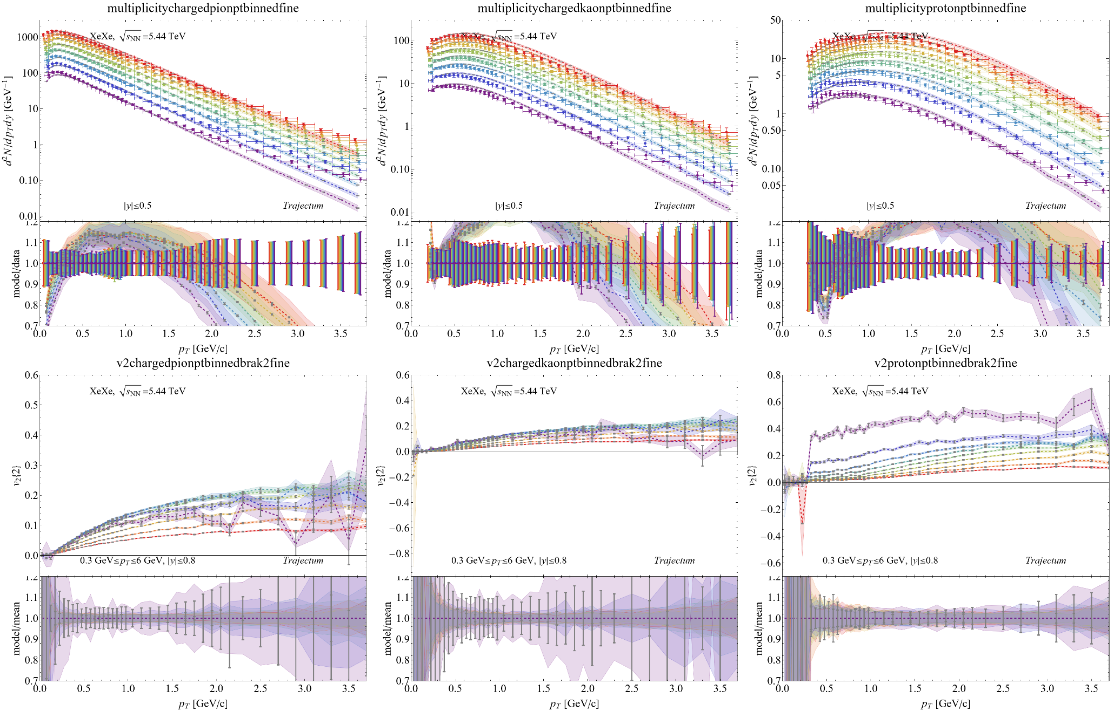
Spectra Xe

