Slide 1
Checking Factors Influencing Fitting Accuracy
Chiaki Yanagisawa
Generative Neural Network for Water Cherenkov Meeting
10/05/2023

Slide 2
Improvement on Resolutions and Biases
Potential studies to improve resolutions and biases
(1) Calculate fit parameter errors
Use the Hessian matrix to estimate the errors on the parameters
See if any correlations between Δp/p and the estimated error on p.
In progress but no result
(2) Calculate the distances between the initial and final parameter values
See if any correlations between Δp/p and the distance of p.
In progress and some results
(3) See if any correlations between Δp/p and likelihood.
In progress and some results

Slide 3
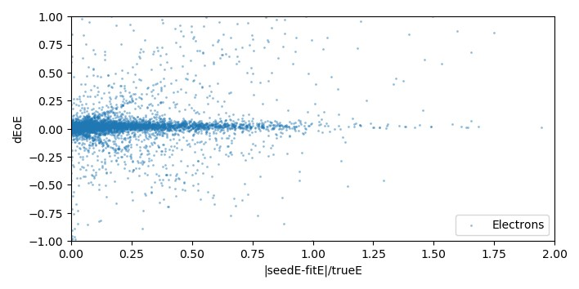
Work in Progress
Correlation between the distance |E_{seed} – E_{fit}|/E_{true} and E_{residual}
Electrons (no cut in vertex position, all energy)
.
What causes this?
E_{residual} =dEoE = (E_{fit}-E_{true})/E_{true}
E_{dist} =|E_{seed} – E_{fit}|/E_{true}
What causes this?

Slide 4
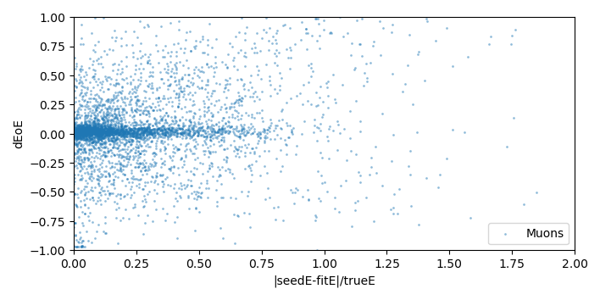
Work in Progress
Correlation between the distance |E_{seed} – E_{fit}|/E_{true} and E_{residual}
Muons (no cut in vertex position, all energy)
.
What causes this?
E_{residual} =dEoE = (E_{fit}-E_{true})/E_{true}
E_{dist} =|E_{seed} – E_{fit}|/E_{true}
What causes this?

Slide 5
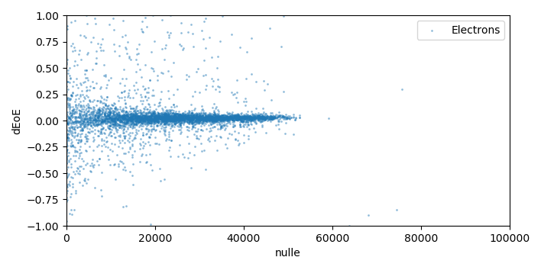
Work in Progress
Correlation between natural log likelihood nll and E_{residual}
Electrons (no cut in vertex position, all energy)
.
E_{residual} =dEoE = (E_{fit}-E_{true})/E_{true}
nll = Minimum natural log likelihood
We minimize nll, and what is called nll is actually the smallest nll.
Then the smaller nll, the better the fit.
Then why there is wider spread when nll is smaller?
If the energy is smaller, is nll smaller (smaller number of PMTs involved )?

Slide 6
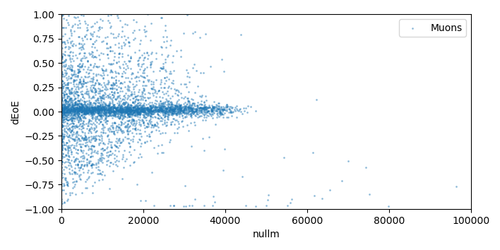
Work in Progress
Correlation between natural log likelihood nll and E_{residual}
Muons (no cut in vertex position, all energy)
.
E_{residual} =dEoE = (E_{fit}-E_{true})/E_{true}
nll = Minimum natural log likelihood

Slide 7
Work in Progress
Estimating fitting error on each parameter (already discussed)
Modifications of fit_event.py
data["epos"] = collections.defaultdict(list)
data["edir"] = collections.defaultdict(list)
data["et0"] = collections.defaultdict(list)
data["eE"] = collections.defaultdict(list)
…
import numdifftools as ndt
Hfun = ndt.Hessian(function, full_outut=True, args=(network, [0.,1.,0.]) # is the correct order?
hessian_ndt, info = Hfun(e_X) # needs args?
se = np.sqrt(np.diag(np.linalg.inv(hessian_ndt)))
... Normalization...
data["epos"]["fit_e"] = ....
data["edir"]["fit_e"] = ....
data["eE"]["fit_e"] = ....
... Similar for fit_mu......

Slide 8
Conclusions
It is not clear whether the distance between E_{initial} and E_{fit} is a useful measure
for fit quality check.
It is also not so clear whether the natural log likelihood (minimum) is useful.
However, the fit involves multi-variables. So just checking energy E may be
looking a tip of iceberg.
Maybe the cut on Dwall/Towall should be applied to clean up.
Also, energy dependence should be checked.

