Slide 1
Theory needs for the LHC
J. Huston
Michigan State University
Loopfest 2024
conversation starter

Slide 2
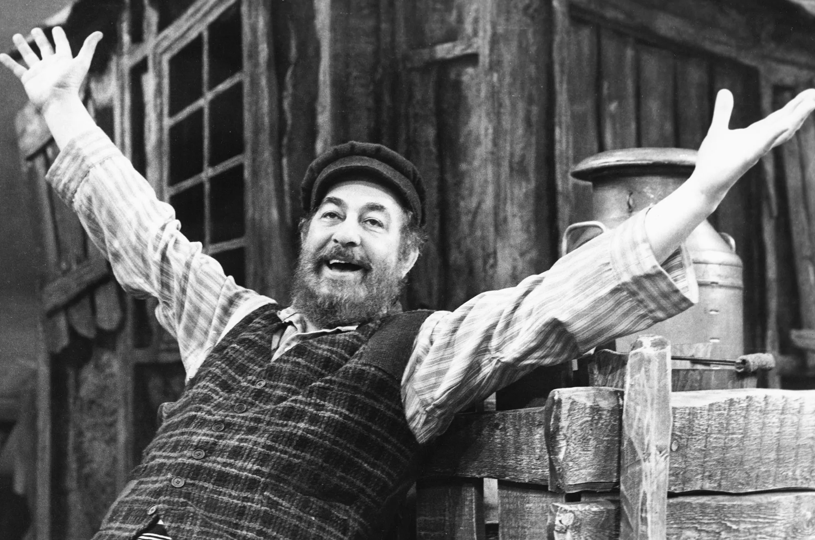
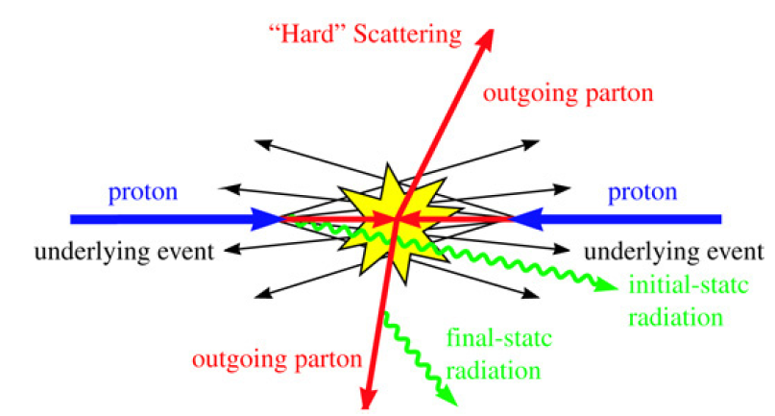
To quote Tevye in Fiddler on the Roof
PDFs, especially the
determination of uncertainties
L₂ sensitivity, hopscotch, ~N3LO,
~N3LO gluon and the Higgs
α_{s}(m_{Z}), especially determinations
at the LHC
Matrix elements->the LH wishlist
->experimental uncertainties that
require theory improvements
STXS: multi-boson template cross
sections for VBF/VBS
Jet algorithms: issues with heavy
flavor, issues with NNLO comparisons
quark/gluon jet discrimination
->https://arxiv.org/abs/2003.01700
Precision!
…is one of the keys for better understanding SM Higgs production and looking for possible BSM physics

Slide 3
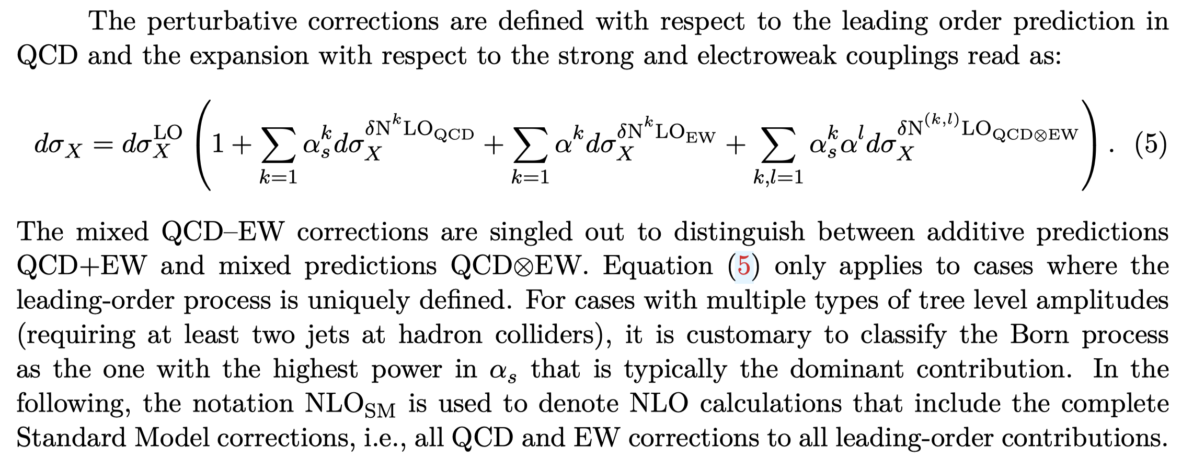
Theory predictions
Predictions can be at fixed order, fixed order + resummed, or fixed order + parton shower, with both QCD and EW corrections
Respect the fixed order in inclusive regions of phase space

Slide 4
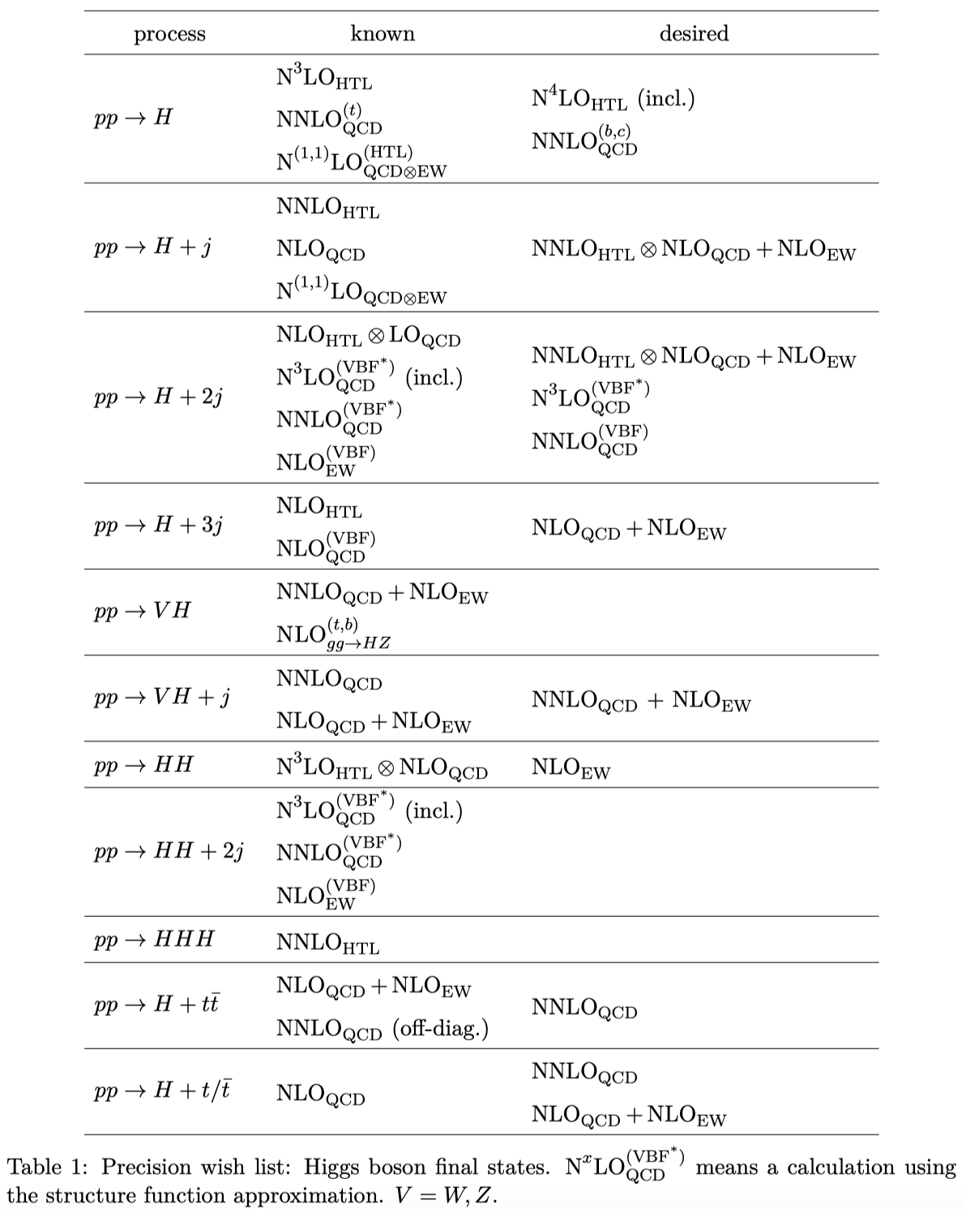
The Les Houches wishlist (arXiv:2207.02122)
A. Huss, J. Huston, S. Jones, M. Pellen
Higgs sector
2023 revision in progress with
above plus Raoul Rontsch

Slide 5
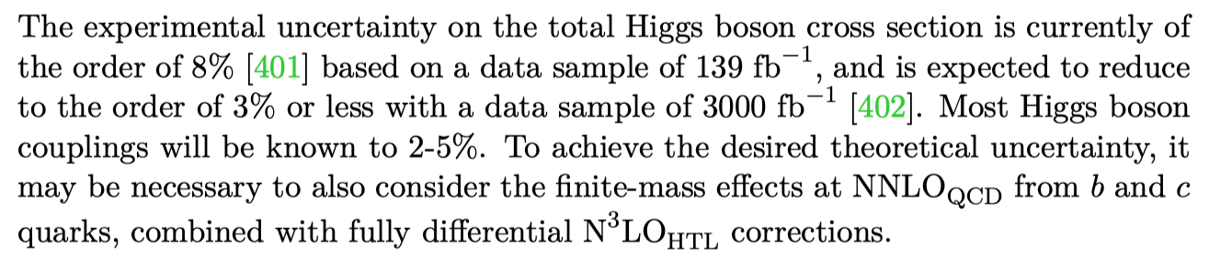
The Les Houches wishlist (arXiv:2207.02122)
A. Huss, J. Huston, S. Jones, M. Pellen
experimental justification
need combination exercise of mixed QCD/EWK
N⁴LO doable within timescale of Run 3

Slide 6
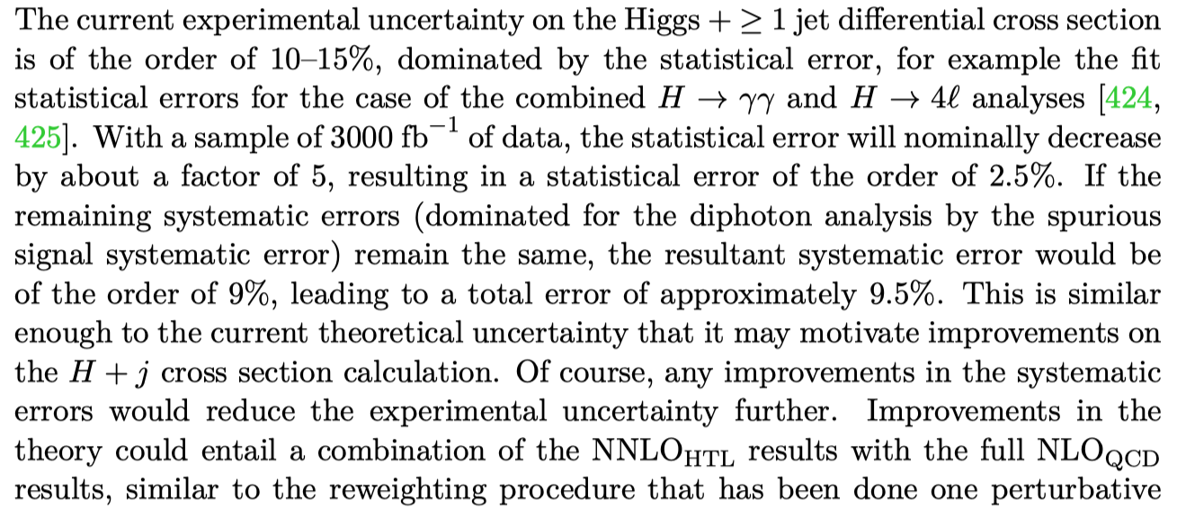
The Les Houches wishlist (arXiv:2207.02122)
A. Huss, J. Huston, S. Jones, M. Pellen
N3LO HTL+matching to resummation for
intermediate regime; may need to do better
than HTL NNLO+NLO QCD for high p_{T}
regime; mass uncertainties and perturbative
stability may become issue at high p_{T}; EWK
corrections for ggF at high p_{T} are still
incomplete

Slide 7
The Les Houches wishlist (arXiv:2207.02122)
A. Huss, J. Huston, S. Jones, M. Pellen
2->3 at NNLO is current frontier;
techniques almost complete
NNLO HTL probably most crucial; help
with understanding VBF background
probably fine
effectively 2->2
~NNLO available; still need 2 loop virtuals
but impact should be small, or is it?
singularity structure is very complex; see
Manfred’s talk on Monday
soft Higgs
approximation
only 2->2, but with two masses

Slide 8
Improvements in Monte Carlos
Ongoing effort towards NLL-accurate parton showers, by Panscales (see Silvia’s talk) as well as Sherpa and Herwig; NLL is important but not all-important
For example, for multi-jet final states such as Higgs+jets, matching/merging uncertainties are probably more important than shower logarithmic accuracy
For many Monte Carlo predictions at the LHC, non-perturbative effects can dominate (->VBF production; for both signal and ggF background; are these non-reducible?)
Above issues are being addressed in a study in progress, specifically looking at the ggF backgrounds to VBF production
Many LHC results have at least a partial veto of phase space, for example with jet binning (1 jet, 2 jet,…)
  can quote exclusive cross sections, but where possible also provide inclusive cross sections, e.g. Higgs+>=1 jet
  perhaps can estimate the size of binning for inclusive cross sections by using Caesar-style resummation in parton shower Monte Carlos
Complex final states (such as Higgs + 3 jets at NLO) have an issue with negative weights; cell resampling (arXiv:2303.15246) seems to be a great way of speeding up Monte Carlo production in the presence of many negative weight events

Slide 9
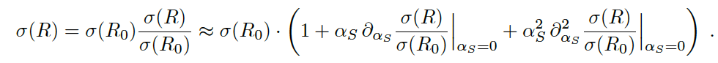
Scale dependence of NNLO cross sections with jets
By looking at the scale dependence of jet cross sections as a function of R, it becomes clear that there can be an artificial reduction of the ‘true’ scale dependence at NNLO due to accidental cancellations resulting from the restriction in phase space
For example for dijet, Z+jet, there are R-values near 0.4 for which the scale uncertainty is apparently zero->artifact
Idea: view the differential cross section as a combination of a fixed-order term and the normalized all-orders result (1602.01110), i.e. the production of a parton and then the fragmentation of that parton into a jet of size R
  combine through multiplicative matching
  re-expand to fixed order
There are several possible choices as to the implementation of the factorization on RHS
There’s more work to be done on this. It’s on my to-do list.

Slide 10
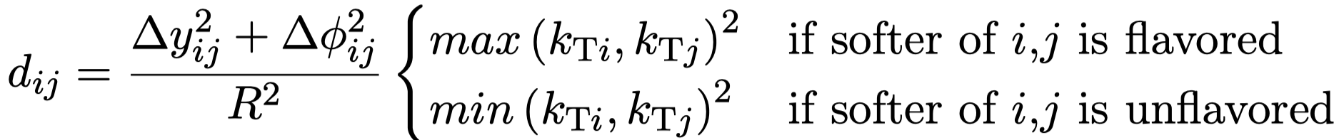
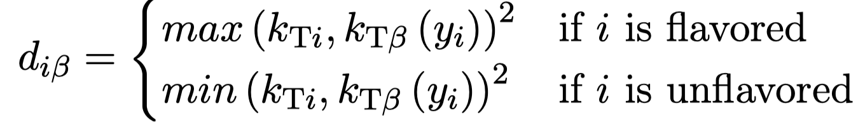

Jet tagging
There is also the issue of how heavy flavor jets are tagged; the theory predictions use a flavor tagging k_{T} jet algorithm in which the distance between pseudo-jets i and j (d_{ij}) are dependent on the flavour of the considered partons
  the distance to the beam is also flavour-dependent
The experimental measurements typically use the anti-k_{T} jet algorithm with later flavor identification (Eur.Phys.J.C 47 (2006) 113)
The difference between the two may not be small (10-15%)
There are a plethora of theory solutions to this issue; how well do they work in an experimental environment
Workshop at Durham in June

Slide 11

Enkhbat Tsedenbaljir
now available as a free
download thanks to the
SCOAP3 foundation
OAPEN
https://library.oapen.org › 9780199652747_Print

Slide 12
VBF paper plans
Lack of time resulted in not having complete comparison of ggF backgrounds from different ME+PS predictions to VBF in this previous paper
We are working on that problem in this next study
We also did not produce plots at the hadron level for the previous paper, as that was not the primary goal
We will do so in this paper, having the MC authors chose their best tune/parameters, as well as the ATLAS/CMS tunes and look for differences in the resulting distributions
  comparing cluster and string fragmentation within same MC framework
We have collected the information for current MC running in ATLAS and CMS (see extra slides)
  reference p_{T0} values, primordial k_{T} and PDFs for evolution different between ATLAS and CMS, but nothing alarming
Would be nice to ultimately have a common tune between ATLAS and CMS, but perhaps the tuning is too tied to the detector-specific environment
If we see a smaller difference between Monte Carlo predictions in this study for VBF and ggF, and larger differences in official ATLAS/CMS predictions, then we need to understand why
Will have both differential and STXS distributions (see extra slides)
  Rivet routine(s) will be made available

Slide 13
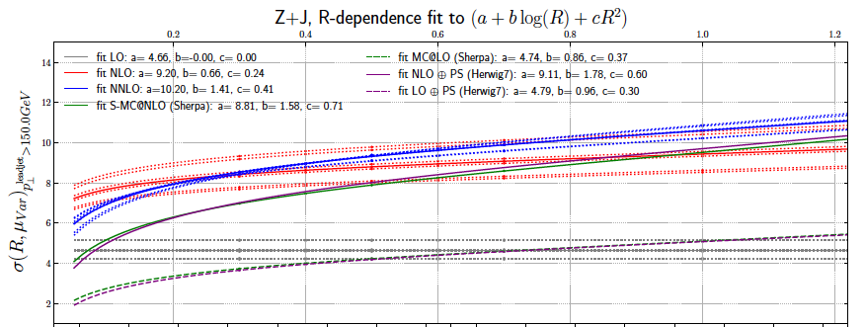
R-dependence of scale uncertainty (Z+j)
Again, scale dependence decreases from LO->NLO->NNLO and as R decreases
Scale uncertainty at NNLO~0 for R=0.3

Slide 14
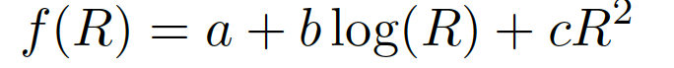
Ansatz
σ(R)/σ(R_{o}) on RHS not expanded, and combine the parton and fragmentation uncertainties in quadrature
Determine scale uncertainties from fits to coefficients a,b and c and combine them in quadrature
Original ansatz in 1602.01110; use the expansion shown on the top of the slide

