Slide 1

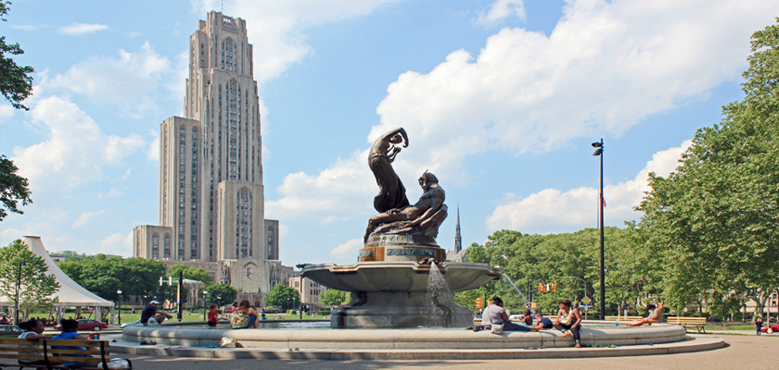
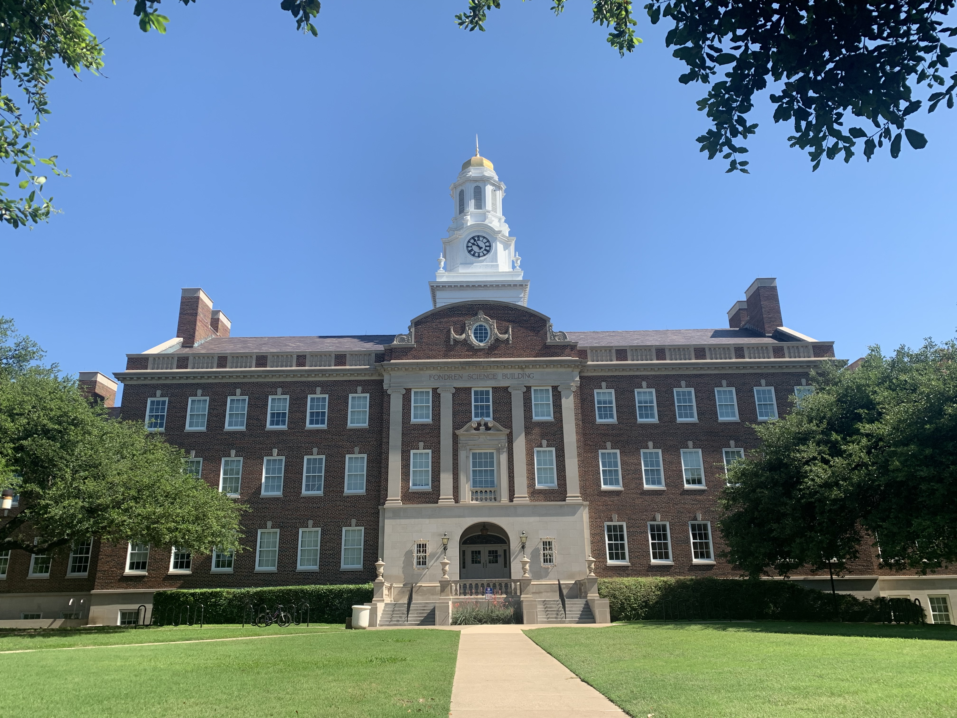
EW physics at very high energies
-- Splitting & Showering
Tao Han
LoopFest XXII - 2024
SMU – Dallas, May 21, 2024

Slide 2
Topics:
EW physics @ high energies
Splitting functions, EW showering
EWSB and Goldstone bosons
Splittings in the broken phase: Ultra collinear
EW evolution beyond the leading log
J.M. Chen, TH & B. Tweedie, arXiv:1611.00788;
TH, Y. Ma & K. Xie, arXiv:2007.14300; 2103.09844

Slide 3
EW Physics at Higher Energies
Some numerology:
→ sensitive to HE/UV physics.
(2).
At E>>v ,
→ massless theory; EW symmetry restored!
as power corrections:
Like QCD: higher-twist terms 𝛬²_{QCD}/Q².
Unlike QCD: perturbatively defined!

Slide 4
Some numerology:
(3).
The top quark at the a 10-TeV pCM Collider would be
as “massless” as b-quark was at the Tevatron.
→ Top quark PDF? 6 active flavors?
Daswon, Ismail, I. Low (2014); TH, Sayre, Westhoff (2015).
At scale Q:

Slide 5
Some numerology:
(4). EW logarithms
At scale Q :
J. Chiu, A. Manohar et al., 2005; Manohar, Bauer et al. (SCET);
M. Chiesa et al., PRL (2013);
T. Becher et al., 1305.4202;
Bauer, Ferland, 1601.07190;
Virtual Sudakov suppression;
Real emission enhancement.
(Bryan Webber)
SU(2) versus SU(3):
Gauge boson splitting

Slide 6
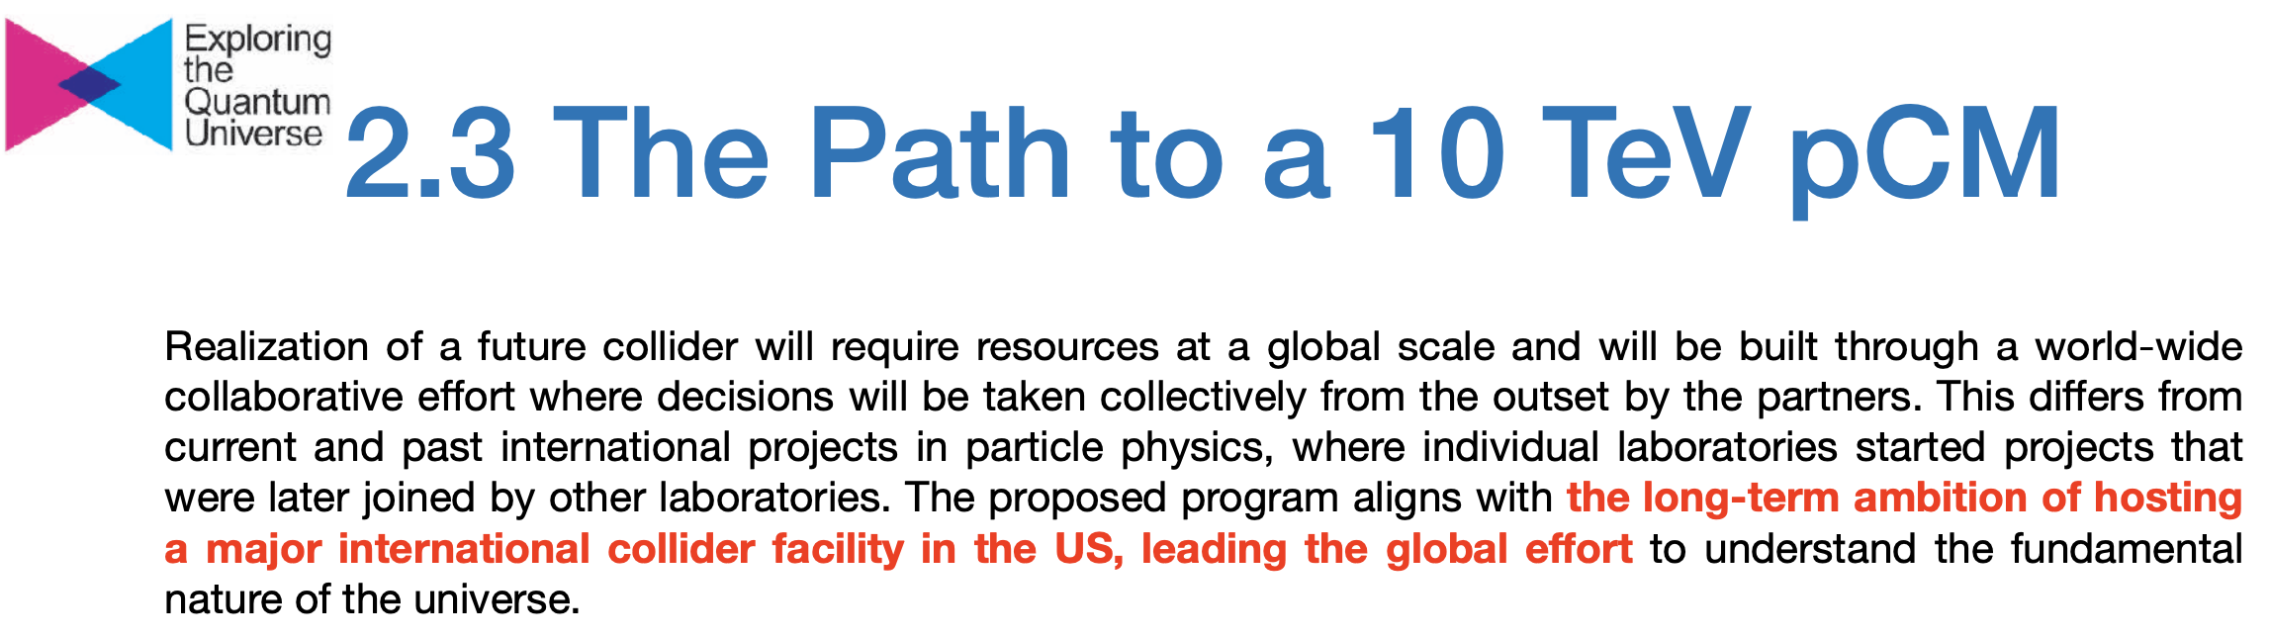
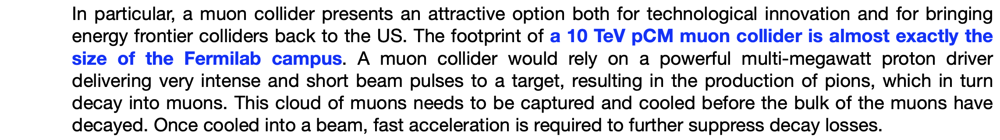


Slide 7
Splitting: the dominant phenomena
On the dimensional ground:
For the factorization formalism to be valid:
infra-red safe & leading behavior
Ciafaloni et al., hep-ph/0004071, 0007096; J.M. Chen, TH & B. Tweedie, arXiv:1611.00788; C. Bauer, Ferland, B. Webber et al., arXiv:1703.08562; 1808.08831; A. Manohar et al., 1803.06347.

Slide 8
EW Splitting functions
Start from the unbroken phase – all massless.
Chiral fermions: f_{s}, gauge bosons: B,W⁰,W±;
e.g.: fermion splitting:
Ciafaloni et al.,
Hep-ph/0505047.
Infrared & collinear singularities (P_{gq})
Collinear singularity,
Chirality-flip, Yukawa

Slide 9
EW Splitting functions
SM in the unbroken phase
e.g.: Gauge boson splitting:
Infrared & collinear (P_{gg})
Collinear (P_{qg})
Collinear (new)
Interference (BW⁰) must be included!

Slide 10
EW gauge bosons from splitting@Fcc-hh
W radiation costs ~ 1/10
M. Mangano
Diagramatic calculations
Each W costs you a factor of ~ 1/100 (EW coupling)

Slide 11
WZ+1 jet @ F_{CC}: 100 TeV
MadGraph 2→3 fixed order
We reach good
agreement
Lack of
3-V splitting
P. Richardson et al., arXiv:2108.10817

Slide 12
EW Symmetry breaking &
Goldstone-boson Equivalence Theorem (GET):
At high energies E>>MW, the longitudinally polarized gauge bosons behave like the corresponding Goldstone bosons. (They remember their origin!)
Lee, Quigg, Thacker (1977); Chanowitz, Gailard (1984);
Y.-P. Yao, C.-P. Yuan (1988); J. Bagger, C. Schmidt (1990) …
“Scalarization” to implement the Goldstone-boson Equivalence Theorem (GET):
+ O(M_{W}/E)

Slide 13
(a). Unitarity at higher energies:
bad high-energy behavior!
A “light Higgs” fixes it:
D. Dicus & V. Mathur (1973);
Lee, Quigg, Thacker (1977).

Slide 14
(b). Puzzle of massless fermion radiation
V_{L} contributions dominant at high energies:
Then, massless fermion splitting
f → f V_{L}
would be zero, in accordance with GET for
f → f φ (y_{f} → 0).
GET ignored the EWSB effects at the order M_{W}/E
(higher twist effects)

Slide 15

Corrections to GET
1st example: “Effective W-Approximation”
G. Kane, W. Repko, W. Rolnick (1984);
S. Dawson (1985); Chanowitz & Gailard (1984)
At colliding energies E >> M_{W},
f → f W_{L}, f Z_{L} do not vanish; no collinear-log!
Vector boson fusion observed at the LHC
WW, ZZ→h & W⁺W⁺ scattering

Slide 16
EW Splitting functions
in the broken phase
New fermion splitting:
V_{L} is of IR, h no IR
Chirality conserving:
Non-zero for massless f
Chirality flipping:
~m_{f}
The PDFs for W_{L} thus don’t run at leading log
→ A broken gauge
“Bjorken scaling” restored,
or higher-twist effects like 𝛬²_{QCD}/Q².

Slide 17
Splitting in the Broken Gauge
New gauge boson splitting in 3-W_{L}
Vector boson V_{L} is of IR.
h has no IR.

Slide 18
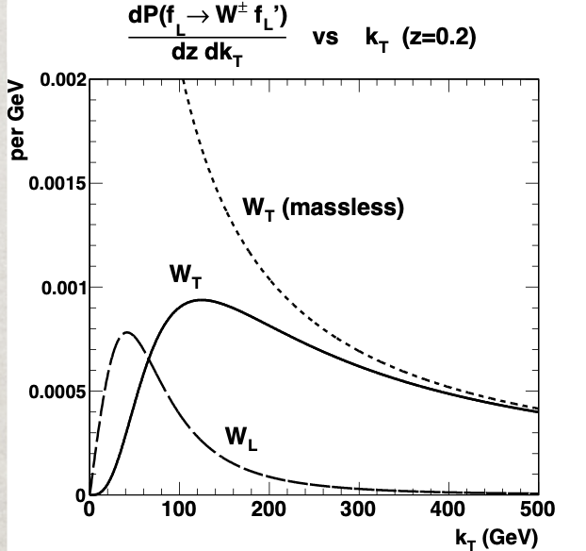
“Ultra collinear behavior”
New characteristics with the mass:
k_{T}² > m_{W}², it shuts off;
k_{T}² < m_{W}², flattens out!
Kinematic basis for
“forward jet-tagging, central jet-vetoing” !
The PDFs for W_{L}: no log(Q²/M²).

Slide 19
Top decay/showering (10 TeV):
J.M. Chen, TH & B. Tweedie, arXiv:1611.00788
Leading ultra-collinear:
Yukawa:
U(1) gauge:

Slide 20
In a nutshell: splitting probabilities
gauge couplings
Non-Abelian gauge spliting larger than fermion splitting!
Collinear splittings larger than perturbative radiation!
J.M. Chen, TH & B. Tweedie, arXiv:1611.00788

Slide 21
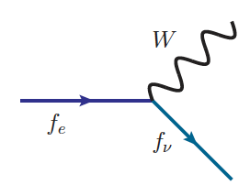
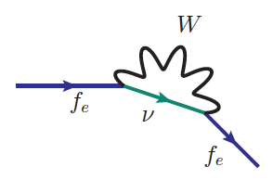
EW Evolution beyond Leading Log
W⁻
e⁻ 𝛎_{e}
Z/W⁻
𝛎_{e}
Incomplete cancellation for non-inclusive process in SU(2):
SU(2) “color” (e,𝝂) distinguishable, unlike QCD!
non-cancelled sub-leading log(Q²/M_{w}²)
Bloch-Nordsieck theorem violation!
→ Need sufficiently inclusive processes & infrared safe-observables
Bauer et al., 1703.08562; Manohar et al., 1808.08831;
TH, Ma, Xie, 2007.14300.

Slide 22
EW PDFs at a muon collider:
“partons” dynamically generated
Initially, the “valence parton”:
+ …
Leading order “sea parton”:
Beyond leading order with DGLAP evolution:
Take into account two scales: 𝛍_{QCD} ~ 𝛬_{QCD} , 𝛍_{EW} ~ v

Slide 23
EW PDFs at a muon collider:
“partons” dynamically generated
: the valance.
: LO sea.
Quarks: NLO; gluons: NNLO.
TH, Yang Ma, Keping Xie, arXiv:2007.14300

Slide 24
“Semi-inclusive” processes
Just like in hadronic collisions:
𝞵⁺𝞵⁻ → exclusive particles + remnants
VBF
𝞵⁺𝞵⁻
annihilations

Slide 25
separable sub-processes:
VBF
𝞵⁺𝞵⁻anni
𝞵⁺𝞵⁻anni
Partonic contributions
𝞵⁺𝞵⁻ Collider:
“Buy one, get one free”
Annihilation +VBF
VBF

Slide 26
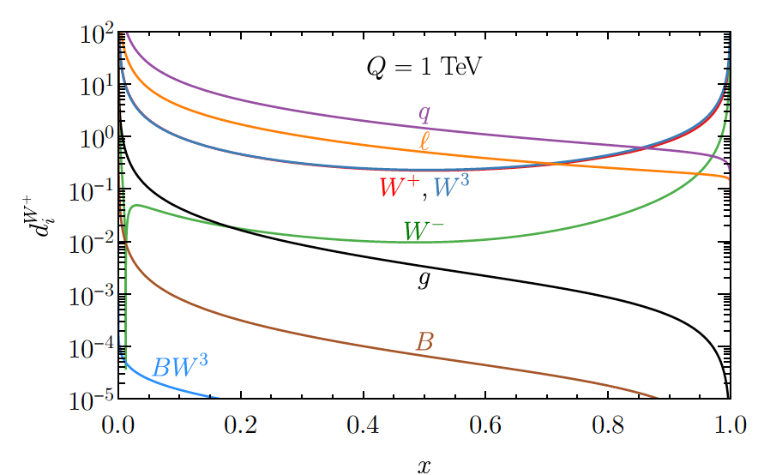
“Leptonic showering”
With W/Z showers, all leptons/neutrino components exist!
EW “jets”: e.g., a HE 𝝂 → an observable jet!
J.M. Chen, TH & B. Tweedie, arXiv:1611.00788;
TH, Ma, Xie, arXiv:2203.11129

Slide 27
Conclusions
EW splitting/showering will become an increasingly important part at higher energies.
It still has technical & conceptual challenges at higher energies.
Be prepared:
Very high-energy W, Z, h, t may serve as
tools for the next discovery !

Slide 29
High-Energy Muon Collider
Collider benchmark points:
The Higgs factory:
Barger, Berger, Gunion, Han
PRL 75, 1995; PR 1997
E_{cm} =m_{H ;} L ~ 1 fb⁻¹/yr
𝜟E_{cm} ~ 5 MeV
Multi-TeV colliders:
Lumi-scaling scheme: 𝛔 L ~ const.
1 ab⁻¹ /yr
Current choices: 3, 10, 14(?) TeV @ FNAL
European Strategy, arXiv:1910.11775; arXiv:1901.06150; arXiv:2007.15684.

