Slide 1
Characterisation of the University of Birmingham Proton Irradiation Facility
A. Chisholm, L. Gonella, A. Hunter, E. Liu

Slide 2
Overview
Introduction of the University of Birmingham’s MC40 cyclotron facility – typical performance in irradiations for detector R&D.
Characterisation Studies:
  Geant4 simulation of the irradiation beamline.
  Proton hardness factor for different beam energies via irradiation of silicon diodes.

Slide 3
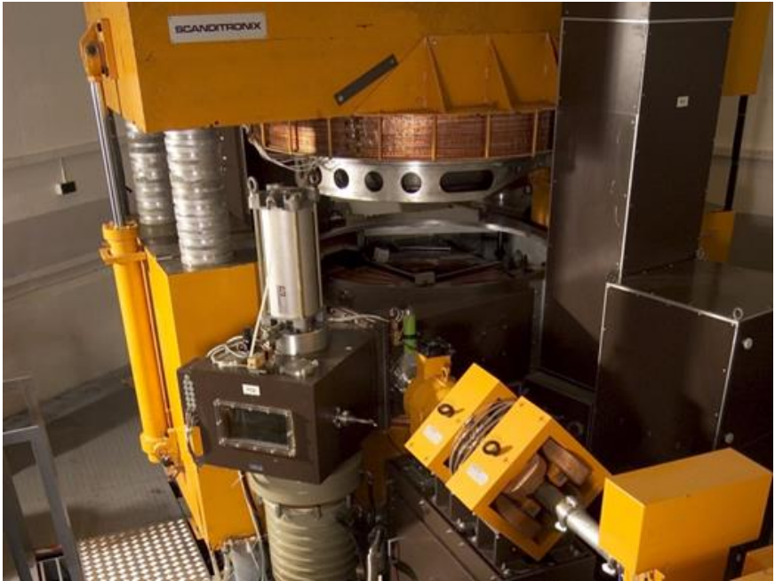
The MC40 Cyclotron Facility
The MC40 cyclotron facility at the University of Birmingham is primarily used for radioisotope production for medical applications. It is also involved with several research programs.
Usually proton beams but can deliver deuterons and helium isotopes.
Proton beam energy ranges from 2 – 38 MeV.
Proton beam currents up to a few μA.

Slide 4
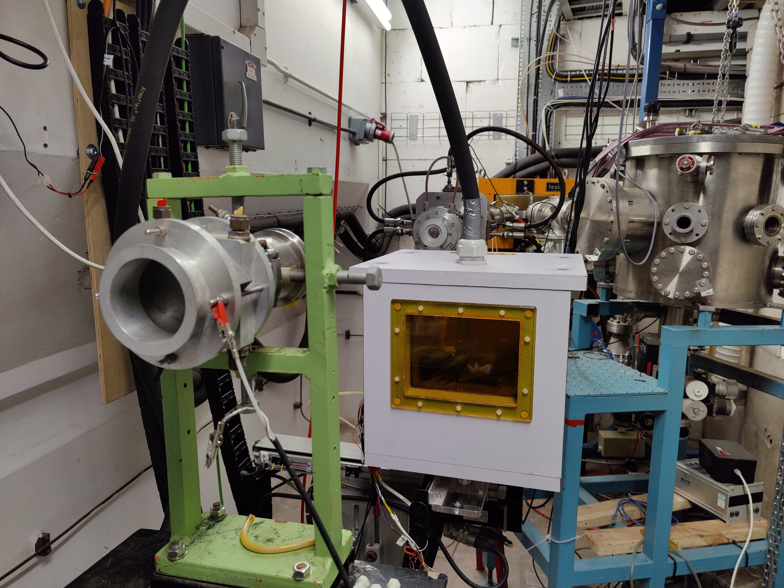
Detector R&D Irradiation Line
Typically run with 27 MeV proton beam at a current of 200 nA.
  Enables a few 10¹⁵ n_{eq}/cm² to be delivered to a small area of samples (~ 10 cm²) in one day.
Samples are housed in a climate box.
  Maintained at -27°C via liquid nitrogen evaporative cooling.
  Relative humidity < 10%.
Beam is collimated into approximately a 10 x 10 mm² square with roughly uniform intensity.
Box sits on an XY stage. For most irradiations, a grid scanning pattern is used to deliver a uniform fluence across the samples.
During irradiation, beam current is monitored via Faraday cup.
Offline dosimetry is performed using nickel foil (details in backup).
Beamline Exit
Faraday Cup
Climate Box

Slide 5
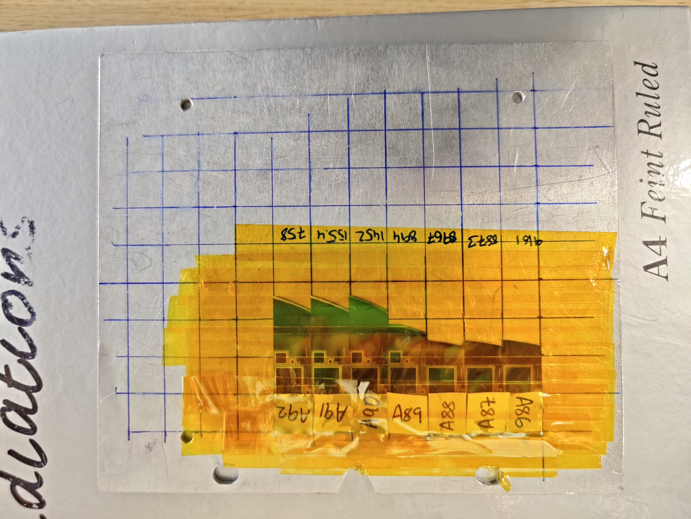
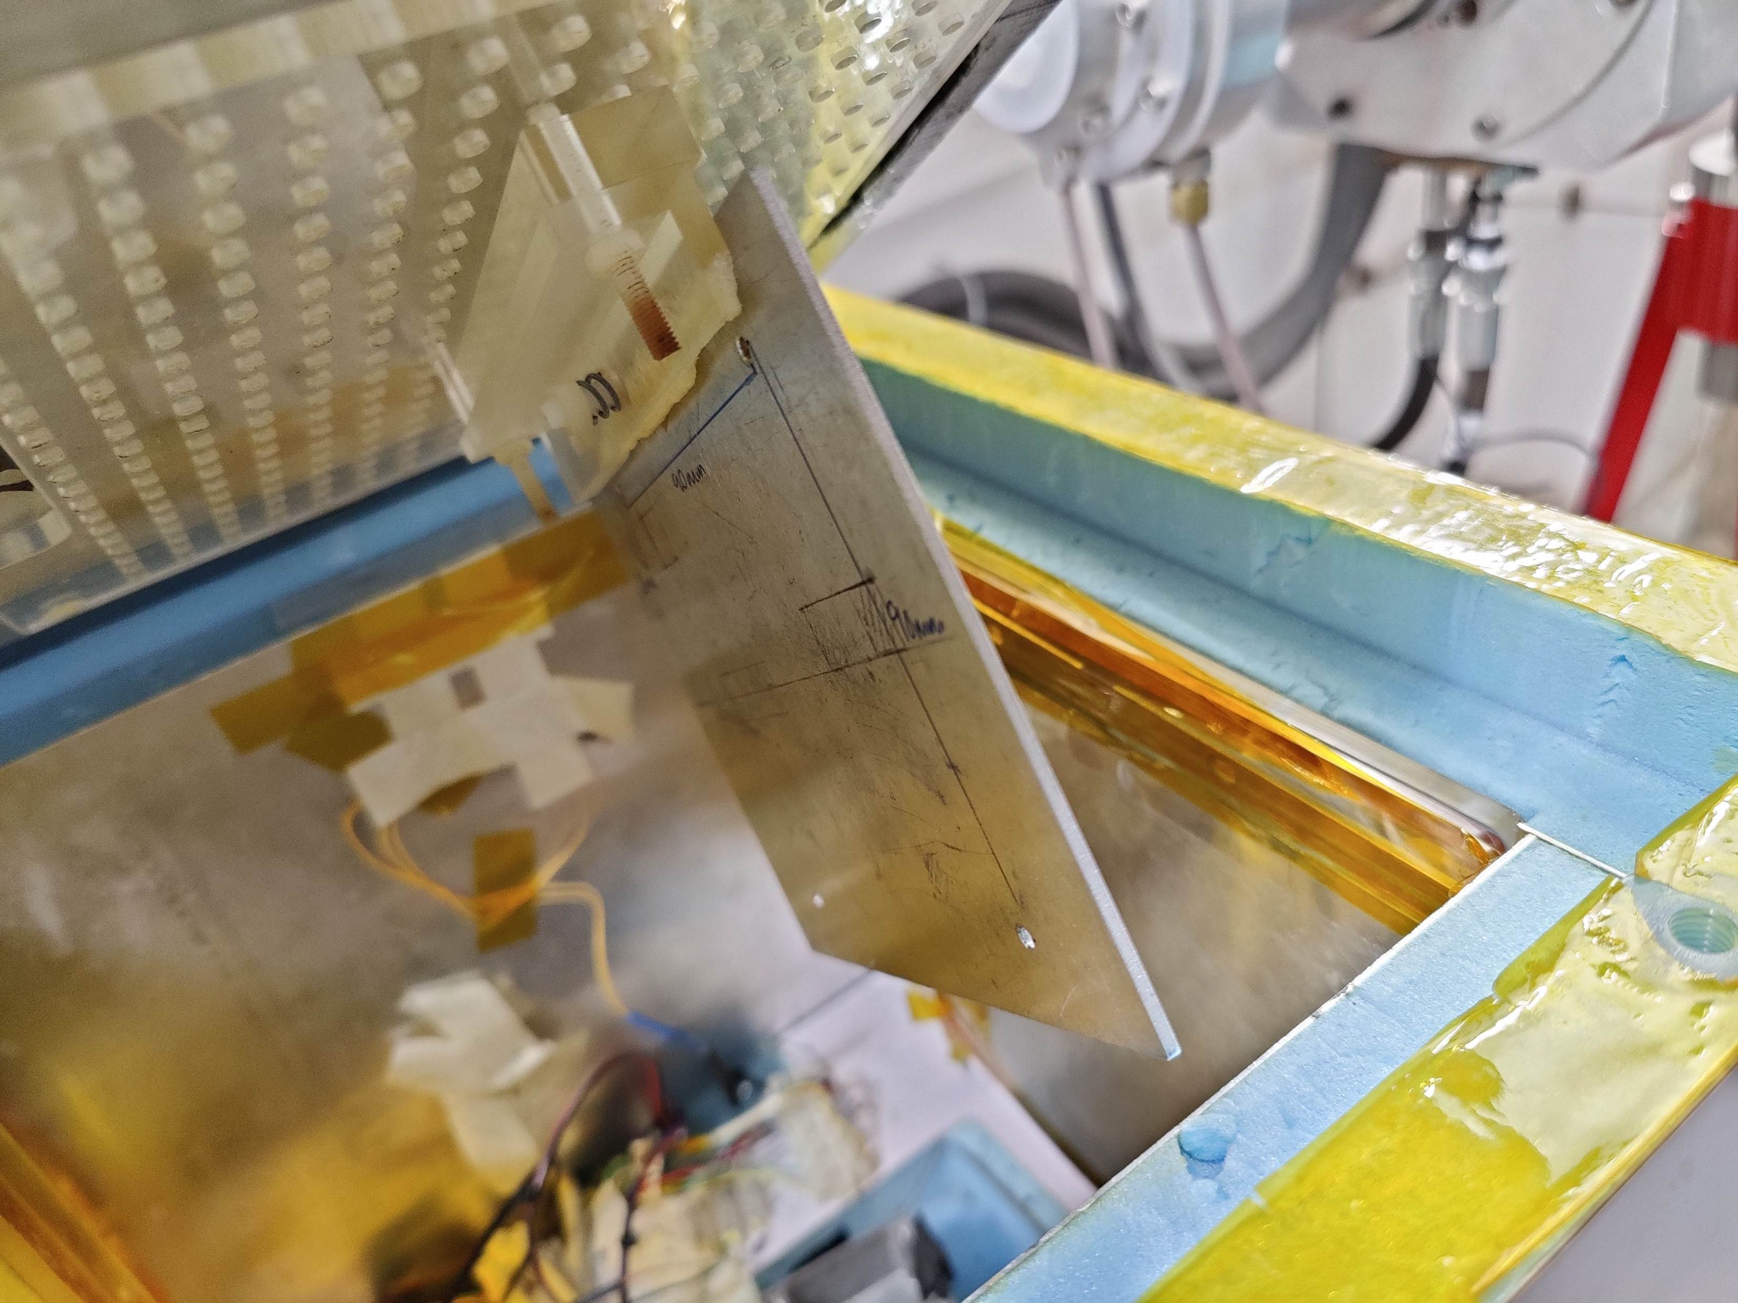
Detector R&D Irradiation Line
Irradiation samples and nickel foils attached to a 2mm thick aluminium plate. A single layer of kapton tape separates the samples from the plate and foils.
A view of the inside of the irradiation box: sample holder attachment point and 0.3 mm thick aluminium plate to filter low energy components.
Al Shield

Slide 6
Characterisation of the Irradiation Line
Seek to evaluate the performance of the cyclotron for R&D irradiations and compare to expected performance.
Two complementary investigations:
Simulation of the Irradiation Line using Geant4
  Beam energy attenuation: understand the effects of upstream material on the proton energies before they hit the sample which would otherwise be difficult to compute analytically.
  Estimate the total ionising dose (TID) delivered to the samples.
Experimental Studies of Delivered Dose
  Irradiations performed on silicon sensors to extract the hardness factor for different proton energies accessible at the facility.

Slide 7
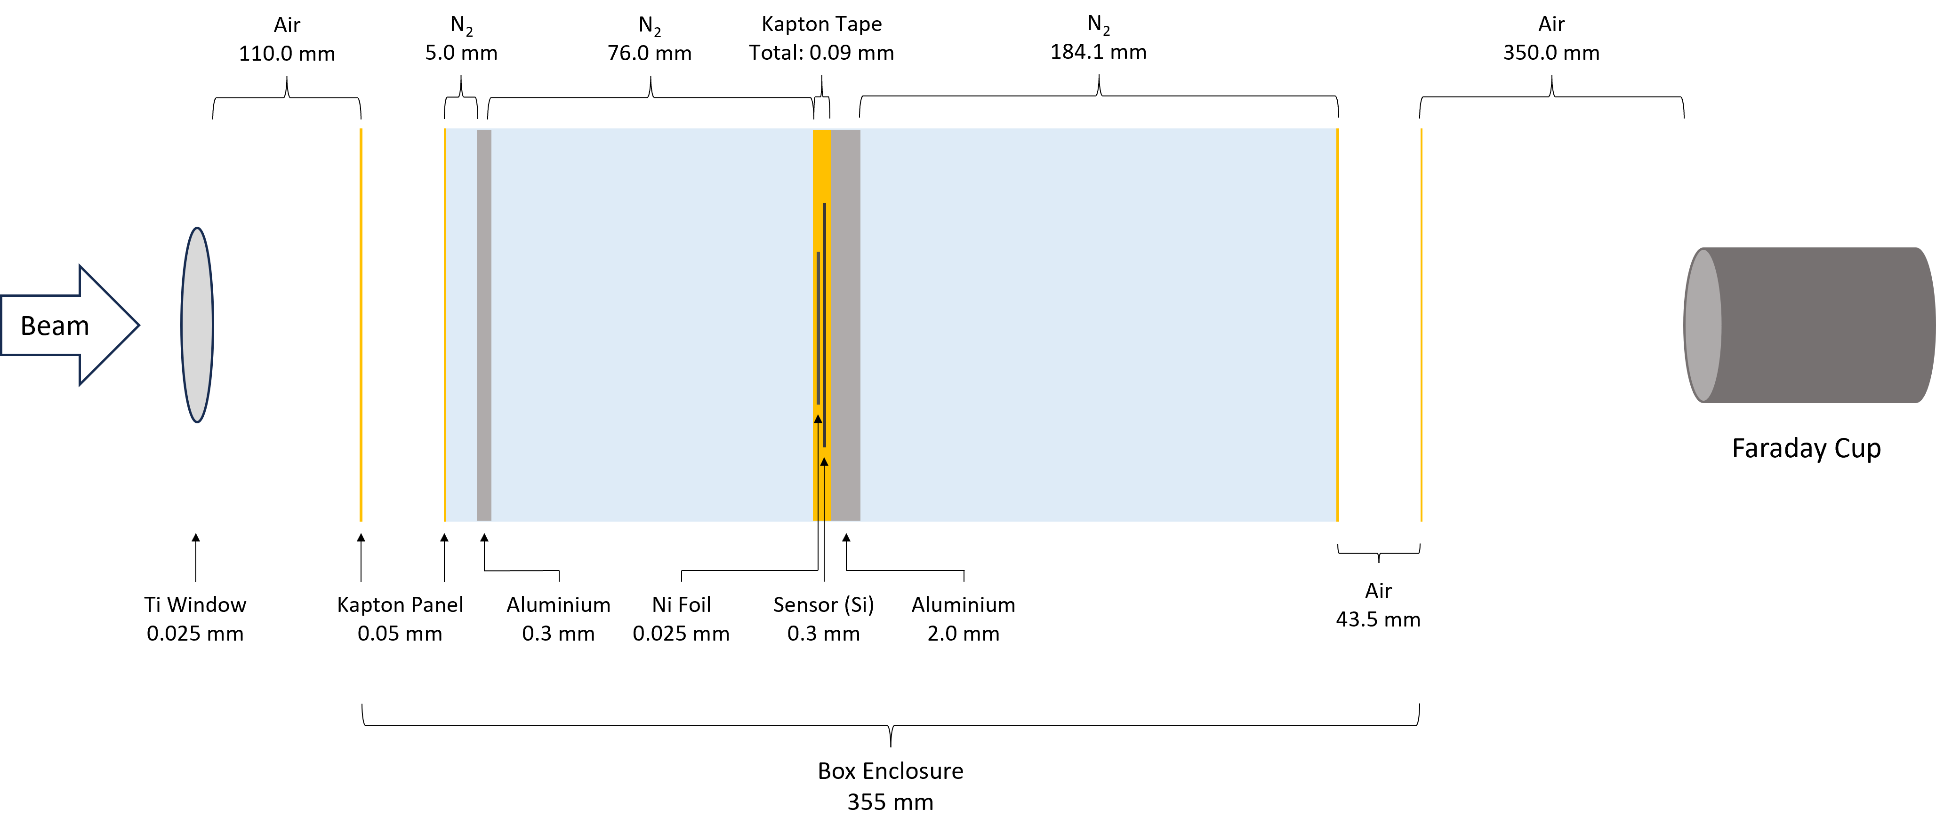
Schematic of the Irradiation Line

Slide 8
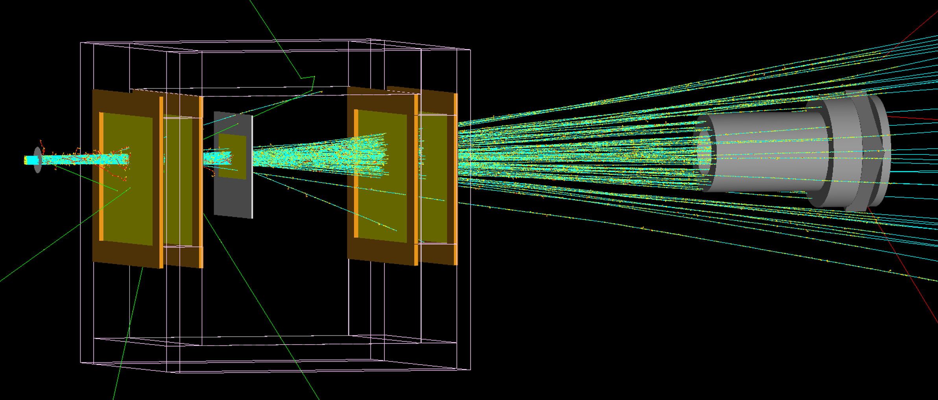
Geant4 Simulation Setup
Beam
Sample Holder:
Ni Foil
300 μm monolithic Si
(Separated with Kapton Tape)
Kapton Window
Faraday Cup

Slide 9
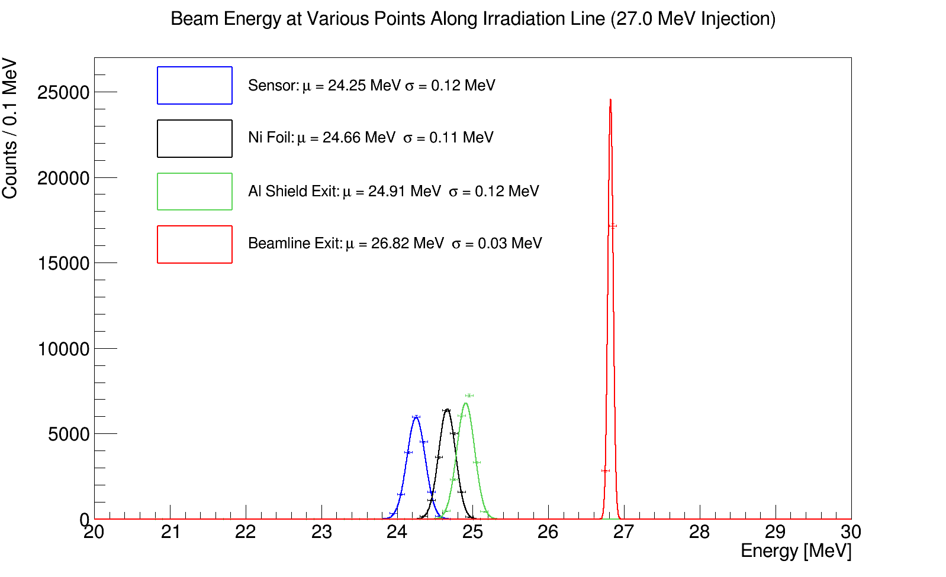
Beam Energy Profile
Simulation of 20000 protons passing through setup.
With an injection energy of 27 MeV, the average beam energy seen at the samples is 24.3 MeV with a spread of 0.1 MeV.
The beam energy on the nickel foil, 24.7 ± 0.1 MeV, is used as an input for the dosimetry calculation.
  The cross-section for ⁵⁷Ni production is energy dependent.

Slide 10
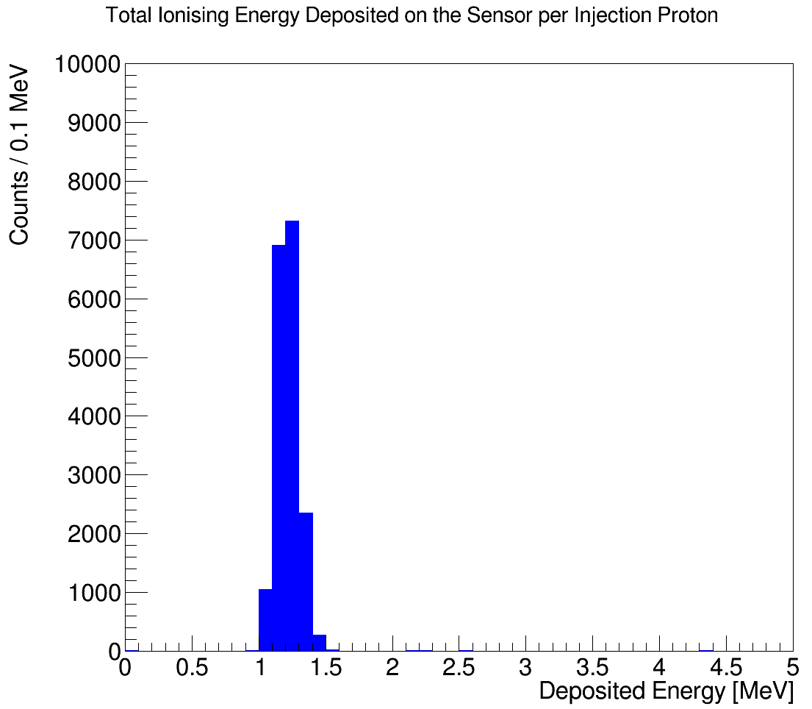
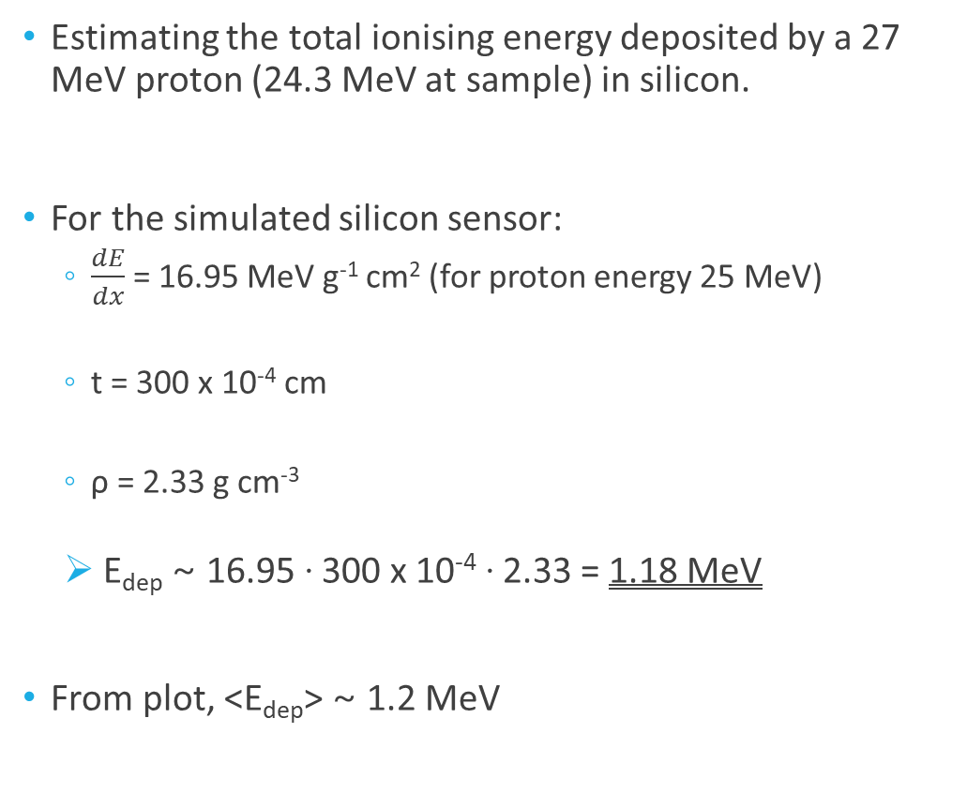
Total Ionising Dose Delivered
Estimating the total ionising energy deposited by a 27 MeV proton (24.3 MeV at sample) in silicon.
For the simulated silicon sensor:
  $\frac{dE}{dx}$ = 16.95 MeV g⁻¹ cm² (for proton energy 25 MeV)
  t = 300 x 10⁻⁴ cm
  ρ = 2.33 g cm⁻³
  E_{dep} ~ 16.95 · 300 x 10⁻⁴ · 2.33 = 1.18 MeV
From plot, <E_{dep}> ~ 1.2 MeV

Slide 11
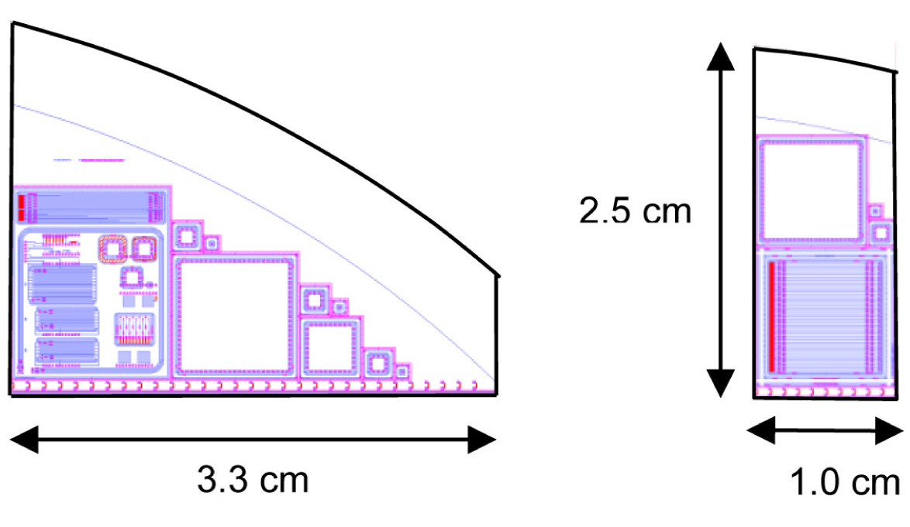
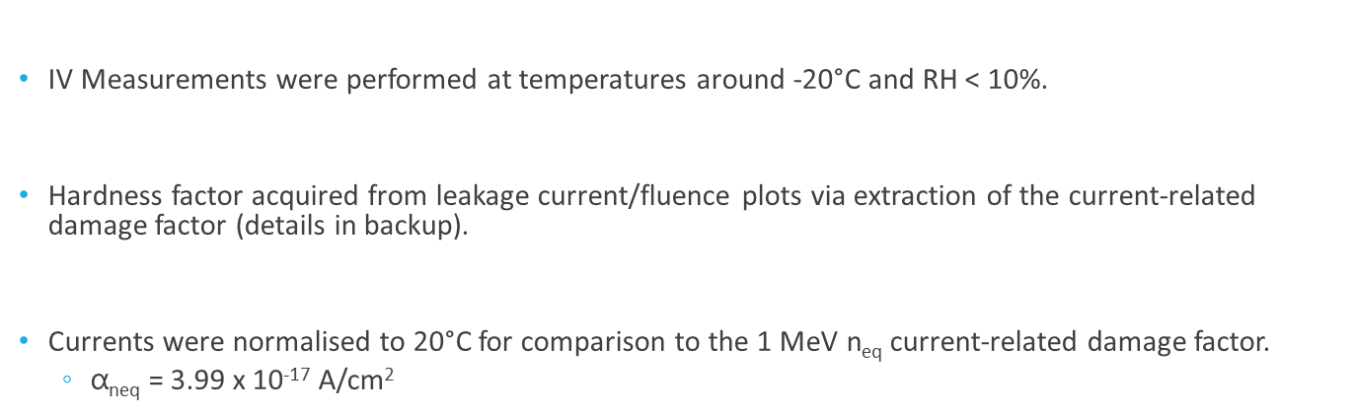
Hardness Factor Measurement
Past measurement of the 27 MeV hardness factor by Allport et al. [JINST 14 (2019) P12004] was performed using BPW34F photodiodes and FZ pad diodes → κ = 2.11 ± 0.49
Since then, the irradiation setup has been recommissioned, and the majority of the samples irradiated are n⁺-in-p silicon devices.
Remeasure the hardness factor for the new setup using the commonly irradiated sensors.
Monitor Diodes (MD8) on ATLAS ITk QA test chips and mini sensors were irradiated to various fluence points at both 20 MeV and 27 MeV.
Samples were annealed before measurement at 60°C for 80 minutes as per the RD50 standard.
IV Measurements were performed at temperatures around -20°C and RH < 10%.
Hardness factor acquired from leakage current/fluence plots via extraction of the current-related damage factor (details in backup).
Currents were normalised to 20°C for comparison to the 1 MeV n_{eq} current-related damage factor.
  $\text{α}\text{neq}\text{ =}$ 3.99 x 10⁻¹⁷ A/cm²
Monitor Diode (MD8)
Test Chip & MD8
Mini & MD8

Slide 12
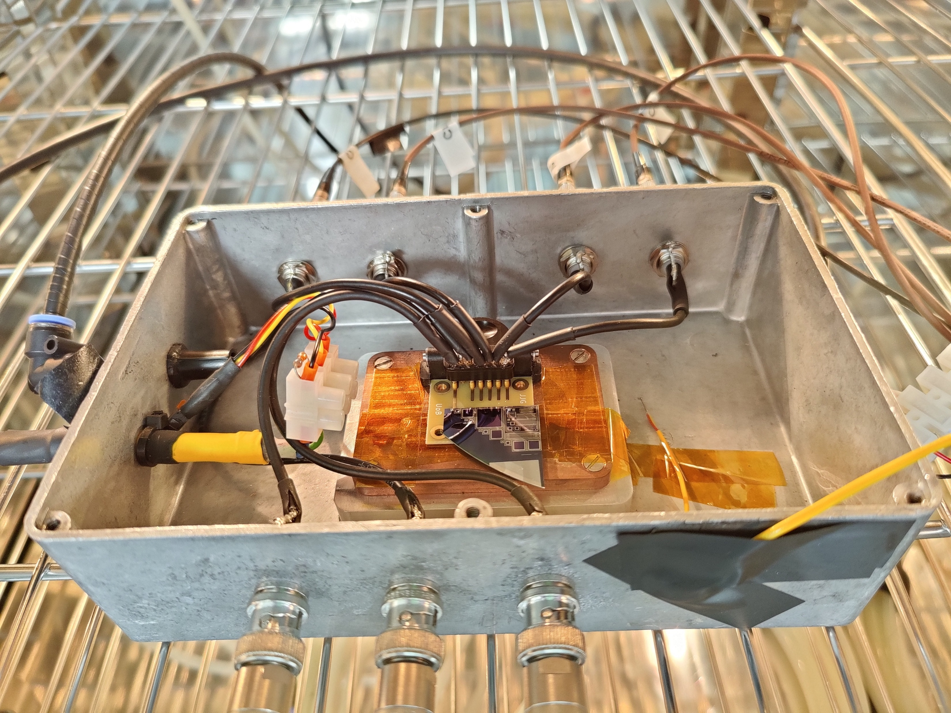
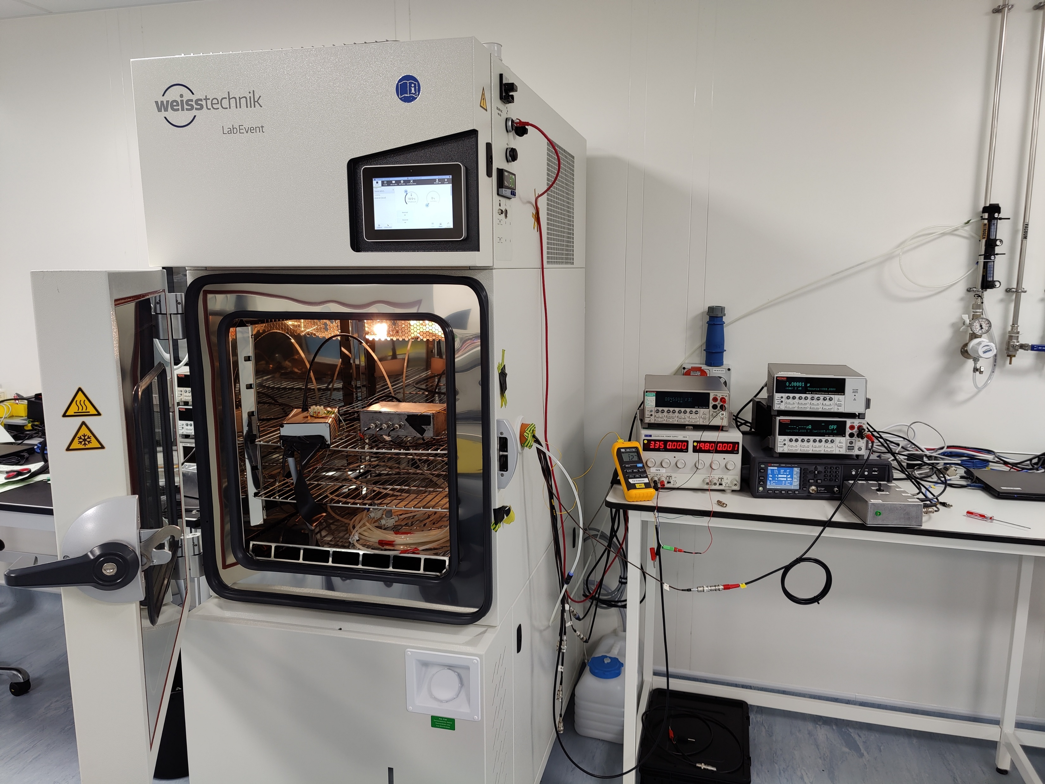
Measurement Setup
Climate Chamber
Keithley 6517b + 2410
MD8 (ITk QA test chip on PCB)
Humidity and Temperature Monitor

Slide 13
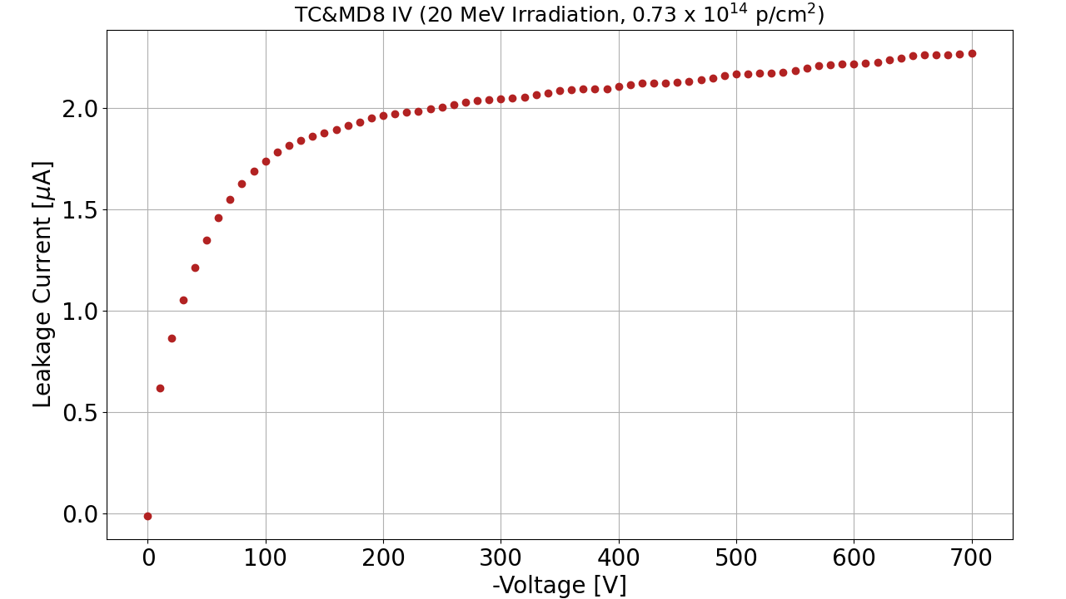
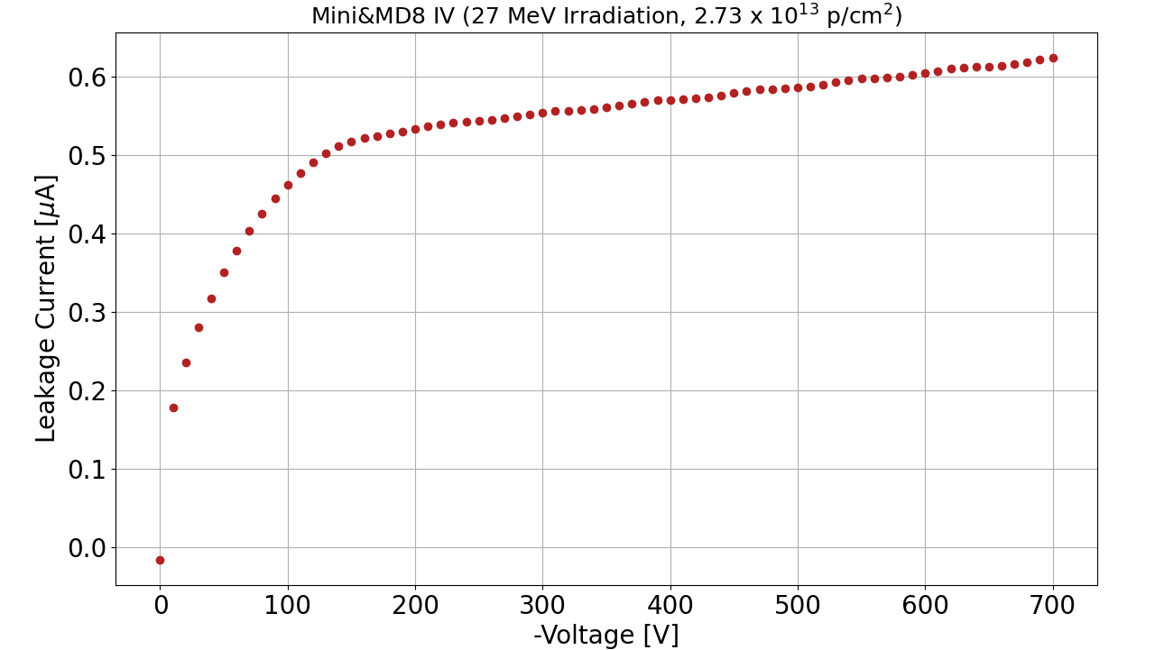
Example MD8 IV Curves
MD8_IV leakage current IV measurement curves for a 20 MeV and 27 MeV irradiated sample.
Leakage current for hardness factor extracted at V_{bias} = -500 V.
  Expect that the diodes are fully depleted by this voltage.

Slide 14
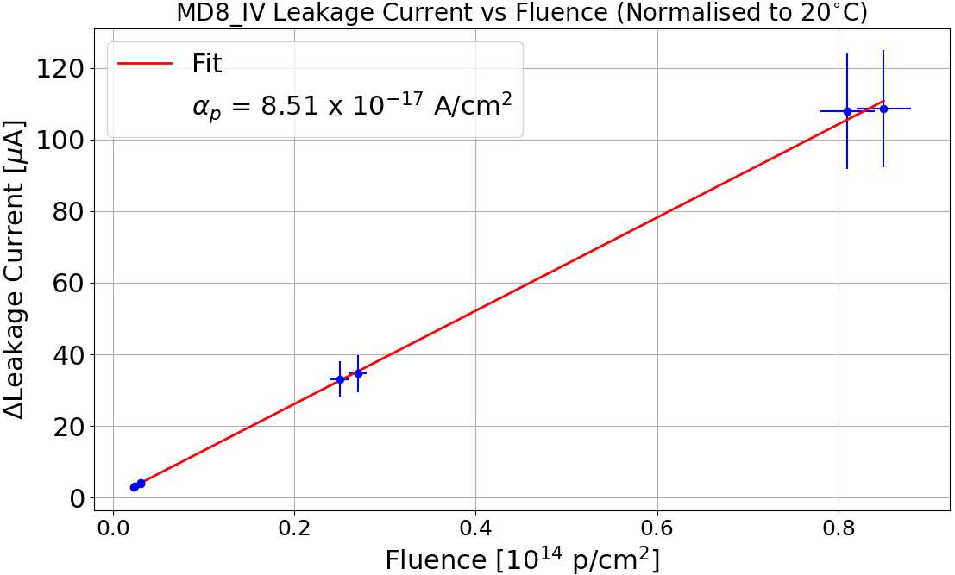
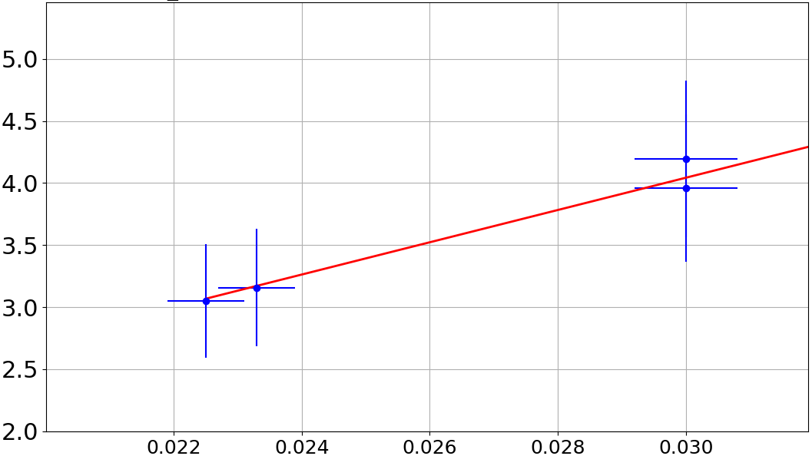
Proton Hardness Factor at 27 MeV (24.3 MeV on Sensor)
8 MD8s irradiated to fluences in the range 1.0 x 10¹² protons/cm² to 1.0 x 10¹⁴ protons/cm².
Hardness Factor: κ = 2.13 ± 0.20
Uncertainty on fluence ~5% from the ⁵⁷Ni dosimetry.
Uncertainty on the current from a study of the precision of extrapolation of I from -20°C to 20°C.
  Motivates ~15% uncertainty for an E_{a} = 1.21 eV [JINST 8 (2013) P10003]
Preliminary

Slide 15
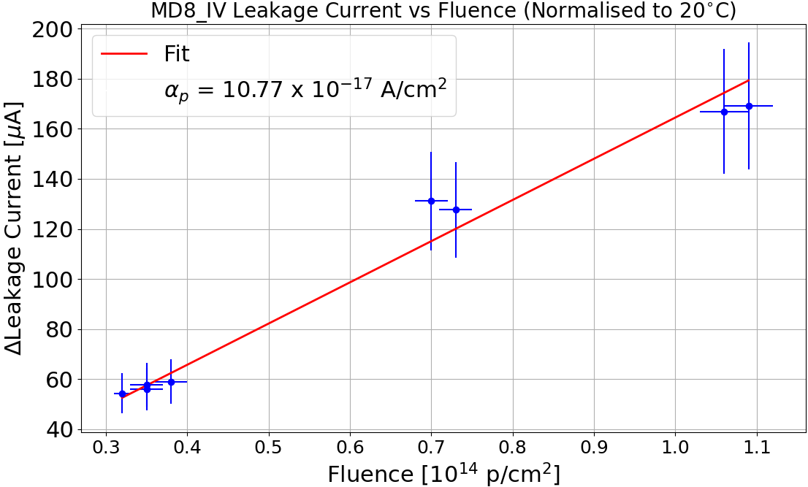
Proton Hardness Factor at 20 MeV (16.4 MeV on Sensor)
8 MD8s irradiated to fluences in the range (0.3 - 1.1) x 10¹⁴ protons/cm².
Hardness Factor: κ = 2.70 ± 0.41
Uncertainty on fluence ~5% from the ⁵⁷Ni dosimetry.
Uncertainty on the current from a study of the precision of extrapolation of I from -20°C to 20°C.
  Motivates ~15% uncertainty for an E_{a} = 1.21 eV [JINST 8 (2013) P10003]
Preliminary

Slide 16
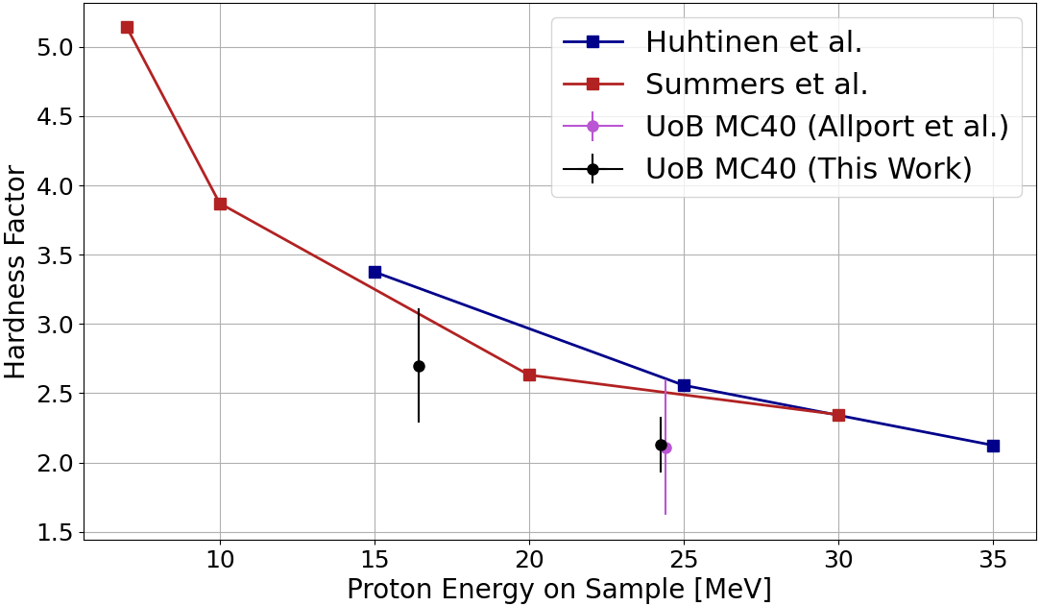
Hardness Factor Summary
Results from the UoB MC40 investigation alongside the tabulated values from Huhtinen et al. [NIM A 335 (1993) 580] and Summers et al. [IEEE NS 40 (1993) 1372] – Values taken from the RD50 displacement damage factor site.
Preliminary

Slide 17
Summary
The University of Birmingham MC40 cyclotron facility is involved with detector R&D, being able to deliver a few 10¹⁵ n_{eq}/cm² in one day.
A detailed reconstruction of the irradiation setup has been performed in Geant4.
  Beam energy at the Ni foil used for dosimetry calculations.
  The simulated TID agrees with the theoretical value for a given proton energy.
Preliminary hardness factor measurement using silicon monitor diodes at proton energies of 20 MeV and 27 MeV.
  For 20 MeV: 2.70 ± 0.41
  For 27 MeV: 2.13 ± 0.20
Planned irradiation at the highest possible proton beam energy at the facility and measure another hardness factor.
Aim to further investigate interplay between fluence and TID effects on silicon sensors.

Slide 18
Backup

Slide 19
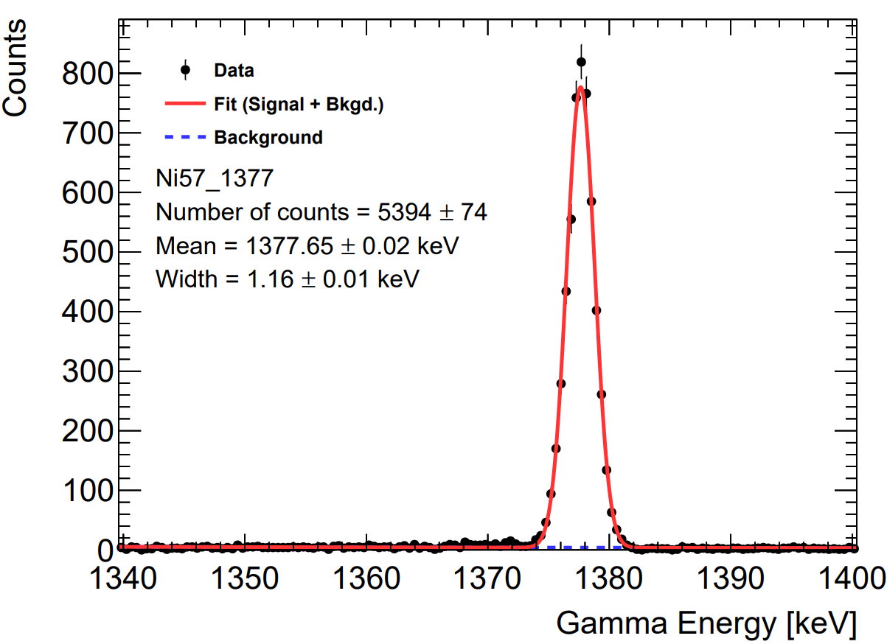
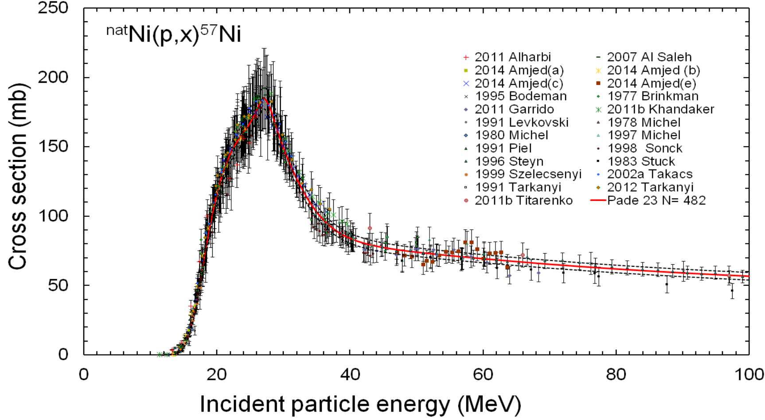
Dosimetry via Nickel Foil
The proton dosimetry is performed using natural nickel foils.
Several isotopes are produced, but main reaction of interest is ^{nat}Ni(p, x)⁵⁷Ni
The ⁵⁷Ni undergoes γ-decay – activity measured using a calibrated high purity Ge detector.
  Main characteristic peak is the 1377 keV line.
The peak intensity along with the ⁵⁷Ni production cross-section gives the number of protons incident on the foil, from which the proton fluence can then be acquired.
https://www-nds.iaea.org/medical/nip57ni0.html

Slide 20
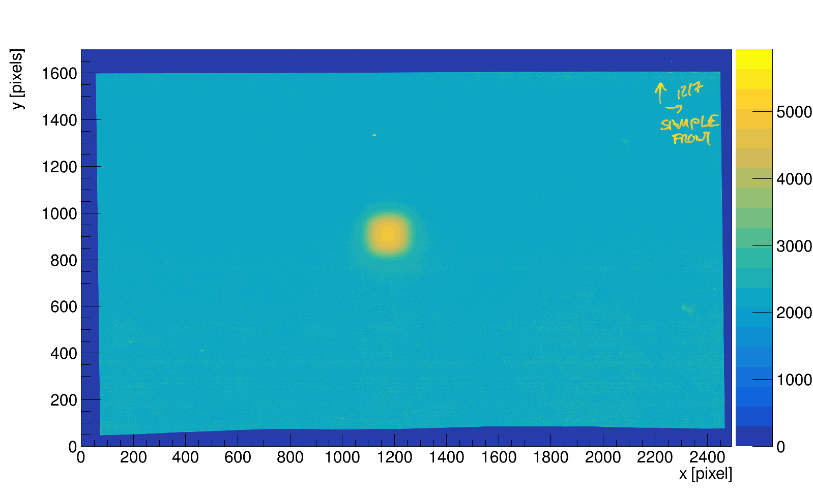
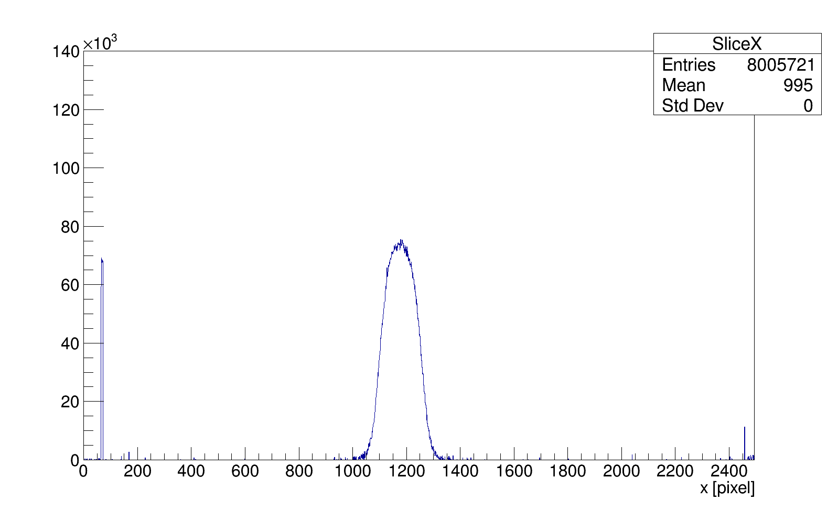
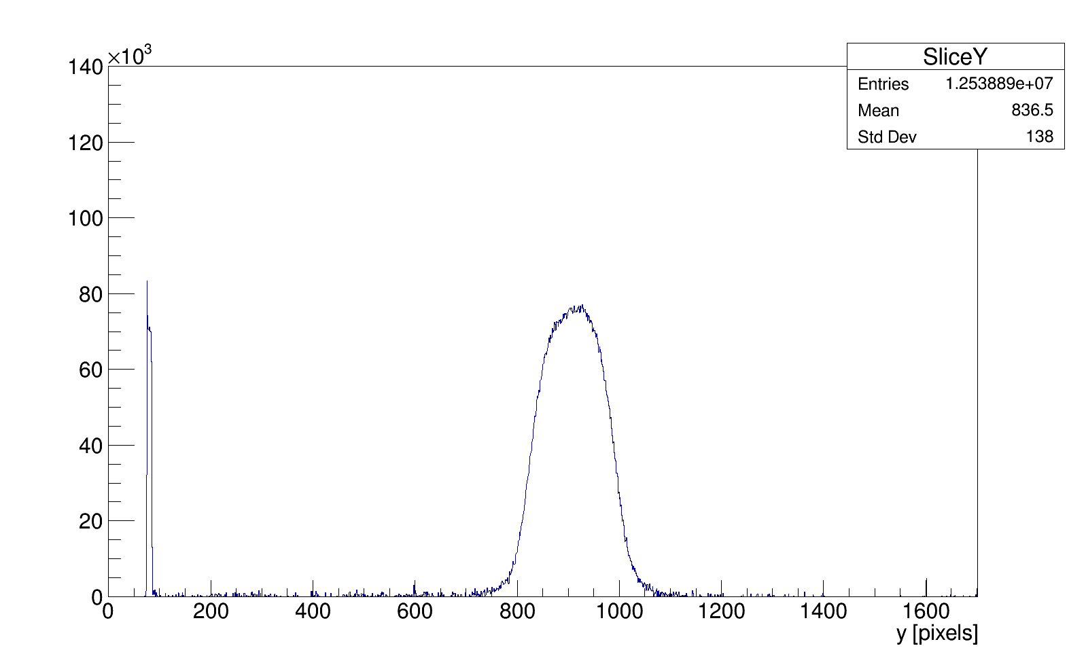
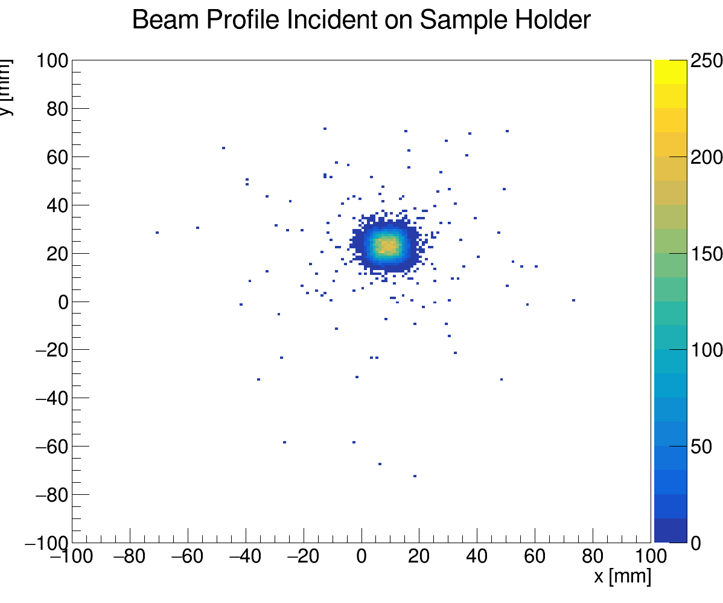
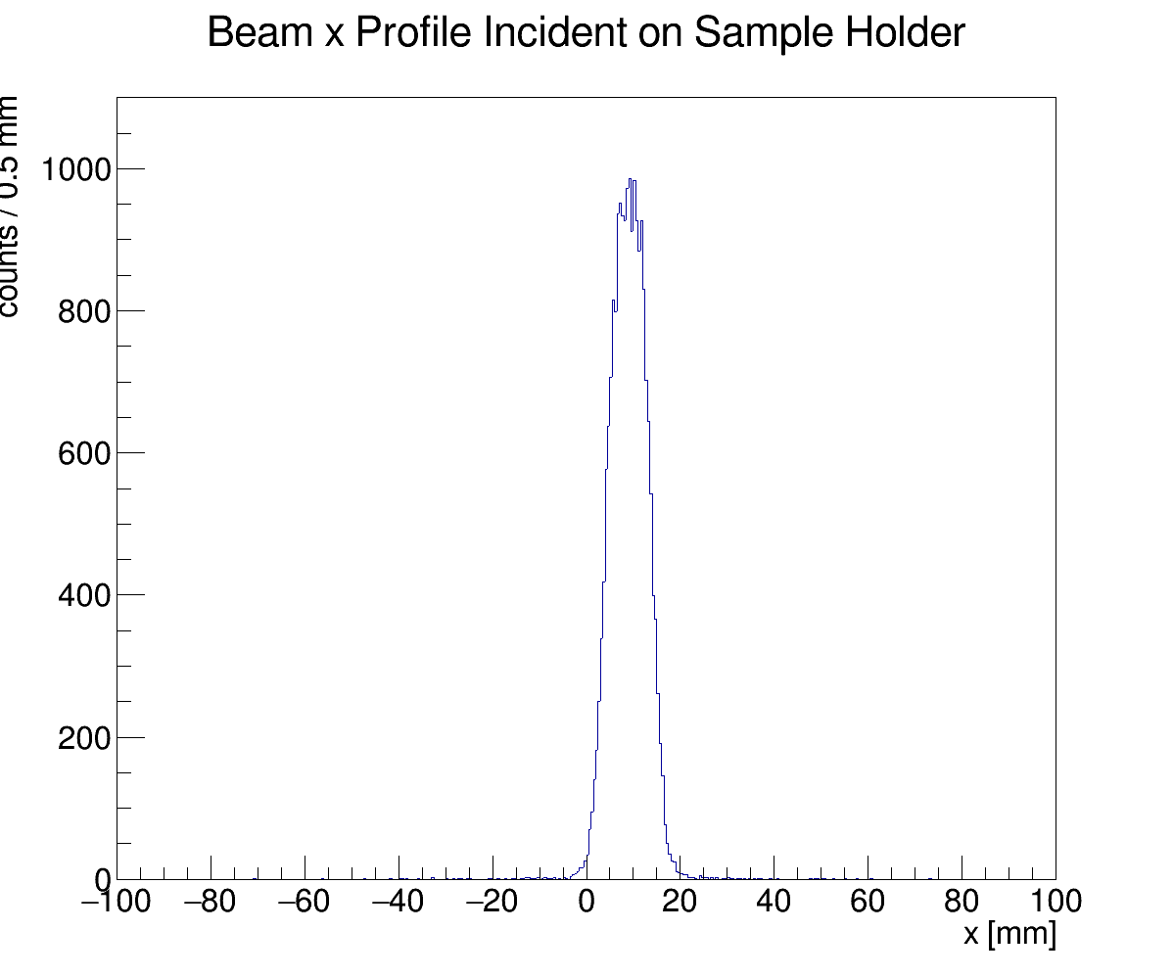
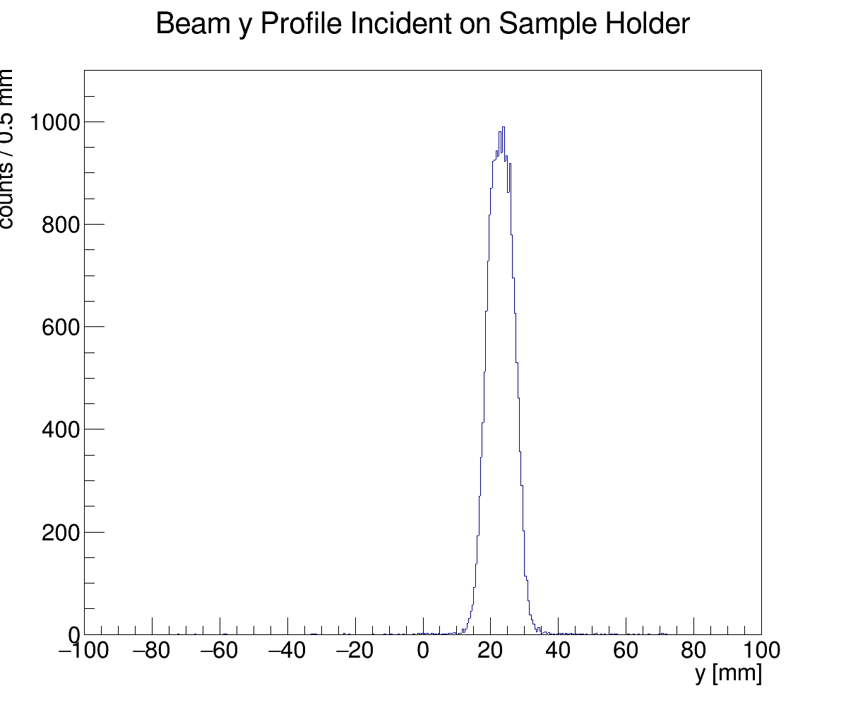
Gafchromic Film Validation
Acquire film
Convert to ROOT file
Project along x, y axis
Compare to simulated beam profile
Work in progress – the set of Gafchromic film further upstream were too saturated

Slide 21
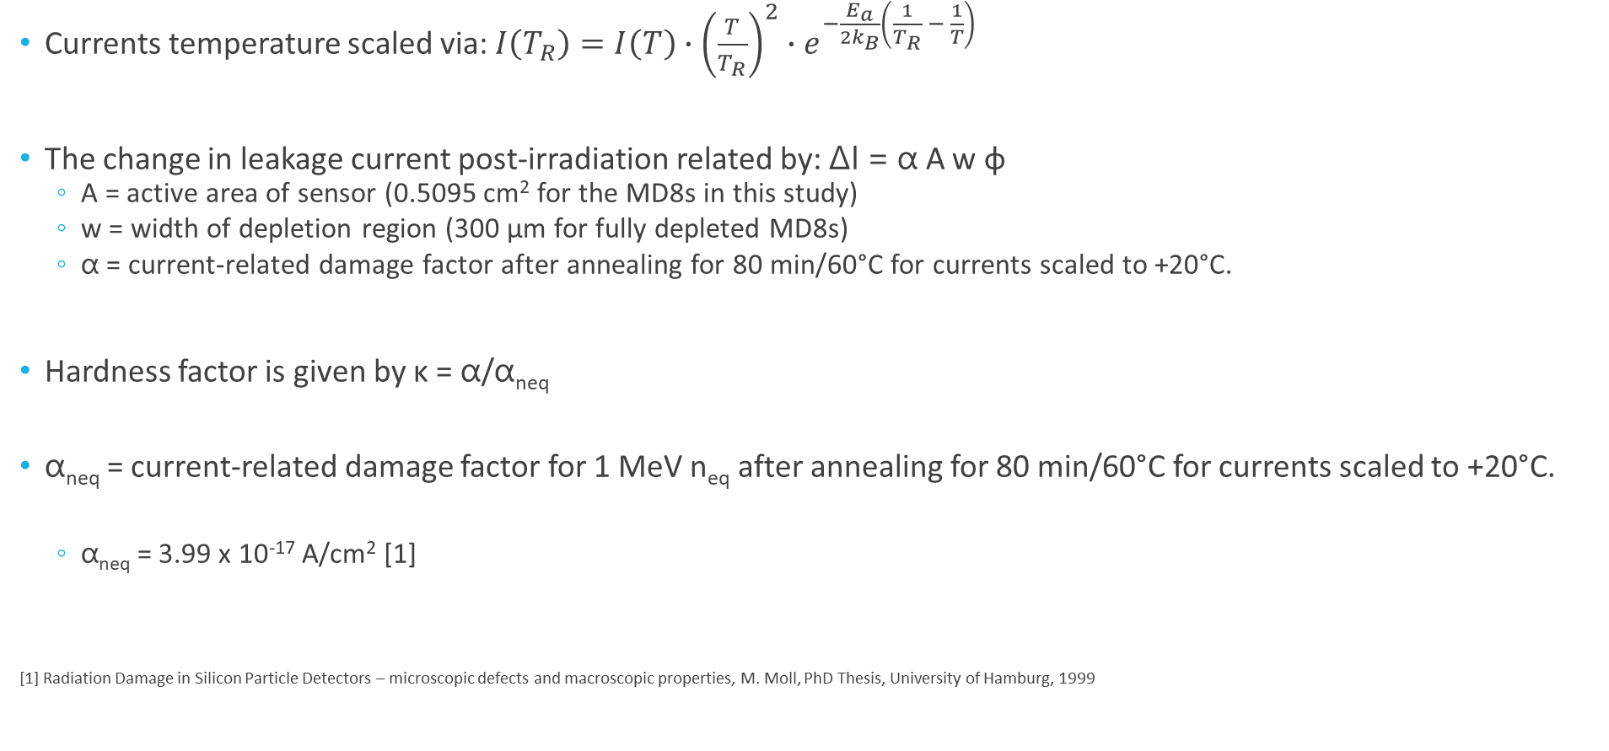
Analysis of Results
Currents temperature scaled via: $I\left(T_{R}\right)=I\left(T\right)∙{\left(\frac{T}{T_{R}}\right)}^{2}∙e^{−\frac{E_{a}}{2k_{B}}\left(\frac{1}{T_{R}} − \frac{1}{T}\right)}$
The change in leakage current post-irradiation related by: ΔI = α A w φ
  A = active area of sensor (0.5095 cm² for the MD8s in this study)
  w = width of depletion region (300 μm for fully depleted MD8s)
  α = current-related damage factor after annealing for 80 min/60°C for currents scaled to +20°C.
Hardness factor is given by κ = α/α_{neq}
α_{neq} = current-related damage factor for 1 MeV n_{eq} after annealing for 80 min/60°C for currents scaled to +20°C.
  α_{neq} = 3.99 x 10⁻¹⁷ A/cm² [1]
[1] Radiation Damage in Silicon Particle Detectors – microscopic defects and macroscopic properties, M. Moll, PhD Thesis, University of Hamburg, 1999

Slide 22
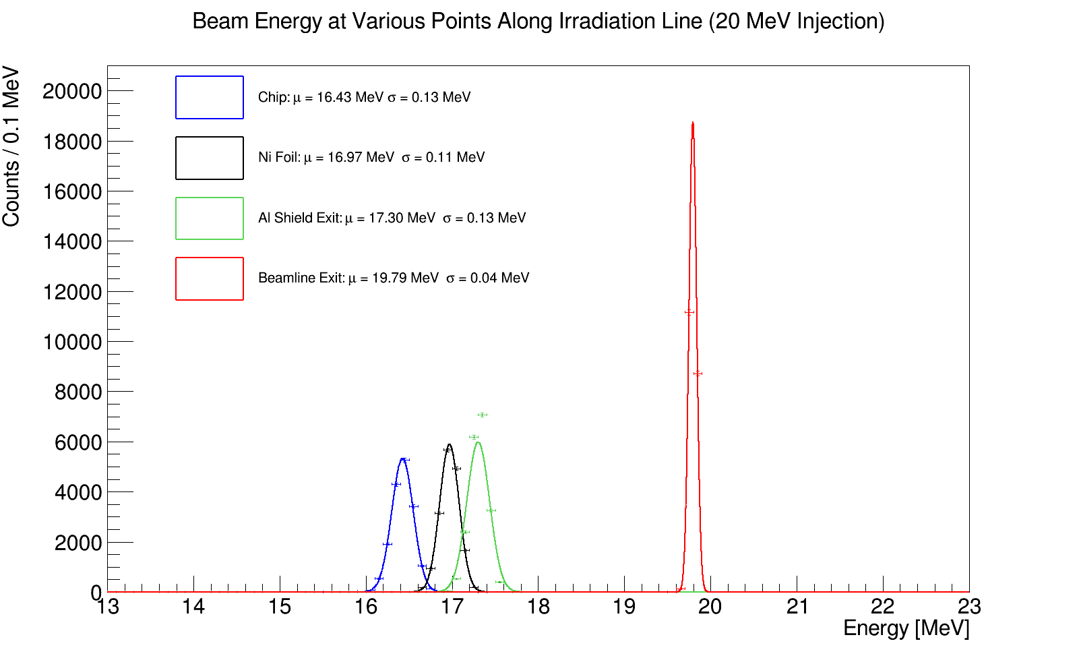
Simulated Beam Energy Profile for 20 MeV Protons

