Slide 1
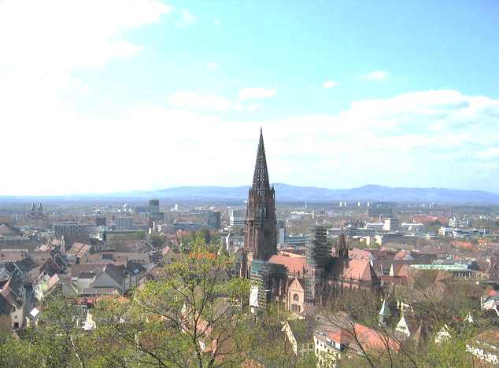

DRD3 WG8 –
Dissemination, Outreach,
Speakers Committee
Clara Nellist, Pablo Fernandez-Martinez, Ulrich Parzefall
Ulrich Parzefall
3 Dec 2024

Slide 2
WG8 – Who We Are
Outreach and Dissemination
Clara Nellist (Nikhef / UvA), @particlara
Speakers Committee
Pablo Fernandez-Martinez (CNM Barcelona), Clara, Uli Parzefall (Freiburg)

Slide 3
WG8 Activities
Conference Talks (there were probably more)
  Pixel 2024 (Wide Band Gap Materials, WG6, Alexander Oh)
  CEPC (4D Detectors, WG2 , Alessandro Tricoli)
  DRD3 Speakers Committee (SC) should deal with talks covering several WGs.
  Both talks above WG-specific talks -> no SC involvement

Slide 4

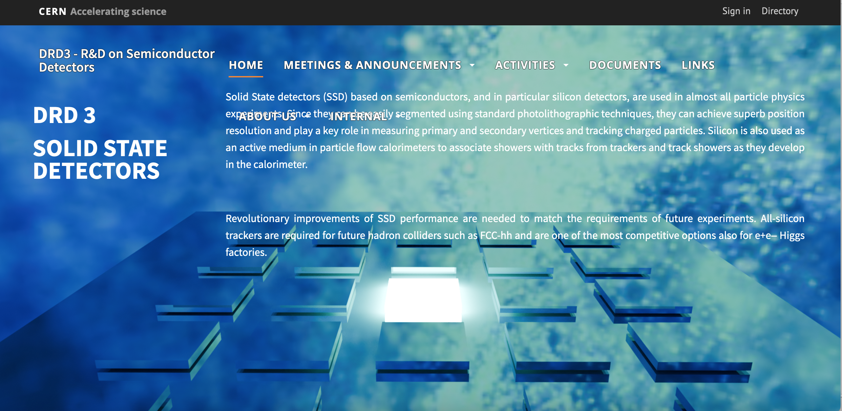
WG8 Activities
DRD3 Logo
  We propose a process where DRD3 members
  can design and present (=suggest) a Logo,
  and then all DRD3 can vote.
  Similar to RD50 Logo selection process.
  Beyond fame, most popular logo will also win
  bottle of award-winning white wine
  from Rhine valley
Web Page
  https://drd3.web.cern.ch:
  List of conferences
  List of events of
  interest (schools etc.)
  Possible to post job
  vacancies
Seen in several DRD3 talks. Originally drafted by Michael Moll, but never intended as logo

