Slide 1


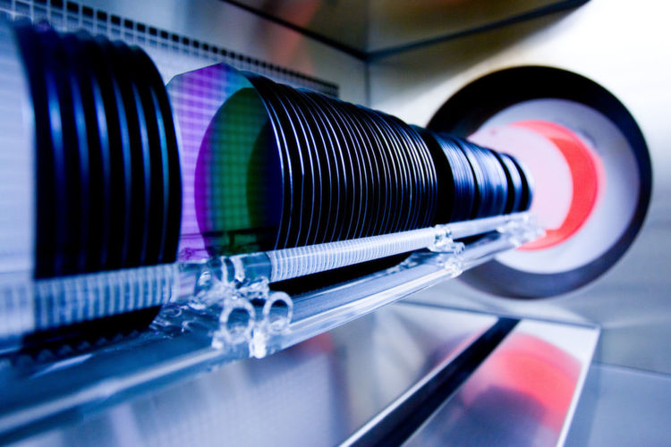

Competence in Silicon
The numerous configurations of „interstitial boron“ and their involvement in ARP of LGADs 30.11.2023
Kevin Lauer, Aaron Flötotto, Katharina Peh, Robin Müller, Wichard Beenken, Erich Runge, Dirk Schulze, Stefan Krischok, Thomas Ortlepp

Slide 2
Overview
Existing A_{Si}-Si_{i}-defect model
Configurations of “interstitial boron” obtained by DFT calculations
Defect energy landscape
Explanation of ARP in LGADs by the B_{Si}-Si_{i}-defect mode
Summary
Acknowledgement

Slide 3
Existing A_{Si}-Si_{i}-defect model

Slide 4
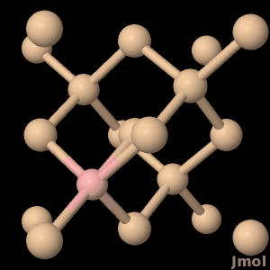
A_{Si}-Si_{i} defect model
A_{Si}: acceptor atom is close to its substitutional position
Silicon interstitial is moving around (tetrahedral, hexagonal and split interstitial position assumed so far)
Model and experimental evidence recently reviewed [1]
[1] K. Lauer et al. In: Phys. Status Solidi A (Aug. 2022), 2200099

Slide 5
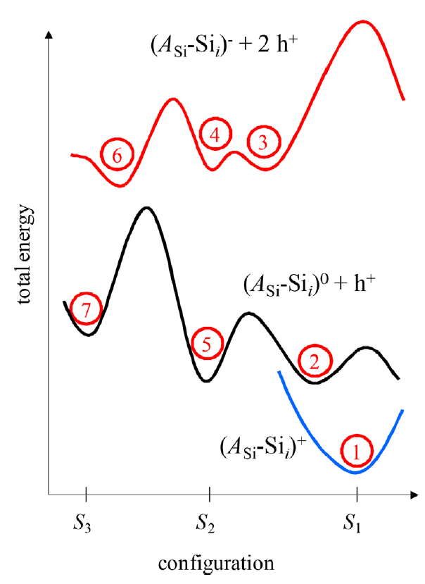
A_{Si}-Si_{i} defect model
Configuration coordinate total (electronic + elastic) energy diagram [1] deduced from simulation results of the silicon interstitial [2]
Three charge states (+, 0, -) and three configurations (S₁, S₂ and S₃) of A_{Si}-Si_{i} exist within the model
Energy barriers between configurations (e.g. E₃₄, E₄₆)
Negative charge state: S₃ energetically favored
Neutral charge state: S₂ and S₁ energetically favored
[1] K. Lauer et al., Physica Status Solidi (c) 14, 1600033 (2017).
[2] R. Jones et al., Materials Science and Engineering: B 159–160, 112 (2009).

Slide 6
Explanation of LID by A_{Si}-Si_{i} defect model
LID: light-induced degradation in silicon solar cells [1]
Transition 1 to 3: defect captures electrons under illumination
Transition 3 to 4: thermally stimulated, fast component of LID (FRC)
Transition 4 to 6: thermally stimulated, slow component of LID (SRC)
Transition 7 to 1: thermally stimulated, recovery of defect, without illumination
[1] C. Möller et al., phys. stat. sol. RRL 7, 461 (2013)

Slide 7
Configurations of “interstitial boron” obtained by DFT calculations

Slide 8
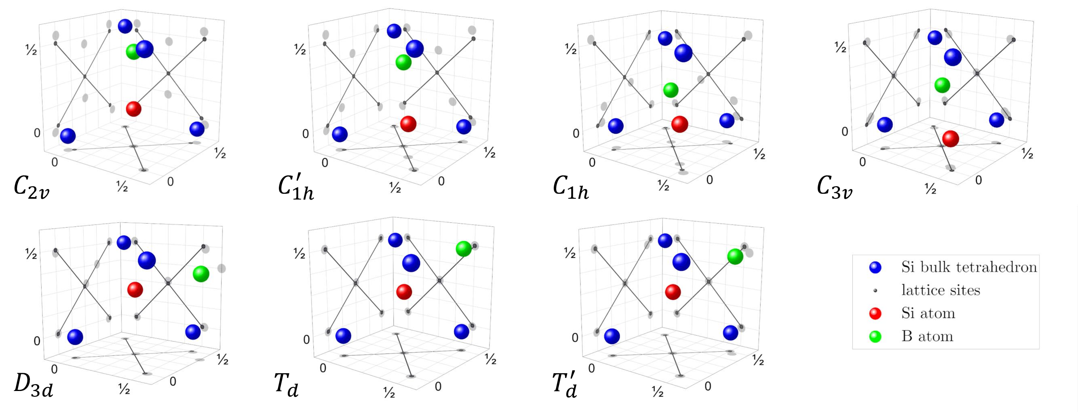
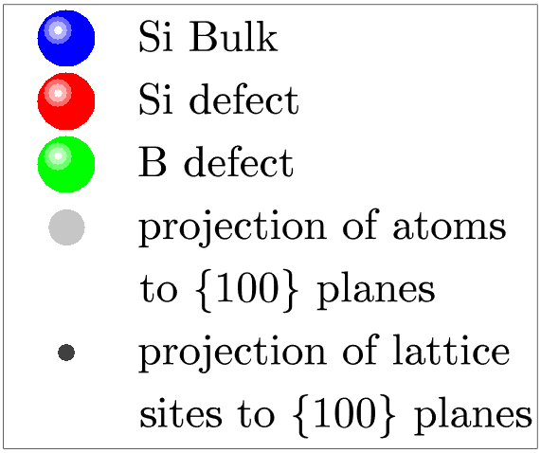
DFT calculation of stable defect configurations
B_{i}Si_{i}V
B_{Si} Si_{i}
unstable
B_{i}
Six different stable configurations found
To be published A. Flötotto et al. 2024

Slide 9
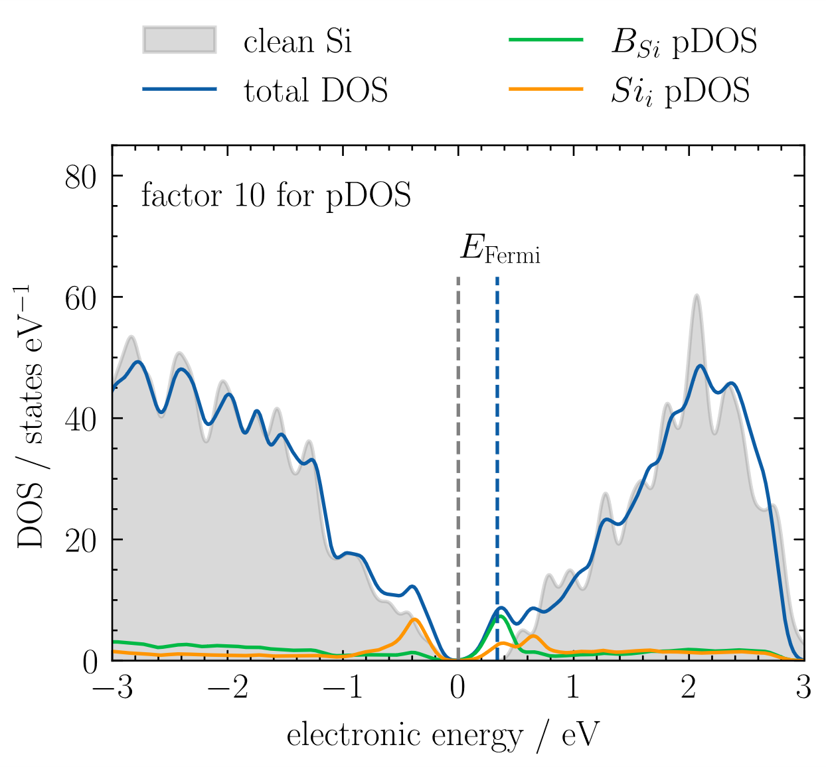
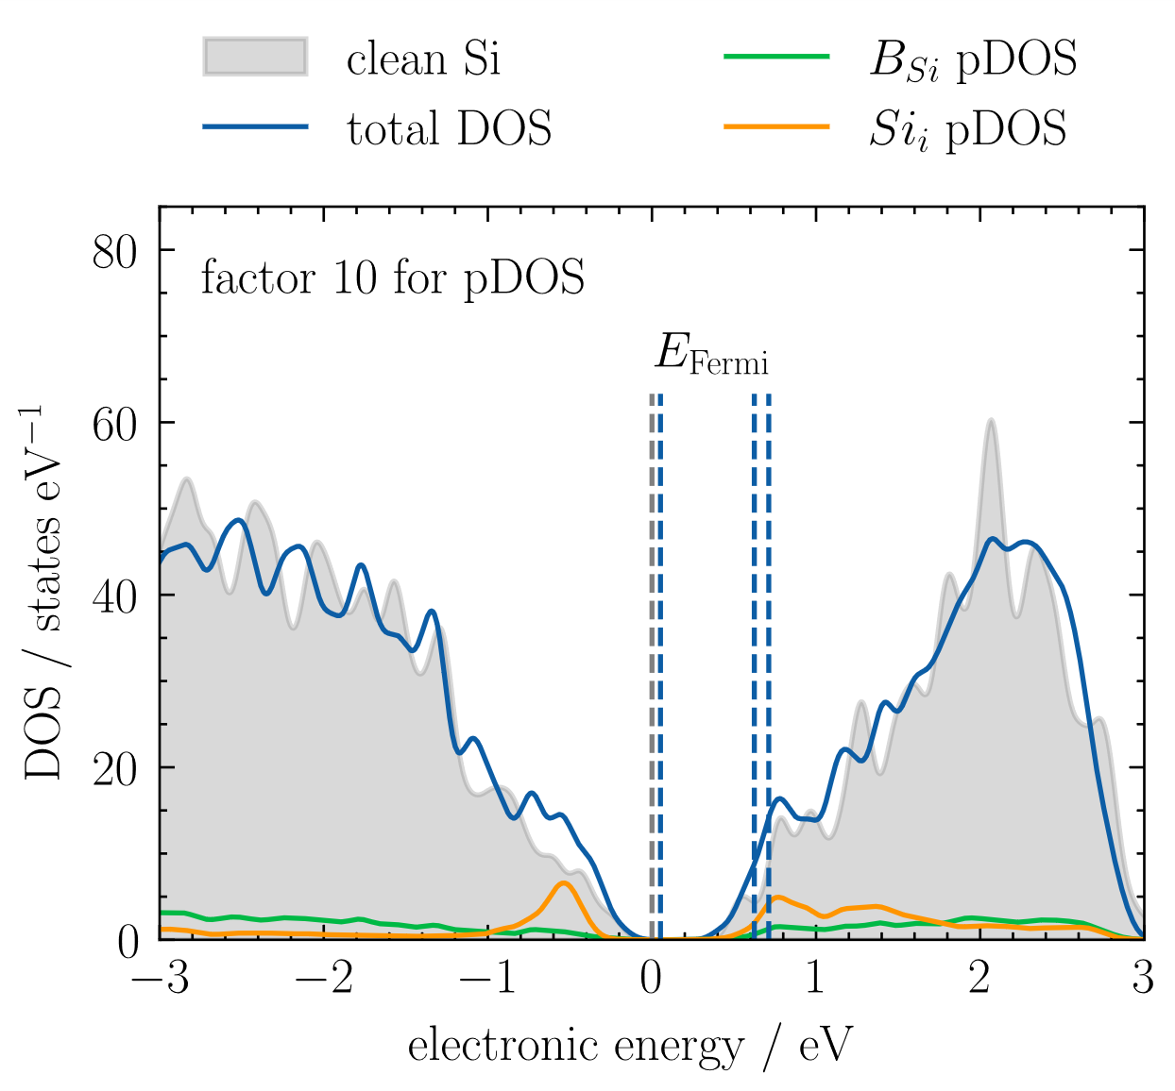




DFT calculation of density of states (DOS)
B_{i}Si_{i}V defect (C_{1h})
B_{si}Si_{i} defect (C_{3v})
$$q_{tot}=0$$
$$q_{tot}=0$$
Si bulk
$$q_{tot}=−1$$
$$q_{tot}=+1$$
Deep donor
Shallow donor
B_{Si}Si_{i} defect in C_{3v} configuration is shallow donor
To be published A. Flötotto et al. 2024

Slide 10
Calculated electronic defect states
deep
shallow
4 deep and 3 shallow centers found
To be published A. Flötotto et al. 2024

Slide 11
Defect energy landscape

Slide 12
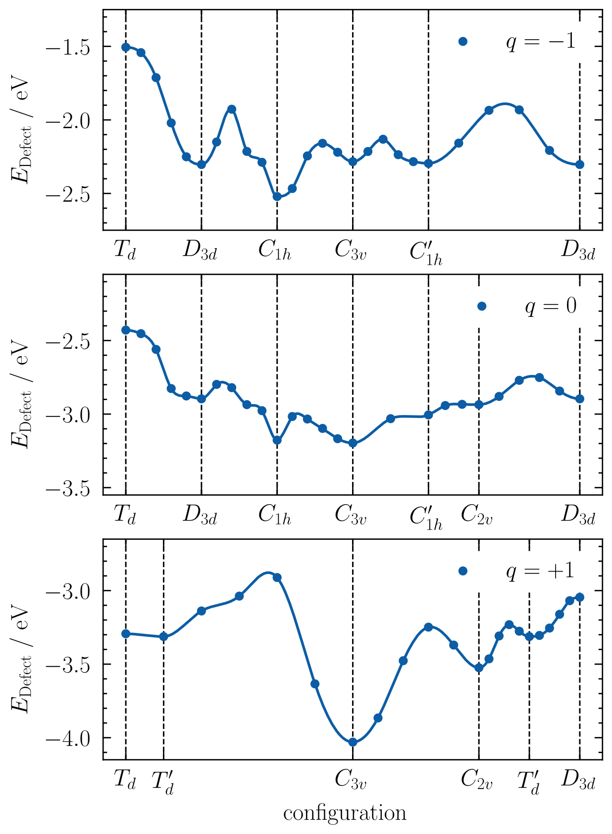
Calculated defect energy landscape
Calculation of all Minimal Energy Paths (NEB method) between defect configurations for each charge state
Ground state in positive charge state (p-type silicon) is C_{3v} configuration
From DFT calculations: no energetical reason for the substitutional boron to follow the Watkins replacement reaction!
To be published A. Flötotto et al. 2024

Slide 13
Explanation of ARP in LGADs by the B_{Si}-Si_{i}-defect mode

Slide 14
Explanation of ARP in LGADs by B_{Si}-Si_{i}-defect mode
Irradiation removes silicon atoms from lattice positions
At low temperatures (~20K) the removed silicon atom moves due to the energy gained by the collision event and is eventually captured by substitutional boron. [1]
At about room temperature the removed silicon atom might additionally diffuse thermally due to its weak mobility. [2]
Shallow donor mode of the B_{Si}-Si_{i}-defect (C_{3v}) forms
[1] K. Lauer et al., https://arxiv.org/abs/2311.07280
[2] A.N. Buzynin et al., NIMB, 186(1), 366–370 (2002).

Slide 15
Summary
Comprehensive DFT calculations made for “interstitial boron”
Six different stable configurations found
Configuration with lowest energy in p-type silicon is C_{3v} with boron residing very close to regular lattice position
C_{3v} configuration is found to be a shallow donor
Explanation of acceptor removal phenomenon (ARP) in low-gain avalanche detectors (LGAD):
  Substitutional boron acceptor captures silicon atom, which was removed from a lattice position by irradiation.
  The resulting defect is a shallow donor.
  Amplification property of the boron gain layer in LGADs gets lost by irradiation.

Slide 16


Thank you for your kind attention!
DFG Project SimASiSii:
DFG KR 2228/11-1, LA 4623/1-1, RU 1383/6-1
BMWI Project eLGAD (49MF220095)
Titular Saint
Franz of Assisi

Slide 17
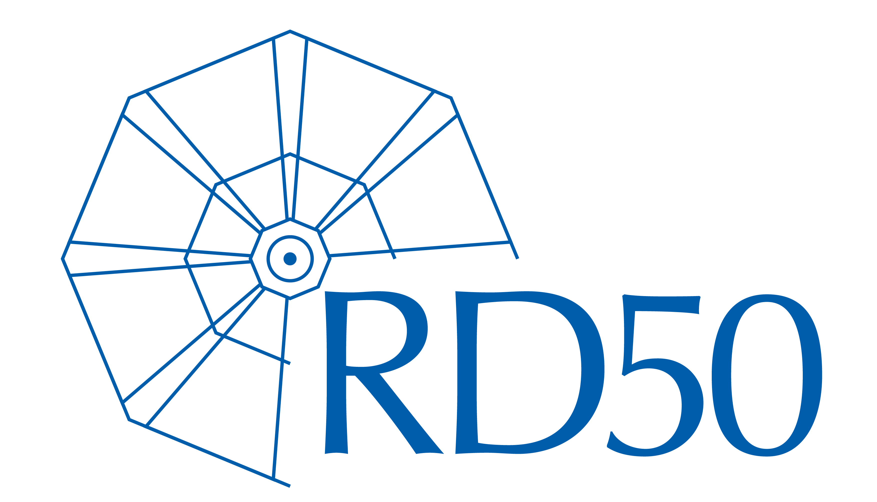
Thanks to RD50 for possibility to present crazy ideas!

Slide 18
Back-up

Slide 19
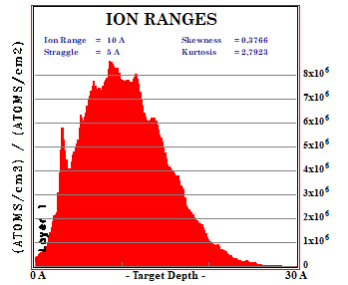
Possibility for silicon recoils to reach B atoms
1 MeV electron irradiation of silicon generates silicon recoils exhibiting kinetic energy
~10% of these recoils have more than 80eV
~50% of these 10% travel more than 1nm (SRIM)
For 10¹⁶cm⁻³ boron density every 23th of these left recoils is able to reach a boron atom
If 10% of the silicon recoils reaching boron to form the B_{Si}-Si_{i}-defect, a B_{Si}-Si_{i}-defect density of about 10¹⁵cm⁻³ is under typical conditions (electron current and duration) possible.
=> Sufficient to explain EPR signals [1] without assumption of fast defect diffusion [2]
[1] G.D. Watkins, Physical Review B 12(12), 5824 (1975).
[2] K. Lauer et al., https://arxiv.org/abs/2311.07280

