Slide 1
LGAD: a Little bit of the early history
Giulio Pellegrini
Salvador Hidalgo

Slide 2

Outline
Why LGADs became such a hot topic in the last decade? My recall of how the whole thing started and continues….
I apologize for omission or forgetting names and fact… I will appreciate any correction or comment.

Slide 3
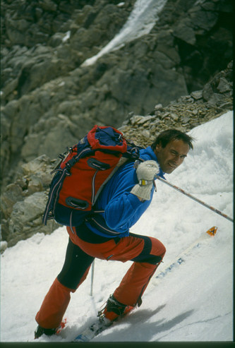
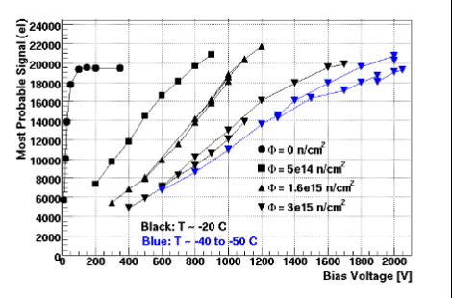
Charge multiplication (<2010)
It was clear in 2010 the charge Multiplication effect in Highly Irradiated Planar Sensors -> mainly strips.
A considerable R&D activity for improving the radiation tolerance of finely segmented silicon detectors has been stimulated by the requirements of the future upgrade of the LHCaccelerator at CERN.
microstrip detectors
RD50 has shown that irradiated sensors were capable to recover at least the same charge as before irradiation, or even more if biased to sufficiently high voltages.

Slide 4
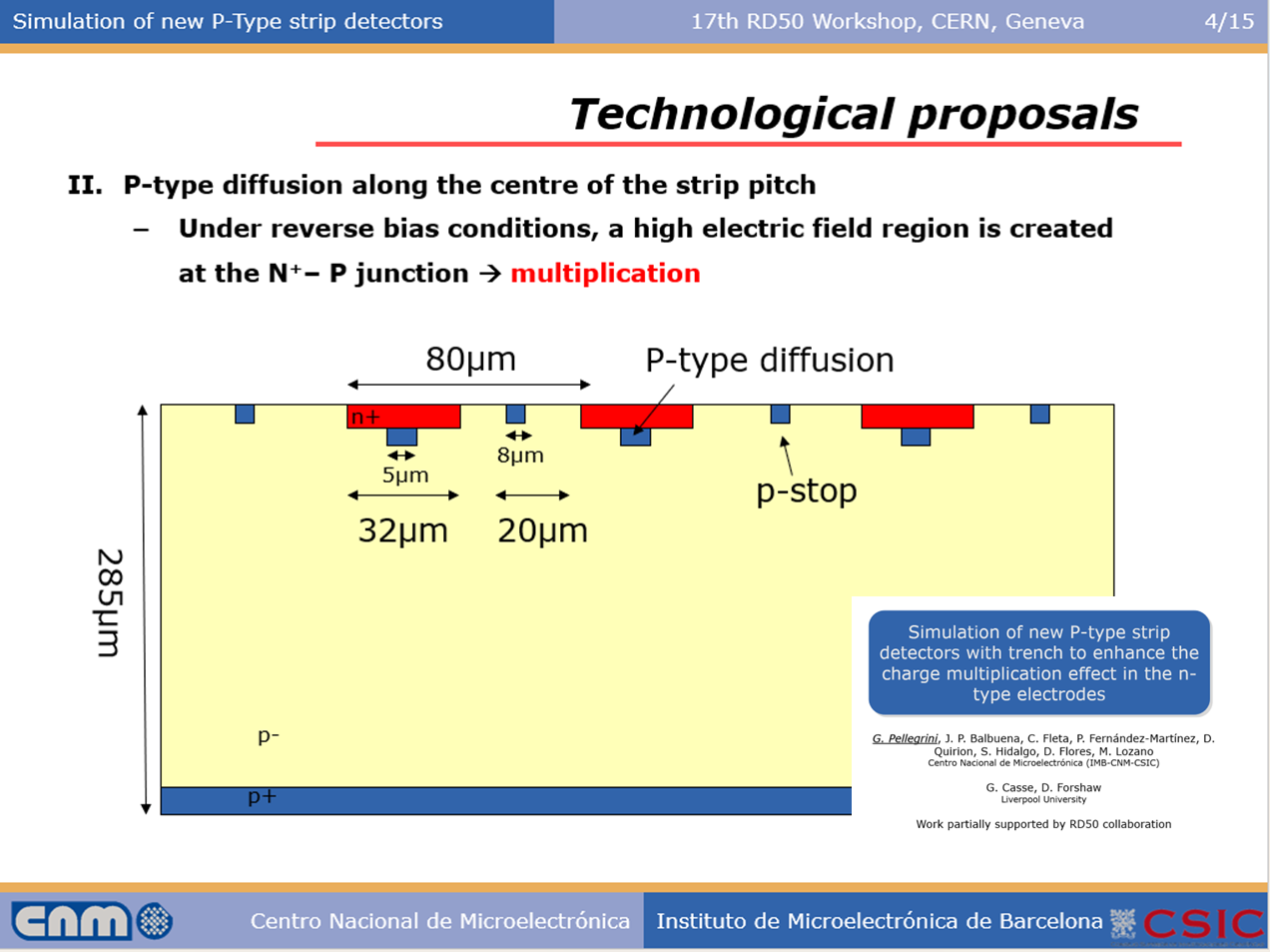
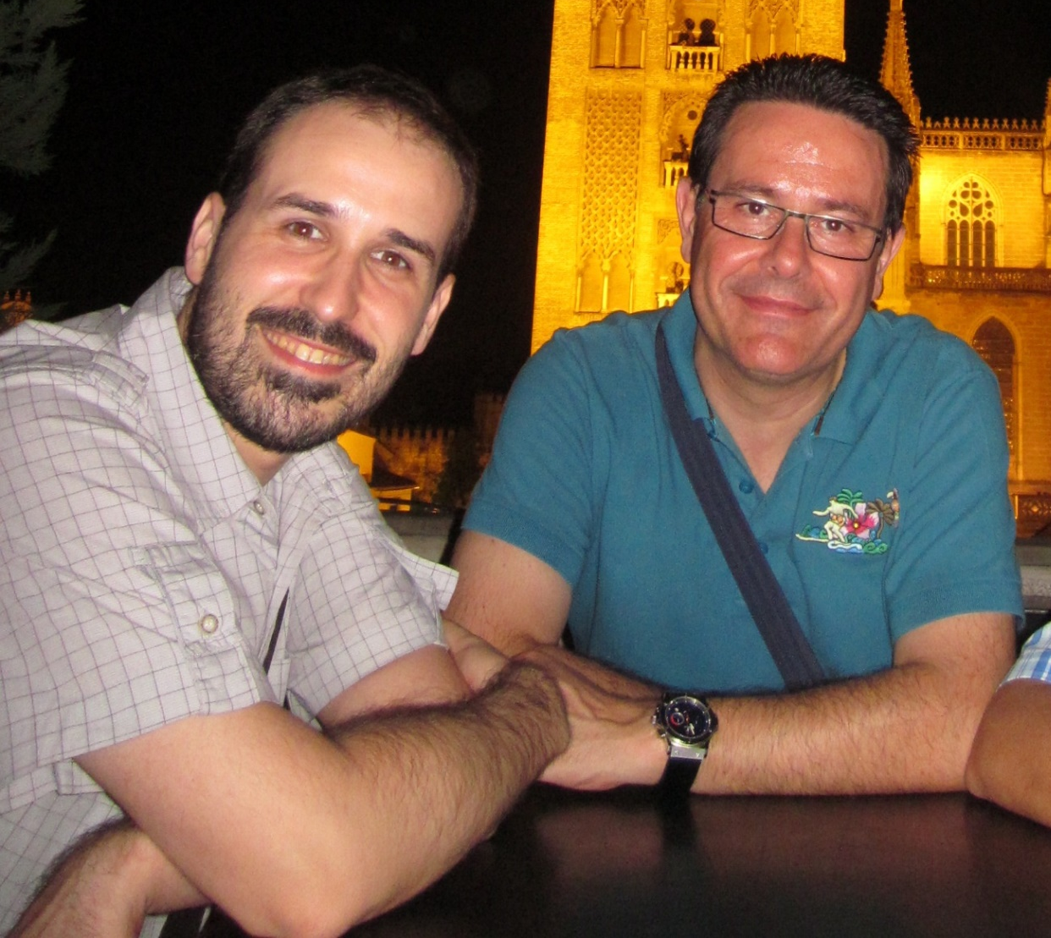
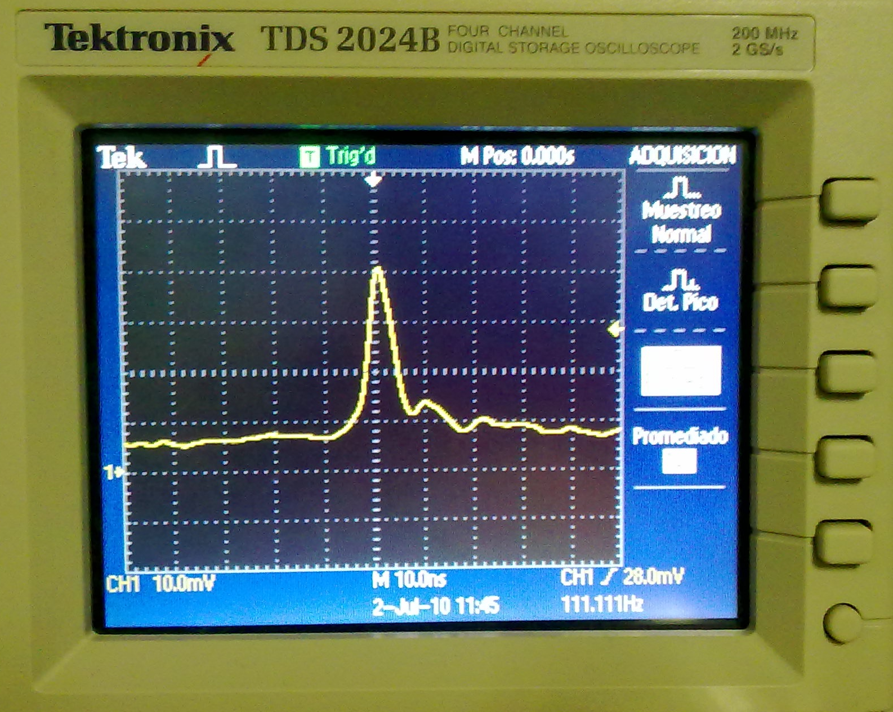
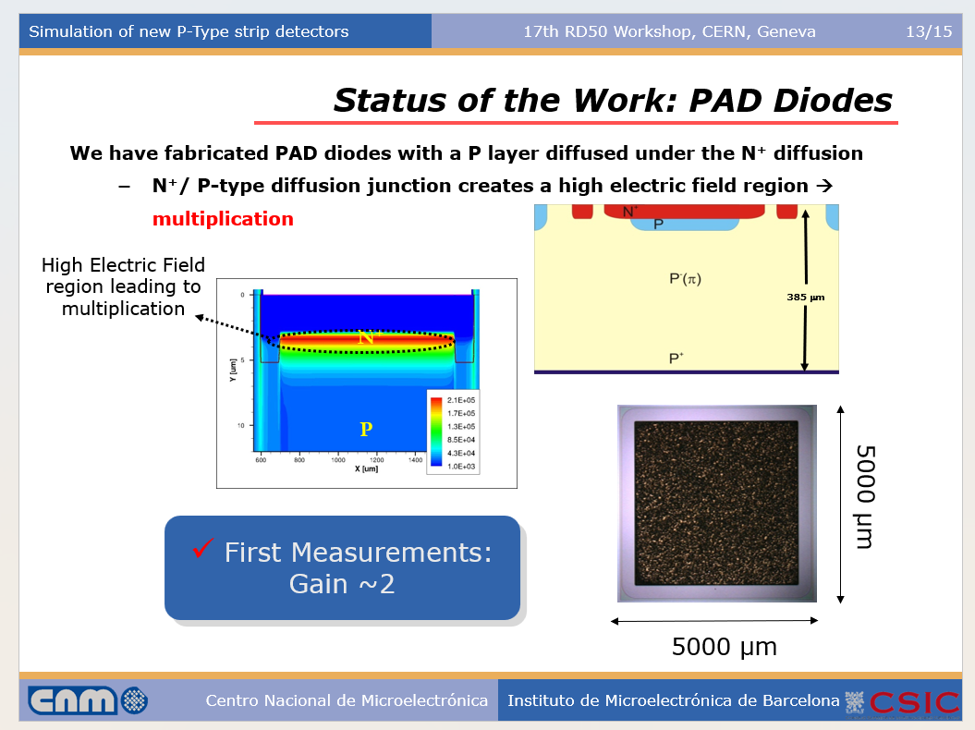
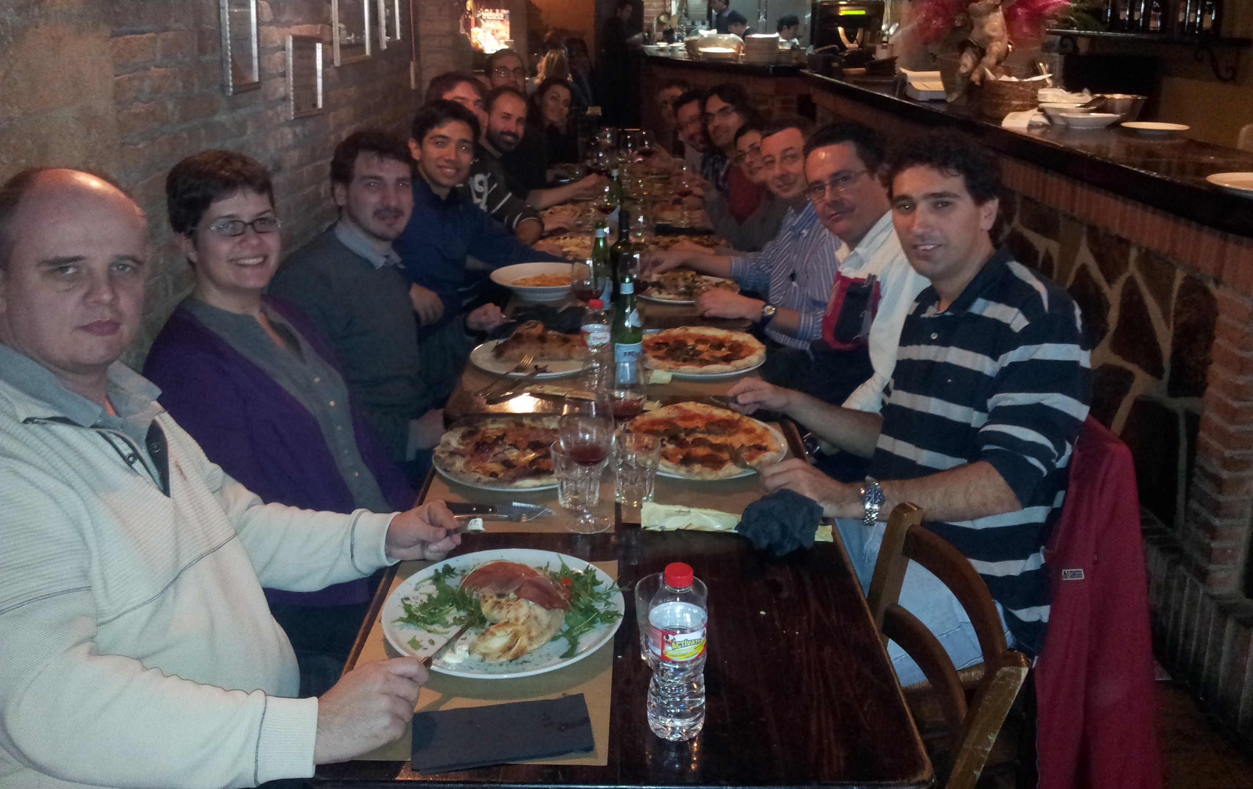
2010
First idea of a detector with a moderate Gain
Strip detector
PhD thesis of Pablo Fernandez
July 2010

Slide 5
Early Historical developments : The first appearance on scene of the LGAD (2011-2012)
Status of the RD50 funding request for "detectors with enhanced multiplication”

Slide 6

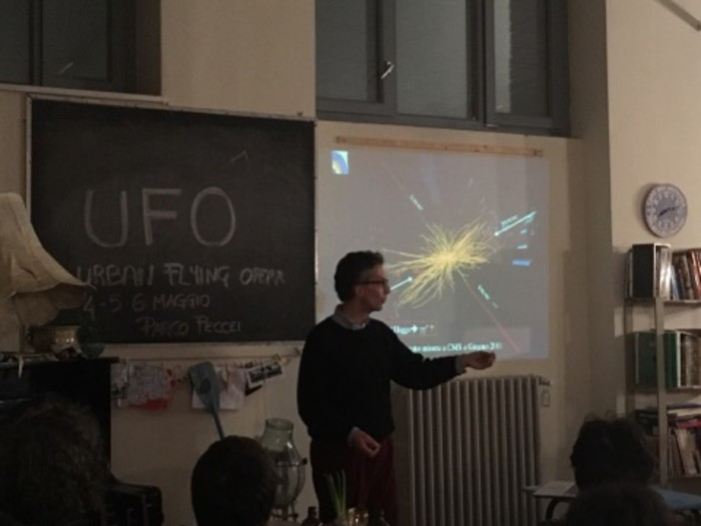
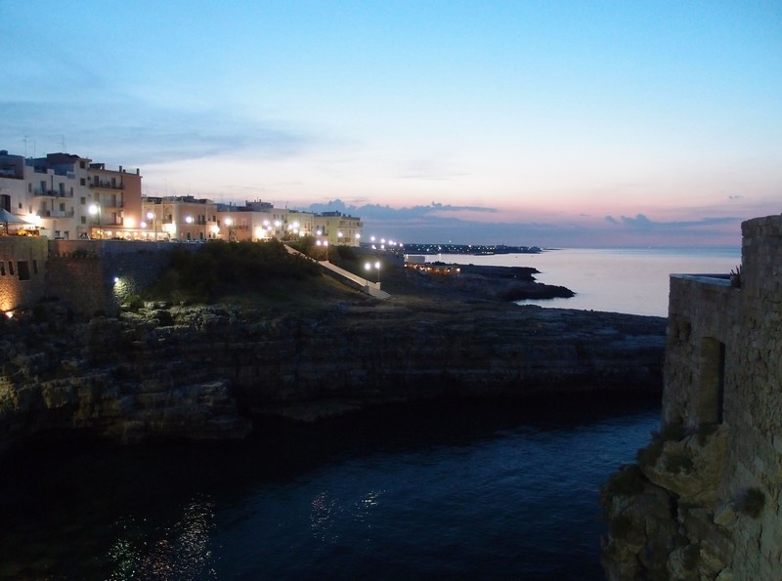
Who requested the LGAD? A few months before in Bari (2012)
Great interest of Atlas and CMS for HGTD and ETL
Great vision!
6

Slide 7


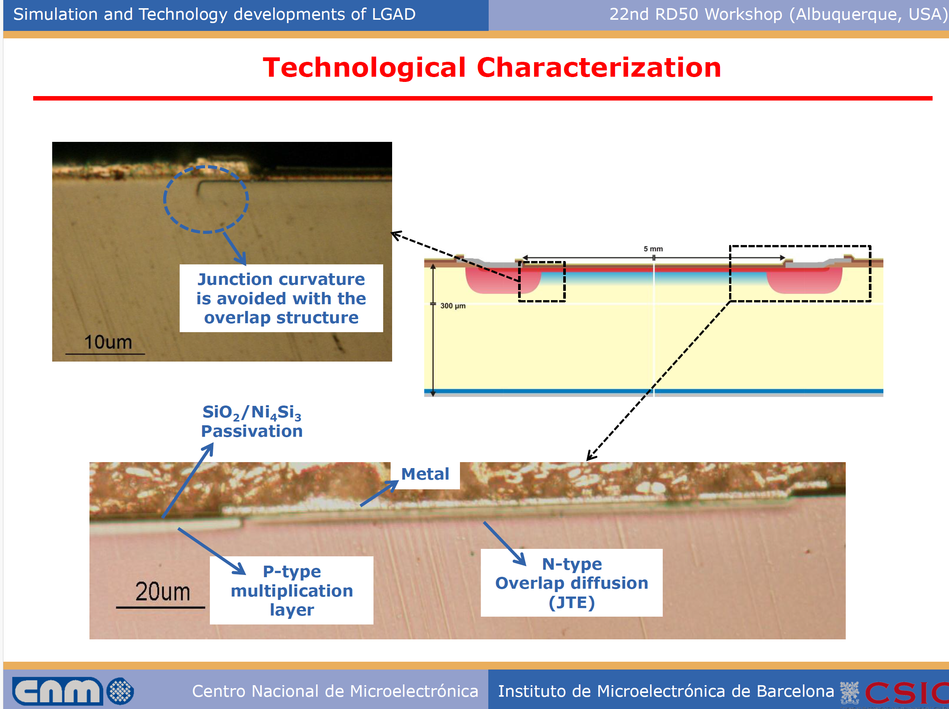
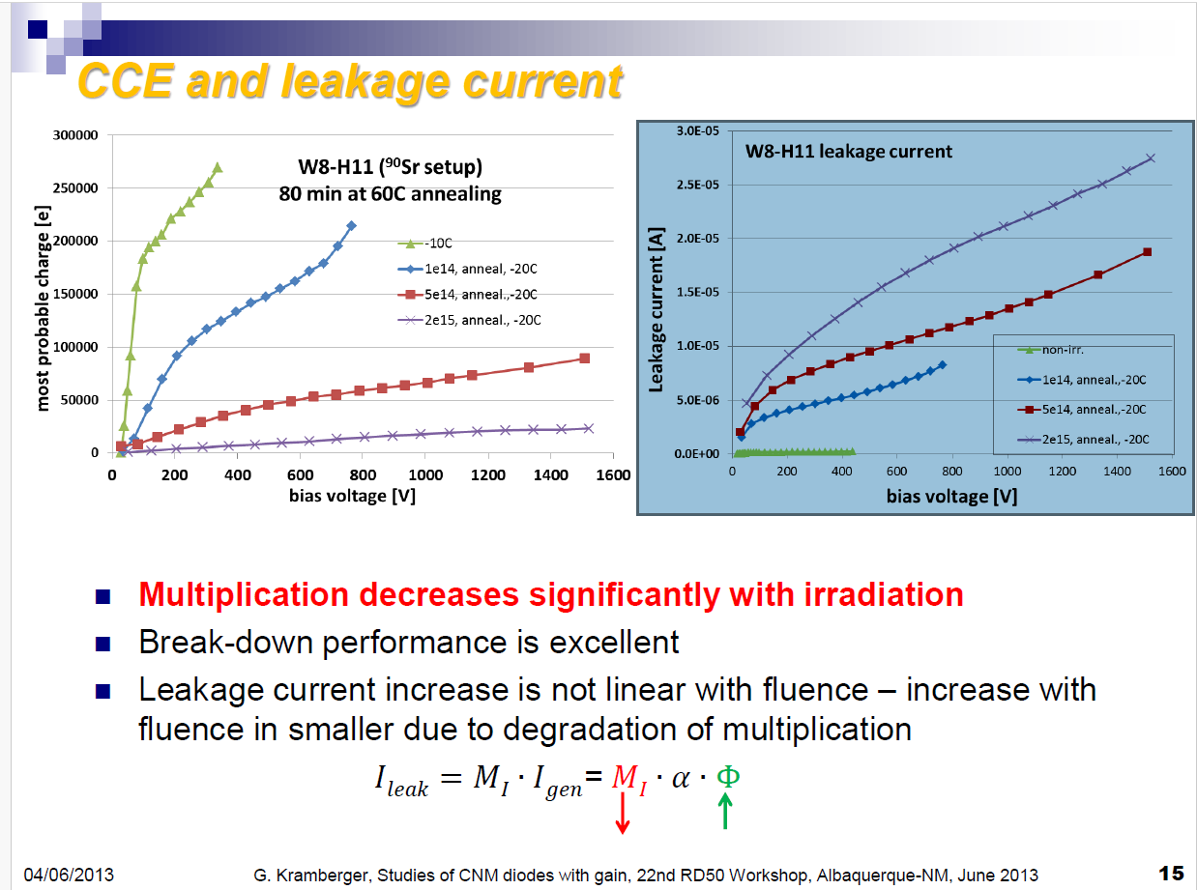

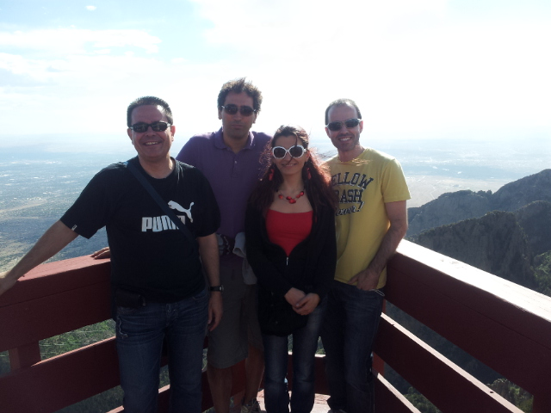
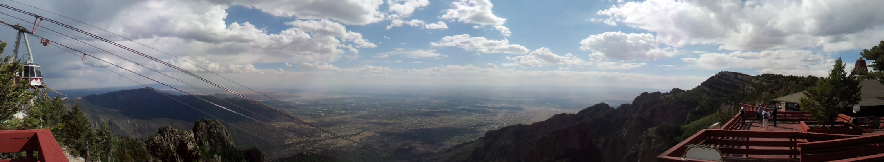
2013
Devices available to all interested groups
First irradiations studies Boron Removal
.

Slide 8
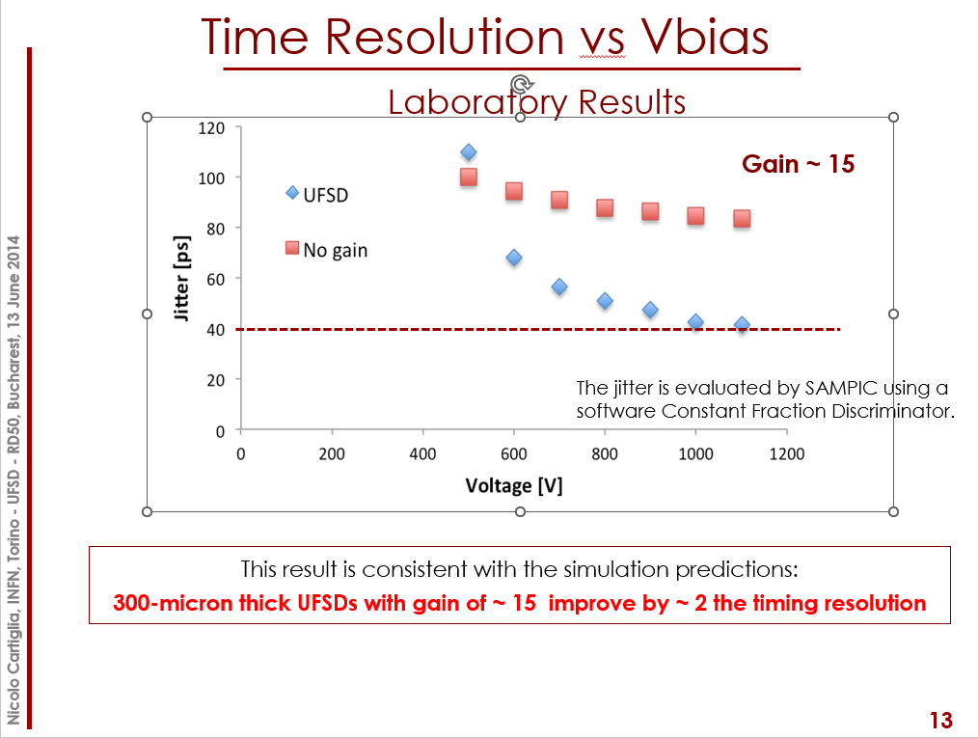
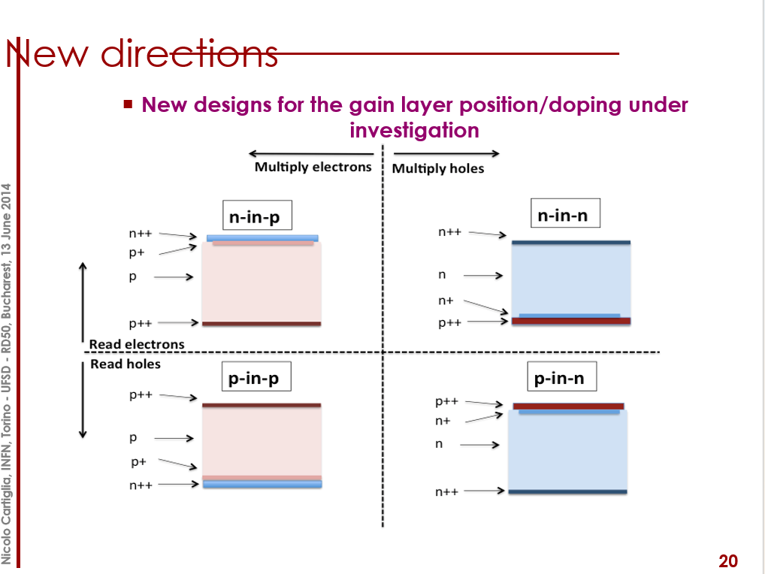


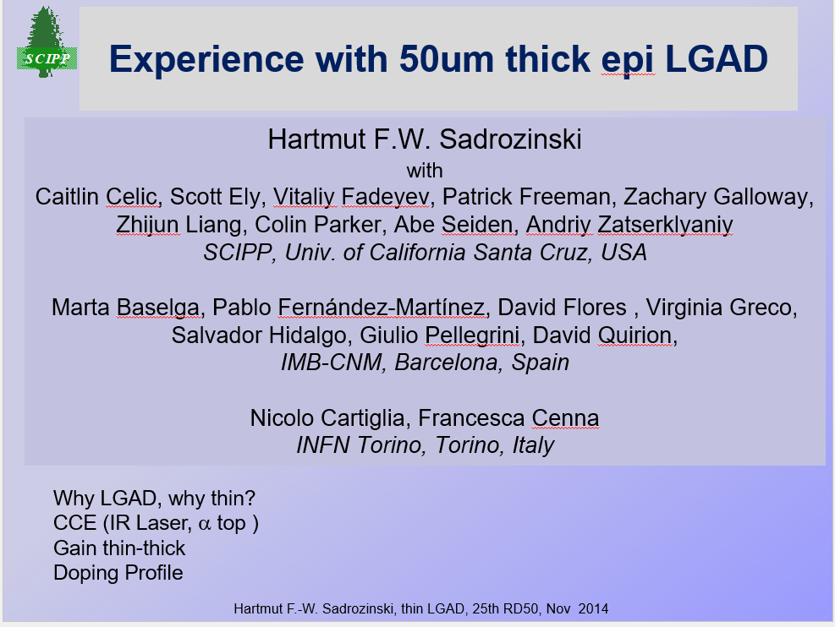
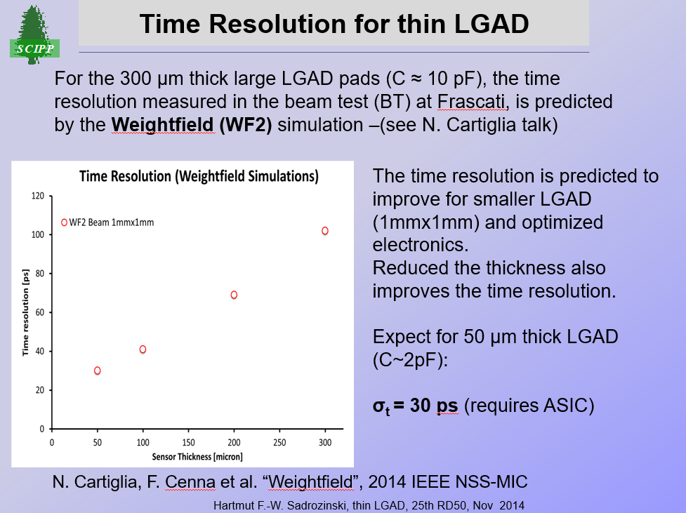
2014
Thin LGAD
C and G doping
In backup slides
Discussion session

Slide 9
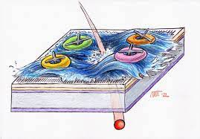
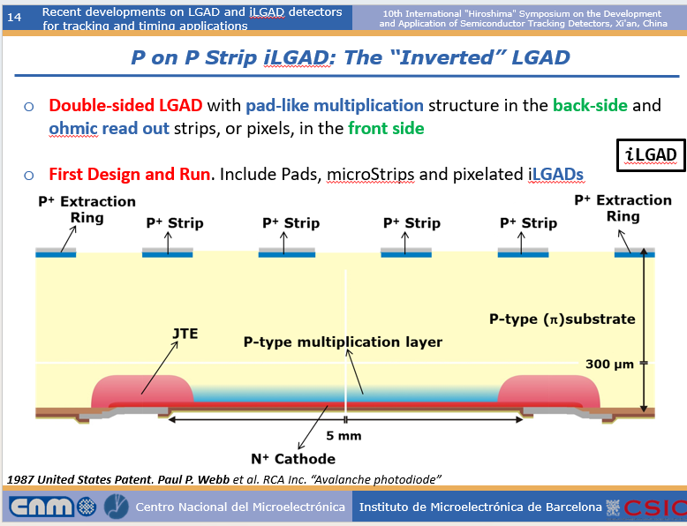
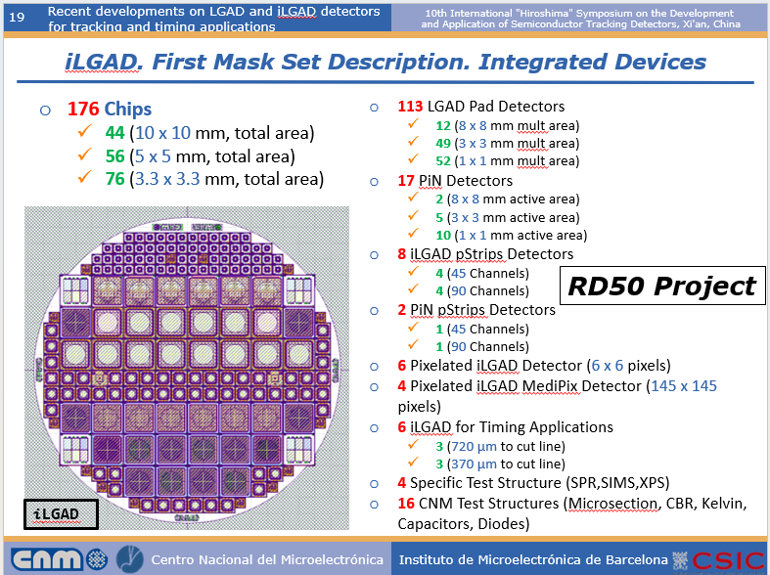
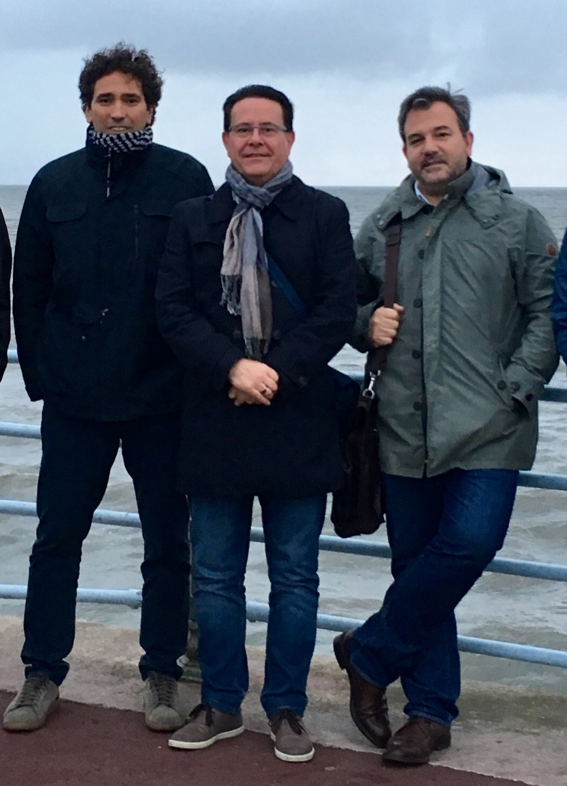
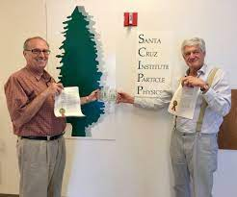
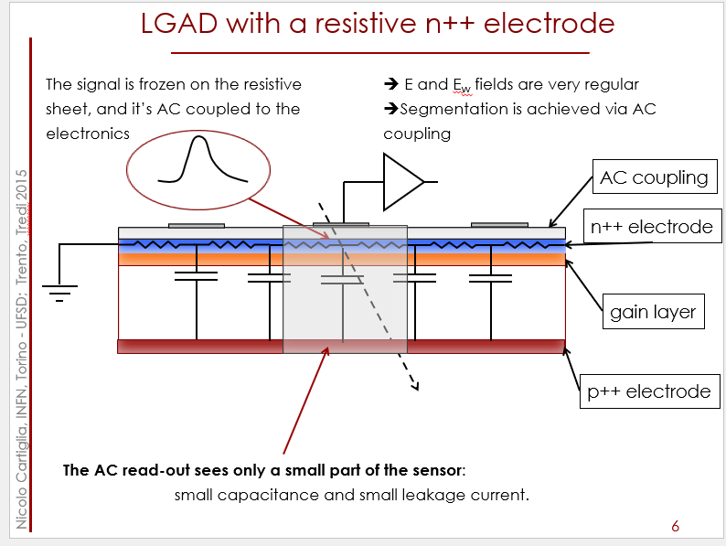
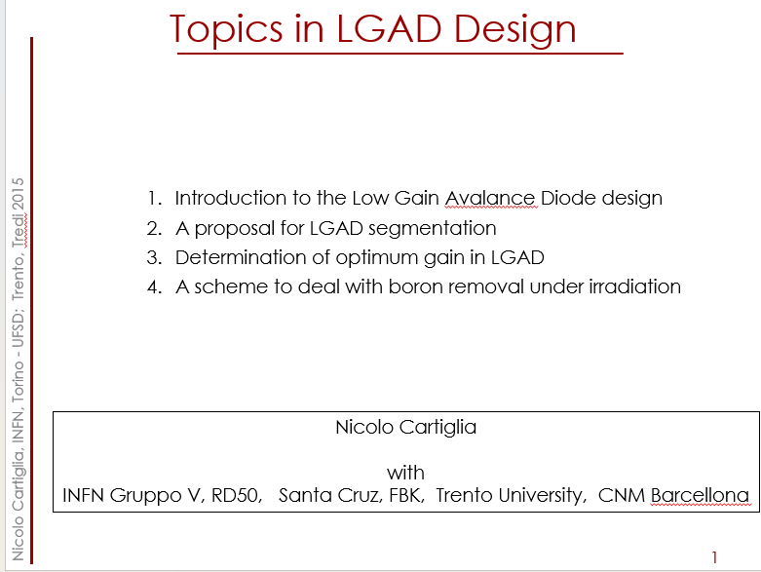

2015
Fill Factor
iLGAD & AC-LGAD

Slide 10
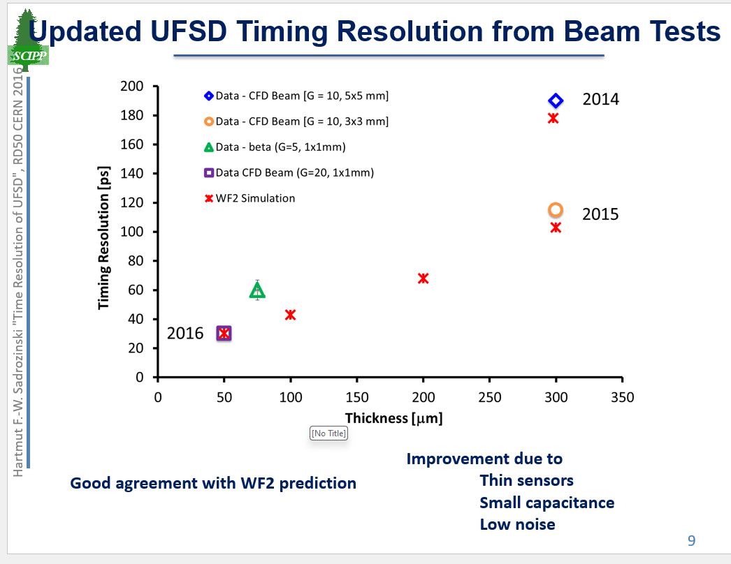
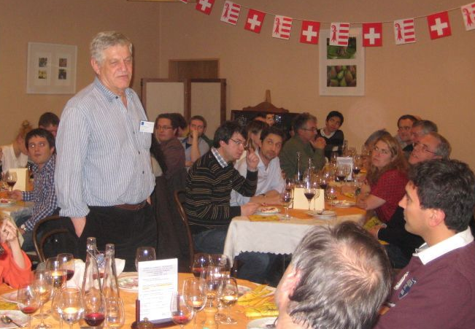

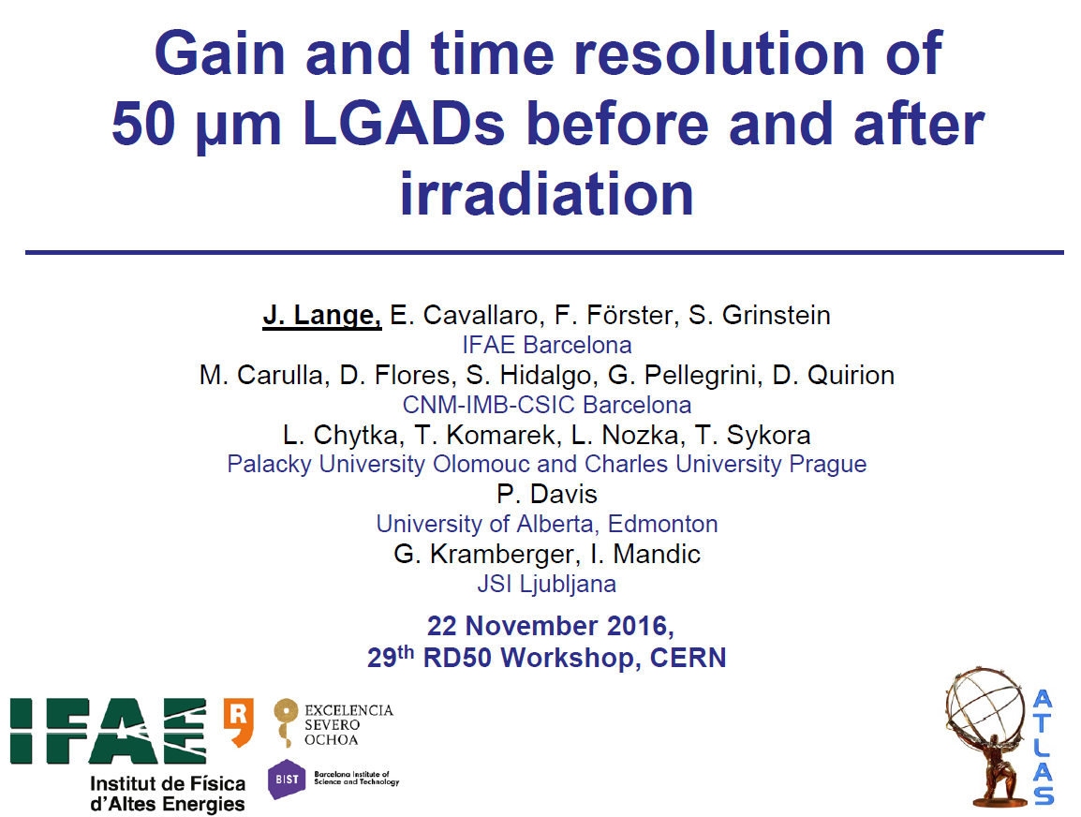
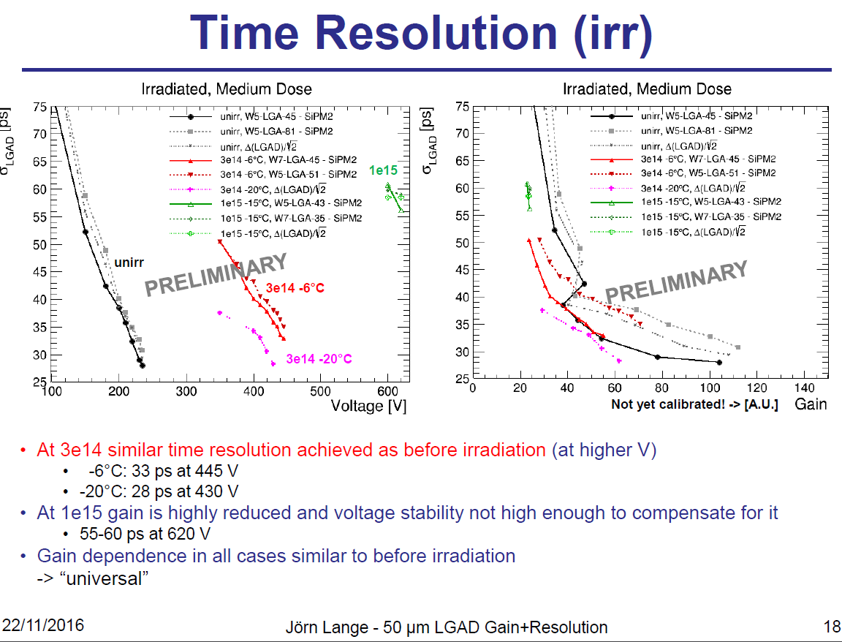
2016
Time resolution before and after irradiation on 50um thick detectors.
Head of Production and Development at X-Spectrum GmbH

Slide 11
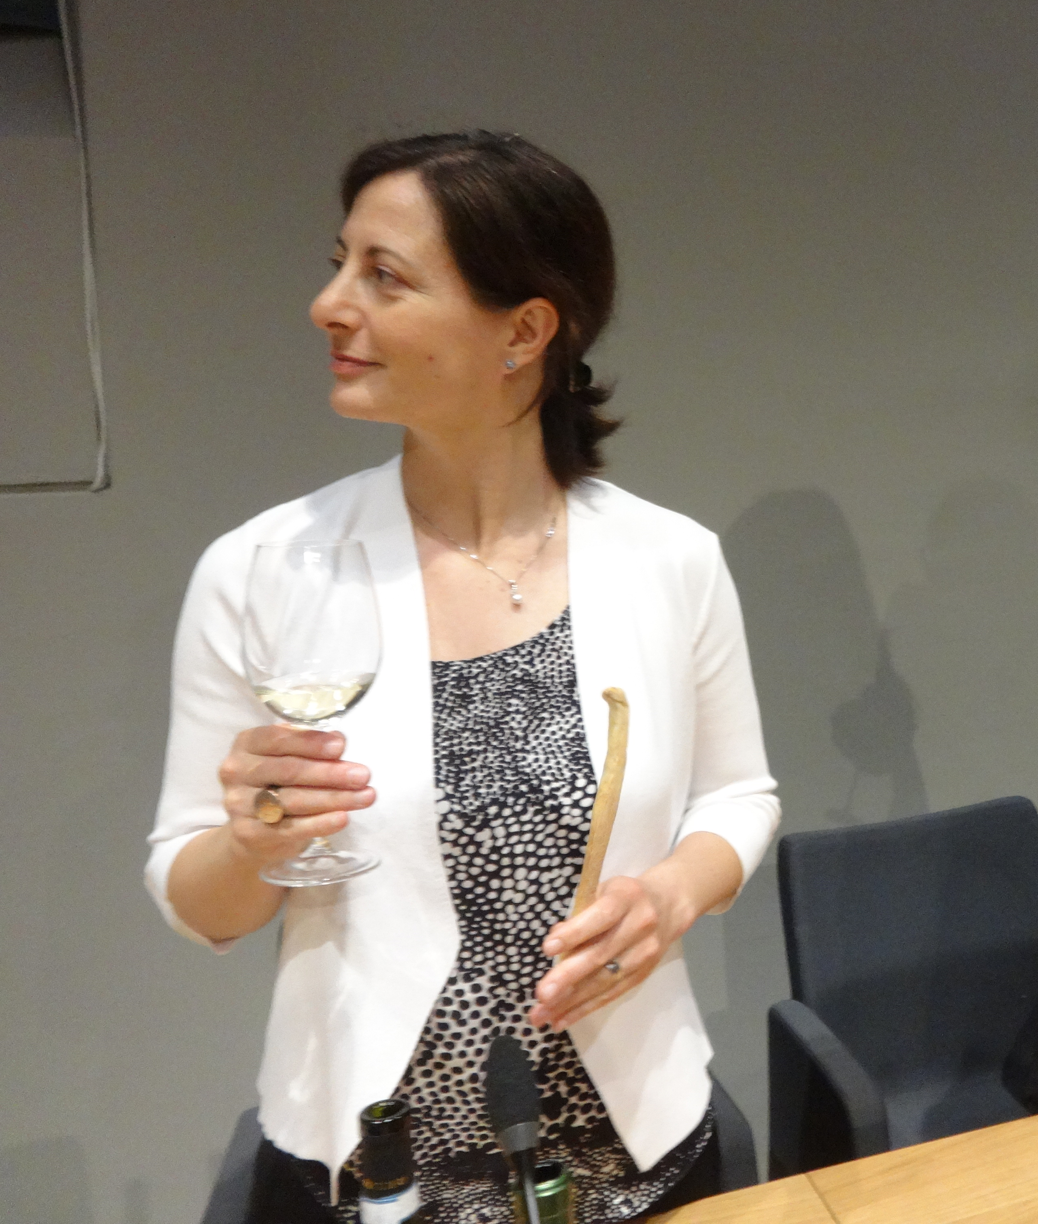
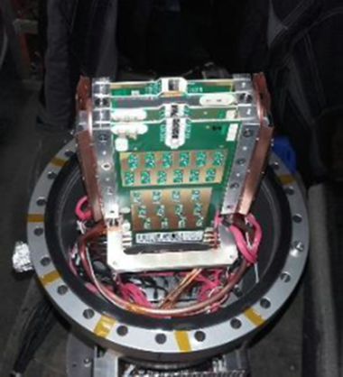

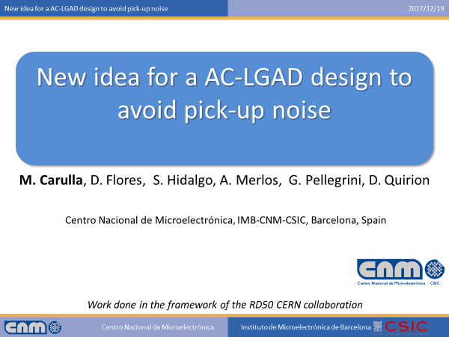
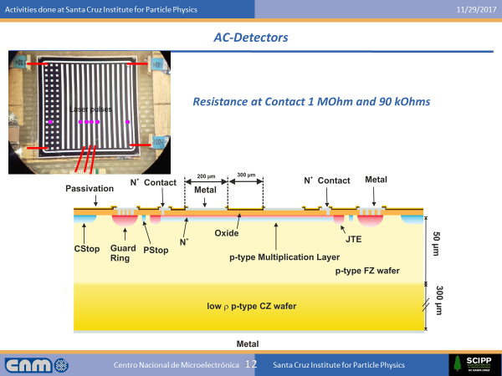
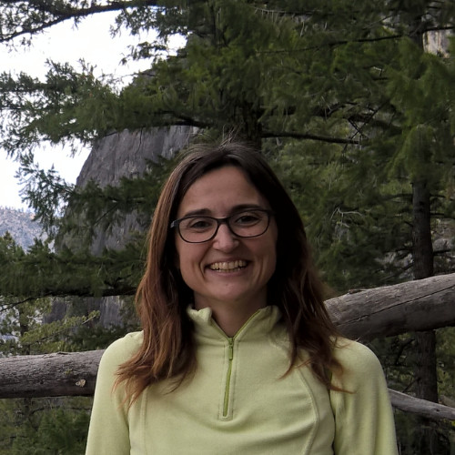
2017
TOTEM CT-PPS
First CERN experiment
First measurements of AC-LGAD

Slide 12
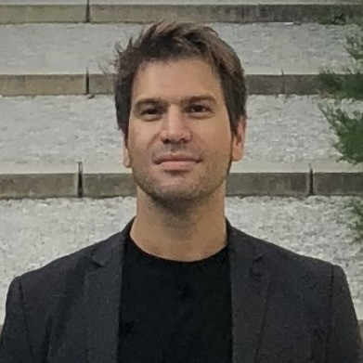
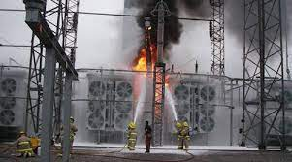
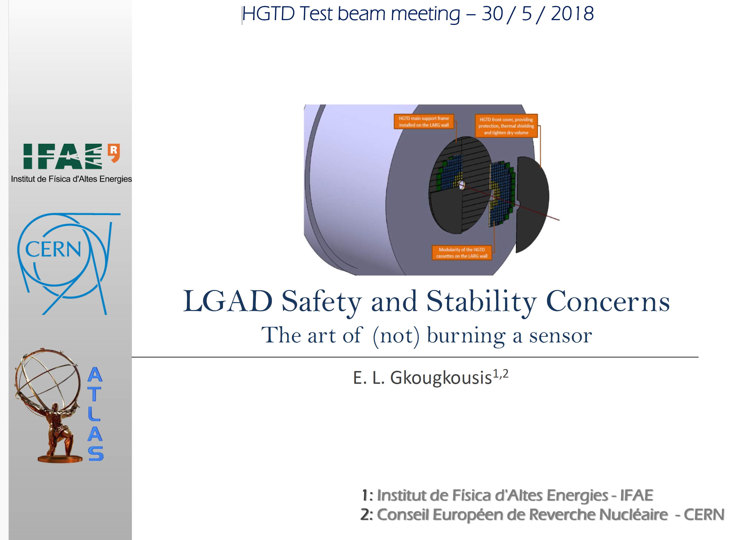
2018
Single Event Burnout

Slide 13
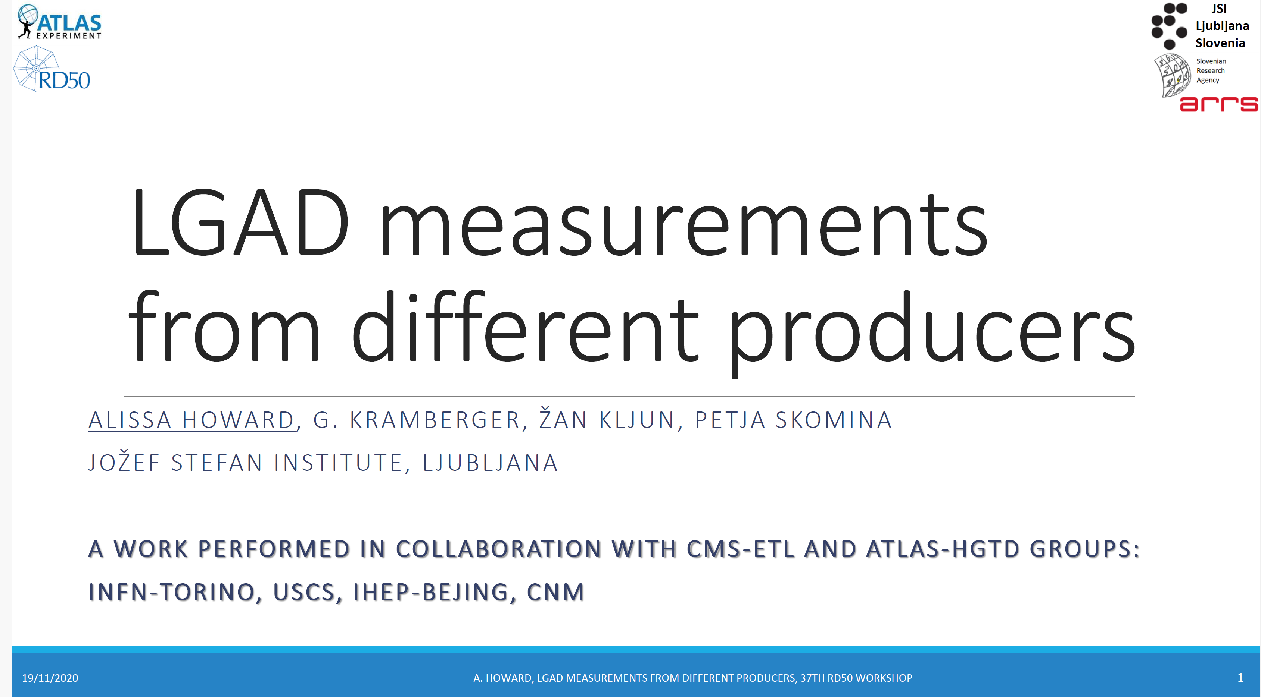
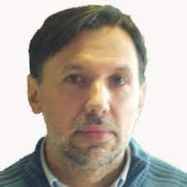
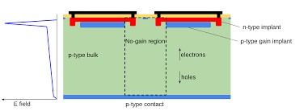
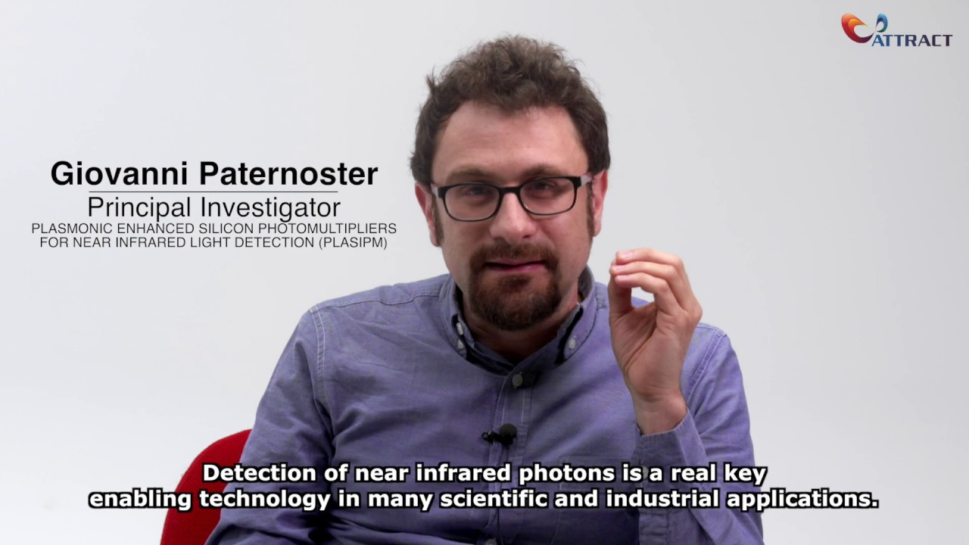
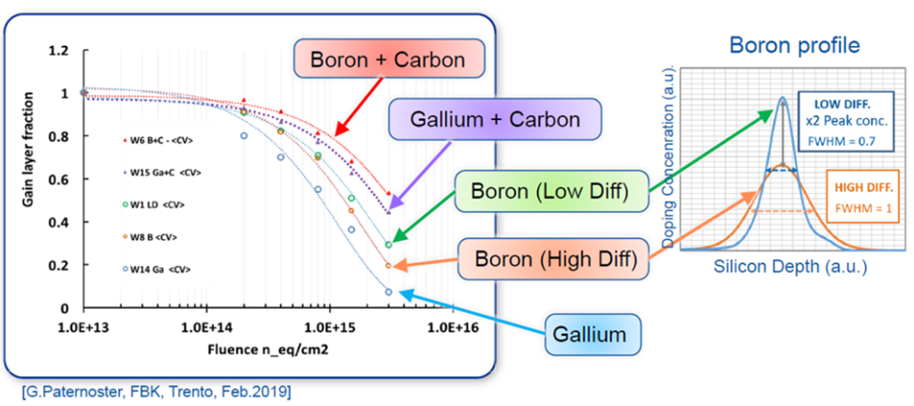
2020
Mattero Centis

Slide 14
N. Cartiglia

Slide 15
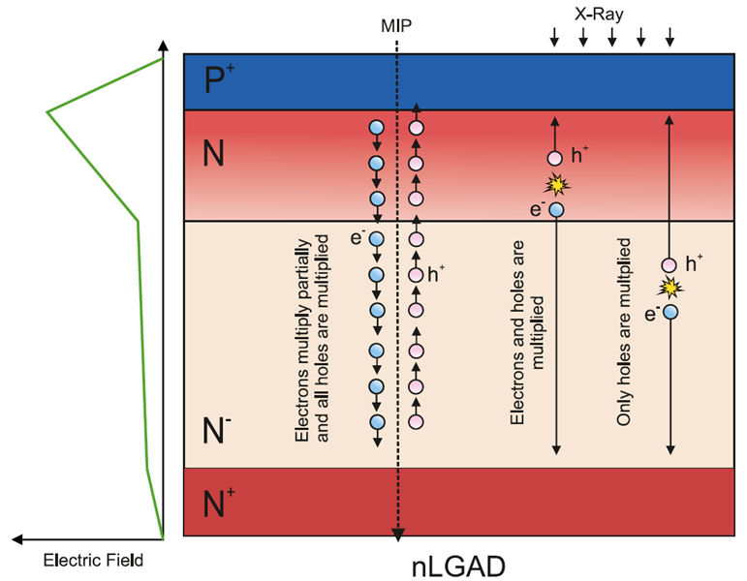
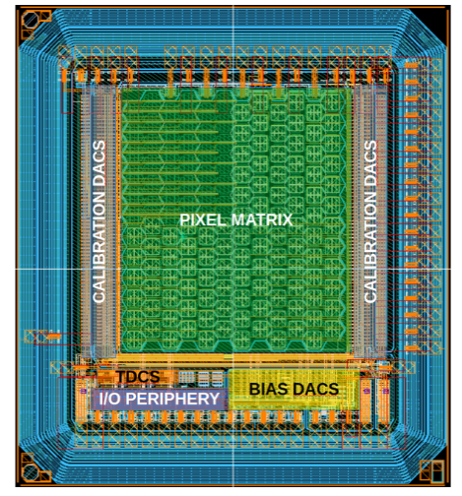
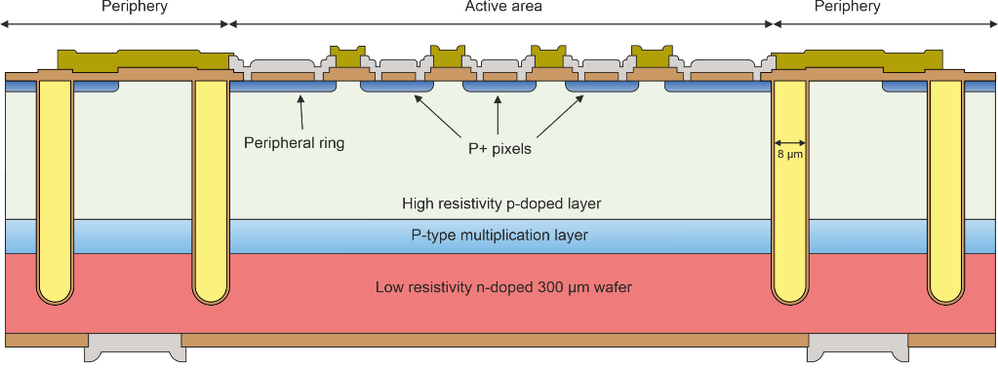
Example 2
Fill factor, low penetrating particles and large area devices
Trenches iLGAD
pLGAD
LGAD-in-CMOS Design
Picosecond Avalanche Detector
Picosecond Avalanche Detector — working principle and gain measurement with a proof-of-concept prototype: DOI 10.1088/1748-0221/17/10/P10032
Effects of Shallow Carbon and Deep N++ Layer on the Radiation Hardness of IHEP-IME LGAD Sensors : DOI: 10.1109/TNS.2022.3161048
Trench-Isolated Low Gain Avalanche Diode, DOI: 10.1109/LED.2020.2991351
First results for the pLGAD sensor for low-penetrating particles, https://doi.org/10.1016/j.nima.2022.167220
Inverse LGAD (iLGAD) Periphery Optimization for Surface Damage Irradiation, https://doi.org/10.3390/s23073450
Fabrication and performance of AC-coupled LGADs, https://doi.org/10.48550/arXiv.1906.11542
A new approach to achieving high granularity for silicon diode detectors with impact ionization gain, https://doi.org/10.48550/arXiv.2101.00511

Slide 16
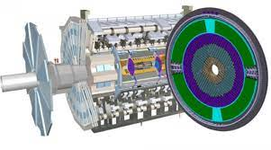
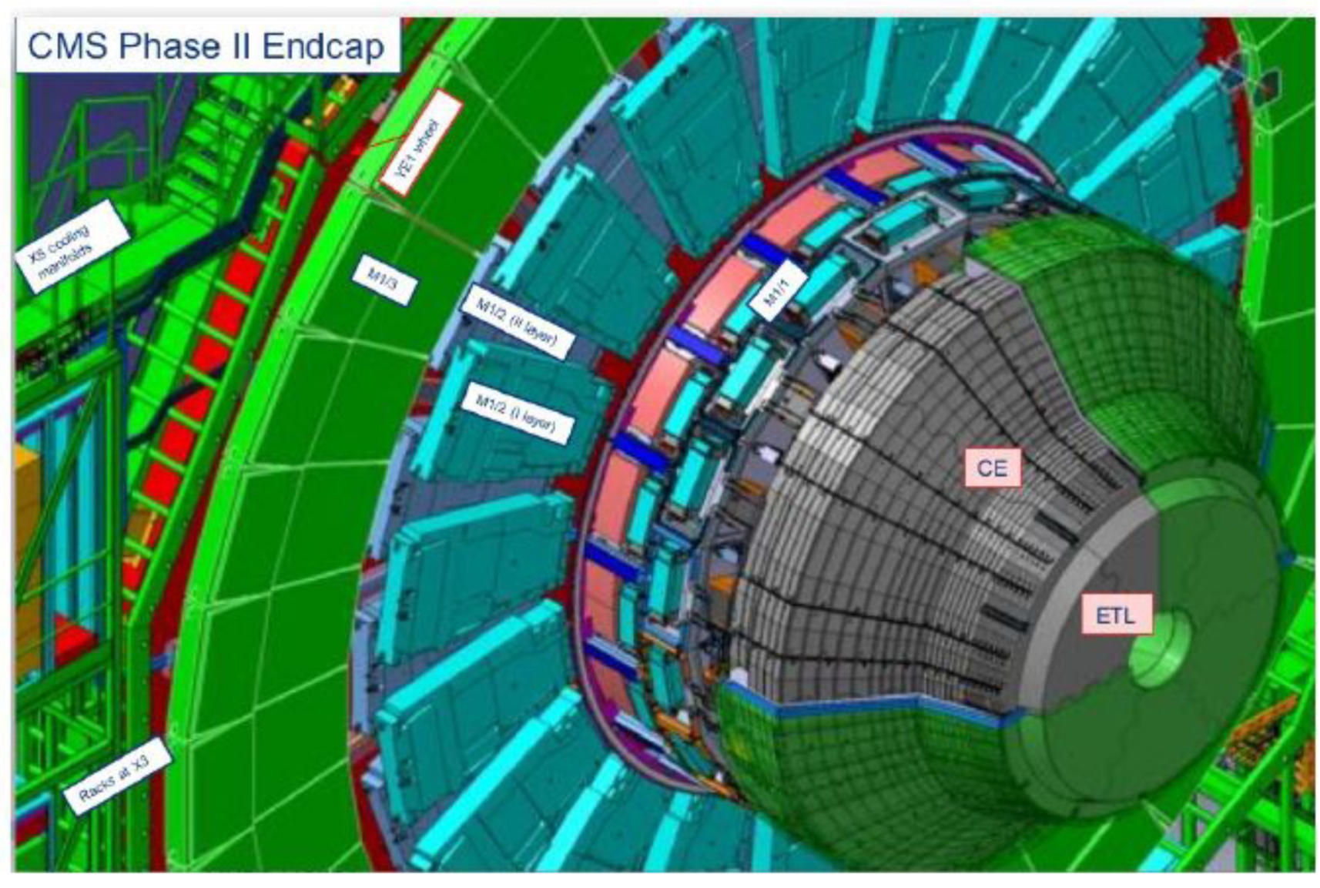

Atlas and CMS….
Radiation hardness improvement
Large area detectors
Fabrication in 200mm wafers
High yield
…
DRD3

Slide 17
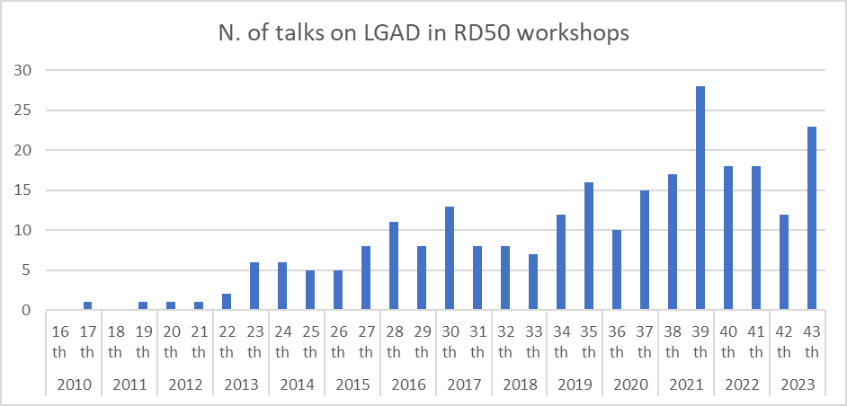

$$\sum{=260 Talks ‼‼}$$
Albuquerque, New Mexico
LGAD/UFSD/iLGAD/RSD/etc…

Slide 18
RD50 LGAD projects
2013-01:Fabrication of p-type pixel detectors with enhanced multiplication (Giulio Pellegrini, CNM)
2014-02:Fabrication of 200 um p-an n-type pad detectors with enhanced multiplication(Giulio Pelegrini, CNM)
2014-05:Thin LGAD devices (Nicolo Cartiglia, Torino)
2015-04:Doping profiling of LGAD and other devices, SIMS (Hartmut Sadrozinski, SCIPP, USA)
2016-02:Gallium doping (David Fores, CNM, Barcelona)
2016-03:Acceptor Removal in boron doped silicon wafers (Giulio Pelegrini, CNM)
2017-01:LGAD based on EPI wafers (G.Pellegini, CNM, Barcelona)
2017-03:LGAD fabricated with epitaxial layer (G.Pellegrini, CNM, Barcelona)
2017-05:50 µm thin LGAD fabricated with Ga multiplication layer (Joern Lange, IFAE Barcelona)
2017-06:Thin LGADs characterization using IBIC and time-resolved IBIC at CAN (Carmen Jiménez-Ramos, Sevilla)
2017-08:50 µm thin AC-LGAD (Mar Carulla, CNM Barcelona)
2018-01:Development of Segmented LGAD with small pixels and high Fill-Factor (Giovanni Paternoster, FBK)
2020-02:Proof-of-concept and radiation tolerance assessment of thin pixelated Inverse Low Gain Avalanche Detectors (ILGAD) (Ivan Vila, UC-CSIC, Santander)
2021-03:Defect engineering for sensors with intrinsic gain(Gkougkousis Evangelos, CERN)
2022-01: Defect engineering in PAD diodes mimicking the gain layer in LGADs (Ioana Pintilie, NIMP)
2023-01: SiC-LGAD, (Thomas Bergauer,HEPHY Vienna)
2023-03: DeepJunction-LGAD and adaptive gain layer, (Simone M.Mazza, SCIPP, UC Santa Cruz)
2023-05: Partial Activation of Boron (PAB) to enhance radiation tolerance (Valentina Sola, Torino)

Slide 19











From lab to companies
Clean Rooms that develop LGAD technology
2013
2016
2017
2018
2021
First time used in TOTEM CT-PPS at CERN
LGAD is the baseline technology of the timing detectors for the high-luminosity upgrade of the ATLAS (HGTD) and CMS (ETL) experiments.

Slide 20
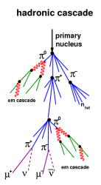
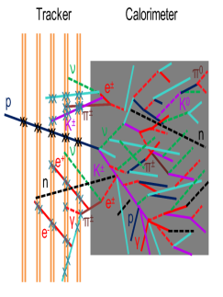



LGAD and timing beyond HEP
Space Applications
(Time resolved tracking)
Medical Physics
(4D tracking, X-ray detection...)
Synchrotron Applications
(LGAD tailored for X-ray detection)
Neutron Imaging
(Combining timing LGAD with a conversion layer)
Nuclear Physics
(Particle identification)
Please check dedicated sessions at:
RD50 Workshops
TREDi workshops
VERTEX
Vienna conference on Instrumentation
Etc…
HADES

Slide 21



Conclusions
Lesson I learned in RD50 meeting:

Slide 22


Congratulation to Valentina!
European Research Council (ERC)
-Doping Compensation in Thin Silicon Sensors: the pathway to Extreme Radiation Environments

Slide 23


