Slide 1
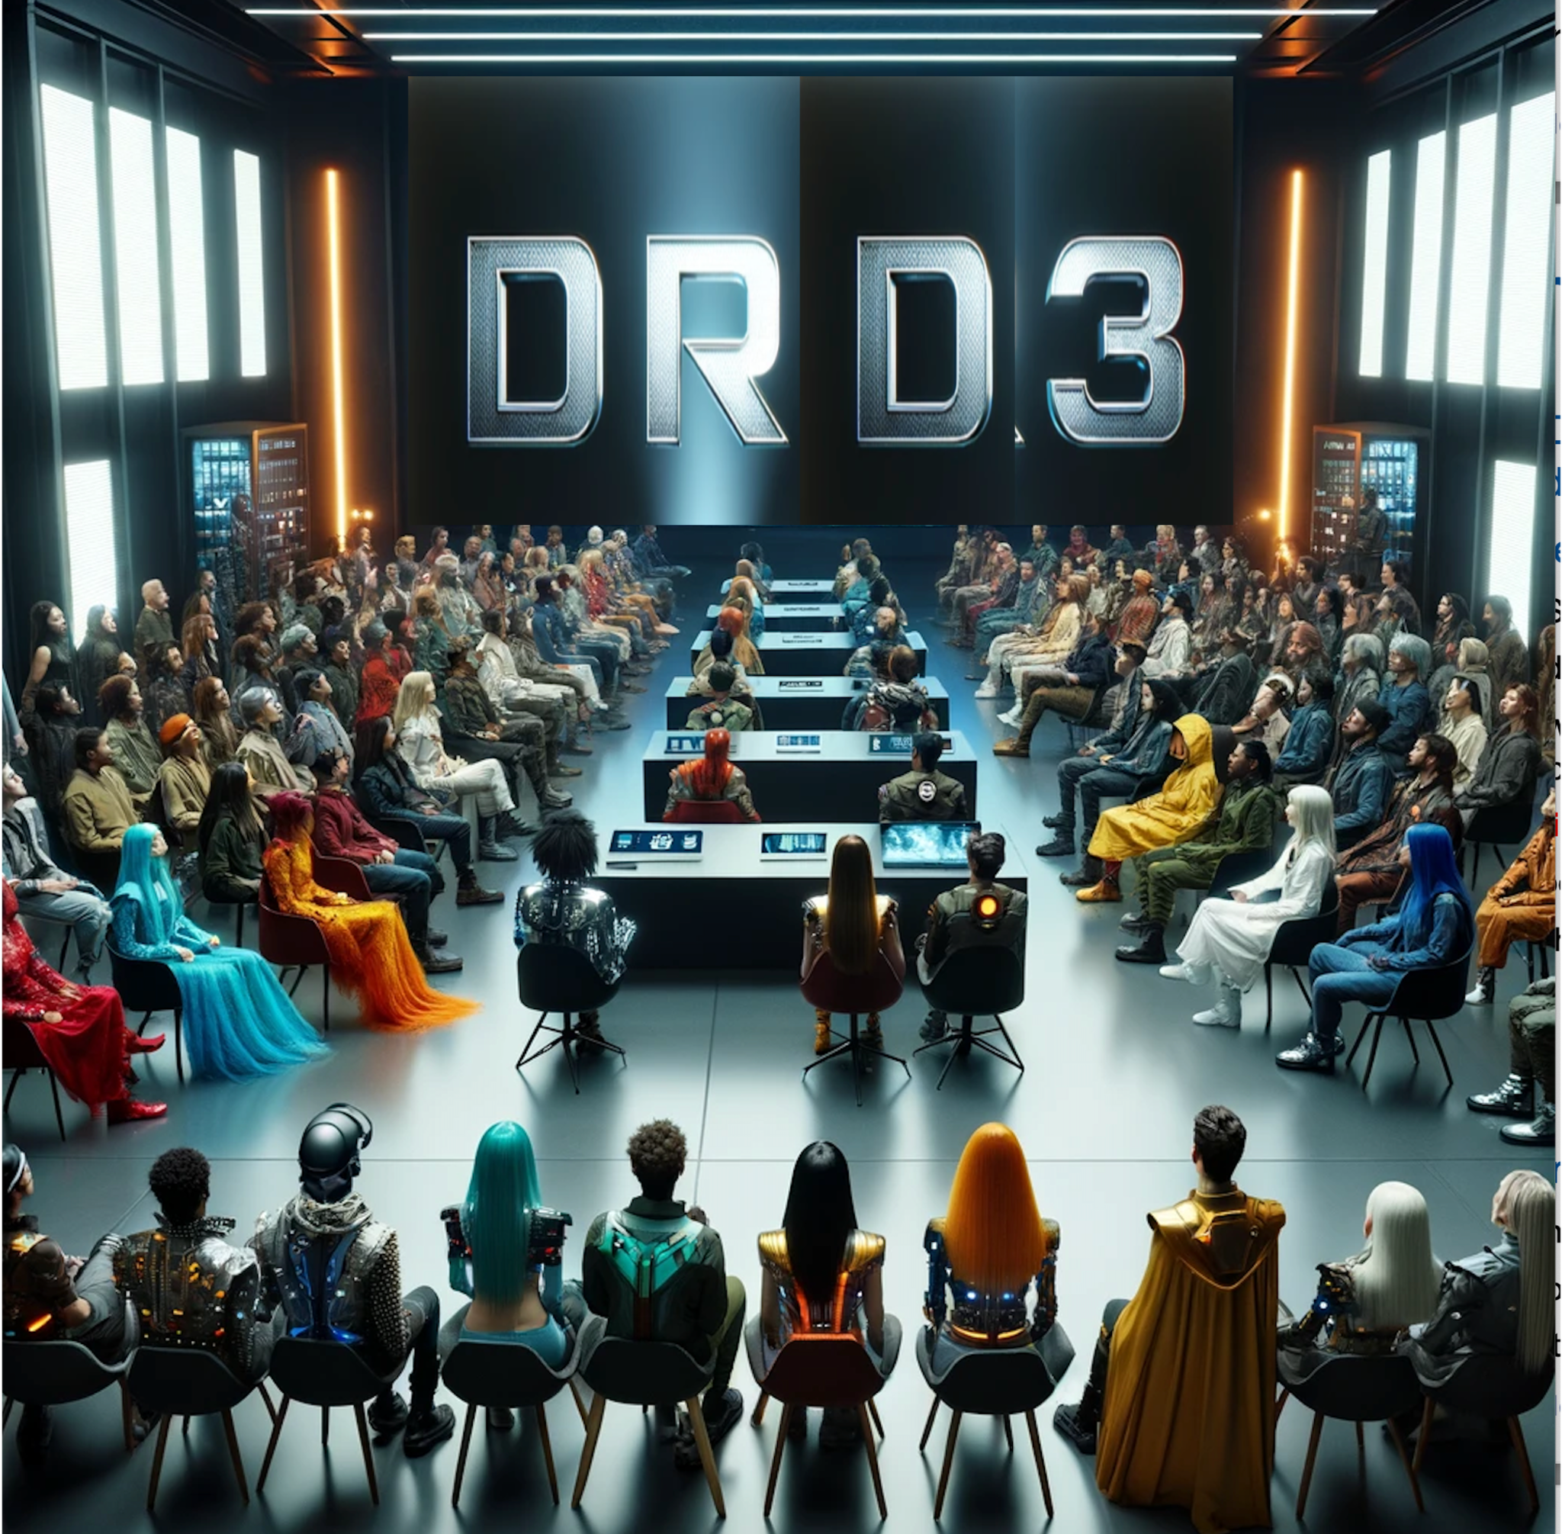
DRD3 Proposal:
Solid State Detectors
From TF3…..
….. to DRD3
G. Calderini¹ N. Cartiglia², G. Casse³, G. Kramberger⁴, M. Moll⁵, I. Pintilie⁶, G. Pellegrini⁷, E. Vilella ³, I. Vila Alvarez ⁸
1 LPNHE, CNRS (Paris), 2 INFN (Torino), 3University of Liverpool (Liverpool), 4 Jozef Stefan
Institute (Ljubljana), 5 CERN (Geneve), 6 National Institute of Materials Physics (Bucharest),
7 Centro Nacional de Microelectronica IMB-CNM-CSIC (Barcelona), 8 Instituto de Fısica de Cantabria (Santander)

Slide 2
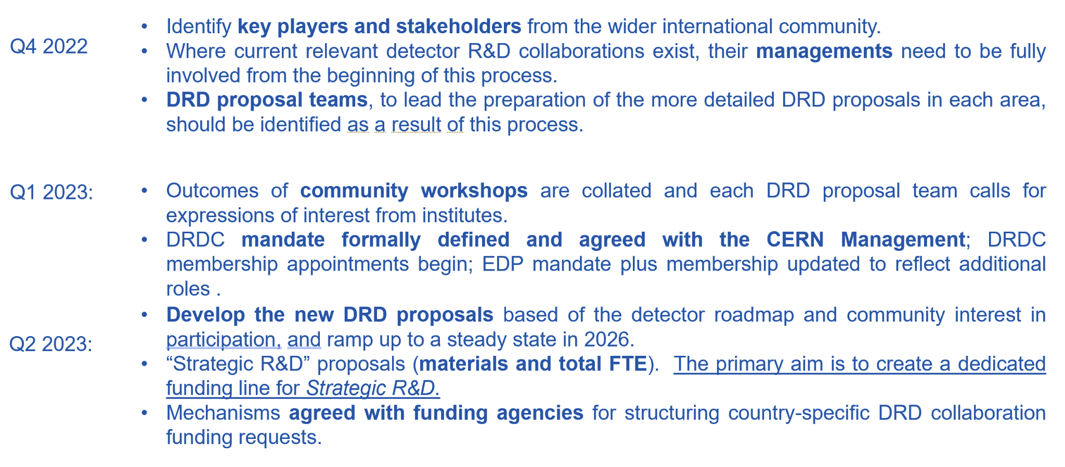
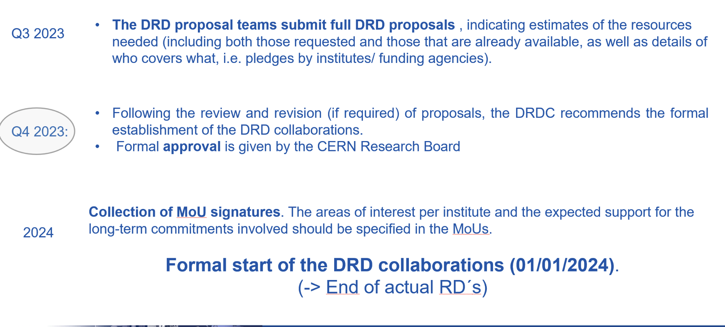
For the RD50
Status of the document
The first version was distributed to the whole community.
The second version includes the suggestions from the DRDC; it has not been distributed due to time constraints. The changes were mostly organizational, with the restructuring of the workpackages and milestones. No major scientific changes.
The final version will be circulated after DRDC approval,
DRDC meeting on Monday 4th/12/2023
Detector R&D Committee (DRDC):https://committees.web.cern.ch/drdc

Slide 3
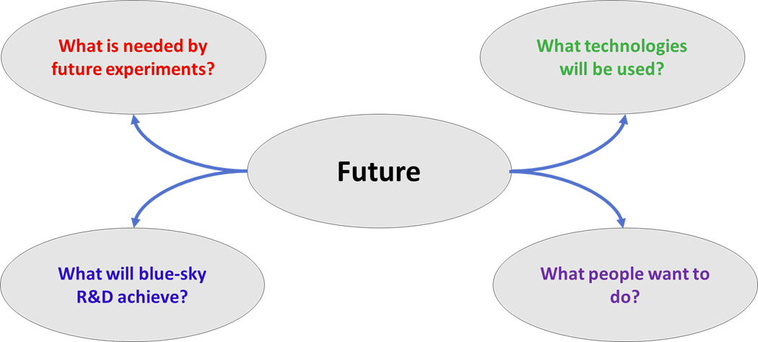
Objectives of the collaboration
The DRD3 collaboration has the dual purpose of pursuing the realization of the strategic developments outlined by the Task Force 3 (TF3) in the ECFA road map and promoting blue-sky R&D in the field of solid-state detectors.

Slide 4
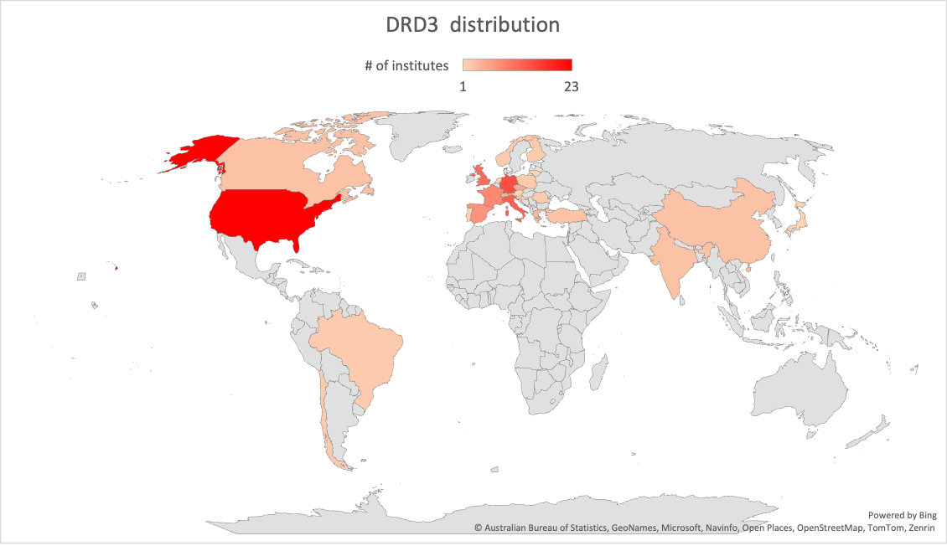
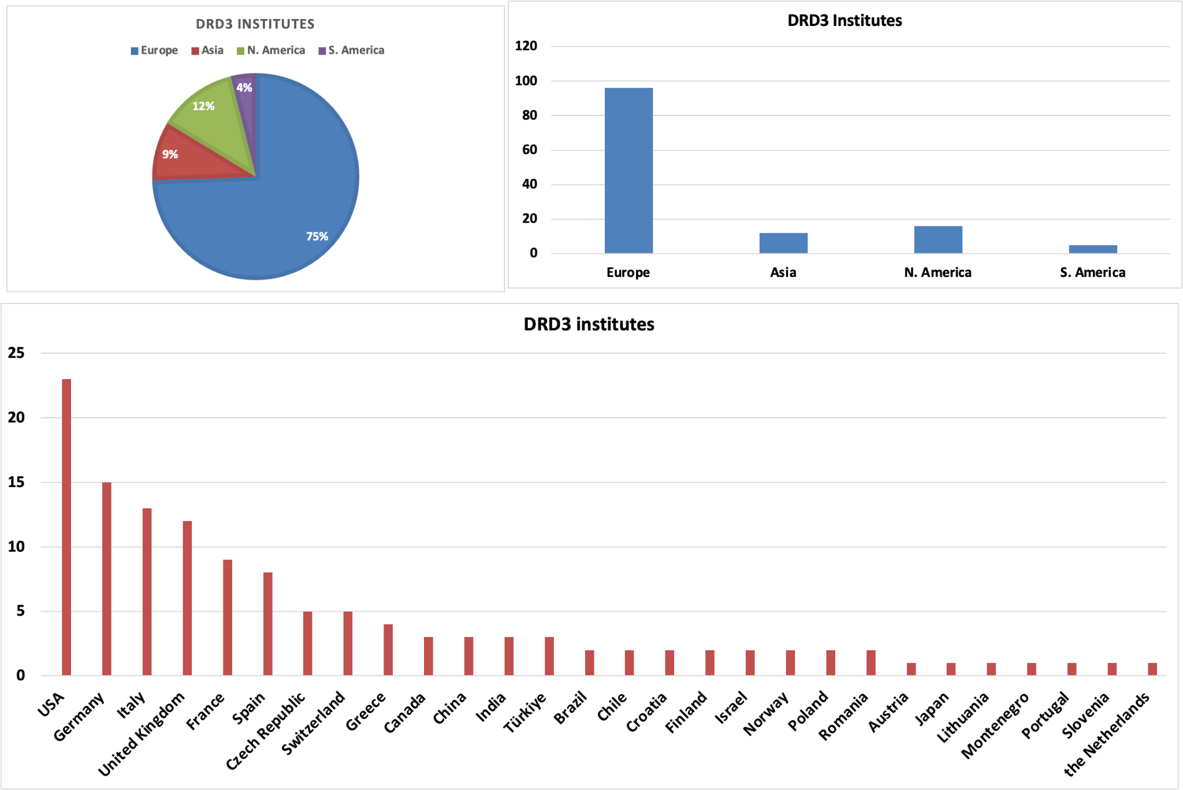
The DRD3 geographical distribution
number of institutes = 129 (x2 RD50)
*9 institutes from USA did not send the questionnaire but are included in the list

Slide 5
Workforce
Number of researchers = 900 (x2 Rd50)
Number of FTE= 170 (permanent researchers), 156 (non-permanent)
Strategic non permanent= 171 (non-permanent)
 | FTE/y
Workpackages | Permanent | Non-permanent | Strategic non-permanent
WP1 | 65 | 62.6 | 69.4
WP2 | 42.2 | 41.5 | 39.2
WP3 | 42.6 | 37 | 42.5
WP4* | 20.5 | 15.2 | 19.9
Total | 170 | 156 | 171
*Mechanics and cooling were added at a late stage and no included in the questionnaire

Slide 6
Total budget: existing and requested
 | Budget [kCHF/y]
Workpackages | Existing | Requested
WP1 | 2013 | 3427.4
WP2 | 1196.5 | 1542.5
WP3 | 1193.6 | 1921.8
WP4 | 667.1 | 1006.9
Total | 5070.2 | 7898.6
Total/institute* | 47.5 | 65.8
*Only considered 120 institutes that send the questionnaire

Slide 7
Who is composing DRD3?
95%
RD50
Rad Hard det.
24%
Other institutes or companies
RD42
Diamond
20%
54%
AidaInnova
DRD3
RD53
Mon. CMOS

Slide 8
Formation of the collaboration
DRD3 proposal team will call for nominations for the CB chair, select ~5 candidates, and organize for a collaboration vote by 6.1.2024. Vote by multiple round majority system, using one of the standard ones, by the end of January at the first organizational kickoff workshop.
The main body deciding on all DRD3 matters is the CB, presided by CB chair, who will nominate the deputy chair.
The CB chair will form a search committee for spokesperson. The candidates should present the program (including WP/WG leaders) at first full/scientific DRD3 workshop in June 2024.
The CB elects the spokesperson and heads of all commeetes (speakers, DRD sync….). The CB chair is responsible to form search committees for all elected positions. The CB is responsible for endorsement of all appointed positions.
The spokesperson should nominate WG conveners which will be endorsed by CB.
The DRD3 proposal team suggests for the spokesperson to have two deputies, coordinating two WPs each.

Slide 9
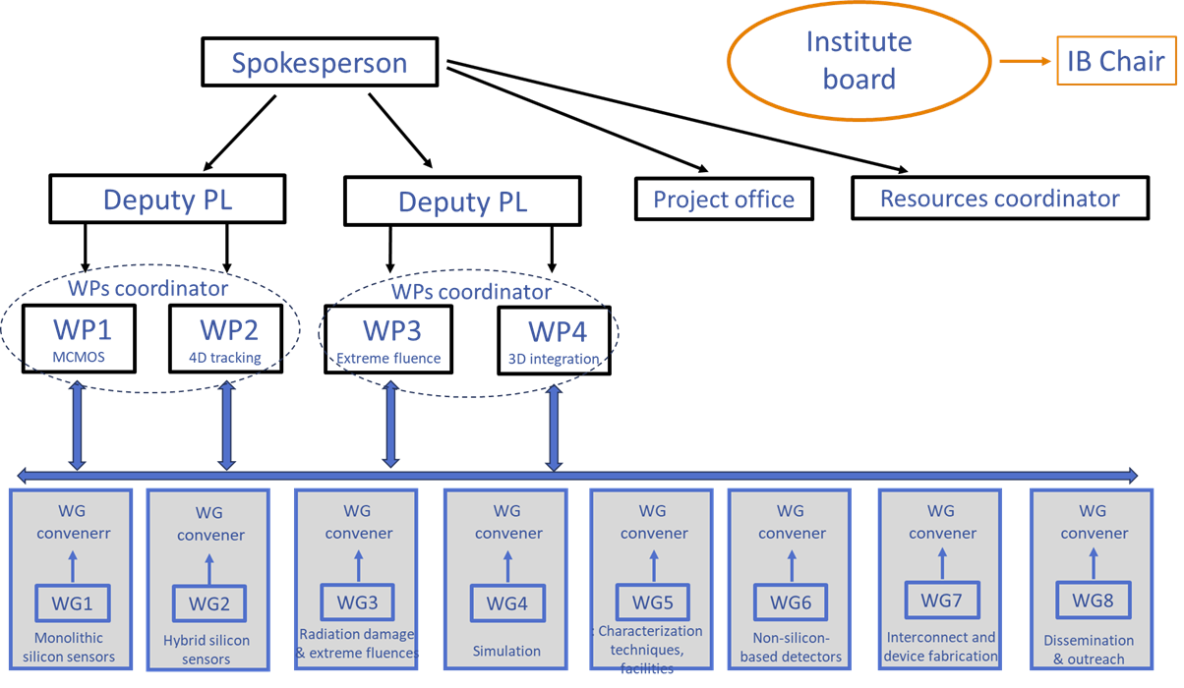
The organigramme
Not exactly the same as in the submitted document!

Slide 10
Timeline
Request of nomination for the CB chair | 31/12/23
Select 4-5 candidates for the CB chair |  | 06/01/24
First online workshop, only for the CB |  |  | 22/01/24
Election of the CB chair |  |  | 22/01/24
CB chair select comitee for Spokesperson |  |  |  | 15/02/24
Call for Spokesperson |  |  |  |  | Mar-24
Deadline for Spokesperson nomination |  |  |  |  |  | May-2024
First in person workshop at CERN |  |  |  |  |  |  | Mid-june-2024
Election of the Spokesperson |  |  |  |  |  |  | Mid-june-2024

Slide 11
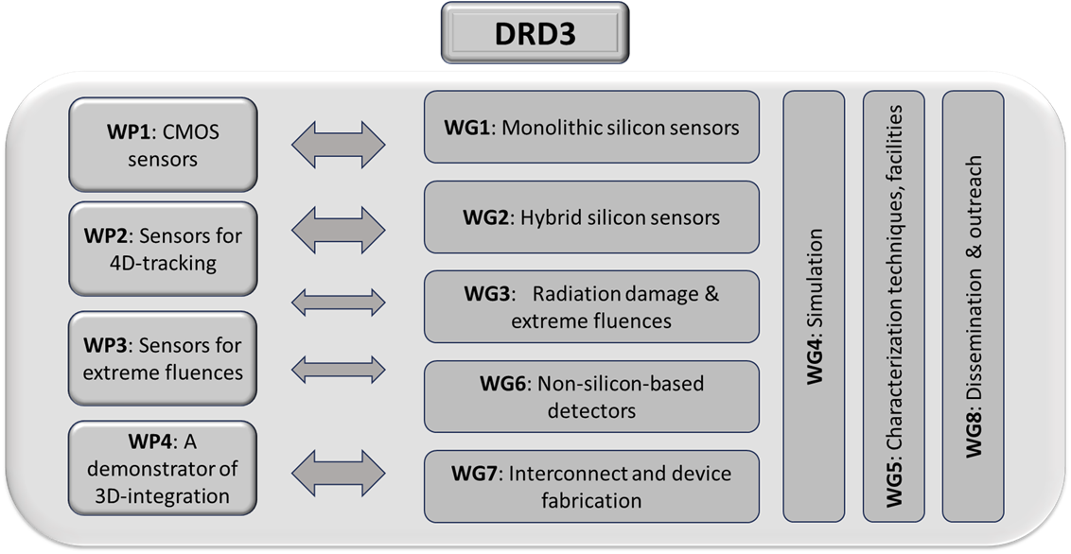
DRD3 Scientific Organization
The Work Packages (from the Detector R&D Themes (DRDT)) address the need of the strategic R&D objectives.
The Working Groups link together activities broadly focused on the same scientific goals

Slide 12
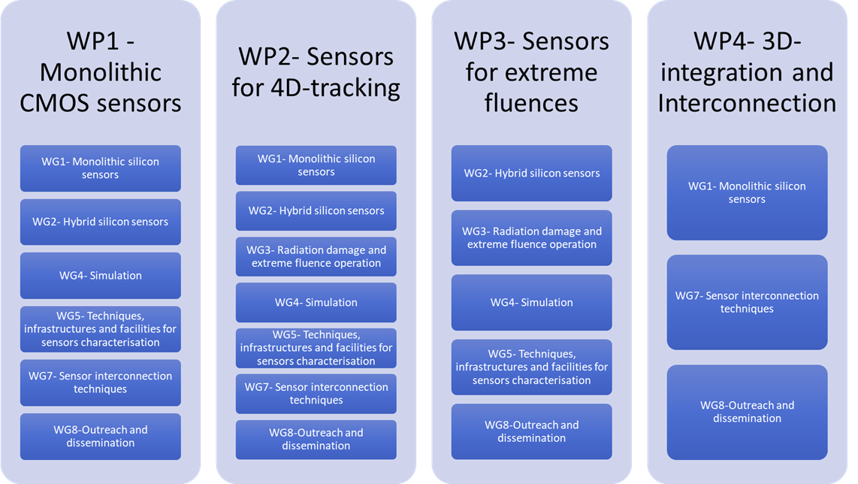
Relation among WPs and WGs

Slide 13
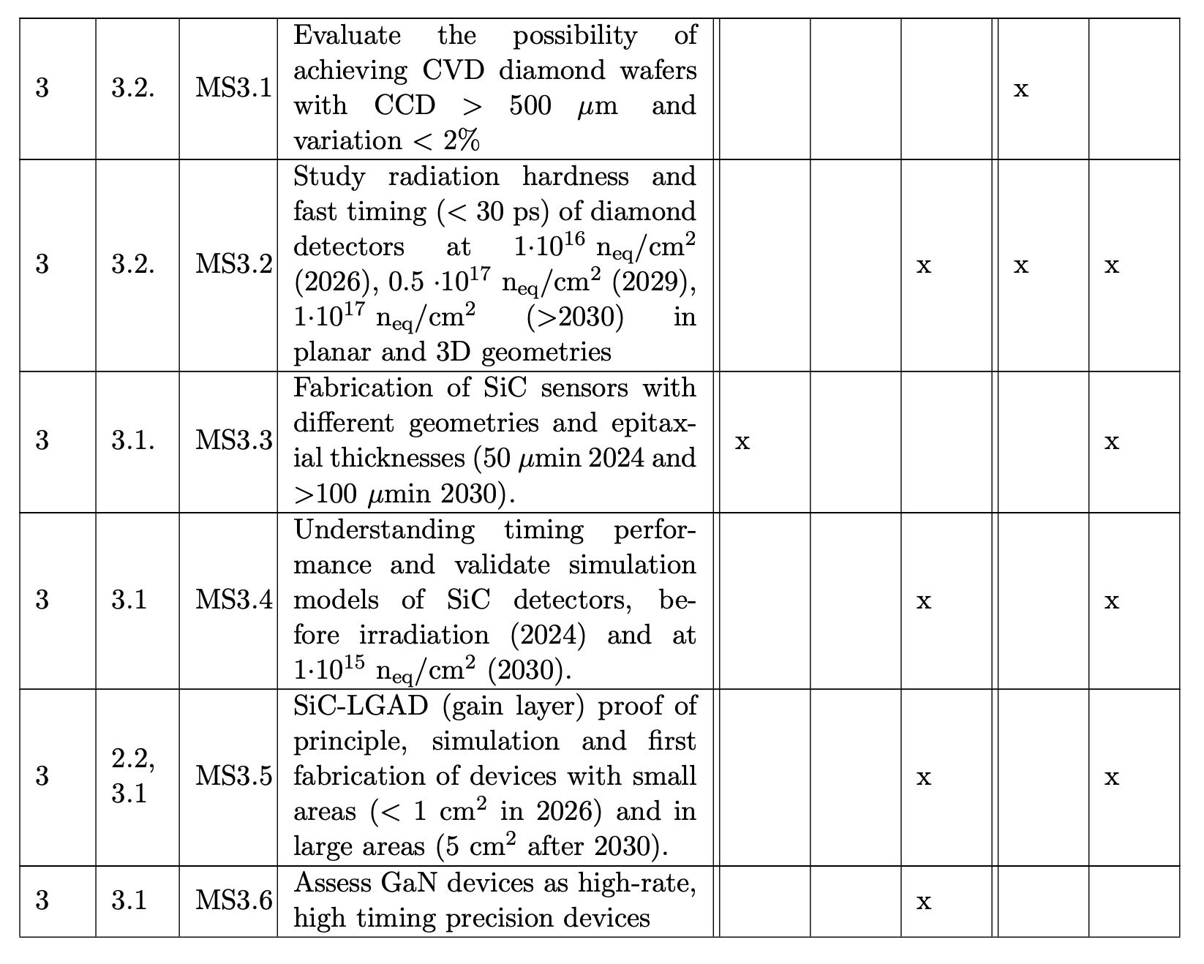
For each WP, tasks are defined
WP3: sensors for extreme fluences
Example: the first tasks of WP3
Full list in the document

Slide 14
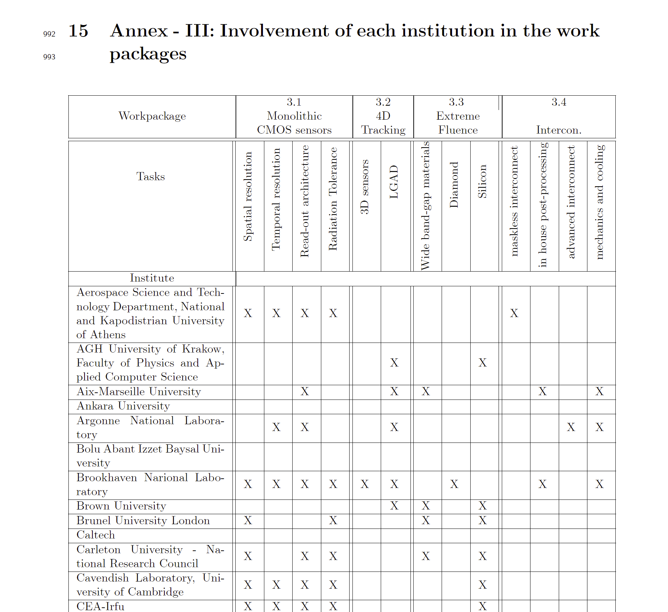
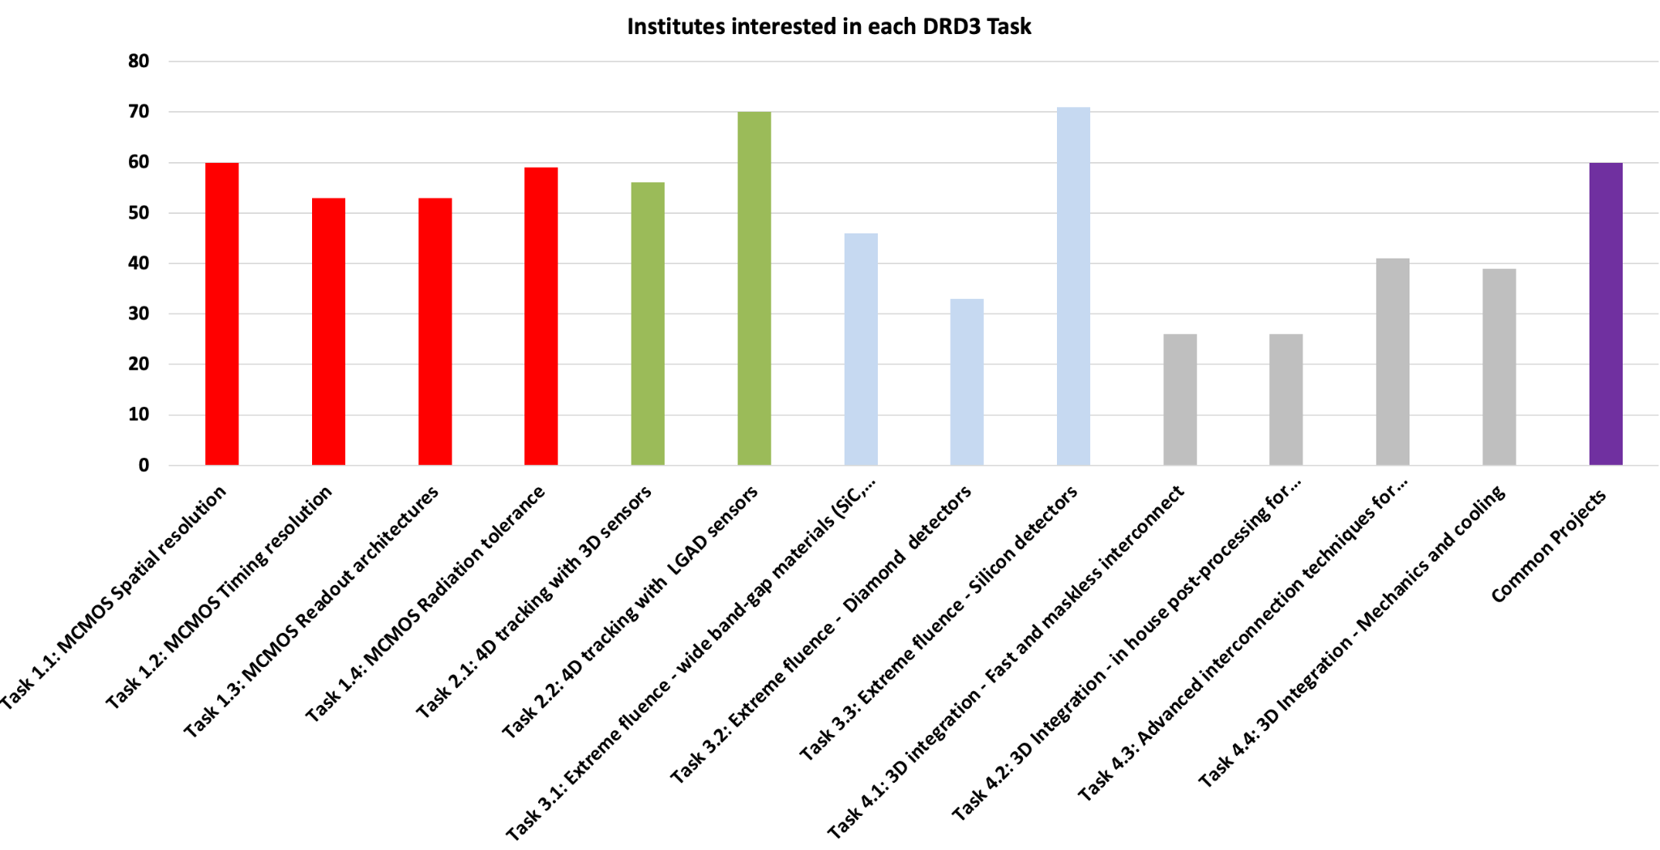
Interest of institutes

Slide 15
Operation
The first organizational kick-off meeting formalizing the collaboration will take place in January and it will be on-line only.
The first full scientific meeting will take place in June, it will be in person at CERN.
Regular DRD3 workshops will take place twice a year (spring/autumn) for a full week with plenary contributions only. One will be at CERN and the other outside.
The DRD3 activities will be published in a webpage (following agreed upon security concerns and personal data protection)
The scientific output of DRD3 shall be published open access.

Slide 16
How the WGs & WPs are funded
The DRD3 collaboration will be regulated by a light-MoU (not resource-loaded).
Institutes not signing the light MoU that contribute to the common fund are allowed to take part in DRD3 collaboration.
Each institute, regardless of the light-MoU signature, should follow the rules of collaboration.
Each WP will be regulated by a resource-loaded MoU annex. The resources committed to the WP can be labour/material/service; this will be regulated by the agreement between the WP participants.
The WPs can accept the participation of institutions that do not sign the corresponding MoU annex, provided that the non-signing institutions make a clear contribution to the WP.
Participation to the WGs does not require the signature of a resource-loaded MoU
The only funding regulated by the WGs are those of the common projects. The goals of the common project might directly support the realization of the WPs goals.

Slide 17
DRD3 R&D common funds
Each institution should contribute to the DRD3 R&D common funds.
The common projects funding rules are:
  At least 3 participation institutions
  Funding is limited to material & service cost
  The DRD3 participation is limited to 50% of the total cost
  The common projects are reviewed, approved and followed by a nominated committee (normally the WG conveners)
In addition to finance the common projects, the R&D common funds can be used for activities such as:
  Support to young students with travel scholarships and accommodation for internship in other laboratories
  Support participation to conferences
  Support interchange with other fields of applications
The R&D common funds cannot cover administrative cost (secretariat, services, etc)

Slide 18
RD50 legacy common funds
RD50 funds within DRD3
RD50 running projects will continue to get funded from the funds transferred to DRD3 and will stay under control of RD50 CB (as the large part of the RD50 is in the DRD3 this will form a subset). The running RD50 projects can spend the resources in three years after the foreseen duration of the project. This period can be prolonged by RD50 CB when activities related to the project are still ongoing. Any unspent money from the project will be treated as unallocated in the RD50 common fund.
The unallocated resources in the RD50 common fund will be transferred to the DRD3 common fund. These RD50 resources will be available to the future DRD3 projects for those groups within the DRD3 project which were also members of RD50.
DRD3 projects with participation of the RD50 groups will be allowed to include RD50 fund in the financial scheme of the DRD3 project in accordance to RD50 agreed scheme. Those resources will count as a direct financial contribution from the participating institute.
To be approved by the RD50 CB

Slide 19
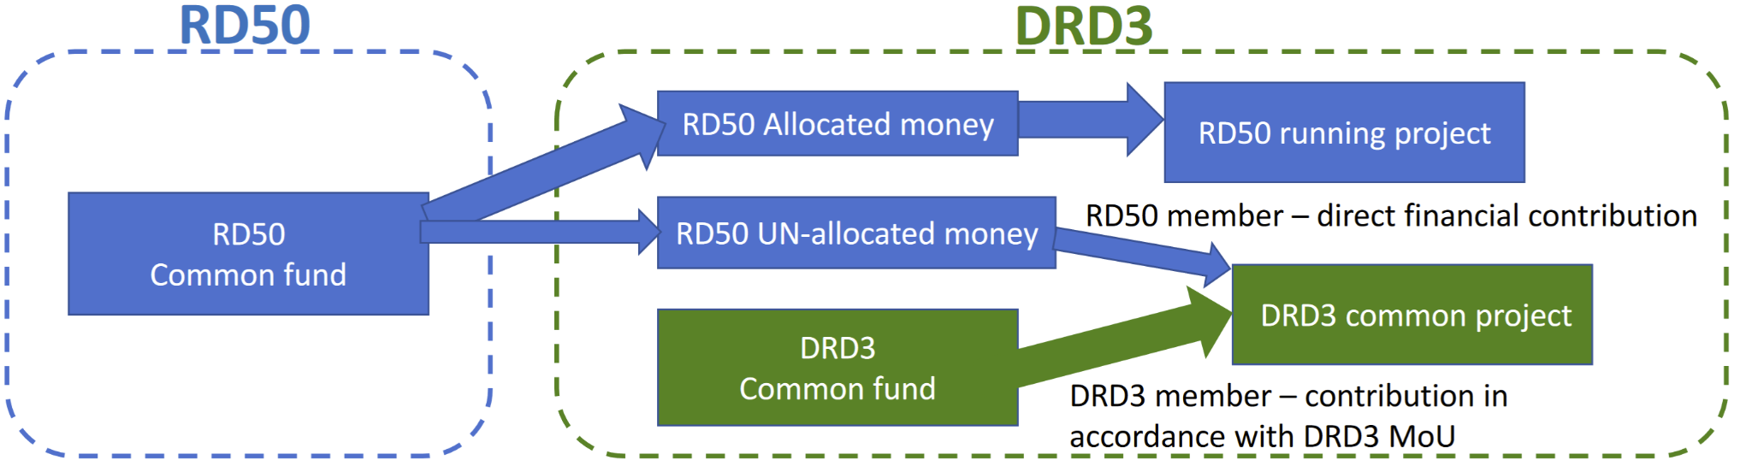
RD50 legacy common funds (2)

Slide 20
Interlink with other DRDs
DRD4: SiPM, possible collaboration may arise from understanding mechanism to mitigate the radiation damage mechanism in the gain layer.
DRD5: 2D materials, very early stage. Future interaction may be possible.
DRD6: interconnecting technologies used for calorimeters with silicon sensitive layers for the readout, such as silicon pixel high granularity calorimeter.
DRD7: the development and characterization of devices are aimed to the sensors part will go to DRD3, while all developments more electronics oriented such as tier-to-tier interconnections for example are clearly more suitable to belong to DRD7. Regular meeting will be organized inside and outside the workshop.
First meeting with the Executive board of the Solid State and Radiation Damage of the CPAD
For each DRD a contact person will be nominated by the collaboration:
at the moment is Eva Villena is the contact for DRD7 and Giovanni Calderini for DRD6.

Slide 21
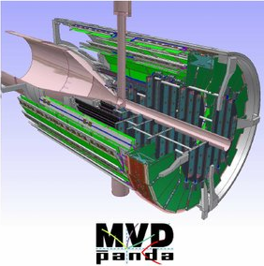
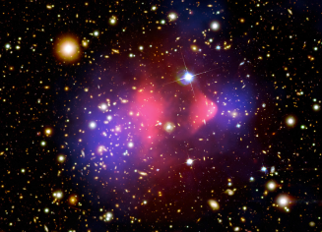
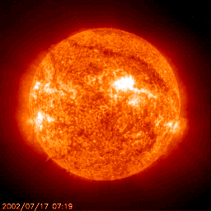
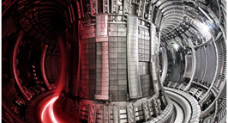
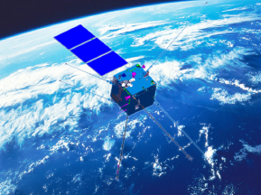
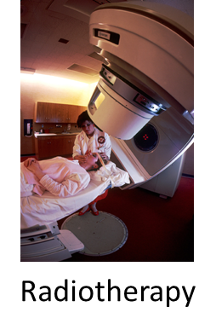
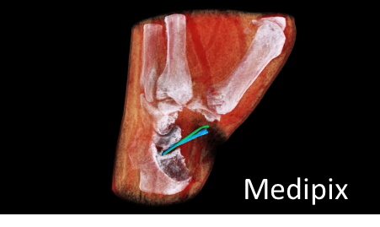
Synergies with other fields (WG8)
Nuclear Physics
Quantum sensing
R&D for future colliders
Fusion
Space
Medical imaging
CSES-Limadou 2

Slide 22
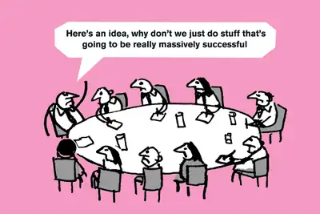
Thank you for your attention

Slide 23
Work package

Slide 24
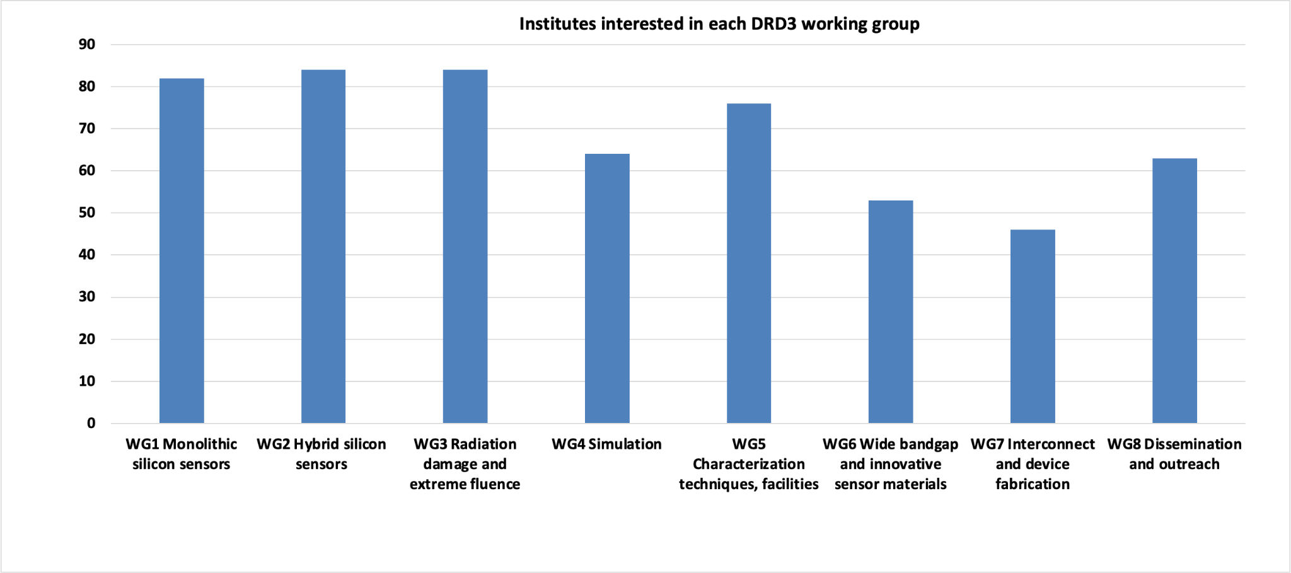
Working groups

Slide 25
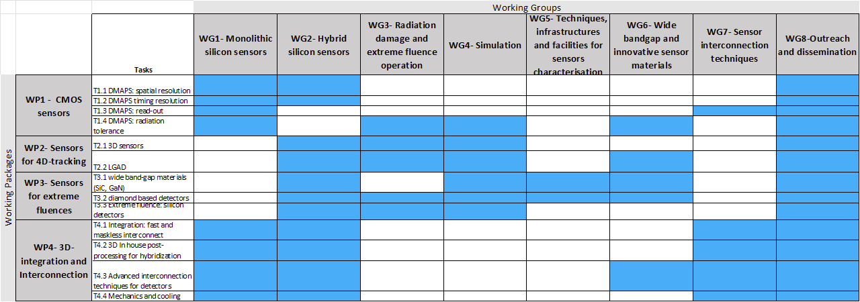
WG, WP and Tasks

