Slide 1


Learning HISPANoS, a new Neutron Beam Facility at CNA
Detector and SEE experiments
Francisco Rogelio Palomo Pintoª, Ricardo Ascazubi^{c}, Alexis C.Vilas Bòas^{c} , Jorge Jiménez-Sánchezª , Caterina Soldado^{e}, Begoña Fernández-Martínez^{b}, Carlos Guerrero-Sánchez^{b}
fpalomo@us.es
ªElectronic Engineering Dept. of School of Engineering, University of Seville, Spain
^{b}Nuclear Physics Dept. at Physics Faculty, University of Seville, Spain
^{c}Intel Corp.
^{d} Centro Universitario da Fei, Universidade de São Paulo, Brazil
^{e}Electronics and NanoEngineering Dept., Aalto University, Finland

Slide 2
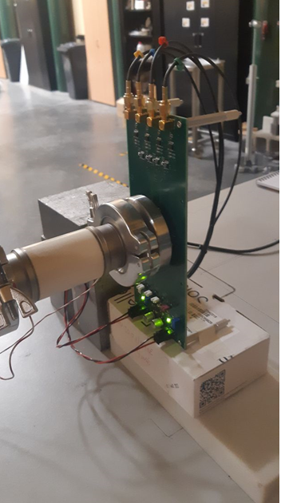
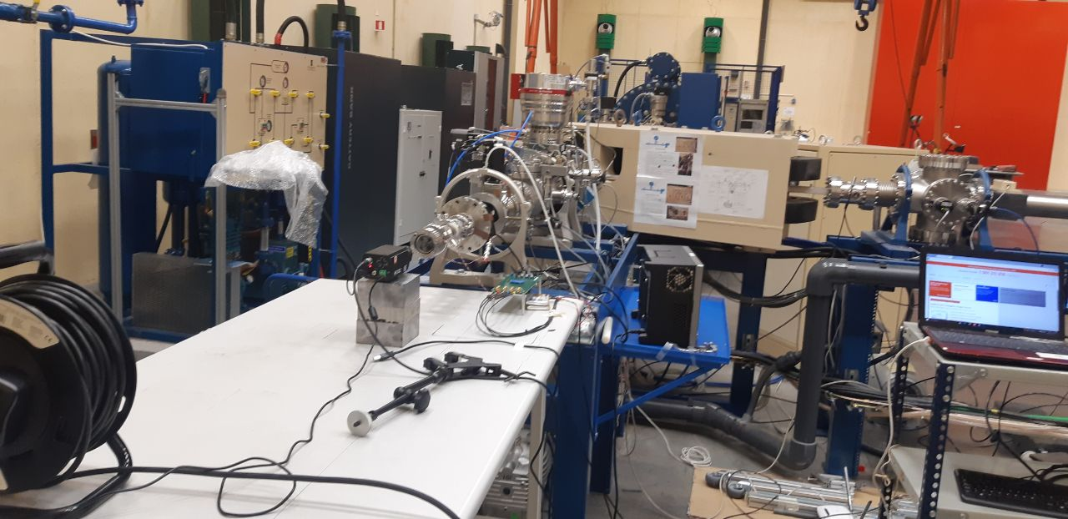
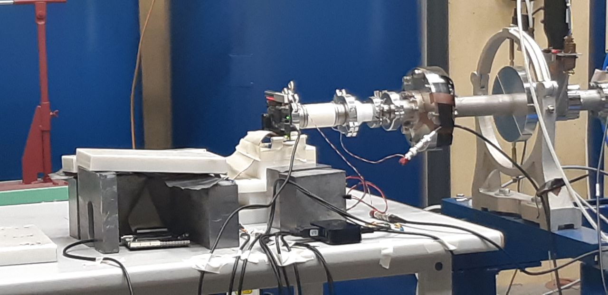

Learning HISPANoS, a new neutron beam facility at CNA
Introduction
About the new HISPANoS neutron beam now open for experiments at the National Center of Accelerators, Sevilla, Spain
On a first experiment about detection of neutron induced nuclear reactions in silicon photodiodes and its intrincacies
Neutron induced Single Event Effects in an Intel MAX10 FPGA (55 nm)
Preparation of the Neutron Beam Line for the
experiment
SEU FPGA experiment
Photodiode Matrix
Experiment
Notes:
Introduction:
Description of the Hispanos facility
Description of the Detector Experiment
Description of the SEU Experiment

Slide 3
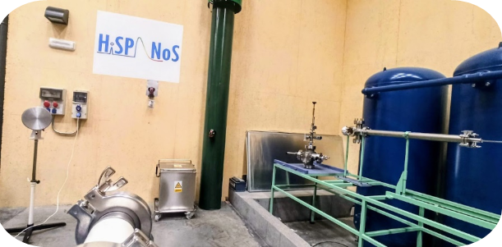
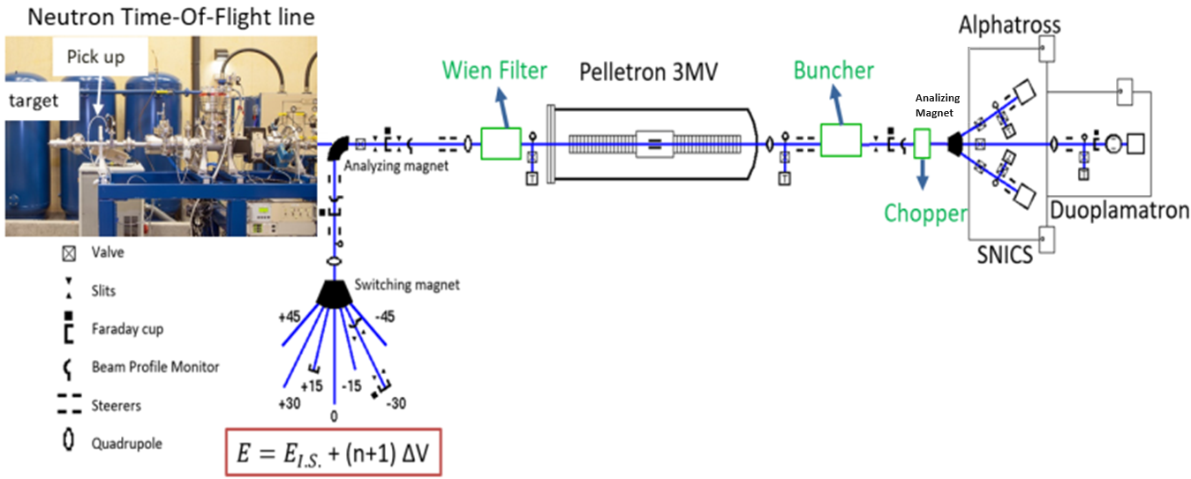
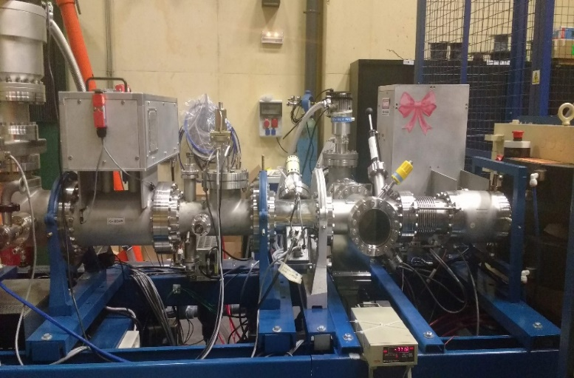
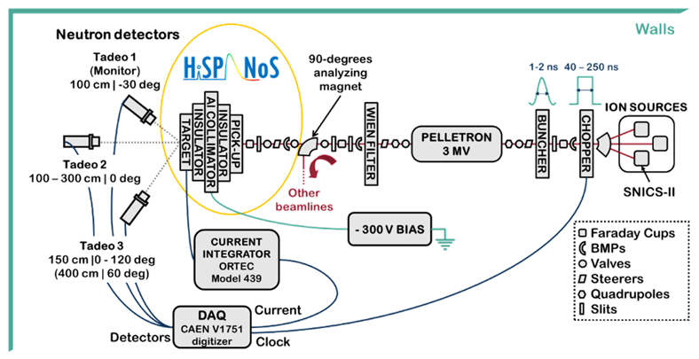
Learning HISPANoS, a new neutron beam facility at CNA
Buncher
Chopper
Beam
Pulsing system: p,d & α
Chopper:
Variable width: 40 ns-250 ns
RR: 31.25 kHz-2MHz
Switcher Voltage: 650 V
Buncher:
Needs tuning (delay & power) for synchronization
HiSPANoS is the first Accelerator-based neutron source in Spain and it is installed at the 3 MV Tandem Accelerator.
Operates since 2013 in continuous mode and since 2018 in pulsed mode.
more info at: https://indico.cern.ch/event/1132520/ ,Carlos Guerrero's presentation
Notes:
Description of the Hispanos Facility

Slide 4
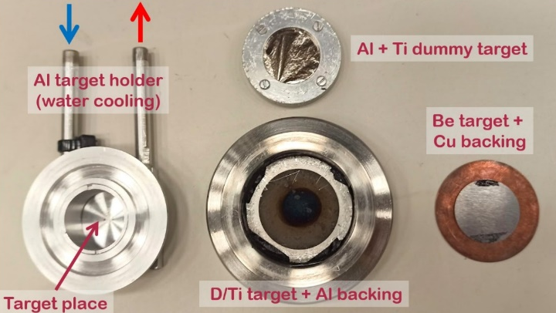
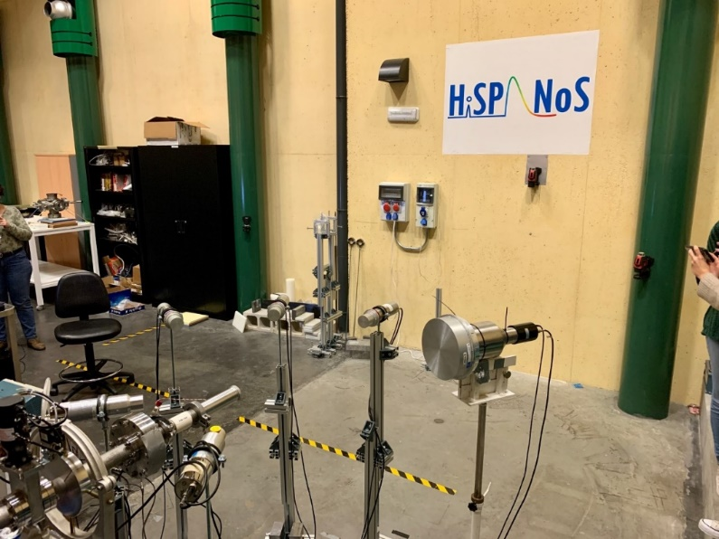
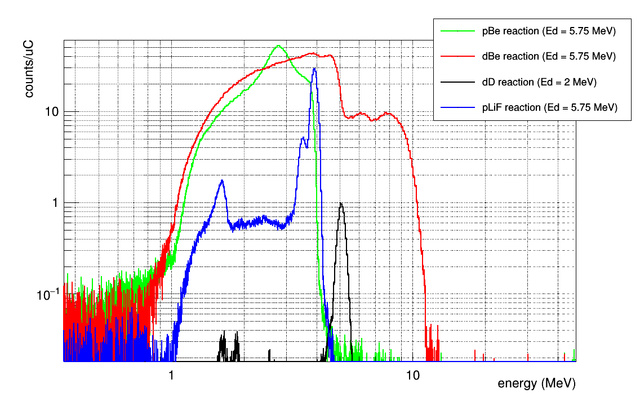
Learning HISPANoS, a new neutron beam facility at CNA
Neutron production targets/mechanisms
Monoenergetic and broad energy neutron beams
For our experiments we choose Fast Neutrons between up to 10 MeV,
²H on ⁹Be target (⁹Be(d,n)¹⁰B)
Reaction | Q-value (MeV) | Eth (MeV) | Target |  |  | Neutron spectra
 |  |  | Material | Thickness | Diameter
²H(d,n)³He | 3,27 | 0,0 | D/Ti | 546 µg/cm² | 30 mm | Quasi-monoenergetic 2,2 – 6,1 MeV
⁹Be(p,n)⁹B | -1,85 | 2,06 | Be | 500 µm | 25 mm | Continuum up to 4 MeV
⁹Be(d,n)¹⁰B | 4,36 | 0,0 |  |  |  | Continuum up to10 MeV
⁷Li(p,n)⁷Be | -1,64 | 1,88 | Li | 500 µm | 25 mm | Continuum up to 4 MeV
⁷Li(d,n)⁸Be | 15,03 | 0,0 |  |  |  | Continuum up to 20 MeV
Projectiles
¹H, ²H up to 6 MeV
⁴He up to 6 MeV
Continuous mode
Up to 10 uA
Pulsed mode
1-2 ns pulse width
32,5 kHz - 2 MHz
1- 4 m flight path
HiSPANoS
EJ301 @30º
EJ301 @0º
monoenergetic
PickUp
100 cm
Be target
Notes:
Experimento con FPGA's: descripción del montaje y de las FPGAs usadas

Slide 5
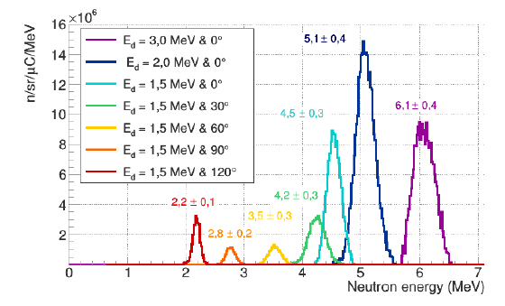
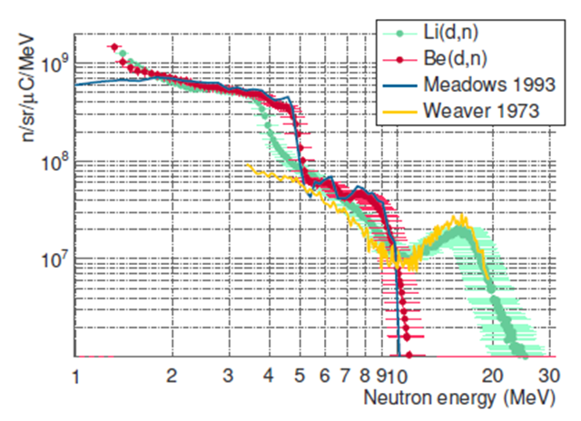
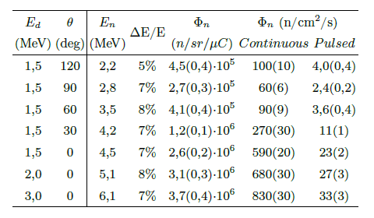
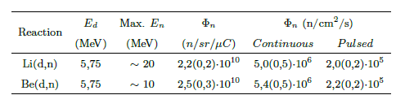
Learning HISPANoS, a new neutron beam facility at CNA
Monoenergetic and Broad Energy Neutron Beams

Slide 6
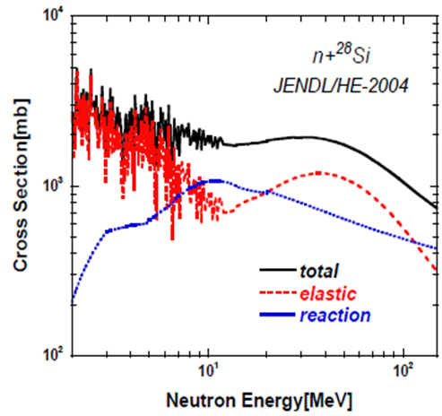
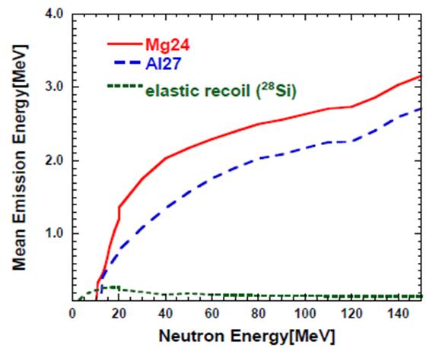
Learning HISPANoS, a new neutron beam facility at CNA
Expected Nuclear reactions in silicon
Reaction | Threshold (MeV)
²⁸Si(n,n)²⁸Si | <keV
²⁸Si(n,α) ²⁵Mg | 2.75
²⁸Si(n,p) ²⁸Al | 4.00
²⁸Si(n,n,α)²⁴MgOff limits | 10.34 Off limits
Neutron total, elastic and reaction cross-section of ²⁸Si from JENDL/HE-2004
Averaged emission energy for elastic recoil ²⁸Si(n,n)²⁸Si and main nuclear reactions ²⁸Si(n,p)²⁷Al, ²⁸Si(n,α)²⁴Mg
Nuclear data relevant to single event upsets in semiconductor memories induced by cosmic-ray neutrons and protons, Y. Watanabe, H. Nakashima, Proc. of 2006 Symposium on Nuclear Data, Jan 25-26, 2007, SND2006-III.03
Incidence of multiparticle events on soft error rates caused by n-Si Nuclear Reactions, F.Wrobel et al, IEEE TNS 47(6), 2000

Slide 7
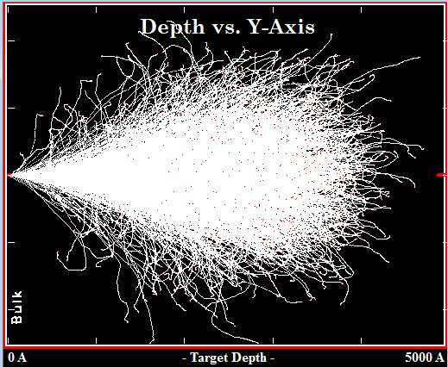
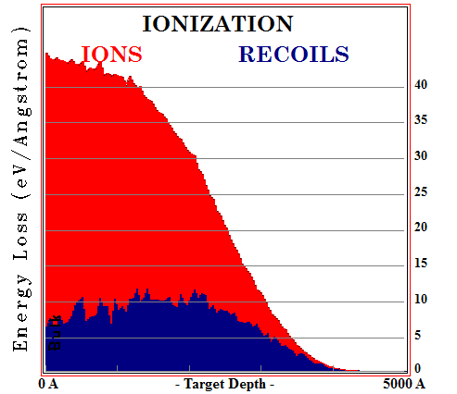
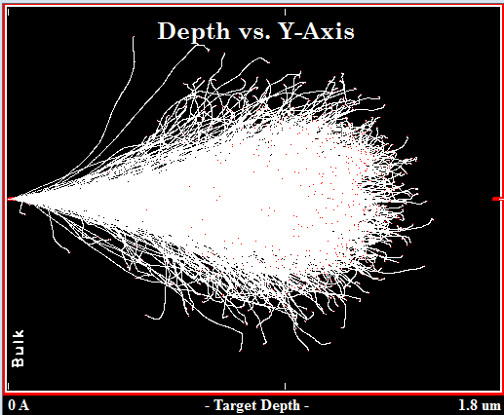
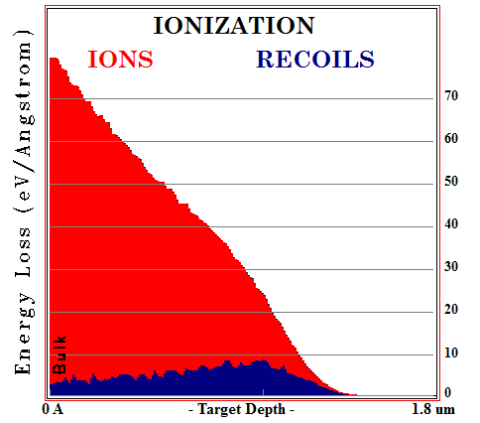
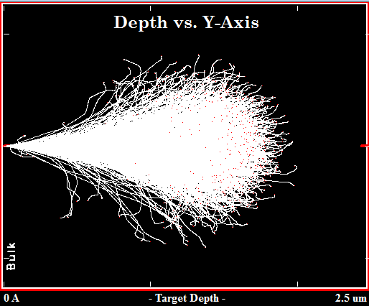
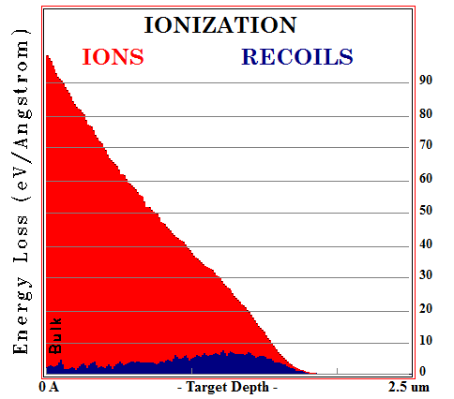
Learning HISPANoS, a new neutron beam facility at CNA
Expected Nuclear reactions in silicon
SRIM simulations for Si, Mg and Al ions at different possible kinetic energies
from a nuclear reaction gives a hint about LET (minimum) and range in the
Silicon Detector Bulk: the ion gives all its energy to the bulk and is trapped.
²⁸Si(n,n)²⁸Si
²⁸Si(n,p)²⁷Al
SRIM range/straggling simulation, IEL, NIEL ²⁸Si 200 keV in silicon bulk
SRIM range/straggling simulation, IEL, NIEL ²⁷Al 750 keV in silicon bulk
²⁸Si(n,α)²⁵Mg
Ion | IEL (eV/Å) | LET (MeV/cm²-mg) | Mean Range Long./Lateral (μm)
²⁸Si (elastic recoil) | ~30 | ~1.3 | ~0.27/0.06
²⁵Mg (from ²⁸Si(n,a)²⁵Mg) | ~50 | ~2.1 | ~1.4/0.3
²⁷Al (from ²⁸Si(n,p)²⁷Al) | ~40 | ~1.7 | ~1.1/0.2
SRIM range/straggling simulation, IEL, NIEL ²⁵Mg 1 MeV in silicon bulk
Ionizing Energy Loss, IEL. Non-Ionizing Energy Loss, NIEL
Notes:
estas simulaciones son para valores pequeños de energía cinética del ión. Muestran dos cosas: que son iones eficientes para dejar energía en el silicio (LET alto aunque K sea baja) y que su poder de penetración es minúsculo (menor de 1.5 um) por lo que si se generan en el detector, van a quedarse allí dentro, no importa lo delgado (20 um) de la zona de deplexión.

Slide 8
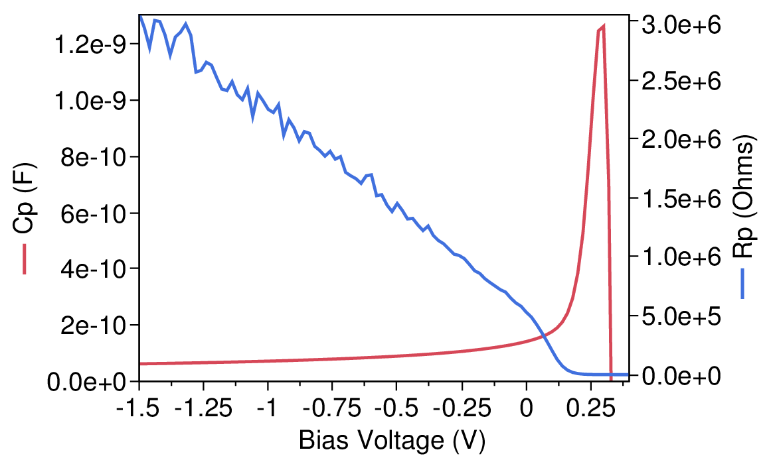
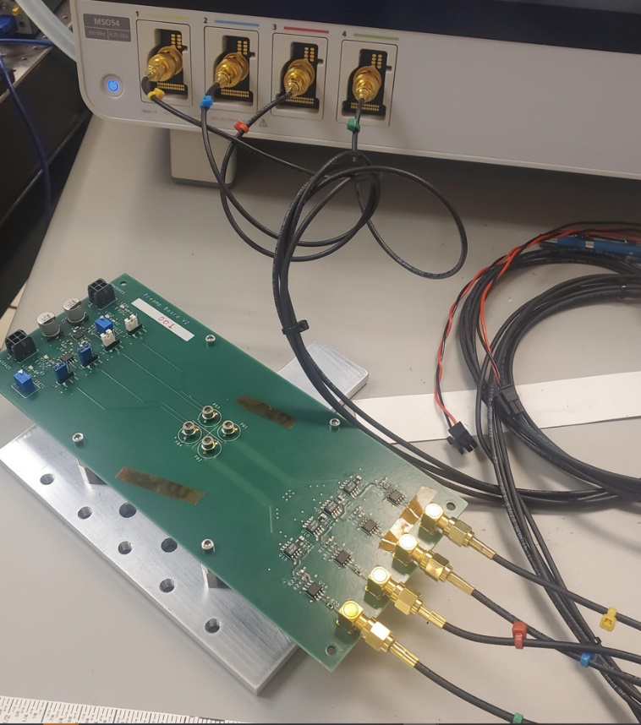
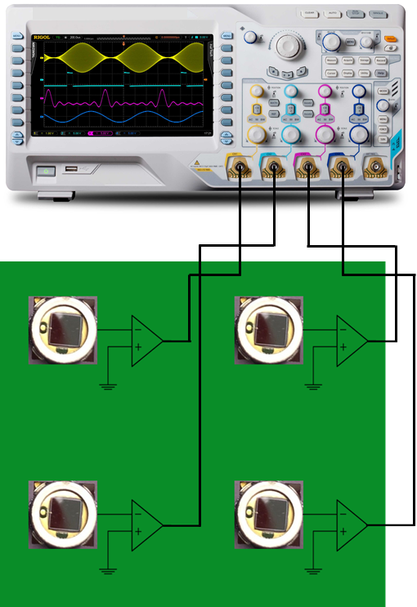
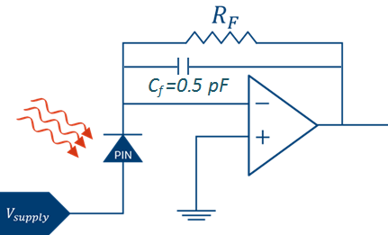
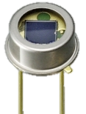
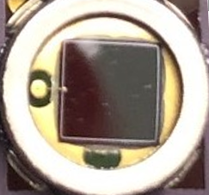
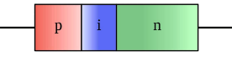


Learning HISPANoS, a new neutron beam facility at CNA
Photodiode Experiment
$$d=\frac{εA}{C}$$
Key to successful result is to achieve a very low noise, high speed pre-amplifier.
  Battery-powered pre-amp board (remove AC noise).
  Single trans-impedance amplifier, 500MHz BW, femtoA input bias, femtoF input cap (from Analog Devices Inc.).
  VREF-filtered voltage regulators for low noise (uV) high ripple rejection (68dB).
  Custom board layout to minimize parasitic capacitances
Multiple diodes to maximize exposed cross section/oscilloscope channel usage.
Hamamatsu S1336 series PIN detectors, 20 μm depletion depth
At bias=-1.5 V we
calculate depletion depth
from the Capacitance
Formula, d=20 μm
3.6 mm
=4.7kΩ
3.6 mm
$$V_{OUT}={−I}_{photo}R_{F}$$
Notes:
Descripción de la electrónica

Slide 9
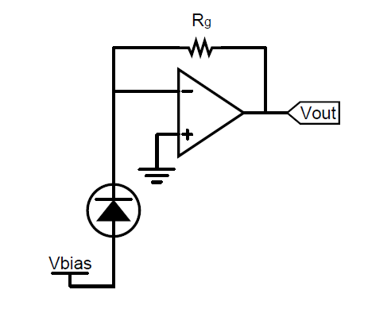
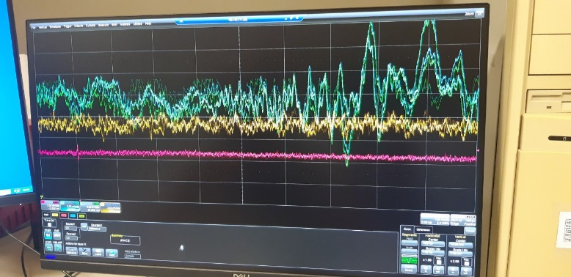
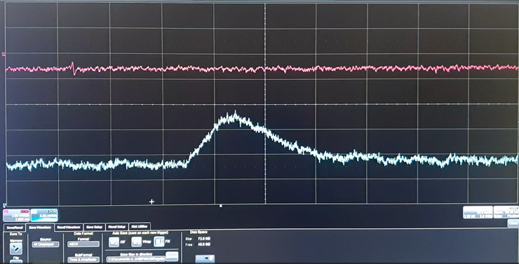

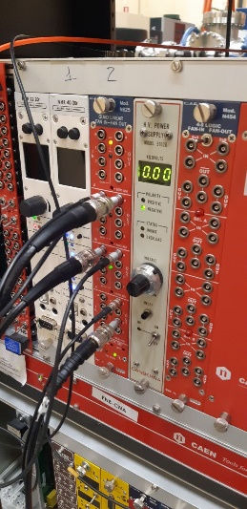
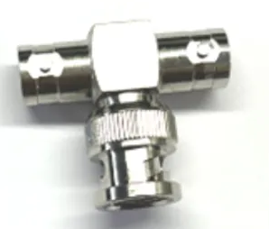
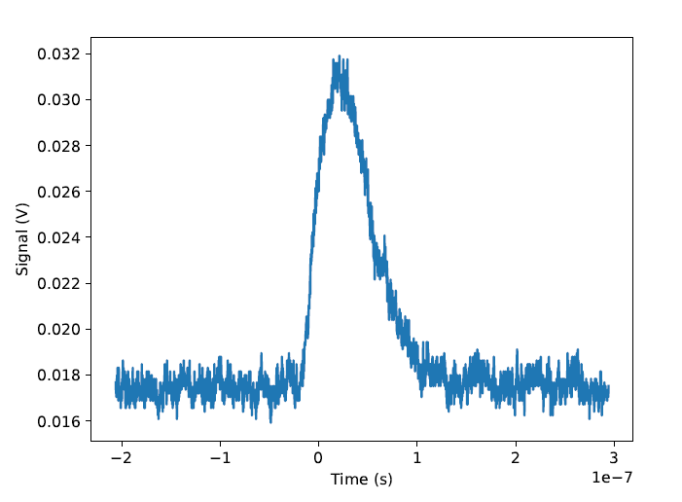
Learning HISPANoS, a new neutron beam facility at CNA
Photodiode Experiment
Direct measurement (Trans Impedance Amplifiers) is useful to get signals in a straight manner but it is very sensitive to Electro Magnetic Interference. There is plenty of EMI in the accelerator room, with an amplitude no less than 30 mV. The EMI signal is the same in both detectors but the ionization signal, at an instant, happens in only one.
Deuteron arrival to production target
4ns delay line
coax
Difference
Signal
Level trigger positive
+
RF Signals
&
Neutrons
The synchronous difference signal shows only the ionization pulse when a neutron arrives at one detector. Changing Level Trigger Sign selects pulses
from one or the other
detector
A typical signal from a nuclear reaction,
~100 ns long
CAEN N625
Quad Linear
Fan In/Fan Out
Signal Inversion
(delay = 4ns)
Notes:
Montaje de señales para evitar interferencia electromagnética

Slide 10
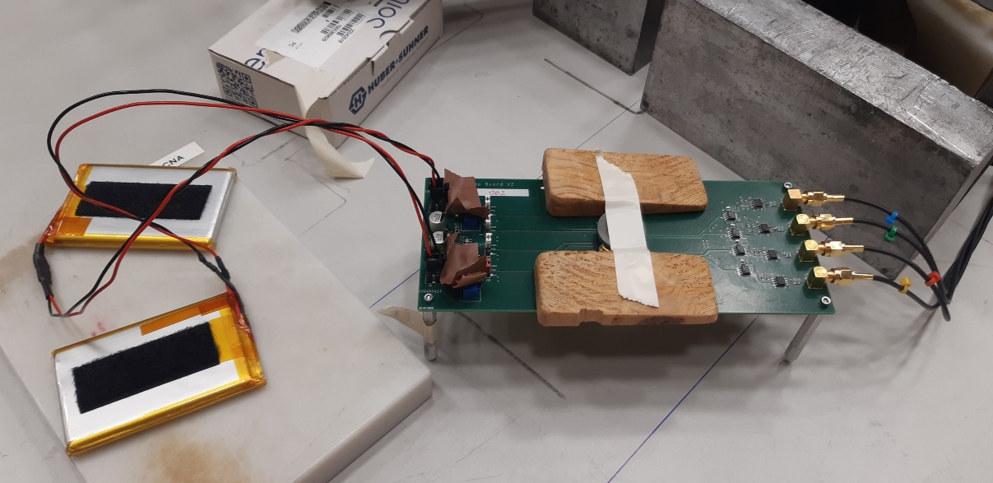
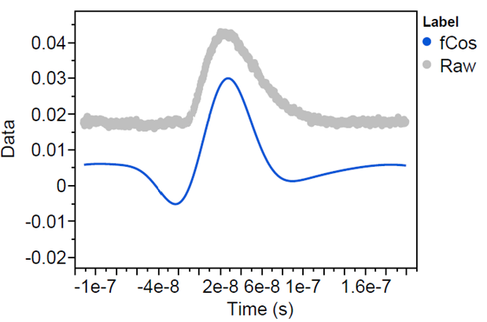


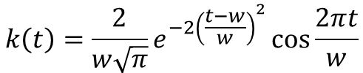
Learning HISPANoS, a new neutron beam facility at CNA
Photodiode Experiment
Just for calibration we put the same setup under gamma radiation from a Co60 source (accelerator shut off). We detect no spike from gamma photons so we concluded the dataset from the experiment with the accelerator on was due to neutron induced nuclear reactions in the photodetectors silicon bulk.
Digital Signal Processing of the data set showed the same conclusion:
Digital Data
Processing
(low pass convolution
filter)
$$k\left(t\right)=\frac{2}{w\sqrt{π}}e^{−2{\left(\frac{t−w}{w}\right)}^{2}}\cos{\frac{2πt}{w}}$$
low pass filter kernel
Notes:
Experimento de calibración con gammas, acelerador apagado

Slide 11
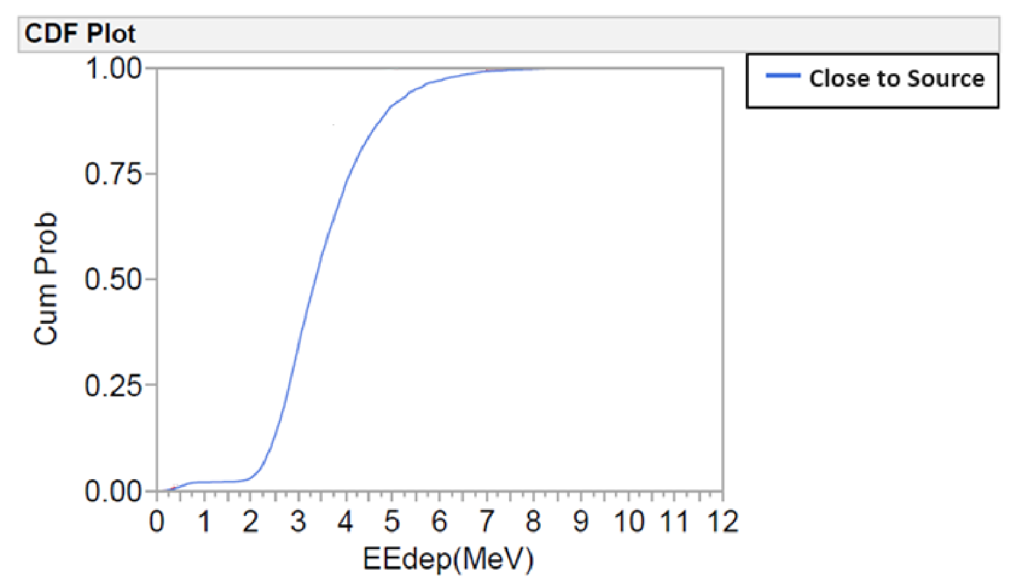
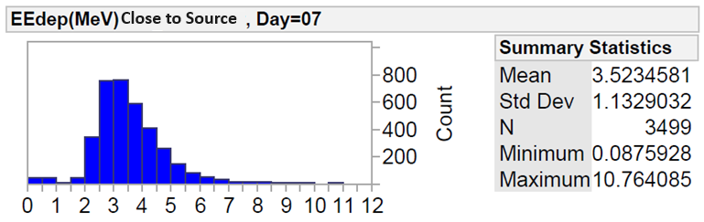
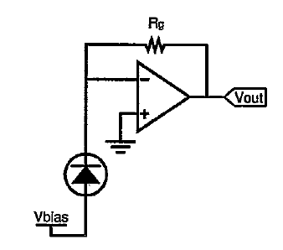
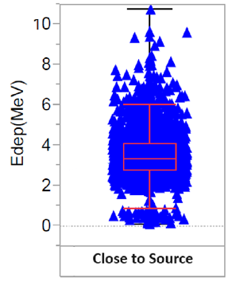
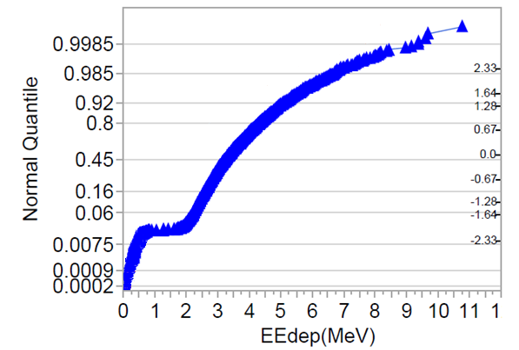
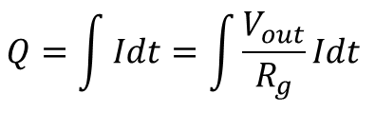

Learning HISPANoS, a new neutron beam facility at CNA
Photodiode Experiment
$$Q=\int{Idt=\int{\frac{V_{out}}{R_{g}}Idt }}$$
$$E_{dep}=\frac{Q}{e}(3.6 eV)$$
The analyzed data is consistent with the hypothesis that signals come from ions generated by neutron induced nuclear reactions in Silicon, as expected.
blue: close to neutron source
Event distribution of
captured events
Notes:
Descripción del montaje para el experimento de neutrones

Slide 12
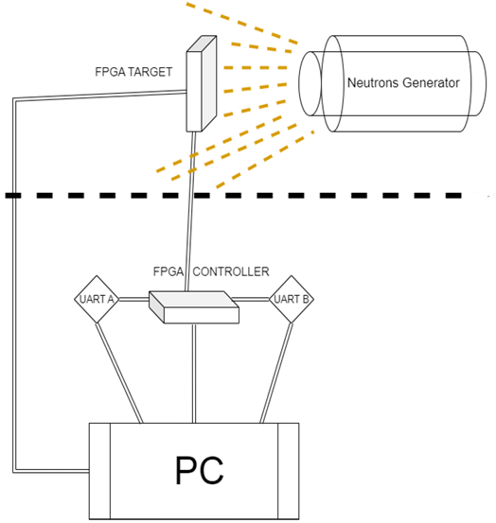
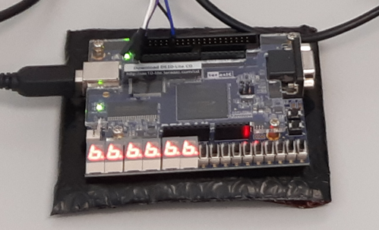
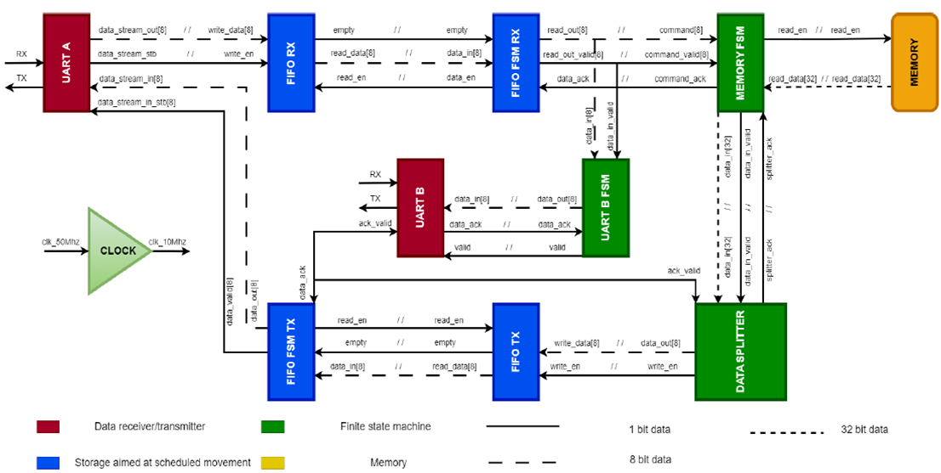
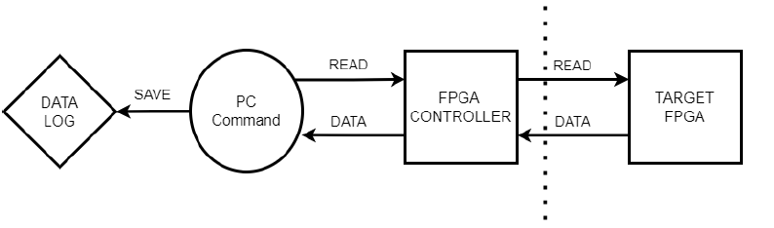
Learning HISPANoS, a new neutron beam facility at CNA
FPGA Experiment
The second experiment was oriented to evaluate the usefulness of HISPANoS for Single Event Upset experiments. The target was a MAX10 FPGA card, with another MAX10 FPGA out of beam as local controller. The MAX10 target had simple digital design: a memory controller and a RAM matrix, made with the flip-flop pool of the FPGA. A simple word (fff...) was recorded in the FPGA RAM memory. The memory controller readouts the RAM and send the data stream to the controller FPGA, from there to the control computer on a safe place. We used two uarts as a double check in the data transfer.
Controller FPGA
(off beam)
Target FPGA
(on beam)
In this experiment the difficult part is at the digital design. Irradiation data analysis is very easy (just a disagreement in the fff... word received).
Notes:
Experimento con FPGA's: descripción del montaje y de las FPGAs usadas

Slide 13
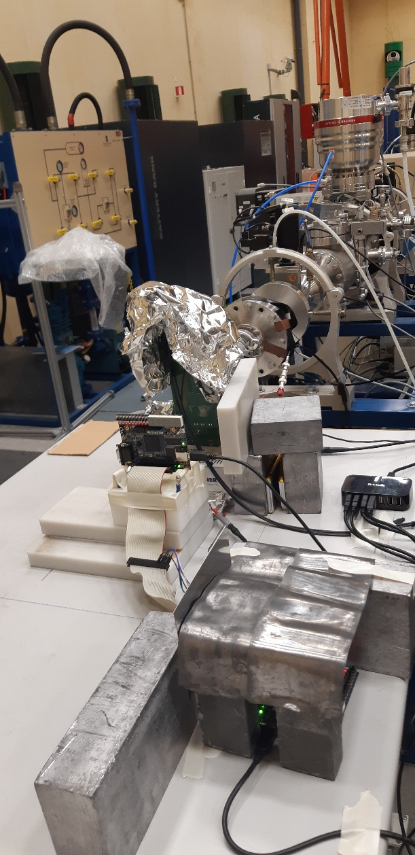
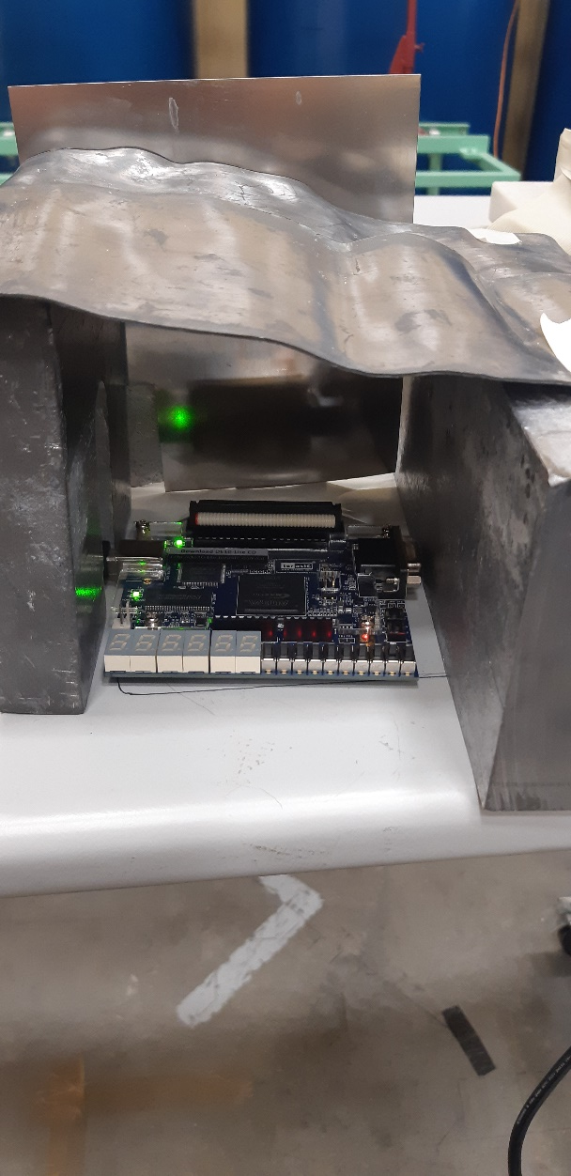


Learning HISPANoS, a new neutron beam facility at CNA
FPGA Experiment
With the Target FPGA close to the neutron source we detected SEUs at a rate of one every couple of minutes, sometimes even a total failure of the readout (an indication of SEU in the memory controller). No stuck bits in any case were seen, with the Target FPGA in pristine condition after scrubbing (or reconfiguration). For future experiments we will design a Shift Register structure in the Target FPGA, without the internal memory controller block, now possible because the MAX10 is insensitive to Single Event Effects Stuck Bits.
Target MAX10 FPGA
Controller
MAX10 FPGA
MAX10 FPGA experiment layout
FPGA RAM memory dump
Notes:
Experimento con FPGA's: detalle de los autómatas implementados

Slide 14
Learning HISPANoS, a new neutron beam facility at CNA
Conclusions
We learned about how to make neutron detection experiments in the new
HISPANoS neutron beam facility at CNA, Sevilla
The photodiode experiment opens the way to more sophisticated detector experiments in the facility. As a plus, we got straight signals from neutron (up to 10 MeV) induced nuclear reactions in silicon.
The MAX10 FPGA shows no stuck bits under neutron irradiation. New Neutron Single Event Effects experiments are planned.
Thanks to the funding programme H2020-ARIEL
Notes:
Conclusiones generales

Slide 15
Learning HISPANoS, a new neutron beam facility at CNA
Thanks for your attention!
fpalomo@us.es

