Slide 1
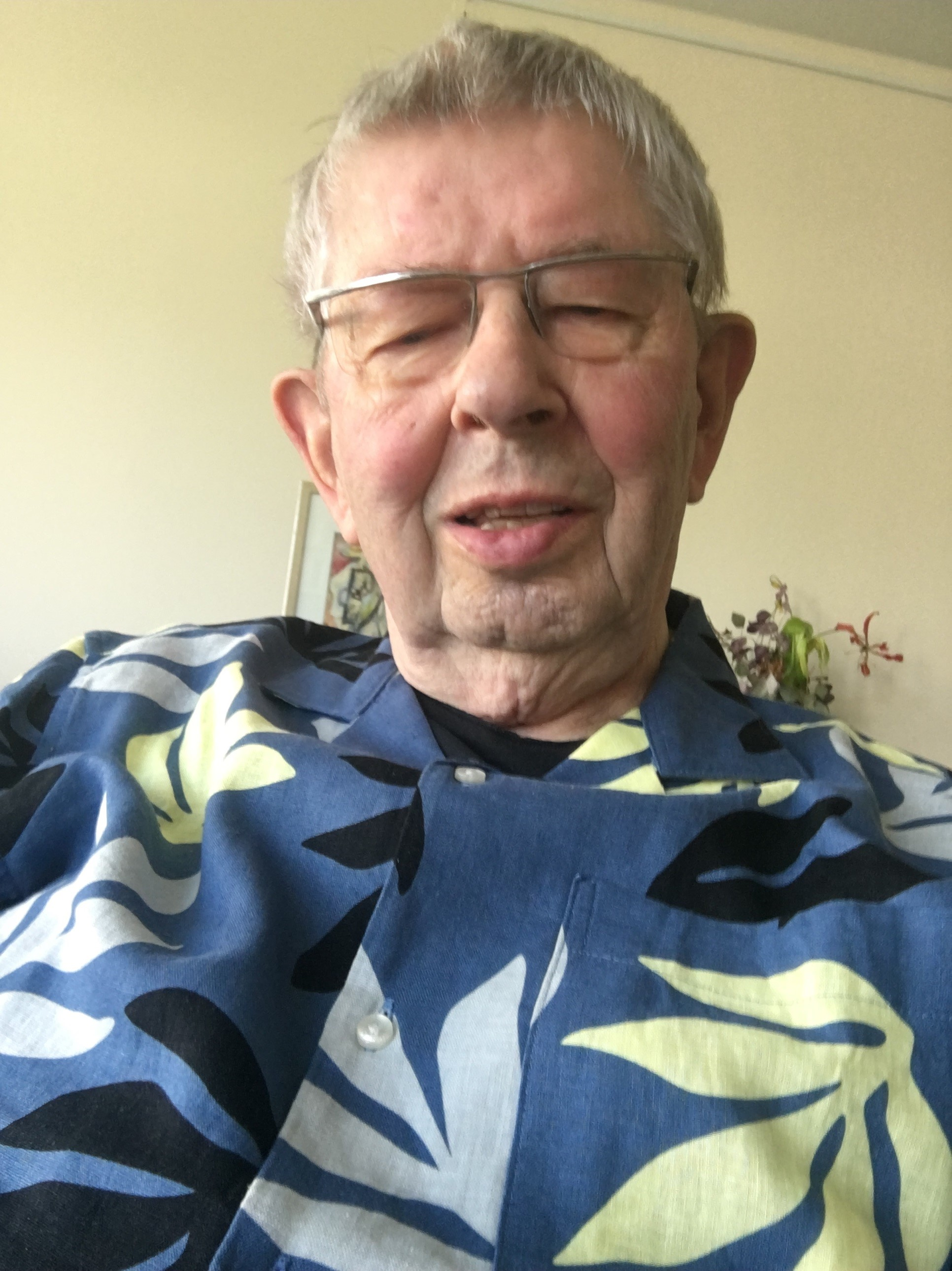
Greetings from Hamburg
Dear colleagues and friends
I would have very much liked to join your meeting, however certain age related limitations prevented that. Instead Michael had asked me to address you with some words this way.
I am looking back to 30 years of silicon detector research, first in the RD2 collaboration, followed by RD48 and finally for more than 20 years in RD50.
I am very glad to have participated in this ever expanded community and like to thank everybody of you with whom I had the opportunity to work with. Above the development of ideas and the pleasure of solving problems, it was also a lot of personal fun.
I like to mention a few of you to whom I feel especially indebted.
First of all there is Michael whom I have known as PhD student in Hamburg, from where he then moved to CERN. For many years he has now been spokesperson of RD50 and I think everybody agrees that he did a superb job. Many thanks, Michael
The one colleague I know even longer and who has been the main guide and teacher in our Hamburg group is Eckhart. For all his help and cooperation I could not have missed him. Special thanks to you, Eckhart.
During our work we came to think that we should learn about the microscopic reasons responsible for the macroscopic deterioration caused by irradiation. In this respect Ioana with her intim knowledge of semiconductor physics was certainly a break thru. Many interrelations between defects and detector performance were discovered .
I like to mention a special event related with Mara. Probably only a few of you are aware that Mara apart from physics got an education in classical singing. She once told me during a private conversation and then, in one of our social events of an RD50 workshop I asked her to perform one opera aria. So she did and every one present got much moved. Till now I remember that event very intensely, thank you Mara.
Last not least good luck to all of you and enjoy the forthcoming work In the new collaboration.
Gunnar Lindstroem

