Slide 1

IPPOG – GTU Agreement
A tool for the development of tools for education and outreach in particle physics
P. Abreu, LIP and IST, Co-Chair
2nd Partners Meeting for a Better Collaboration
GTU, Tiblísi, Georgia
08 November 2023

Slide 2
Outline
Introduction
The IPPOG-GTU Agreement
The expected tool(s)
IPPOG – The forthcoming prospects

Slide 3
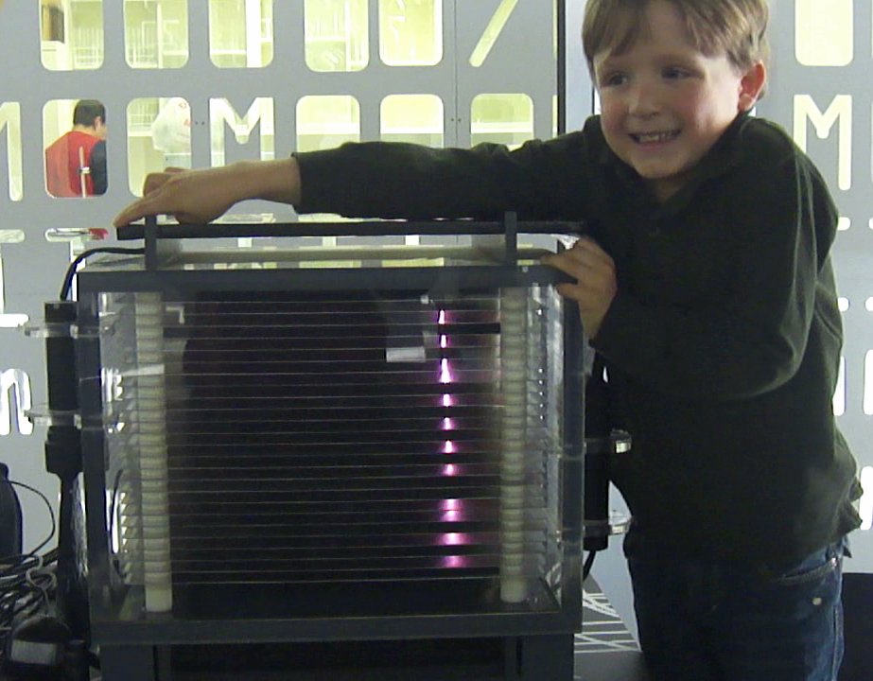
Introduction
Communications
  Report Goals and Results to the public
  Extend Reach through methods & networks
Education & Outreach
  Establish Understanding of scientific process
  Instil Appreciation of fundamental research
  Engage with communities
  Train the Next(*) Generation of scientists
(*)...and the next-to-next generation
The Education, Communication & Outreach we do today
lays the foundation for tomorrow’s support and secures the next generation of scientists.

Slide 4
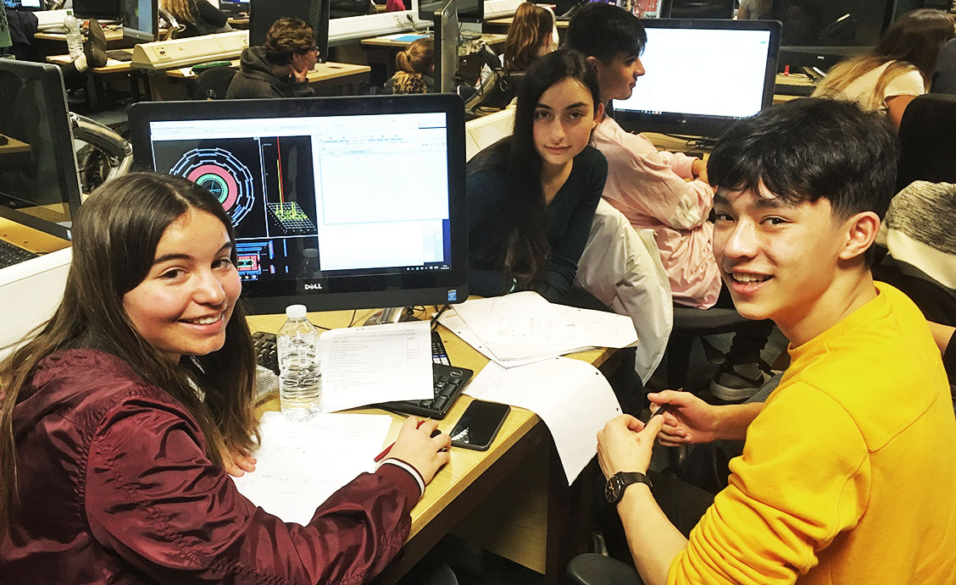
About IPPOG
International Scientific Collaboration
  Active Researchers with Experience in Education & Outreach
  Experts in Communication & Education
Global Network
  33 countries, 7 experiments, 1 int’l lab (CERN)
  2 associate members: 2 national labs (DESY, GSI)
  A link to national networks
Organise Global Activities
  International Particle Physics Masterclasses
  World-Wide Data Day, Global Cosmics, etc.
Support Local Activities
  Sharing of expertise, best practices, material database
  Resources to support events, kick-start activities
  Accession of Georgia in 2020

Slide 5
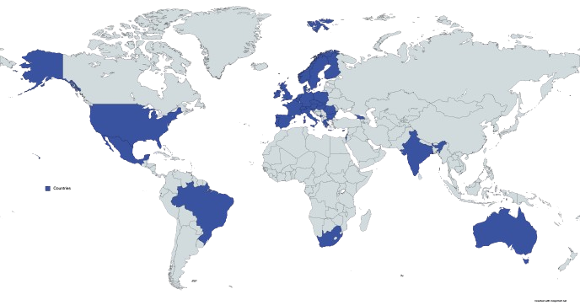
IPPOG Today
33 Countries
+CERN (Int’l Laboratory)
+International Collaborations
ALICE, ATLAS, BELLE II, CMS,
HAWC, LHCb, Pierre Auger Obs.
+Associated Members (DESY, GSI)

Slide 6
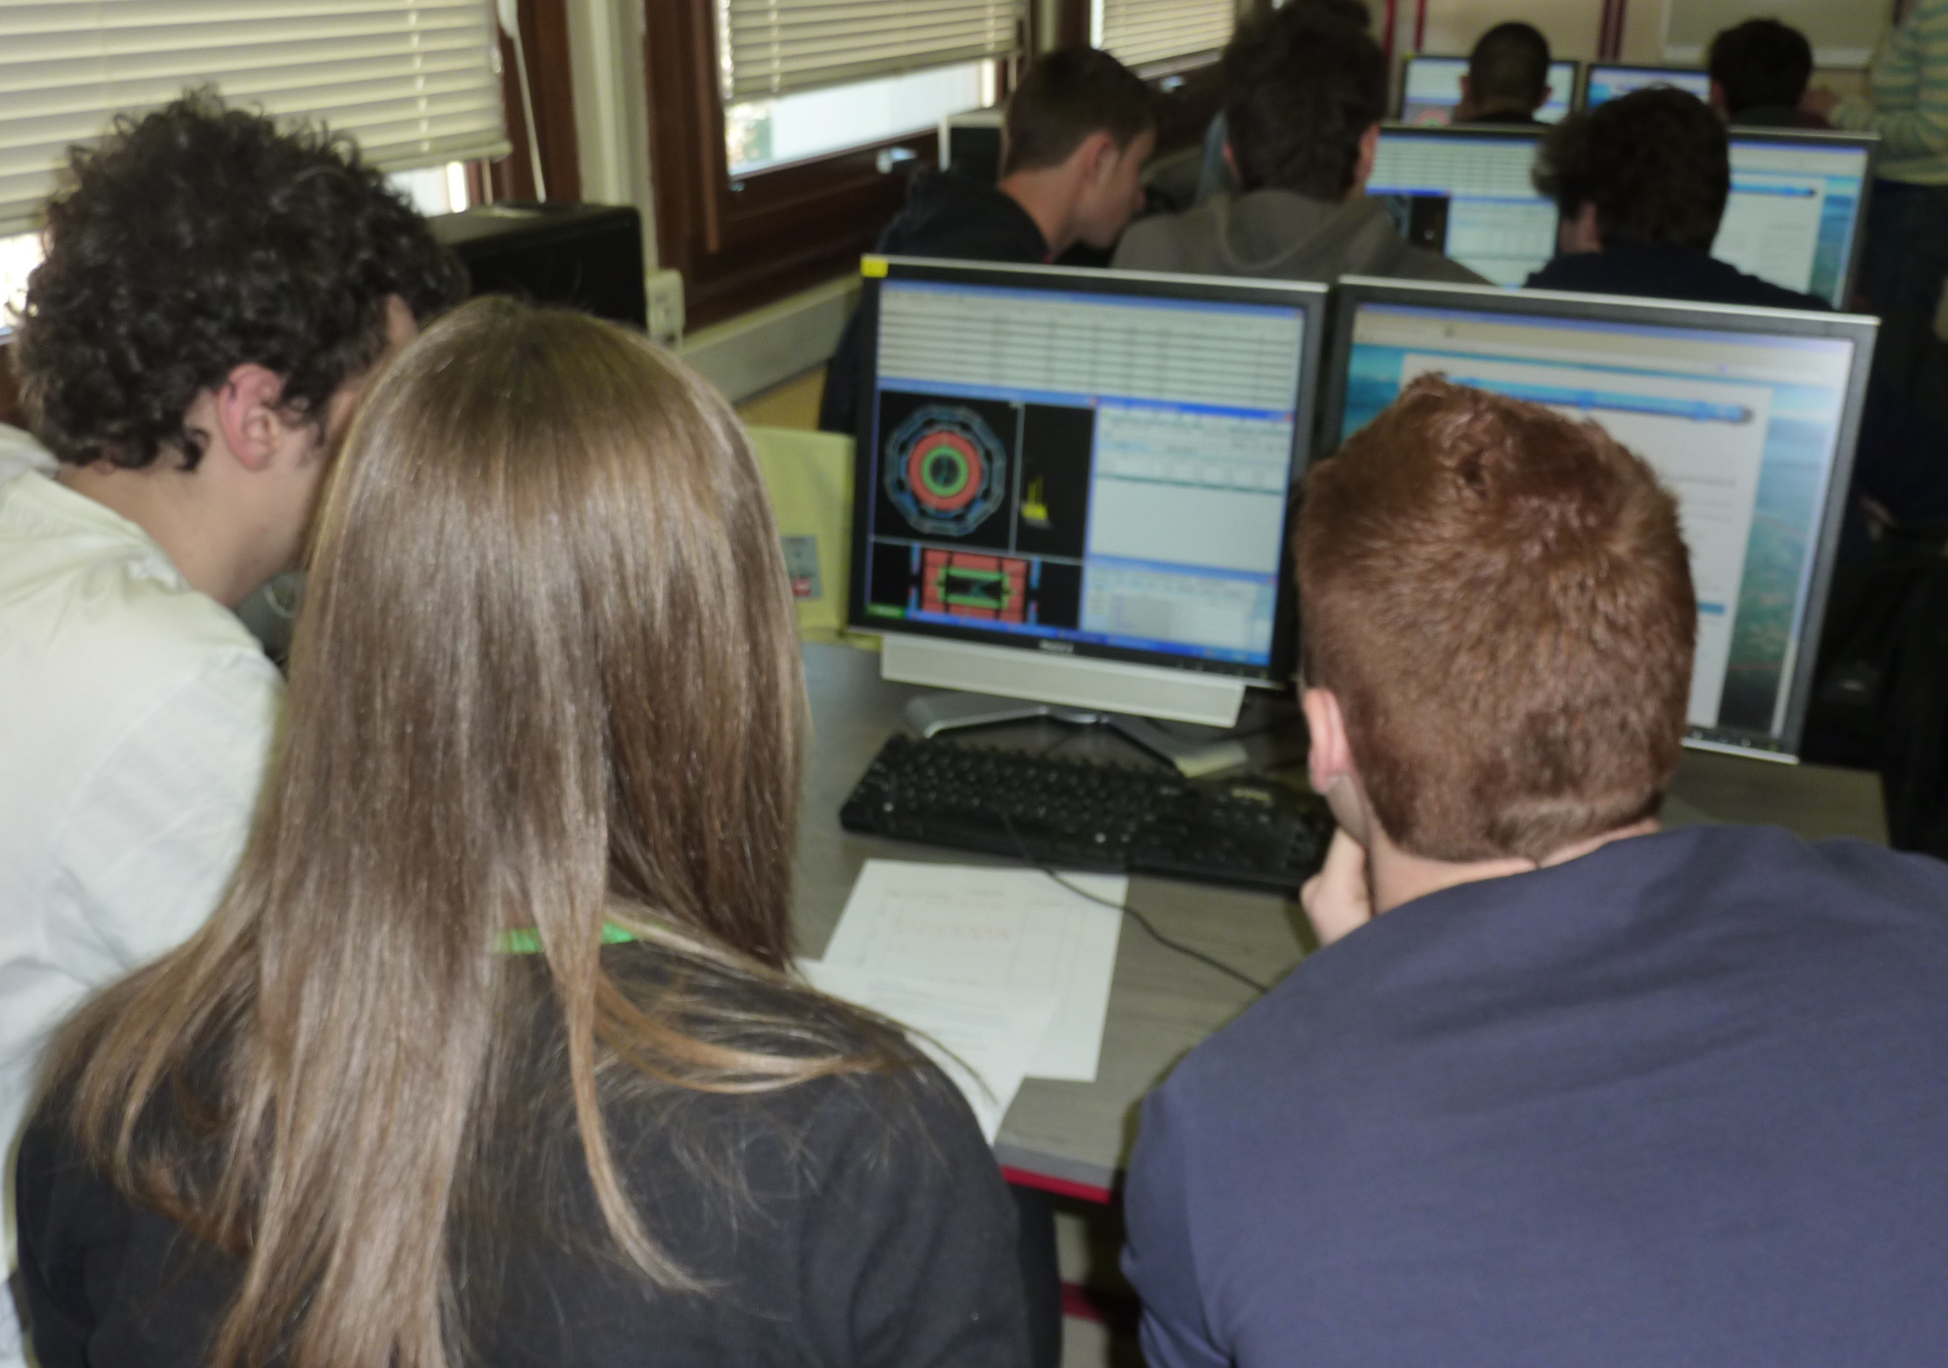
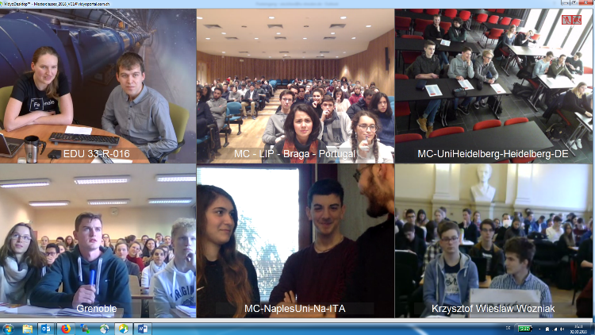
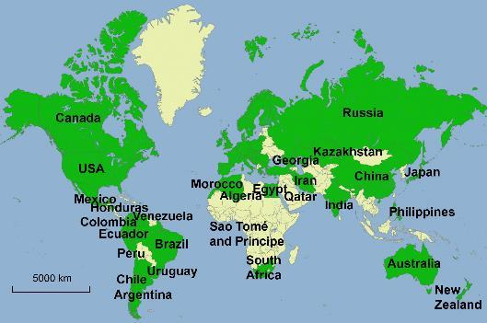
IPPOG – International Masterclasses
The Flagship Activity of IPPOG
  Students become “Scientists for a Day” at a Research Inst.
  Introduction to Particle Physics, Detectors, etc.
  Analyse real data provided by experiments (ATLAS, CMS, etc)
  Discuss results via videoconference
  with other students around the world
Global Reach (2019; recovering after pandemic)
  60 countries
  220 research labs
  14,000 Students
  Videoconferences with moderators at
  CERN, FNAL, KEK, GSI, TRIUMF

Slide 7
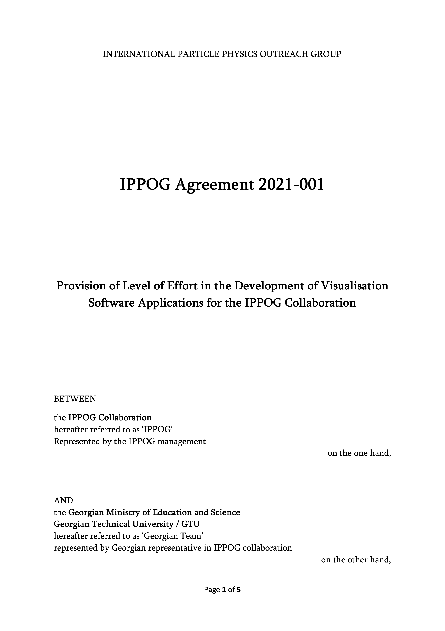
The IPPOG-GTU Agreement
Following the accession of Georgia to IPPOG (represented by GTU) in Oct.2020
First agreement between IPPOG and a country (/representative)
to support the development of tools for outreach activities:
Provision of Level of Effort in the Development of Visualization Software Applications for the IPPOG Collaboration
Commitment from the Ministry of Education and GTU to support the Georgian Team
in the development of Visualization Software Applications, namely in 3D Visualization of ATLAS events, of potential use in the Int’l Masterclasses programmes
…signed on 8th July 2021

Slide 8
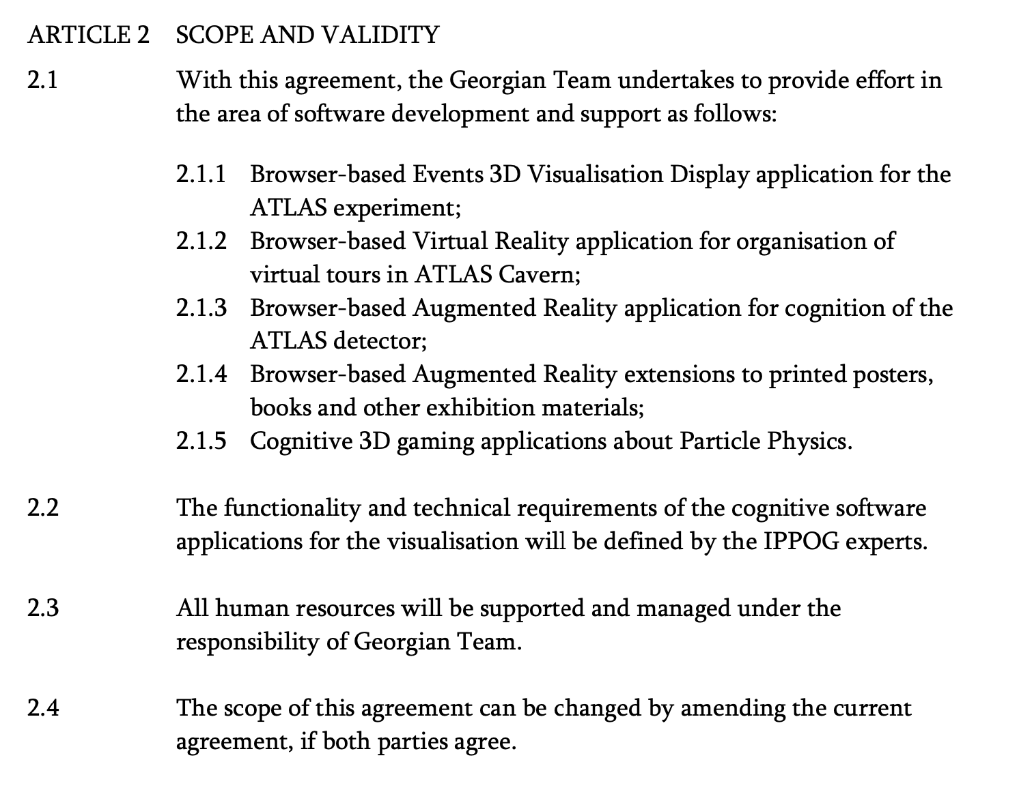
The IPPOG-GTU Agreement Apps
Software Visualization Applications such as
Browser-based Events 3D Visualisation Display
application for the ATLAS experiment;
Browser-based Virtual Reality application for organisation of virtual tours in ATLAS Cavern;
Browser-based Augmented Reality application for cognition of the ATLAS detector;
Browser-based Augmented Reality extensions to printed posters, books and other exhibition materials;
Cognitive 3D gaming applications in Particle Physics.

Slide 9
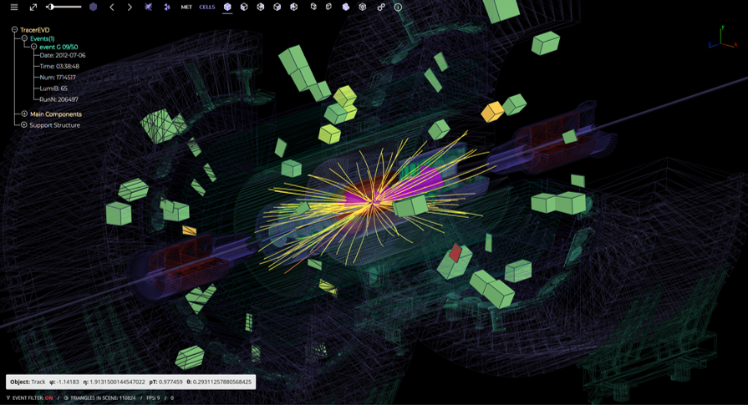
The Expected Tools
Browser-based Events 3D Visualisation Display application for the ATLAS experiment;
(from Lasha’s presentation on IPPOG 2021
Autumn meeting, 17th Nov. 2021:
indico.cern.ch/event/1084892/timetable/ )
Application will be browser based and will ensure the high performance and quality of the 3D scenes together with the standard functionalities of other ATLAS event displays

Slide 10
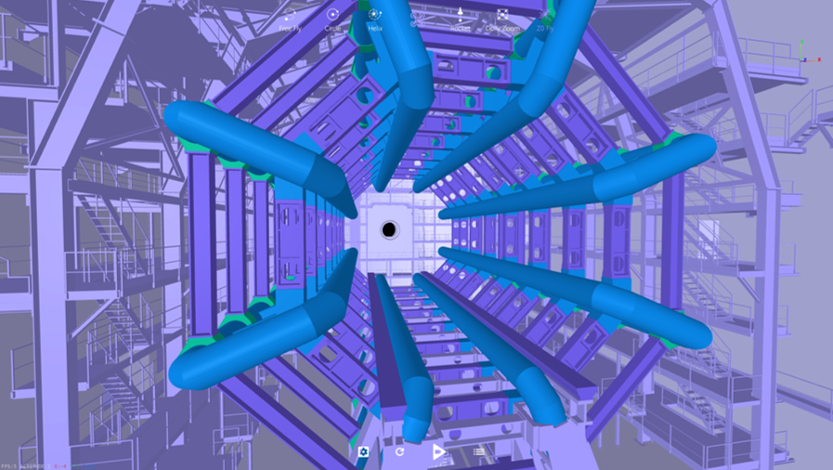
The Expected Tools
Browser-based Virtual Reality application for organisation of virtual tours in ATLAS Cavern;
(from Lasha’s presentation on IPPOG 2021
Autumn meeting, 17th Nov. 2021:
indico.cern.ch/event/1084892/timetable/ )
Application will run in browsers, using average mobile phones and cheap Google cardboards
No special hardware, graphics engines or super notebooks

Slide 11
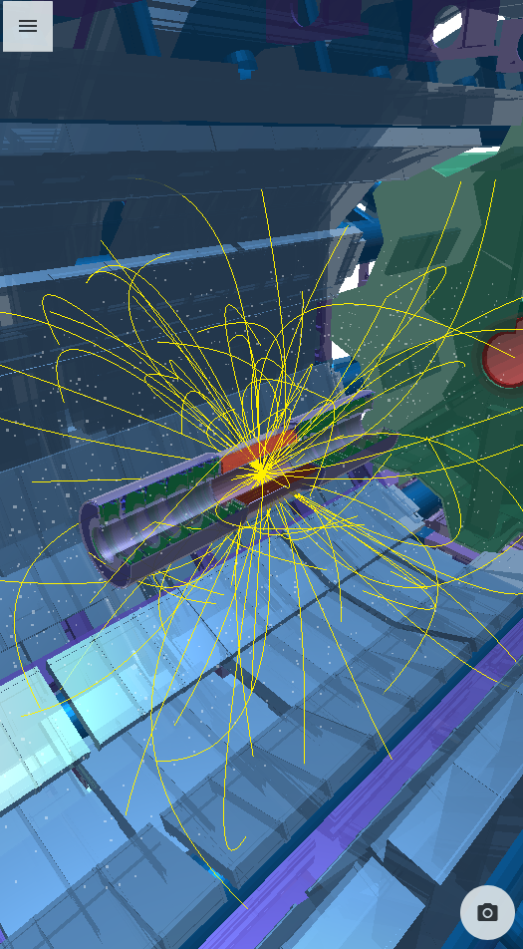
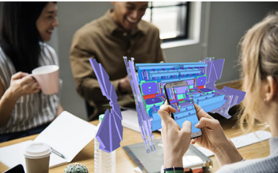
The Expected Tools
Browser-based Augmented Reality application for cognition of the ATLAS detector;
(from Lasha’s presentation on IPPOG 2021
Autumn meeting, 17th Nov. 2021:
indico.cern.ch/event/1084892/timetable/ )
Detailed and realistic descriptions of full ATLAS infrastructure
Realistic geometric cuts
High performance

Slide 12
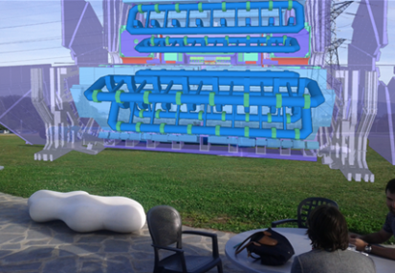
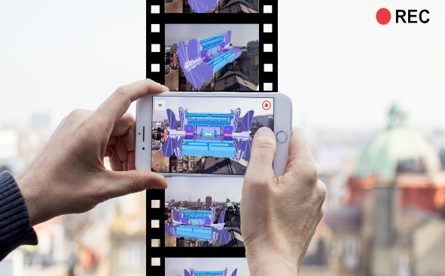
The Expected Tools
Browser-based Augmented Reality extensions to printed books and exhibition materials;
Cognitive 3D gaming applications in Particle Physics.
(from Lasha’s presentation on IPPOG 2021 Autumn meeting, 17th Nov. 2021: indico.cern.ch/event/1084892/timetable/ )

Slide 13
The forthcoming prospects
Evaluation of the status of [readiness of] the tools;
Tests of the use of selected tools in the context of a Masterclass:
  ATLAS W-Path or Z-Path Measurement
  Small (<40), Medium (~80) and Large (>120) number of participants
  Client satisfaction feedback (clients being the participants in the Masterclass), regarding its simplicity, interest, wow effect, learning help effect, usability of the tool
  Facility of installation of [any] software, usage documentation, data to be loaded
Path towards [free] distribution to Organizers of Masterclasses (in selected institutes and/or for IPPOG forum members and through the whole IMC network)
Language availability assessment (possible translations, etc)

Slide 14


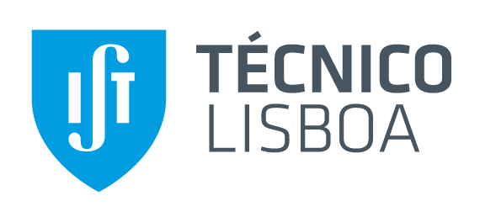
Thank you for your attention!
...and
to all the people collaborating in all these activities!
Any questions?
You can find me at abreu@lip.pt
Planting
a future
ippog.org

