Slide 1
Calculation of the radiation length for the simulation tasks

Slide 2
Project N5 – Anticorodal Aluminum Structure of ITk Pixel PP1
Simplified CATIA Geometry – Modified vs. Gmx-Geometry
Calculation of Radiation Length (Xo)
Niko Tsutskiridze
Giorgi Mirziashvili
Team Leader: Alexander Sharmazanashvili
4/10/2023

Slide 3
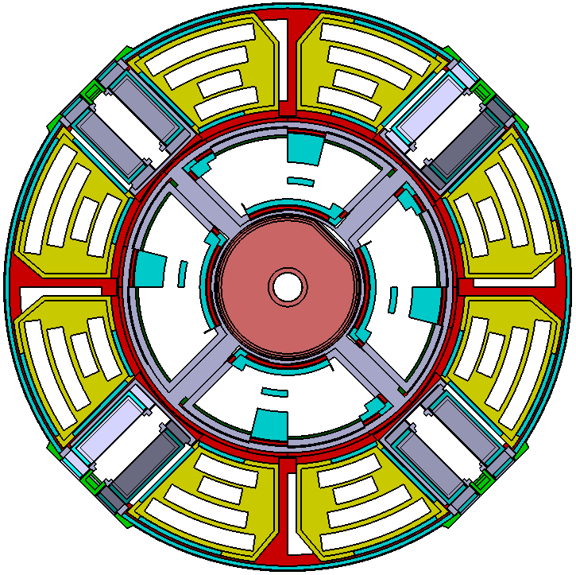
Selection Area for calculation Radiation Length L(Xo)
S1
S4
S2
Because of geometries in each sectors (S1, S2, S3, S4) are identical the Radiation length will be the same for all of them
S1 = S2 = S3 = S4
S3

Slide 4
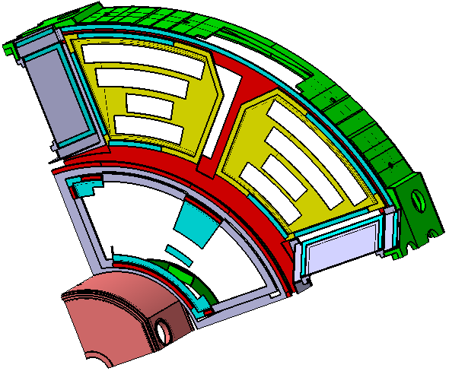
Selection Area for calculation Radiation Length L(Xo)
S1
So, detailed calculation of the Radiation Length performed for the sector S1

Slide 5
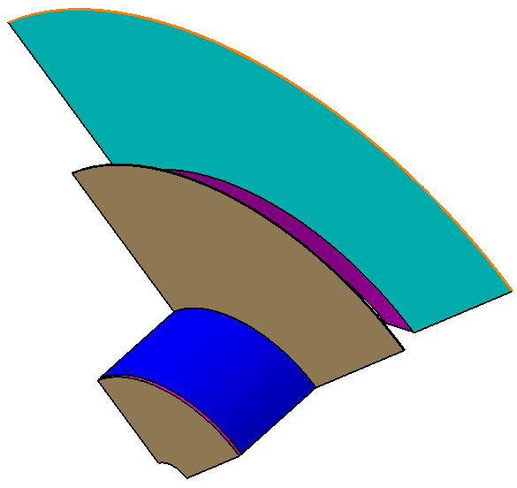
Compare Analyses – Radiation Length
Simplified CATIA Geometry-Modified
Gmx Geometry
Vs.

Slide 6

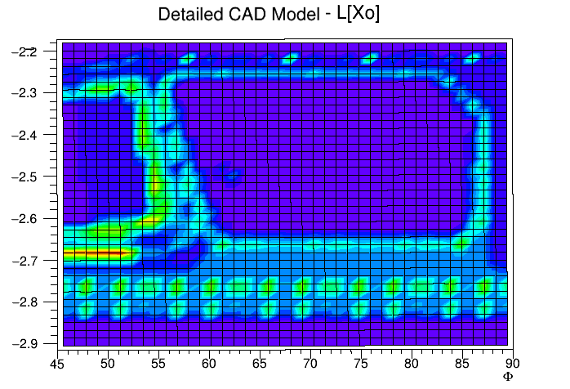
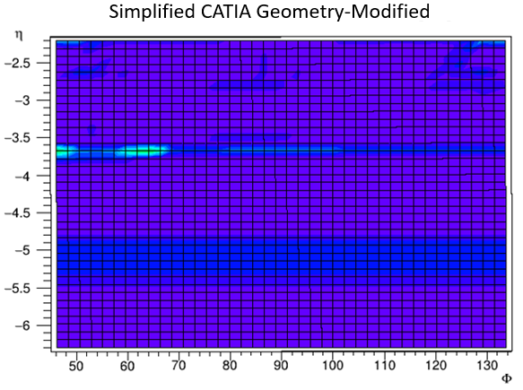
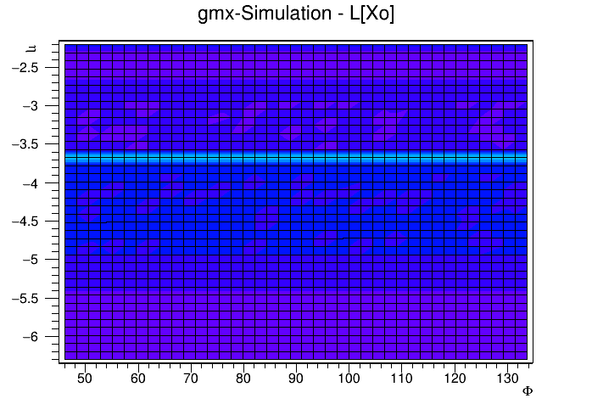

Compare Analyses – Radiation Length
Gmx Geometry

Slide 7
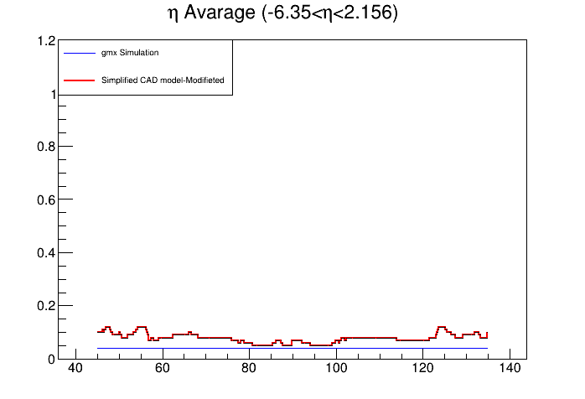
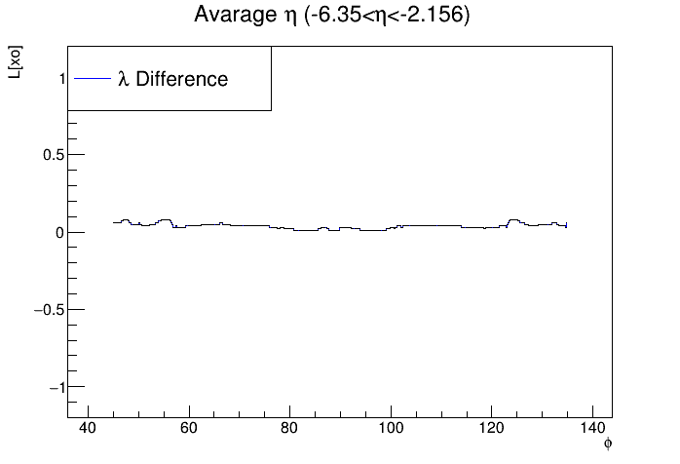
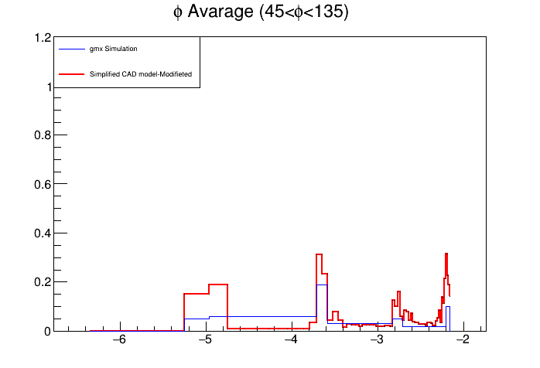
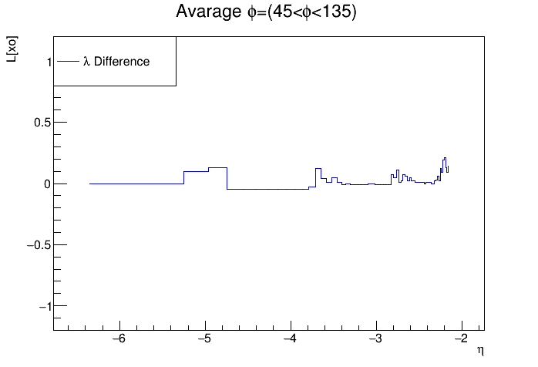
Compare Analyses – Radiation Length (Average Values)

Slide 8
Calculation of Radiation Length (Xo)
η =-2.203
η =-3.259
η =-5.252
45< Φ <135

Slide 9
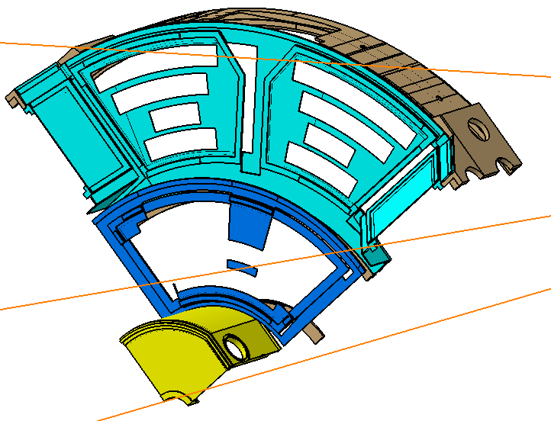
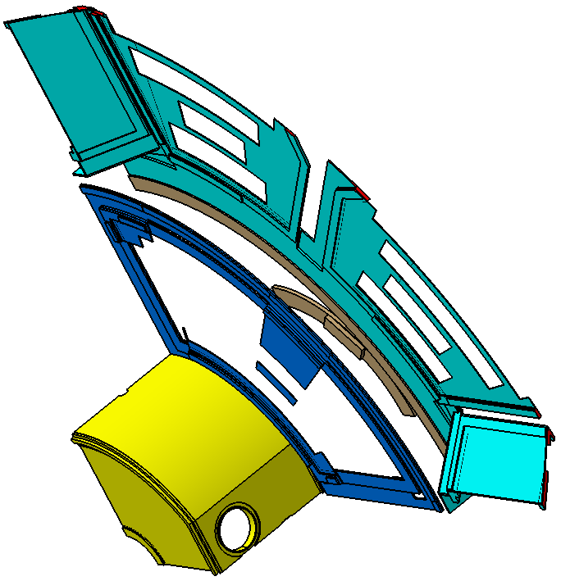
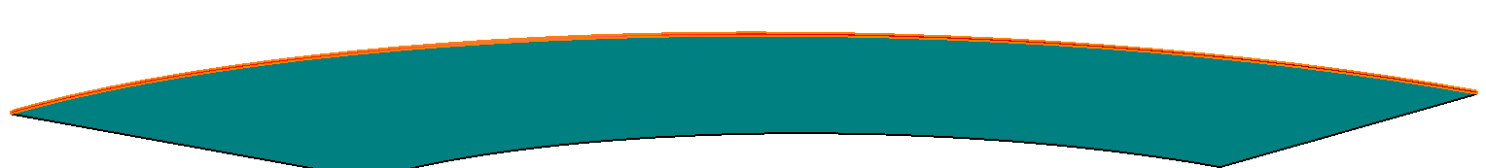
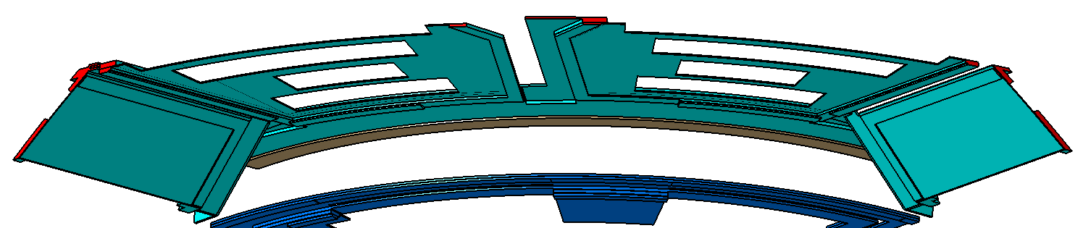
η = -2.304
Compare Analyses – Radiation Length L(Xo) – Line 1
Simplified CATIA Geometry-Modified
Gmx Geometry

Slide 10
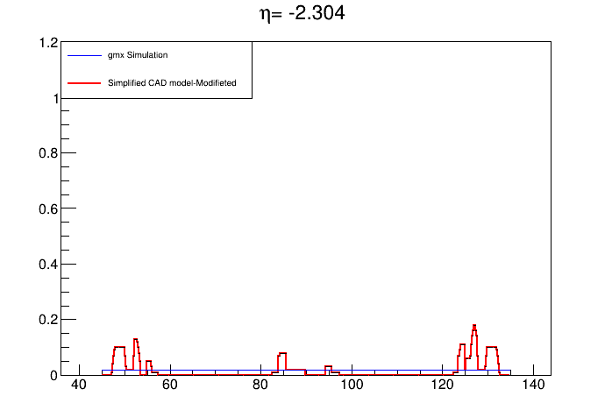
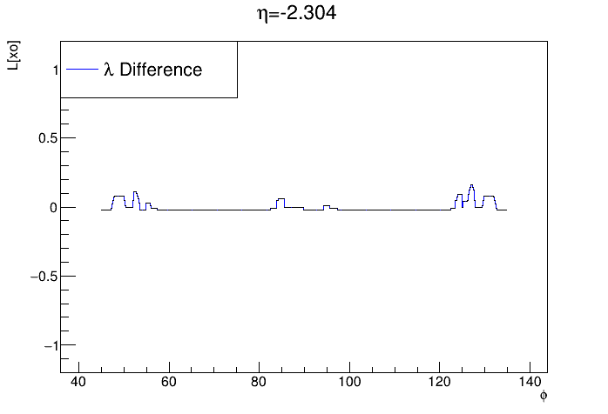
Compare Analyses – Radiation Length L(Xo) – Line 1

Slide 11
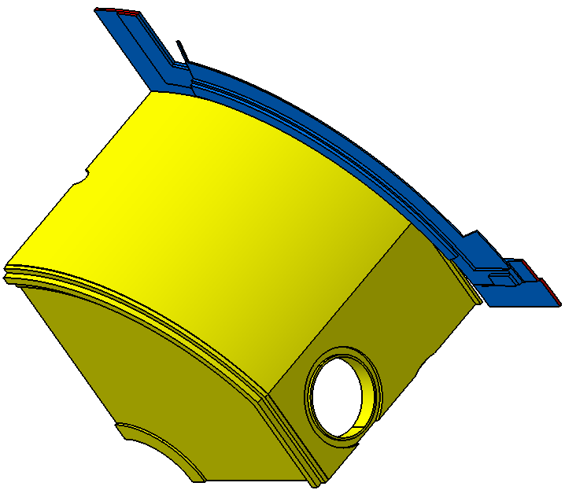
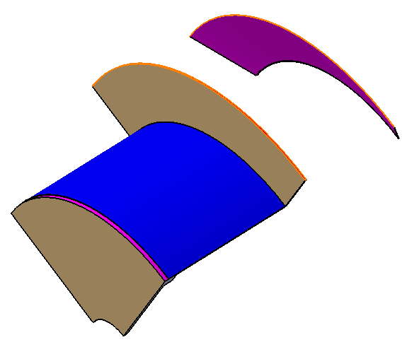
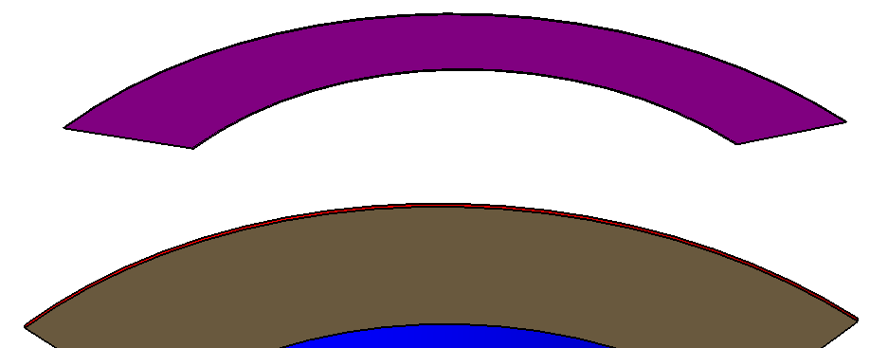
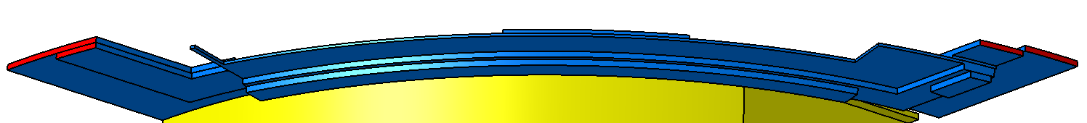
η =-3.259
Compare Analyses – Radiation Length L(Xo) – Line 2
Simplified CATIA Geometry-Modified
Gmx Geometry

Slide 12
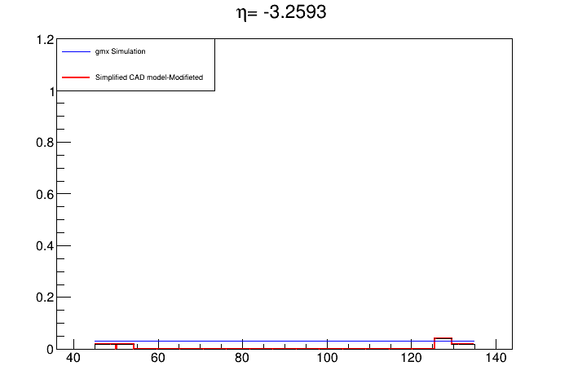
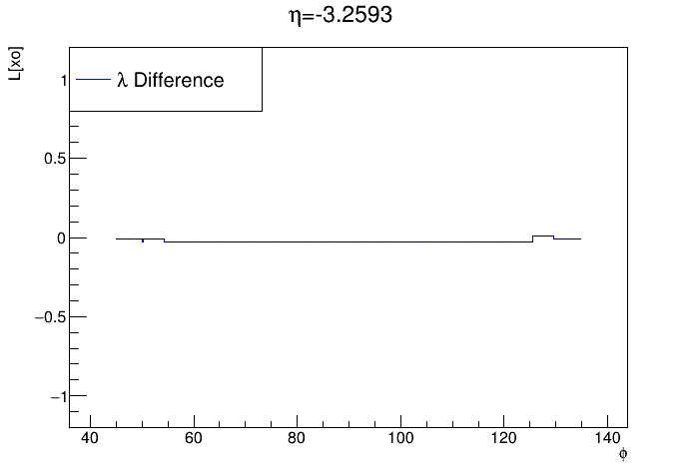
Compare Analyses – Radiation Length L(Xo) – Line 2

Slide 13


η =-5.252
Compare Analyses – Radiation Length L(Xo) – Line 3
Simplified CATIA Geometry-Modified
Gmx Geometry

Slide 14
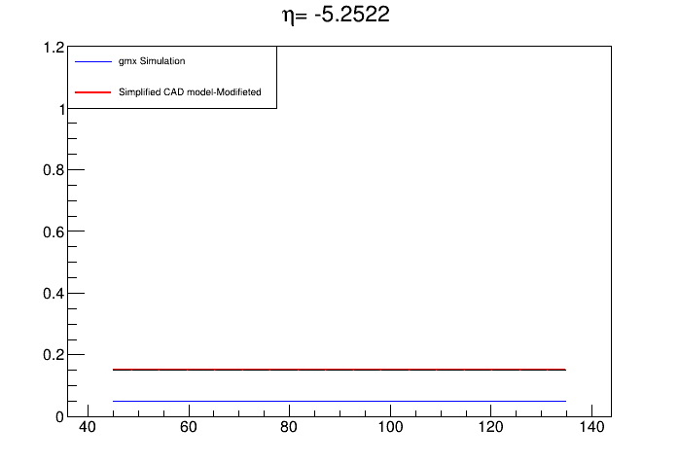
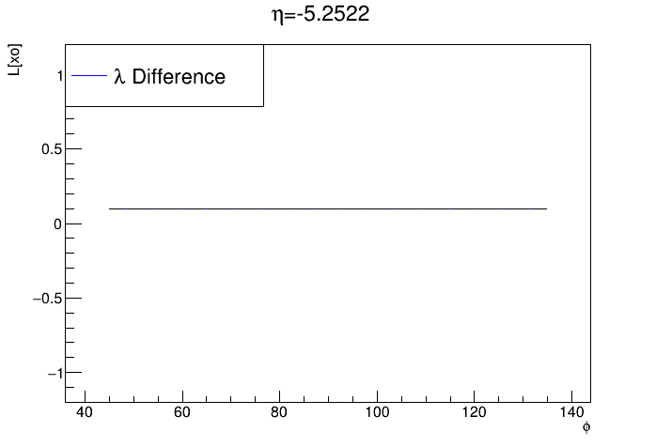
Compare Analyses – Radiation Length L(Xo) – Line 3

Slide 15
Calculation of Radiation Length (Xo)
Φ = 46
Φ = 70
Φ = 91
Φ = 124.4
-6.35 < η < - 2.15

Slide 16
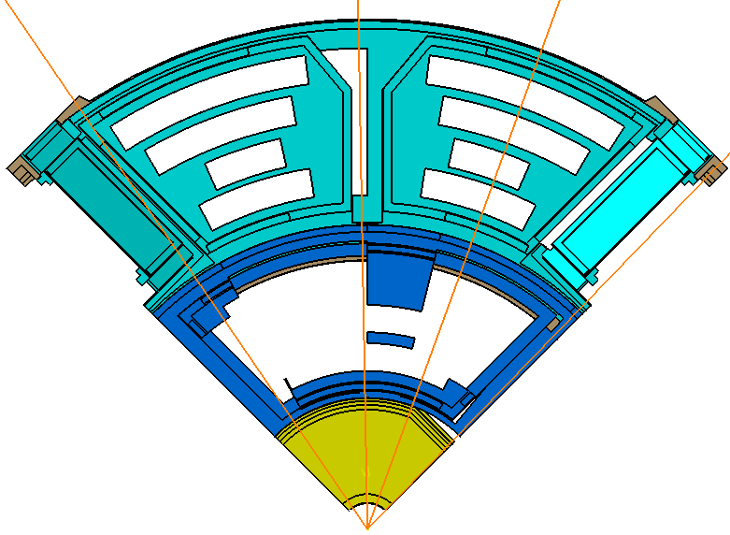
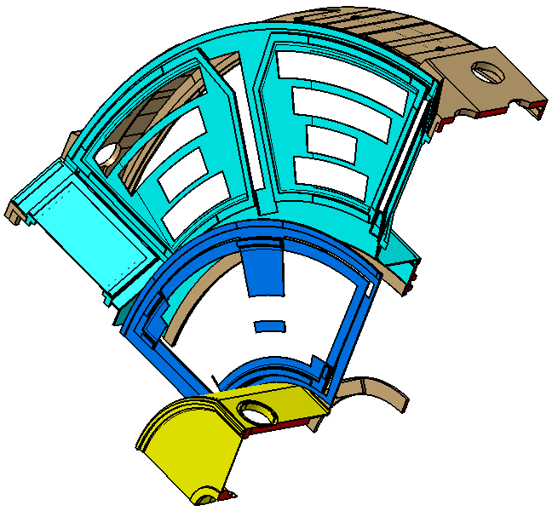
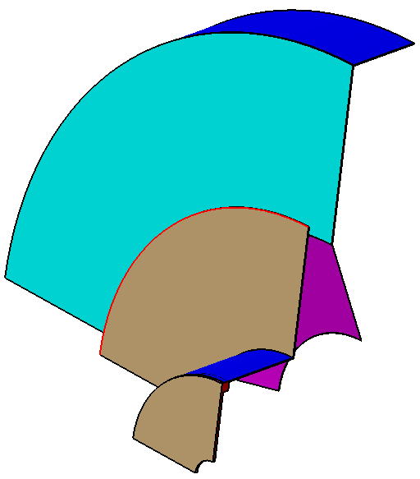
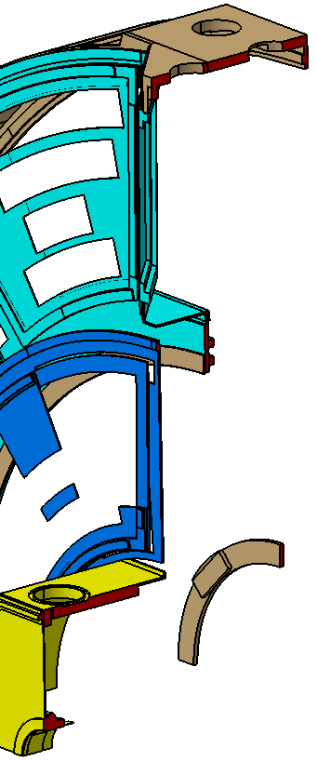
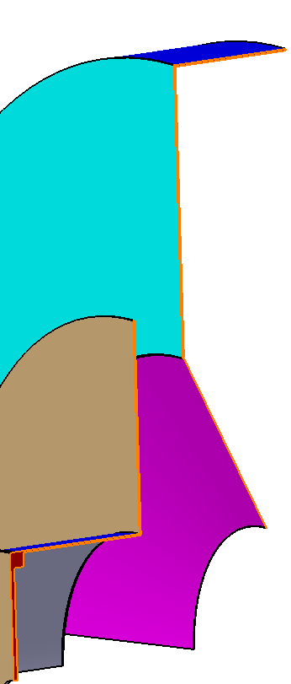
Compare Analyses – Radiation Length L(Xo) – Line 1
Φ = 46
Simplified CATIA Geometry-Modified
Gmx Geometry

Slide 17
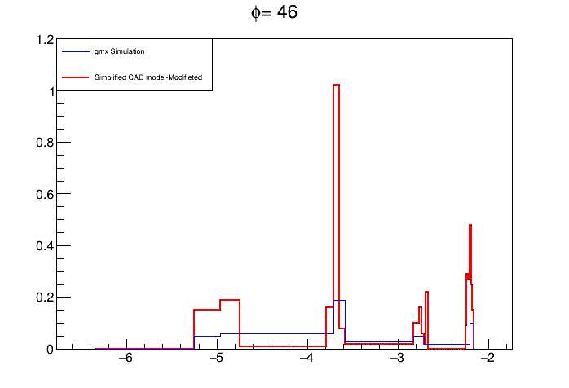
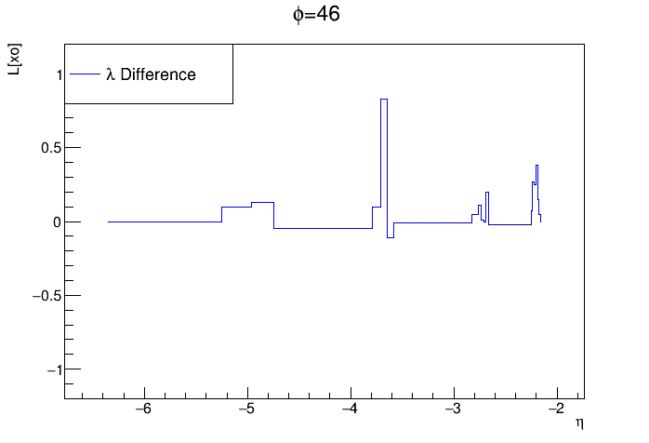
Compare Analyses – Radiation Length L(Xo) – Line 1

Slide 18
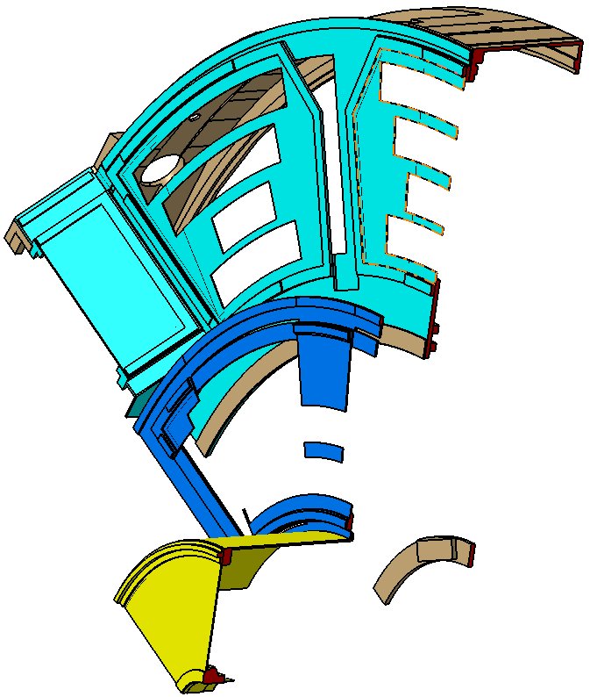
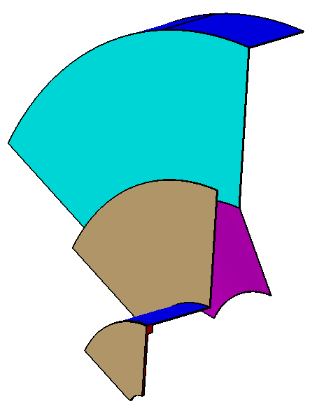
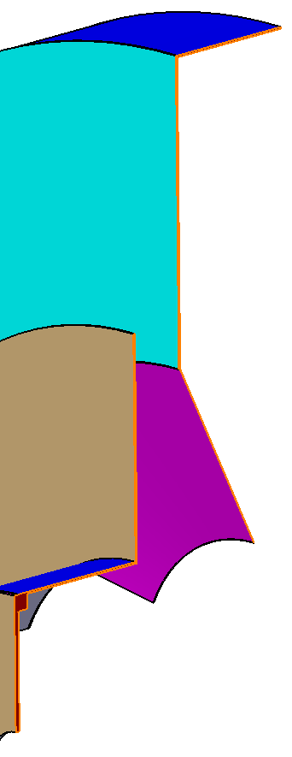
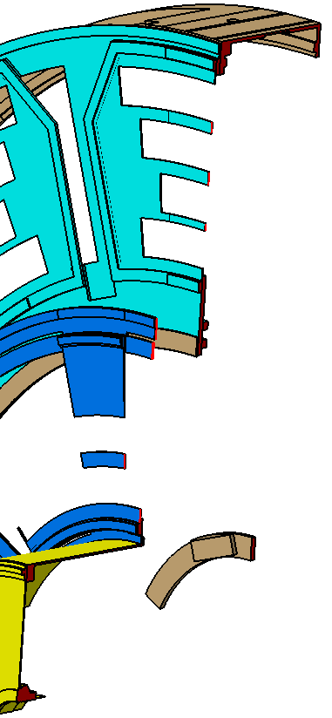
Compare Analyses – Radiation Length L(Xo) – Line 2
Φ = 70
Simplified CATIA Geometry-Modified
Gmx Geometry

Slide 19
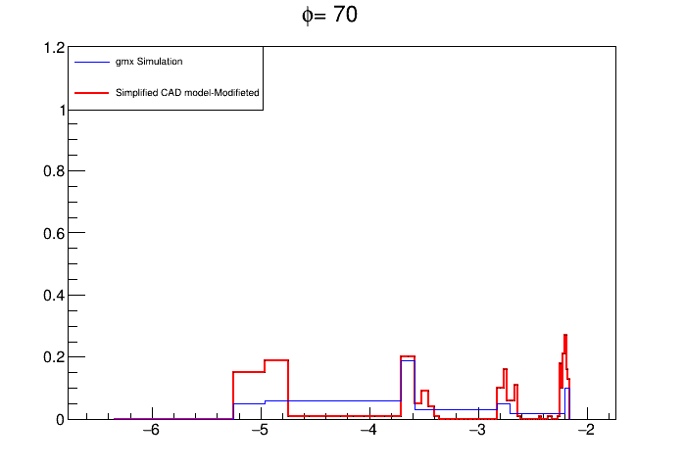
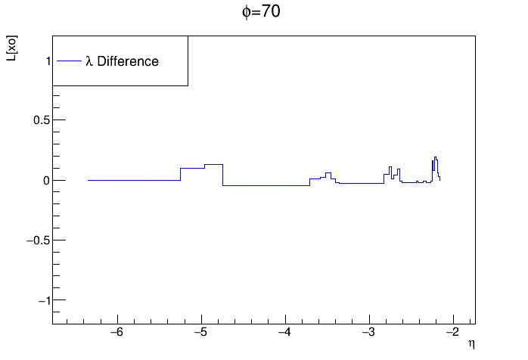
Compare Analyses – Radiation Length L(Xo) – Line 2

Slide 20
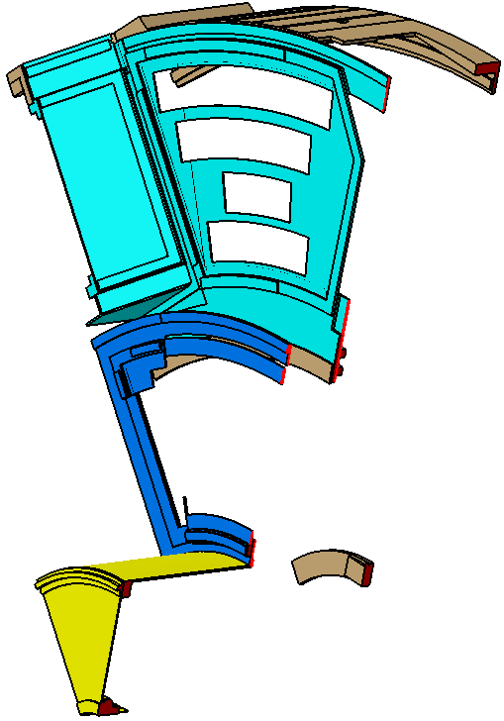
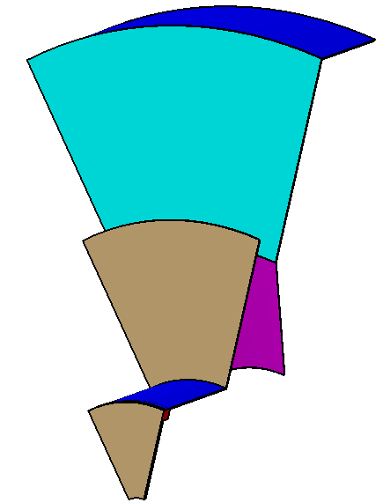
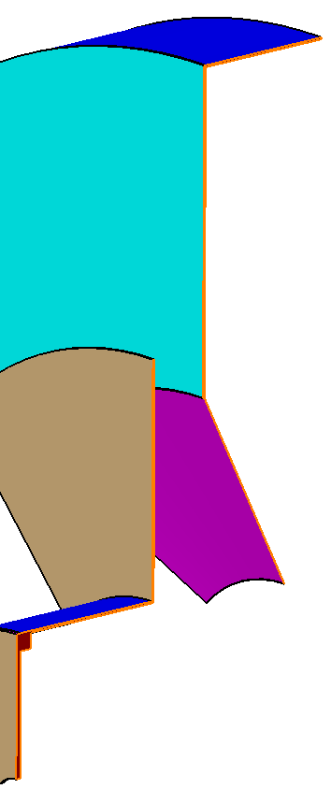
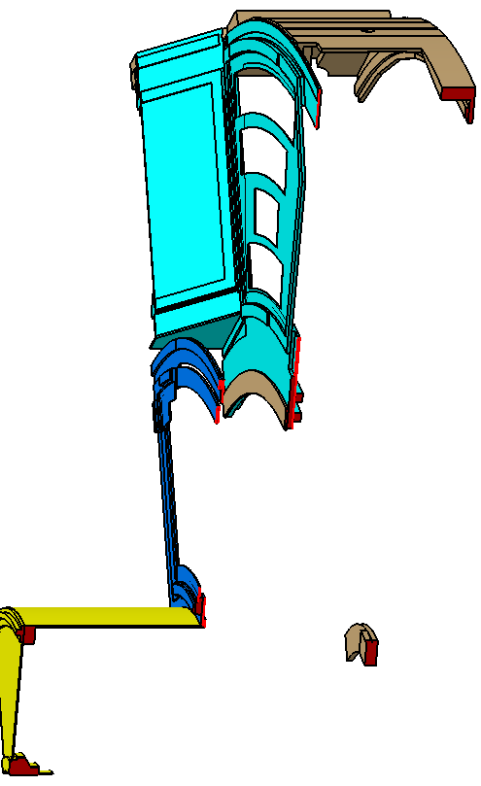
Compare Analyses – Radiation Length L(Xo) – Line 3
Φ = 91
Simplified CATIA Geometry-Modified
Gmx Geometry

Slide 21
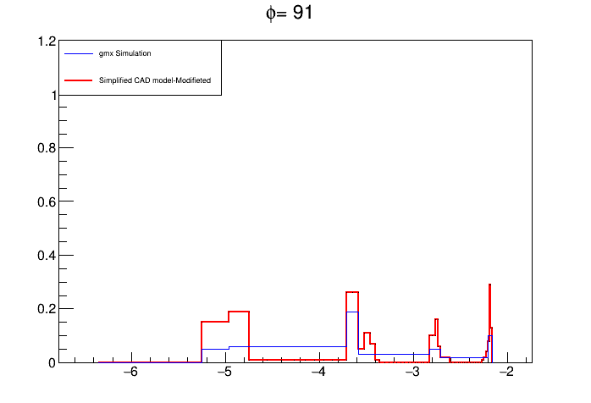
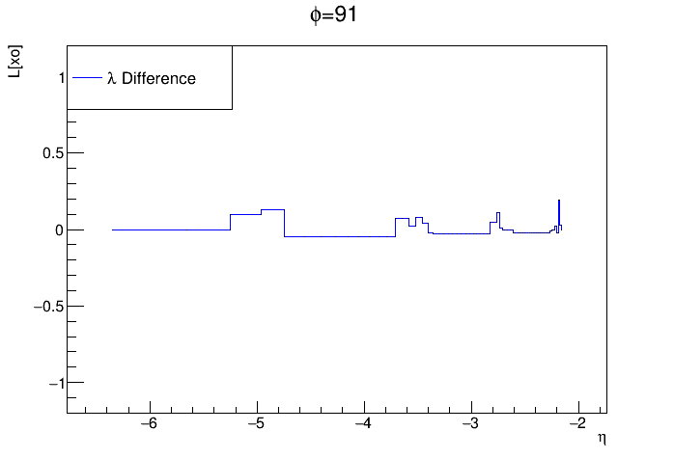
Compare Analyses – Radiation Length L(Xo) – Line 3

Slide 22
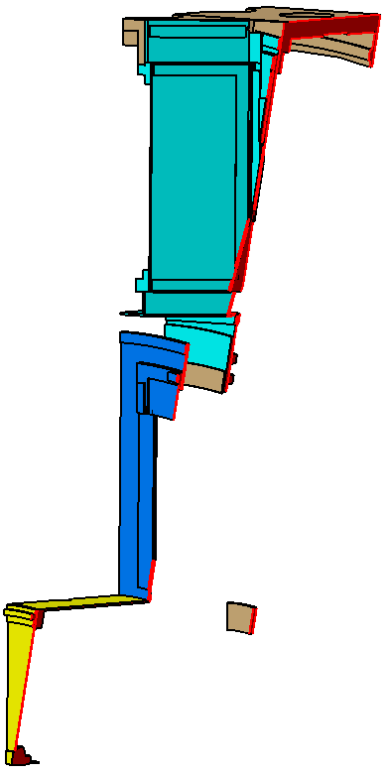
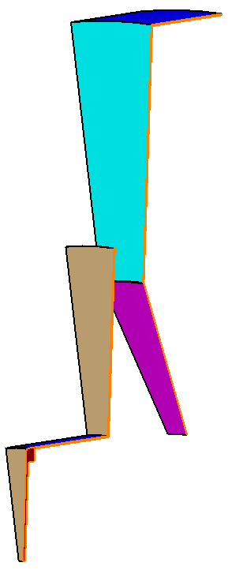
Compare Analyses – Radiation Length L(Xo) – Line 4
Φ = 124.4
Simplified CATIA Geometry-Modified
Gmx Geometry

Slide 23
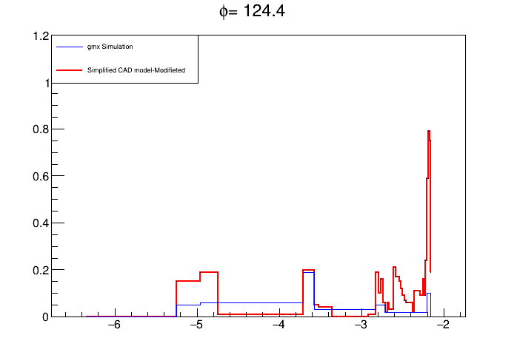
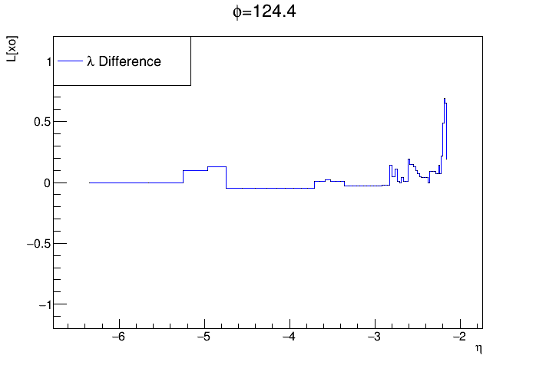
Compare Analyses – Radiation Length L(Xo) – Line 4

Slide 24
Tank you for attenyion

