Slide 1
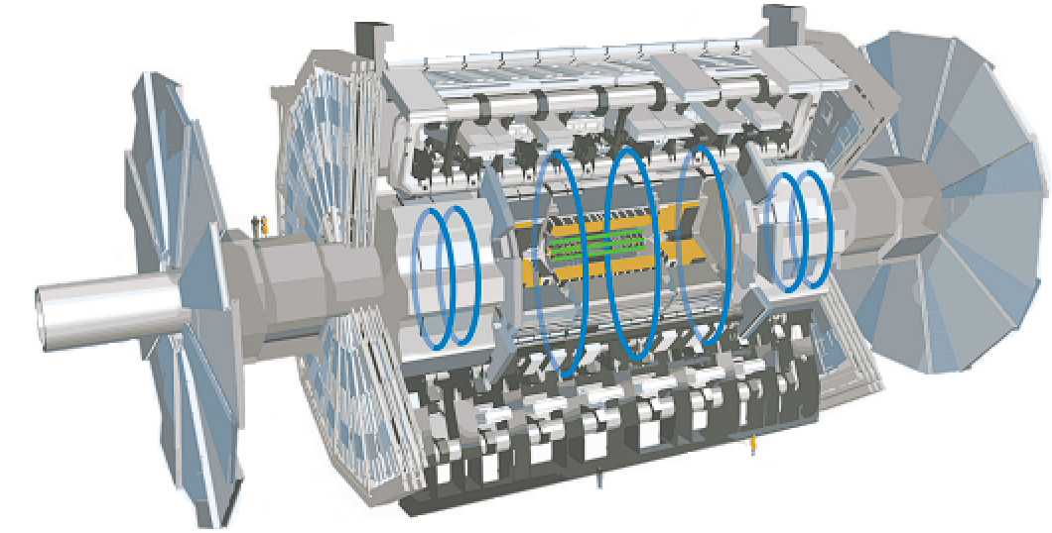



AR BOOK
Augmented Reality ATLAS fact sheet extension
Development stage presentation
Draft presentation with QR code scanner
Second PMBC'2023 Workshop
ATLAS Partners Meeting
7-10 November 2023
https://indico.cern.ch/event/1334518/
Georgian Team: Vladimir Dolinski
Notes:
Please allow me to introduce myself. I'm Vladimir Dolinski, a member of the GTU NEC team and a supporter for the merging of technology and education. Today, I stand before you as a student and the driving force behind an interesting Augmented Reality (AR) project.

Slide 2


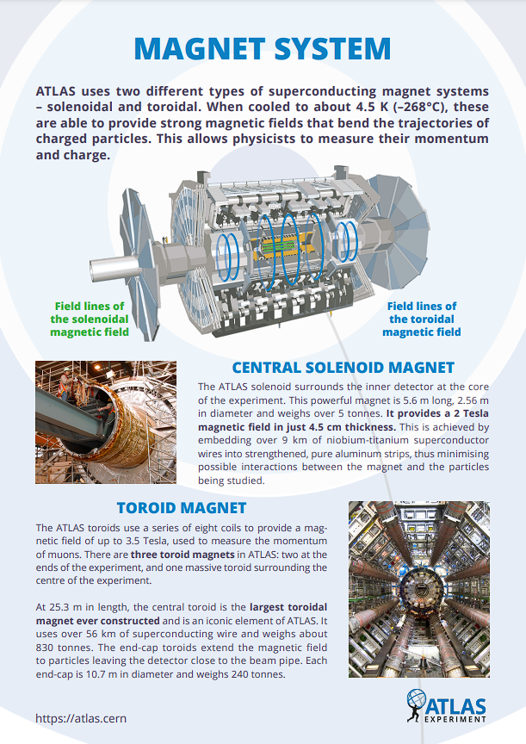
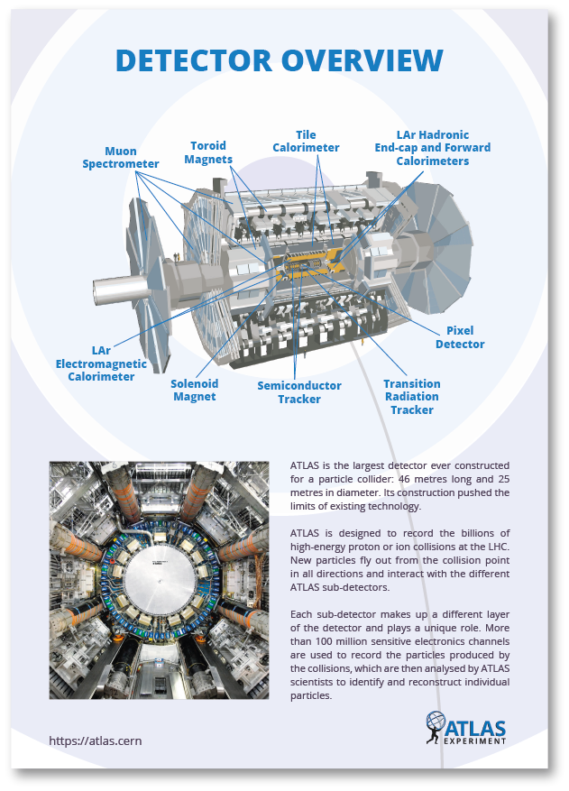
PROJECT HIGHLIGHT
HIGHLIGHTS
AGENDA
Introduction
Benefits of Web AR
AR & 8thWall
Challenges and Considerations
Project basis
Project Main Functions
Next Step
Draft presentation
QA
1
2
3
4
5
6
7
8
9
2
Notes:
Today’s agenda includes discussions about AR technology, development status, challenges, and a draft presentation of an actual project.
I'll walk you through the journey of our project, throwing light on its foundations, functions, and the technologies we use to make it all happen.

Slide 3
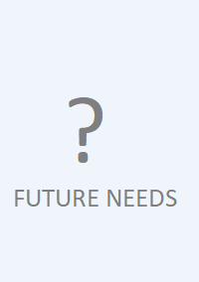
INTRODUCTION
GOALS
Be extension of numerous Fact Sheets and not only
Be simple to access from browser
Be informative
1
Who am I
Goal of AR Book
Projects
2
3
3
Notes:
The goal of this AR application is simple yet impactful:
1.Be an Extension of Numerous Fact Sheets: Our primary goal is to broaden the reach of traditional fact sheets and resources. AR technology provides an immersive environment for improving learning and comprehension. We want to bring educational content to life, making it more engaging and accessible.
2. Be Simple to Access from Your Browser: We understand the value of simplicity and accessibility. Our augmented reality application is designed to be accessed directly from your web browser. There are no app downloads or complicated installations required. All you need is internet connection.
3. Be Informative: Our AR application is about delivering meaningful content, not just the wow factor of augmented reality. We aim to provide educational and enriching experiences that bridge the digital and physical worlds. Our goal is for every interaction with the AR application to leave you with a better understanding and knowledge.

Slide 4
BENEFITS OF WEB AR
Enhanced User Engagement
Marketing Opportunities
Cost-Effectiveness
Cross-Platform Accessibility
4
Notes:
Benefits of WebAR: WebAR, or Web Augmented Reality, offers a range of compelling benefits that make it an increasingly important technology in various fields:
Enhanced User Engagement: WebAR provides an immersive and interactive experience for users, which can significantly enhance engagement with digital content and products.
Marketing Opportunities: It opens up new avenues for marketing, allowing us to create unique and engaging promotional campaigns that capture the attention of target audience which are pupils, students and other who interested in CERN and others.
Cost-Effectiveness: WebAR is often more cost-effective compared to traditional AR applications, as it doesn't require users to download and install apps; they can access AR experiences directly through web browsers.
Cross-Platform Accessibility: WebAR can run on various devices with web browsers, making it accessible to a broad audience, including smartphones, tablets, and desktop computers.

Slide 5
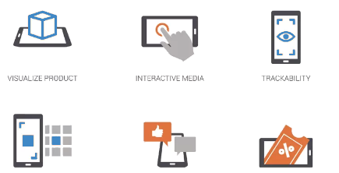

AR & 8THWALL
COMMON AR APPLICATION PIPELINE
Physical Environment
Display
Capture
Tracking
Application
Render
1
1
2
3
1
AR development process is powered by
It uses proprietary SLAM (Image Targets and World Tracking) AR engine using WebAssembly & Computer Vision
For the transformation of this tracked environment into interactive AR experiences, we rely on
2
3
5
Notes:
Our AR development process is powered by 8th Wall, a leading platform for Web Augmented Reality. They offer an advanced platform that empowers developers to create immersive augmented reality experiences on the web. Image tracking is one of 8th Wall's standout features. At its core, it uses the device's camera to capture the physical surroundings, which serves as the first stage in our AR experience.
8th Wall's advanced image tracking technologies partially based on C++ 3D game engine and Python Libraries which are then used to precisely monitor and track this environment within the application.
We use A-Frame framework to convert this tracked environment into interactive AR experiences. Our rendering powerhouse, A-Frame, brings data and instructions to life by creating digital images and 3D elements. These elements are displayed on the device screen and are smoothly layered onto the physical world.
We can develop immersive AR content by combining 8th Wall and A-Frame.

Slide 6
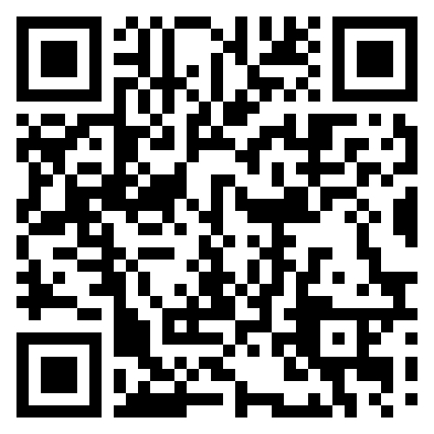
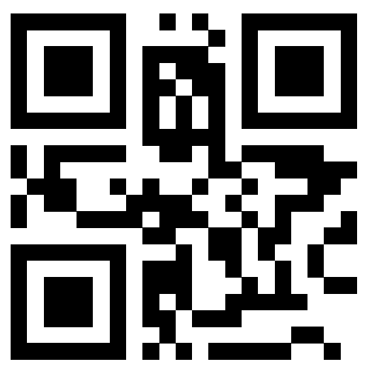
AR & 8THWALL
MINDAR (AR.JS) MAGNET SYSTEM QR CODE
MAGNET SYSTEM FACT SHEET
8THWALL MAGNET SYSTEM QR CODE
6
Notes:
I can discuss the previous 8thwall project there, as well as our initial attempt using the open-source ARJS library based on MINDAR branch modifications. Due to time constraints, I have made a video comparison for the following slide, but you may always check it out on your own at any time because it is stored in the Indico Workshop.

Slide 7
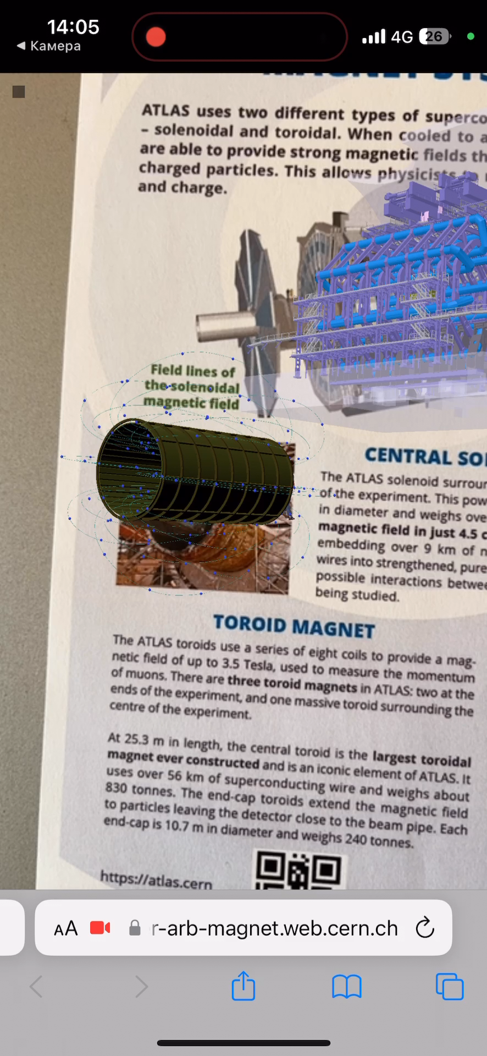
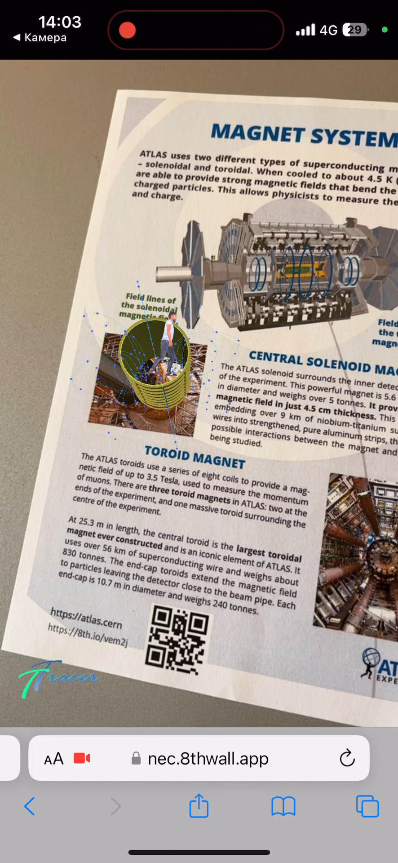
AR & 8THWALL
MINDAR (AR.JS) MAGNET SYSTEM TEST VIDEO
8THWALL MAGNET SYSTEM TEST VIDEO
7
Notes:
There, I present two identical scenes on the same device, but as you can see, the first is far worse, which is why we are looking for better alternatives for open-source applications. Sadly, any excellent open-source software eventually becomes proprietary or has flaws connected with support or community interest.

Slide 8





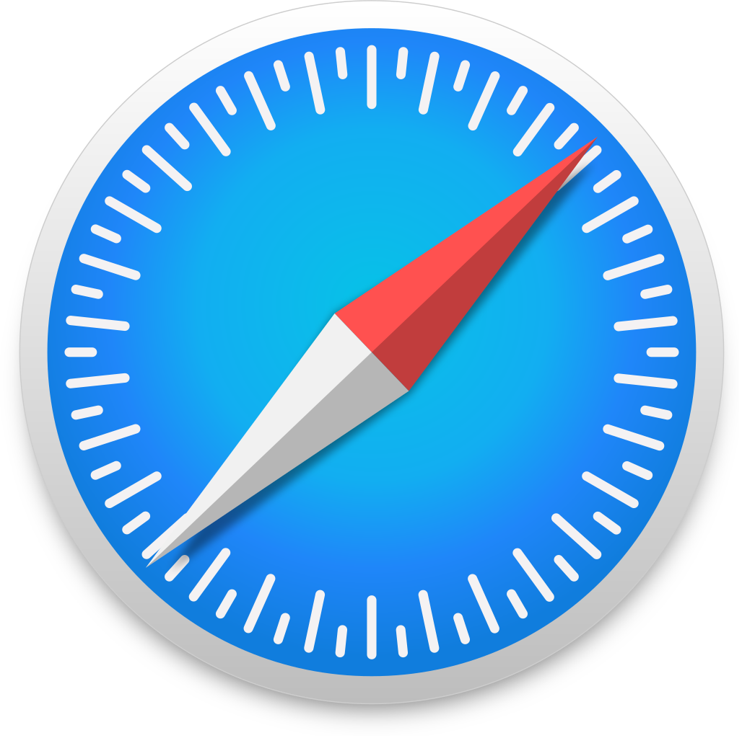

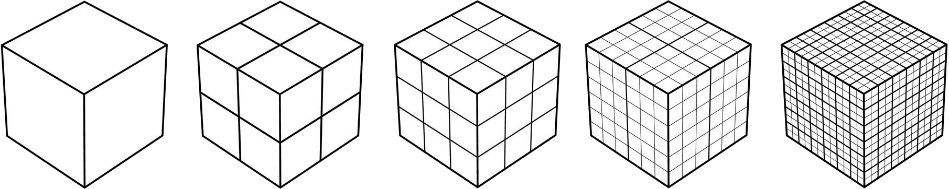






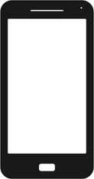
CHALLENGES AND CONSIDERATIONS
WEB AR MAIN POINTS OF INTEREST
CHART OF POPULAR WEB SOLUTIONS
1
AR.JS WebXR WebAssembly
Device compatibility
Popular Browsers
*
Most Android & iOS devices and browsers
*
Performance & Optimization
Low-poly geometry is needed for smartphones
User Experience & Drawbacks
Good usability
Environment & Hardware
Complexity
Features 3/10 6.5/10 8.5/10
8
Notes:
Our journey into the world of Web Augmented Reality is marked by two significant elements - the transition from a Software as a Service (SaaS) prototype to a local, open-source solution and the challenges that accompany this transformation.
Ensuring device compatibility across Android and iOS systems is paramount, as each system boasts its set of incompatible APIs, demanding functions to be written separately. Performance optimization is another focal point, as smartphones have inherent limitations that necessitate thoughtful resource management. Crafting user-friendly experiences in the realm of 3D UI elements, while essential, can be complex.
We navigate these challenges with a preference for open-source solutions that empower us to build a sustainable and cost-effective solution.

Slide 9
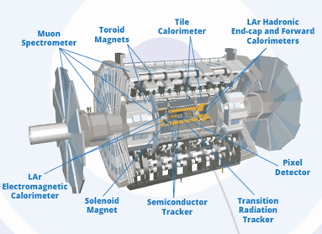
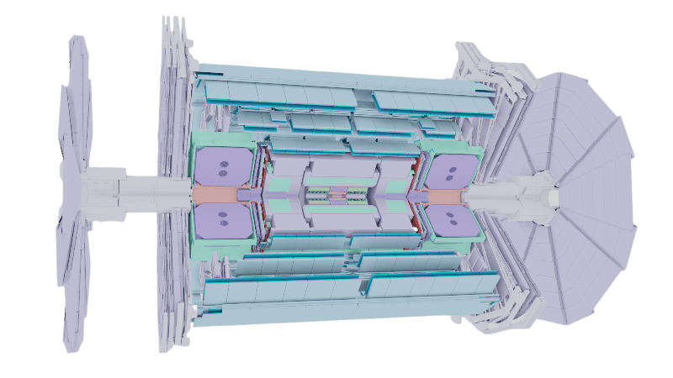
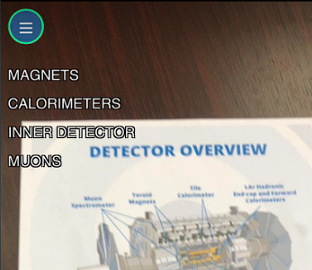
PROJECT BASIS
SHOW ATLAS DETECTOR GEOMETRY IN AR
PREVIEW
MENU BUTTONS
We need to show:
The geometry of Detector Subsystems
Menu
AR APP of Detector Overview contains MENU button with 4 main groups with multiple geometries to be able select them separately.
1
2
9
Notes:
Detector overview is our second project. This application's goal is to show the detector's main subsystems and gather more details (descriptions) about a selected subsystem to supplement the fact sheet.

Slide 10
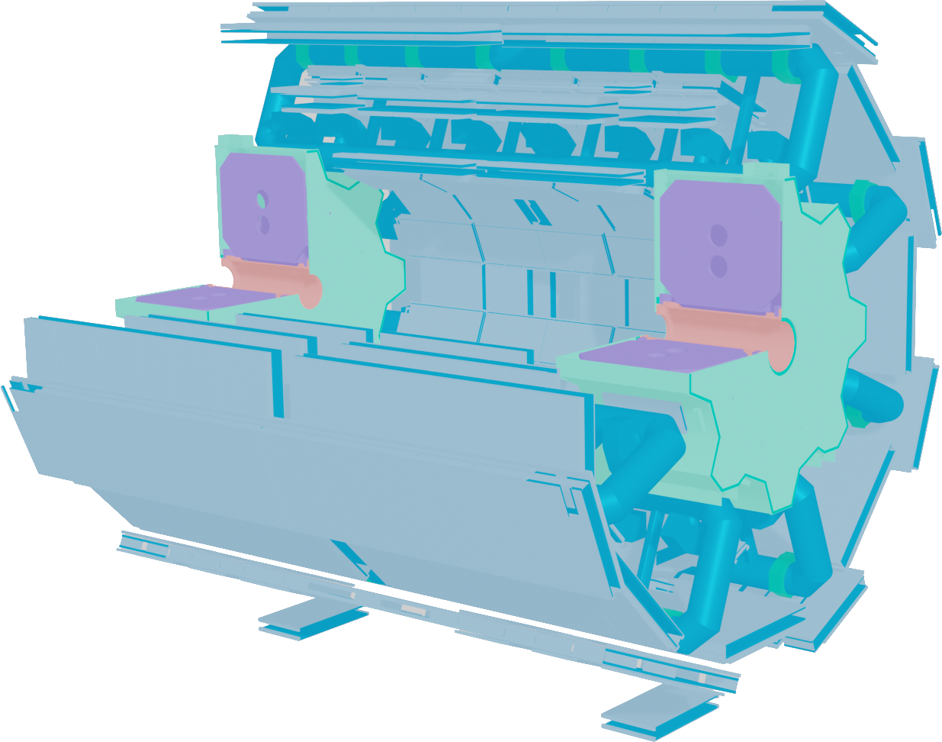
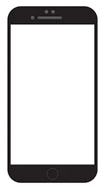
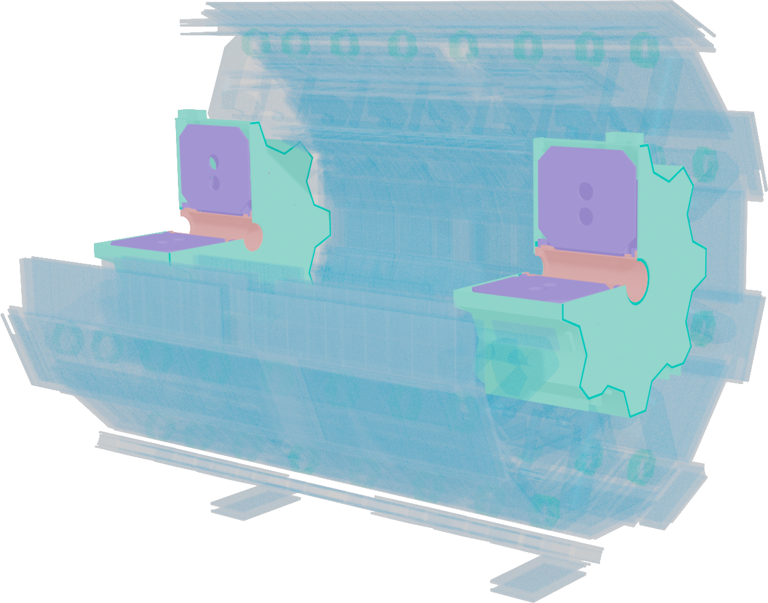
PROJECT BASIS
AR PROJECT GOALS
1
SELECT SUBSYSTEM ON CLICK
MAKE VISIBLE WINDOW WITH DETECTOR SUBSYSTEM AFTER SELECTION
2
ENDCAPS DESCRIPTION
10

Slide 11
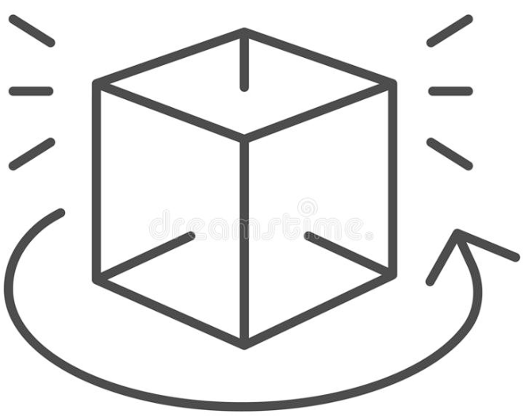


PROJECT MAIN FUNCTIONS
BUTTON-BOUND FUNCTIONS
MAIN BUTTON
MENU BUTTON HAVE GEOMETRY SHOW/HIDE FUNCTION, TO NOT BLOCK VIEW;
&FULLSCREEN ENABLE(works in chrome, wip)
MENU BUTTON
GESTURE CONTROL FUNCTIONS
WINDOW POP-UP WITH CORRESPONDING TEXT
ROTATE
CLICK
SCALE
11
Notes:
The primary features of the project include a menu button that categorizes detector subsystems and gesture control features like rotation, touch screen click response, and two-finger scaling.

Slide 12
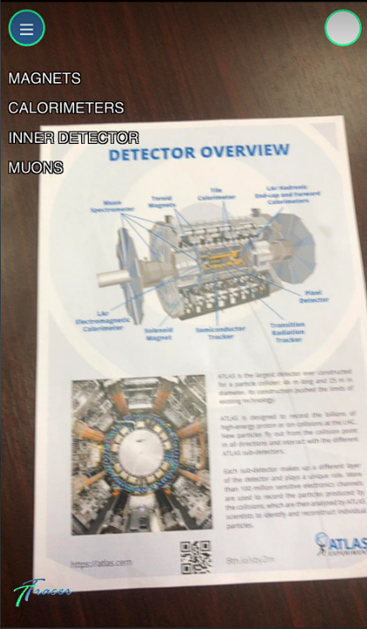
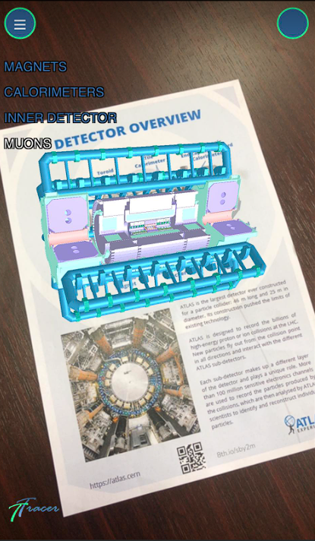
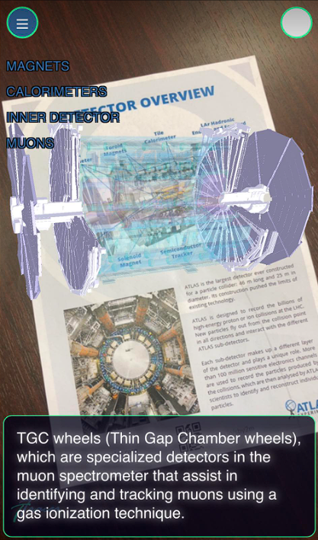
PROJECT MAIN FUNCTIONS
PREVIEW
FIRST START
GEOMETRY SELECTION
CLICKING ON GEOMETRY
12
Notes:
As you can see from the little preview, I have a Heads-up display with text in the left corner. You can click on some of them to reveal the geometry, and you can also click on geometry elements to learn more about them.

Slide 13
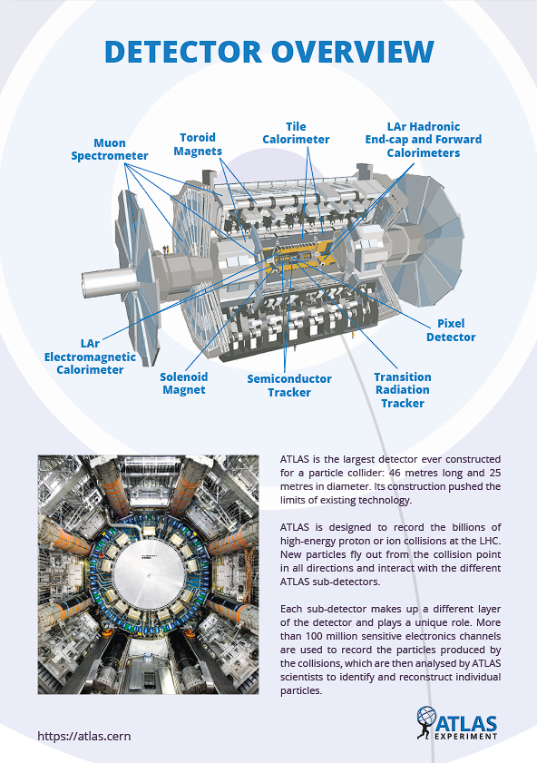
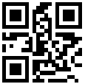
DRAFT PRESENTATION
QR Code
13

Slide 14
END OF PRESENTATION
vladimir.dolinski@cern.ch
THANK
YOU
Comments are Welcome
vladimir.dolinski@cern.ch
14

