Slide 1

VideoMAE For Emotion Recognition
This Project is funded by the European Union HORIZON
EUROPE - WIDERA-2021-ACCESS-03 (Twinning ) programme
under the grant agreement No. 101078950
Natia Kukhilava
Tatia Tsmindashvili
Rapael Kalandadze
Laura Ferrari
Valeryia Strizhkova

Slide 2
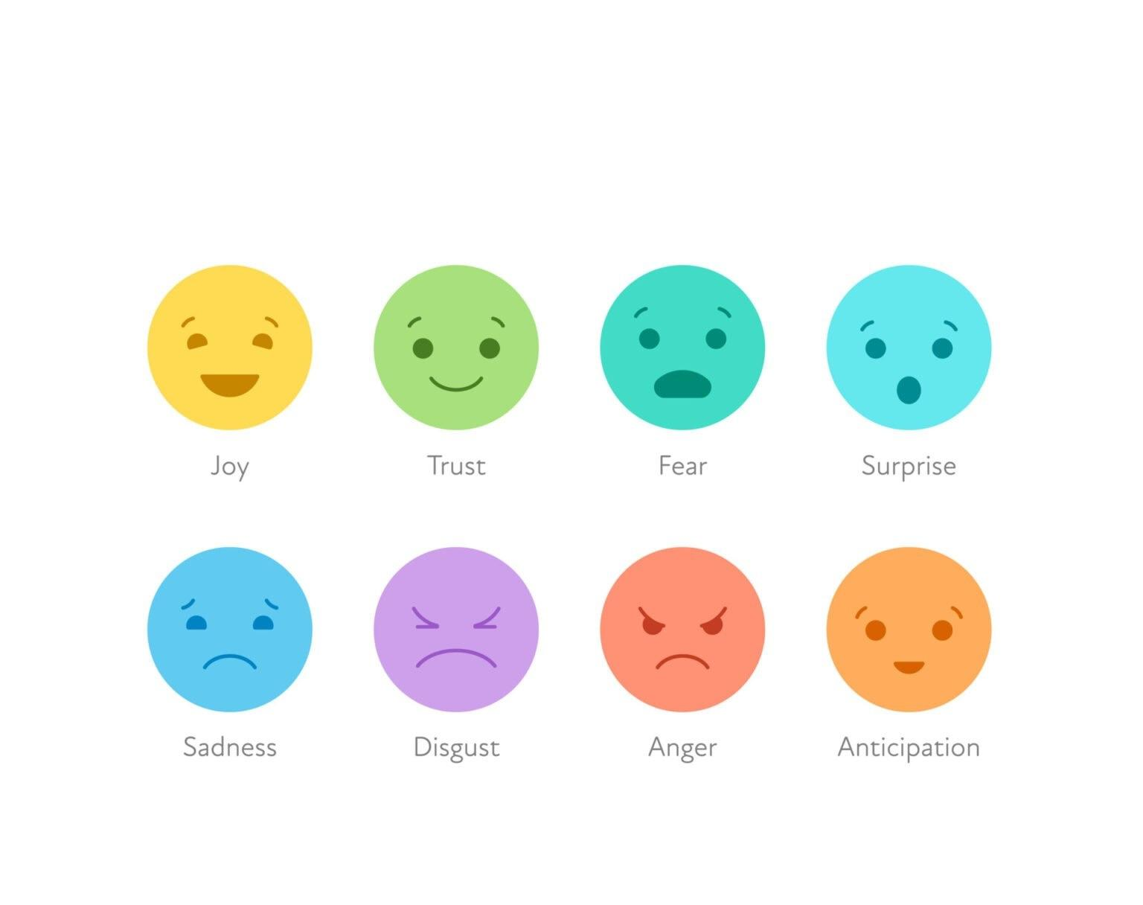

Slide 3
Research Goal
Try VideoMAE on larger videos
Scaling VideoMAE
Compare SSL and SL pretraining strategies

Slide 4
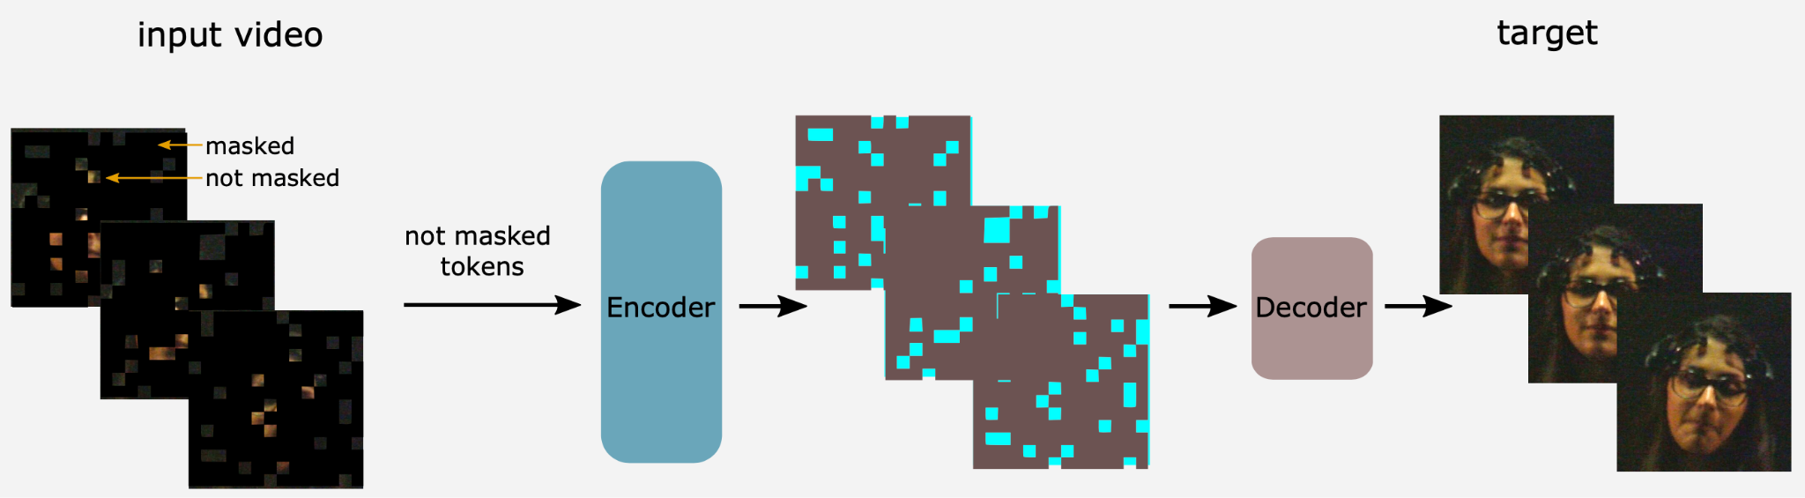
VideoMAE
Self Supervised Video pre-training Method
Inspiration
Adaptation to Video - masks random “cubes”

Slide 5
VideoMAE - Challenges
Temporal Redundancy - easy to guess missing part without understanding video’s content
Temporal Correlation - masked in one frame, visible in the next

Slide 6
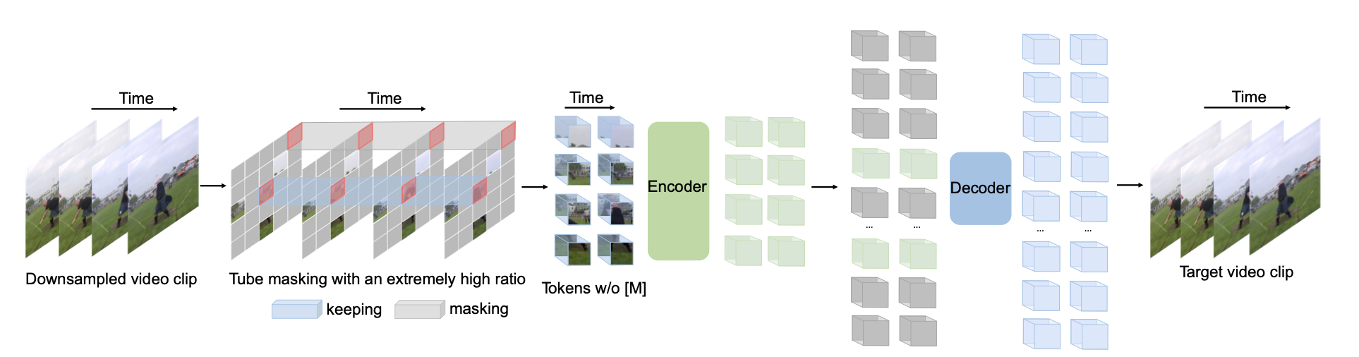
VideoMAE - Strategic Masking
Temporal Redundancy - high masking ratio
Temporal Correlation - tube masking strategy

Slide 7
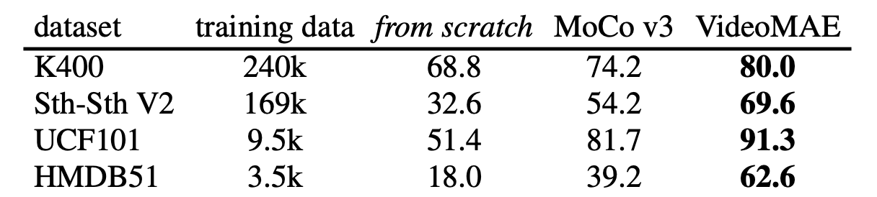
VideoMAE - Strategic Masking
Comparisons with the results of previous self-supervised pre-training methods on different datasets:

Slide 8
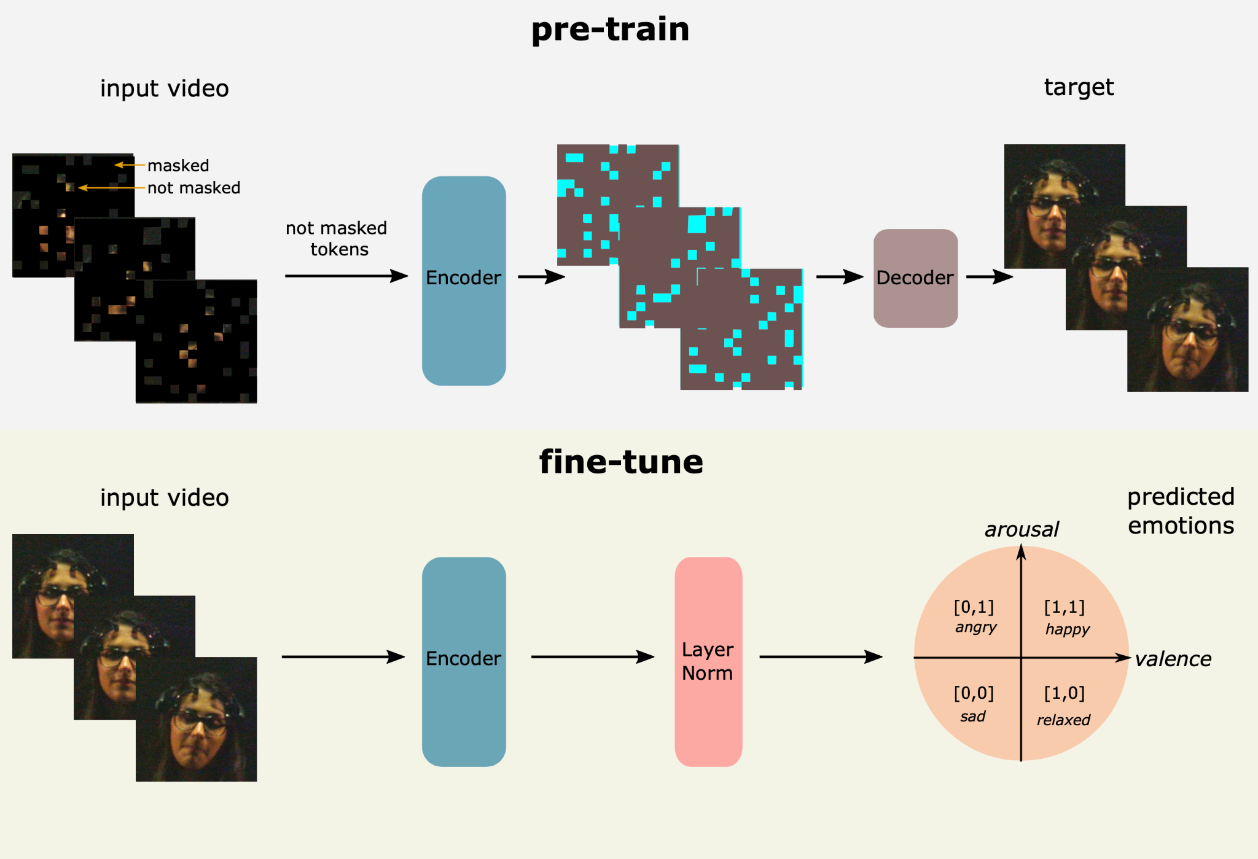
Pipeline

Slide 9
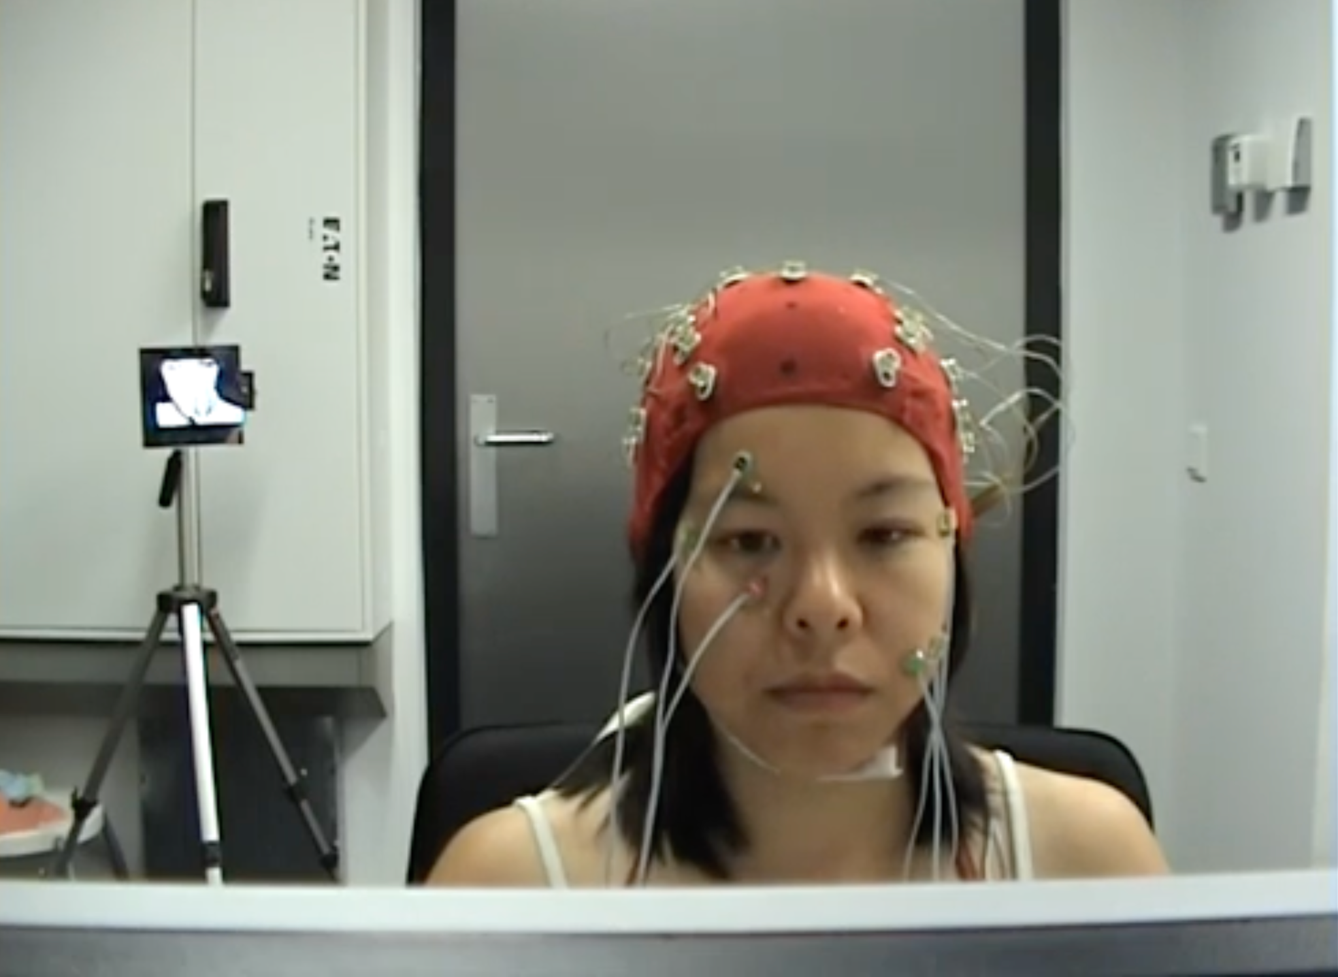
Datasets - DEAP
22 Participants
40 Videos
Video length - 1 minute

Slide 10
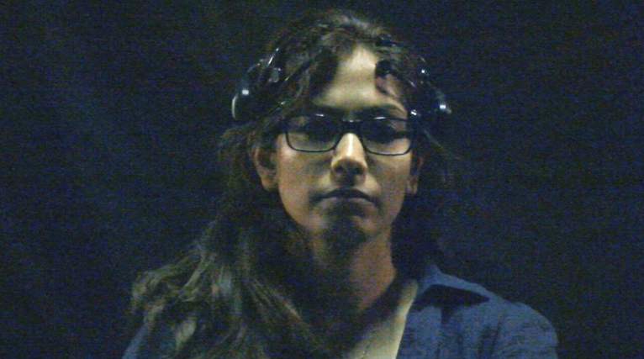
Datasets - AMIGOS
40 Participants
16 Videos
Video length - 2-3 minute

Slide 11
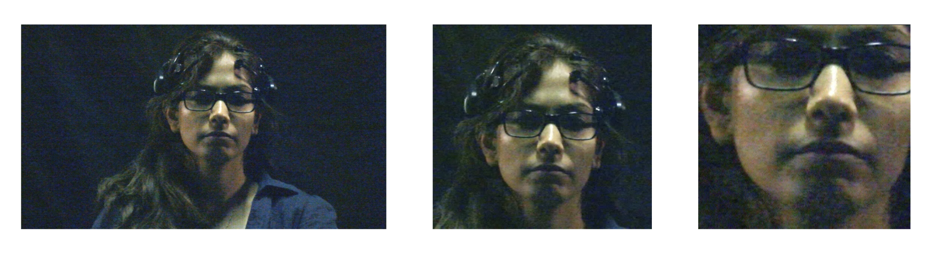
Cropping Strategy
Larger crop produces 7-9% higher accuracy and weighted F1 score

Slide 12
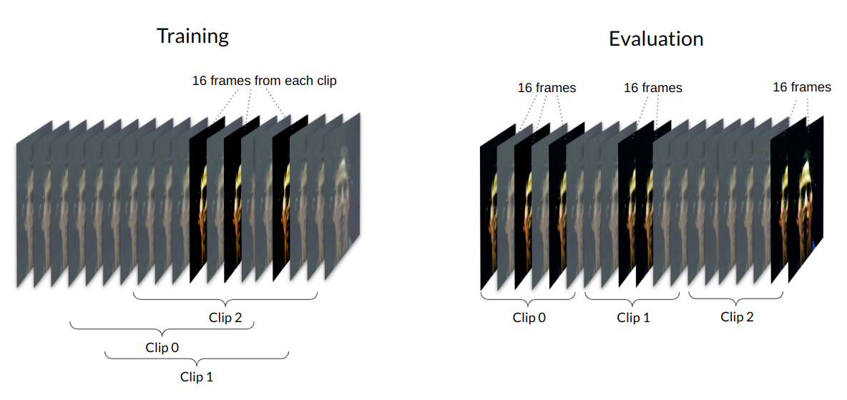
Data Input

Slide 13
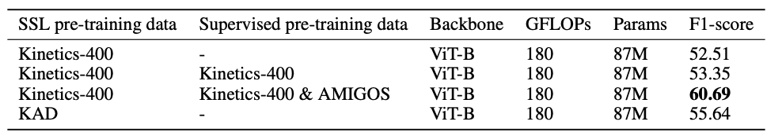
Experiments - DEAP
Framework: https://github.com/EmotionLab/EmotionVMAE

Slide 14
Future Work
Try ViT-L Backbone for model scaling
Try without weights
Finalize and Publish Framework

Slide 15
Questions?

