Slide 1



On the Mathematical Aspects of the Numerical Calculation of Engineering Constructions Weakened by Cracks
M. Kublashvili (MICM/GTU, Georgia), Z. Sanikidze (MICM/GTU, Georgia),
T. Saginadze (MICM/GTU, Georgia), M. Kublashvili (MICM/GTU, Georgia),
This Project is funded by the European Union
HORIZON EUROPE - WIDERA-2021-ACCESS-03
(Twinning ) programme under the grant agreement No. 101078950

Slide 2
Introduction
The actual strength of solids essentially depends on the defects in the structure. In real materials, there are always numerous micro defects of different types. When subjected to external loads, these defects can develop, leading to the formation of cracks that may ultimately result in local or complete rupture of the material. This phenomenon is particularly characteristic of brittle or quasi-brittle deformable solid bodies. The study of structural elements and the strength of structures with cracks is of great interest to many well-known researchers.
One of the key points investigations in these works is the analysis of stress distribution within bodies during the occurrence of cracks and holes. Thus far, solutions for stress-strain state of bodies with various types of cracks have primarily been addressed within the framework of linear elasticity. These solutions often pertain to bodies with a single crack or a specific arrangement of cracks, and the employed solution methods are limited to certain classes of problems.
The primary tool of said investigation will be singular integral equations.

Slide 3
Introduction
Brittle fracture mechanics primarily centers on the study of the stress-strain state of cracked bodies in the vicinity of crack tips or other types of defects. Additionally, it involves the criteria for crack propagation in deformable bodies subjected to external forces. The foundation of brittle fracture mechanics can be traced back to Griffith's pioneering work, with subsequent development by G. Irvin, E. Orovan, and others. Numerous new studies have emerged in this field, with their numbers increasing each year. Notably, significant progress has been made in understanding the stress-strain state of plates weakened by cracks.
The study of stress states along cracks dates to as early as 1909 when Kolosov examined an evenly stretched plane weakened by an elliptical hole. England subsequently considered the same problem with various loads and elliptical holes. Muskhelishvili addressed the issue of weakened plane tension. Of particular interest in fracture mechanics is the study of stress and displacement distribution in the vicinity of crack tips.

Slide 4
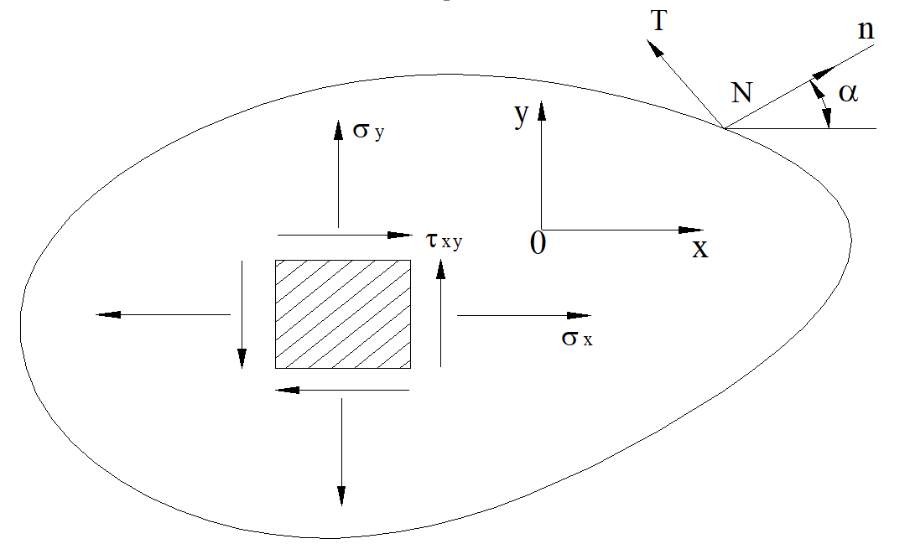
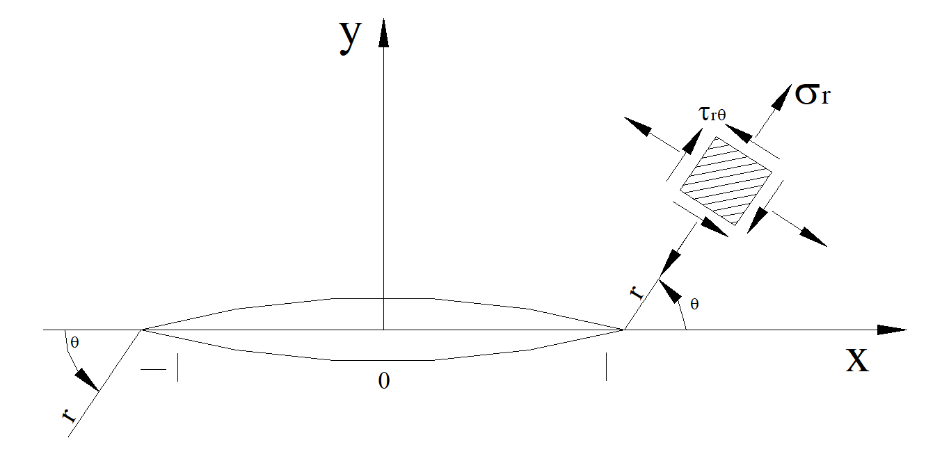
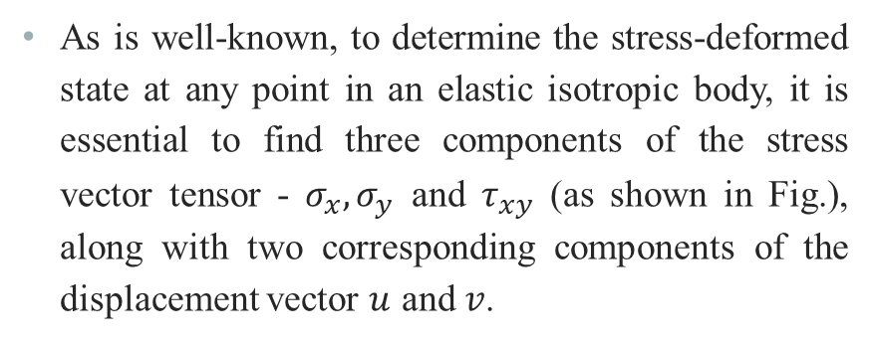
Stress-Strain Analysis of an Elastic Plane with a Linear Cut
As is well-known, to determine the stress-deformed state at any point in an elastic isotropic body, it is essential to find three components of the stress vector tensor - $σ_{x},σ_{y}$ and $τ_{xy}$ (as shown in Fig.), along with two corresponding components of the displacement vector $u$ and $v$.

Slide 5
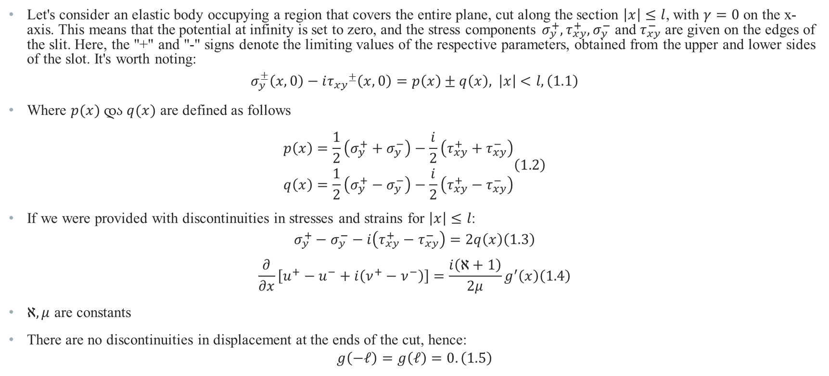
Setting up the Problem and Formulating it as an Integral Equation
Let's consider an elastic body occupying a region that covers the entire plane, cut along the section $\left|x\right|≤l$, with $γ=0$ on the x-axis. This means that the potential at infinity is set to zero, and the stress components $σ_{y}^{+},τ_{xy}^{+},σ_{y}^{−}$ and $τ_{xy}^{−}$ are given on the edges of the slit. Here, the "+" and "-" signs denote the limiting values of the respective parameters, obtained from the upper and lower sides of the slot. It's worth noting:
$$\begin{aligned}σ_{y}^{±}\left(x,0\right)−i{τ_{xy}}^{±}\left(x,0\right)=p\left(x\right)±q\left(x\right), \left|x\right|<l, \#\left(1.1\right)\end{aligned}$$
Where $p(x)$ და $q(x)$ are defined as follows
$$\begin{aligned}\begin{matrix}p\left(x\right)=\frac{1}{2}\left(σ_{y}^{+}+σ_{y}^{−}\right)−\frac{i}{2}\left(τ_{xy}^{+}+τ_{xy}^{−}\right) \\ q\left(x\right)=\frac{1}{2}\left(σ_{y}^{+}−σ_{y}^{−}\right)−\frac{i}{2}\left(τ_{xy}^{+}−τ_{xy}^{−}\right)\end{matrix}\#\#\left(1.2\right)\end{aligned}$$
If we were provided with discontinuities in stresses and strains for $\left|x\right|≤l$:
$$\begin{aligned}σ_{y}^{+}−σ_{y}^{−}−i\left(τ_{xy}^{+}−τ_{xy}^{−}\right)=2q\left(x\right)\#\left(1.3\right)\end{aligned}$$
$$\begin{aligned}\frac{∂}{∂x}\left[u^{+}−u^{−}+i\left(ν^{+}−ν^{−}\right)\right]=\frac{i\left(ℵ+1\right)}{2μ}g^{′}\left(x\right)\#\left(1.4\right)\end{aligned}$$
$ℵ,μ$ are constants
There are no discontinuities in displacement at the ends of the cut, hence:
$$\begin{aligned}g\left(−𝓁\right)=g\left(𝓁\right)=0.\#\left(1.5\right)\end{aligned}$$

Slide 6
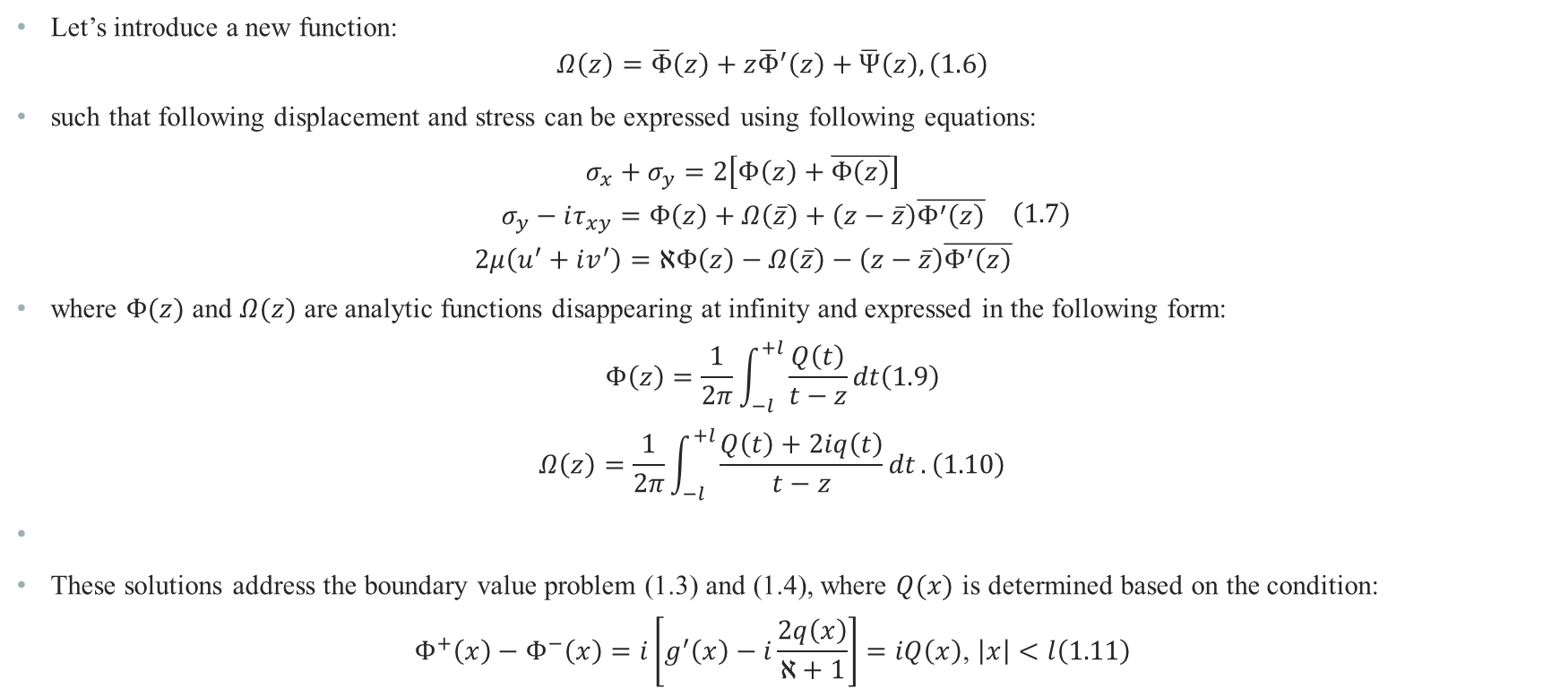
Setting up the Problem and Formulating it as an Integral Equation
Let’s introduce a new function:
$$\begin{aligned}Ω\left(z\right)=\overline{Φ}\left(z\right)+z{\overline{Φ}}^{′}\left(z\right)+\overline{Ψ}\left(z\right),\#\left(1.6\right)\end{aligned}$$
such that following displacement and stress can be expressed using following equations:
$$\begin{aligned}\begin{matrix}σ_{x}+σ_{y}=2\left[Φ\left(z\right)+\overline{Φ\left(z\right)}\right] \\ σ_{y}−iτ_{xy}=Φ\left(z\right)+Ω\left(\overline{z}\right)+\left(z−\overline{z}\right)\overline{Φ^{′}\left(z\right)} \\ 2μ\left(u^{′}+iv^{′}\right)=ℵΦ\left(z\right)−Ω\left(\overline{z}\right)−\left(z−\overline{z}\right)\overline{Φ^{′}\left(z\right)}\end{matrix}\#\left(1.7\right)\end{aligned}$$
where $Φ(z)$ and $Ω(z)$ are analytic functions disappearing at infinity and expressed in the following form:
$$\begin{aligned}Φ\left(z\right)=\frac{1}{2π}\int_{−l}^{+l}{\frac{Q\left(t\right)}{t−z}}dt\#\left(1.9\right)\end{aligned}$$
$$\begin{aligned}Ω\left(z\right)=\frac{1}{2π}\int_{−l}^{+l}{\frac{Q\left(t\right)+2iq\left(t\right)}{t−z}dt}.\#\left(1.10\right)\end{aligned}$$
These solutions address the boundary value problem (1.3) and (1.4), where $Q(x)$ is determined based on the condition:
$$\begin{aligned}Φ^{+}\left(x\right)−Φ^{−}\left(x\right)=i\left[g^{′}\left(x\right)−i\frac{2q\left(x\right)}{ℵ+1}\right]=iQ\left(x\right)\text{, }\left|x\right|<l\#\left(1.11\right)\end{aligned}$$

Slide 7
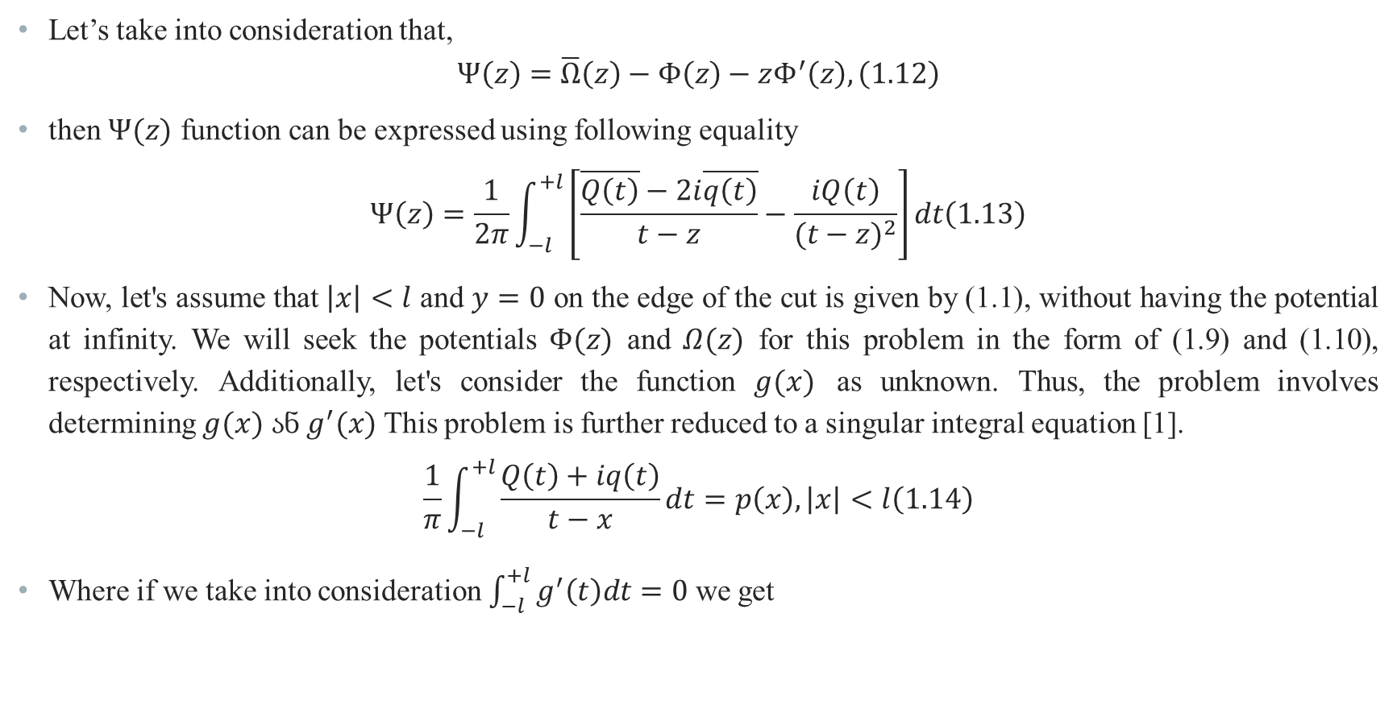
Setting up the Problem and Formulating it as an Integral Equation
Let’s take into consideration that,
$$\begin{aligned}Ψ\left(z\right)=\overline{Ω}\left(z\right)−Φ\left(z\right)−zΦ^{′}\left(z\right),\#\left(1.12\right)\end{aligned}$$
then $Ψ(z)$ function can be expressed using following equality
$$\begin{aligned}Ψ\left(z\right)=\frac{1}{2π}\int_{−l}^{+l}{\left[\frac{\overline{Q\left(t\right)}−2i\overline{q\left(t\right)}}{t−z}−\frac{iQ\left(t\right)}{(t−z)^{2}}\right]}dt\#\left(1.13\right)\end{aligned}$$
Now, let's assume that $\left|x\right|<l$ and $y=0$ on the edge of the cut is given by (1.1), without having the potential at infinity. We will seek the potentials $Φ(z)$ and $Ω(z)$ for this problem in the form of (1.9) and (1.10), respectively. Additionally, let's consider the function $g(x)$ as unknown. Thus, the problem involves determining $g(x)$ ან $g^{′}(x)$ This problem is further reduced to a singular integral equation [1].
$$\begin{aligned}\frac{1}{π}\int_{−l}^{+l}{\frac{Q\left(t\right)+iq\left(t\right)}{t−x}}dt=p\left(x\right), \left|x\right|<l\#\left(1.14\right)\end{aligned}$$
Where if we take into consideration $\int_{−l}^{+l}{g^{′}\left(t\right)dt}=0$ we get

Slide 8
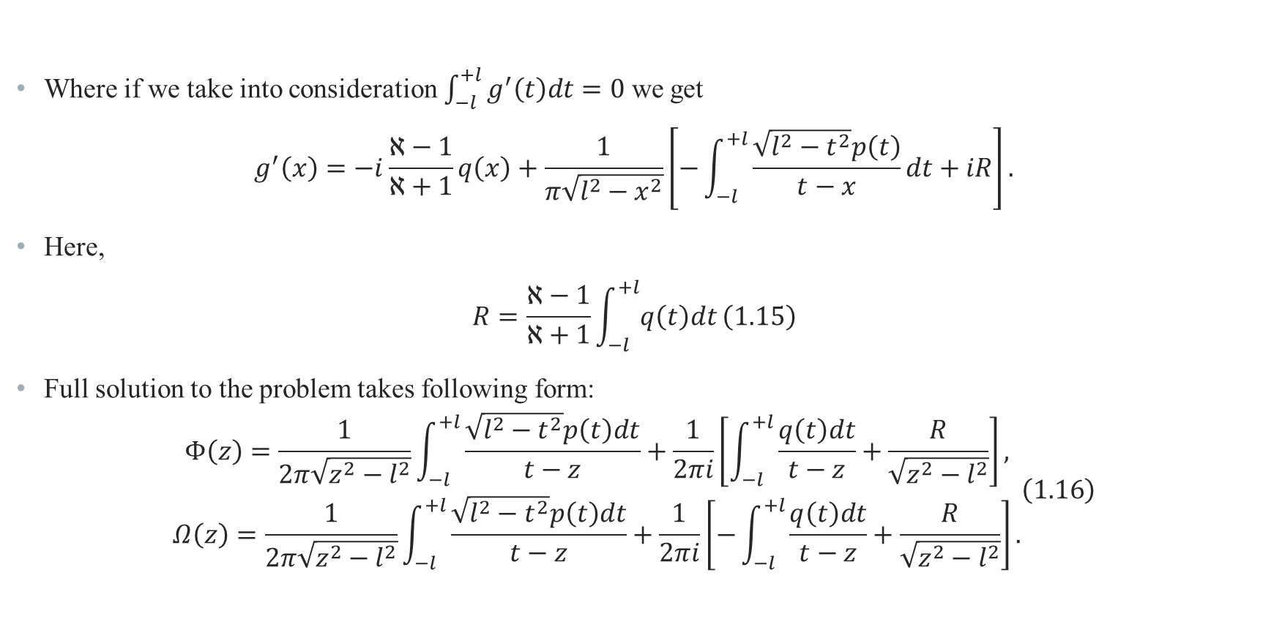
Setting up the Problem and Formulating it as an Integral Equation
Where if we take into consideration $\int_{−l}^{+l}{g^{′}\left(t\right)dt}=0$ we get
$$g^{′}\left(x\right)=−i\frac{ℵ−1}{ℵ+1}q\left(x\right)+\frac{1}{π\sqrt{l^{2}−x^{2}}}\left[−\int_{−l}^{+l}{\frac{\sqrt{l^{2}−t^{2}}p\left(t\right)}{t−x}dt+iR}\right].$$
Here,
$$\begin{aligned}R=\frac{ℵ−1}{ℵ+1}\int_{−l}^{+l}{q\left(t\right)dt}\#\left(1.15\right)\end{aligned}$$
Full solution to the problem takes following form:
$$\begin{aligned}\begin{matrix}Φ\left(z\right)=\frac{1}{2π\sqrt{z^{2}−l^{2}}}\int_{−l}^{+l}{\frac{\sqrt{l^{2}−t^{2}}p\left(t\right)dt}{t−z}+\frac{1}{2πi}}\left[\int_{−l}^{+l}{\frac{q\left(t\right)dt}{t−z}+\frac{R}{\sqrt{z^{2}−l^{2}}}}\right], \\ Ω\left(z\right)=\frac{1}{2π\sqrt{z^{2}−l^{2}}}\int_{−l}^{+l}{\frac{\sqrt{l^{2}−t^{2}}p\left(t\right)dt}{t−z}+\frac{1}{2πi}}\left[−\int_{−l}^{+l}{\frac{q\left(t\right)dt}{t−z}}+\frac{R}{\sqrt{z^{2}−l^{2}}}\right].\end{matrix}\#\left(1.16\right)\end{aligned}$$

Slide 9
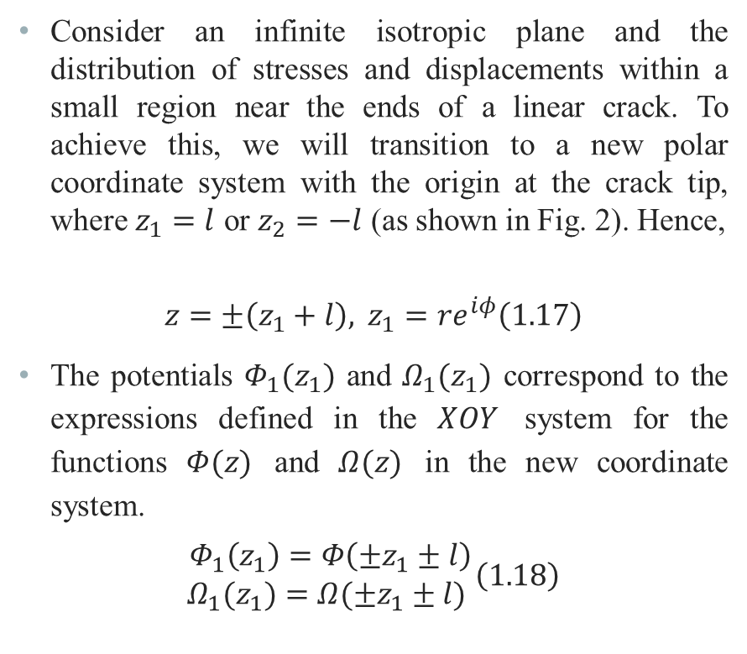
Stress Intensity Factor
Consider an infinite isotropic plane and the distribution of stresses and displacements within a small region near the ends of a linear crack. To achieve this, we will transition to a new polar coordinate system with the origin at the crack tip, where $z_{1}=l$ or $z_{2}=−l$ (as shown in Fig. 2). Hence,
$$\begin{aligned}z=±\left(z_{1}+l\right), z_{1}=re^{iφ}\#\left(1.17\right)\end{aligned}$$
The potentials $Φ_{1}(z_{1})$ and $Ω_{1}(z_{1})$ correspond to the expressions defined in the $XOY$ system for the functions $Φ(z)$ and $Ω(z)$ in the new coordinate system.
$$\begin{aligned}\begin{matrix}Φ_{1}\left(z_{1}\right)=Φ\left(±z_{1}±l\right) \\ Ω_{1}(z_{1})=Ω(±z_{1}±l) \end{matrix}\left(1.18\right)\end{aligned}$$

Slide 10
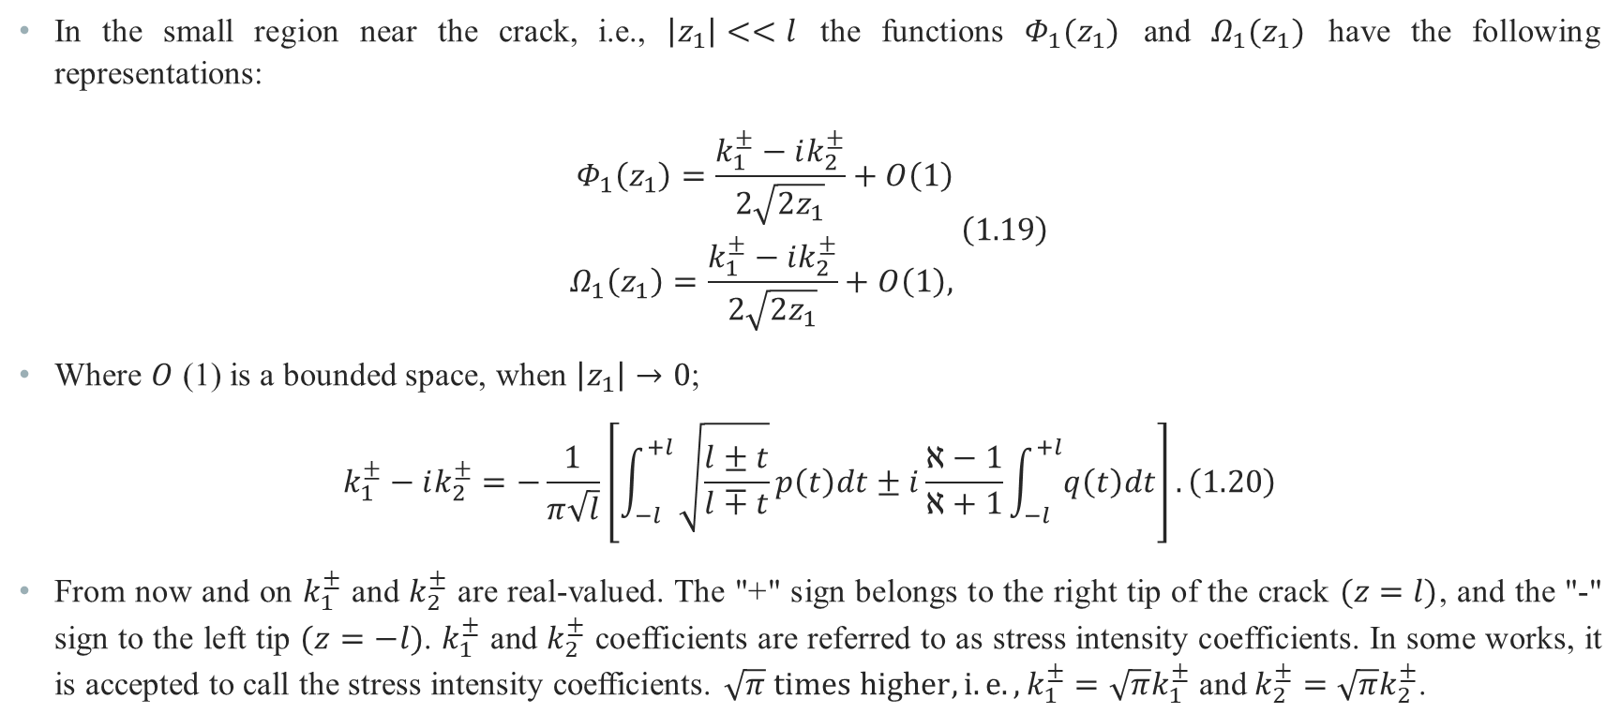
Stress Intensity Factor
In the small region near the crack, i.e., $\left|z_{1}\right|<<l$ the functions $Φ_{1}(z_{1})$ and $Ω_{1}(z_{1})$ have the following representations:
$$\begin{aligned}\begin{matrix}Φ_{1}\left(z_{1}\right)=\frac{k_{1}^{±}−ik_{2}^{±}}{2\sqrt{2z_{1}}}+O\left(1\right) \\ Ω_{1}\left(z_{1}\right)=\frac{k_{1}^{±}−ik_{2}^{±}}{2\sqrt{2z_{1}}}+O\left(1\right), \end{matrix}\#\left(1.19\right)\end{aligned}$$
Where $O$ (1) is a bounded space, when $\left|z_{1}\right|→0$;
$$\begin{aligned}k_{1}^{±}−ik_{2}^{±}=−\frac{1}{π\sqrt{l}}\left[\int_{−l}^{+l}{\sqrt{\frac{l±t}{l∓t}}p\left(t\right)dt±i\frac{ℵ−1}{ℵ+1}}\int_{−l}^{+l}{q\left(t\right)dt}\right].\#\left(1.20\right)\end{aligned}$$
From now and on $k_{1}^{±}$ and $k_{2}^{±}$ are real-valued. The "+" sign belongs to the right tip of the crack $(z=l)$, and the "-" sign to the left tip $(z=−l)$. $k_{1}^{±}$ and $k_{2}^{±}$ coefficients are referred to as stress intensity coefficients. In some works, it is accepted to call the stress intensity coefficients. $\sqrt{π} times higher, i.e.,k_{1}^{±}=\sqrt{π}k_{1}^{±}$ and $k_{2}^{±}=\sqrt{π}k_{2}^{±}$.

Slide 11
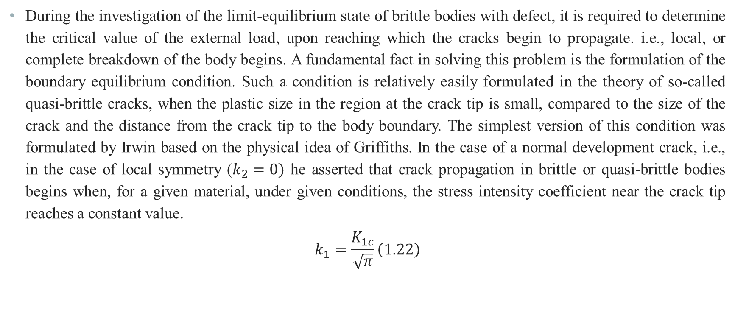
Limit Equilibrium Equation
During the investigation of the limit-equilibrium state of brittle bodies with defect, it is required to determine the critical value of the external load, upon reaching which the cracks begin to propagate. i.e., local, or complete breakdown of the body begins. A fundamental fact in solving this problem is the formulation of the boundary equilibrium condition. Such a condition is relatively easily formulated in the theory of so-called quasi-brittle cracks, when the plastic size in the region at the crack tip is small, compared to the size of the crack and the distance from the crack tip to the body boundary. The simplest version of this condition was formulated by Irwin based on the physical idea of Griffiths. In the case of a normal development crack, i.e., in the case of local symmetry ($k_{2}=0)$ he asserted that crack propagation in brittle or quasi-brittle bodies begins when, for a given material, under given conditions, the stress intensity coefficient near the crack tip reaches a constant value.
$$\begin{aligned}k_{1}=\frac{K_{1c}}{\sqrt{π}}\#\left(1.22\right)\end{aligned}$$

Slide 12
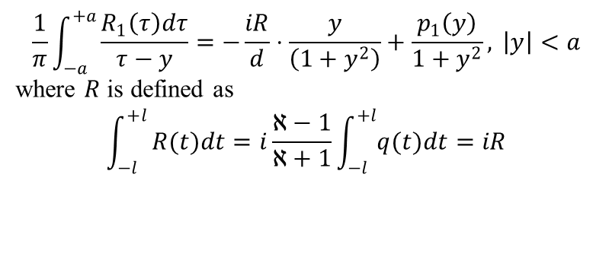
Some Examples of Problems that Reduce to Fredholm Singular Integral Equations of the First Kind
$$\begin{aligned}\frac{1}{π}\int_{−a}^{+a}{\frac{R_{1}\left(τ\right)dτ}{τ−y}}=−\frac{iR}{d}⋅\frac{y}{\left(1+y^{2}\right)}+\frac{p_{1}\left(y\right)}{1+y^{2}}, \left|y\right|<a\end{aligned}$$
where $R$ is defined as
$$\int_{−l}^{+l}{R(t)dt=i\frac{ℵ−1}{ℵ+1}}\int_{−l}^{+l}{q(t)dt=iR}$$

Slide 13
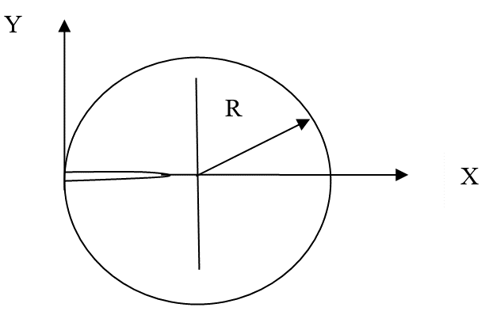
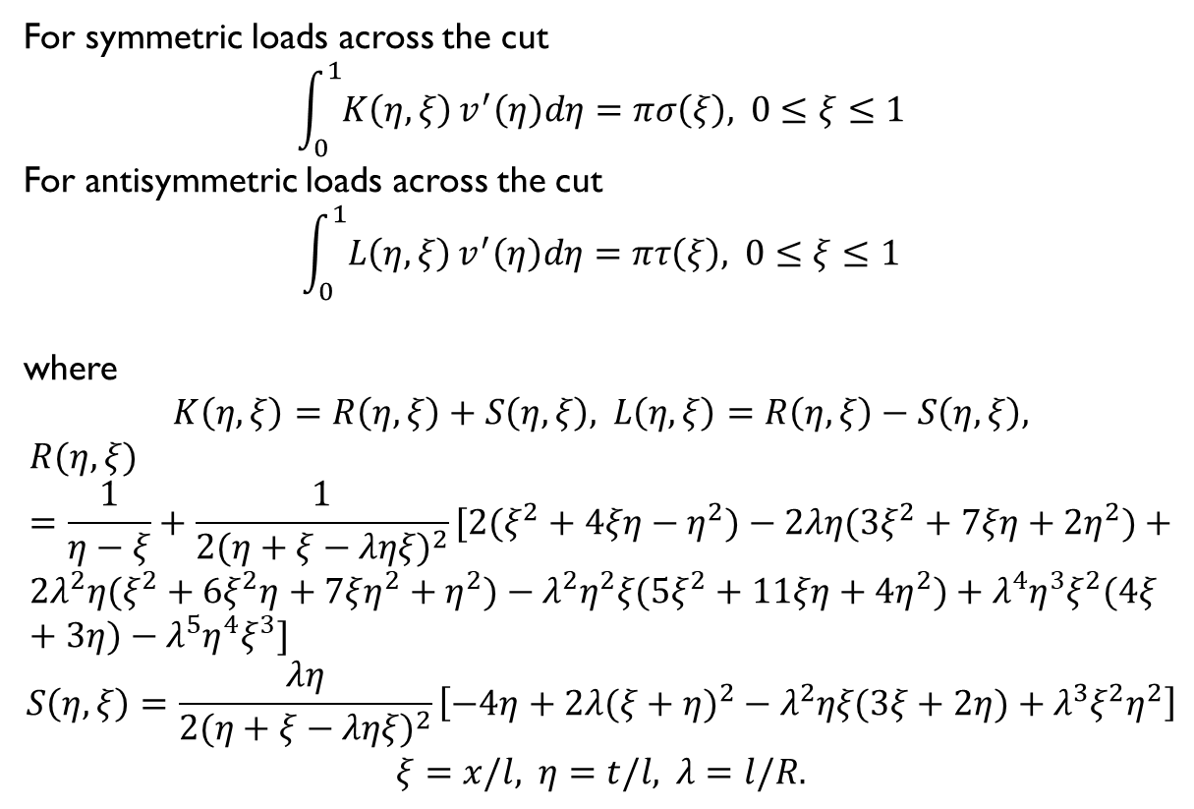
Some Examples of Problems that Reduce to Fredholm Singular Integral Equations of the First Kind
For symmetric loads across the cut
$$\begin{aligned}\int_{0}^{1}{K\left(η,ξ\right)}v^{′}\left(η\right)dη=πσ\left(ξ\right), 0≤ξ≤1\end{aligned}$$
For antisymmetric loads across the cut
$$\begin{aligned}\int_{0}^{1}{L\left(η,ξ\right)}v^{′}\left(η\right)dη=πτ\left(ξ\right), 0≤ξ≤1\end{aligned}$$
where
$$K\left(η,ξ\right)=R\left(η,ξ\right)+S\left(η,ξ\right), L\left(η,ξ\right)=R\left(η,ξ\right)−S\left(η,ξ\right),$$
$$R(η,ξ)=\frac{1}{η−ξ}+\frac{1}{2(η+ξ−ληξ)^{2}}[2(ξ^{2}+4ξη−η^{2})−2λη(3ξ^{2}+7ξη+2η^{2})+ \\ 2λ^{2}η(ξ^{2}+6ξ^{2}η+7ξη^{2}+η^{2})−λ^{2}η^{2}ξ(5ξ^{2}+11ξη+4η^{2})+λ^{4}η^{3}ξ^{2}(4ξ+3η)−λ^{5}η^{4}ξ^{3}]$$
$$S\left(η,ξ\right)=\frac{λη}{2(η+ξ−ληξ)^{2}}\left[−4η+2λ(ξ+η)^{2}−λ^{2}ηξ(3ξ+2η)+λ^{3}ξ^{2}η^{2}\right]$$
$$ξ=x/l, η=t/l, λ=l/R.$$

Slide 14
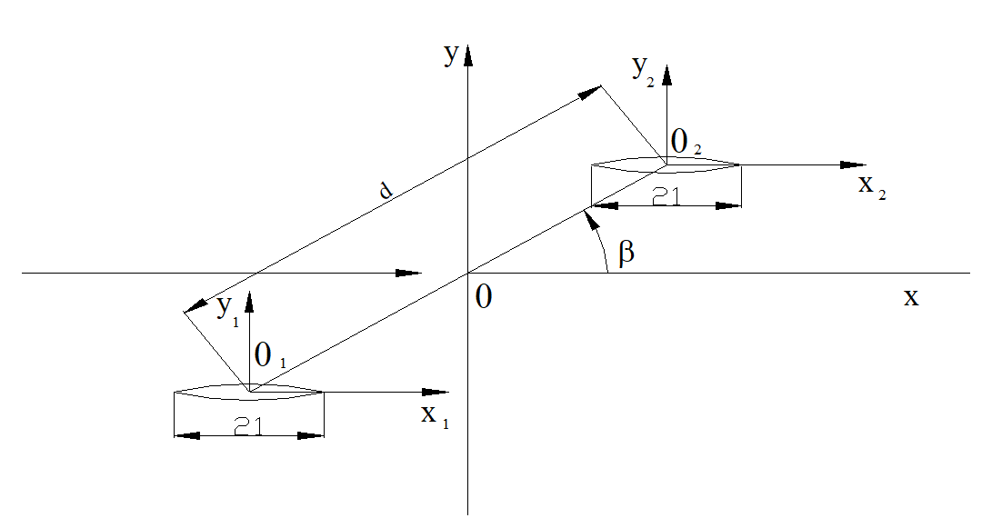
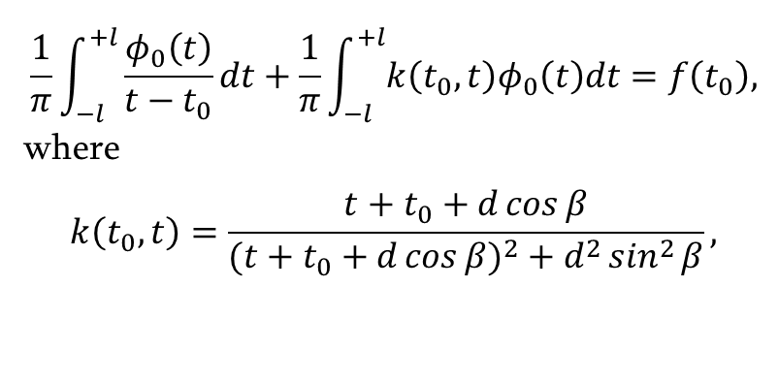
Some Examples of Problems that Reduce to Fredholm Singular Integral Equations of the First Kind
$$\begin{aligned}\frac{1}{π}\int_{−l}^{+l}{\frac{φ_{0}\left(t\right)}{t−t_{0}}}dt+\frac{1}{π}\int_{−l}^{+l}{k\left(t_{0},t\right)φ_{0}\left(t\right)dt=f\left(t_{0}\right),}\end{aligned}$$
where
$$k\left(t_{0},t\right)=\frac{t+t_{0}+d\cos{β}}{(t+t_{0}+d\cos{β})^{2}+d^{2}\sin^{2}{β}},$$

Slide 15
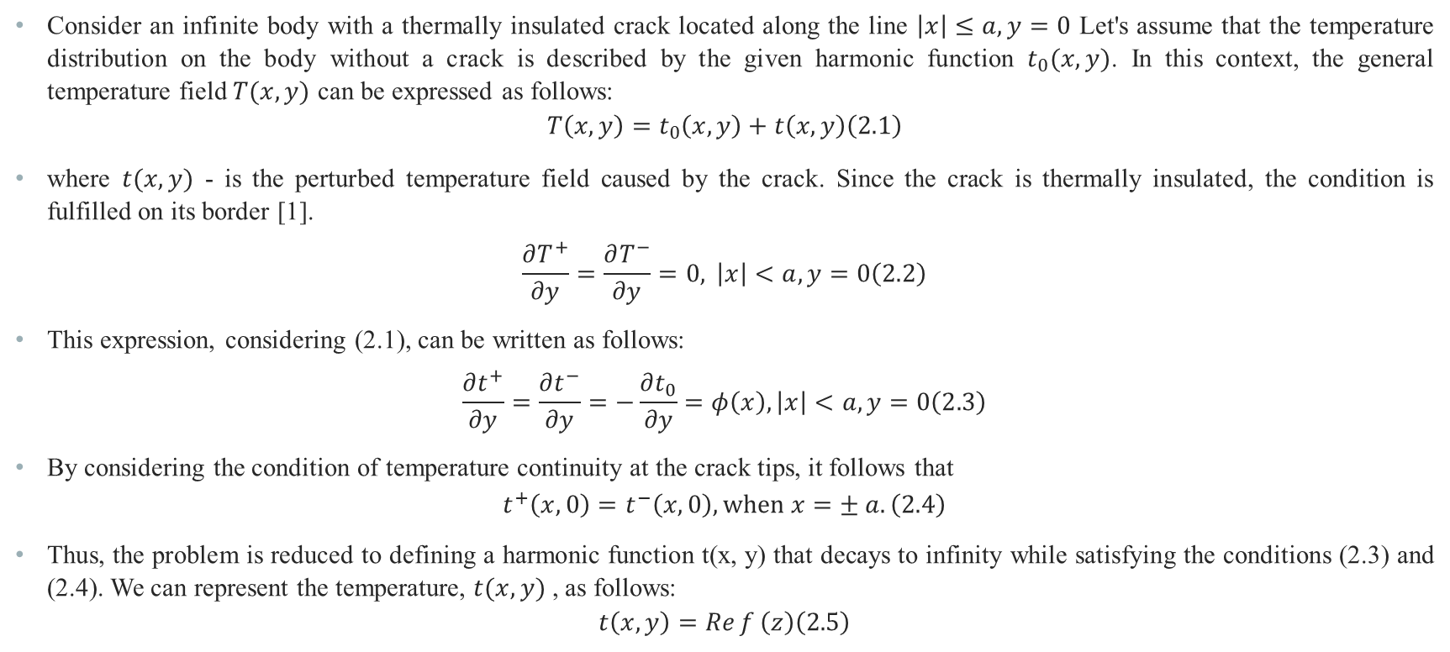
Thermally Insulate Cracks
Consider an infinite body with a thermally insulated crack located along the line $\left|x\right|≤a,y=0$ Let's assume that the temperature distribution on the body without a crack is described by the given harmonic function $t_{0}(x,y)$. In this context, the general temperature field $T(x,y)$ can be expressed as follows:
$$\begin{aligned}T\left(x,y\right)=t_{0}\left(x,y\right)+t\left(x,y\right)\#\left(2.1\right)\end{aligned}$$
where $t(x,y)$ - is the perturbed temperature field caused by the crack. Since the crack is thermally insulated, the condition is fulfilled on its border [1].
$$\begin{aligned}\frac{∂T^{+}}{∂y}=\frac{∂T^{−}}{∂y}=0, \left|x\right|<a,y=0\#\left(2.2\right)\end{aligned}$$
This expression, considering (2.1), can be written as follows:
$$\begin{aligned}\frac{∂t^{+}}{∂y}=\frac{∂t^{−}}{∂y}=−\frac{∂t_{0}}{∂y}=φ\left(x\right),\left|x\right|<a,y=0\#\left(2.3\right)\end{aligned}$$
By considering the condition of temperature continuity at the crack tips, it follows that
$$\begin{aligned}t^{+}\left(x,0\right)=t^{−}\left(x,0\right), when x=± a.\#\left(2.4\right)\end{aligned}$$
Thus, the problem is reduced to defining a harmonic function t(x, y) that decays to infinity while satisfying the conditions (2.3) and (2.4). We can represent the temperature, $t(x,y)$ , as follows:
$$\begin{aligned}t\left(x,y\right)=\operatorname{Re}{f}\left(z\right)\#\left(2.5\right)\end{aligned}$$

Slide 16
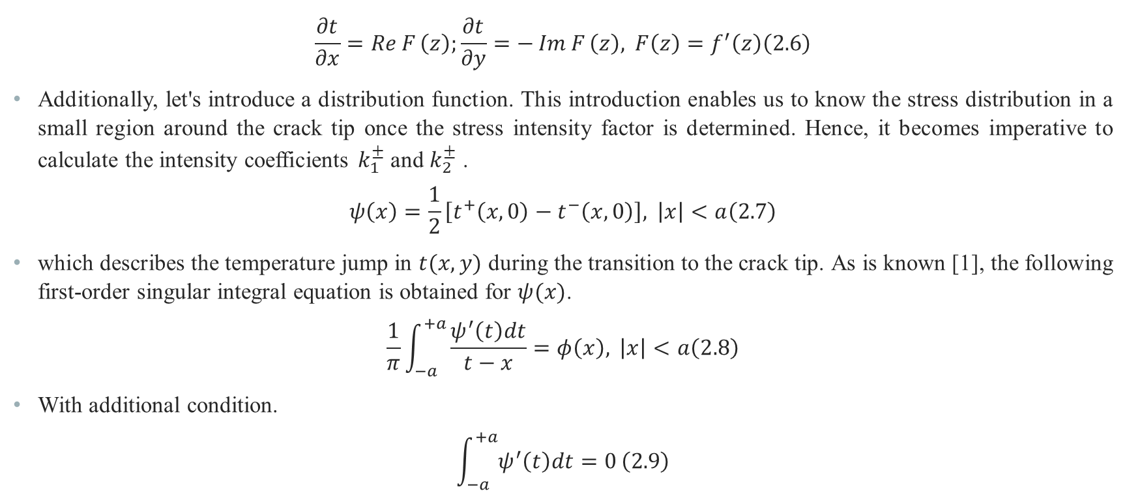
Thermally Insulate Cracks
$$\begin{aligned}\frac{∂t}{∂x}=\operatorname{Re}{F}\left(z\right);\frac{∂t}{∂y}=−\operatorname{Im}{F}\left(z\right), F\left(z\right)=f^{′}\left(z\right)\#\left(2.6\right)\end{aligned}$$
Additionally, let's introduce a distribution function. This introduction enables us to know the stress distribution in a small region around the crack tip once the stress intensity factor is determined. Hence, it becomes imperative to calculate the intensity coefficients $k_{1}^{±}$ and $k_{2}^{±}$ .
$$\begin{aligned}ψ\left(x\right)=\frac{1}{2}\left[t^{+}\left(x,0\right)−t^{−}\left(x,0\right)\right], \left|x\right|<a\#\left(2.7\right)\end{aligned}$$
which describes the temperature jump in $t(x,y)$ during the transition to the crack tip. As is known [1], the following first-order singular integral equation is obtained for $ψ(x)$.
$$\begin{aligned}\frac{1}{π}\int_{−a}^{+a}{\frac{ψ^{′}\left(t\right)dt}{t−x}}=φ\left(x\right), \left|x\right|<a\#\left(2.8\right)\end{aligned}$$
With additional condition.
$$\begin{aligned}\int_{−a}^{+a}{ψ^{′}\left(t\right)dt=0}\#\left(2.9\right)\end{aligned}$$

Slide 17
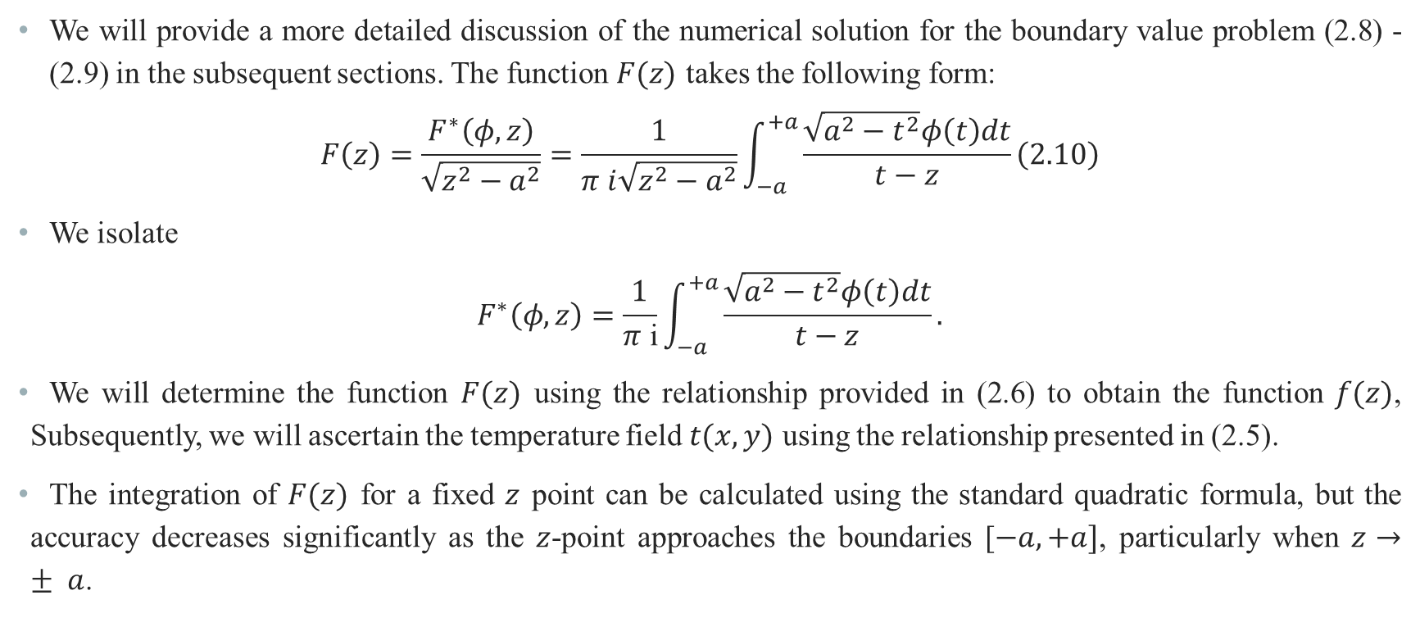
Numerical Solutions for Thermally Insulate Cracks
We will provide a more detailed discussion of the numerical solution for the boundary value problem (2.8) - (2.9) in the subsequent sections. The function $F(z)$ takes the following form:
$$\begin{aligned}F\left(z\right)=\frac{F^{∗}\left(φ,z\right)}{\sqrt{z^{2}−a^{2}}}=\frac{1}{π i\sqrt{z^{2}−a^{2}}}\int_{−a}^{+a}{\frac{\sqrt{a^{2}−t^{2}}φ\left(t\right)dt}{t−z}}\#\left(2.10\right)\end{aligned}$$
We isolate
$$F^{∗}\left(φ,z\right)=\frac{1}{π \text{i}}\int_{−a}^{+a}{\frac{\sqrt{a^{2}−t^{2}}φ\left(t\right)dt}{t−z}}.$$
We will determine the function $F(z)$ using the relationship provided in (2.6) to obtain the function $f(z)$, Subsequently, we will ascertain the temperature field $t(x,y)$ using the relationship presented in (2.5).
The integration of $F(z)$ for a fixed $z$ point can be calculated using the standard quadratic formula, but the accuracy decreases significantly as the $z$-point approaches the boundaries [$−a, +a]$, particularly when $z→± a$.

Slide 18
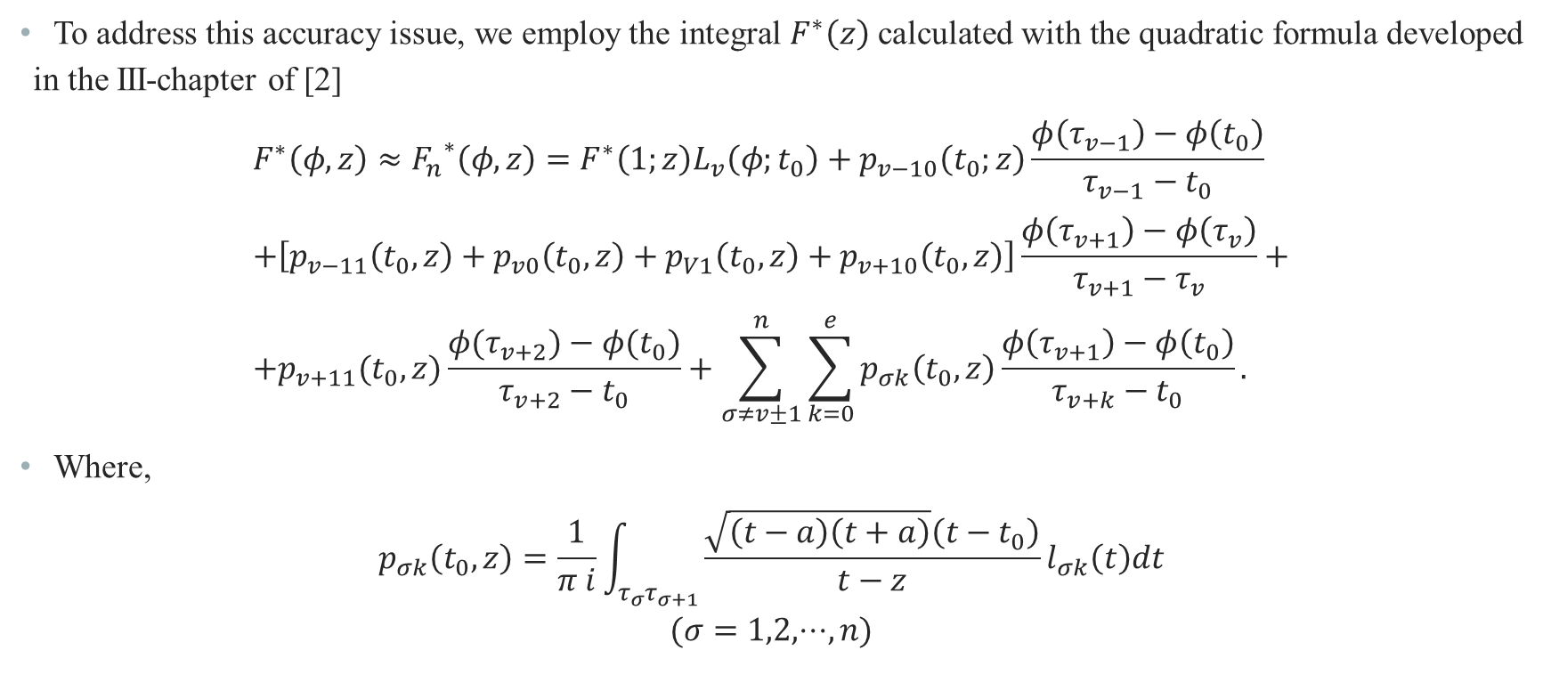
Numerical Solutions for Thermally Insulate Cracks
To address this accuracy issue, we employ the integral $F^{∗}\left(z\right)$ calculated with the quadratic formula developed in the III-chapter of [2]
$$F^{∗}\left(φ,z\right)≈{F_{n}}^{∗}\left(φ,z\right)=F^{∗}\left(1;z\right)L_{v}\left(φ;t_{0}\right)+p_{v−10}\left(t_{0};z\right)\frac{φ\left(τ_{v−1}\right)−φ\left(t_{0}\right)}{τ_{v−1}−t_{0}} \\ +\left[p_{v−11}\left(t_{0},z\right)+p_{v0}\left(t_{0},z\right)+p_{V1}\left(t_{0},z\right)+p_{v+10}\left(t_{0},z\right)\right]\frac{φ\left(τ_{v+1}\right)−φ\left(τ_{v}\right)}{τ_{v+1}−τ_{v}}+ \\ +p_{v+11}(t_{0},z)\frac{φ(τ_{v+2})−φ(t_{0})}{τ_{v+2}−t_{0}}+\sum_{σ≠v±1}^{n}{\sum_{k=0}^{e}{p_{σk}\left(t_{0},z\right)\frac{φ\left(τ_{v+1}\right)−φ\left(t_{0}\right)}{τ_{v+k}−t_{0}}.}}$$
Where,
$$p_{σk}\left(t_{0},z\right)=\frac{1}{π i}\int_{τ_{σ}τ_{σ+1}}{\frac{\sqrt{\left(t−a\right)\left(t+a\right)}\left(t−t_{0}\right)}{t−z}}l_{σk}\left(t\right)dt$$
$$(σ=1,2,⋅⋅⋅,n)$$

Slide 19
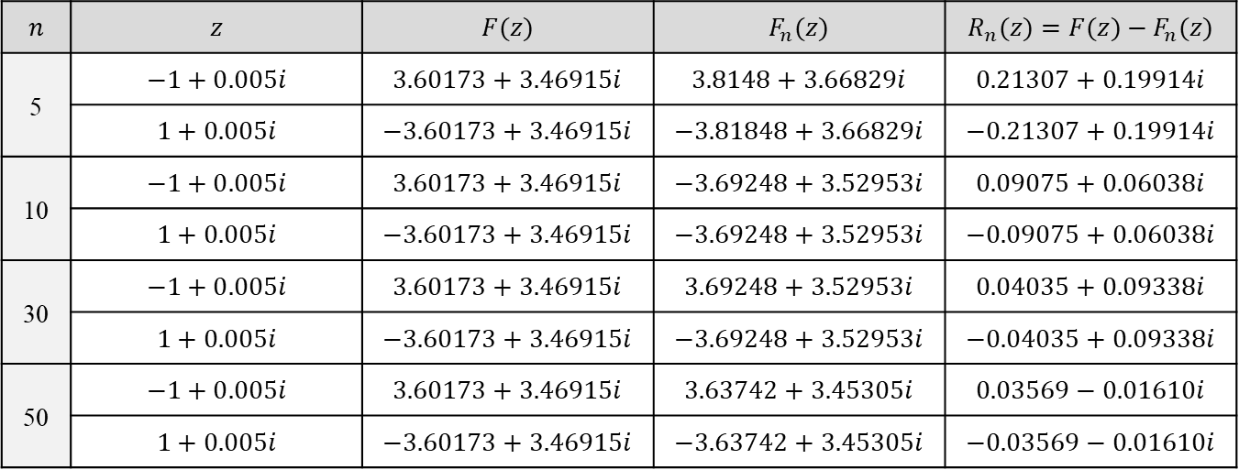
Numerical Solutions for Thermally Insulate Cracks
Below is a table presenting approximate integral calculations of $F(z)$ using the algorithm. The calculations cover various values of $n$ - in the vicinity of the point $z=±1$ ,' with the $φ$ function defined as $φ(t)=\operatorname{Re}{(}t)+\operatorname{Im}{(}t)$.
$$n$$ | $$z$$ | $$F(z)$$ | $$F_{n}(z)$$ | $$R_{n}(z)=F(z)−F_{n}(z)$$
5 | $$−1+0.005i$$ | $$3.60173+3.46915i$$ | $$3.8148+3.66829i$$ | $$0.21307+0.19914i$$
 | $$1+0.005i$$ | $$−3.60173+3.46915i$$ | $$−3.81848+3.66829i$$ | $$−0.21307+0.19914i$$
10 | $$−1+0.005i$$ | $$3.60173+3.46915i$$ | $$−3.69248+3.52953i$$ | $$0.09075+0.06038i$$
 | $$1+0.005i$$ | $$−3.60173+3.46915i$$ | $$−3.69248+3.52953i$$ | $$−0.09075+0.06038i$$
30 | $$−1+0.005i$$ | $$3.60173+3.46915i$$ | $$3.69248+3.52953i$$ | $$0.04035+0.09338i$$
 | $$1+0.005i$$ | $$−3.60173+3.46915i$$ | $$−3.69248+3.52953i$$ | $$−0.04035+0.09338i$$
50 | $$−1+0.005i$$ | $$3.60173+3.46915i$$ | $$3.63742+3.45305i$$ | $$0.03569−0.01610i$$
 | $$1+0.005i$$ | $$−3.60173+3.46915i$$ | $$−3.63742+3.45305i$$ | $$−0.03569−0.01610i$$
As demonstrated in the table, the above-mentioned algorithm achieves an order of accuracy of $10^{−2}$ at special points$z=±1+0,005i$ (located at the ends of the crack) when $n=50$.

Slide 20
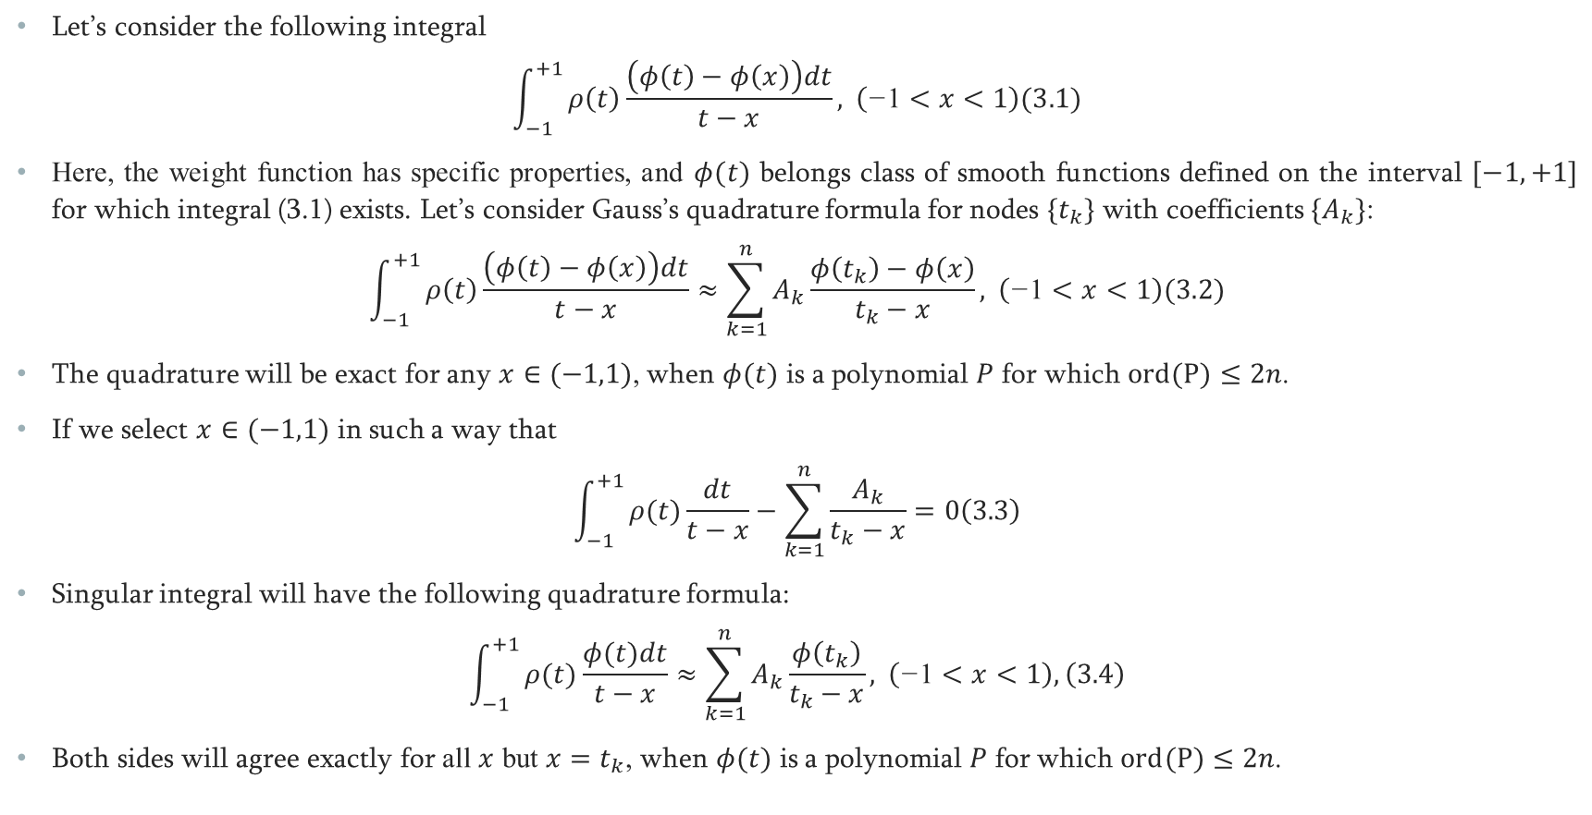
Approximation of Singular Integrals by Quadrature Formulas Close in Accuracy to Gaussian-type Formulas
Let’s consider the following integral
$$\begin{aligned}\int_{−1}^{+1}{ρ\left(t\right)\frac{\left(φ\left(t\right)−φ\left(x\right)\right)dt}{t−x}}, \left(\text{−}\text{1}<x<1\right)\#\#(3.1)\end{aligned}$$
Here, the weight function has specific properties, and $φ(t)$ belongs class of smooth functions defined on the interval $[−1,+1]$ for which integral (3.1) exists. Let’s consider Gauss’s quadrature formula for nodes ${\{t}_{k}\}$ with coefficients $\{A_{k}\}$:
$$\begin{aligned}\int_{−1}^{+1}{ρ\left(t\right)\frac{\left(φ\left(t\right)−φ\left(x\right)\right)dt}{t−x}}≈\sum_{k=1}^{n}{A_{k}\frac{φ\left(t_{k}\right)−φ\left(x\right)}{t_{k}−x}}, \left(\text{−}\text{1}<x<1\right)\#\#(3.2)\end{aligned}$$
The quadrature will be exact for any $x∈(−1,1)$, when $φ(t)$ is a polynomial $P$ for which $ord(P)≤2n$.
If we select $x∈(−1,1)$ in such a way that
$$\begin{aligned}\int_{−1}^{+1}{ρ(t)\frac{dt}{t−x}}−\sum_{k=1}^{n}{\frac{A_{k}}{t_{k}−x}}=0\#\left(3.3\right)\end{aligned}$$
Singular integral will have the following quadrature formula:
$$\begin{aligned}\int_{−1}^{+1}{ρ(t)\frac{φ(t)dt}{t−x}}≈\sum_{k=1}^{n}{A_{k}\frac{φ\left(t_{k}\right)}{t_{k}−x}}, \left(\text{−}\text{1}<x<1\right),\#\left(3.4\right)\end{aligned}$$
Both sides will agree exactly for all $x$ but $x=t_{k}$, when $φ(t)$ is a polynomial $P$ for which $ord(P)≤2n$.

Slide 21
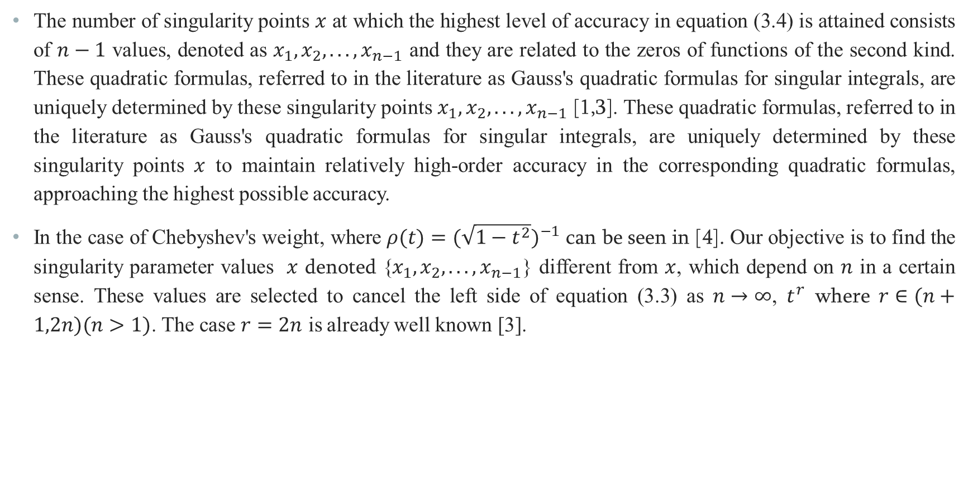
Approximation of Singular Integrals by Quadrature Formulas Close in Accuracy to Gaussian-type Formulas
The number of singularity points $x$ at which the highest level of accuracy in equation (3.4) is attained consists of $n−1$ values, denoted as $x_{1},x_{2},...,x_{n−1}$ and they are related to the zeros of functions of the second kind. These quadratic formulas, referred to in the literature as Gauss's quadratic formulas for singular integrals, are uniquely determined by these singularity points $x_{1},x_{2},...,x_{n−1}$ [1,3]. These quadratic formulas, referred to in the literature as Gauss's quadratic formulas for singular integrals, are uniquely determined by these singularity points $x$ to maintain relatively high-order accuracy in the corresponding quadratic formulas, approaching the highest possible accuracy.
In the case of Chebyshev's weight, where $ρ(t)=(\sqrt{1−t^{2}})^{−1}$ can be seen in [4]. Our objective is to find the singularity parameter values $x$ denoted {$x_{1},x_{2},...,x_{n−1}$} different from $x$, which depend on $n$ in a certain sense. These values are selected to cancel the left side of equation (3.3) as $n→∞$, $t^{r}$ where $r∈(n+1,2n)(n>1)$. The case $r=2n$ is already well known [3].

Slide 22
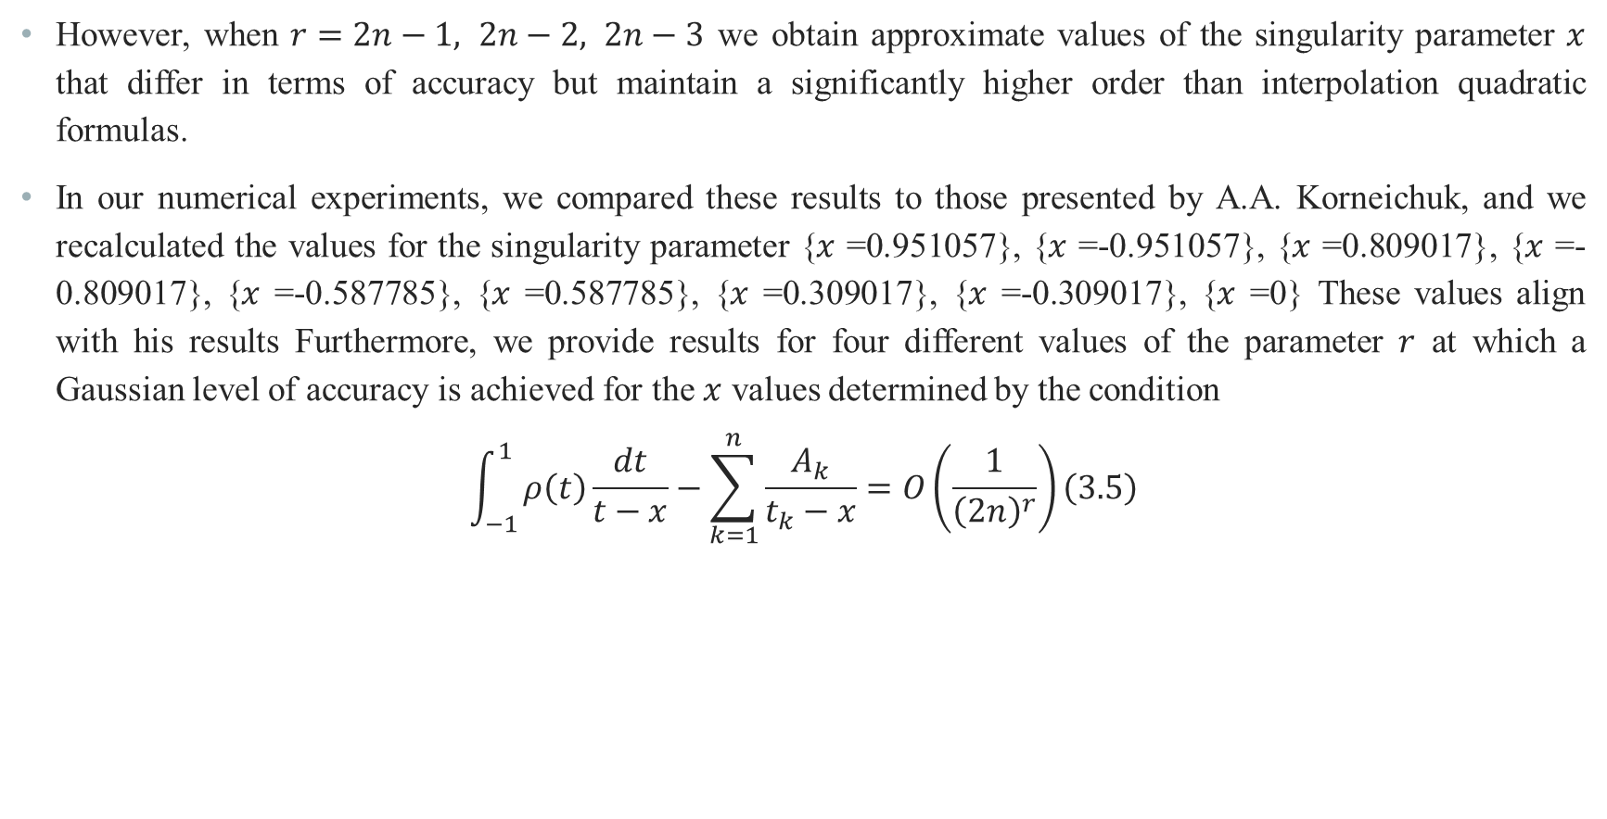
Approximation of Singular Integrals by Quadrature Formulas Close in Accuracy to Gaussian-type Formulas
However, when $r=2n−1, 2n−2, 2n−3$ we obtain approximate values of the singularity parameter $x$ that differ in terms of accuracy but maintain a significantly higher order than interpolation quadratic formulas.
In our numerical experiments, we compared these results to those presented by A.A. Korneichuk, and we recalculated the values for the singularity parameter {$x$ =0.951057}, {$x$ =-0.951057}, {$x$ =0.809017}, {$x$ =-0.809017}, {$x$ =-0.587785}, {$x$ =0.587785}, {$x$ =0.309017}, {$x$ =-0.309017}, {$x$ =0} These values align with his results Furthermore, we provide results for four different values of the parameter $r$ at which a Gaussian level of accuracy is achieved for the $x$ values determined by the condition
$$\begin{aligned}\int_{−1}^{1}{ρ\left(t\right)\frac{dt}{t−x}−\sum_{k=1}^{n}{\frac{A_{k}}{t_{k}−x}}=O\left(\frac{1}{{\left(2n\right)}^{r}}\right)}\#\left(3.5\right)\end{aligned}$$

Slide 23
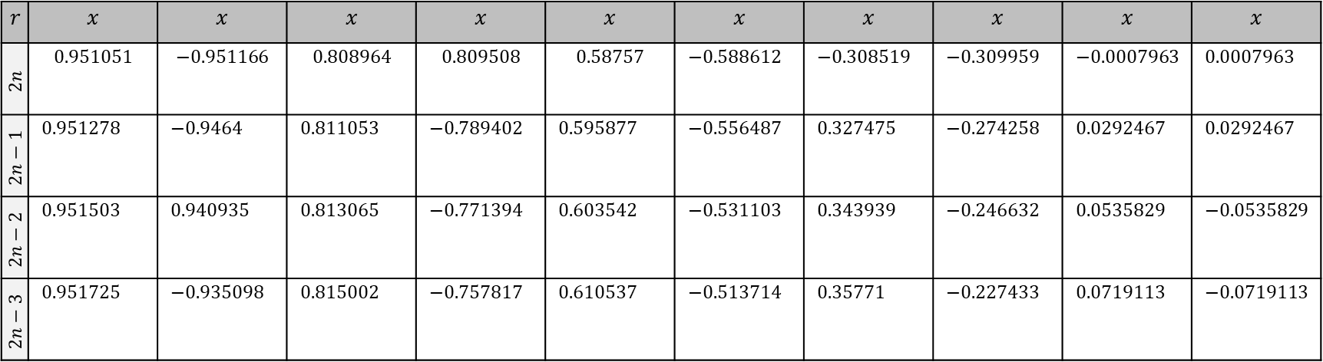
Approximation of Singular Integrals by Quadrature Formulas Close in Accuracy to Gaussian-type Formulas
$$r$$ | $$x$$ | $$x$$ | $$x$$ | $$x$$ | $$x$$ | $$x$$ | $$x$$ | $$x$$ | $$x$$ | $$x$$
$$2n$$ | $$0.951051$$ | $$−0.951166$$ | $$0.808964$$ | $$0.809508$$ | $$0.58757$$ | $−0.588612$ | $−0.308519$ | $−0.309959$ | $−0.0007963$ | $0.0007963$
$$2n−1$$ | $0.951278$ | $−0.9464$ | $0.811053$ | $−0.789402$ | $0.595877$ | $−0.556487$ | $0.327475$ | $−0.274258$ | $0.0292467$ | $0.0292467$
$$2n−2$$ | $0.951503$ | $0.940935$ | $0.813065$ | $−0.771394$ | $0.603542$ | $−0.531103$ | $0.343939$ | $−0.246632$ | $0.0535829$ | $−0.0535829$
$$2n−3$$ | $0.951725$ | $−0.935098$ | $0.815002$ | $−0.757817$ | $0.610537$ | $−0.513714$ | $0.35771$ | $−0.227433$ | $0.0719113$ | $−0.0719113$

Slide 24
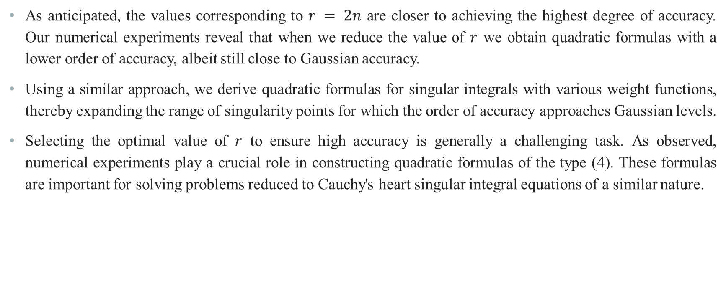
Approximation of Singular Integrals by Quadrature Formulas Close in Accuracy to Gaussian-type Formulas
As anticipated, the values corresponding to $r = 2n$ are closer to achieving the highest degree of accuracy. Our numerical experiments reveal that when we reduce the value of $r$ we obtain quadratic formulas with a lower order of accuracy, albeit still close to Gaussian accuracy.
Using a similar approach, we derive quadratic formulas for singular integrals with various weight functions, thereby expanding the range of singularity points for which the order of accuracy approaches Gaussian levels.
Selecting the optimal value of $r$ to ensure high accuracy is generally a challenging task. As observed, numerical experiments play a crucial role in constructing quadratic formulas of the type (4). These formulas are important for solving problems reduced to Cauchy's heart singular integral equations of a similar nature.

Slide 25
Thank you
for your attention

Slide 26
References
Панасиюк В.В. Саврюк М.П. Дацышин А.П. Распределение напряжений около трешин в пластинах и оболочках.// Киев, Наукова думка ,1976, 443 с.
მ.კუბლაშვილი ბზარების მქონე სხეულების დაძაბულ-დეფორმაციული და რღვევის პროცესების კვლევის მეთოდების დამუშავება სინგულარულ ინტეგრალურ განტოლებათა მეთოდის გამოყენებით, სადოქტორო დისერტაცია, თბილისი 2004 წ.
Корнейчук А.А. Квадратурные формулы для сингулярных интегралов. // В кн.:”Численные методы решения дифференциалъных и интегралъных уравнений и квадратурных формула”.-М.:Наука, 1964.-с.64-74
К. Р. Купатадзе, Д. Г. Саникидзе, Ш. С. Хубежты “О квадратурных формулах для сингулярных интегралов с ядром Коши, имеющих близкую к гауссовской степень точности” // Вісник Харківського національного університету №1063, 2013

