Slide 1
Detector technologies
AN EXTREMELY brief introduction to
Current AND future detector technologies
in High energy particle physics

Slide 2
outline
Definitions
What do we measure
Past and current detector technologies
Future detector technologies

Slide 3
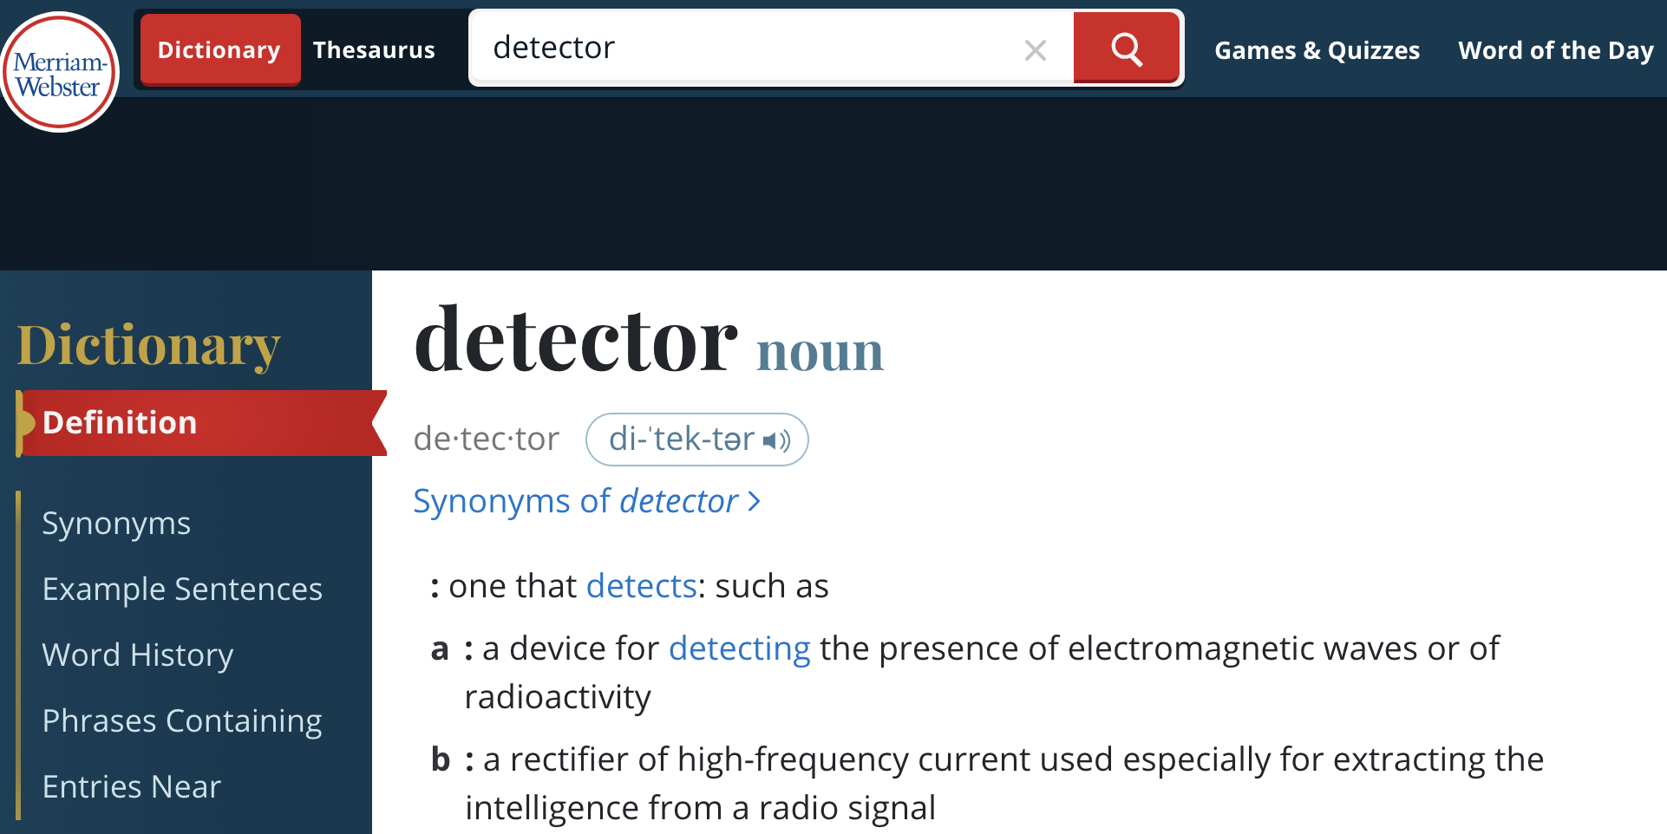
detector

Slide 4
PARTICLE DETECTOR
From Wikipedia, the free encyclopedia
  A particle detector, to detect, track, identify and ionizing particles
  Detectors can measure the attributes of the particle, such as energy, momentum, charge, particle type, as opposed to only detect the presence of the particle
  An absence of the detection of the results of ionization or other “traces”, can lead to a detection, or rather indication of a non-ionizing particle, f.ex. neutrino (missing energy)

Slide 5
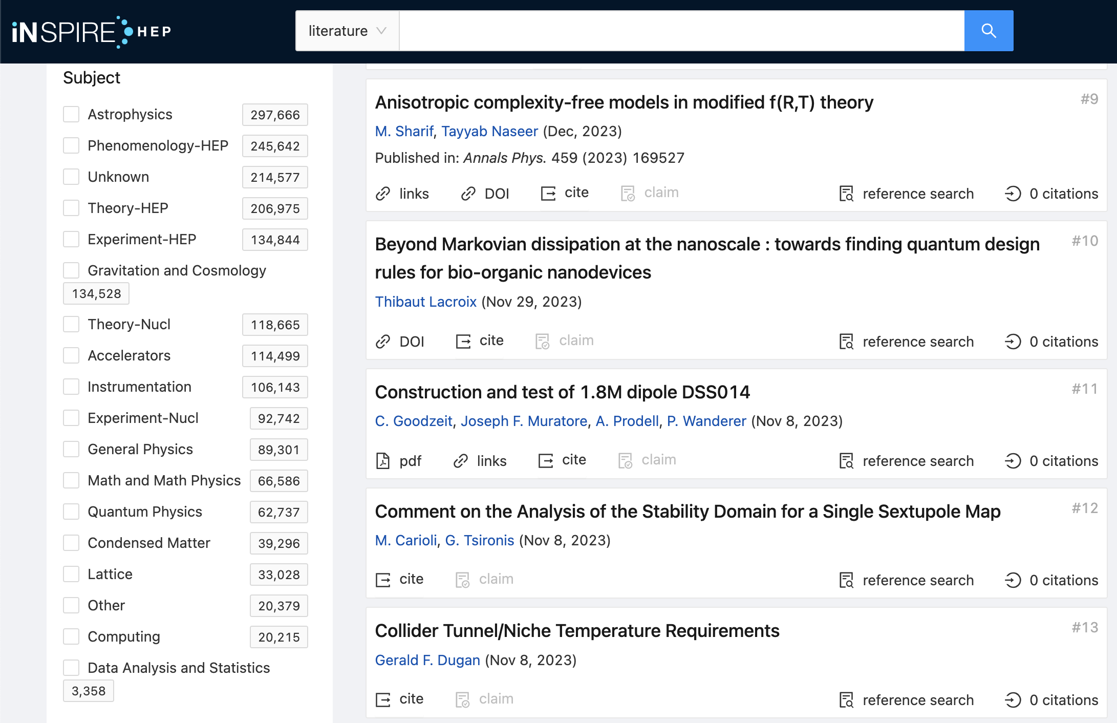
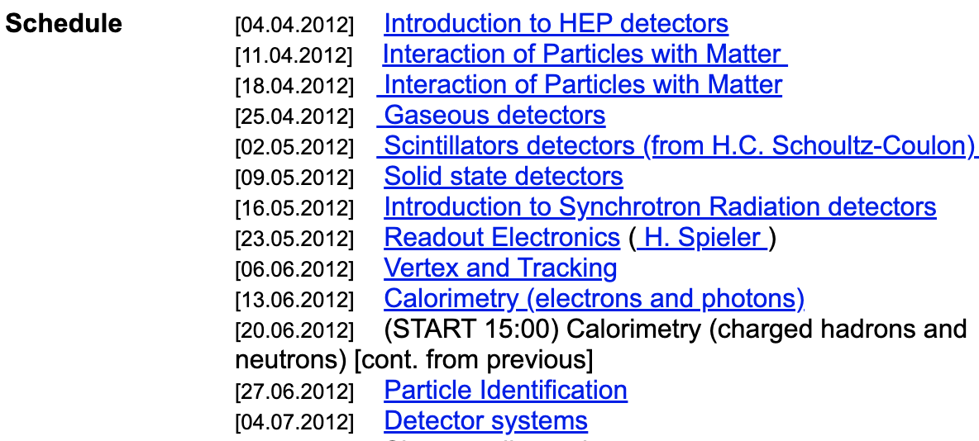
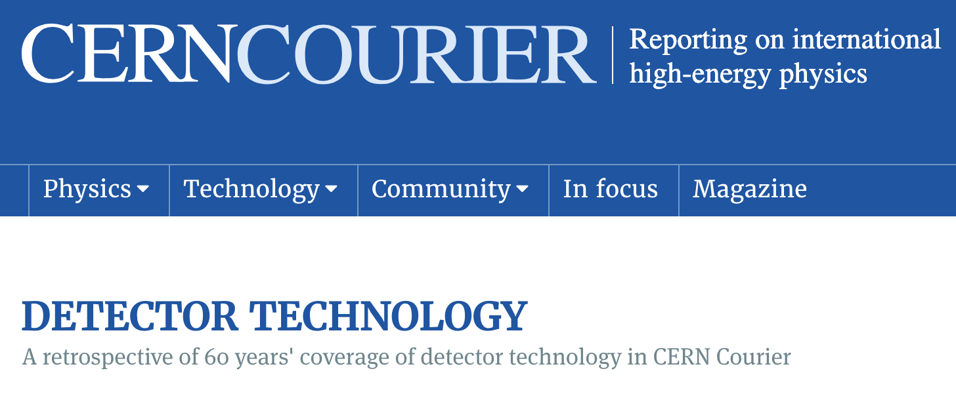
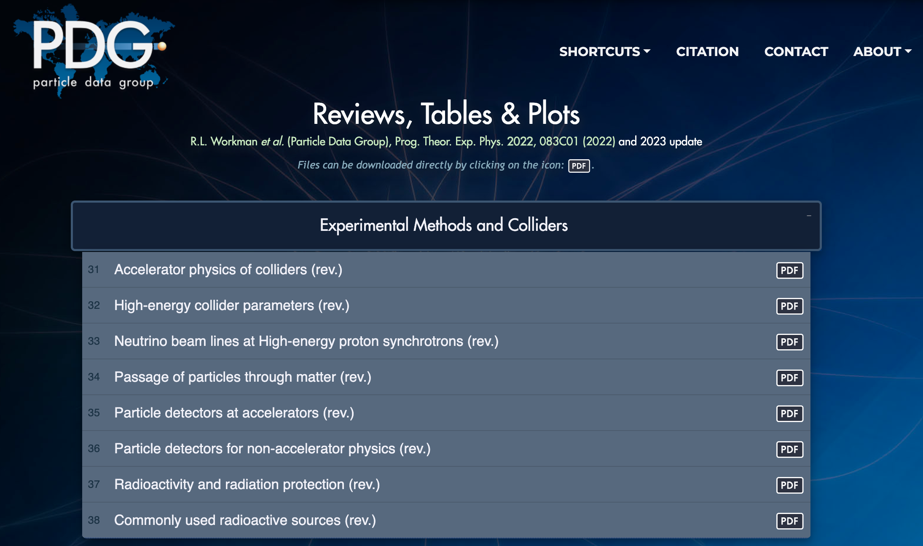
PARTICLE Detector
Vast subject
  INSPIRE HEP paper database
Normally requires a semester to introduce
  Physics of particle detector (DESY)
Rich history
  A retrospective of 60 years' coverage of detector technology
Detailed references
  PDG Experimental Methods and Colliders

Slide 6
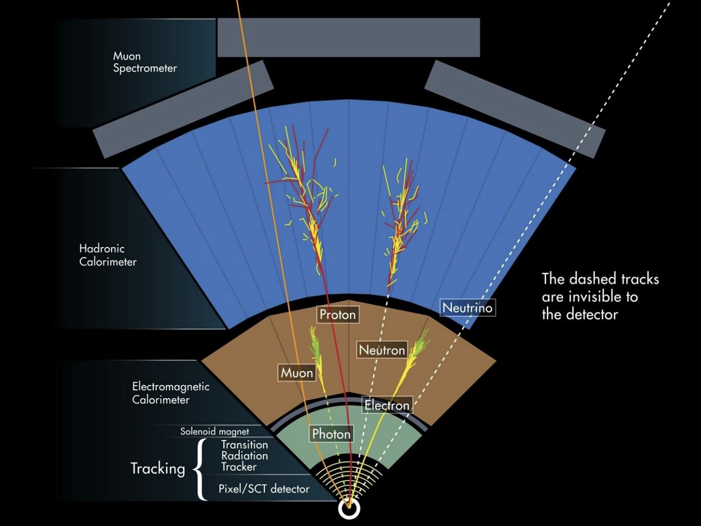
Types of particle detectors
Can categorise in several ways
  By purpose
    Trigger, tracking, calorimeter, particle identification (PID)…
  By detection principle and technology
    Gaseous detector, scintillating counter, Cherenkov counter, semiconductor (solid state) counter, …

Slide 7
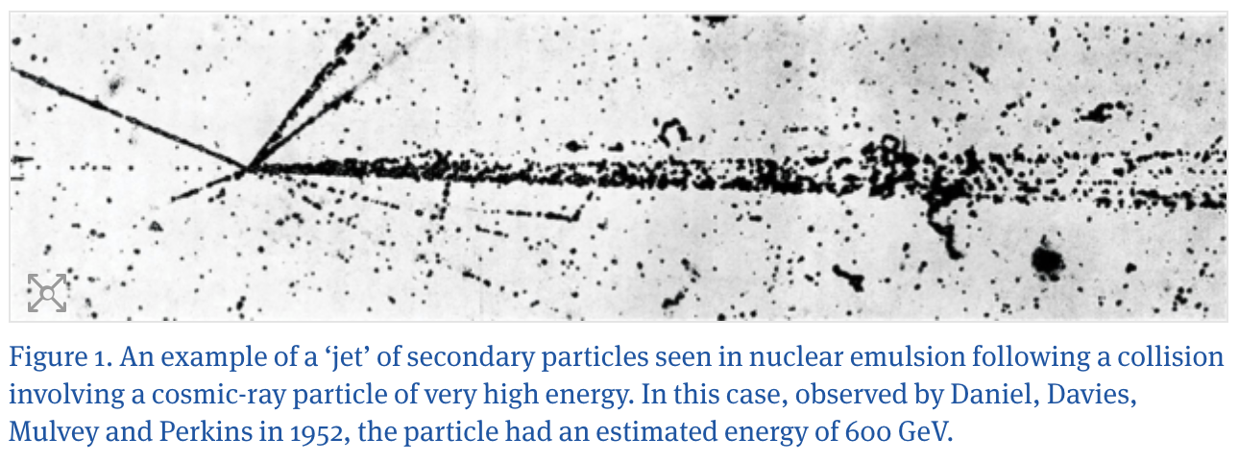
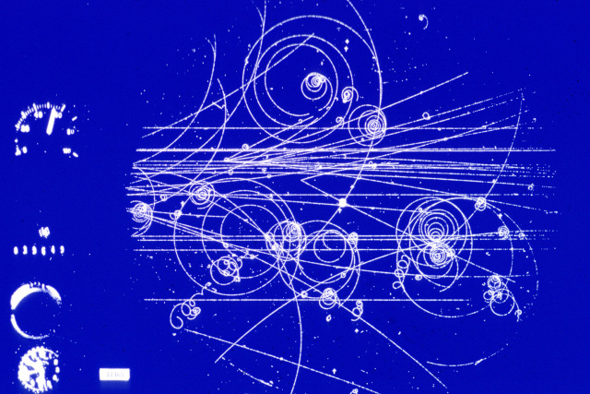
STEP BACK – NUCLEAR EMULSION, BUBBLE CHAMBER
The possibility to detect charged particles using photographic emulsion was investigated already at the beginning of 20th century
Later on a “thick” (>50 microns) emulsion was developed and successfully used
In the 1950x, the “bubble” chamber was invented and successfully used to register tracks from ionising particles by making a photo of the small gas bubbles in the liquid
Nuclear emissions
Bubble chamber image

Slide 8
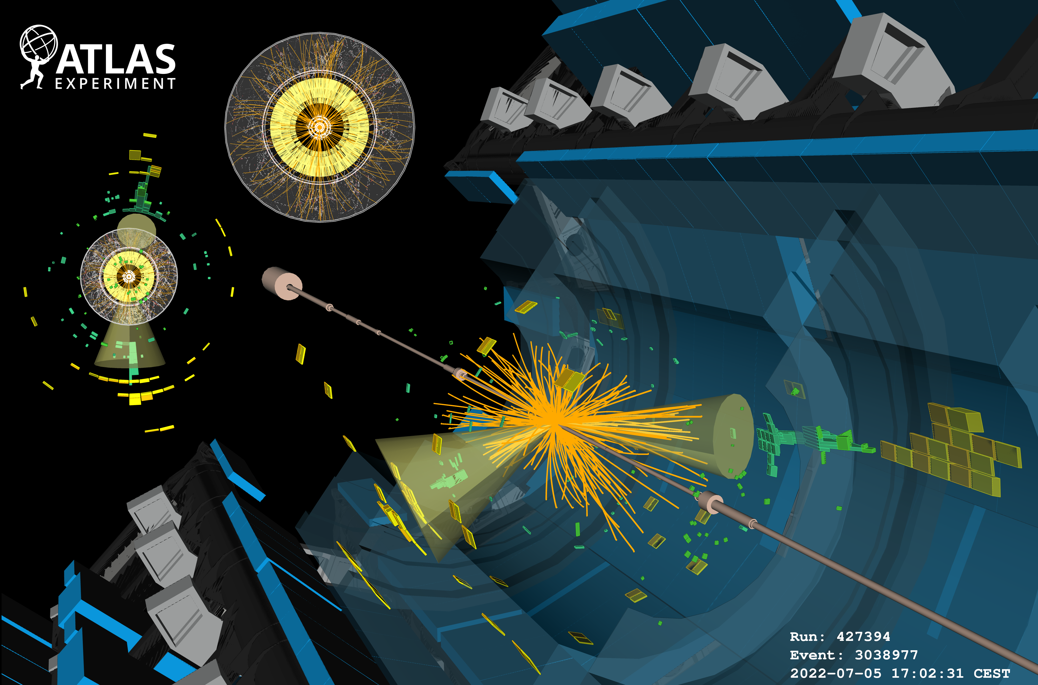
PARTICLE PHYSICS ACCELERATOR EXPERIMENTS
Accelerate particles to gain energy
Hit accelerated particles to transform energy into matter
  Onto a fixed target – fixed target experiments
  Onto an oncoming particle – collider experiments (proton-proton, electron-positron, proton-ion, …)
Produce and observe new particles
Detect, measure and record particle properties
All under controlled and repeatable conditions = experiment
CERN ATLAS Run3 first collisions

Slide 9
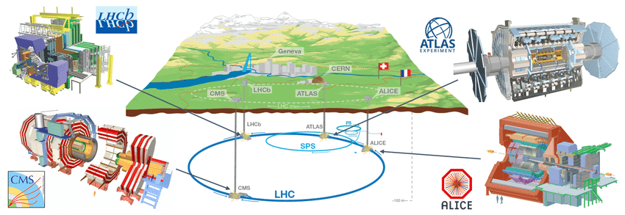
CERN LHC COLLIDER EXPERIMENTS
Large installations (10+ m)
Layered architecture (sandwich or onion)
Hermetical organisation

Slide 10
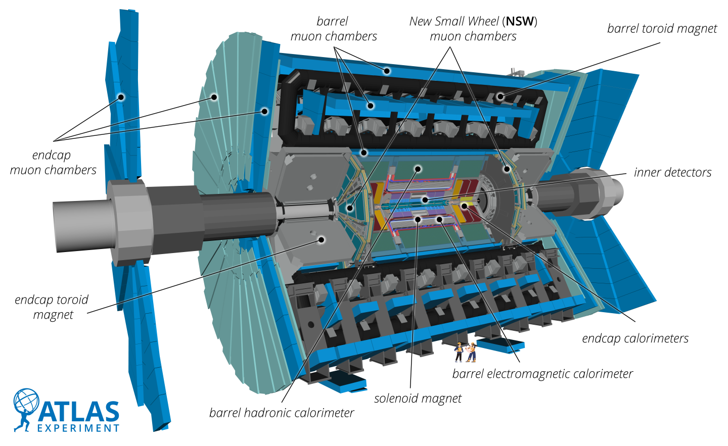
ATLAS DETECTOR
44 m
So-called “4-pi” multi-purpose detector
Ideally has to detect and measure all particles
Hermetical and layered structure
  Tracking detectors – measure momentum
    Close to interaction (collision) point
    Use magnetic field to curve charged particles to sense the charge and measure momentum
  Calorimeters – measure energy
    Measure energy from electro-magnetic showers and nuclear interactions
  Muon detectors
    Located outside of calorimeters to measure the momentum of escaping muons
25 m

Slide 11
Types of particle detectors
Can categorise in several ways
  By purpose
    Trigger, tracking, calorimeter, particle identification (PID)…
  By detection principle and technology
    Gaseous detector, scintillating counter, Cherenkov counter, semiconductor counter, …

Slide 12
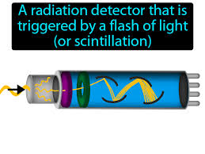
Trigger detectors
Detects a passage of the particle
Scintillating counters
  Plastic scintillator
  Wavelength-shifting fibers
  Photomultiplier (PMT)

Slide 13
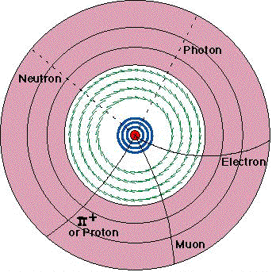
TRACKING DETECTORS
Several layers of sensitive elements, need at least 3 “hits”
Normally in magnetic field
  Charged particles have “bend” trajectories, can measure momentum and detect charge sign
Resolution of each hit depends on the element size and technology
Many types of tracking detectors
  Gaseous (chambers, tubes, etc.)
  Silicon (solid state) detectors
  Fiber trackers

Slide 14
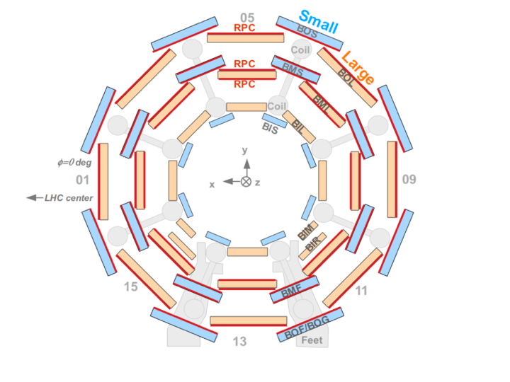
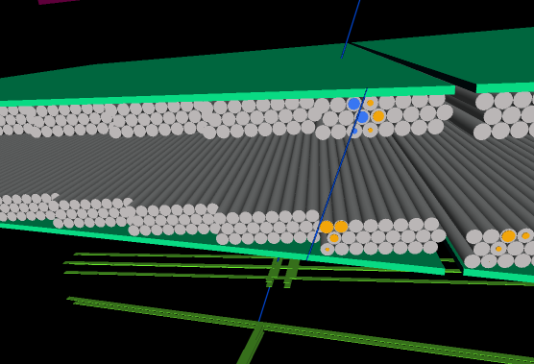
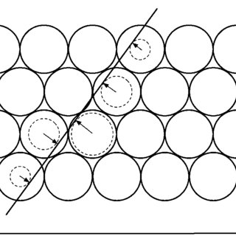
GASEOUS DETECTORS
Tube filled with a gas
Central wire under “high” voltage
Charged particle create ionization on the passage
Results in a signal passing through the wire
Can measure position and time
Can cover large volumes

Slide 15
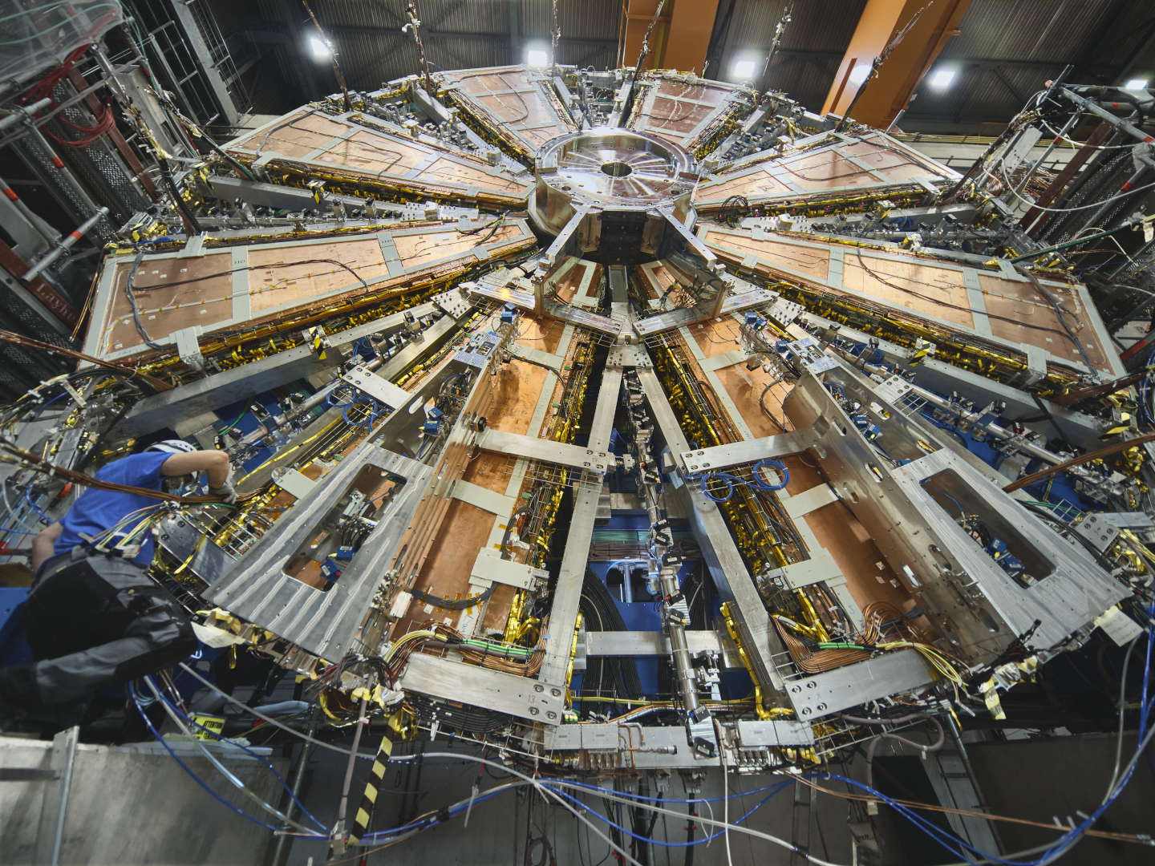
ATLAS MUON CHAMBERS

Slide 16
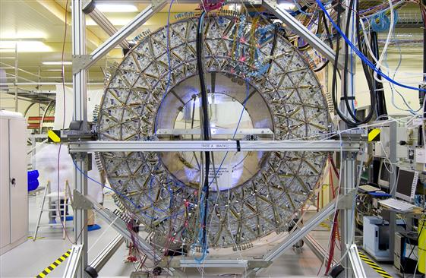
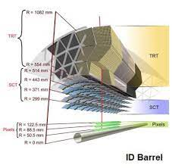
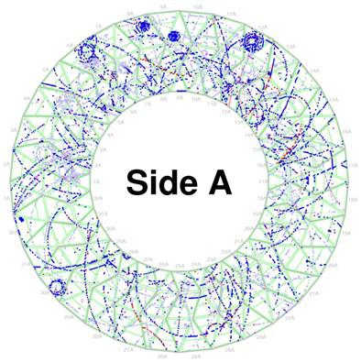
ATLAS TRT (TRANSITION RADIATION TRACKER)
Thin wall tubes
Measure drift time for precise positioning
Measure time-over-threshold (ToT)
Can provide particle identification, like electrons

Slide 17
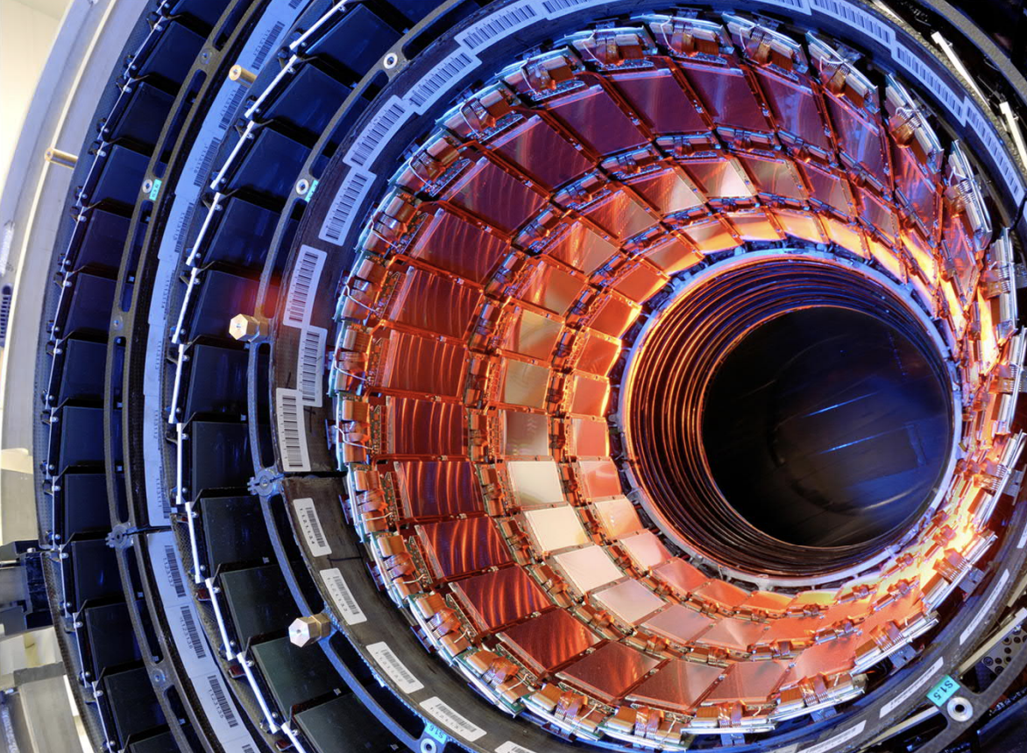
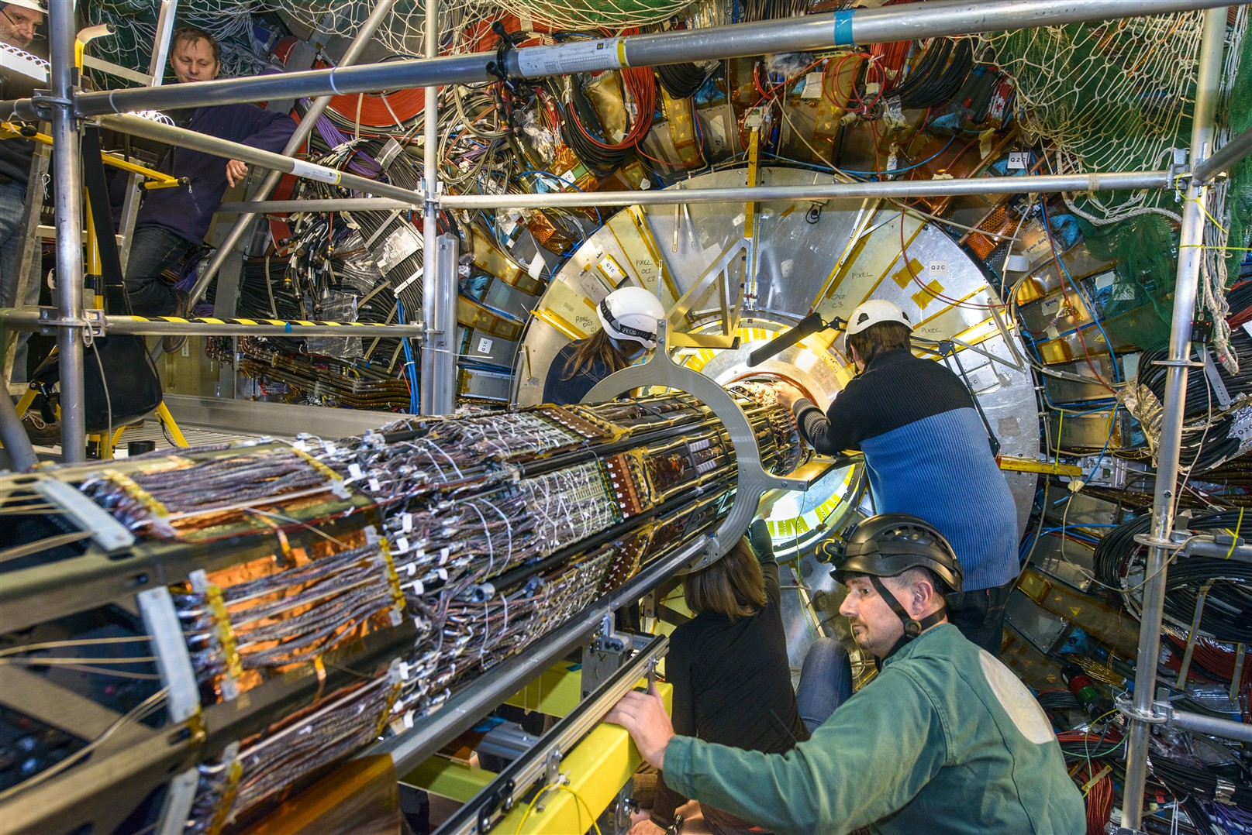
SOLID STATE (SILICON) DETECTORS
Essentially a diode connected in a special way
Charged particle creates electron/hole pairs
This signal can be registered
Can have many channels
Very fine space resolution to separate hits (tracks)
But cannot cover large volumes

Slide 18
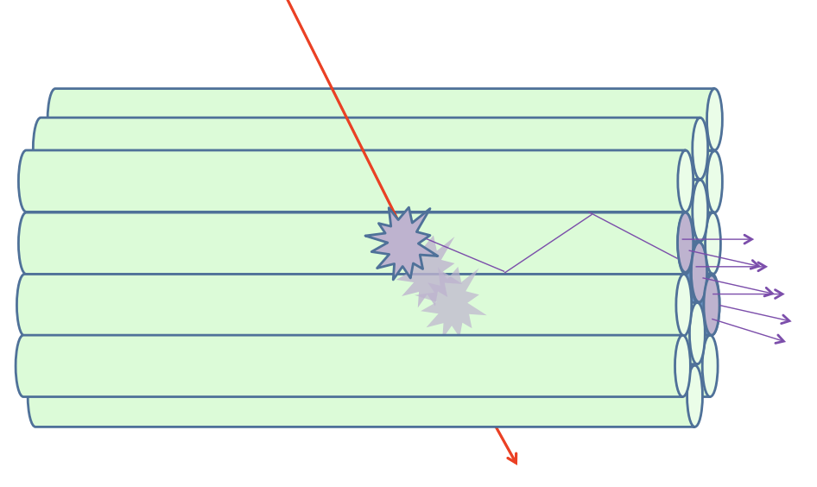
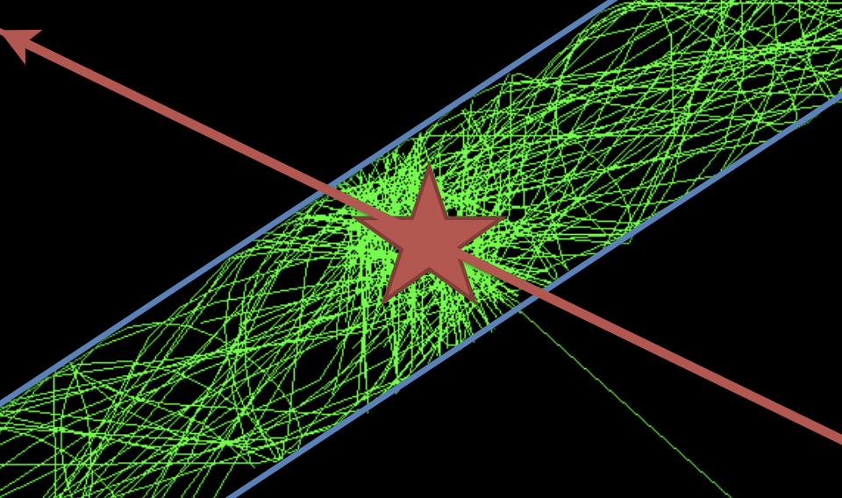
FIBER TRACKERS
Small (~1mm) diameter fibers
Read out by PMTs or other photo-detectors
Measure time and signal strength
Can cover relative large area

Slide 19

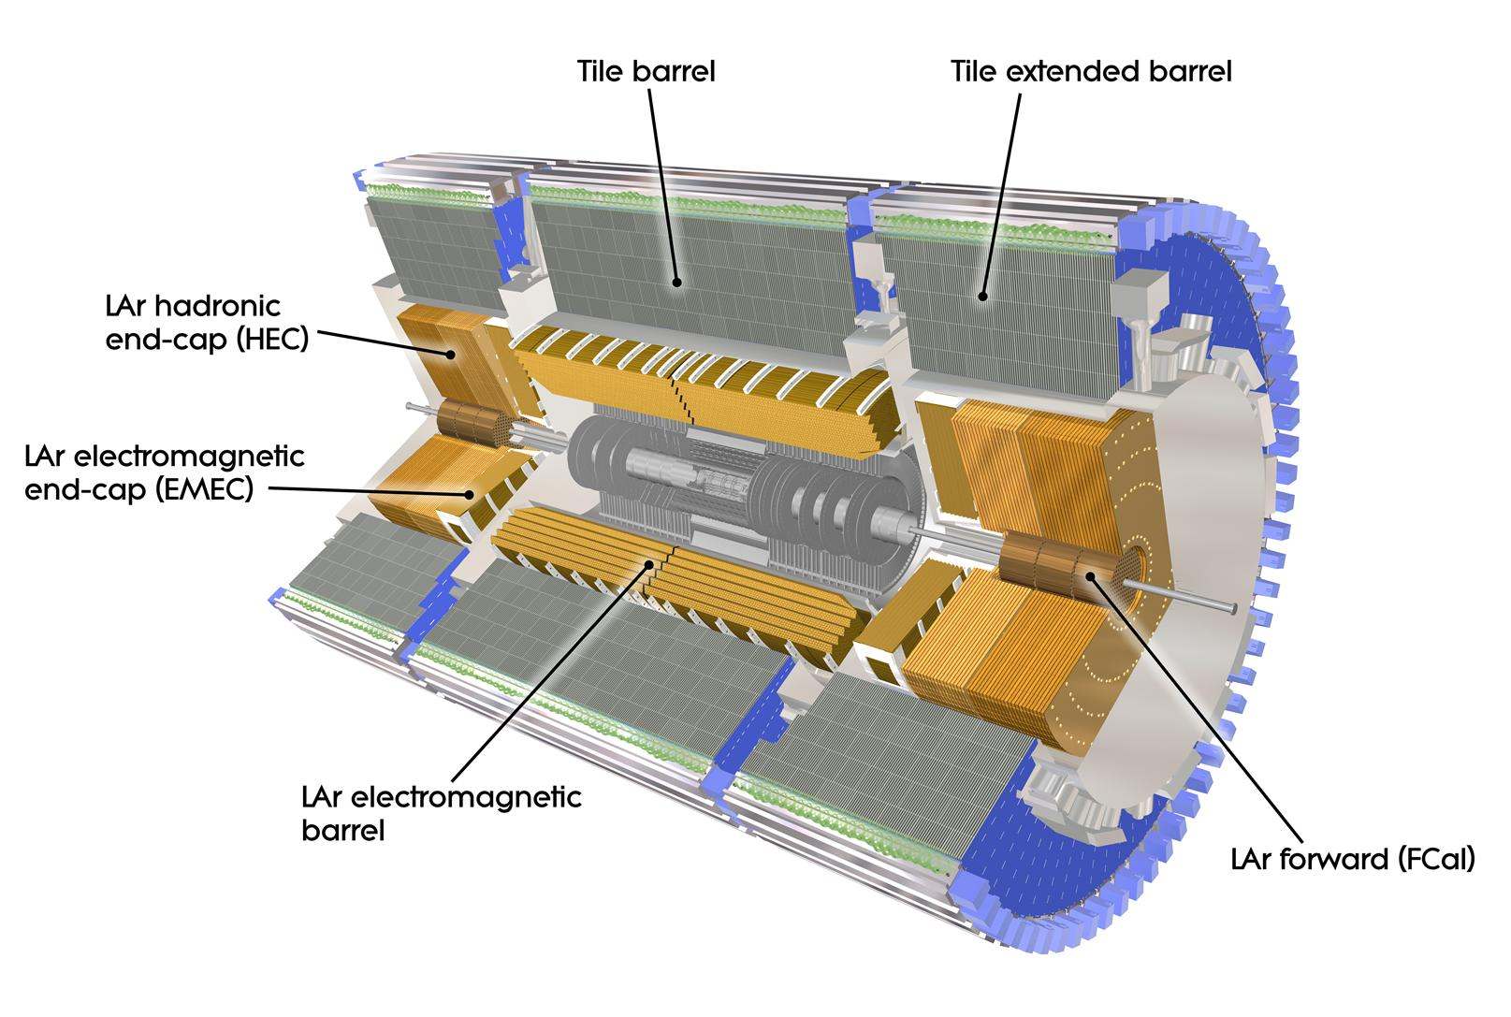
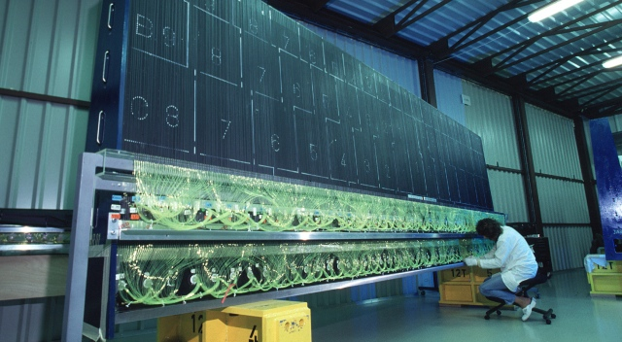
CALORIMETERS
Measure energy and time
Passing particle create “showers” of secondary particles
Number of particles in a shower proportional to the energy of initial one
Stopping most of the particles
Homogeneous or sampling (sandwich type)
Cover large volumes

Slide 20
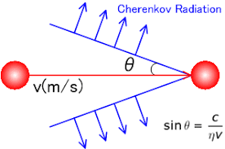
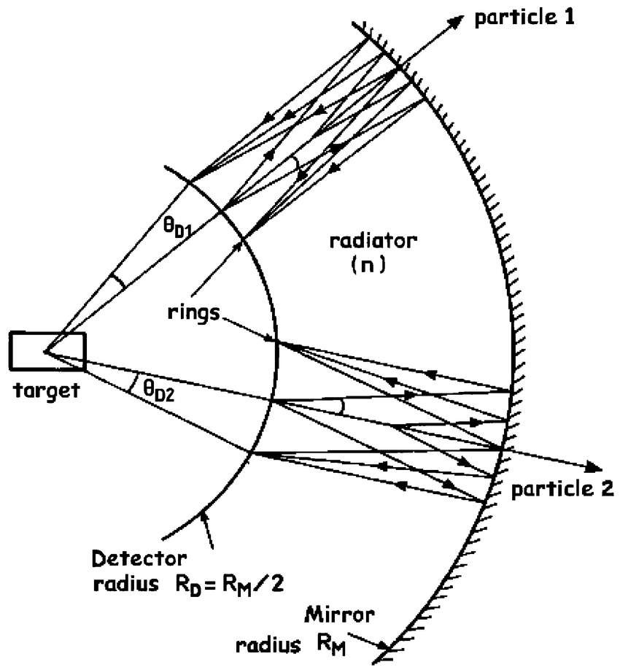
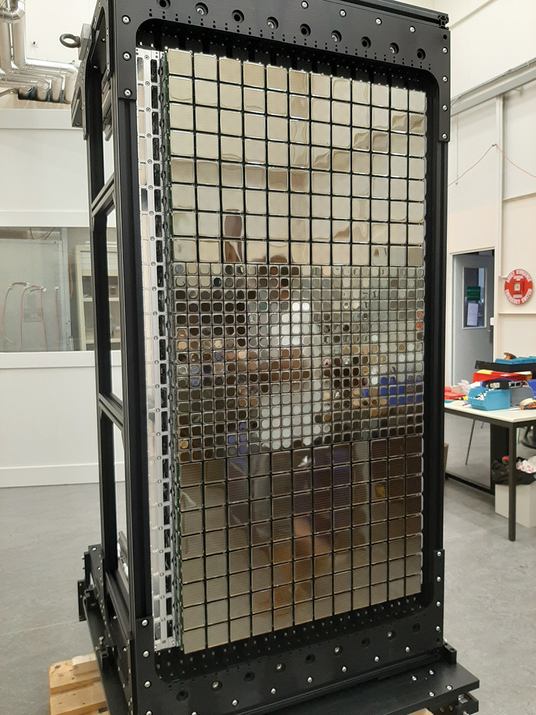
CHERENKOV COUNTER
Charged particle radiates when going faster than some threshold
Can distinguish between different particles
Can provide a “ring” of light

Slide 21
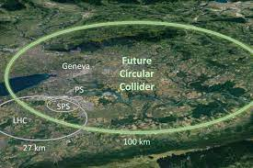
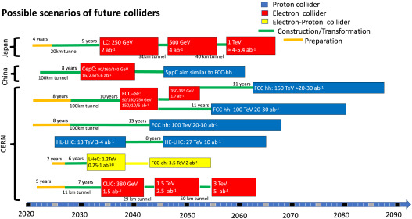
FUTURE ACCELERATORS

Slide 22
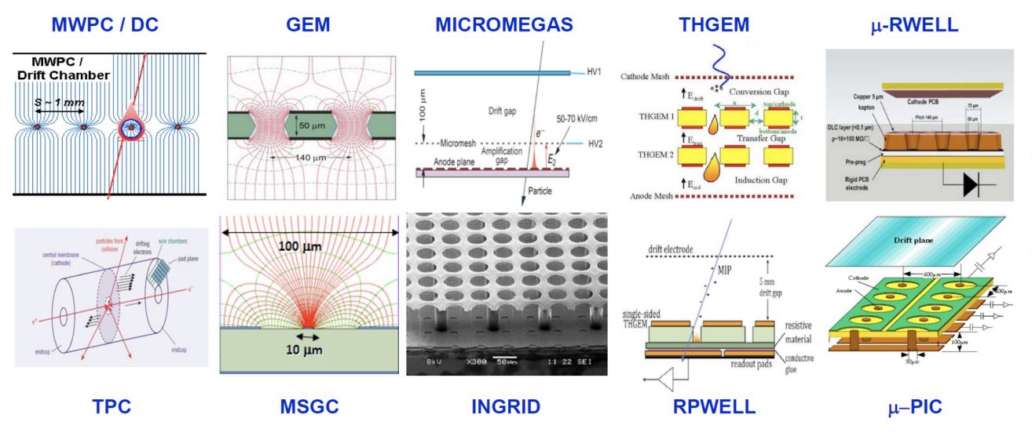
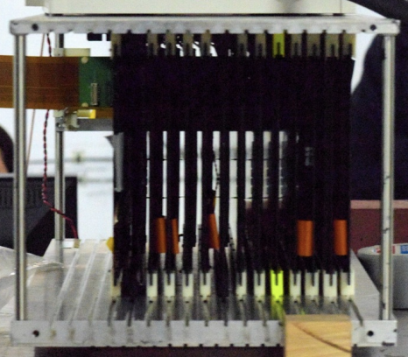
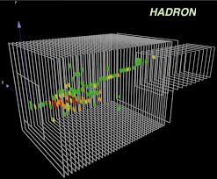
FUTURE TECHNOLOGIES
Need “new” detectors for future experiments
Developing better detectors and electronics
More channels
High granularity
Better precision
Tracking calorimeters
Integration with readout
Lower cost?

