Slide 1
Status of EuPRAXIA
R. Assmann (GSI and INFN) and M. Ferrario (INFN)
TIARA Meeting, 7 Nov. 2023

Slide 2
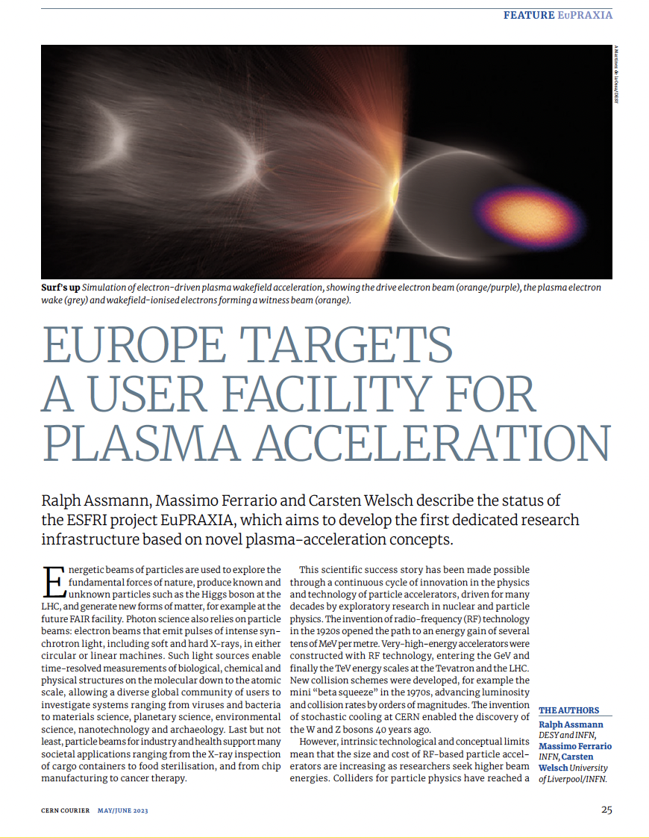
A New European High-Tech User Facility
Building a facility with very high field plasma accelerators, driven by lasers or beams
1 – 100 GV/m accelerating field
Shrink down the facility size
1
Producing particle and photon pulses to support several urgent and timely science cases
Enable frontier science in new regions and parameter regimes
2
https://www.eupraxia-facility.org/

Slide 3
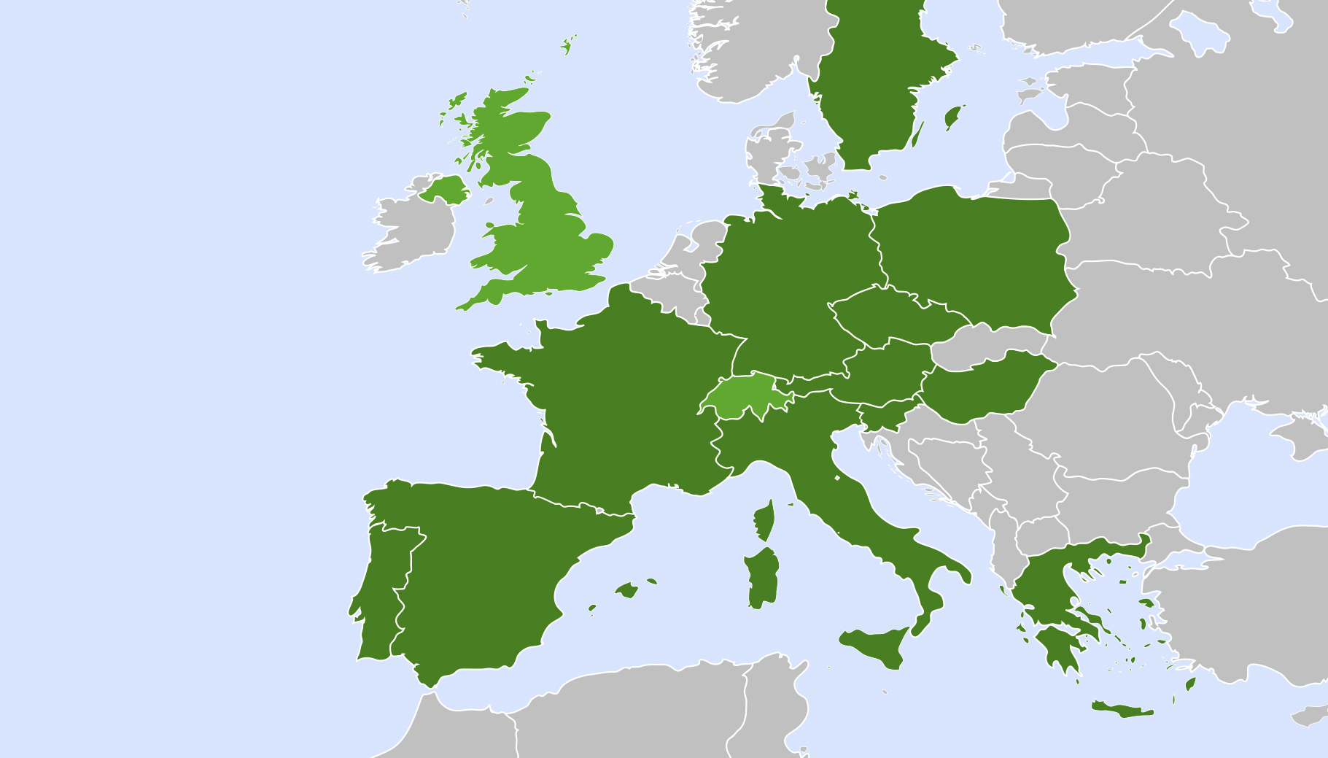


Distributed Research Infrastructure
Beam-driven plasma user facility
EuPRAXIA Headquarter
Laser-driven plasma user facility: candidates
Excellence Center
Advanced Applications Beamlines (UK)
Plasma Acc. & High Rep. Rate Dev. (D)
2
2
3
4
Technology Incubator (CZ - ELI)
Second site will be decided in Preparatory Phase project.
Excellence centers (EC) perform technical developments, prototyping and component construction. Number of EC’s, locations, roles, responsibilities reviewed in Prep. Phase.
2
5
2
6
User Data Center (H)
Laser-Plasma Acc. & 1 GeV FEL (F)
Beam-driven plasma user facility
EuPRAXIA Headquarter
2
1
Theory & simulations (P)
Horizon Europe

Slide 4
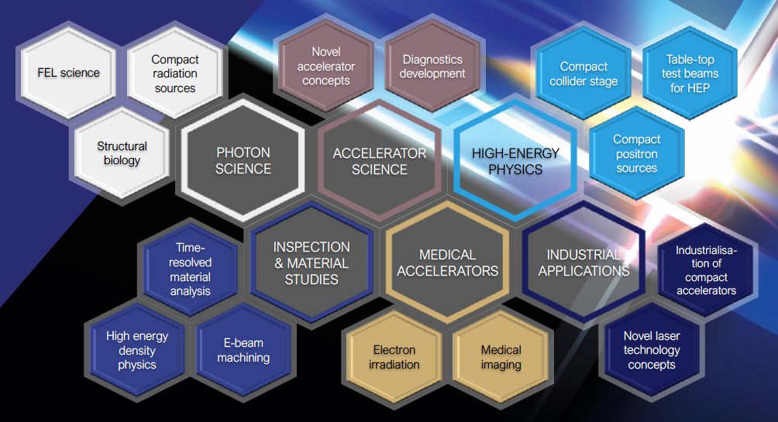
Intense R&D Program on critical components
Electrons
(0.1-5 GeV, 30 pC)
Positrons
(0.5-10 MeV, 10⁶)
Positrons (GeV source)
Lasers
(100 J, 50 fs, 10-100 Hz)
X-band RF Linac
(60 MV/m , up to 400 Hz)
Plasma Targets
Betatron X rays
(1-10 keV, 10¹⁰)
FEL light
(0.2-36 nm, 10⁹-10¹³)

Slide 5
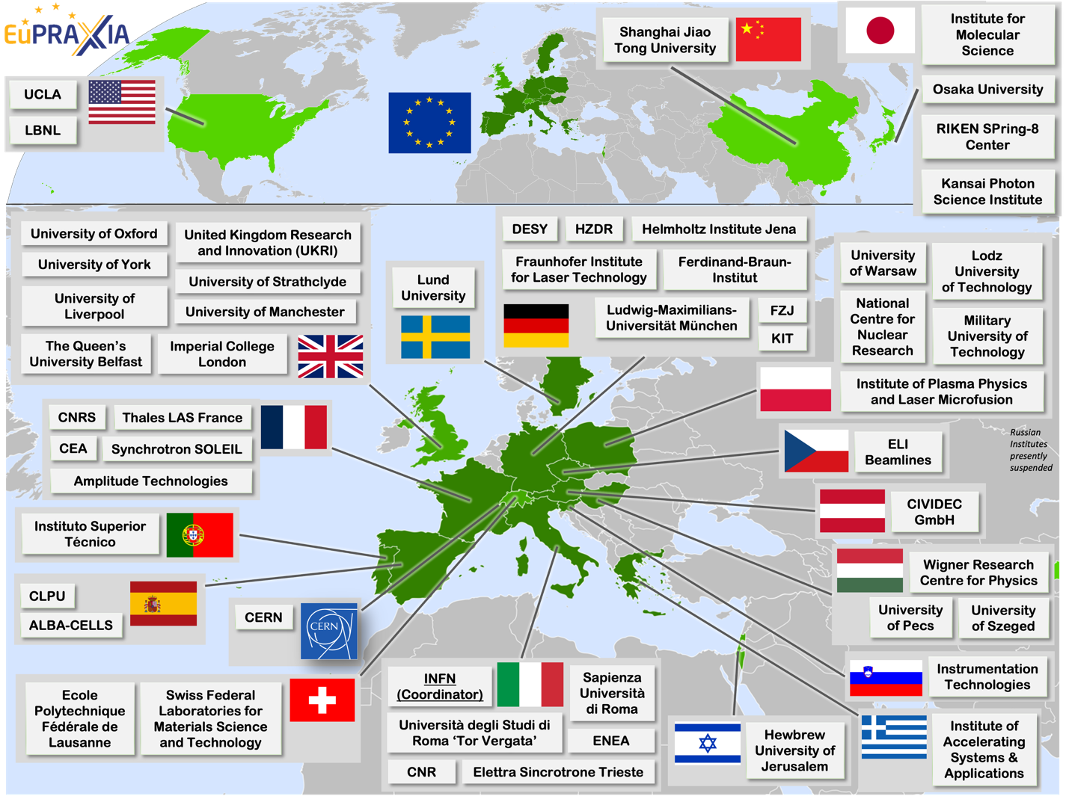
Wide International Collaboration
The EuPRAXIA Consortium today: 54 institutes from 18 countries plus CERN
Included in the ESFRI Road Map
Efficient fund raising:
  Preparatory Phase consortium (funding EU, UK, Switzerland, in-kind)
  Doctoral Network (funding EU, UK, in-kind)
  EuPRAXIA@SPARC_LAB (Italy, in-kind)
  EuAPS Project (Next Generation EU)
  What Next? PACRI?

Slide 6
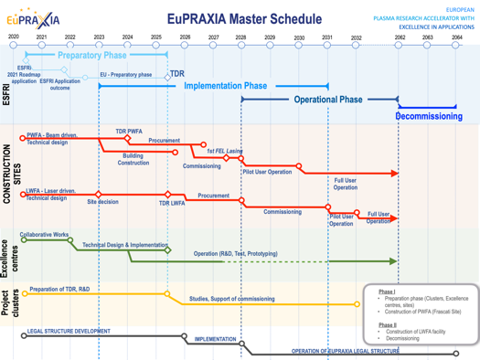
Preparatory Phase Main Goals
Managerial WP`s
  Outreach to public, users, EU decision makers and industry
  Define legal model (how is EuPRAXIA governed?), financial model, rules, user services and membership extension for full implementation
  Works with project bodies and funding agencies → Board of Financial Sponsors
Technical WP‘s (correspond to Project Clusters):
  Update of CDR concepts and parameters, towards technical design (full technical design requires more funding)
  Specify in detail Excellence Centers and their required funding: TDR related R&D, prototyping, contributions to construction
  Help in defining funding applications for various agencies
Output defined in milestones & deliverables with dates

Slide 7
Phased Implementation of Construction Sites
 | Laser-driven | Beam-driven
Phase 1 | FEL beamline to 1 GeV + user area 1 Ultracompact positron source beamline + positron user area | FEL beamline to 1 GeV + user area 1 GeV-class positrons beamline + positron user area
Phase 2 | X-ray imaging beamline + user area Table-top test beams user area FEL user area 2 FEL to 5 GeV | ICS source beamline + user area HEP detector tests user area FEL user area 2 FEL to 5 GeV
Phase 3 | High-field physics beamline / user area Other future developments | Medical imaging beamline / user area Other future developments
INFN (Italy):
Facility for beam-driven plasma accelerators
Beamline BB-A: Radiation sources
FEL user area 1
Undulator
Undulator
Plasma Accelerator
FEL user area 2
RF Injector
RF Accelerator
ICS X-ray source user area (BU3)
HEP detector test user area
laser
Plasma Accelerator
Conversion & conditioning
electrons
GeV-class positron user area
positrons
Beamline BB-B: GeV-class positrons & HEP detector test stand
Beamline LB-C: X-ray imaging – life sciences & materials
Facility for laser-driven plasma accelerators
Plasma Injector
Life-science & materials X-ray imaging user area
Beamline LB-B: Positron beam source & table-top test beam
Table-top test beam user area
Plasma Injector
Plasma Accelerator
Conversion & conditioning
Ultracompact positron source user area
Laser
FEL user area 1
Plasma Accelerator
Undulator
Undulator
RF Injector
Beamline LB-A: FEL
FEL user area 2

Slide 8
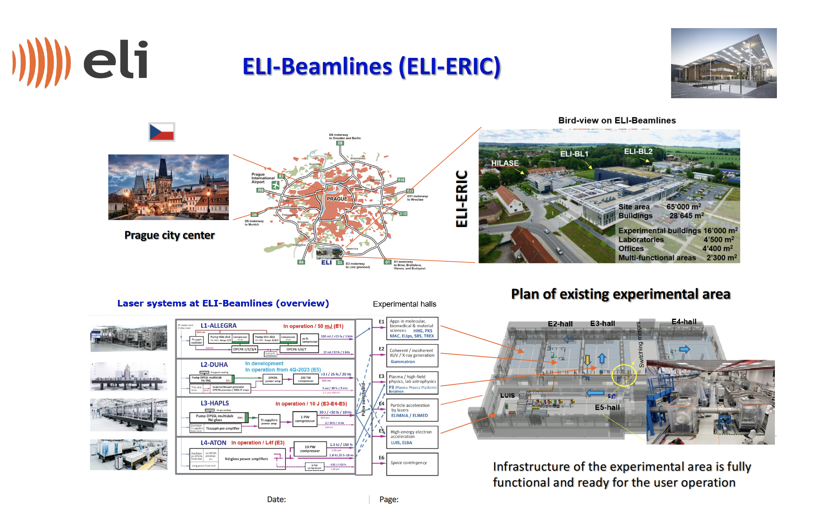
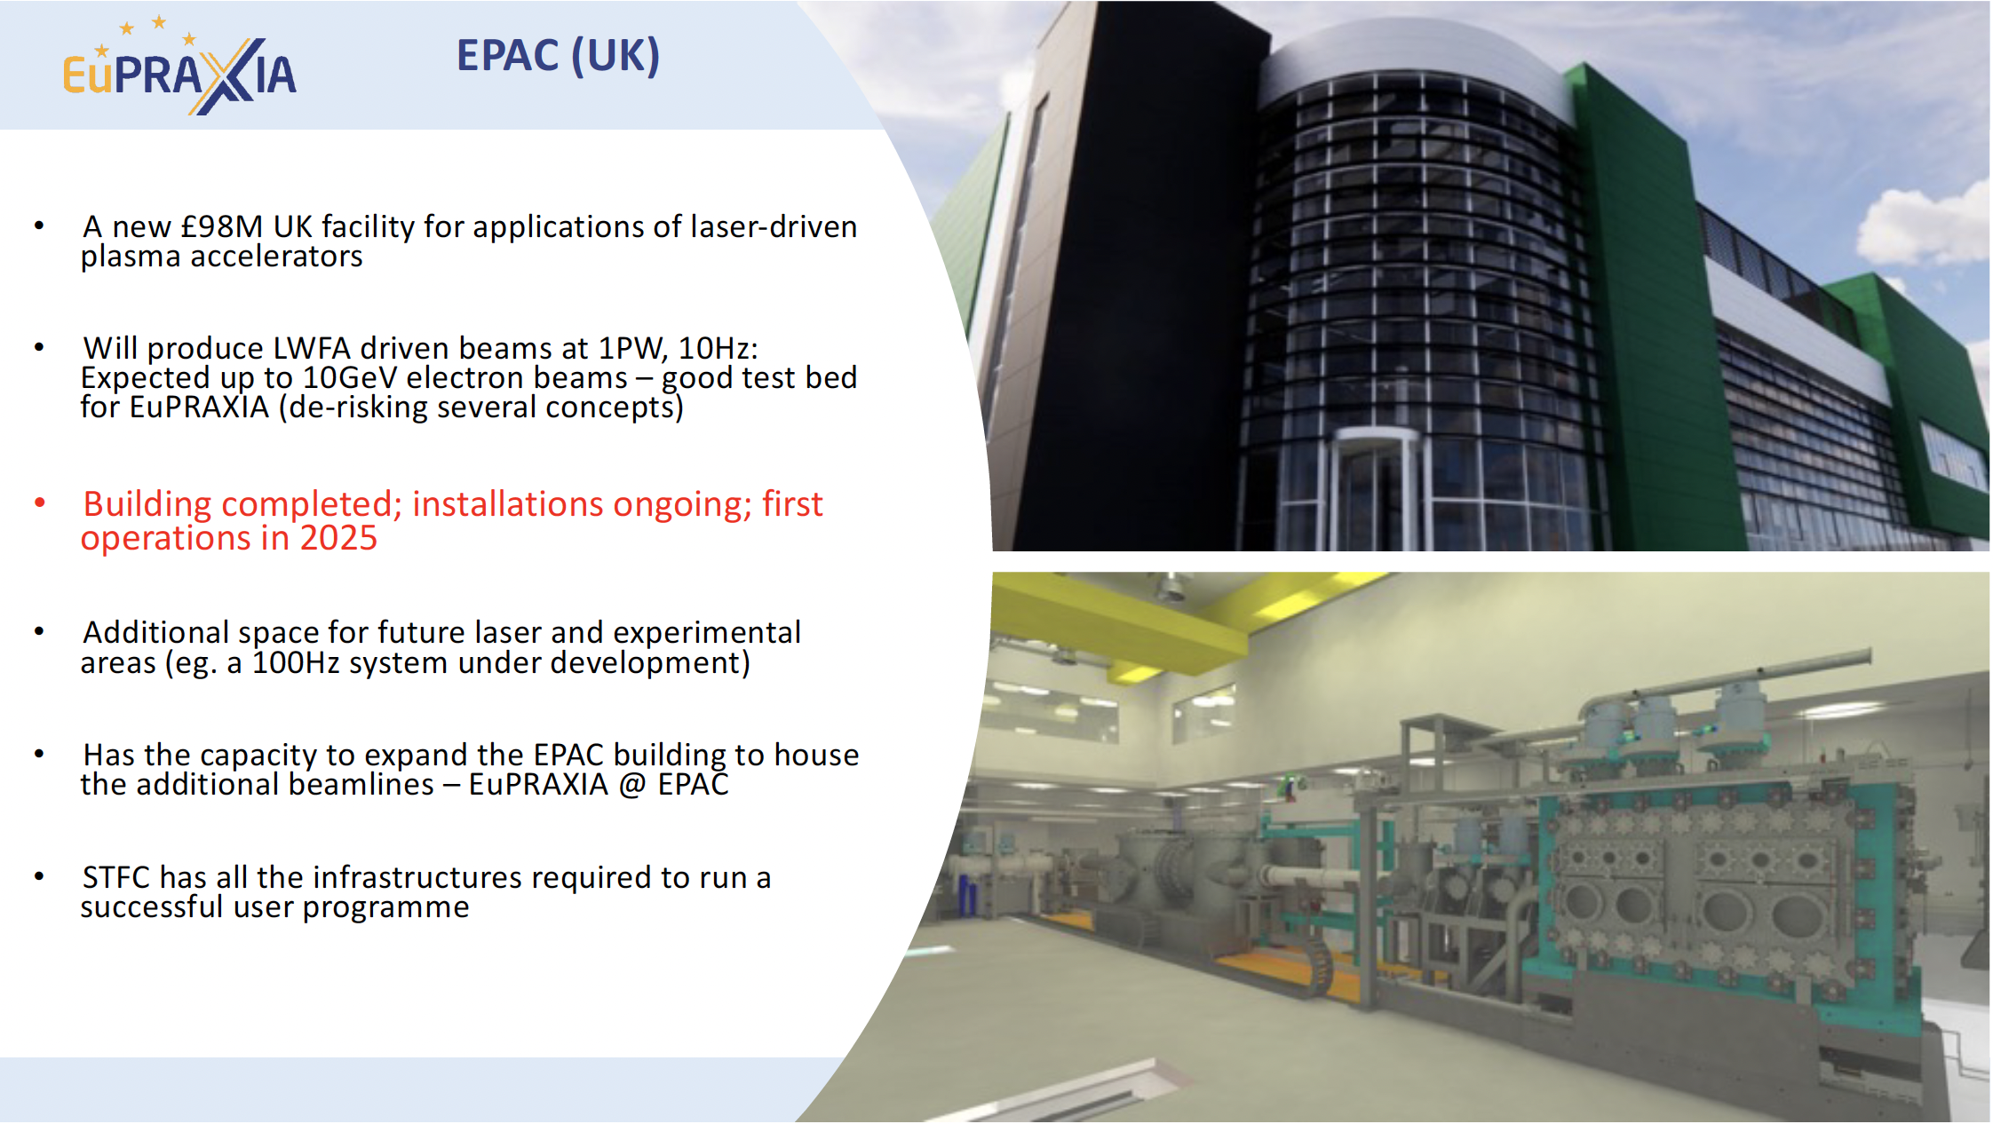
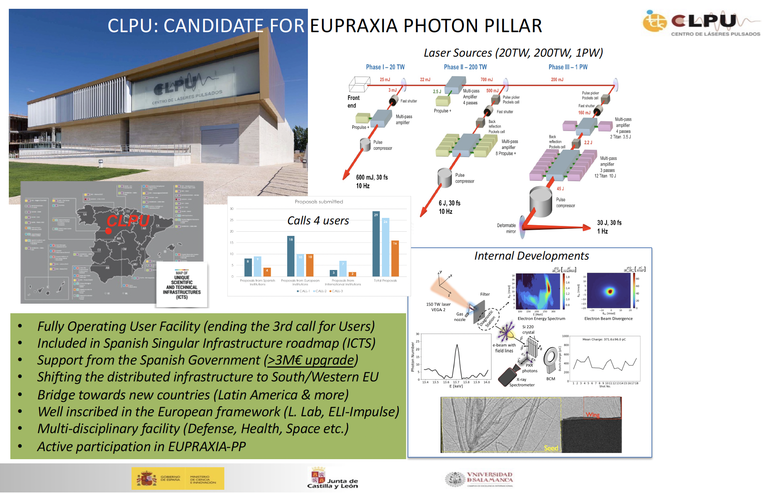
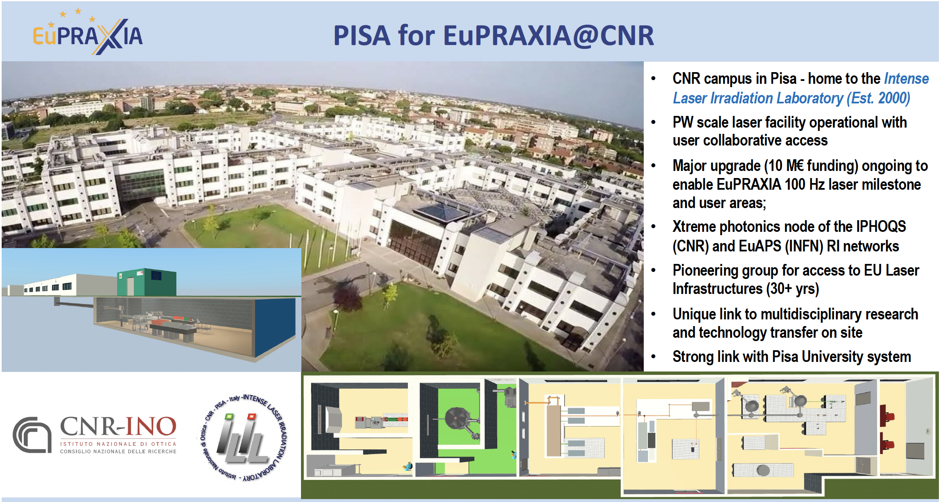
Current Candidates for EuPRAXIA Laser Site
Notes:
Maria

Slide 9
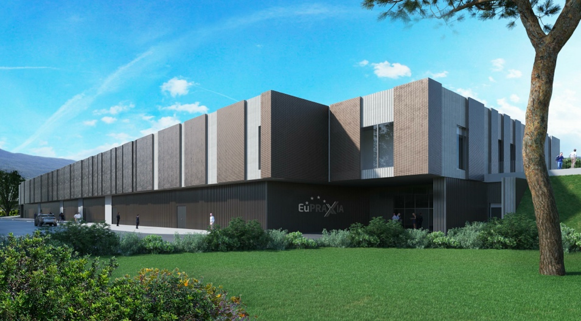
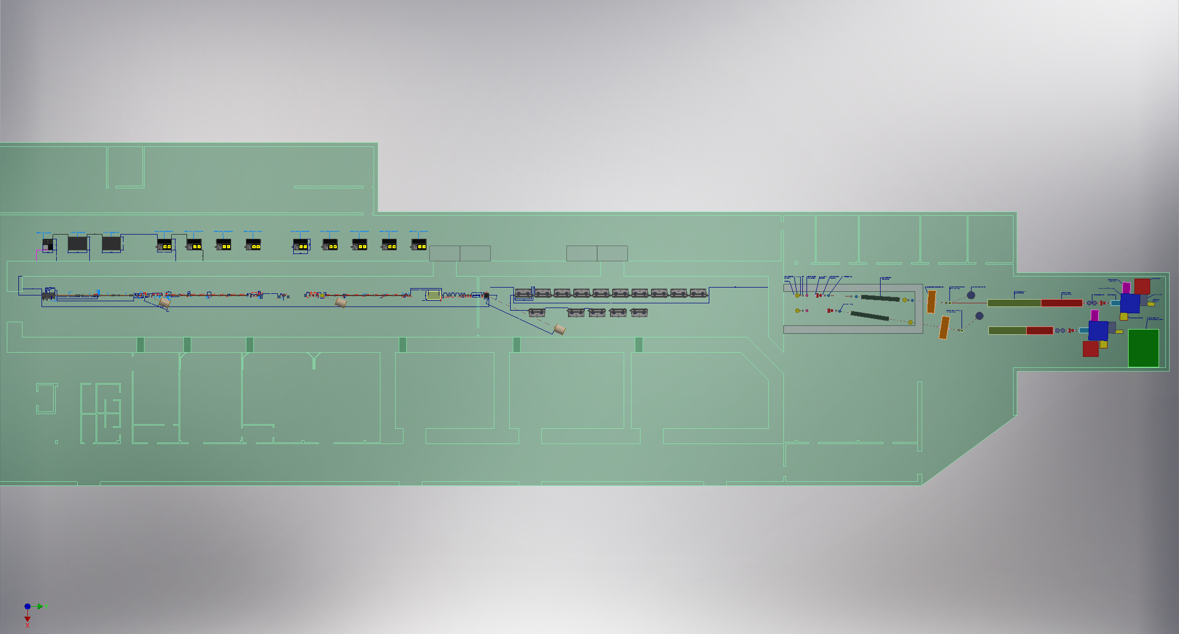
Headquarter and Site 1: EuPRAXIA@SPARC_LAB
Frascati`s future facility
> 130 M€ invest funding
Beam-driven plasma accelerator
Europe`s most compact and most southern FEL
The world`s most compact RF accelerator (X band with CERN)

Slide 10
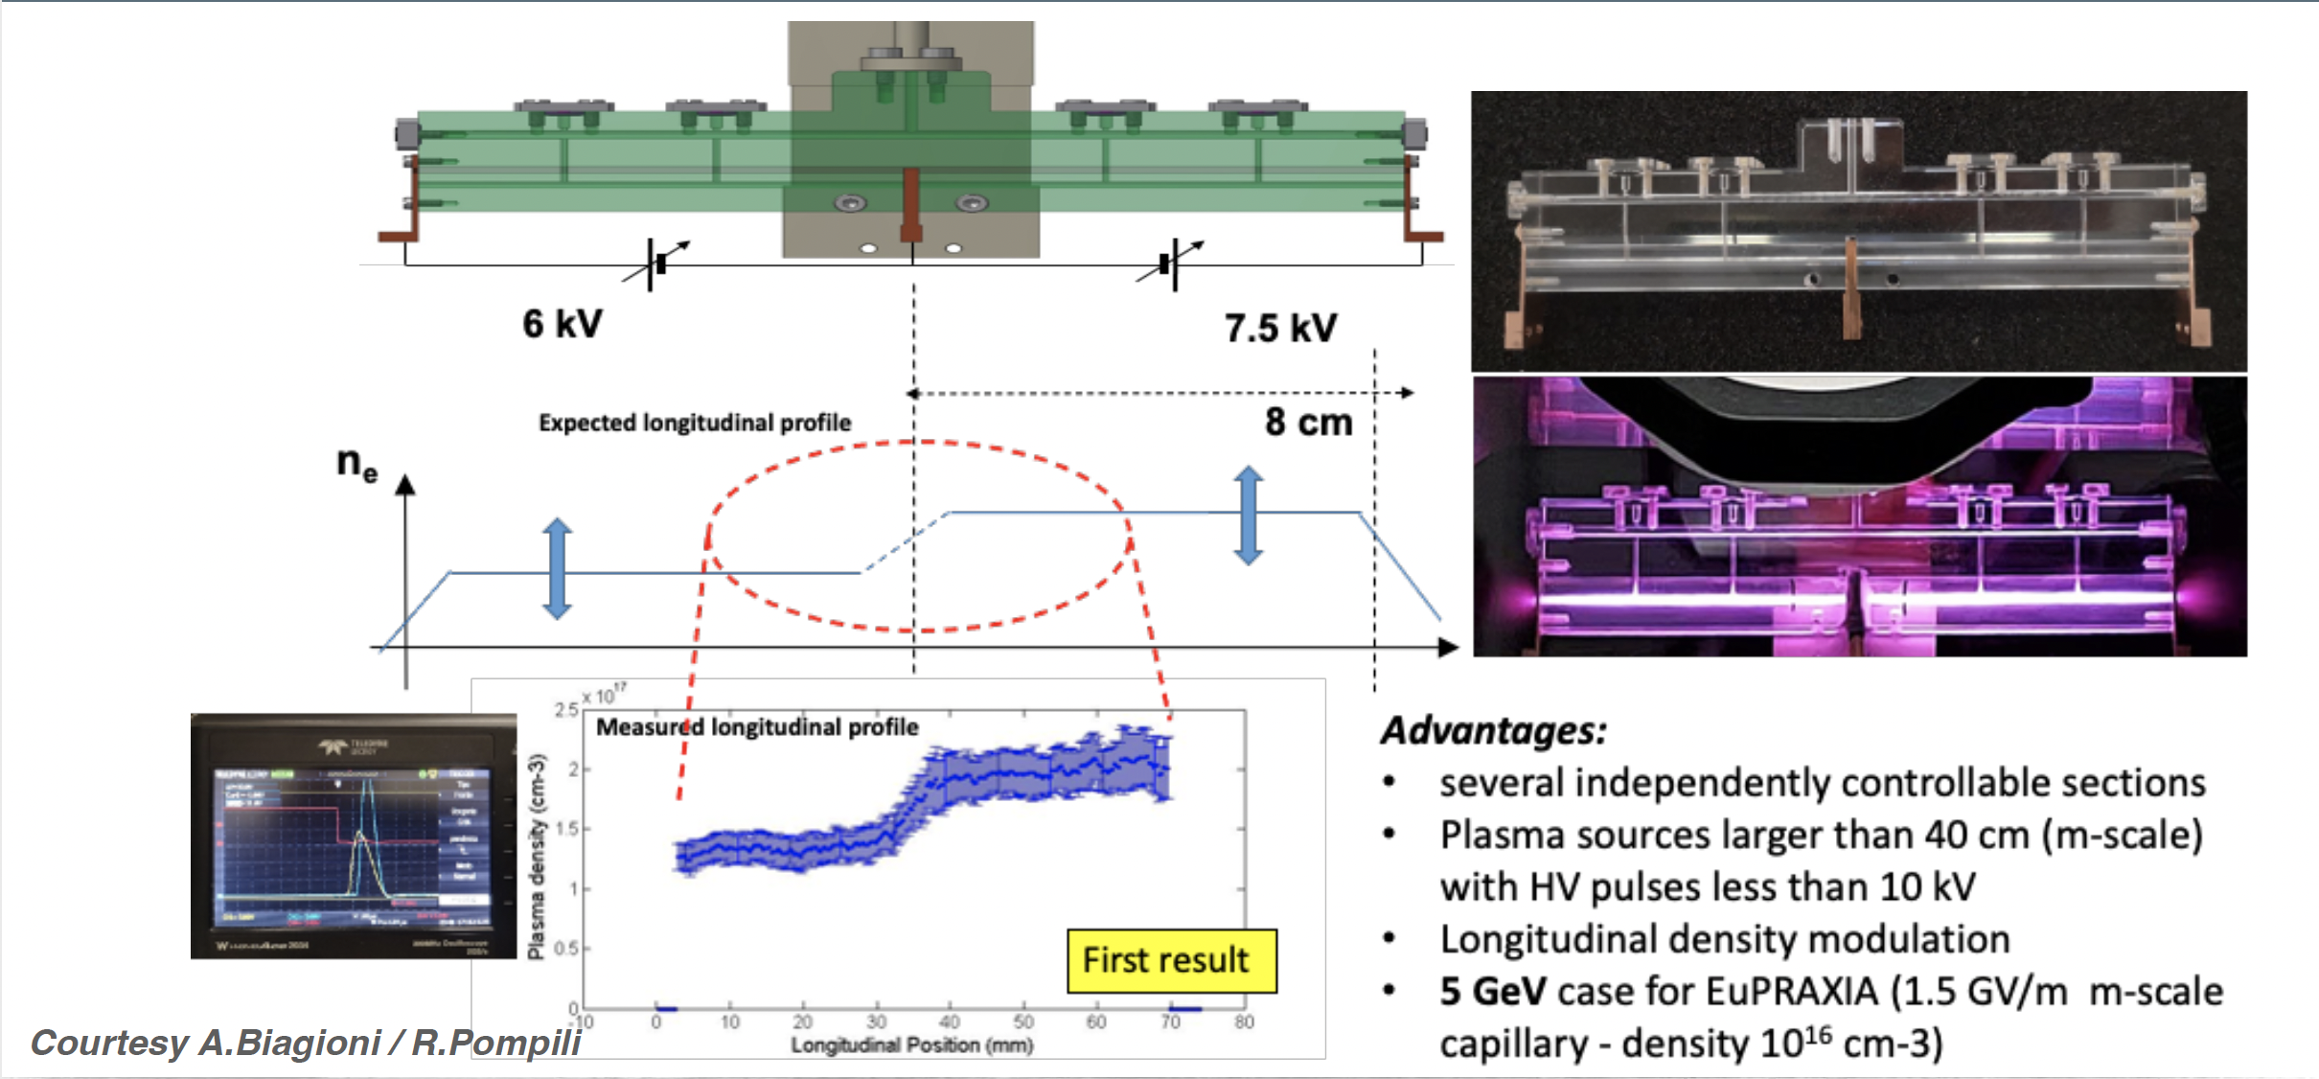
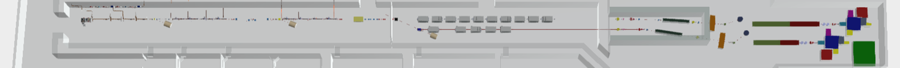
Plasma Module
3.5 m
Courtesy A. Biagioni, R. Pompili

Slide 11
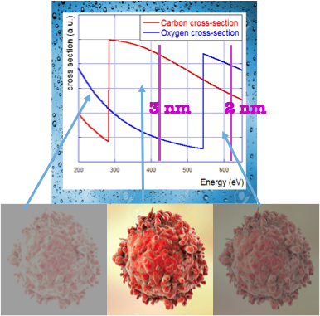
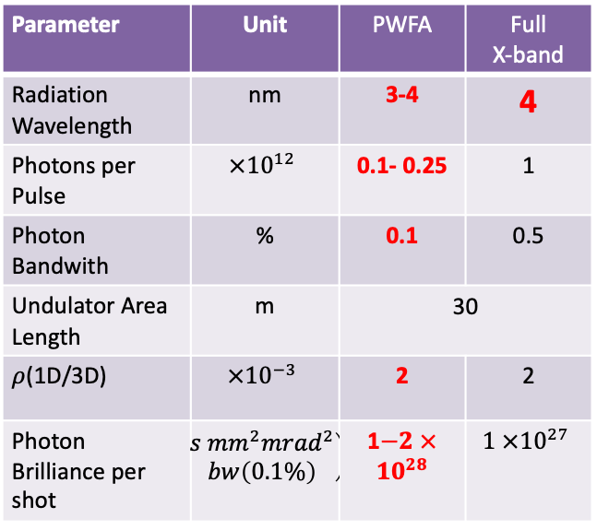
Expected SASE FEL performances
Parameter | Unit | PWFA | Full X-band
Electron Energy | GeV | 1-1.2 | 1
Bunch Charge | pC | 30-50 | 200-500
Peak Current | kA | 1-2 | 1-2
RMS Energy Spread | % | 0.1 | 0.1
RMS Bunch Length | 𝜇m | 6-3 | 24-20
RMS norm. Emittance | 𝜇m | 1 | 1
Slice Energy Spread | % | ≤0.05 | ≤0.05
Slice norm Emittance | mm-mrad | 0.5 | 0.5
In the Energy region between Oxygen and Carbon K-edge 2.34 nm – 4.4 nm (530 eV -280 eV) water is almost transparent to radiation while nitrogen and carbon are absorbing (and scattering)
Parameter | Unit | PWFA | Full X-band
Radiation Wavelength | nm | 3-4 | 4
Photons per Pulse | $$×{10}^{12}$$ | 0.1- 0.25 | 1
Photon Bandwith | % | 0.1 | 0.5
Undulator Area Length | m | 30 | 30
𝜌(1D/3D) | $$×{10}^{−3}$$ | 2 | 2
Photon Brilliance per shot | $$\left(\begin{aligned}s {mm}^{2}{mrad}^{2} \\ bw\left(0.1\%\right)\end{aligned}\right)$$ | 1$−2 ×{10}^{28}$ | $$1 ×{10}^{27}$$
Coherent Imaging of biological samples
protein clusters, VIRUSES and cells
living in their native state
Possibility to study dynamics
~10 ¹¹ photons/pulse needed
Courtesy C. Vaccarezza/L. Giannessi

Slide 12
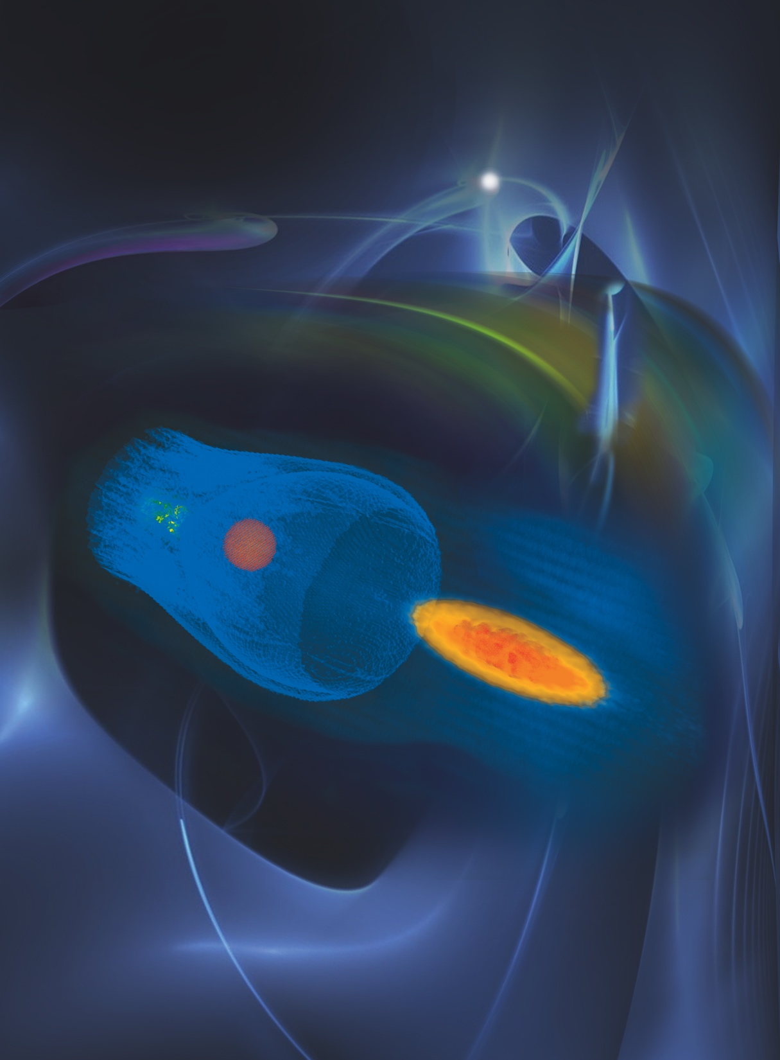
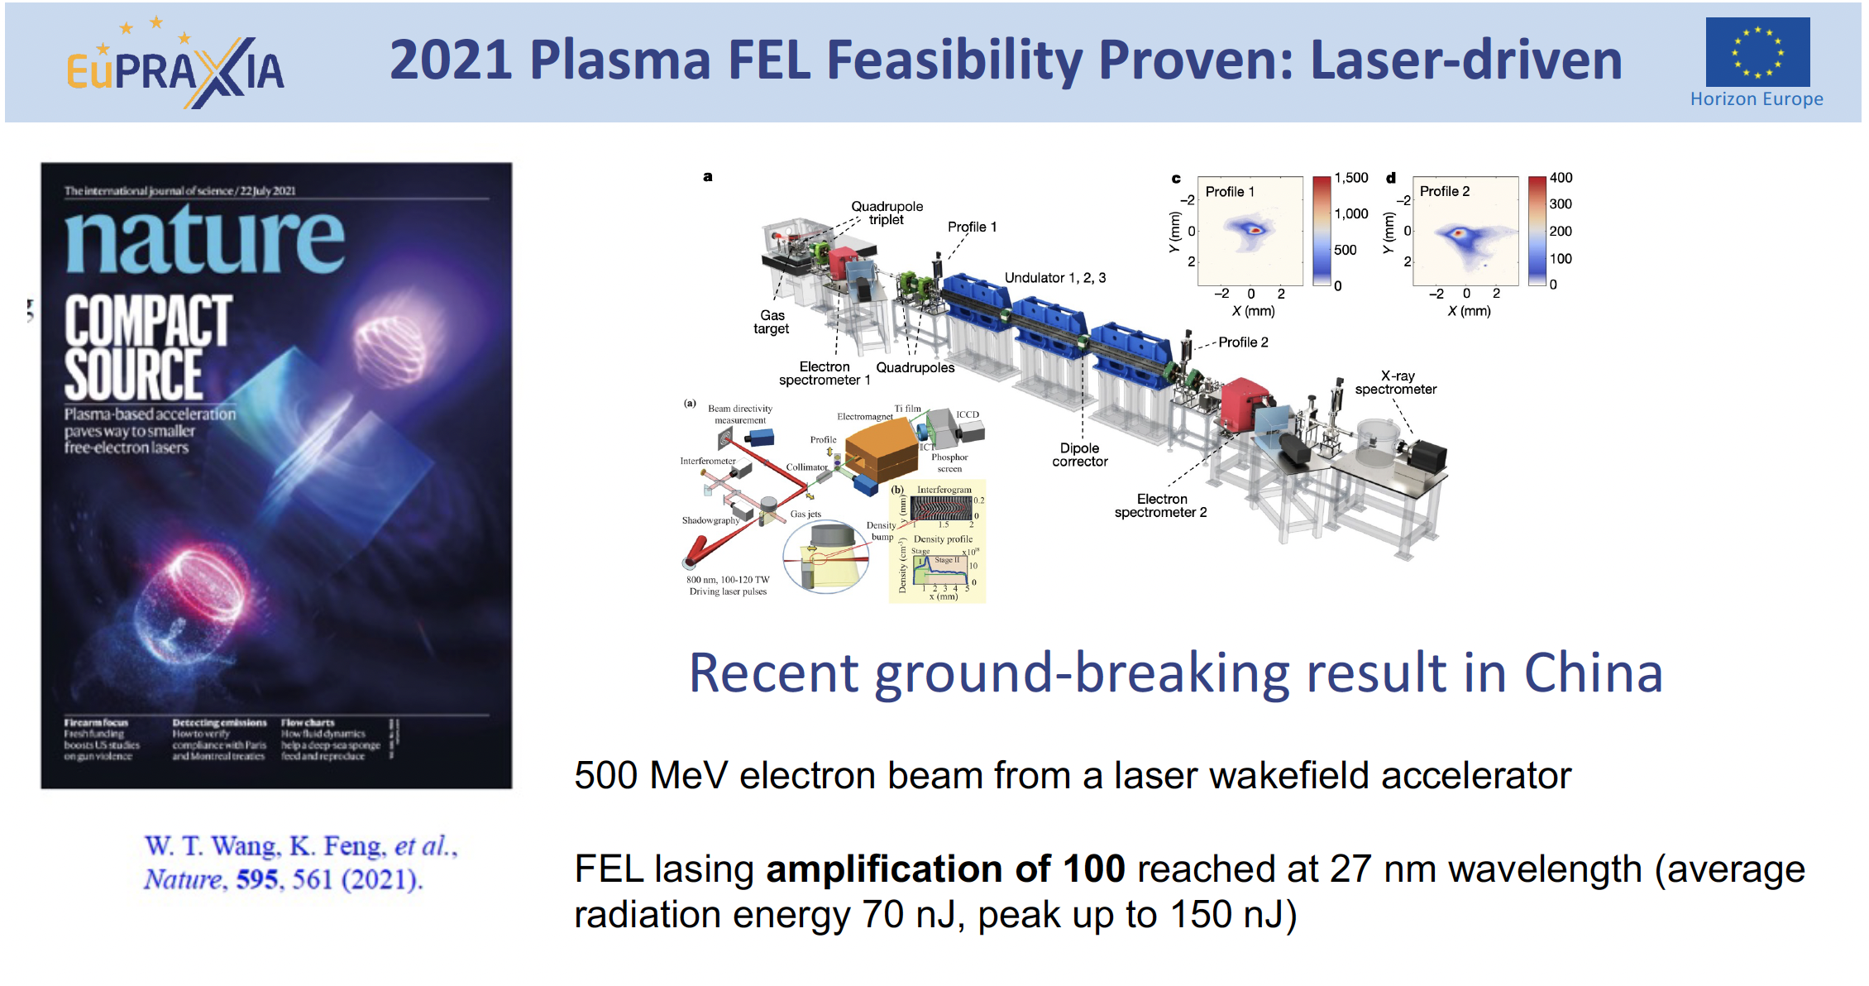
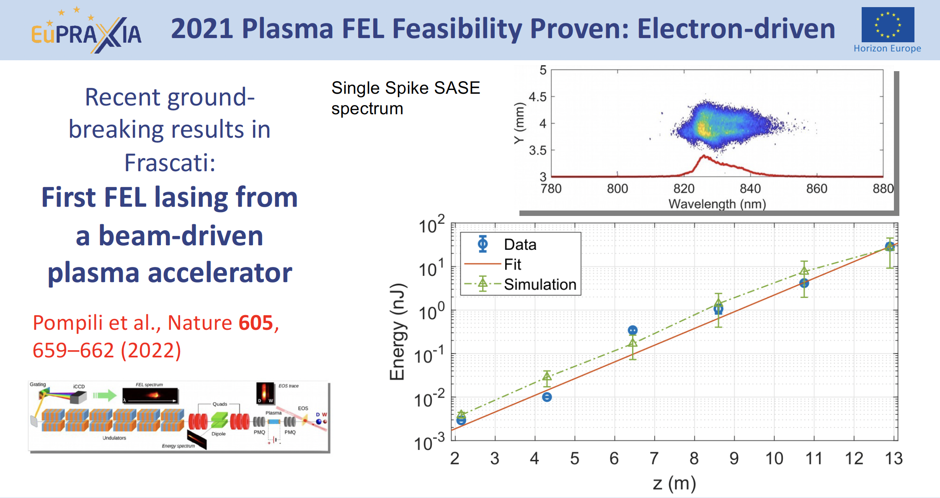
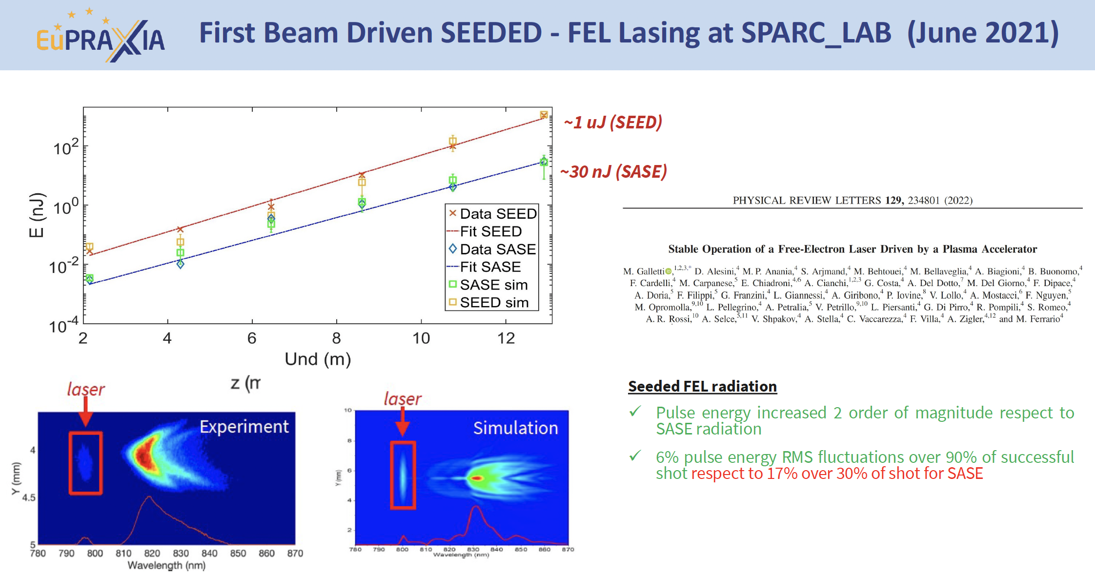
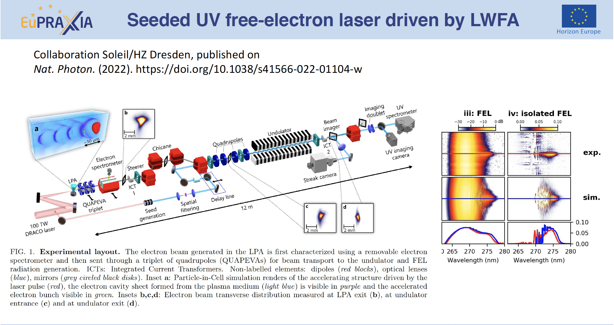
Basic beam quality achieved in pilot FEL experiments

Slide 13
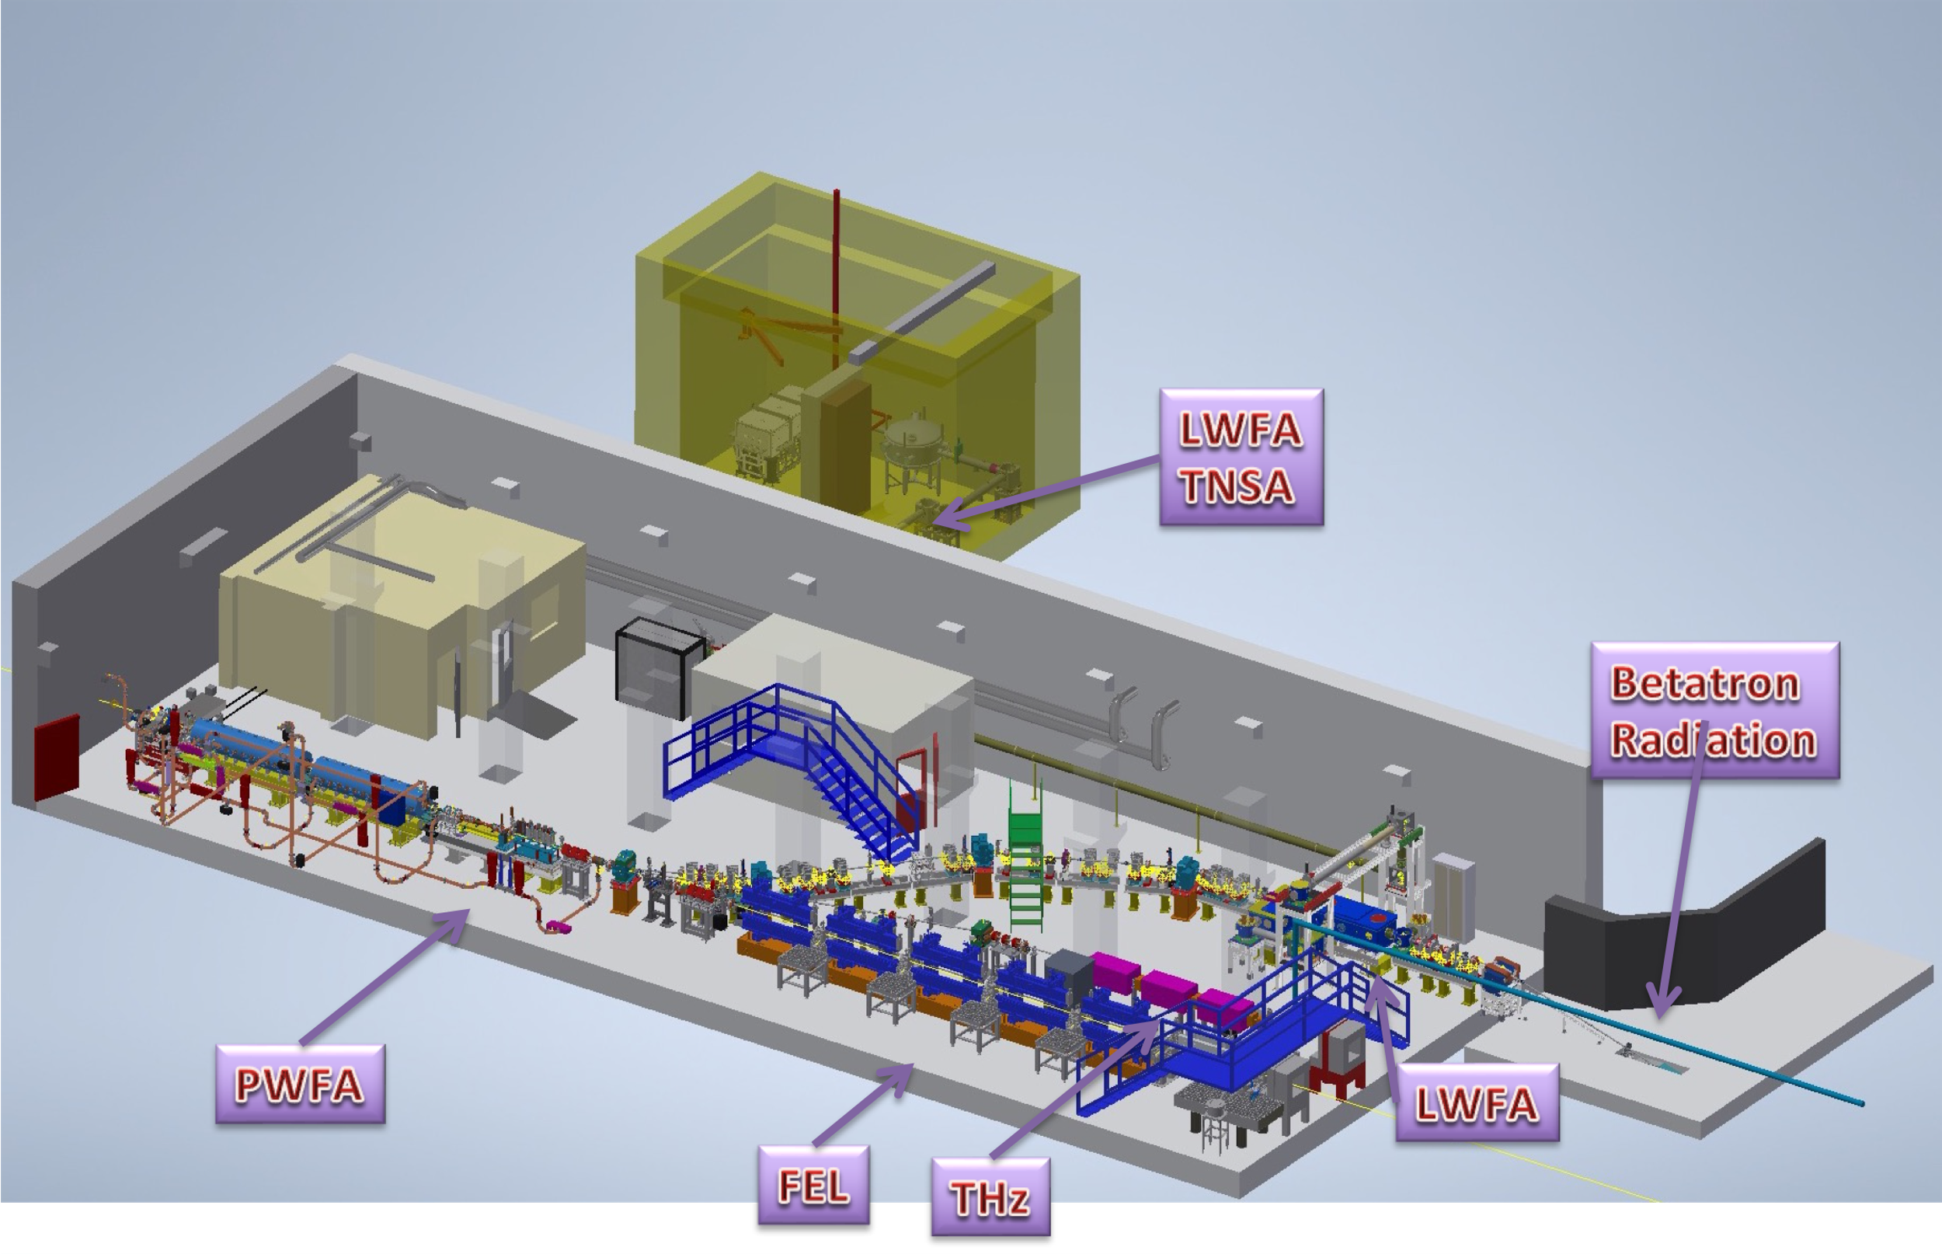
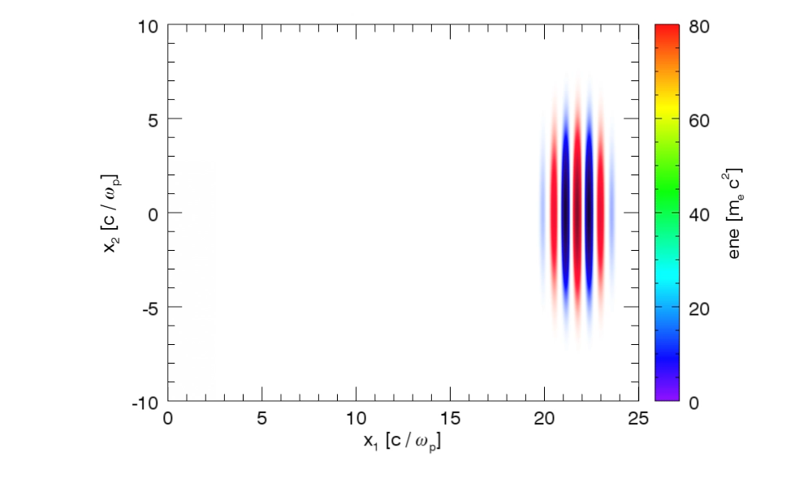
Electron beam Energy [MeV] | 50-800
Plasma Density [cm⁻³] | 10¹⁷ - 10¹⁹
Photon Critical Energy [keV] | 1 - 10
Nuber of Photons/pulse | 10⁶ – 10⁹
Courtesy J. Vieira, R. Fonseca/GoLP/IST Lisbon

Slide 14
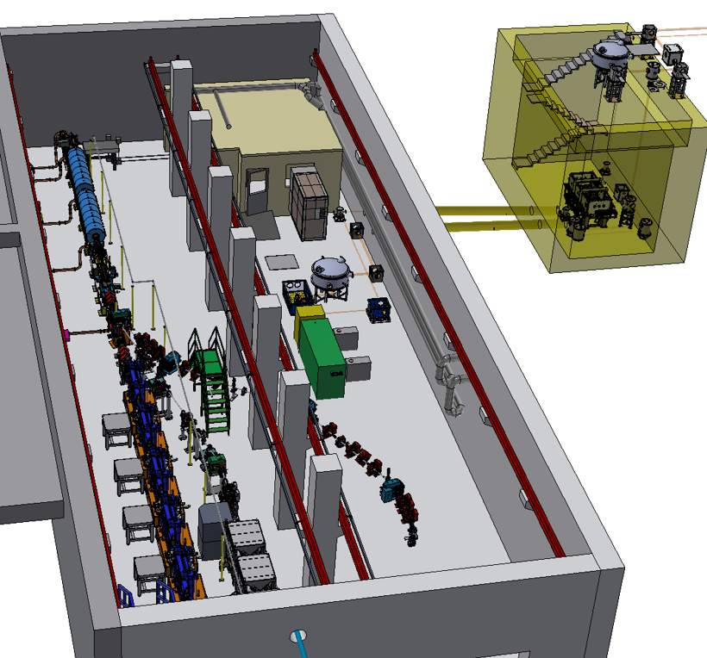
EuPRAXIA Advanced Photon Sources (EuAPS)
Parameter | Value | unit
Electron beam Energy | 100-500 | MeV
Plasma Density | 10¹⁸-10¹⁹ | cm⁻³
Photon Critical Energy | 1 -10 | keV
Number of Photons/pulse | 10⁷-10⁹
Repetition rate | 1-5 | Hz
Beam divergence | 3-20 | mrad
Supported by PNRR funding
Collaboration among INFN, CNR, University of Tor Vergata
EuPRAXIA → laser-driven betatron radiation source @SPARC_LAB
→ development of high power (up to 1 PW at LNS) and high repetition rate (up to 100 Hz at CNR Pisa) laser
→ pre-cursor for user-facility
Ultrafast - laser pulse duration tens of fs useful for time resolved experiments (XFEL tens of fs, synchrotron tens to 100 ps).
Broad energy spectrum - important for X-ray spectroscopy.
High brightness - small source size and high photon flux for fast processes
Large market - 50 synchrotron light sources worldwide, 6 hard XFEL’s and 3 soft-ray ones (many accelerators operational and some under construction).
Courtesy of
A. Cianchi

Slide 15
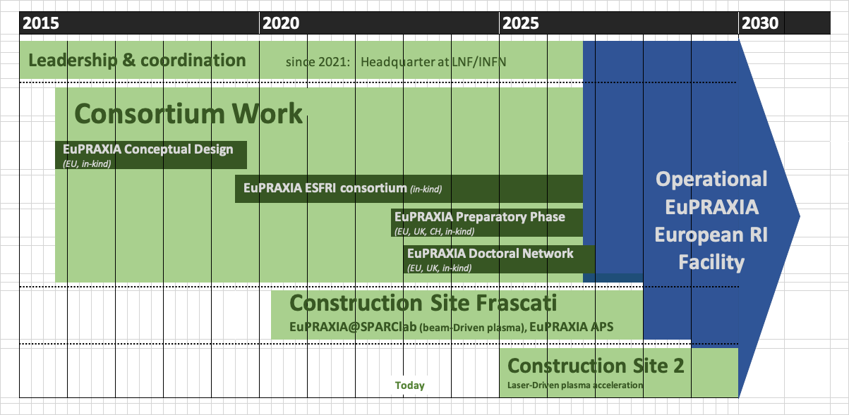
EuPRAXIA Project Timeline
Courtesy A. Falone

Slide 16
ESPP Roadmap Update – Plasma Accelerators

Slide 17
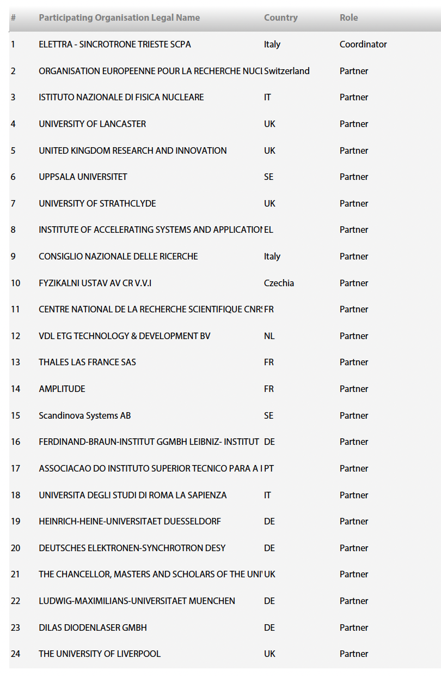
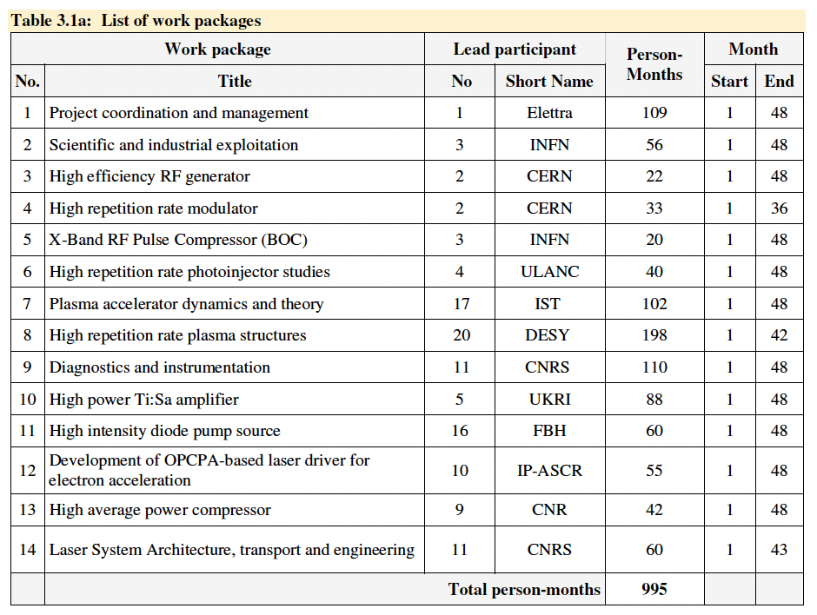
NEXT STEP: PACRI?
HORIZON-INFRA-2024-TECH-01-01: R&D for the next generation of scientific instrumentation, tools, methods, solutions for RI upgrade
Dead line submission March 2024
Target Budget ~10 MEuro
Based on the Legacy of CREATE proposal, submitted to HORIZON-INFRA-2022 TECH

Slide 18
Plasma Accelerators for Compact Research Infrastructures
(PACRI)
The objective of the PACRI project is to develop innovative breakthrough technologies, increasing their Technology Readiness Level (TRL) for electron accelerators while taking energy consumption, resource efficiency, costs, and environmental impact into due account. This includes the following draft non-exclusive goals:
developing high rep-rate plasma modules, as required for the EuPRAXIA project, extending its scientific domain from high average brightness radiation sources up to high energy physics;
developing key laser components required to upscale high-power high repetition rate Laser technology as required by the EuPRAXIA and ELI Research Infrastructure.
improving the performance of normal conducting technology for X-band linac drivers, extending them to the kHz regime, with focus on efficiency and energy consumption;
supporting development towards compact linear colliders and nuclear physics facilities;
developing compact advanced undulator modules, in order to reduce the overall size of the future FEL facilities.
supporting the availability of compact X-ray facilities (FELs, ICSs, Betatron) to serve a larger number of users in many scientific fields, industry and society;

Slide 19
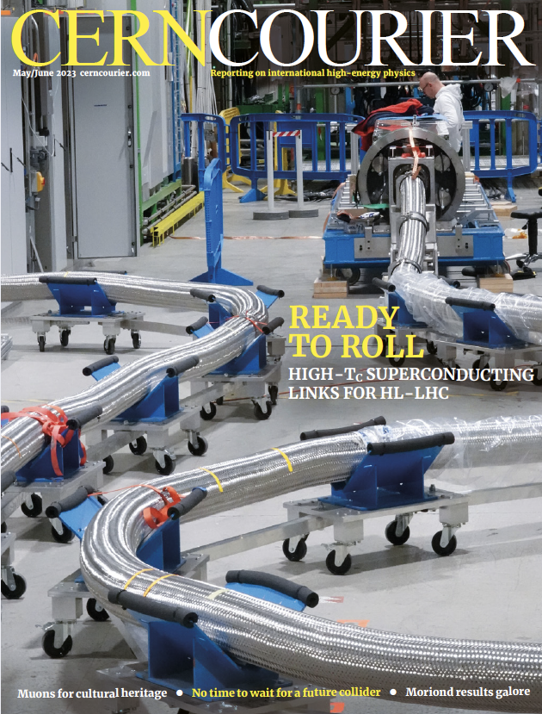
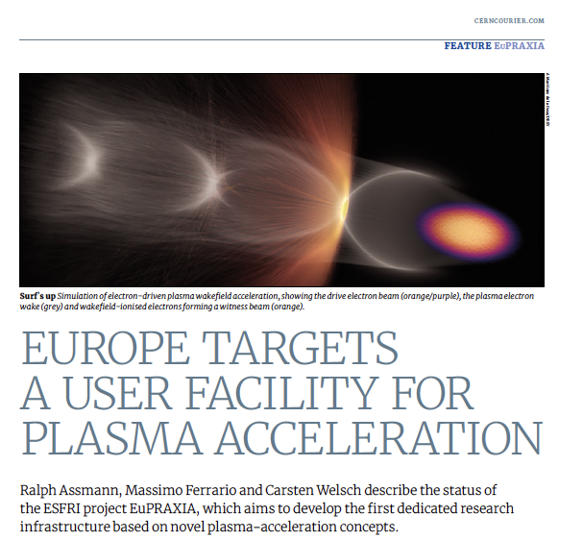
Conclusions
Plasma accelerators have advanced considerably in beam quality, achieving FEL lasing.
EuPRAXIA is a design and an ESFRI project for a distributed European Research Infrastructure, building two plasma-driven FEL´s in Europe.
EuPRAXIA FEL site in Frascati LNF-INFN is sufficiently funded for first FEL user operation in 2028.
Second EuPRAXIA FEL site will be selected in next 18 months, among 4 excellent candidate sites.
Concept today works in design and in reality. Expect (solvable) problems in stability for 24/7 user operation. Facility needed to demonstrate!
Additional fund raising is continuosly going on

Slide 20
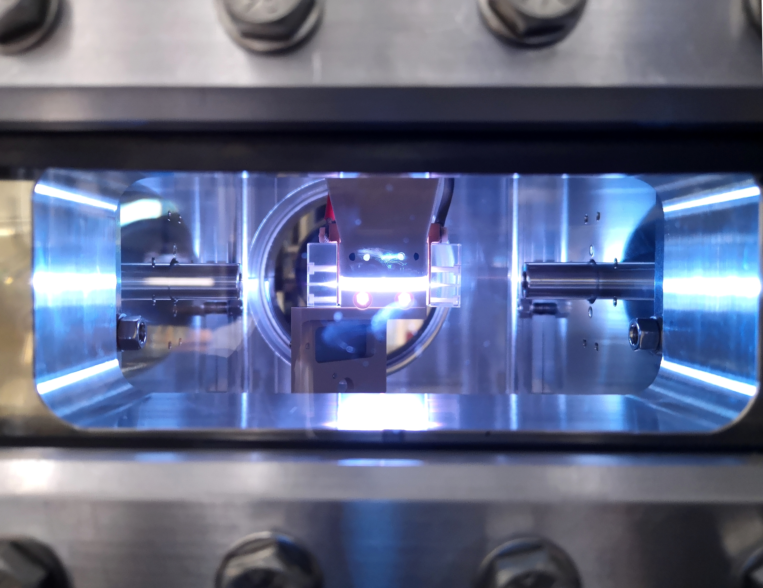
Thank for your attention

