Slide 1
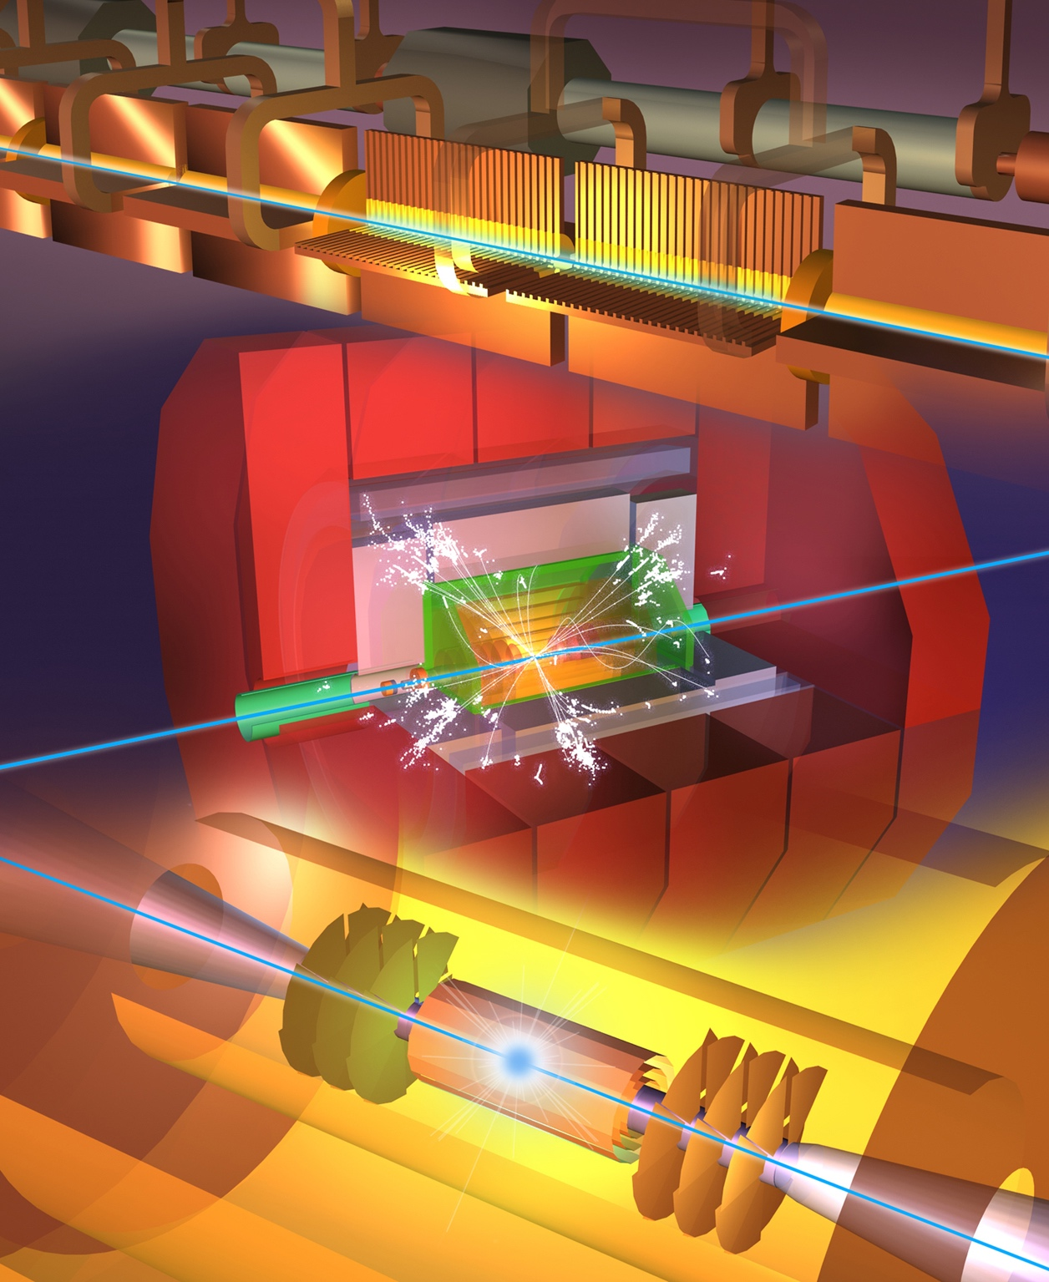
The Compact Linear Collider (CLIC)
Most recent status in Snowmass white paper (March 22) : https://arxiv.org/abs/2203.09186
More details in Project Implementation Plan documents for the European Strategy Update 2018-19.
Focus on ESPP update ~2026

Slide 2
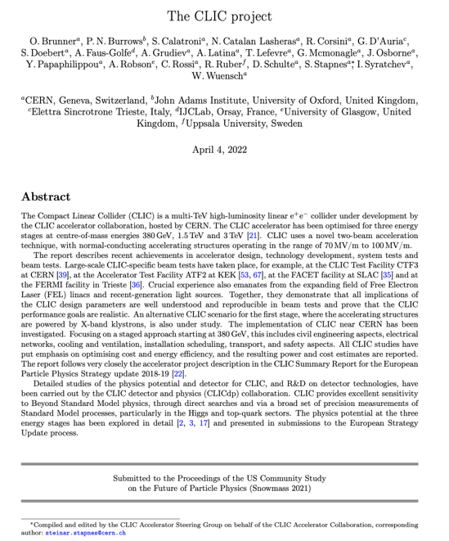
Status reports and studies
Several LoIs have been submitted on behalf of CLIC and CLICdp to the Snowmass process:
The CLIC accelerator study: Link
Beam-dynamics focused on very high energies: Link
The physics potential: Link
The detector: Link
Snowmass white paper:
https://arxiv.org/abs/2203.09186
Available at:
clic.cern/european-strategy
Broadly speaking: “Updated accelerator part of 2018 Summary Report”

Slide 3
Readiness Report around ~2025-26
Update wrt Project Implementation Plan document 2018
Key updates:
Luminosity numbers, covering beam-dynamics, nanobeam studies and hardware, and positron production - at all energies
  Risk reduction (wrt performance), bumps, redundancies
Energy/power/sustainability: 380 well underway, 3 TeV to be done, L-band klystrons
Sustainability issues, more work on running/energy models, carbon (construction/operation/disassembly)
X-band progress – for CLIC, smaller machines, industry availability, including RF network
RF design optimization/development – including injectors, R&D for higher energies, gradient (cool/HTS/etc.), power, beam parameters - links to plasma (if it can be made)
Cost update. Changes wrt to 2018, plus impact of going green.
Physics “update”, use for “diversity” types of physics, LDM etc.
Low cost/power klystron version, with fewer klystrons, 250 GeV

Slide 4
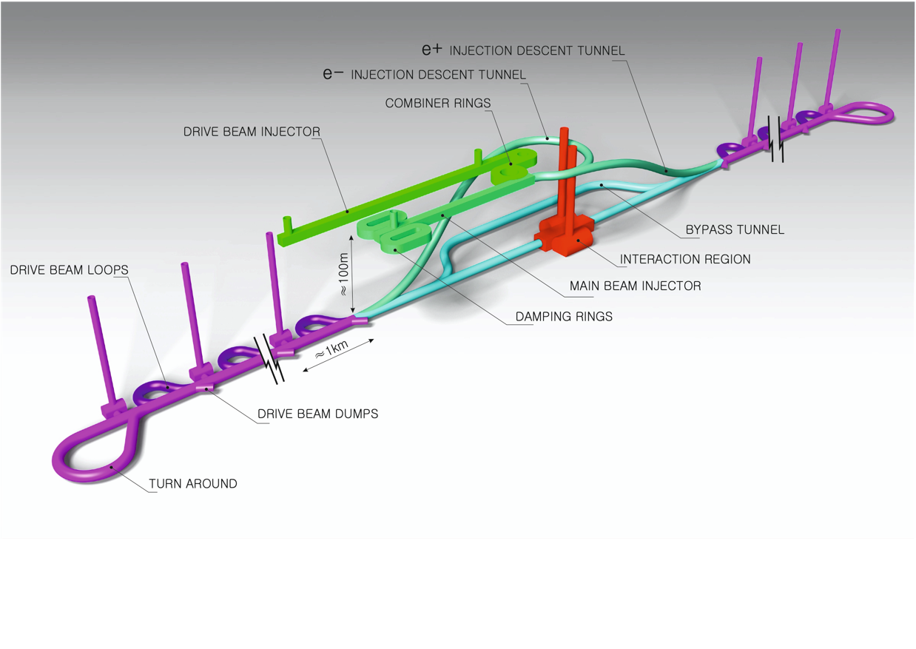
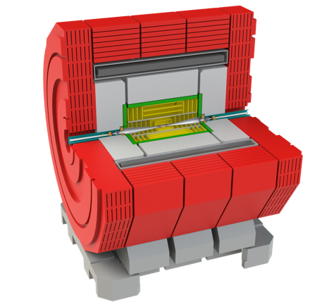
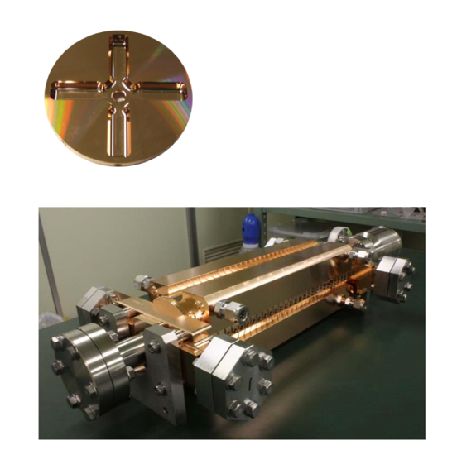
The Compact Linear Collider (CLIC)
  Timeline: Electron-positron linear collider at CERN for the era beyond HL-LHC
  Compact: Novel and unique two-beam accelerating technique with high-gradient room temperature RF cavities (~20’500 structures at 380 GeV), ~11km in its initial phase
  Expandable: Staged programme with collision energies from 380 GeV (Higgs/top) up to 3 TeV (Energy Frontier)
  CDR in 2012 with focus on 3 TeV. Updated project overview documents in 2018 (Project Implementation Plan) with focus 380 GeV for Higgs and top.
  Cost: 5.9 BCHF for 380 GeV
  Power/Energy: 110 MW at 380 GeV (~0.6 TWh annually),
  corresponding to 50% of CERN’s energy consumption today
  Comprehensive Detector and Physics studies
Accelerating structure prototype for CLIC:
12 GHz (L~25 cm)
Notes:
Include Phys and Det studies

Slide 5
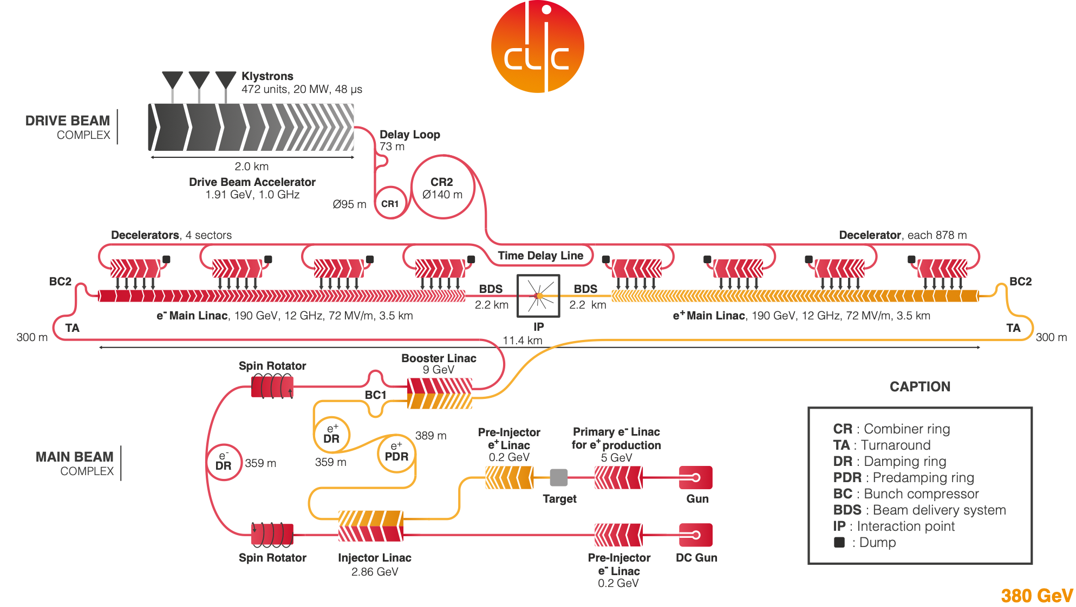
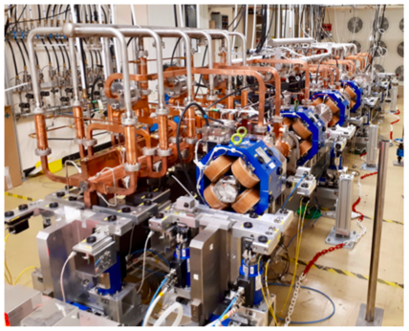
  Drive beam accelerated to ~2 GeV using conventional klystrons
  Intensity increased using a series of delay loops and combiner rings
  Drive beam decelerated and produces high-RF
  Feed high-RF to the less intense main beam using waveguides
Accelerator layout

Slide 6
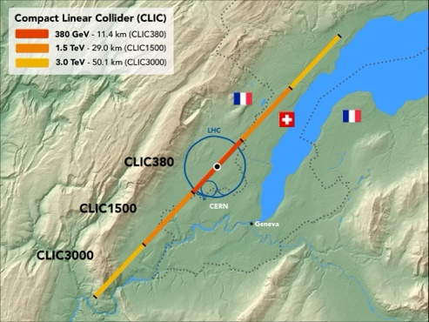

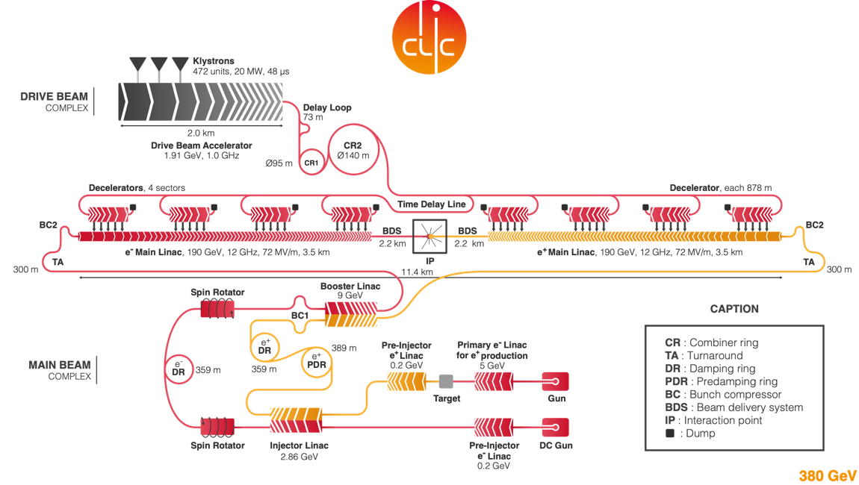
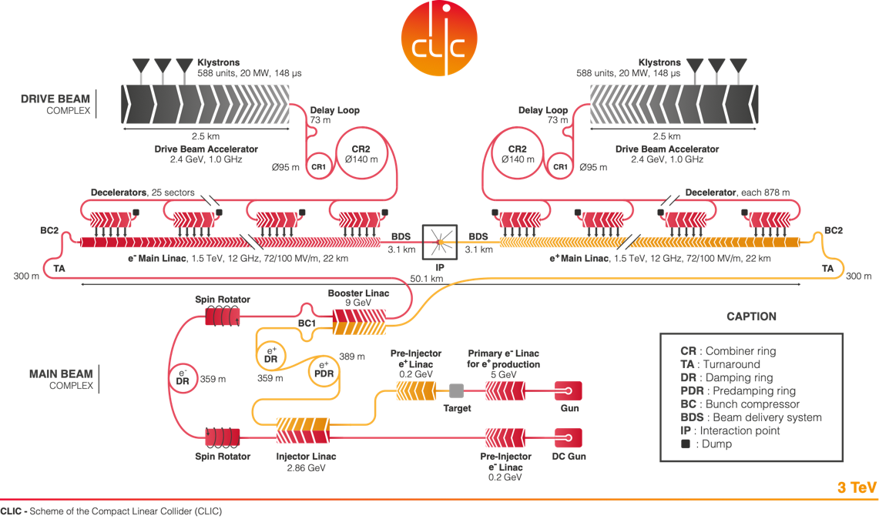
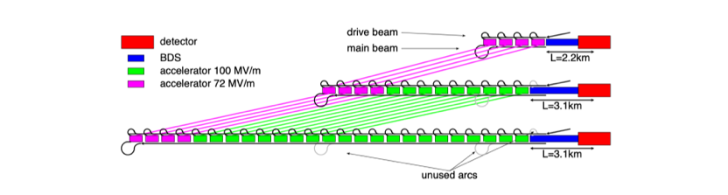
CLIC can easily be extended into the multi-TeV region
  What are the critical elements:
    Physics
    Gradient and power efficiency
    Costs
  Drive beam accelerated to ~2 GeV using conventional klystrons
  Intensity increased using a series of delay loops and combiner rings
  Drive beam decelerated and produces high-RF
  Feed high-RF to the less intense main beam using waveguides
  Extend by extending main linacs, increase drivebeam pulse-length and power, and a second drivebeam to get to 3 TeV

Slide 7
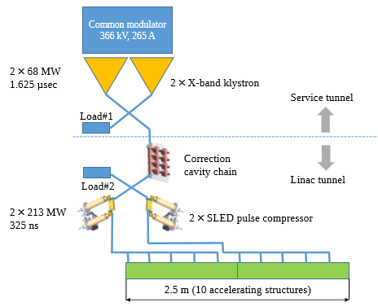
CLIC 380 GeV with X-band klystrons
Design made, many parts prototyped and available (and used in the smaller linacs mentioned on pages 9-10)
Need larger tunnel for klystron gallery (CE study also made for this option)
Also in this case the upgrades would require a drivebeam
Challenges: number of klystrons a factor 10 higher than in drive-beam version (~5500), lifetime a concern, costs (RF costs per 2m module approaching 1 MCHF)
Redesign to reduce the klystron challenge – fewer, current design not optimized since 2018 ?

Slide 8
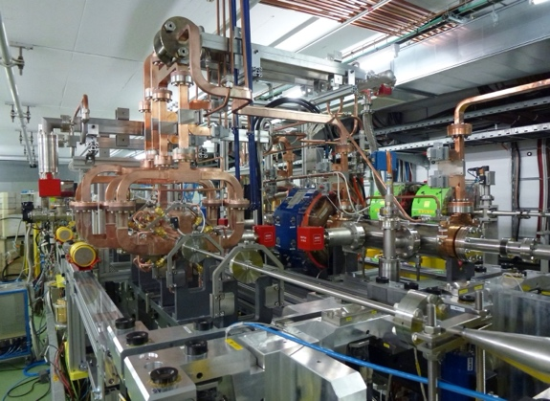
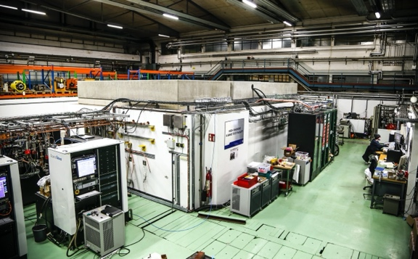
Accelerator challenges/technologies
CLIC baseline – a drive-beam based machine with an initial stage at 380 GeV
Four main challenges
  High-current drive beam bunched at 12 GHz
  Power transfer and main-beam acceleration, efficient RF power
  Towards 100 MV/m gradient in main-beam X-band cavities
  Alignment and stability (“nano-beams”)
The CTF3 (CLIC Test Facility at CERN) programme addressed all drive-beam production issues
Other critical technical systems (alignment, damping rings, beam delivery, etc.) addressed via design and/or test-facility demonstrations
X-band technology developed and verified with prototyping, test-stands, and use in smaller systems and linacs
Two C-band XFELS (SACLA and SwissFEL – the latter particularly relevant) now operational: large-scale demonstrations of normal-conducting, high-frequency, low-emittance linacs
Target and achieved emittance in existing and planned machines
2018
2008

Slide 9
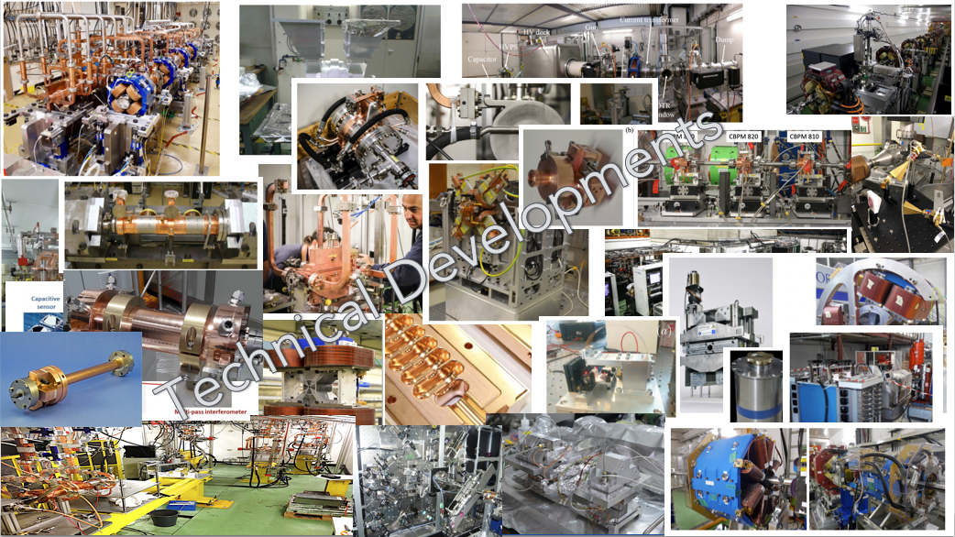
Extensive prototyping over the last ~5-10 years
The CLIC accelerator studies are mature:
Optimised design for cost and power
Many tests in CTF3, FELs, lightsources and test-stands
Technical developments of “all” key elements

Slide 10
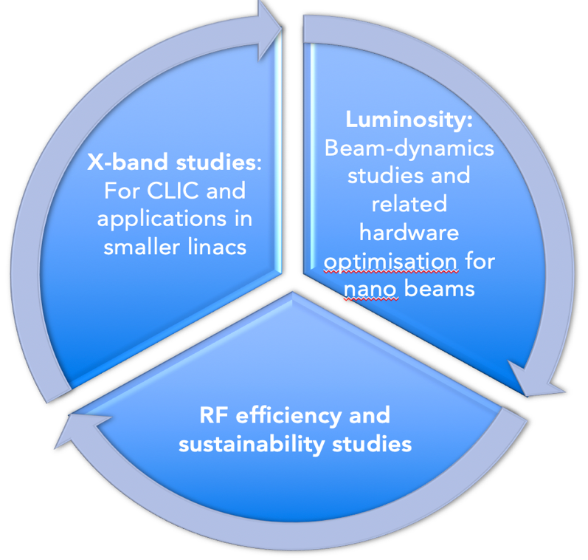
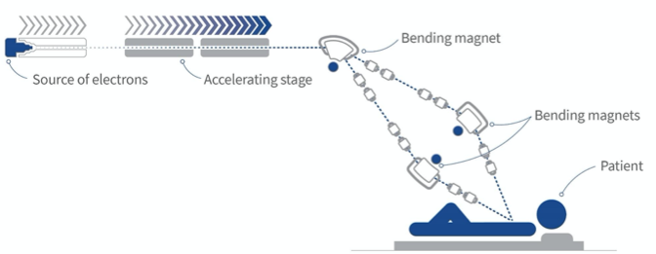
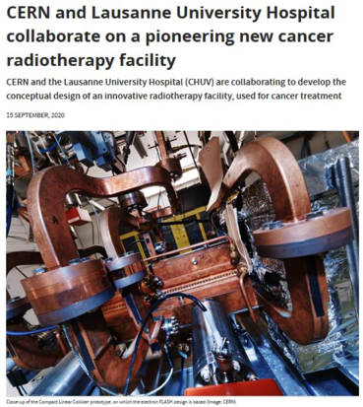
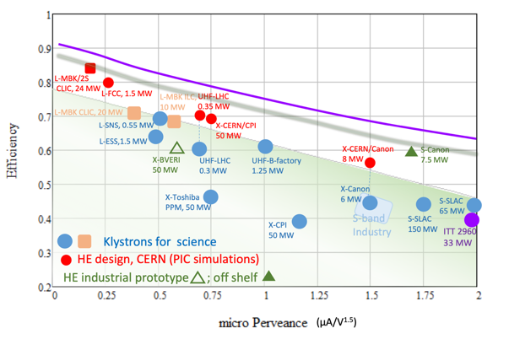
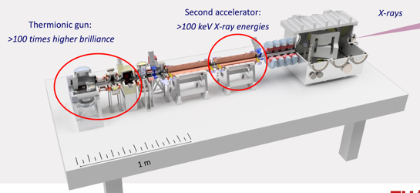
On-going CLIC studies towards next ESPP update
Project Readiness Report as a step toward a TDR
Assuming ESPP in ~ 2026, Project Approval ~ 2028, Project (tunnel) construction can start in ~ 2030.
The X-band technology readiness for the 380 GeV CLIC initial phase - more and more driven by use in small compact accelerators.
Optimizing the luminosity at 380 GeV – already implemented for Snowmass paper, further work to provide margins will continue.
      Luminosity margins and increases:
    Initial estimates of static and dynamic degradations from damping ring to IP gave: 1.5 x 10³⁴ cm⁻² s⁻¹
    Simulations taking into accord static and dynamic effects with corrective algorithms give 2.8 on average, and 90% of the machines above 2.3 x 10³⁴ cm⁻² s⁻¹ (this is the value currently used)
    Common LC studies in ATF3 part of this, and also on positron, sources, DRs and beam-dynamics.
Improving the power efficiency for both the initial phase and at high energies, including more general sustainability studies
Power estimate bottom up (concentrating on 380 GeV systems)
Very large reductions since the CDR, better estimates of nominal settings, much more optimised drivebeam complex and more efficient klystrons, injectors more optimized, main target damping ring RF significantly reduced, recent L-band klystron studies
Energy consumption ~0.6 TWh yearly, CERN is currently (when running at 1.2 TWh.
More work needed on LCA (carbon and other issues).

Slide 11
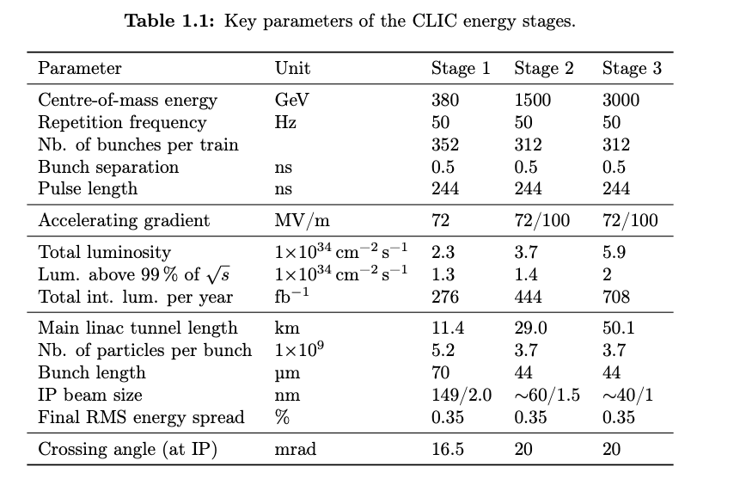
CLIC parameters

Slide 12
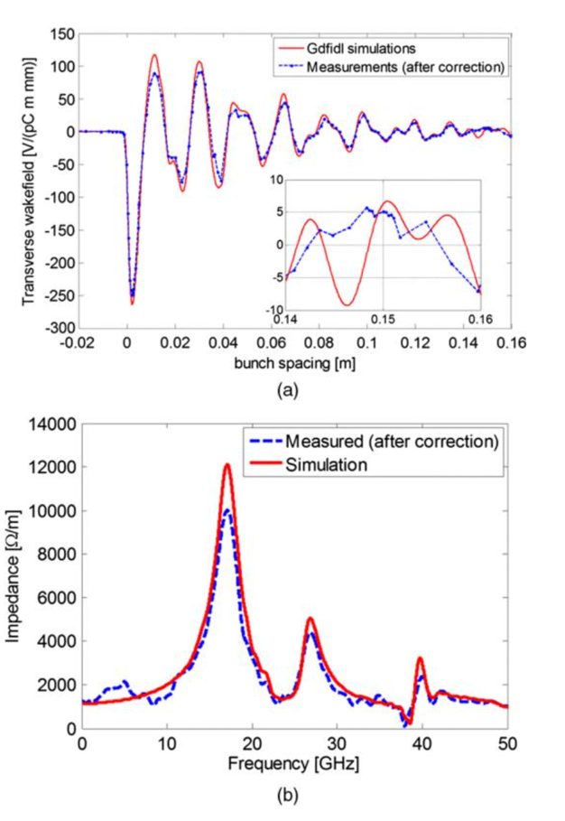
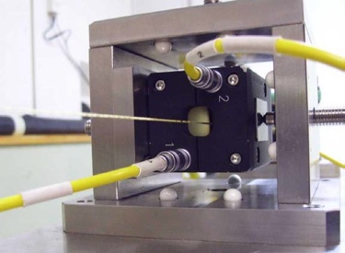
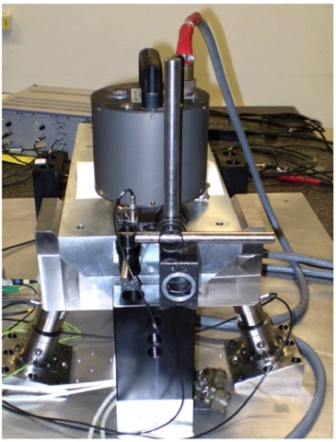
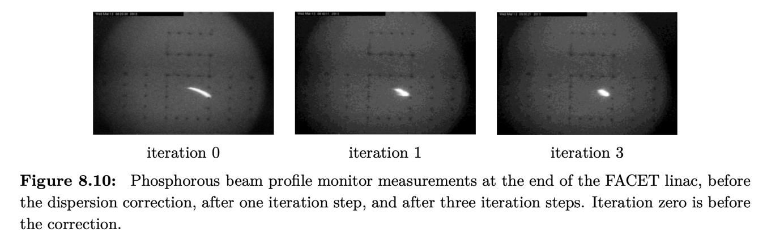
Low emittance generation and preservation
Low emittance damping rings
Preserve by
Align components (10 μm over 200 m)
Control/damp vibrations (from ground to accelerator)
Beam based measurements
– allow to steer beam and optimize positions
Algorithms for measurements, beam and component optimization, feedbacks
Experimental tests in existing accelerators of equipment and algorithms
(FACET at Stanford, ATF2 at KEK, CTF3, Light-sources)
Target and achieved emittance in existing and planned machines
2018
2008
Wake-field measurements in FACET
(a) Wakefield plots compared with numerical simulations.
(b) Spectrum of measured data versus numerical simulation.

Slide 13
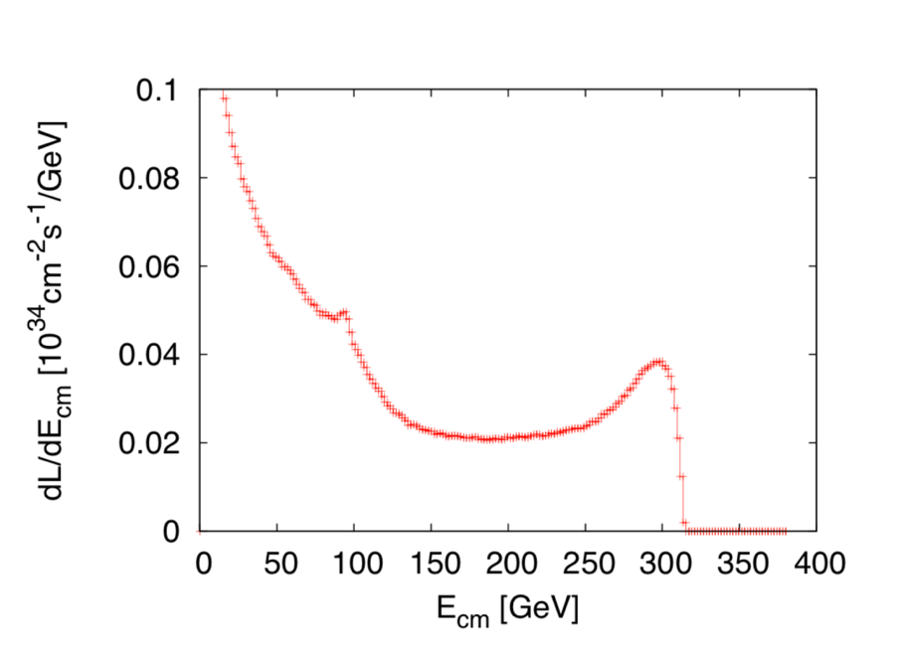
Luminosities studies 2019-22
      Luminosity margins and increases
      Initial estimates of static and dynamic degradations from damping ring to IP gave: 1.5 x 10³⁴ cm⁻² s⁻¹
      Simulations give 2.8 on average, and 90% of the machines above 2.3 x 10³⁴ cm⁻² s⁻¹
      A “perfect” machine will give : 4.3 x 10³⁴ cm⁻² s⁻¹
      In addition: doubling the frequency (50 Hz to 100 Hz) would double the luminosity, at a cost of ~55% and ~5% power and cost increase
    Z pole performance, 2.3x10³² – 0.4x10³⁴ cm⁻² s⁻¹
      The latter number when accelerator configured for Z running (e.g. early or end of first stage)
      Gamma – Gamma spectrum (example)
Notes:
Is this the last version of this slide, now published

Slide 14
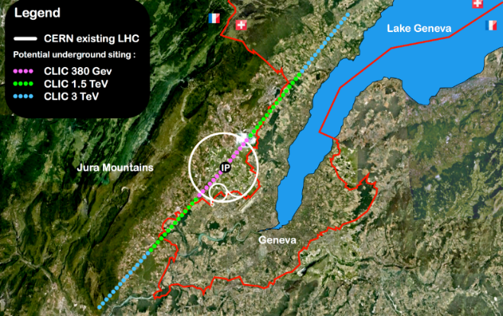
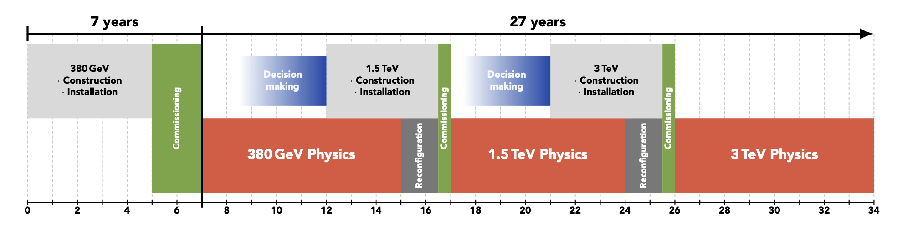
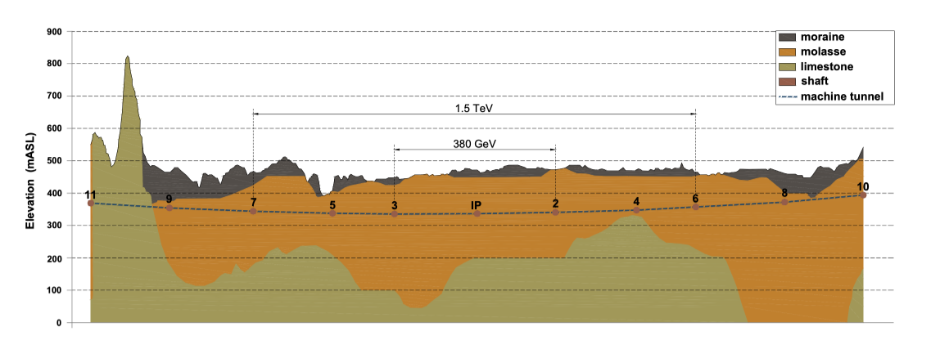
CLIC CE, stages and schedules
Technology Driven Schedule from start of construction shown above.
A preparation phase of ~5 years is needed before (estimated resource need for this phase is ~4% of overall project costs)

Slide 15

Indicative scenarios of future colliders [considered by ESG]
Proton collider
Construction/Transformation
Electron collider
Preparation / R&D
Original from ESG by UB
Updated July 25, 2022 by M.Narain (Snowmass summary)
Muon collider
2038 start physics
Japan
5 years
ILC: 250 GeV
2 ab⁻¹
500 GeV
4 ab⁻¹
1 TeV
≈ 4-5.4 ab⁻¹
20km tunnel
31km tunnel
40 km tunnel
2035 start physics
China
CepC: 90/160/240 GeV 100/6/20 ab⁻¹
100km tunnel
SppC: 75-125 TeV, 10-20 ab⁻¹
LHC HL-LHC (14TeV, 3 ab⁻¹)
(13.6TeV, 450 fb⁻¹ )
2048 start physics
100km tunnel, installation
FCC-ee: 90/160/250 GeV -150/10/5 ab⁻¹
350-365 GeV 1.7 ab⁻¹
installation
CERN
FCC hh: 100 TeV ≈ 30 ab⁻¹
29 km tunnel
50 km tunnel
2020
2030
2040
2050
2060
2070
2080
2090

Slide 16
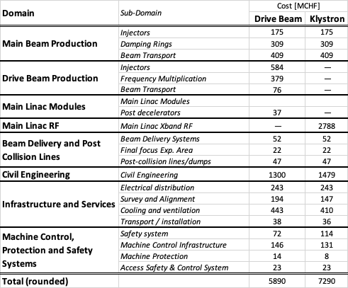
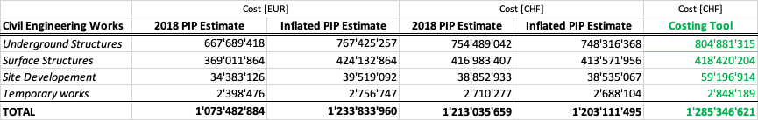


Proposed Strategy for CLIC cost review
CLIC PIP 2018 – 380 GeV
Review Areas that may produce a relevant impact on cost:
Civil Engineering
Injectors
Damping Rings
RF (Modulators + Klystrons)
Cooling and Ventilation
Additional Detector (push – pull)
Invest 0.3FTE in the development of a more user friendly
Interface to the existing Costing Tool ?
First Draft of cost review due by June 2024 ?
CE DB “Light” Review performed
In 2018 1 EUR = 1.13 CHF
2018 – 2023 CE index= + 15%
2018 – 2023 IPP index= + 2.9%
In 2023 1 EUR = 0.9751 CHF

Slide 17
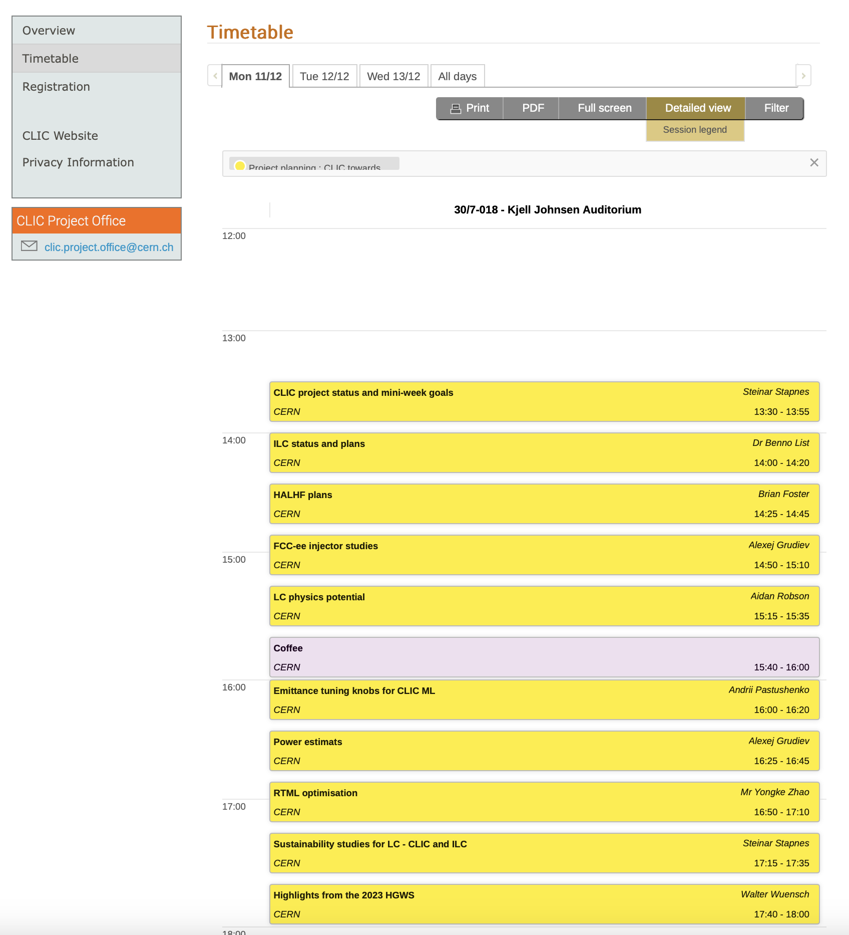

Slide 18
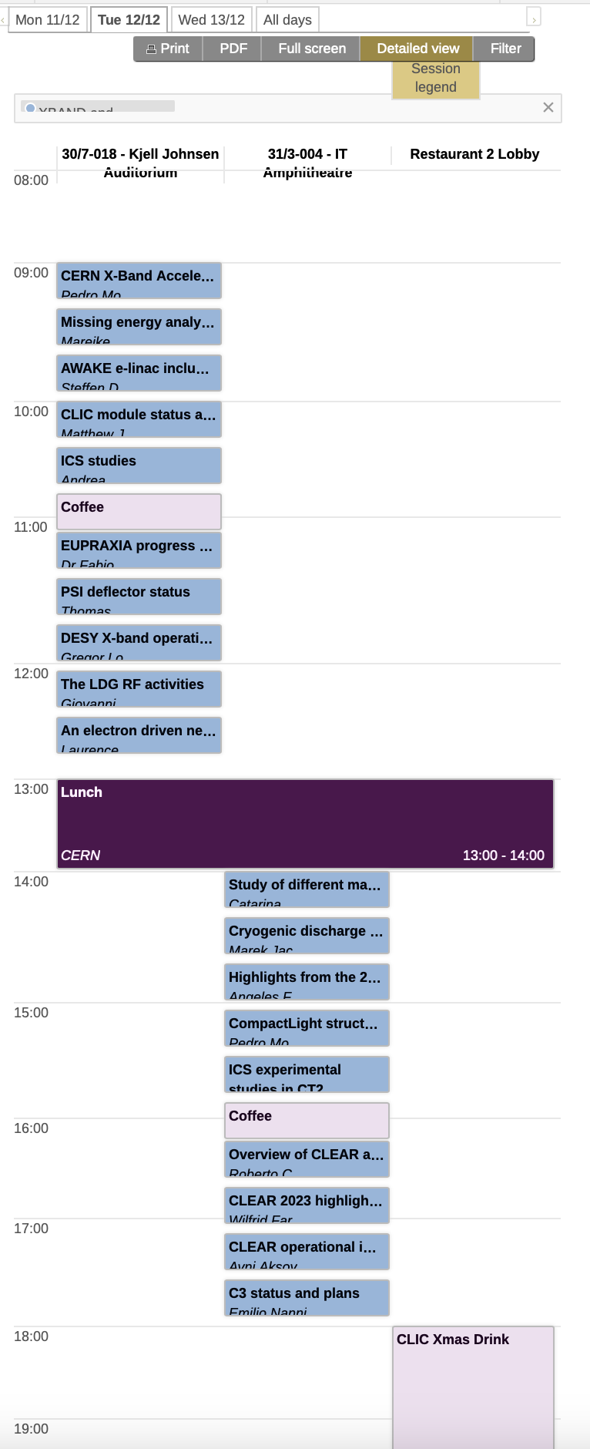
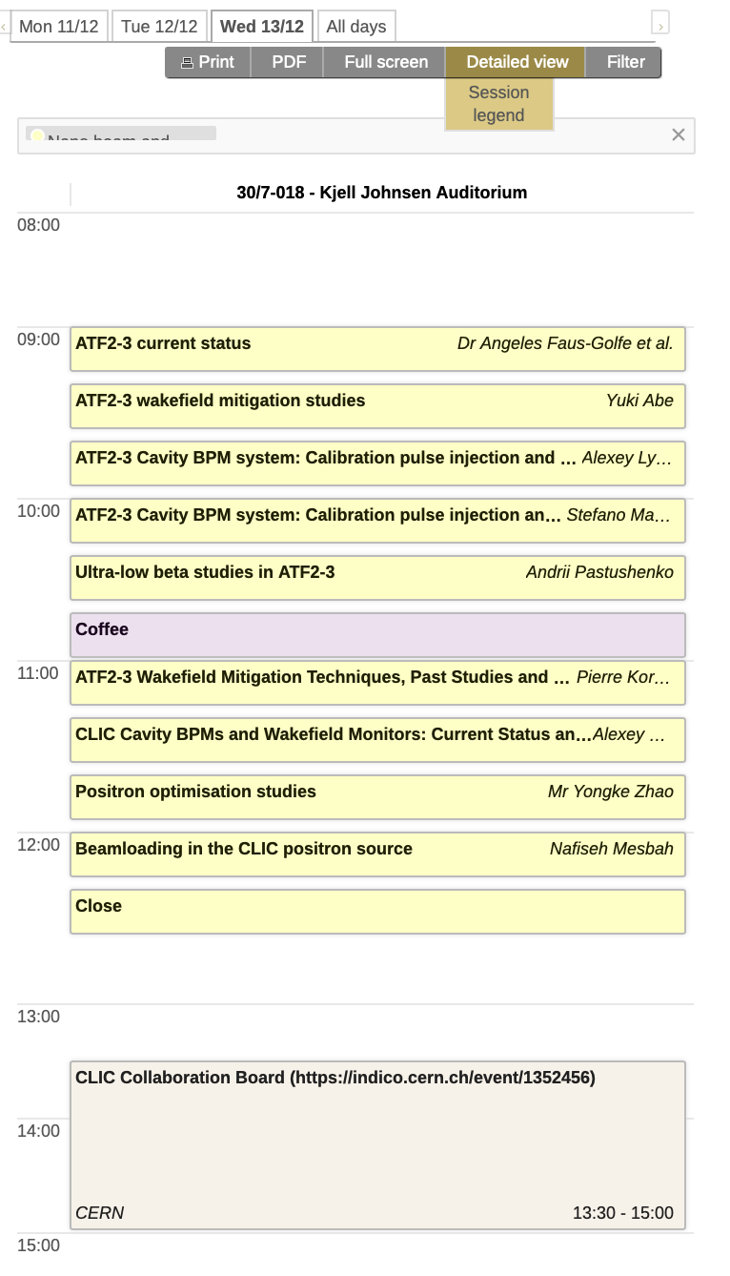

Power and Sustainability, see talks later

Slide 19
Summary and thanks
CLIC studies focused on core technologies, X-band and nanobeam, for next ESPP update well underway.
  Many common studies with ILC – the traditional ones but also recently related to sustainability, also common interactions with C³
  Keep focus on both 380 GeV and multi-TeV performance and R&D
Greatly helped by studies of smaller linacs and systems using X-band technology – important for collaboration and industry capabilities
Thanks to many CLIC accelerator colleagues for slides and input

